Slide 1
MQXF Work Organization at CERN and LARP
CERN-LARP Integration & Communication
Paolo Ferracin, Giorgio Ambrosio
International Review of the Inner Triplet Quadrupoles (MQXF) for HL-LHC
7-10 June, 2016
CERN

Slide 2
Outline
Activities at CERN
  Short model
  Prototype
Exchange of information with LARP

Slide 3
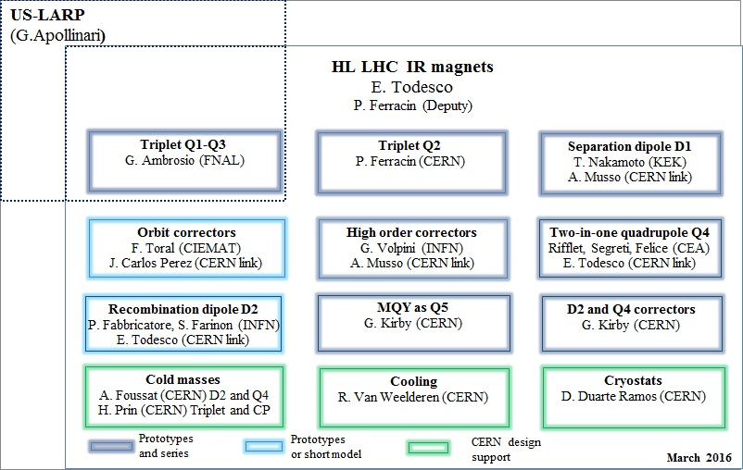
MQXF activities
Within HiLumi, MQXF is part of the WP3 (E. Todesco)
  Definition of specification/requirements, conceptual design, interaction with other projects within WP3 and with other WPs
    ~Monthly meeting to share information

Slide 4
MQXF short model activities
Activities carried out in the MDT section (G. De Rijk) and in 927 (J.C. Perez)
  Weekly meeting to coordinate different projects
Strand/cable activities (SCD section, A. Ballarino)
  Strand: B. Bordini
  Cable: J. Fleiter
  Monthly meetings to define cable fabrications need, check status, plans (other projects included) → cable fabrication and coil fabrication sequence

Slide 5
MQXF short model activities
Magnet design and analysis
  S. Izquierdo Bermudez
    Magnetic design and analysis
    Coil and coil-parts design
    Coil part procurement
  G. Vallone
    Mechanical design and analysis
  E. Todesco and S. Izquierdo Bermudez
    QP system design and analysis
CAD models and drawings
  T. Sahner (EN/MME)
  Meetings every 2-3 months to define plans and resources

Slide 6
MQXF short model activities
Coil fabrication
  J.C. Perez
    J. Mazet
      Cable braiding and coil winding/curing
    N. Bourcey
      Reaction
    G. Maury
      Instrumentation
    R. Gauthier
      Impregnation
    J.C. Perez
      Trace fabrication
      Electrical tests (F.O. Pincot)
      Dimensional measurements (J. Ferradas Troitino)
    E. Cavanna (ASG)
      QC, documentation, follow-up

Slide 7
MQXF short model activities
Magnet fabrication
  J.C. Perez
    N. Bourcey
      Assembly and loading operations
    P. Grosclaude and M. Guinchard (EN/MME)
      Strain gauge installation and analysis
    A. Dallocchio and P. Moyret (EN/MME)
      Magnet parts procurement
    P. Bestmann (EN-ACE-SU)
      Alignment measurements
Magnet test
  H. Bajas (TF Section, M. Bajko)
    Test and analysis
  L. Fiscarelli (MM Section, S. Russenschuck)
    Magnetic measurements

Slide 8
MQXF prototype activities
Activities carried out in the LMF section (F. Savary) in 180
Strand/cable activities (SCD section, A. Ballarino)
  Strand: B. Bordini
  Cable: J. Fleiter
  Monthly meetings to define cable fabrications need, check status, plans (other projects included) → cable fabrication and coil fabrication sequence

Slide 9
MQXF prototype activities
Transfer of information from short model to prototype
  J.C. Perez
    E. Cavanna (ASG)
      Coil fabrication
    N. Boursey
      Support structure and assembly tooling
Coil fabrication
  F. Lackner
    S. Triquet
      Winding/curing (P. Revilak, BNG)
    S. Triquet
      Reaction/impregnation/instrumentation (T. Genestier, Alstom-GE)
    J.C. Perez
      Trace fabrication
    A. Dallocchio and P. Moyret (EN/MME)
      Coil parts procurement
Magnet fabrication
  F. Lackner
    Coil-pack assembly
  H. Prin
    Yoke-shell assembly, magnet pre-loading and cold-mass assembly
  A. Dallocchio and P. Moyret (EN/MME)
    Magnet parts procurement

Slide 10
MQXF prototype activities
Cryostat
  D. Duarte (CMI Section, V. Parma)
Test
  H. Bajas (TF Section, M. Bajko)
    Test and analysis
  L. Fiscarelli (MM Section, S. Russenschuck)
    Magnetic measurements

Slide 11
CERN meetings
Weekly meeting for short model activity
Weekly meeting on prototype activities
  Join 11T weekly meeting in June
J.C. Perez participate to LMF meetings
F. Lackner participate to MDT meetings

Slide 12
LARP MS Organization

Slide 13
LARP Organization
L1: G. Apollinari
L2 for Magnet systems: G. Ambrosio
L3 in Magnet systems:
  Design & analysis: G. Sabbi
  Materials (conductor & insulation): L. Cooley
  Coil fabrication wind&cure: M. Yu
  Coil fabrication react&impr: J. Schmalzle
  Magnet assembly: S. Prestemon
  Cold-mass & cryostat: S. Feher
  Tests and measurements: G. Chlachidze
Task leaders: see next slide
Laboratory representatives: P. Wanderer (BNL), S. Prestemon (LBNL), G. Ambrosio (FNAL)

Slide 14
LARP Task codes & Task Leaders

Slide 15
Cooley
Prestemon
Feher

Slide 16
LARP Meetings
Weekly LARP Magnet System meetings
  All LARP MS people attending
Meetings within each lab as planned/requested by Lab Representatives, or L3s, or Task Leaders
Technical meetings are mostly done by LARP-CERN Working Groups

Slide 17
CERN-LARP Integration, Coordination and Communication

Slide 18
Working Group Mtgs
We have several Working Groups attended and organized by CERN and LARP people.
  Conductor WG
  Coil WG
  Structure WG
  Testing WG
  Ad-hoc WGs for special topics (cold mass, …)
Meetings are by video-conference
There is one-two WG video-mtg(s) every week
Presentations and documents are stored on Indico
Minutes, Decisions, and Action Items are distributed and stored (Indico or DocDB).

Slide 19
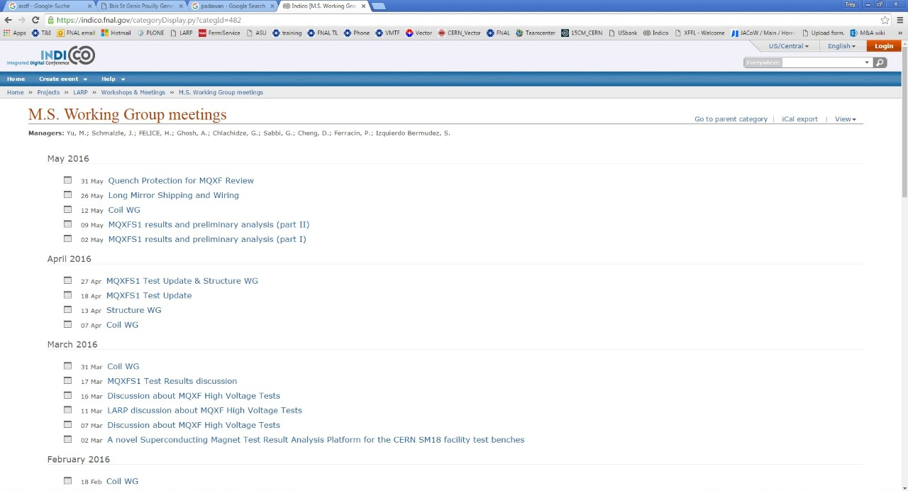
LARP-CERN Working Group mtgs
WG mtgs in the last few months:

Slide 20
Workshops & Collaboration Mtgs
We have topical Workshops attended and organized by CERN-LARP people.
Key people are travelling, and some people may join by video-conference
There are about two Workshops per year
  Quench Protection
  Structures (Last one was in February)
  Coil fabrication
  Test Facilities (First one is next week)
There is a LARP-HiLumi Collaboration Mtg every 6 months
  Attended by the whole collaboration

Slide 21
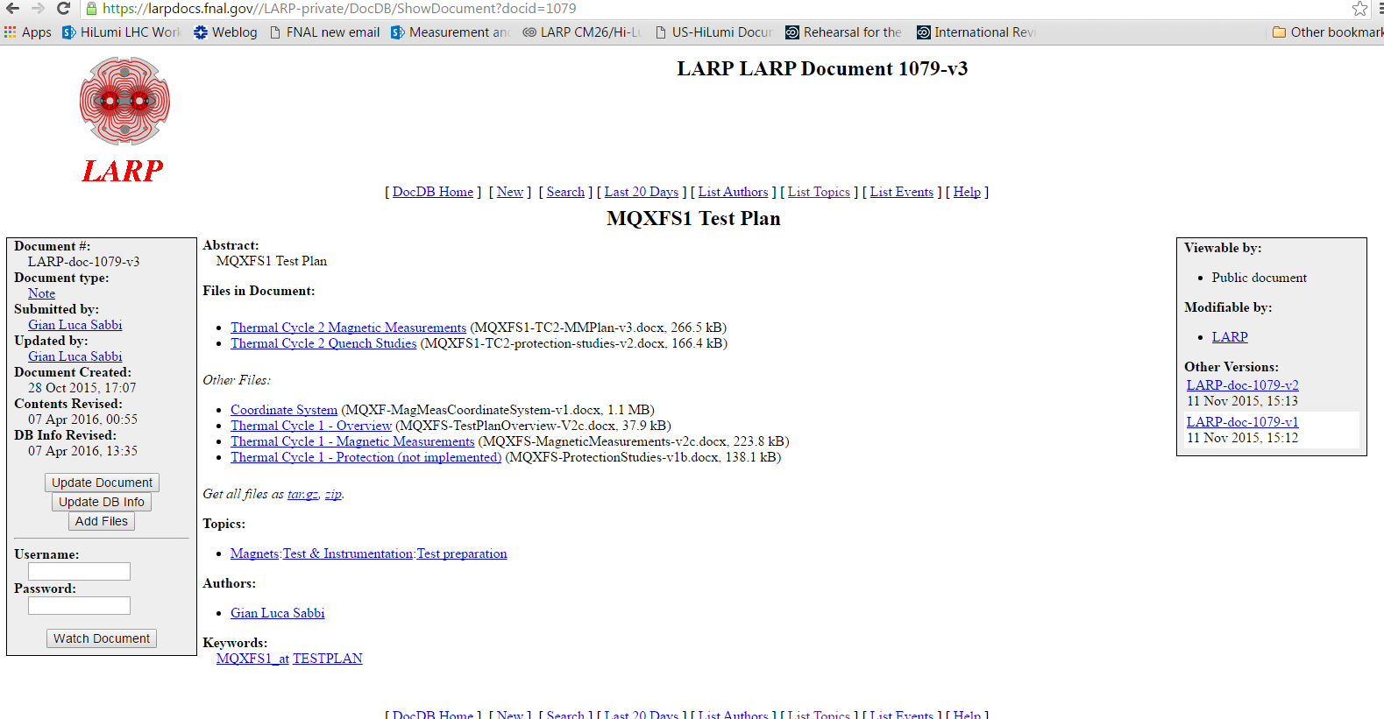
Test plan
Test plans are developed by Test WG
Test plan document is shared with larger collaboration for comments, and stored on LARP DocDB
Test plan implementation discussed weekly (phone/skype/mtgs)

Slide 22
Coordination
Giorgio Ambrosio and Paolo Ferracin have phone or skype coordination meetings almost every week.
Sometimes other people (Ezio Todesco, some LARP L3s) join these meetings.

