Slide 1
Inner Triplet Protection Strategy
LHC & HL-LHC
Daniel Wollmann
with Inputs from B. Auchmann, G. Ambrosio, R. Denz, P. Fessia, E. Ravaioli, F. Rodrigues Mateos, G. Sabbi, E. Todesco, A. Verweij, M. Zerlauth
International Review of the Inner Triplet Quadrupoles (MQXF) for HL-LHC 07.-10.06.2016 - CERN

Slide 2
Outline
LHC inner triplet protection
  Protection Scheme
  Heater Redundancy
  Protection Hardware
Protection Strategy for HL-LHC IT
  Circuit layout
  Failure cases OH+CLIQ
  Failure cases OH

Slide 3
Schematics of LHC IT protection as today
A quench in the superconducting circuits is detected and all the quench heaters are fired as soon as one of the following signals exceeds the threshold.
URES,Q1=U1,Q1+U2,Q1
URES,Q2=U1,Q2+U2,Q2
URES,Q3=U1,Q3+U2,Q3

Slide 4
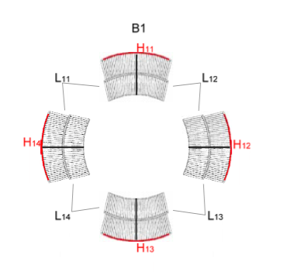
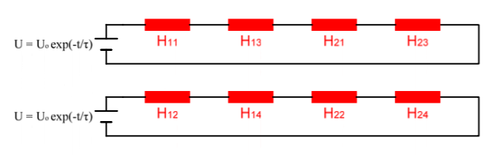
Heater Redundancy – IT LHC as today
Two heater circuits per magnet, each covering 2 poles per magnet.
8 heater circuits per triplet circuit.
In case of quench all heaters are fired for the circuit.
Operation not allowed in case a failure detected in one heater circuit → beam dump & automatic ramp down.
Courtesy: A. Erokhin

Slide 5
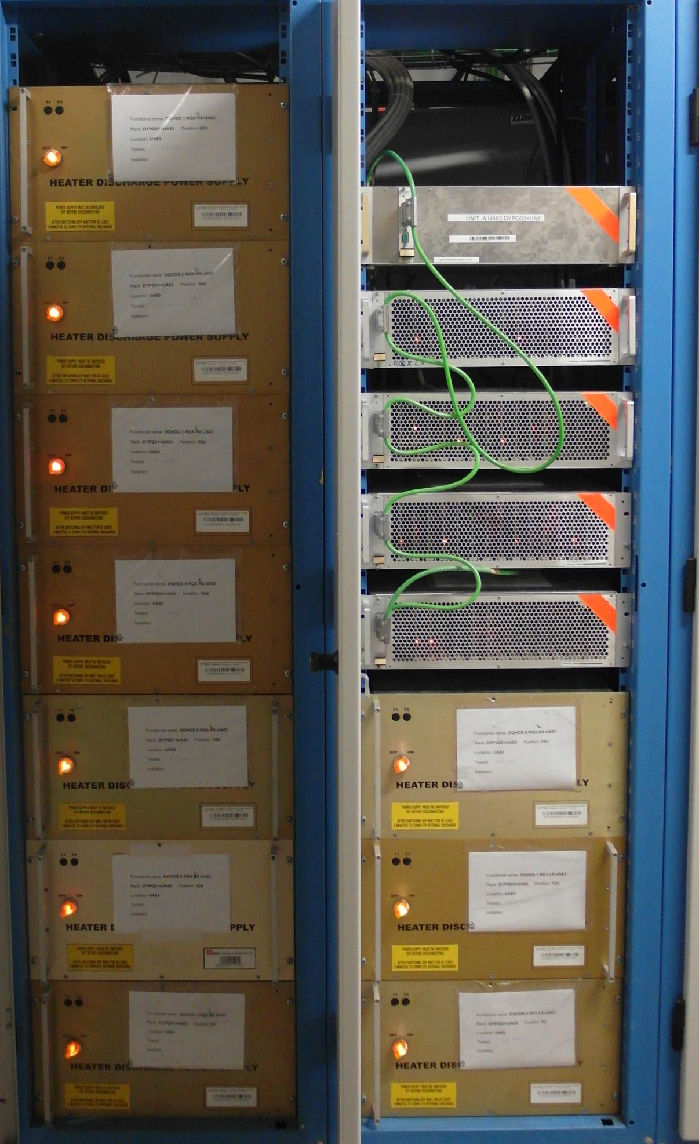
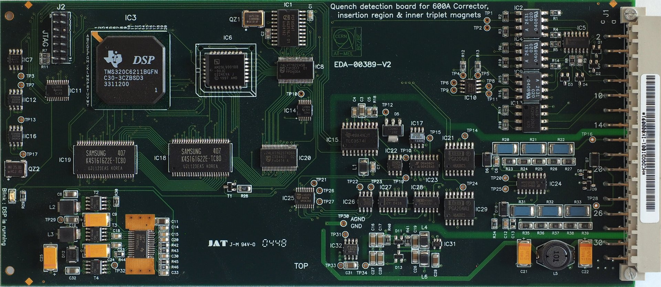
Protection Hardware - IT LHC as today
Quench detection HW
    Redundant Boards A / B (Q1, Q3, Q2a/b), comparing voltages via redundant voltage tabs (1oo2 logic) → total 6 detectors per triplet
    1oo6 fires all heaters
    Lead protection (8x) (1oo8 fires all heaters)
    Powered by two independent UPS.
  Quench Heater Power Supplies
    4 x 2 heater power supplies.
    Charging voltage: 900 V (+-450 V)
    Capacitance: 7.05 mF
    Powering evenly distributed onto two independent UPS.
Courtesy R. Denz

Slide 6
Advantages of IT protection via OH + CLIQ as compared to OH only for HL-LHC
(as concluded after internal workshop and circuit review)
Reduced hot spot temperature
Lower thermal stresses
Increased diverse redundancy (two independent systems, no common mode of failure)
Bigger margin as detection/protection assumptions have not yet been validated in full size magnets.
Experience operating the LHC shows that heaters can fail in time and the importance of redundant heater circuits.
Heater power supplies fail (~1 per 1000 per year)

Slide 7
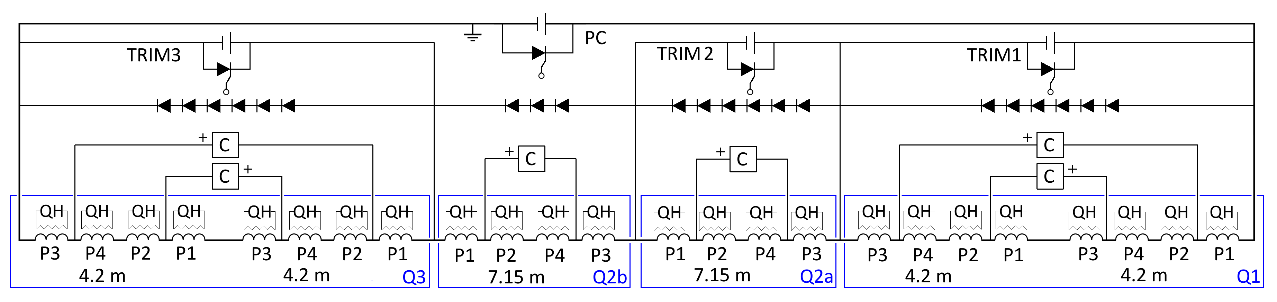
Protection Strategy IT HL-LHC
Failure case studies performed for OH + CLIQ and OH (by E. Ravaioli).
New quench detection system under development for Nb3Sn magnets
  Eight channel device with circuit current dependent detection settings.
  First to be used in 11T dipole.
  Typically used in 1oo2 scheme.
  Redundant voltage tabs including tabs for symmetric quench protection required (see A. Verweij, circuit review)
  Alternative detection schemes are under study.
Use of LHC type quench heater power supplies with improved reaction time. Correct functionality supervised and regularly executed.
Parallel diodes separating protection of each magnet in the circuit, required with and without CLIQ.
Courtesy E. Ravaioli

Slide 8
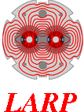

Summary of failure cases - (OH+CLIQ)
Failure | Hot-spot temperature | Voltage to ground | Turn to Turn V | Current through parallel diodes | Comment
One QH supply (2 strips) not triggered | = | = | = | = | Parallel diodes
Two QH supplies (4 strips) not triggered | = | = | = | = | Parallel diodes
CLIQ capacitor in open circuit | = | = | = | 500 A for <100ms | Capacitors in parallel, Parallel diodes
CLIQ capacitor in short circuit | = | = | = | 1000 A for <100ms | Capacitors in series, Parallel diodes
One CLIQ unit triggered spuriously | = | = | = | 2000 A for <100ms | Units interlocked
One CLIQ unit not triggered | +70 K (300 K) | = | +20 V (54 V) | 2500 A for <100ms | Double trigger, voltage monitor, parallel diodes
One CLIQ unit and one QH supply not triggered | +70 K (300 K) | = | +30 V (65 V) | 2500 A for <100ms | QH connection scheme
One parallel element disconnected | = | = | = | 500 A for <100ms
One lead of the parallel elements disconnected | = | = | = | 500 A for <100ms
Two leads of the parallel elements disconnected | probability is nihil |  |  |  | Monitoring currents in the circuit during each discharge
Entire CLIQ unit in short circuit | probability is nihil |  |  |  | Capacitors in series, Protected CLIQ chargers, QH
One CLIQ unit not triggered and one lead of the parallel elements disconnected | probability is nihil |  |  |  | Monitoring currents in the circuit during each discharge
One CLIQ unit and all QH protecting the same magnet not triggered | probability is nihil |  |  |  | Redundant triggers for CLIQ and QH
Courtesy E. Ravaioli

Slide 9
Summary of failure cases - (OH only)
Failure | Hot-spot temperature | Voltage to ground | Turn to turn V | Current through parallel diodes | Comment
One QH supply (2 strips) not triggered | +25 K (350 K) | +150 V (570 V) | +10 V (65 V) | To be studied | Parallel diodes
Two QH supplies (4 strips) not triggered | +40 K (360 K) | +250 V (670 V) | +15 V (71 V) | To be studied | Parallel diodes
One QH unit triggered spuriously | To be studied
One parallel element disconnected | To be studied
One lead of the parallel elements disconnected | To be studied
Two leads of the parallel elements disconnected | probability is nihil |  |  |  | Monitoring currents in the circuit during each discharge
One QH unit not triggered and one lead of the parallel elements disconnected | probability is nihil |  |  |  | Monitoring currents in the circuit during each discharge
All QH protecting the same magnet not triggered | probability is nihil |  |  |  | Redundant triggers for CLIQ and QH
Courtesy E. Ravaioli

Slide 10
Thanks you for your attention!
Question?

Slide 11
Compatibility between SC link and MQXF protection system – Magnet current discharge
In order to assure the protection of the magnet’s hot-spot against overheating, the current in the magnet circuit has to be discharged in a few hundred millisecond (at nominal current, about 200 ms). The choice of the quench protection system (only outer QH; outer and inner QH; outer QH and CLIQ; outer and inner QH and CLIQ) changes the discharge time only by a few tens of millisecond.
Following the recommendation of the HL-LHC Circuit Review, the busbars of the superconducting link need to be designed to operate in this condition without interference to the busbars of other circuits. The electro-magnetic coupling between busbars of different circuits should be studied in detail to assure no spurious quench detection is triggered after a quench in an MQXF magnet.

Slide 12
Compatibility between SC link and MQXF protection system – CLIQ system
CLIQ introduces an oscillating current with a peak of about 1.5 kA and a frequency of about 12 Hz.
Overcurrent: The charging polarity of the CLIQ units can be chosen so as to introduce a first peak lower than the initial current in the circuit. At nominal current, the current in the circuit is rapidly discharged and the second peak is also lower than the initial current (see figure below). Thus, CLIQ introduces no overcurrent in the superconducting link main busbars.
Overvoltage: The voltage across each cold mass of the circuit (Q1, Q2a, Q2b, Q3) is limited by the presence of the parallel diodes and of the crowbars of the power supplies. Thus, CLIQ introduces no overvoltage across the superconducting link main busbars.
Electro-magnetic interference: The amplitude of the current changes introduced by CLIQ is lower than that developed during the discharge of the magnet. Thus, using only QH or QH+CLIQ does not change the peak dI/dt of the current through the superconducting link.

Slide 13
Simulated currents in the circuit
Q2a/Q2b
Q1/Q3
CLIQ units for Q2a/Q2b
Charging voltage: 1000 V
Capacitance: 40 mF
CLIQ units for Q1/Q3
Charging voltage: 600 V
Capacitance: 40 mF
Diodes
Hot-spot temperature T_{hot}~230 K
Currents through the SC Link (no fault case)
Main leads: Magnet current ± AC oscillations, 1.5 kA, 12 Hz
Trim leads: Their initial current + AC pulse, 500 A, 12 Hz
CLIQ
Courtesy E. Ravaioli

Slide 14
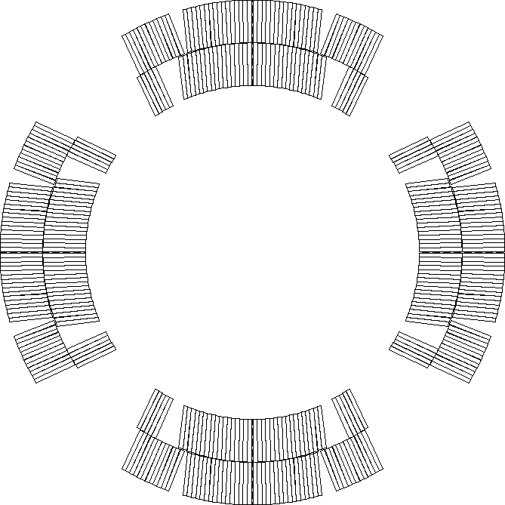
Proposed QH Connection Scheme
Each QH supply is connected to 2 strips in series
  Connection scheme that compensates the voltages induced by CLIQ and QH
  Connecting in series 2 strips attached to different poles reduces the effects of failures (hot-spot temperature, voltage distribution)
LF3
LF2
HF3
HF2
HF4
HF1
IN3
IN2
LF4
IN4
IN1
LF1
Standard LHC quench heater power supply
Charging voltage: 900 V
Voltage to ground: ±450 V
Capacitance: 7.05 mF
LF1
IN1
IN4
LF4
IN2
IN3
HF1
HF4
  Only a quarter of the circuits shown
HF2
LF2
LF3
HF3
Courtesy E. Ravaioli, and G. Sabbi

Slide 15
Peak Temperatures and Voltages
Scenarios: |  | 1 | 2 | 3 | 4 | 5 | 6
OL heaters |  | Y | Y | Y | Y | F1 | F2
IL heaters |  | Y | Y | N | N | N | N
CLIQ |  | Y | N | Y | N | N | N
Hot-spot Temp. | K | 219 | 229 | 228 | 324 | 349 | 363
Coil-Ground | V | 507 | 314 | 507 | 287 | 467 | 579
Turn-Turn | V | 31 | 32 | 35 | 54 | 65 | 71
Layer-Layer | V | 497 | 259 | 497 | 426 | 572 | 670
Mid-plane | V | 509 | 34 | 509 | 33 | 237 | 376
Note: Coil to QH voltage never below 450 V in all configurations (place of thinnest insulation)
Assumptions:
Detection | mV | 100
Verification | ms | 10
Heater switch delay | ms | 5
Circuit |  | Single Power Converter for Inner Triplet
Energy extraction |  | NO
Dynamic effect on inductance |  | YES
Quench back |  | YES
Quench propagation OL-IL |  | YES, simulated
Simulations performed with Tales by E. Ravaioli
Failure scenarios:
F1 | one OL-HF circuit ( = 2 strips)
F2 | one OL-HF circuit and one OL-LF circuit, on the same coil and same side (= 4 strips)

