Slide 1
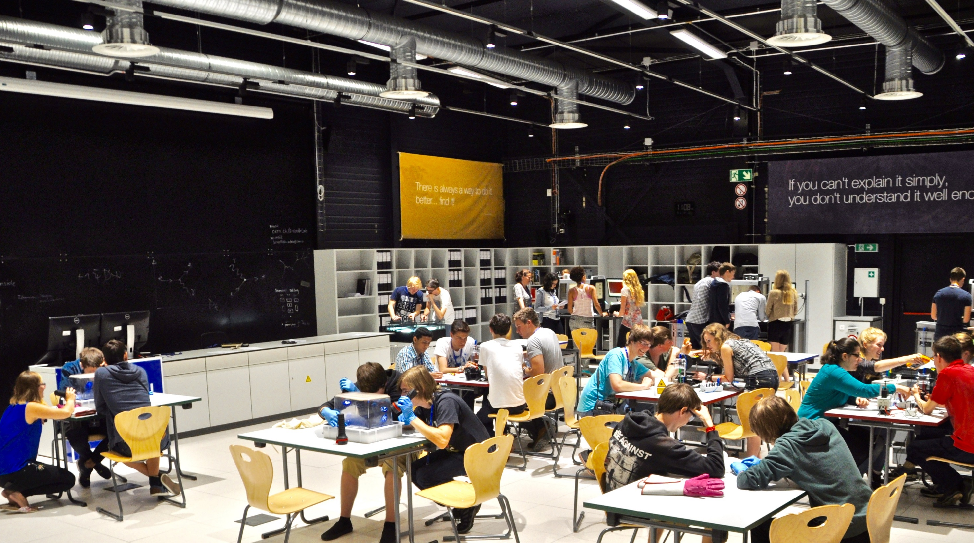

IR Cloud Chamber Workshops
20/05/2016

Slide 2

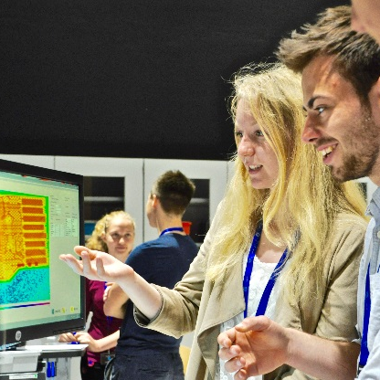
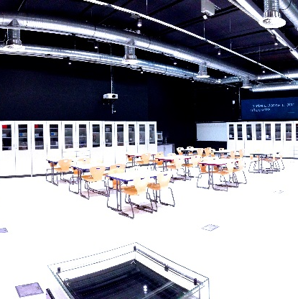
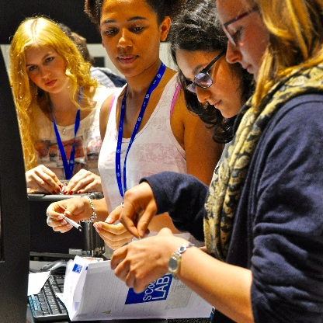
What is S’Cool LAB?
Notes:
Use new pictures

Slide 3
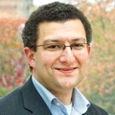
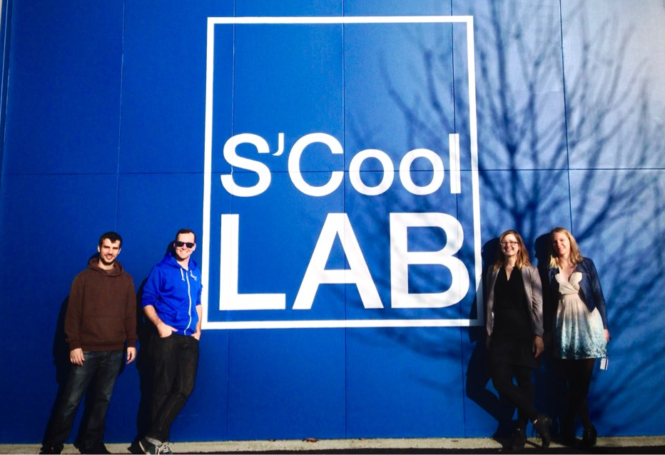
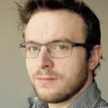
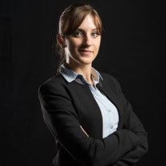
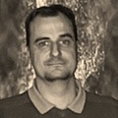

Who is S’Cool LAB?
ADMI

Slide 4
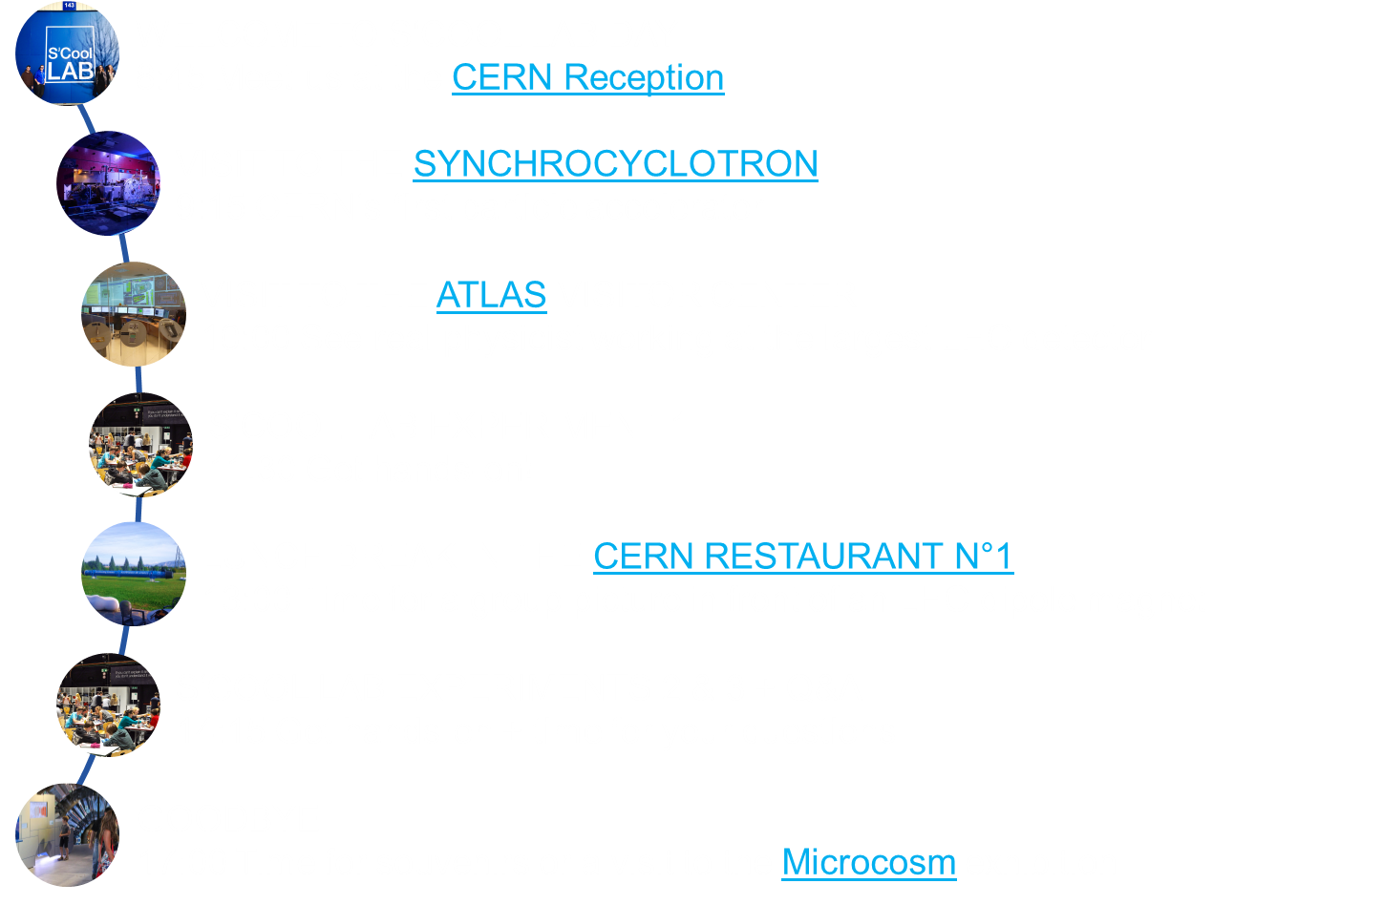
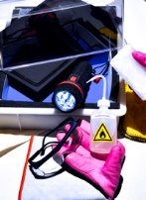
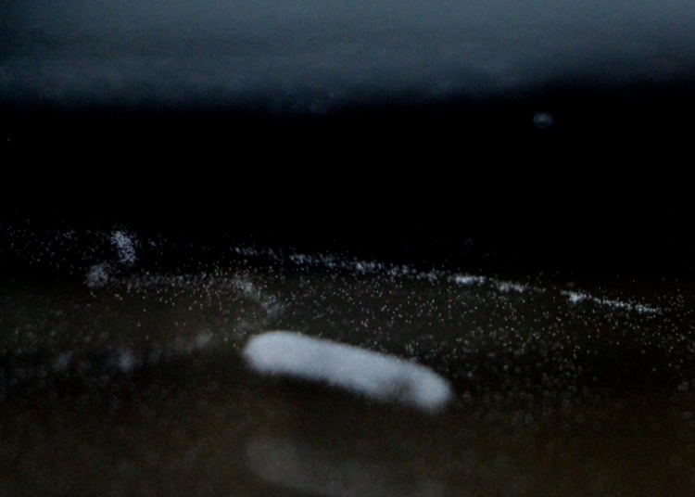
What do we offer?
S‘Cool LAB Days
for high-school students (16 – 19 y)
Cloud Chamber Workshops
for teacher and student groups
Participants 2015: 430 students
Participants 2015: 2400 students and >1000 teachers

Slide 5
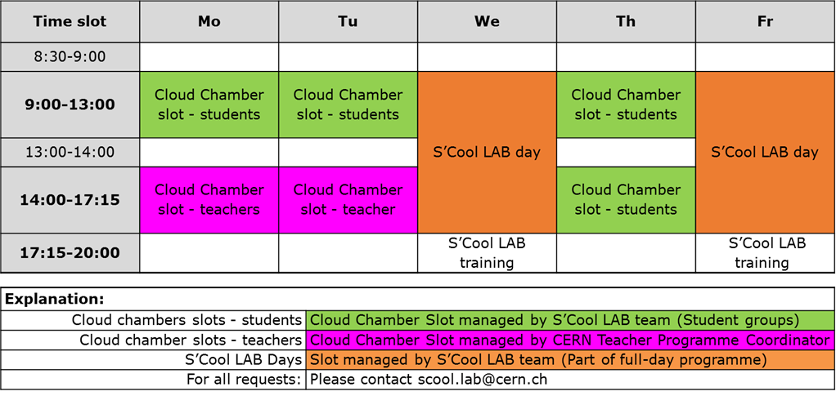
What do we offer?
S’Cool LAB Workshop Schedule

Slide 6

Applications for S’Cool LAB days 2015/16
1 Application
Applications by teachers via
http://cern.ch/s-cool-lab

Slide 7
Applications for S’Cool LAB days 2015/16
Brazil
US
Singapore
1 Application
So far: 241 applications for 51 S’Cool LAB days

Slide 8
S’Cool LAB days 2015/16
US
1 S’Cool LAB Day
So far: 241 applications for 51 S’Cool LAB days

Slide 9

Time to get hands-on!

Slide 10
Rules in S‘Cool LAB

Slide 11

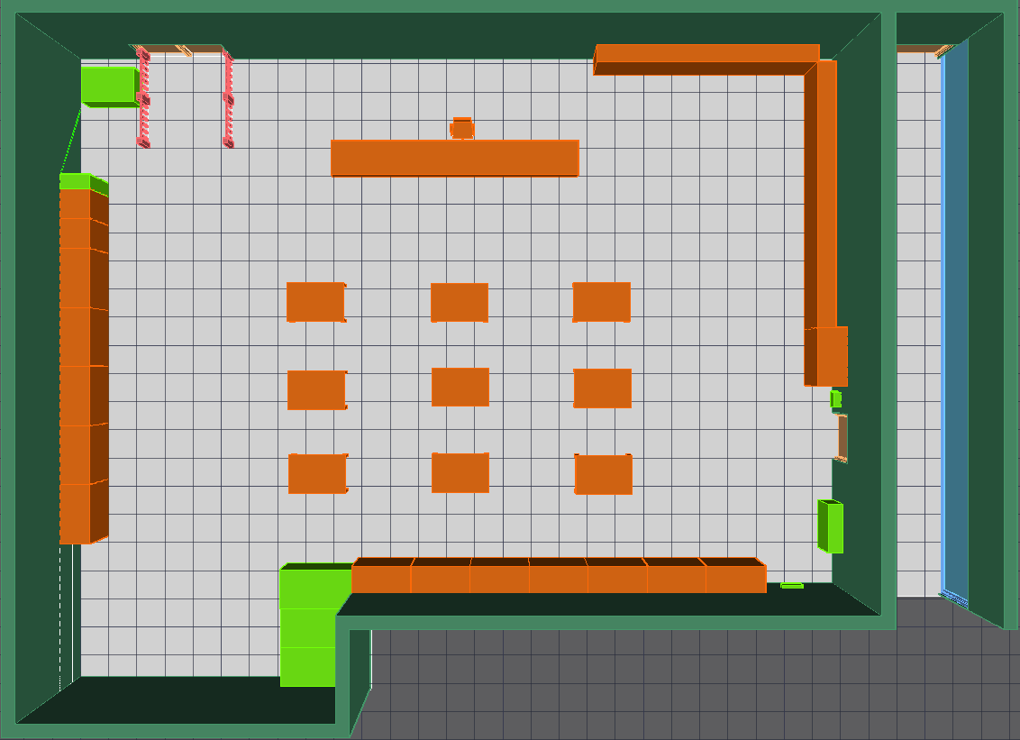



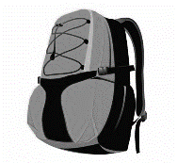


Bags

Slide 12
Emergency exits

Slide 13
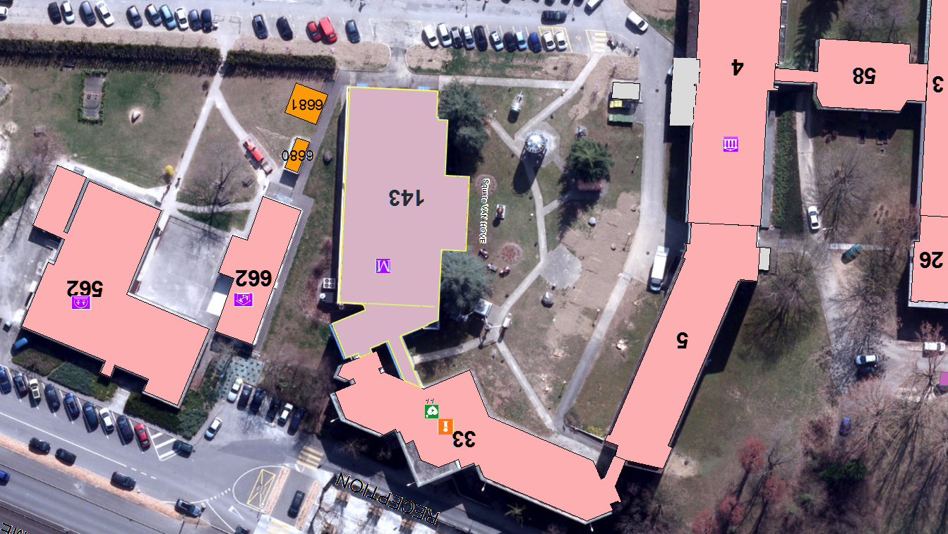


Assembly point

Slide 14
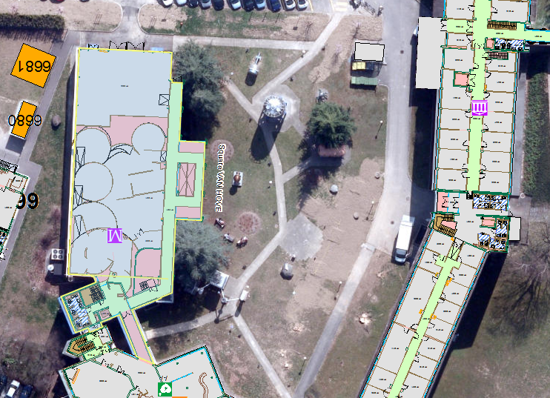

Rest rooms

Slide 15
Cloud Chamber Workshop

Slide 16
Outline
History
Step by step tutorial
Build your own particle detector
Tidying up
Discussion and explanations

Slide 17
History

Slide 18
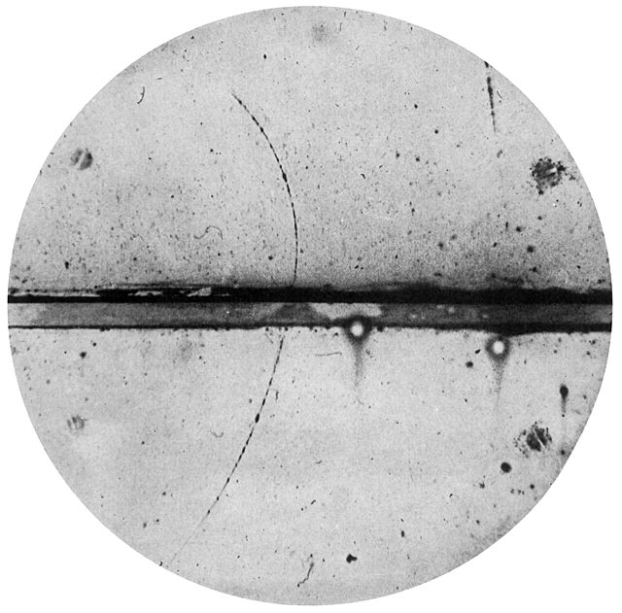
History
Charles T. R. Wilson (1869 - 1959)
Carl Anderson (1905 - 1991)
This Scottish physicist perfected the first (expansion) cloud chamber in 1911 and received the Nobel Prize in 1927.
This physicist discovered the positron in 1932 and the muon in 1936 using a cloud chamber. He received the Nobel Prize in 1936.
C. T. R. WILSON: On an Expansion Apparatus for Making Visible the Tracks of Ionising Particles in Gases and Some Results Obtained by Its Use. Proc. R. Soc. Lond. A. 1912 87 277-292 DOI:10.1098/rspa.1912.0081
Carl D. Anderson (1905–1991) - Anderson, Carl D. (1933). "The Positive Electron". Physical Review 43 (6): 491–494. DOI:10.1103/PhysRev.43.491.

Slide 19
Step by step tutorial

Slide 20
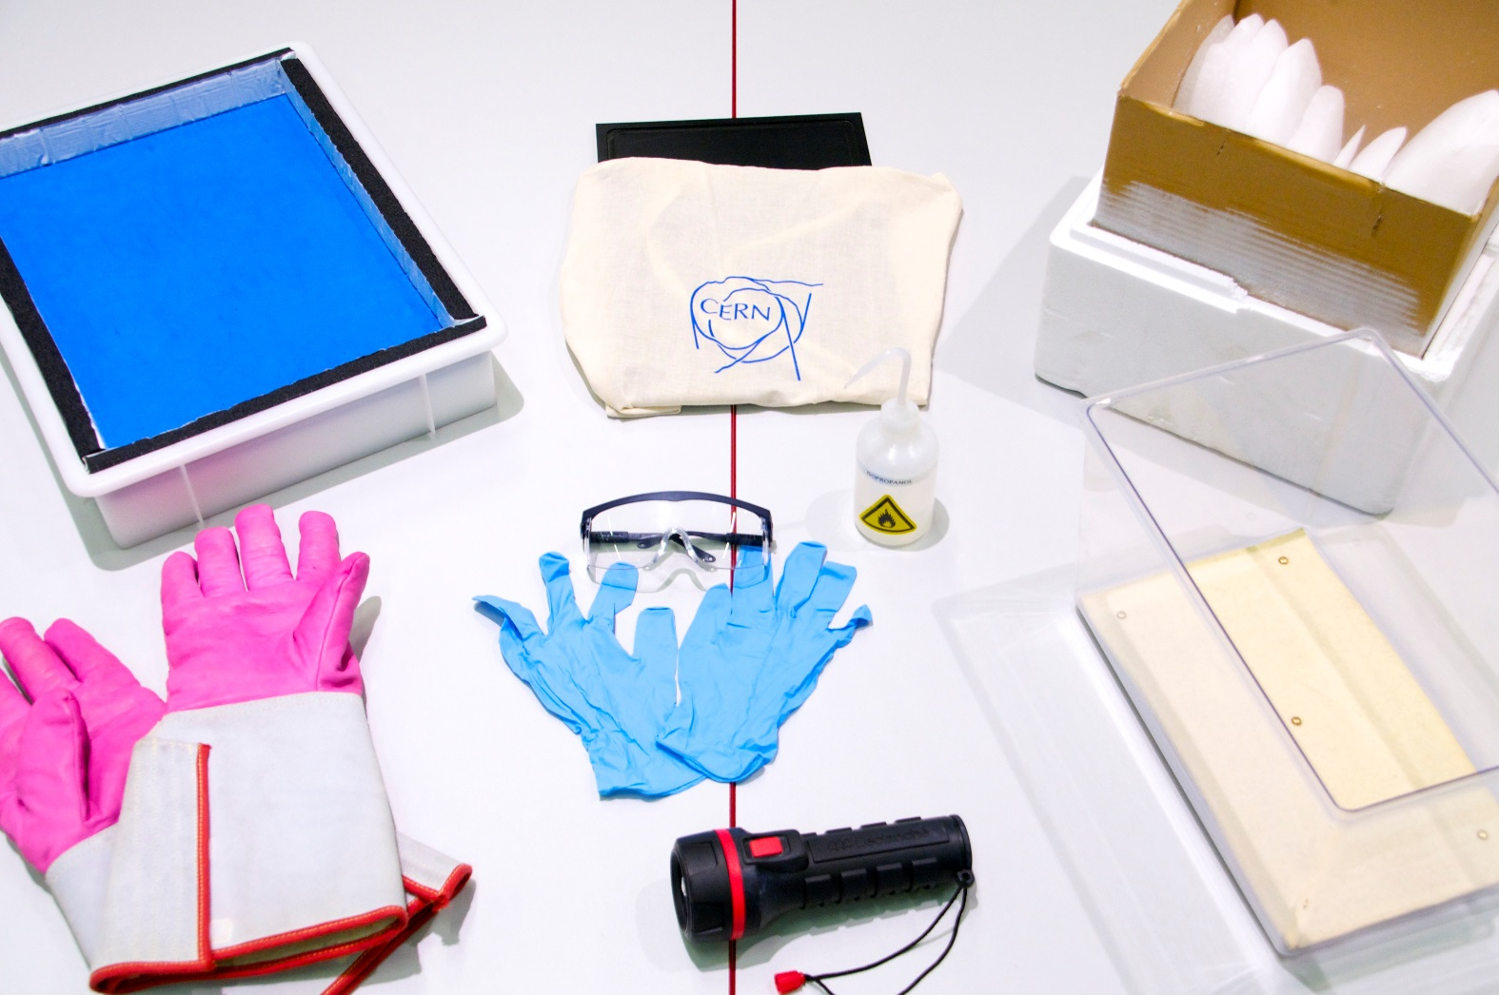
Build your cloud chamber - step by step

Slide 21
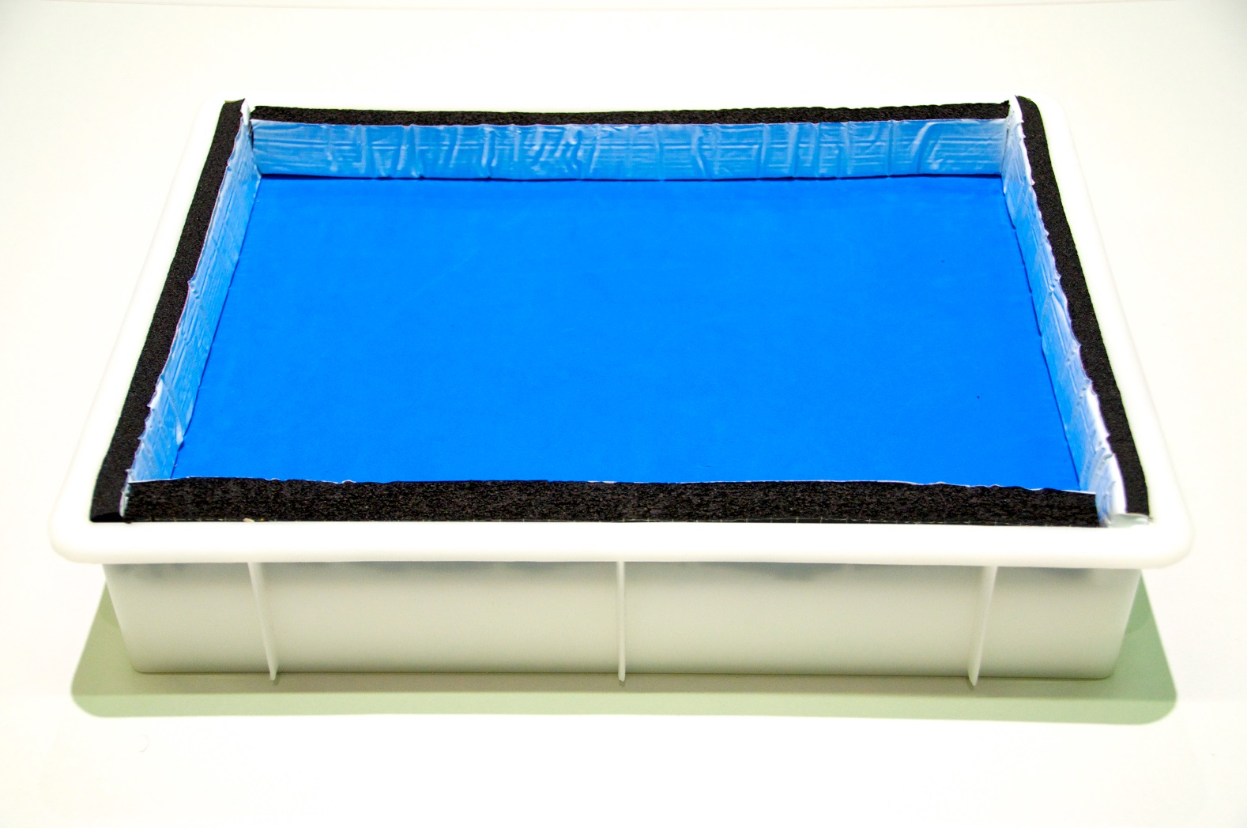

Slide 22
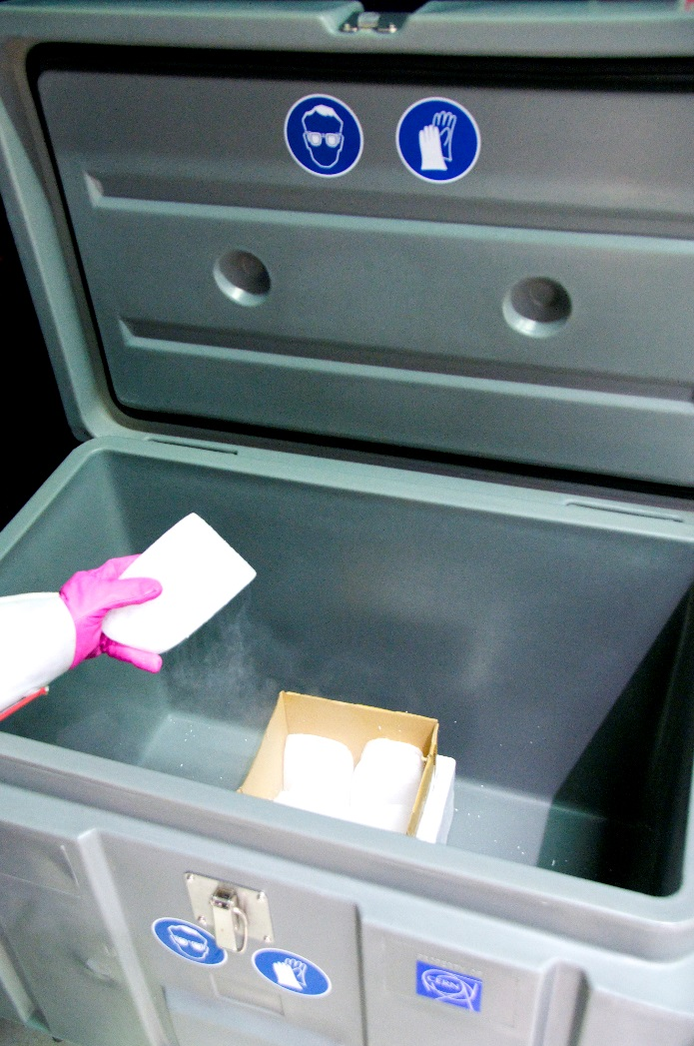
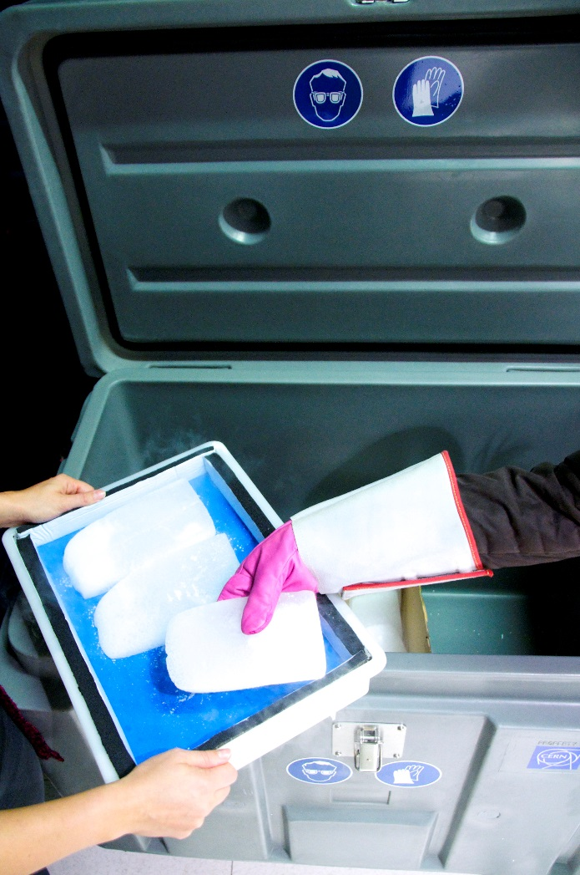

Slide 23
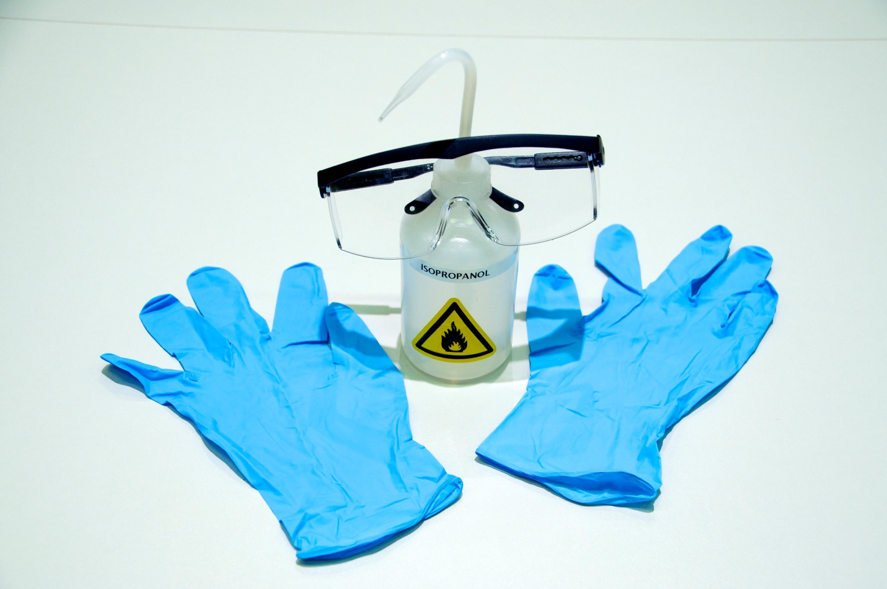

Slide 24
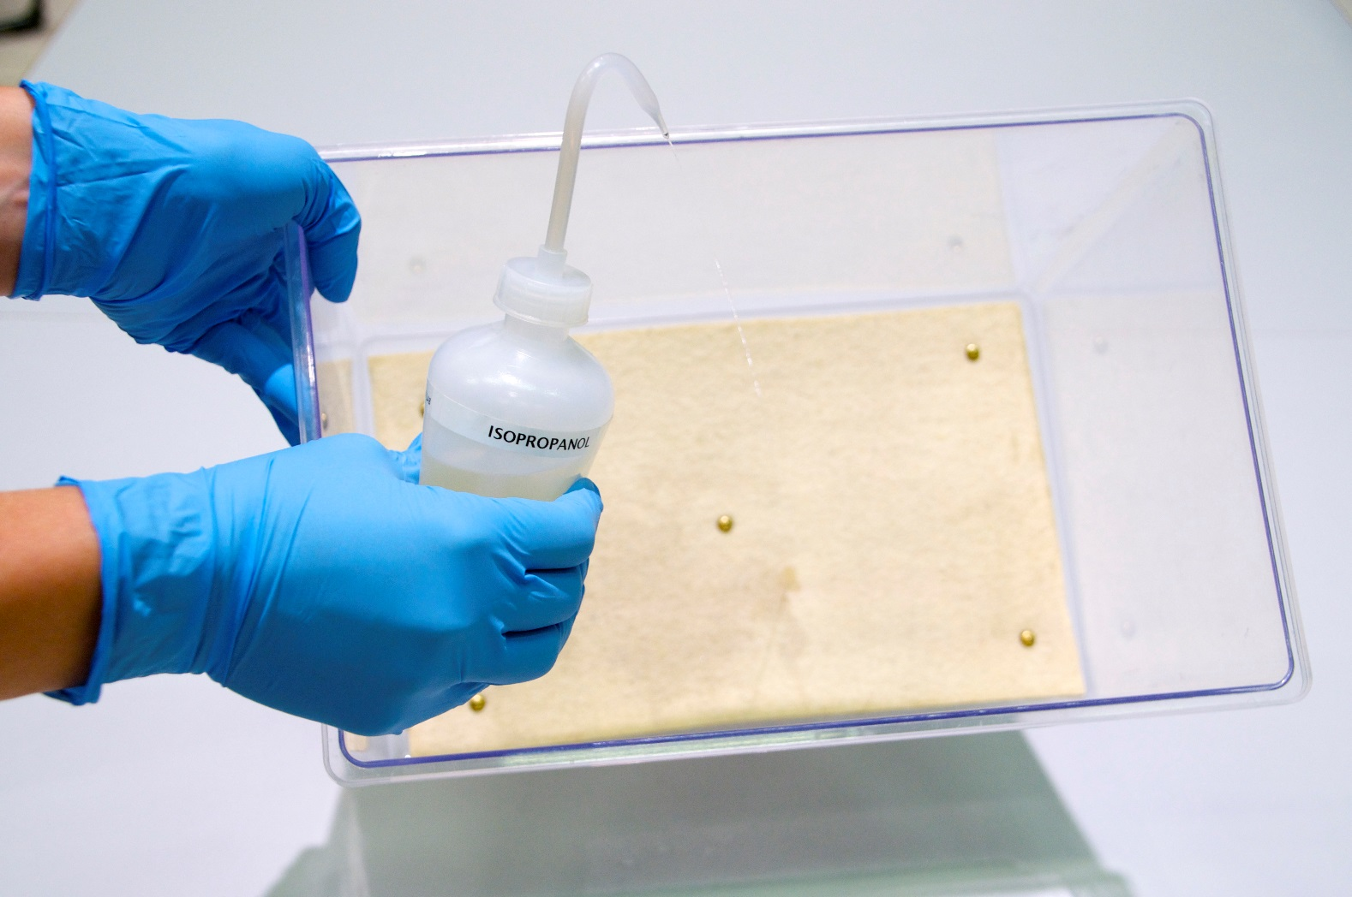
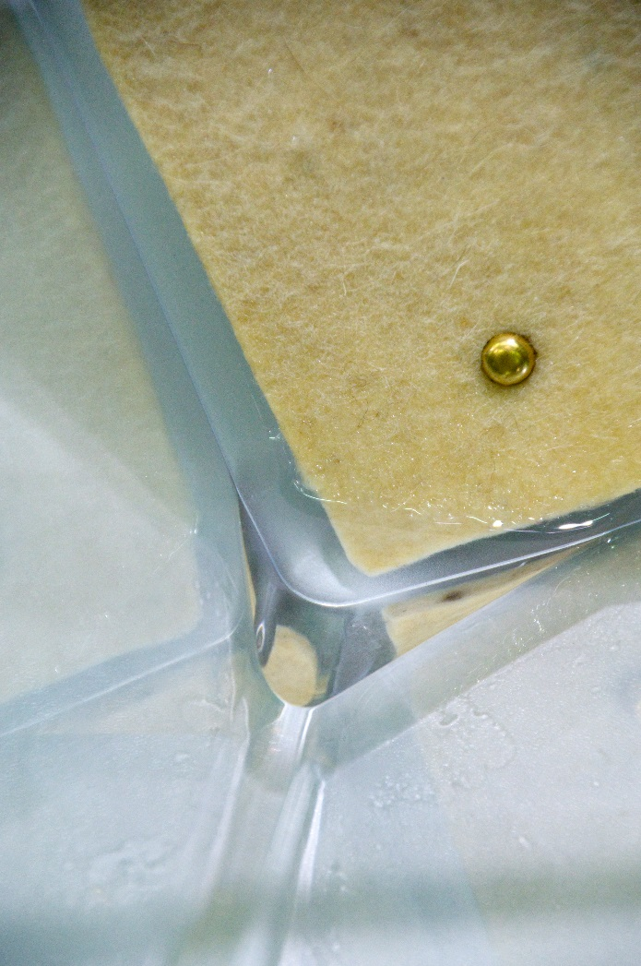

Slide 25
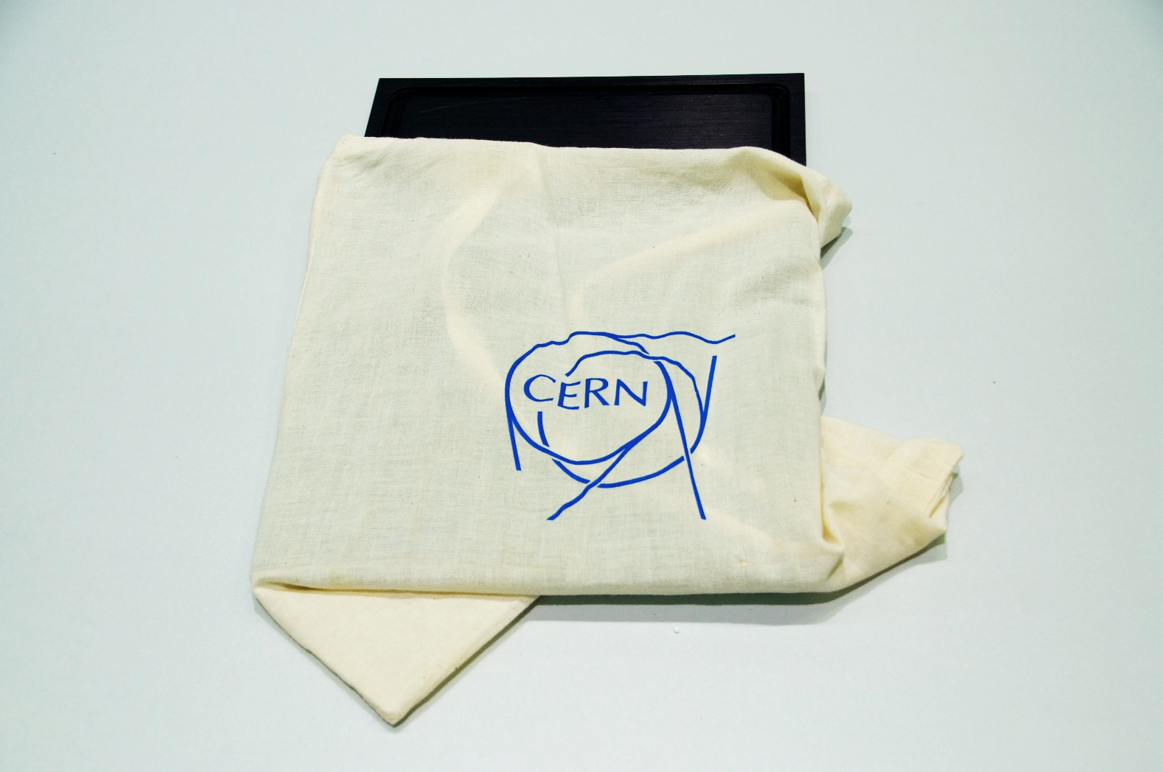

Slide 26
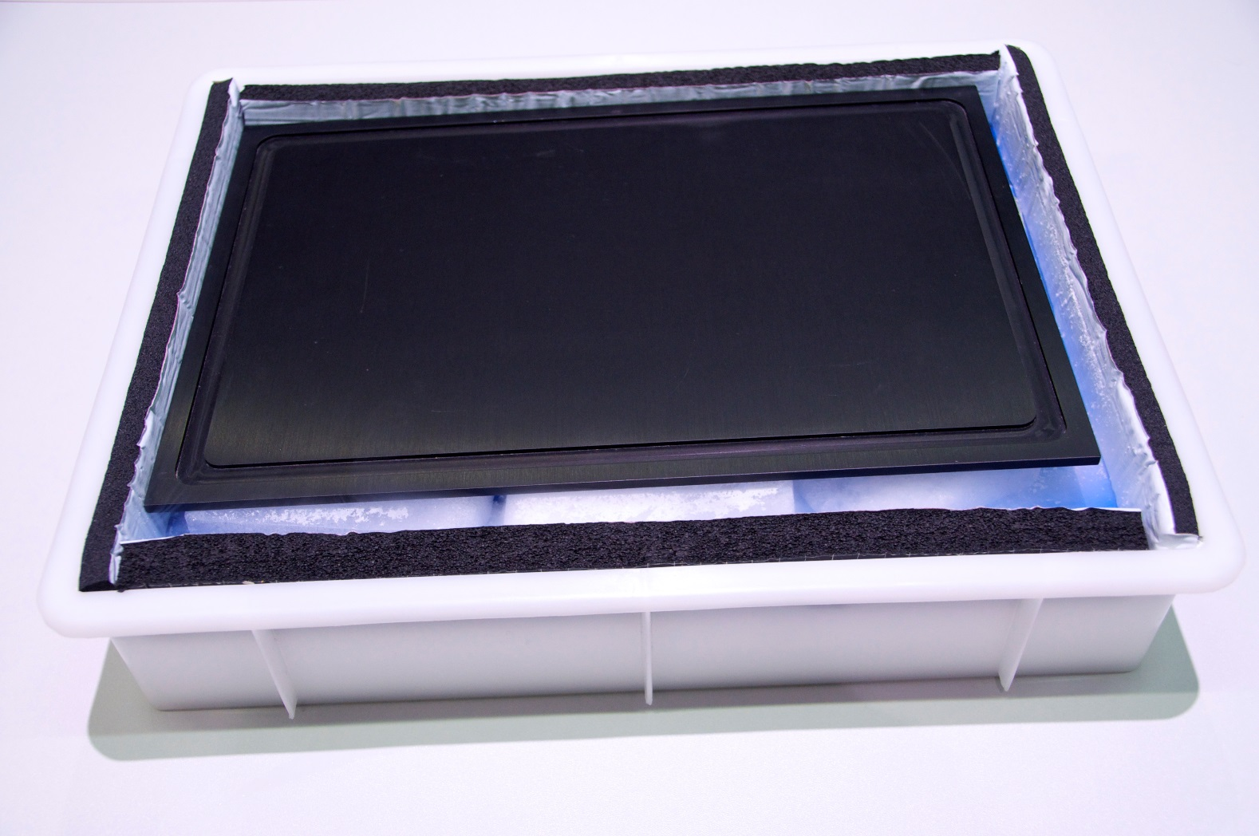

Slide 27
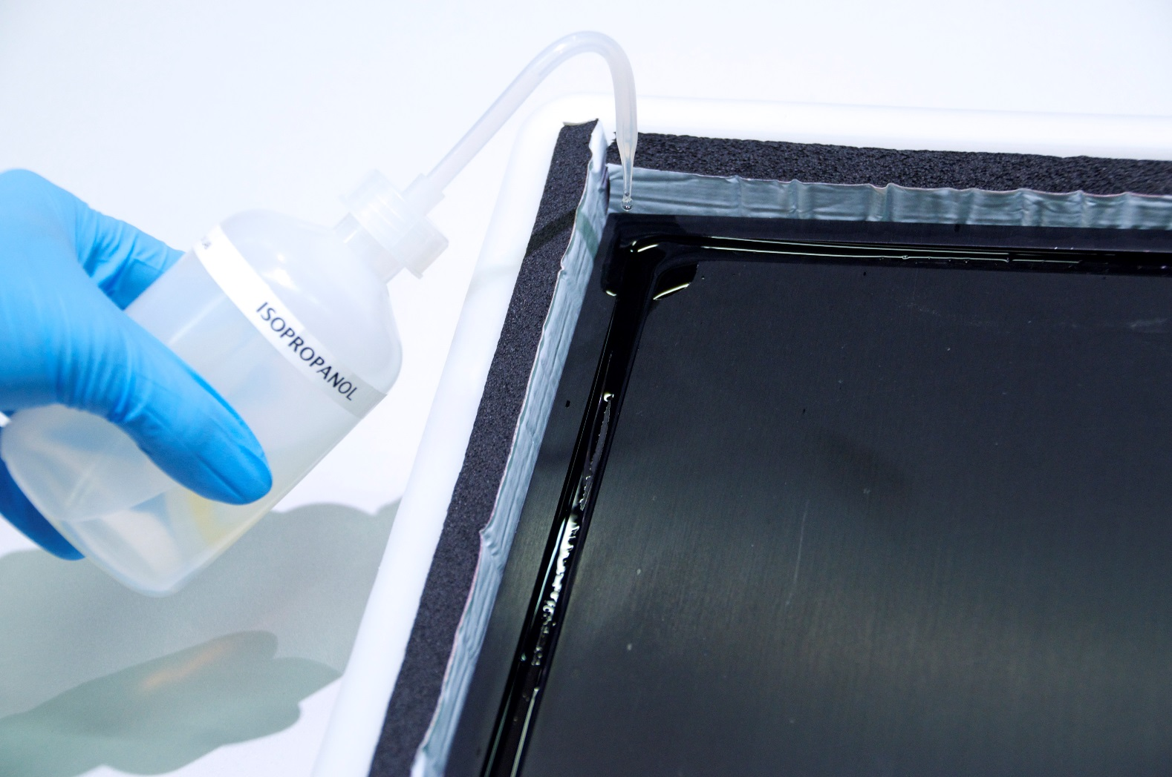

Slide 28
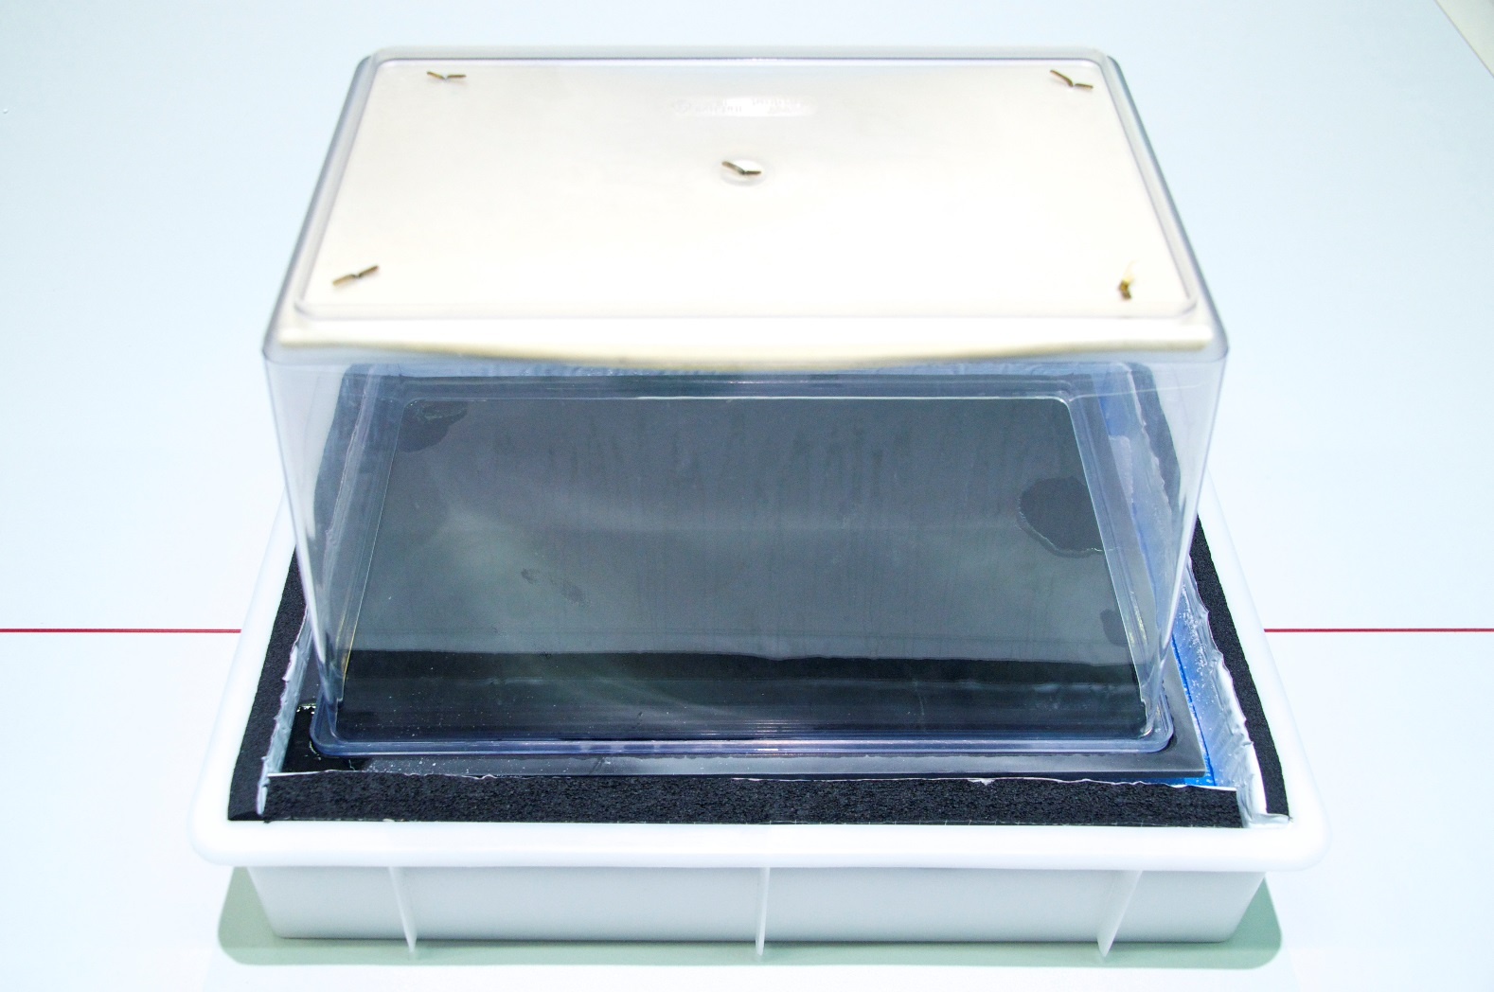

Slide 29
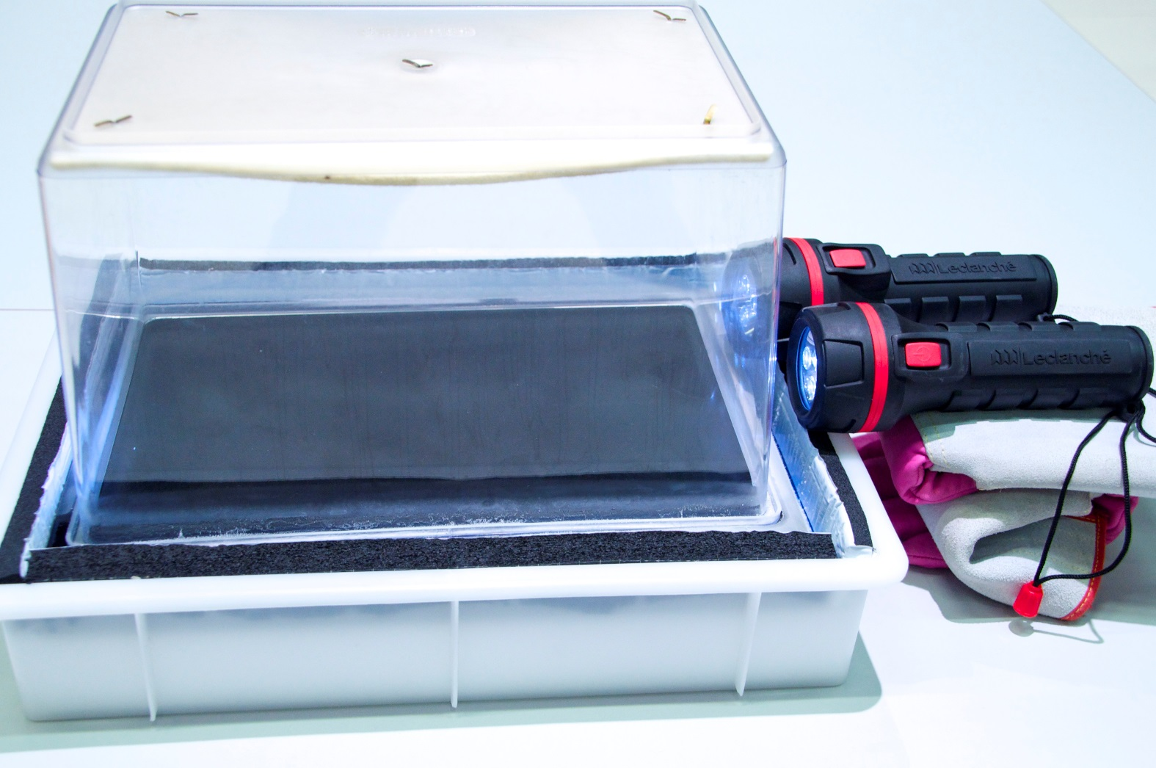

Slide 30
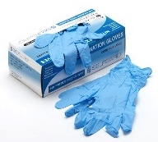
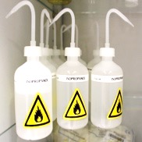
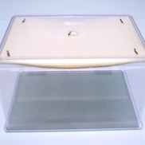
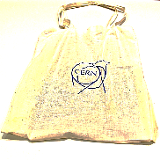
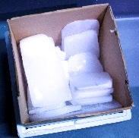
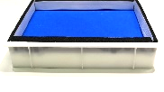
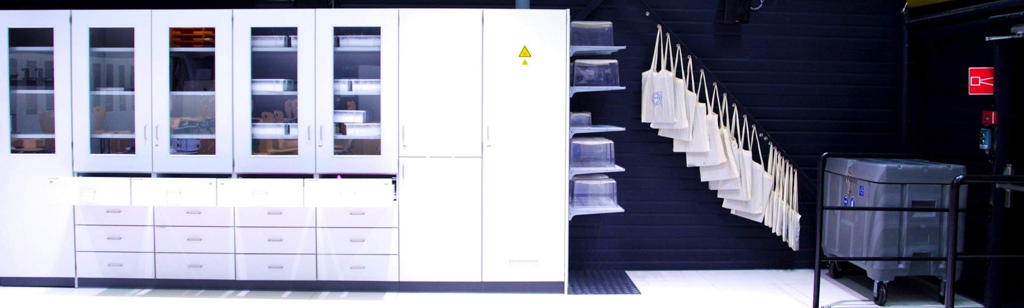
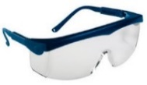



☞ Build your own particle detector!

Slide 31
☞ Build your own particle detector!
Tasks
Observe your Cloud Chamber
Find the optimal torch position and the optimal observation position
Describe visible tracks (shape, length, width, …)
Discuss the reason for these tracks
Count the number of tracks you can see for 1 minute, repeat this measurement 2 times

Slide 32
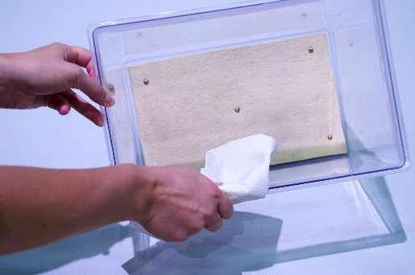
☞ Tidying up
!

Slide 33
Discussion and explanations

Slide 34
CosMO Experiment

Slide 35
Additional Material

Slide 36
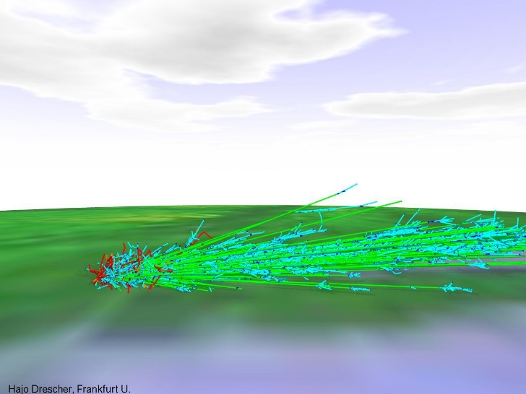
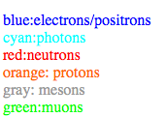
Air Shower Simulation
Cosmic Ray Air Shower Pictures
by H.-J. Drescher drescher@th.physik.uni-frankfurt.de.
Air showers are cascades of secondary particles induced in the atmosphere by high energy cosmic rays. What you see here is a visualisation of realistic simulations of these showers. Of course, not all of the particles in a shower are displayed, there are far too many! The fraction displayed here is about 1e-6, sampled with a thinning algorithm.
http://th.physik.uni-frankfurt.de/~drescher/CASSIM/

Slide 37
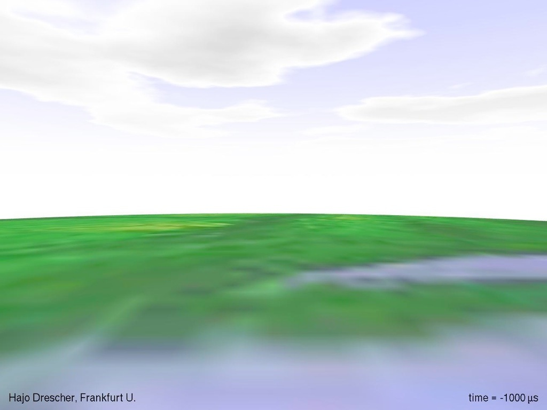

Slide 38


Slide 39


Slide 40


Slide 41


Slide 42


Slide 43
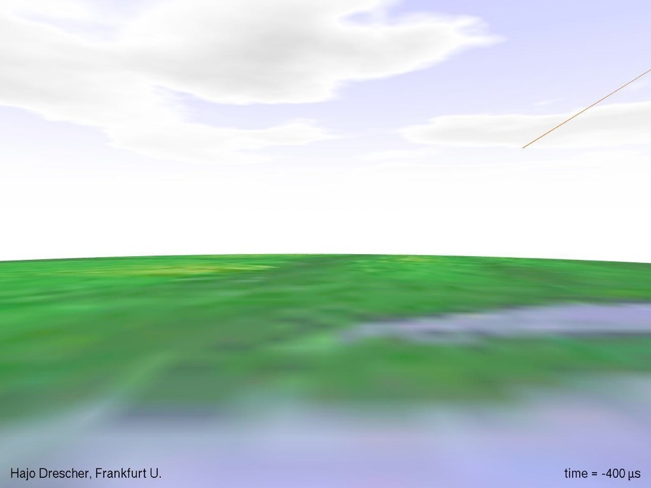

Slide 44
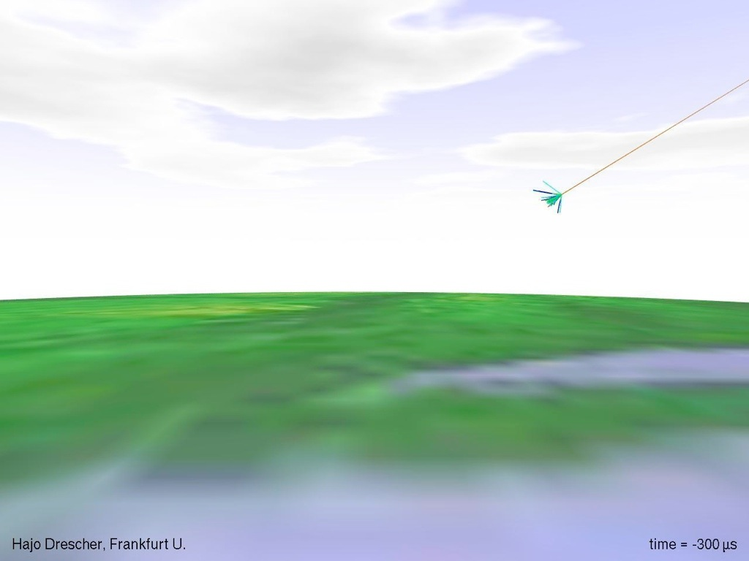

Slide 45
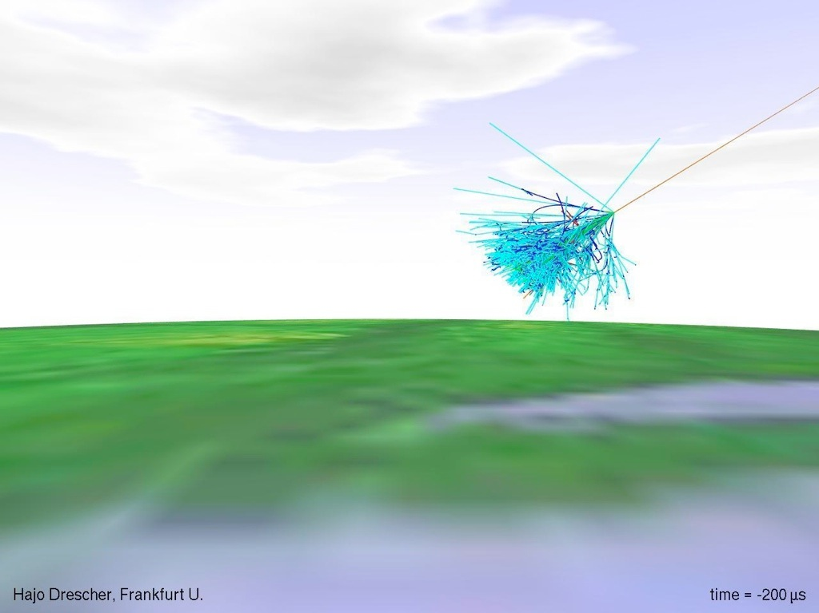

Slide 46
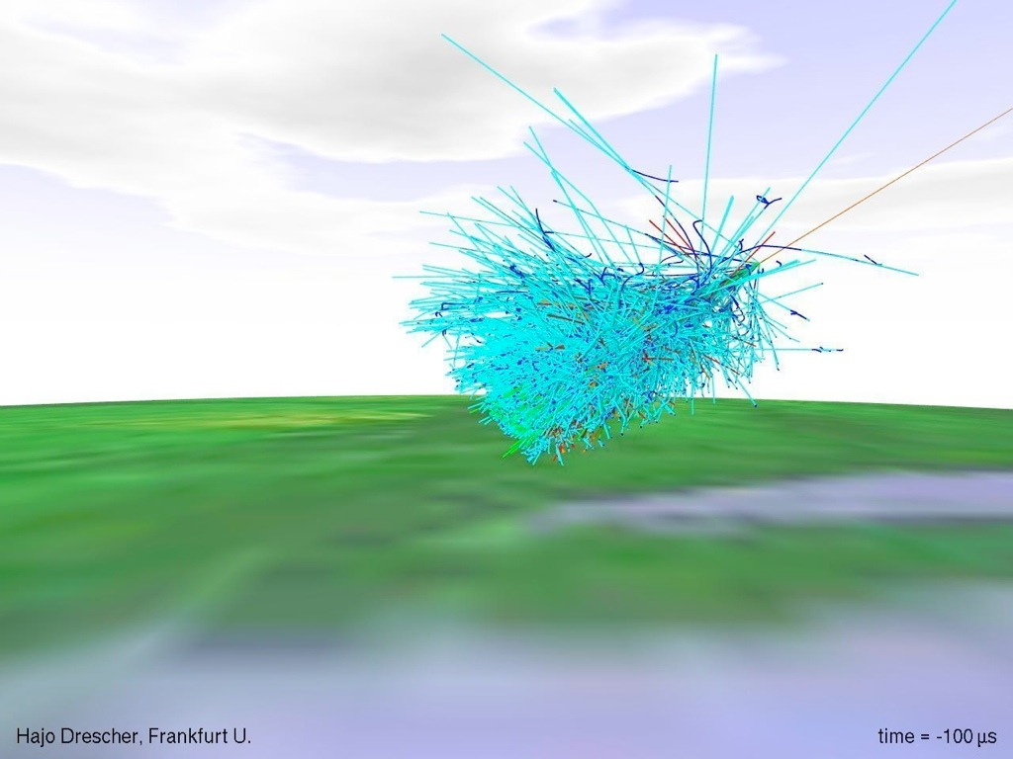

Slide 47
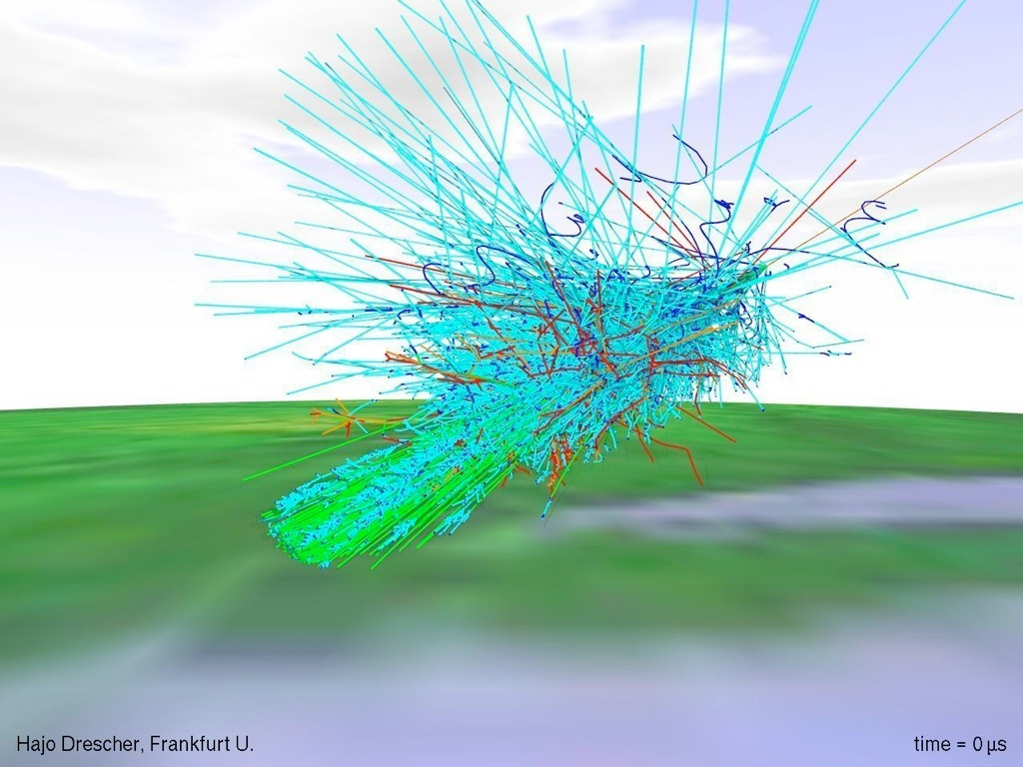

Slide 48
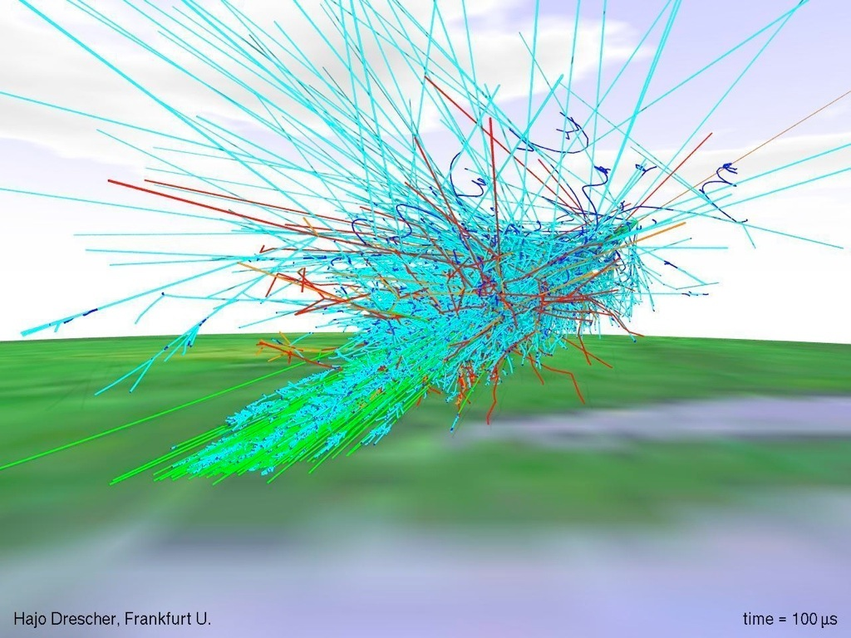

Slide 49


Slide 50
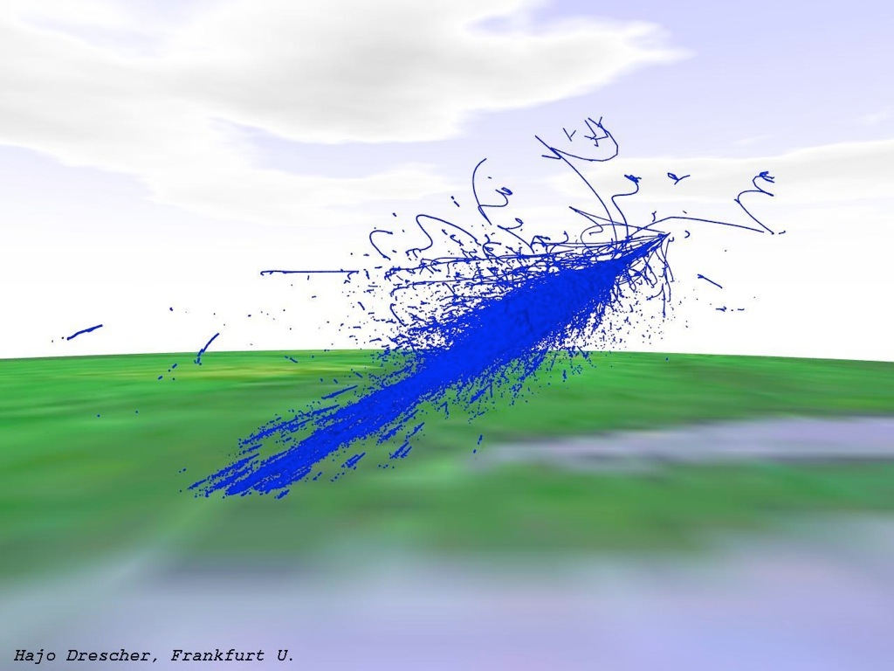

Slide 51
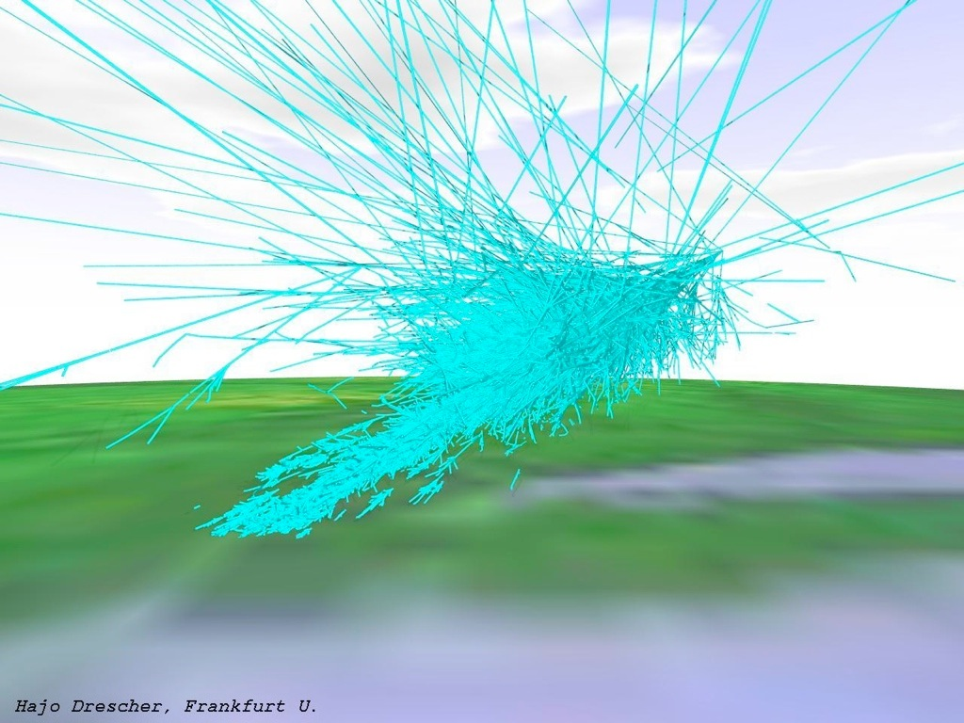

Slide 52


Slide 53


