Slide 1
BE-ABP Information meeting – 28/04/2016

Slide 2
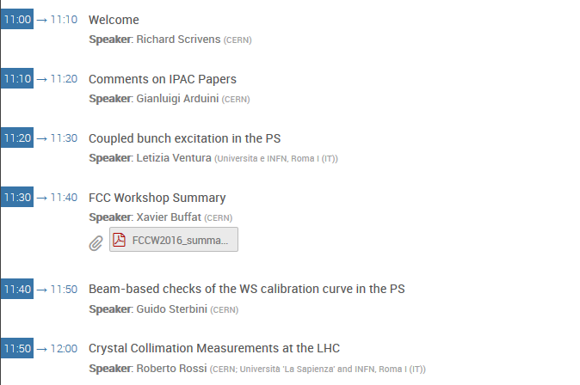
Agenda for Today

Slide 3
New Arrivals
David Yves AMORIM HSC
Raul JANEIRO COSTA LAT

Slide 4
Next Meetings
Group Meeting and BBQ:
June: 09/06/2016

