Slide 1

HL-LHC LSSR5 integration - Alignment
Pablo Santos Díaz - Vincent Baglin
HL-LHC R5 integration – Alignment
CERN Geneva / 19-04-2016

Slide 2
OUTLINE
Introduction: HI-LUMI LSSR5.
Vacuum chamber dimensions study.
Bellow dimensions study.
Alignment equipment.
Questions.

Slide 3
Introduction:
HI-LUMI LSSR5

Slide 4
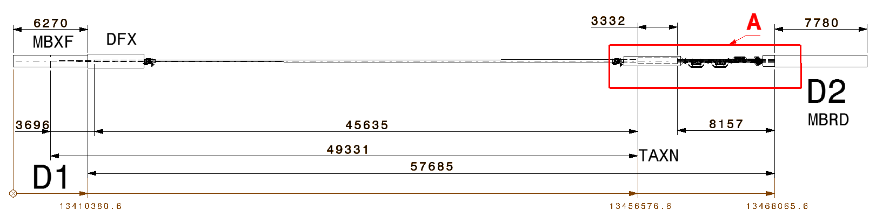
Introduction: HI-LUMI LSSR5
    Working on the LSSR5 integration establishing the vacuum equipment needed:
      Valves, bellows
      Vacuum Assemblies
      Gauges
      Vacuum chamber → setting the dimensions
      …

Slide 5
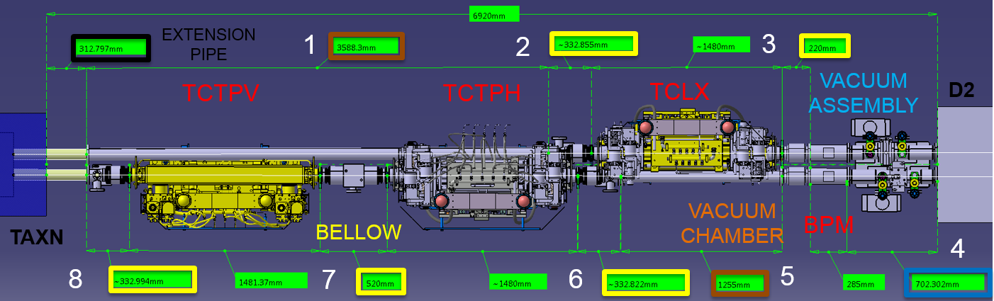
Introduction: LSSR5 – between TAXN and D2
5th axis = +/- 10 mm lateral displacement ➔ specific bellows (VMT type)
Detail A

Slide 6
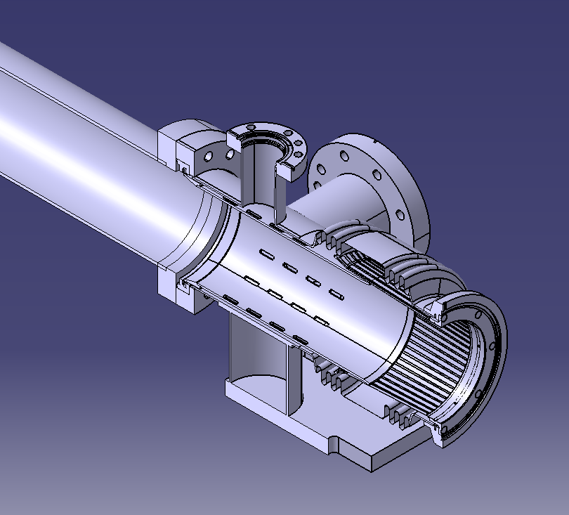
Introduction: LSSR5 – bellow-pipe transition
PIPE
    Vacuum chamber inner diameter
    must be set to determine:
      If new bellows has to be design.
      Collisions between components.
BELLOW

Slide 7
What is required to set the dimensions
of the vacuum chamber?

Slide 8
Vacuum chamber dimensions study

Slide 9
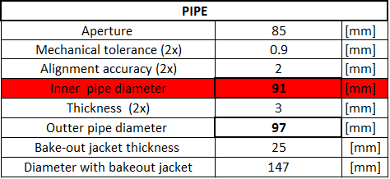
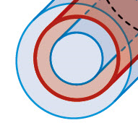
Vacuum chamber dimensions study
    Inputs:
      Beam aperture: 85 mm.
    Data required for tolerance:
      Pipe mechanical tolerance&.
      Pipe alignment accuracy.
Assumed*
Minimum value
    Which is the alignment tolerance accuracy?
85 + yellow + yellow = 85+0.9+0.9 = 86.8
86.8 + purple + purple = 90.8 ➔ 91 mm
& Mech Tol. = Cylindricity = concentricity+straightness+parallelism = 1.8 mm
* Today for LHC = 3 mm

Slide 10
Bellow dimensions study

Slide 11
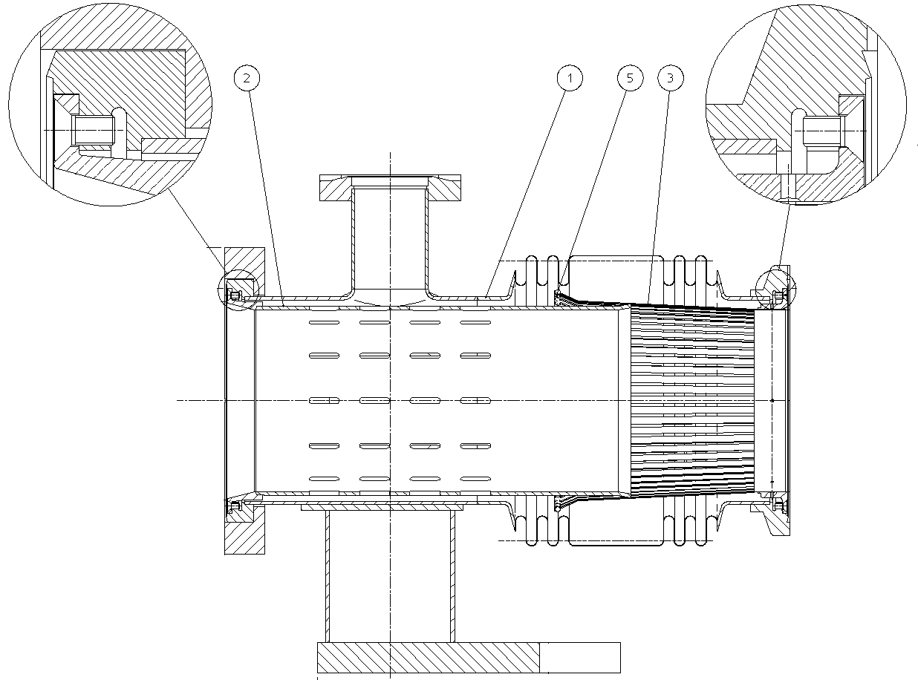
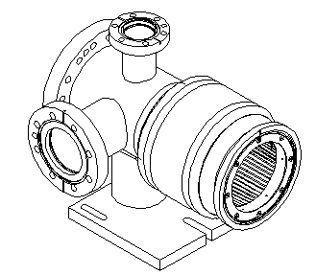
Bellow optimization
Wen need to fit the inner diameter of the vacuum chamber with the inner diameter of RF bridge of the bellow in order to have no transition (tapering) between them.
Bellow body
Transition tube
RF fingers
RF bridge = transition tube + RF fingers

Slide 12
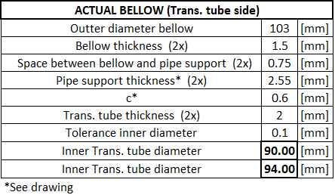
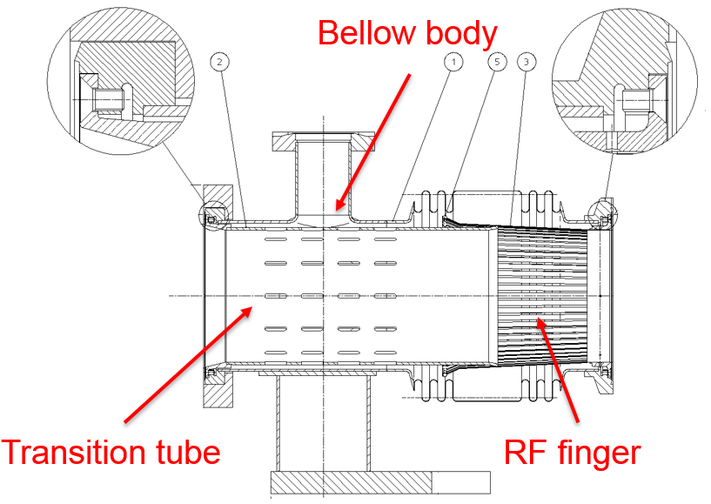
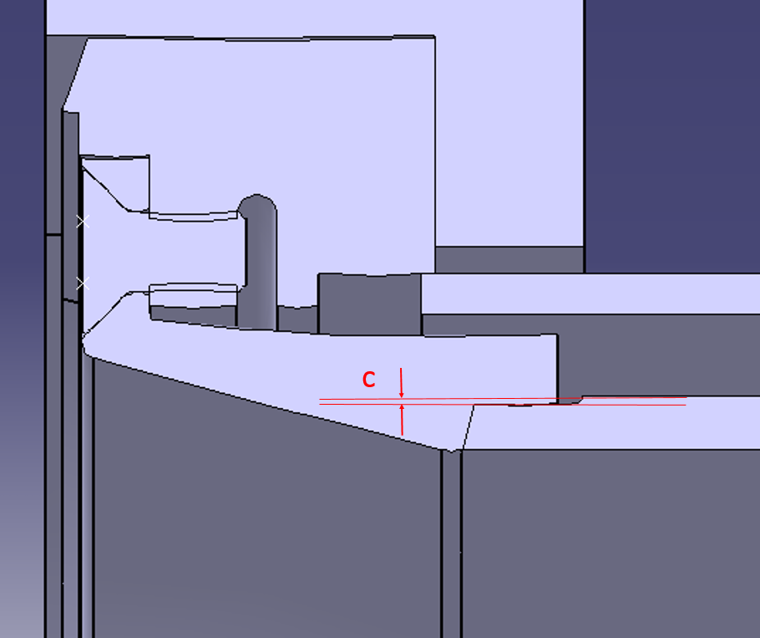
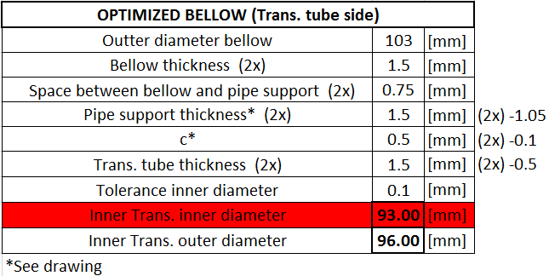
Transition tube joint
Max. inner diameter
in transition tube joint

Slide 13
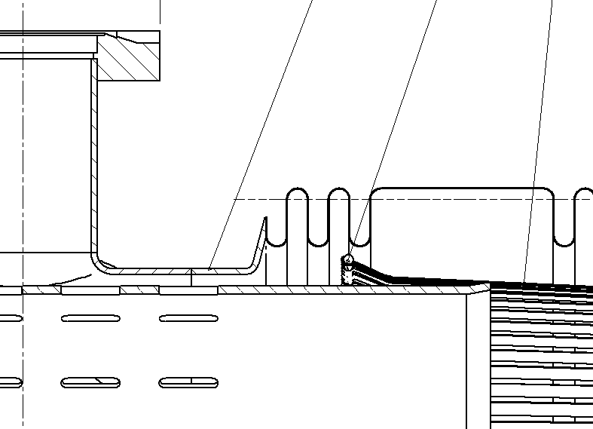
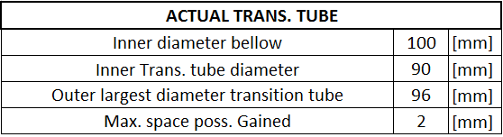
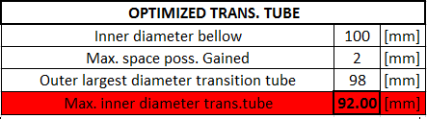
Transition tube
1
2
3
1
1
2
3
2
Max. inner diameter
in transition tube

Slide 14
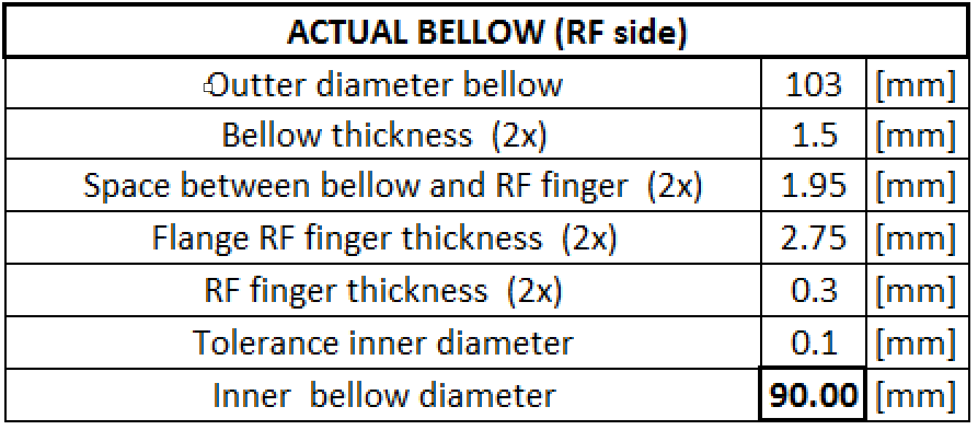
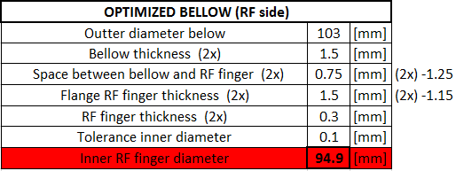
RF Finger joint
Max. inner diameter
in RF finger joint

Slide 15
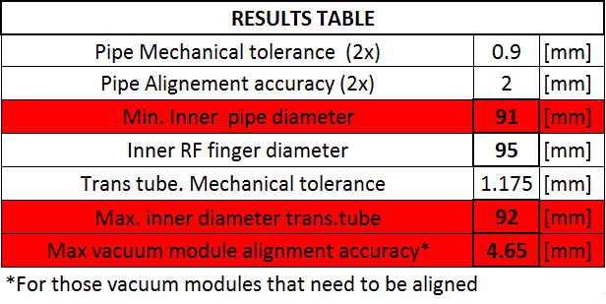
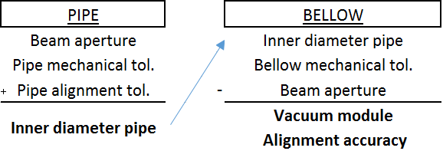
Conclusions
Bellow optimization and vacuum chamber study
Objective → to not have diameter transition between vacuum chamber and bellow:
Min inner diameter → 91 mm
Max inner diameter → 92 mm
Max vacuum module alignment accuracy* → 2.32 mm
TARGET :
ID91, Alignement +/- 1.8 mm
ID92, Alignement +/- 2.3 mm
All the tolerances shown are in radius

Slide 16
Alignment equipment

Slide 17
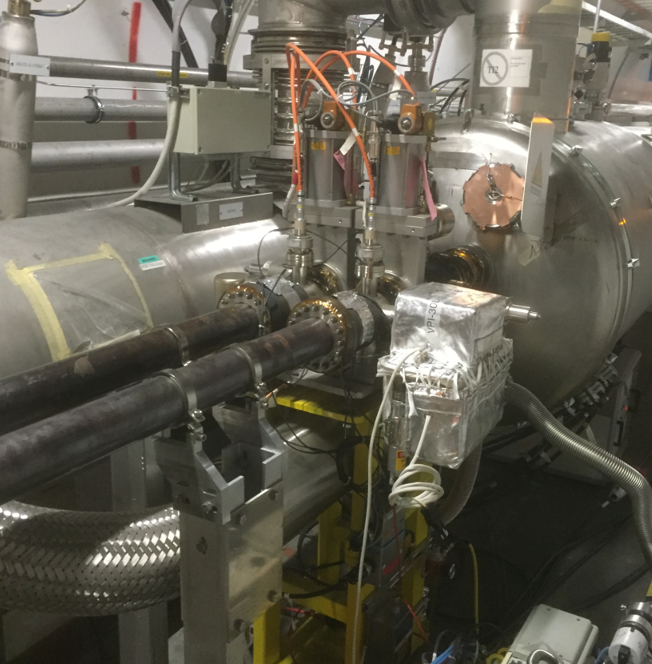
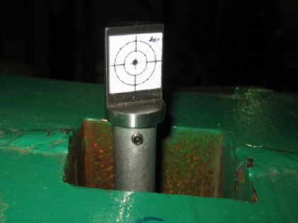
Alignment equipment
    In addition to vacuum chambers (VC), we have to align bellows (VMT), Supports (VHL) and vacuum assemblies (VA).
    For future design, improvement in alignment is
    needed. Today our alignment specification is 3 mm.
    What are the standard tools & means used to align an equipment?
    Which tools do we have to include in the design to do the alignment with your equipment?
Support
    ?
Vacuum assembly
    ?

Slide 18
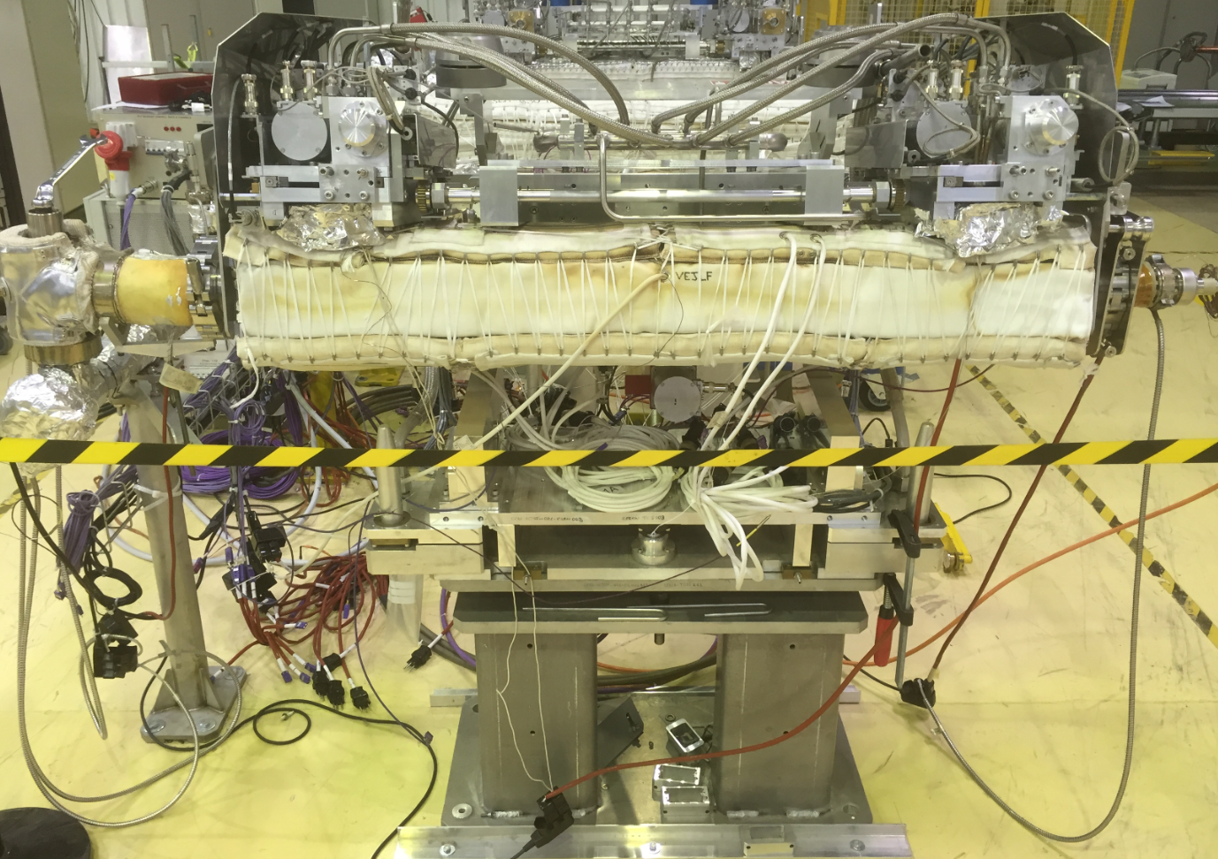
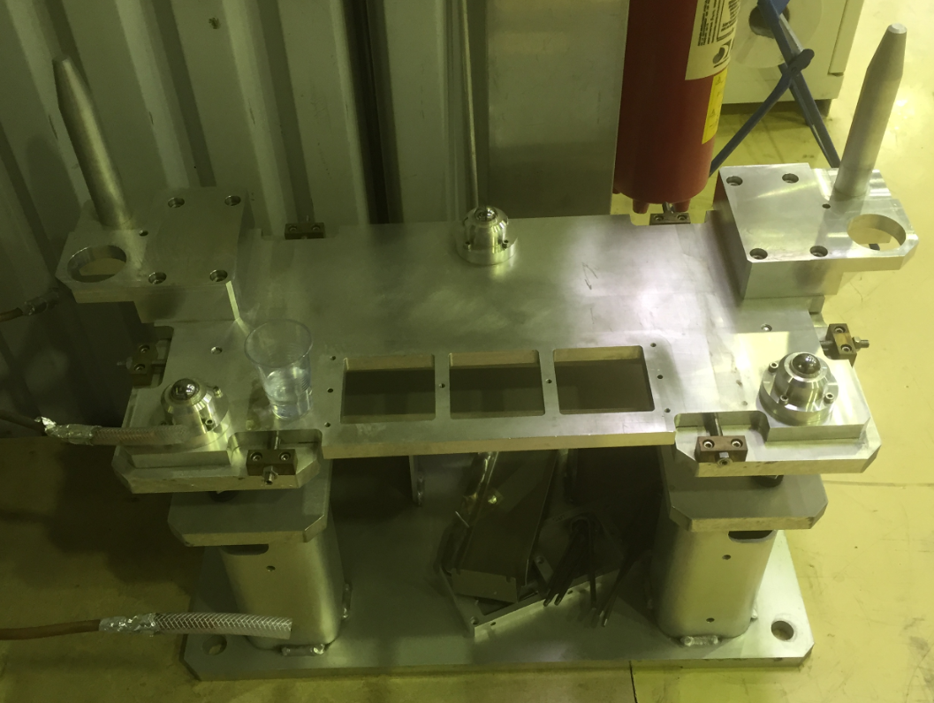
Alignment equipment
    Idea: to have a support aligned only once and its ancillaries easily exchangeable, without re-alignement, in order to follow ALARA recommendations.
      What is the alignment accuracy for this kind of support?
      What are the alignment tools do we need for this kind of support?

Slide 19
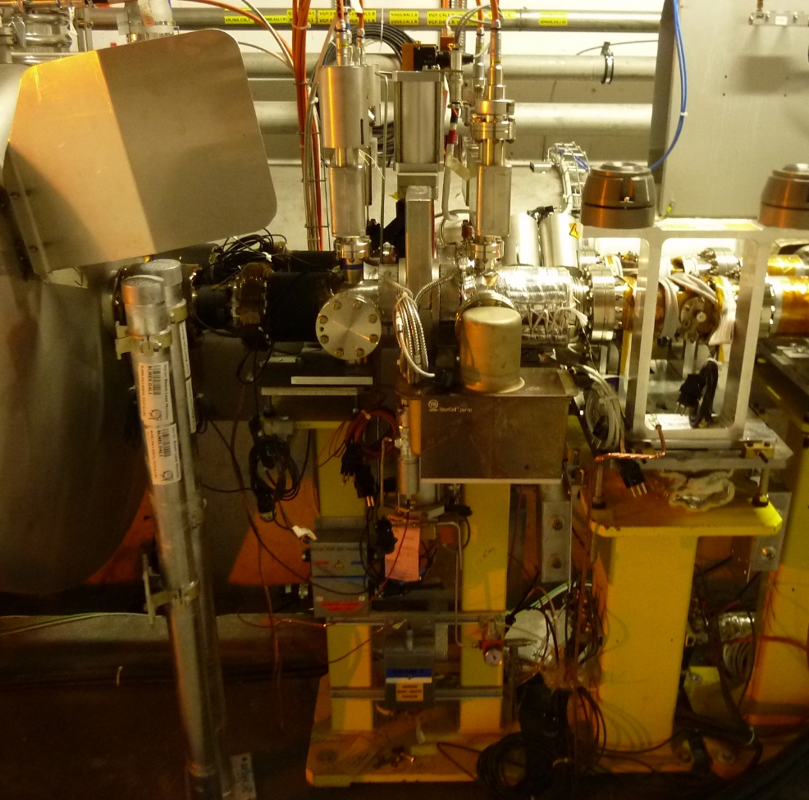
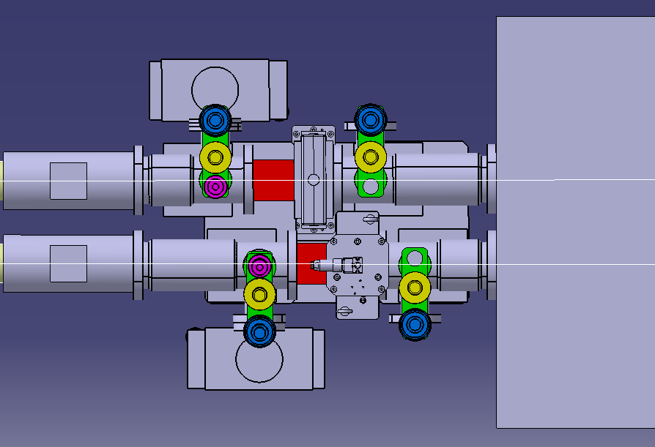
Alignment equipment: VA
Fix to BPM
and aligned
Need to
be aligned
BPM
(aligned)
D2
(aligned)
Alignment
tool
Fix to D2
and aligned

Slide 20
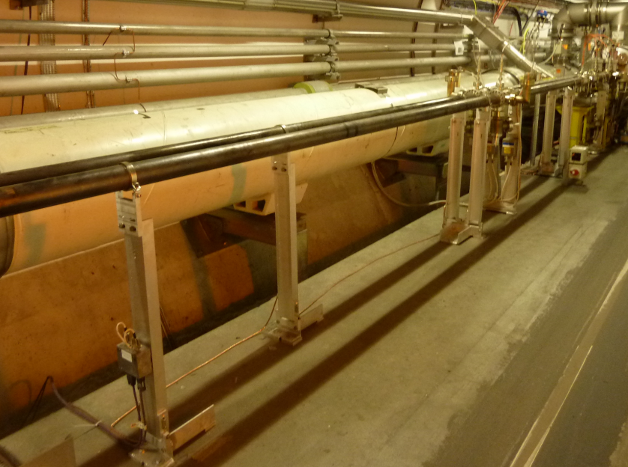
Alignment equipment: VC
Vacuum chamber supports have to be aligned
Movable & fixed supports
Double
support
Single
support

Slide 21
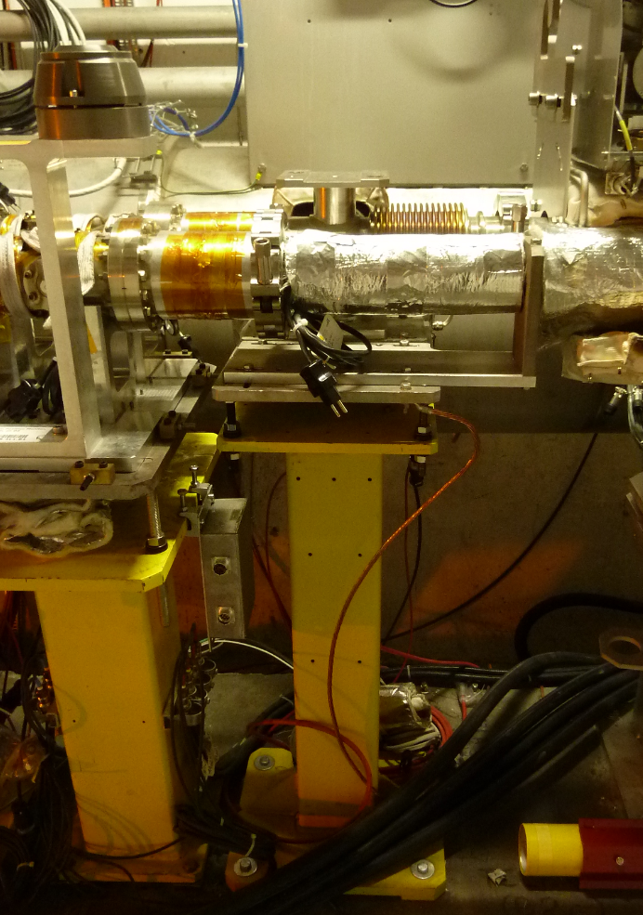
Alignment equipment: VMT
Some Vacuum modules with double bellows have to be aligned
Bellow
Support

Slide 22
Questions

Slide 23
Questions
    What is the achievable alignment accuracy of an upgraded alignment system for the VA, VC, VMT?
Concerning the alignment equipment, what are the tools that you need to align an equipment?
If we design a new support, which tools do we have to include in the design to do the alignment with your equipment?
How do you do the alignment? Which tools or which methodology do you use?

Slide 24
THANK YOU FOR YOUR ATTENTION!!!

