Slide 1
Overview of today
Thomas Schörner-Sadenius
Santander, 31 May 2016

Slide 2
Present today
EU: Marjory Genachte
External reviewer: Paolo Giacomelli (INFN Bologna)
CEA: ---
CERN: Nicolas Friedli, Cecile Granier, Seamus Hegarty, Andrea Latina, Steinar Stapnes
CNRS: Philip Bambade
CSIC: Angeles Faus-Golfe
DESY: Anne Schuetz, Karsten Buesser, Klaus Sinram, Natalia Potylitsina Kube, Marcel Stanitzki, Thomas Schörner-Sadenius
KEK: Katsuo Tokushuku
RHUL: Pavel Karataev, (Emi Yamakawa)
UOXF: Phil Burrows, Neven Blaskovic Kraljevic
UoT: ---

Slide 3
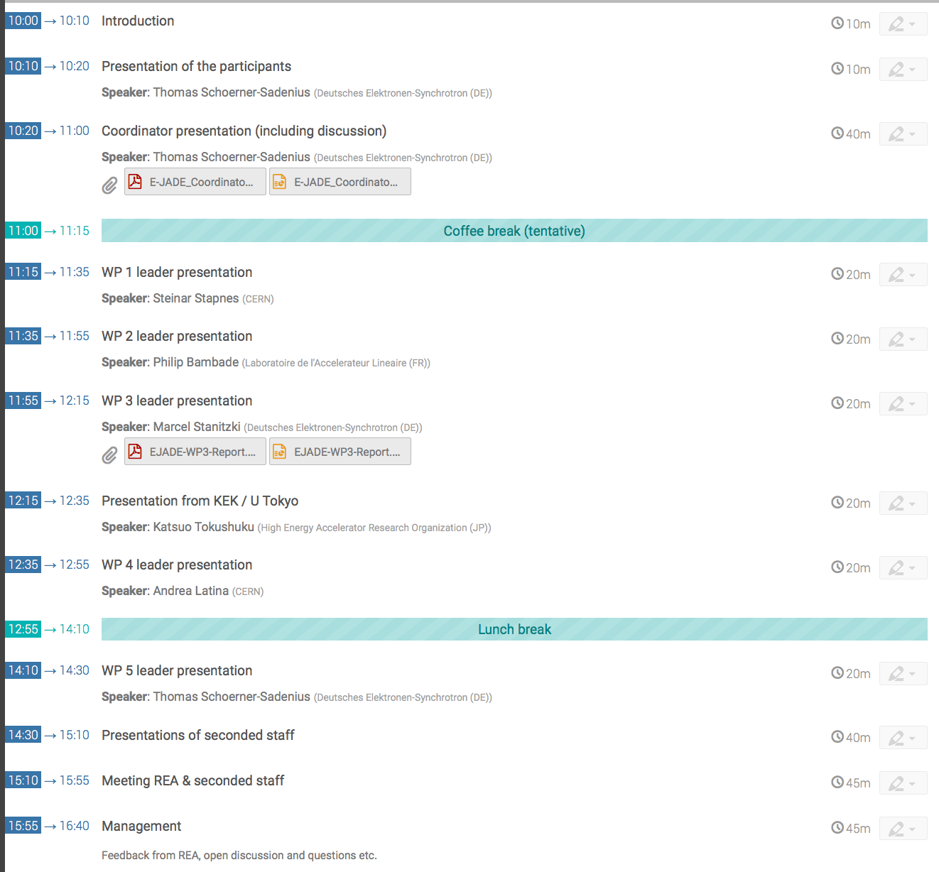
Agenda

