Slide 1
Coordinator’s Report
Thomas Schörner-Sadenius
Santander, 31 May 2016

Slide 2
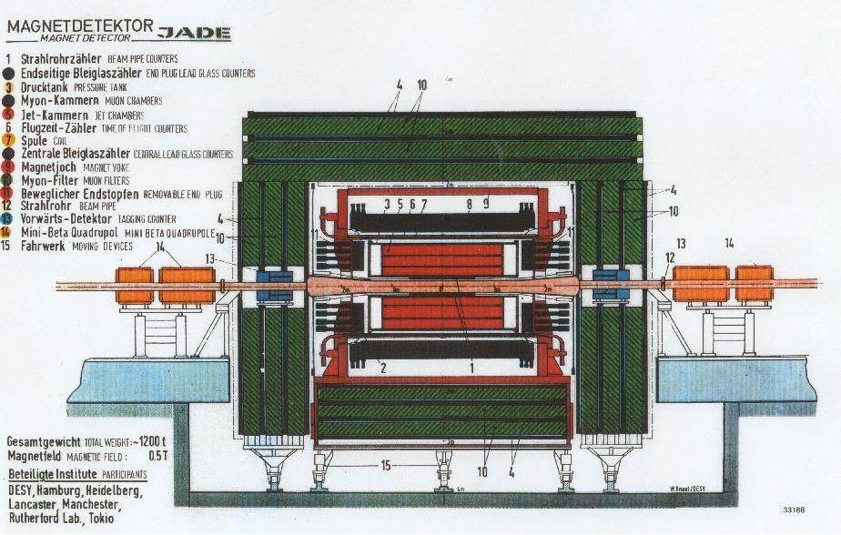

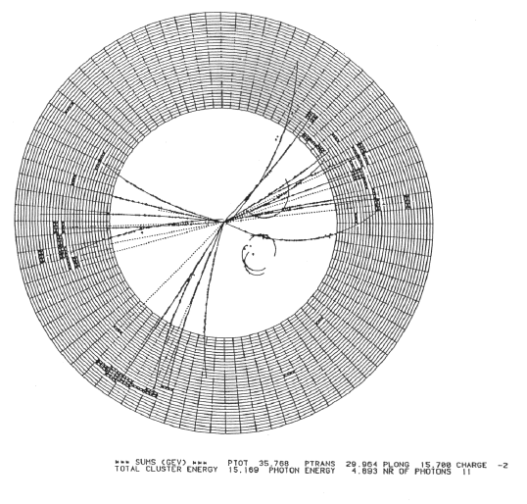

E-JADE
EU-Japan Accelerator Development Exchange Programme
JADE is something very dear to particle physicists, and to
many of us here in particular:
Three-jet event in JADE at
DESY’s PETRA e⁺e⁻ collider

Slide 3
Overview
The E-JADE project – science
The E-JADE project – organisation
The work packages – quick overview
Status of secondments
Feedback to EU
Conclusions and outlook

Slide 4
E-JADE – The Science Scope
Particle physics has since long been a very international endeavour
For funding reasons, there will be only one accelerator of a given type at a given time (e.g. hadron collider, e⁺e⁻ collider, …)
International roadmaps (European, Japanese, but also US) identify similar goals
➔ increased collaboration and exchange between different world regions is mandatory for maximising the chances of realisation
“… E-JADE addresses the urgent need of exchange of ideas on R&D and implementation of future accelerators for particle physics.”
  Basic accelerator R&D
  Prototyping
  Implementation
  Management

Slide 5
E-JADE – Science Overview
Hadron colliders:
LHC, HL-LHC, FCC, …
(WP 1)
Lepton colliders:
LC R&D and management
(WP 3)
Management
and dissemination
(WP 4)
Lepton beams:
nanobeams at ATF
(WP 2)
Training and
knowledge
transfer
(WP 5)

Slide 6
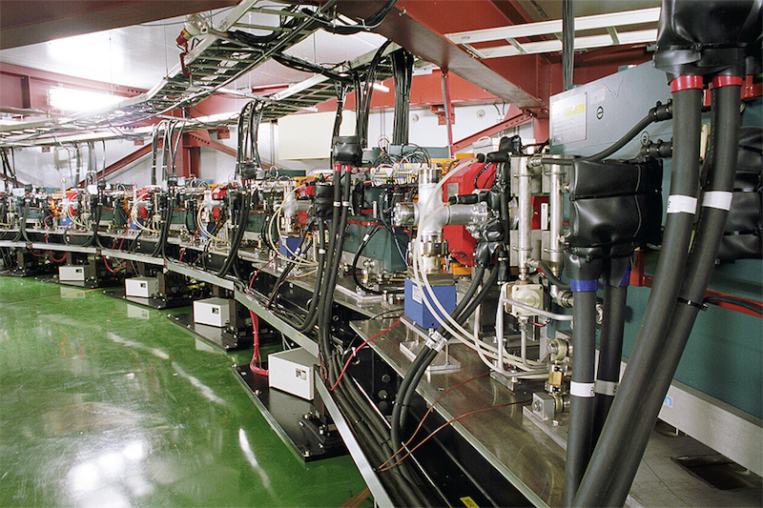
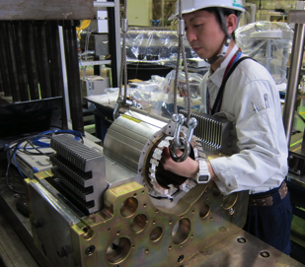
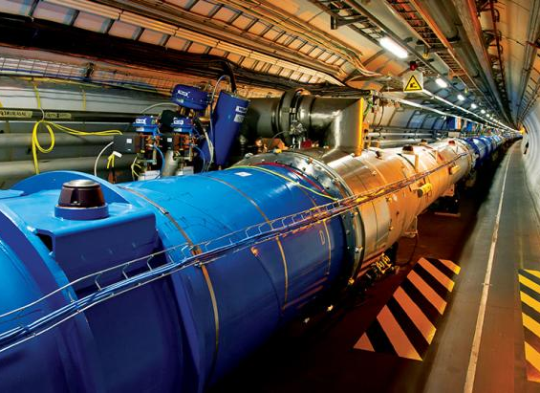
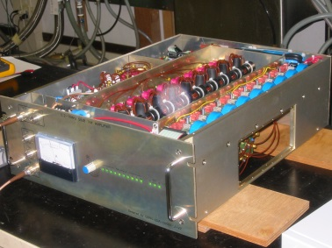
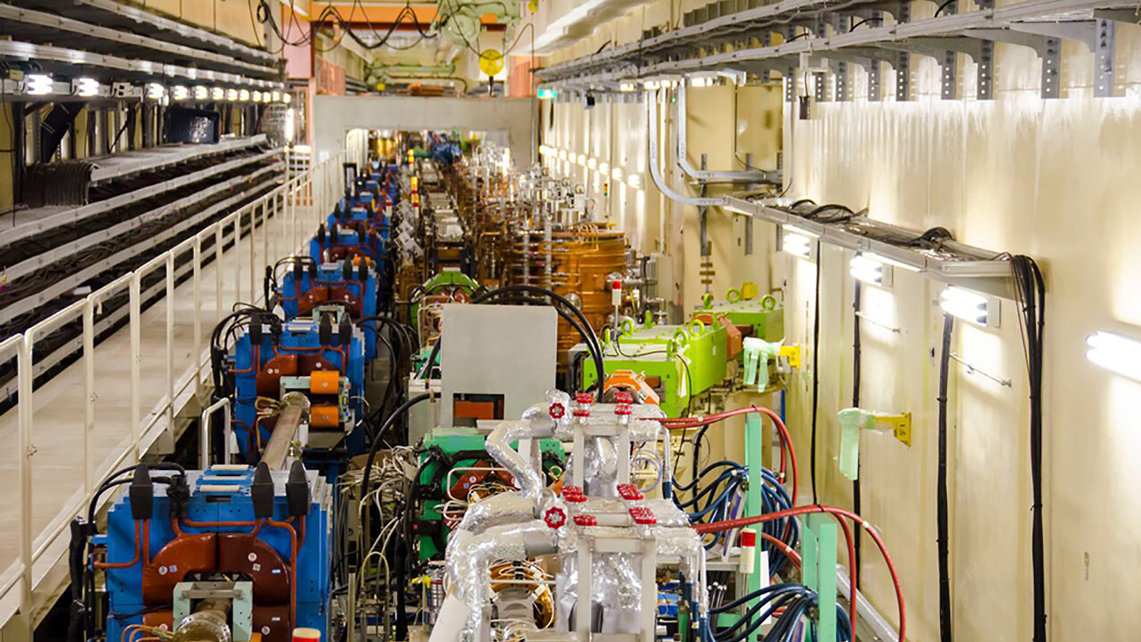
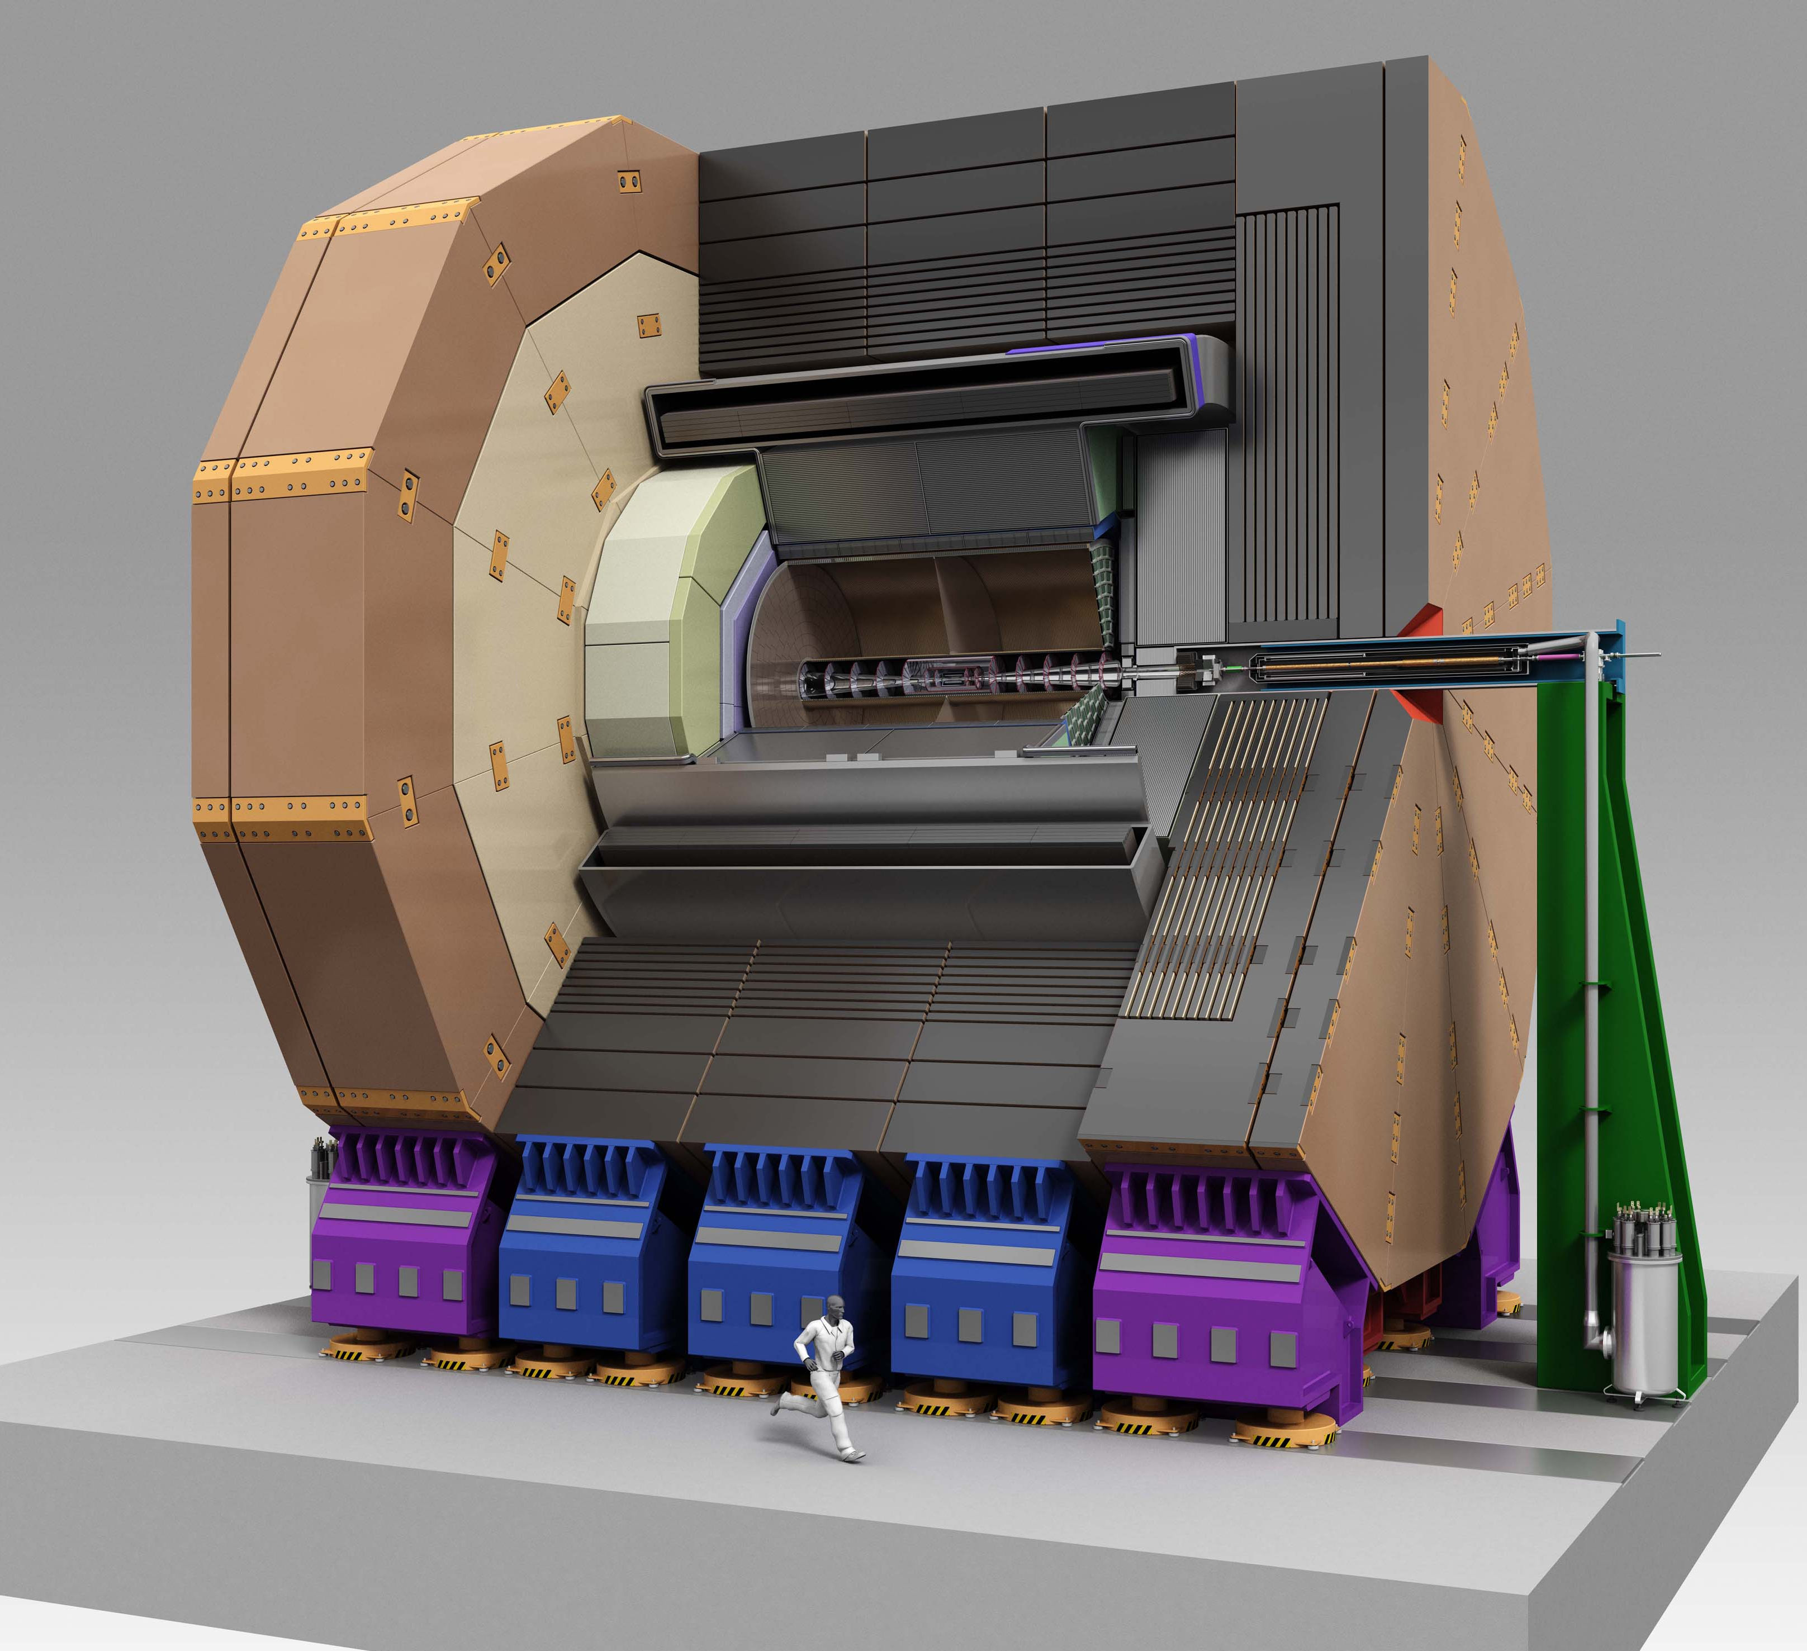
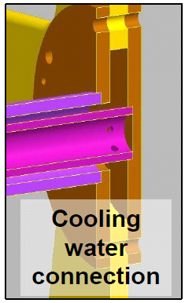
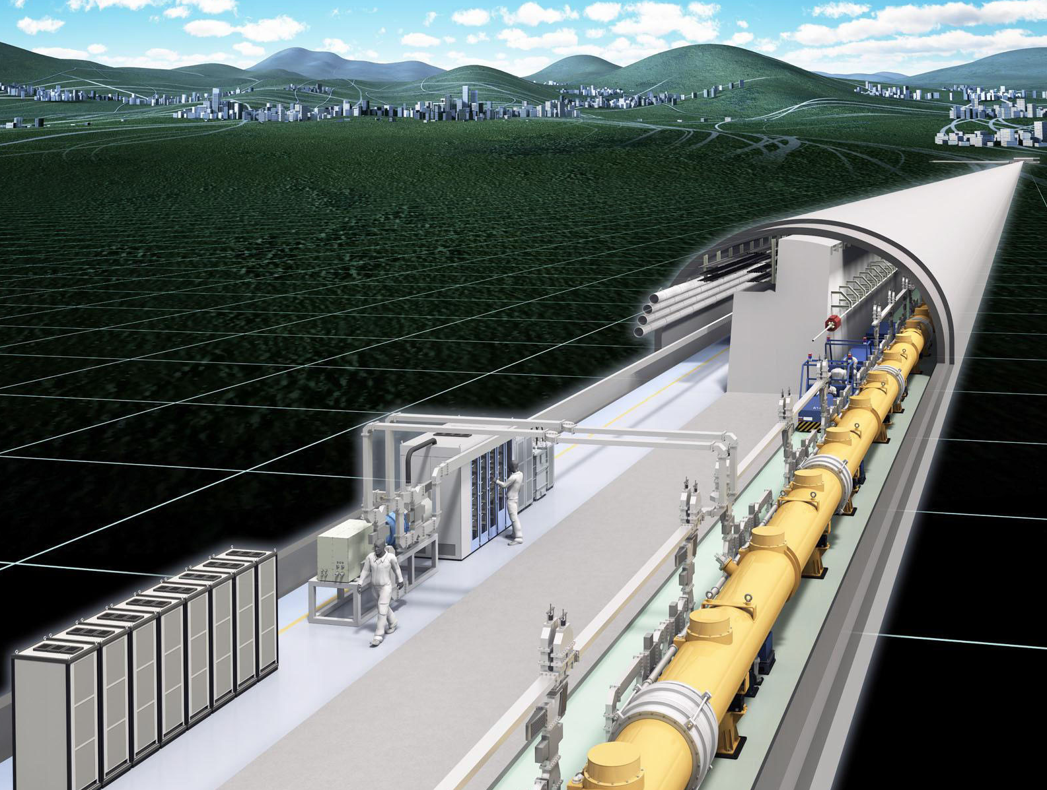
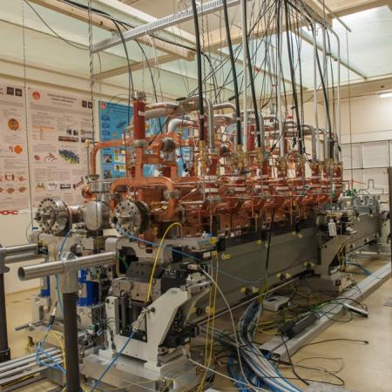
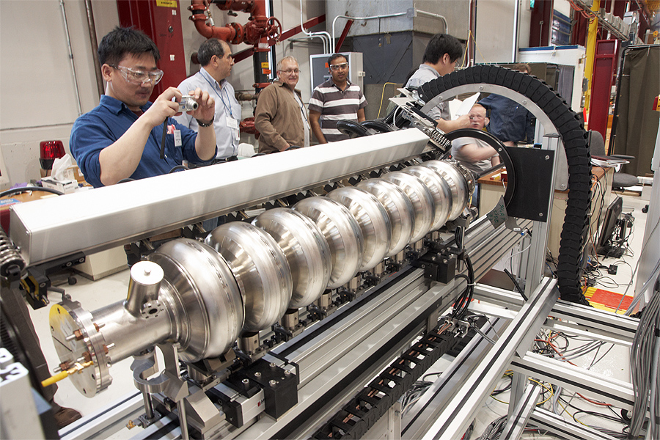
E-JADE – Our Facilities
ATF2: nanometre beams
LHC: analysis, upgrade, R&D
Task 1.2: HL-LHC
SuperKEKB
Task 2.6 BPM
Task 1.3: injectors
Task 3.4
Task 3.2 MDI
Task 3.3 SRF
LC R&D
CLIC
Notes:
Task 1.3 zeigt einen solid-state amplifier for PSB; well-established KEK-CERN collaboration (for J-PARC in 2002-2006), Japan will contribute R&D and 44 SSAs
Steinar: KEK will deliver magnet alloy cores and various other in-kind deliverables, also solid state power supplies. Followed up at KEK by E-JADE secondments. Not very much so far … not optimistc. Currently signing paers – not fully started.

Slide 7
Overview
The E-JADE project – science
The E-JADE project – organisation
The work packages – quick overview
Status of secondments
Feedback to EU
Conclusions and outlook

Slide 8


















E-JADE – Organisation
E-JADE has seven contributing institutes in Europe (coordinator: CERN) and two Japanese partner institutes

Slide 9
E-JADE – Organisation
E-JADE Scientific Coordinator: Steinar Stapnes
  Interim: TSS
E-JADE Project Manager: TSS
E-JADE has five work packages:
  WP 1: LHC consolidation, upgrades and R&D for future hadron machines
  Leaders: Lucio Rossi / Steinar Stapnes (CERN)
  WP 2: Nanometre scale beam handling at the ATF
  Leader: Philip Bambade (CNRS Orsay)
  WP 3: Linear collider targeted R&D
  Leader: Marcel Stanitzki (DESY)
  WP 4: Management and dissemination
  Leader: Andrea Latina (CERN)
  WP 5: Training and knowledge transfer
  Leader: TSS

Slide 10
E-JADE – Governance
Supervisory Board
Management
WP Leaders
Administrative Contacts
All E-JADE afficionados

Slide 11
Overview
The E-JADE project – science
The E-JADE project – organisation
The work packages – quick overview
Status of secondments
Feedback to EU
Conclusions and outlook

Slide 12
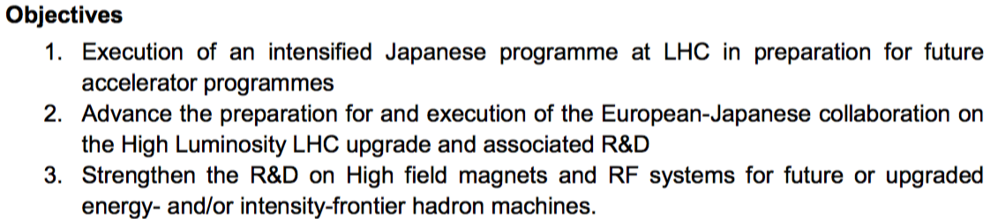
WP 1: LHC Consolidation, Upgrades and
R&D for Future Hadron Machines
LHC exploitation and upgrades (spec. planned Japanese contributions) and R&D for future high-energy/intensity hadron machines (e.g. FCC)
Main objective: integration of European and Japanese efforts (plus other regions) on HL-LHC upgrade into a construction project
CERN (30), KEK (36), U Tokyo (12)
From proposal:

Slide 13
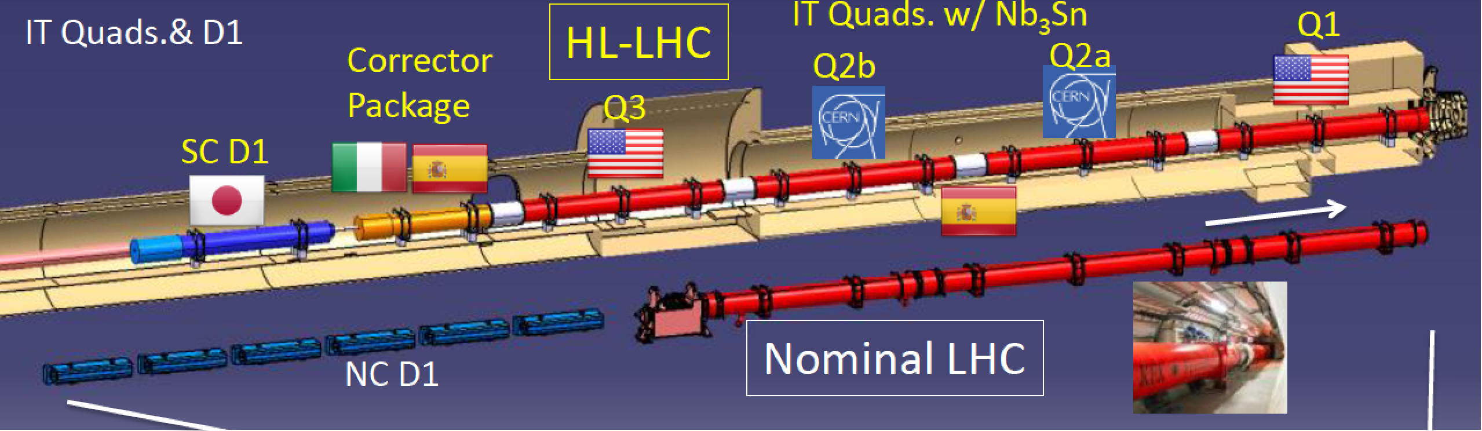

WP 1: Tasks
1.1 – LHC operation and analysis: Integrate Japanese efforts in operation of LHC machines / detectors; gain experience for future developments
1.2 - HL-LHC: Engineering design and validation of two short prototype separation superconducting dipoles (D1) followed by construction preparation, construction and test of the 4 final (plus two spare) D1 dipoles for the upgraded LHC insertion regions. Studies for crab cavities (CC) for LHC luminosity upgrade, benefitting from KEK operational experience
1.3 - high-field magnet R&D and preparation of future hadron injectors / colliders: R&D on HTS magnets of accelerator/collider quality (wideband cavities using magnetic alloy, solid-state amplifiers and low-level RF).
Example: Replacement of current NC D1 by SC D1
Notes:
Status and who for replacement of current NC D1 … ? Wer macht da was wo? Rolle von E-JADE?
Steinar: Delivered by KEK, E-HJADE being used to support people coordinating this on european side. 2m prototype ready - End of 2017 work on prototype ready; less in 2018. Real building later ...

Slide 14
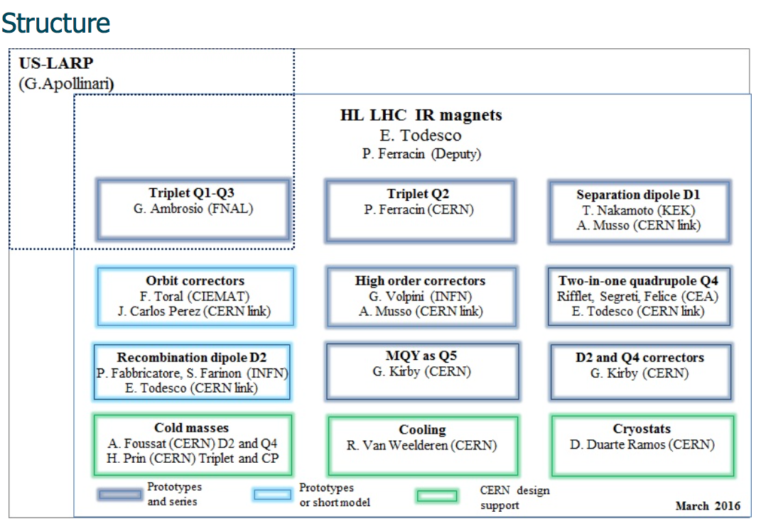
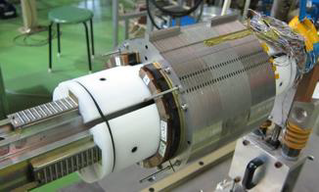
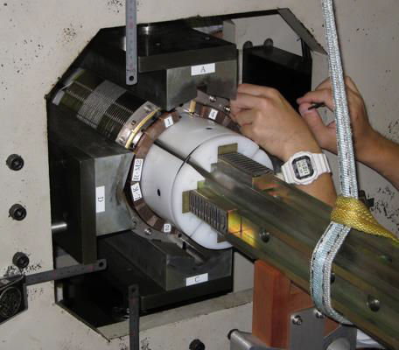
WP 1: Example D1 Magnets / HL-LHC
Secondments / travels currently mostly linked to preparation (prototyping) of the separation dipoles for HL-LHC
Testing of 2m prototyping ongoing this week (A. Musso now at KEK)
See comments about LHC injectors and FCC later (in WP 1 report)
The
Notes:
Unclear what the structure on the right is?
Note down the numbers of secondments from CERN on this.
Andrea Musso as main person – on E-JADE money, now testing prototype at KEK. Part of his travel money notyet in ECAS (also Lucio …). All related to following up in-kind contributions from Japan / KEK.
IN fact 7-8 motnhs out of 30 done, but not yet bookkept

Slide 15
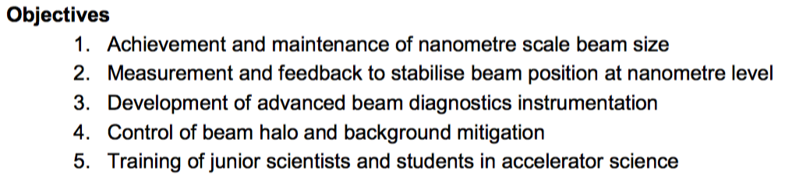
WP 2: Nanometre scale beam handling
KEK operates the ATF facility: damping ring meeting LC specifications with low-energy scaled version of LC final focus beam line
Main objective: Test sophisticated LC beam handling techniques
Partners: CERN (31), CNRS (50), CSIC (12), KEK (13), RHUL (21), UOXF (49), UoT (2)
From the Proposal:

Slide 16
WP 2: ATF and LC
Accelerator Test Facility
Energy: 1.3 GeV
Repetition: 3.12 Hz
Intensity: 1-2x10¹⁰ e-/bunch
1~20 bunches/pulse
Design emittance:
1 nm(H) / 10 pm(V),
Achieved 4 pm(V)
ATF2 beamline: Nano-meter beam R&D
Final focus system development
Technologies to maintain the luminosity at ILC
Beam size: 37 nm (design), 44 nm (achieved)
Beam stabilization via feedback: achieved 67 nm
Beam instrumentation development
Damping Ring (~140m)
Low emittance beam

Slide 17
WP 2: Tasks and Status
2.1 Beam Size Minimisation
2.2 Wake Field
2.3 Ground Motion
2.4 Halo Collimation and Backgrounds
2.5 Beam Instrumentation and control
2.6 Beam Position Feedback
WP2 has followed the schedule of deliveries:
  2 submitted deliverable reports (HaloCollBgds-1, Instr-1) and 1 under preparation (GM-1)
  Delay in secondments: Currently >600 eligible E-JADE days for WP2
  Total in contract: 163 months → have used 10% so far
Explanation (see later): slow start, 50% less ATF beam time in 2015 budget, eligibility criteria,…
Solutions → later slide

Slide 18
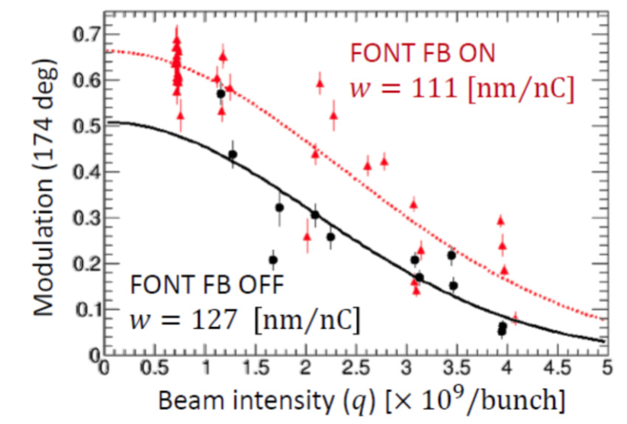
WP 2: Example Highlight
Improvement in modulation depth from the Shintake monitor (which measures the IP beam size at ATF2) when feedback is turned ON.
  Clear positive effect of feedback for the ATF2 spot size

Slide 19
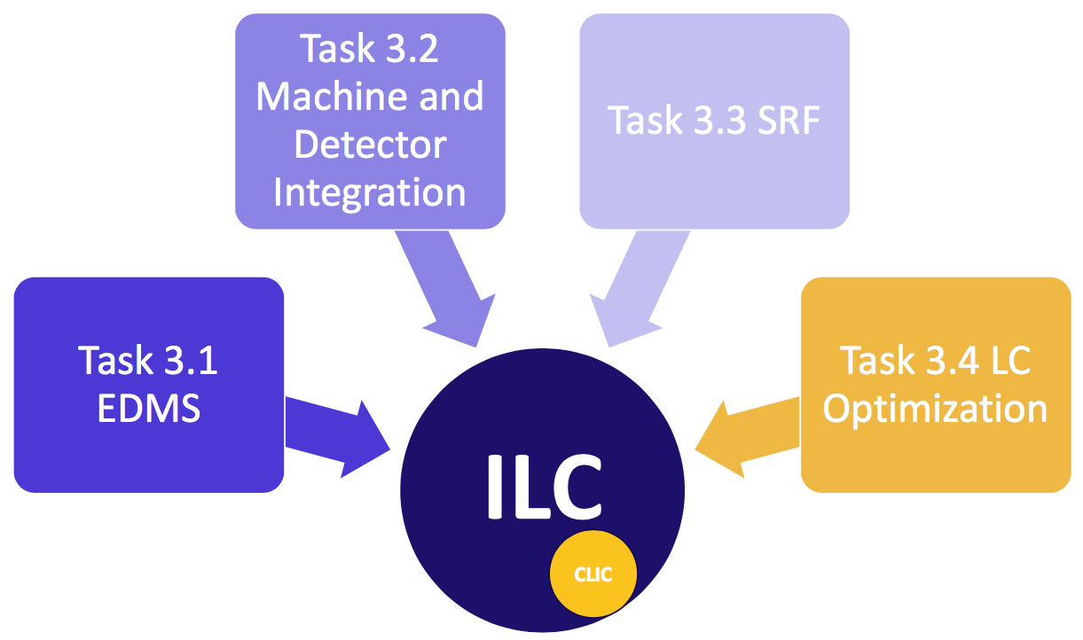

WP 3: Linear Collider Targeted R&D
Main objetive: Perform site-specific optimisations for ILC, based on ILC TDR and the proposed site in Japan
CERN (16), DESY (70), UOXF (10), CEA (8), CNRS (4)
From WP 3 talk today:
Tasks:
  3.1 EDMS
  3.2 MDI
  3.3 SRF
  3.4 LC optimisation
  (e⁺ source, polarisation)
From the proposal:

Slide 20
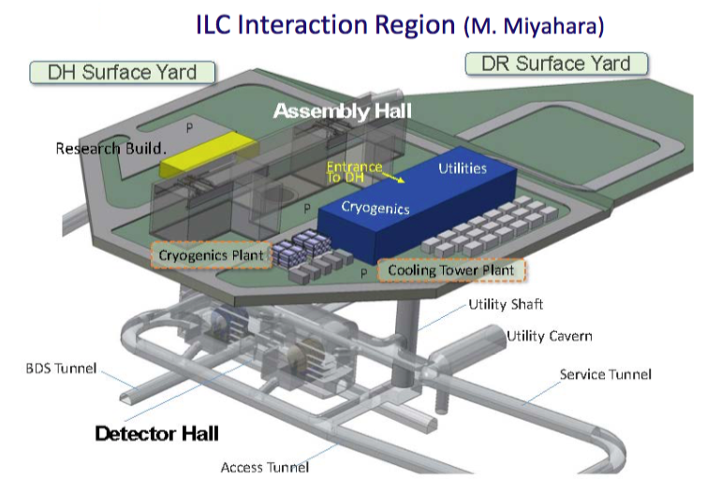
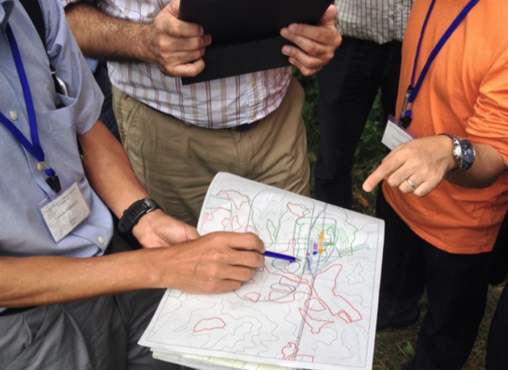
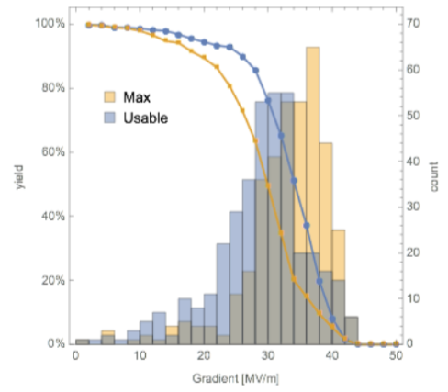
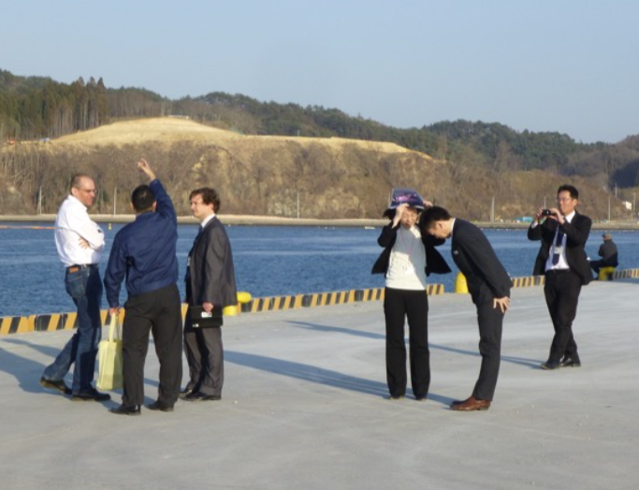
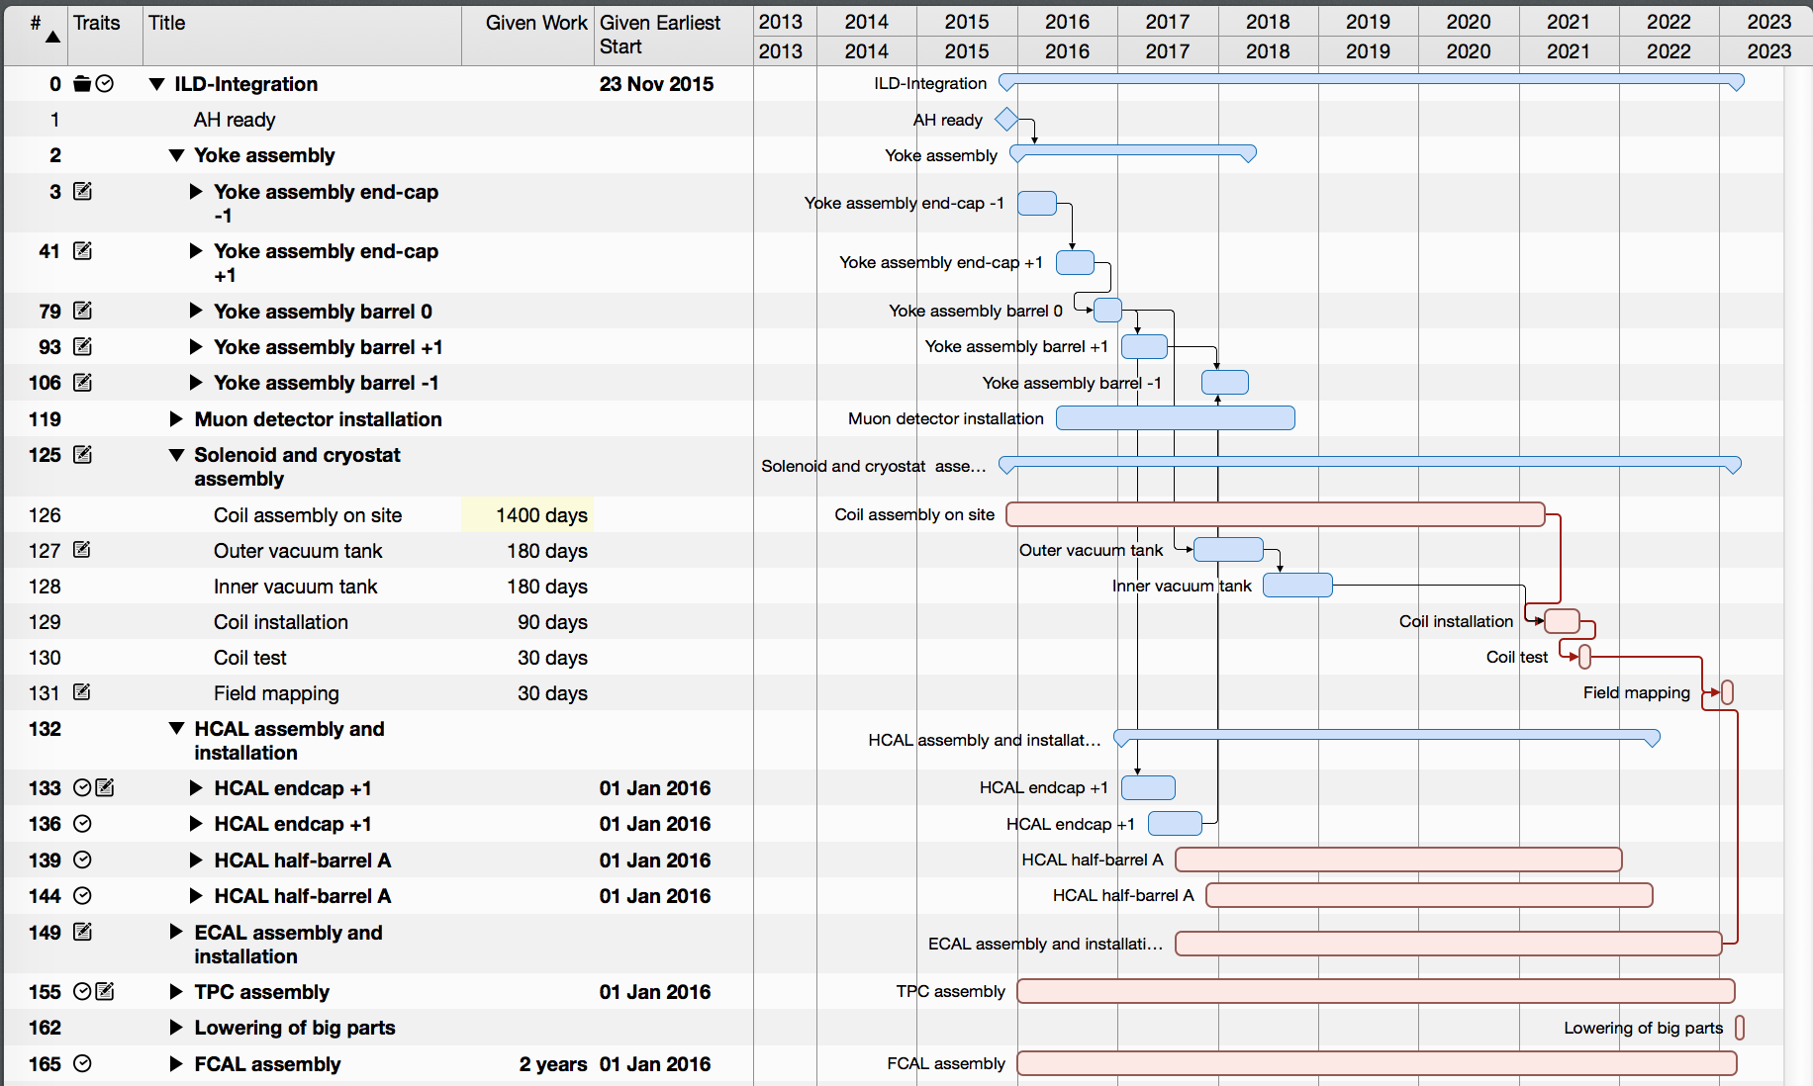
WP 3: ILC-related tasks
Unexpected delay of ILC project → delay e.g. in EDMS and MDI tasks (e.g. impact on EDMSReqUser deliverable)
Nevertheless significant work on MDI/CFS, SRF, and optimisation
  Numerous visits to Japan, many expert discussions
IP planning
Logistics
XFEL experience
for ILC
Infrastructure
Assembly plans

Slide 21
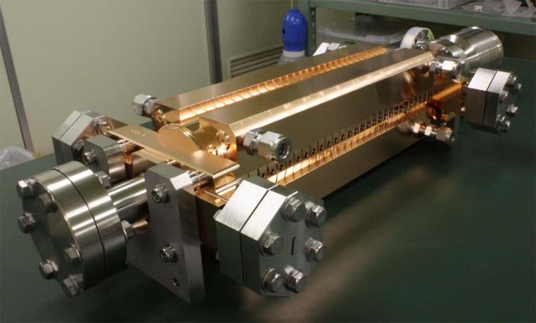
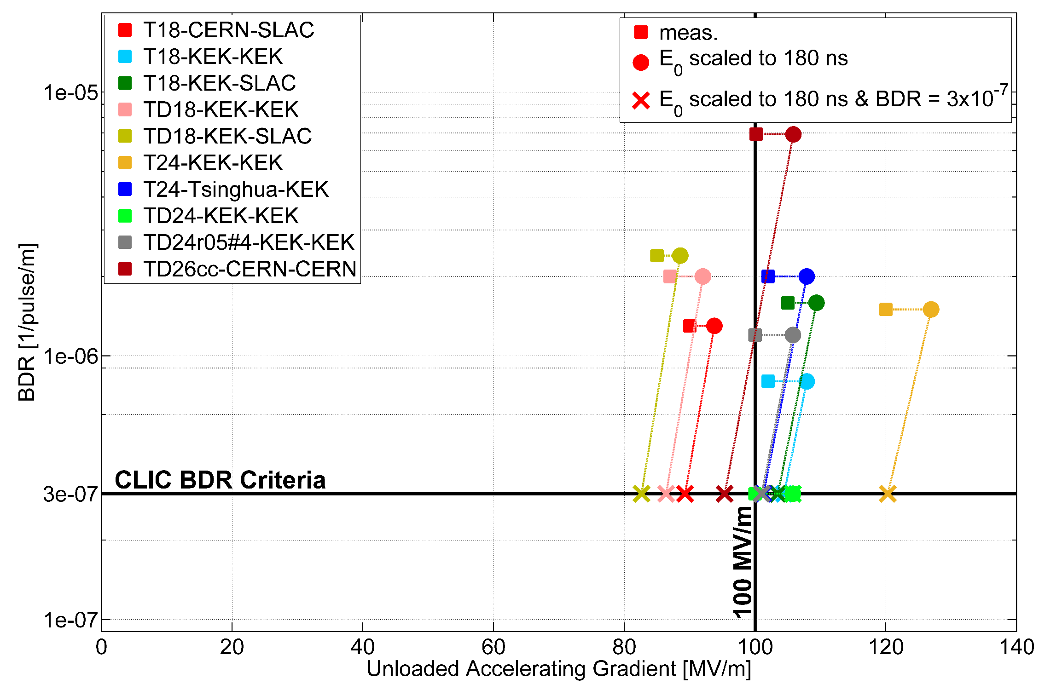
WP 3: CLIC
Under task 3.4 LC optimisation
  12 GHz copper cavities etc.
Work: Optimisation of CLIC structures
using key facility at KEK
  Parameters: gradient versus breakdown rate;
  requires conditioning with high power RF system
KEK tests structures produced with
SLAC, and from Tsinghua and SINAP
Importance of the facility:

Slide 22
WP 4: Management & Dissemination
Tasks
    4.1 Scientific and Financial Management (CERN & KEK): The management of the programme involves the organisation of programme events, managing the secondments of researchers and the financial planning, execution and reporting to the EU.
    4.2 CERN & KEK Offices (CERN & KEK): Permanent offices at CERN and KEK will be set up, which will support the researchers during the duration of their secondment.
    4.3 Communication (CERN & KEK): The Communication of E-JADE achievements experiences and results within the E-JADE programme will ensure most efficient sharing of knowledge and expertise of the seconded researchers. Annual meetings of all E-JADE participants will be organized as well as topical workshops as described in B4.3.1
    4.4 Dissemination (CERN & KEK): A program for dissemination of information from E-JADE will be setup. This involves setting up public web pages and social media accounts as well as providing information for media and general public. The publication of results in scientific journal articles and participation in international conferences will also be monitored

Slide 23
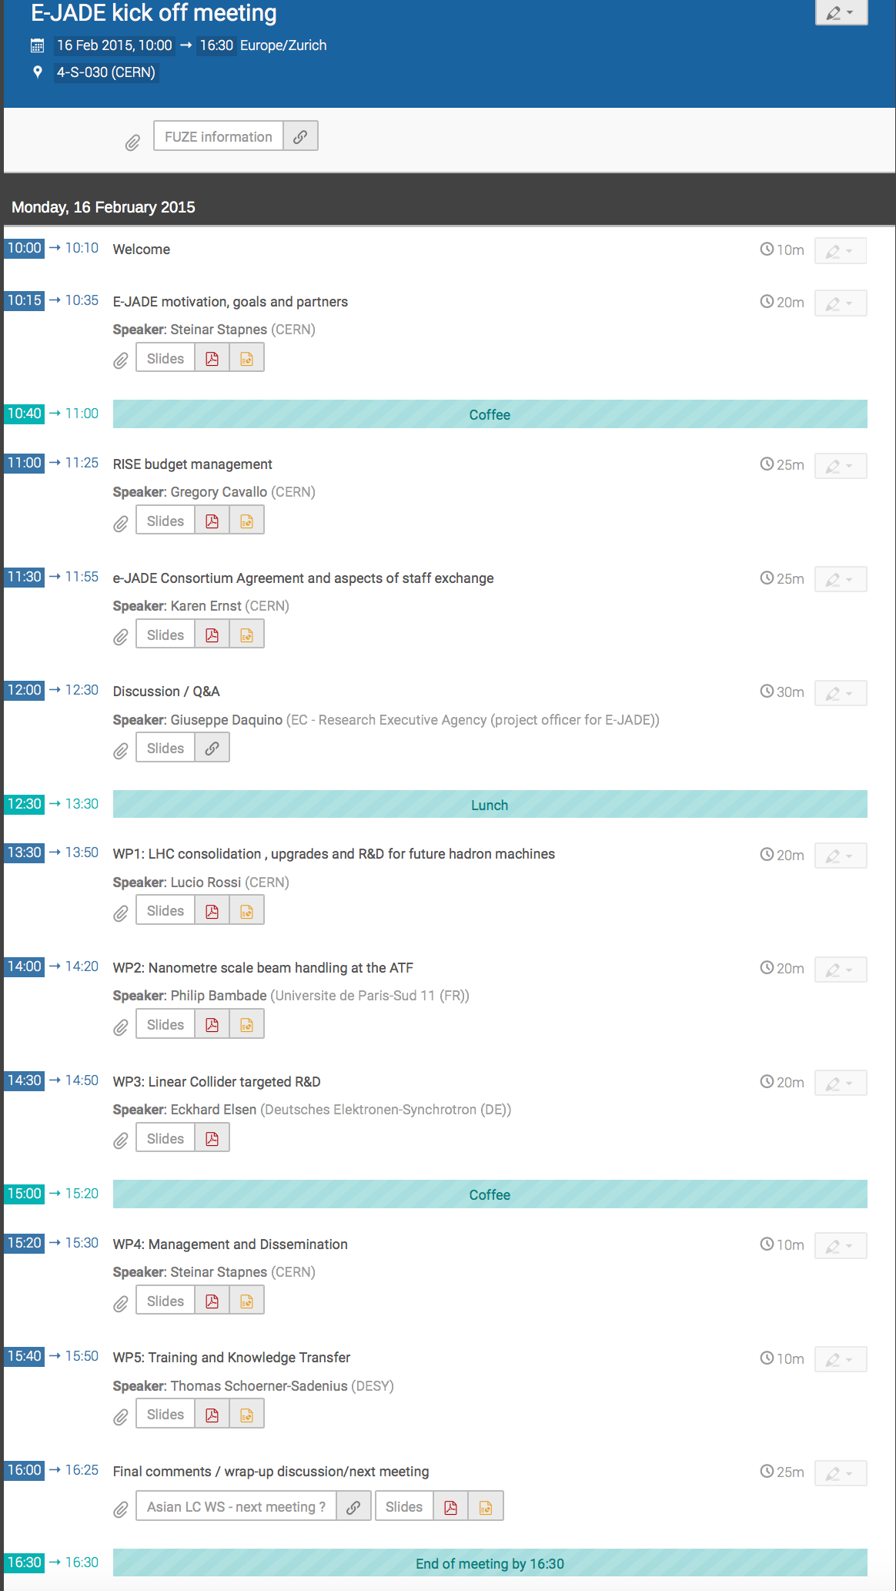
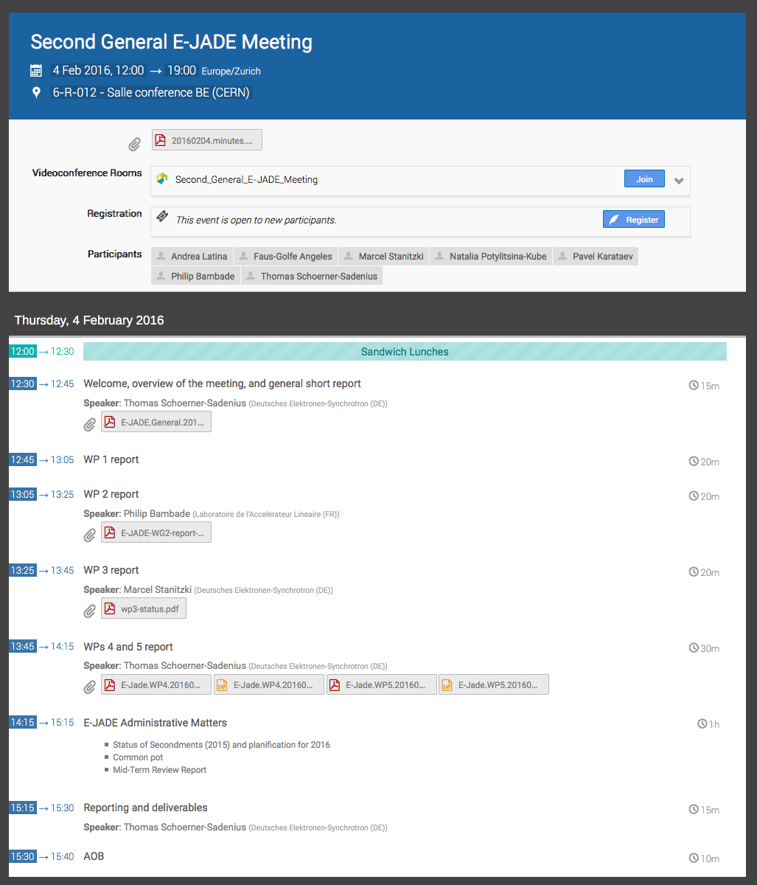
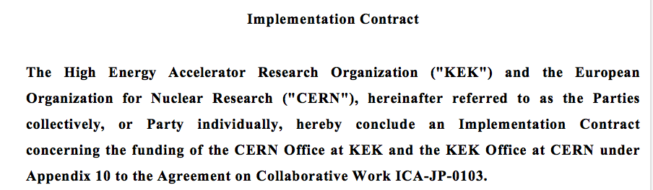
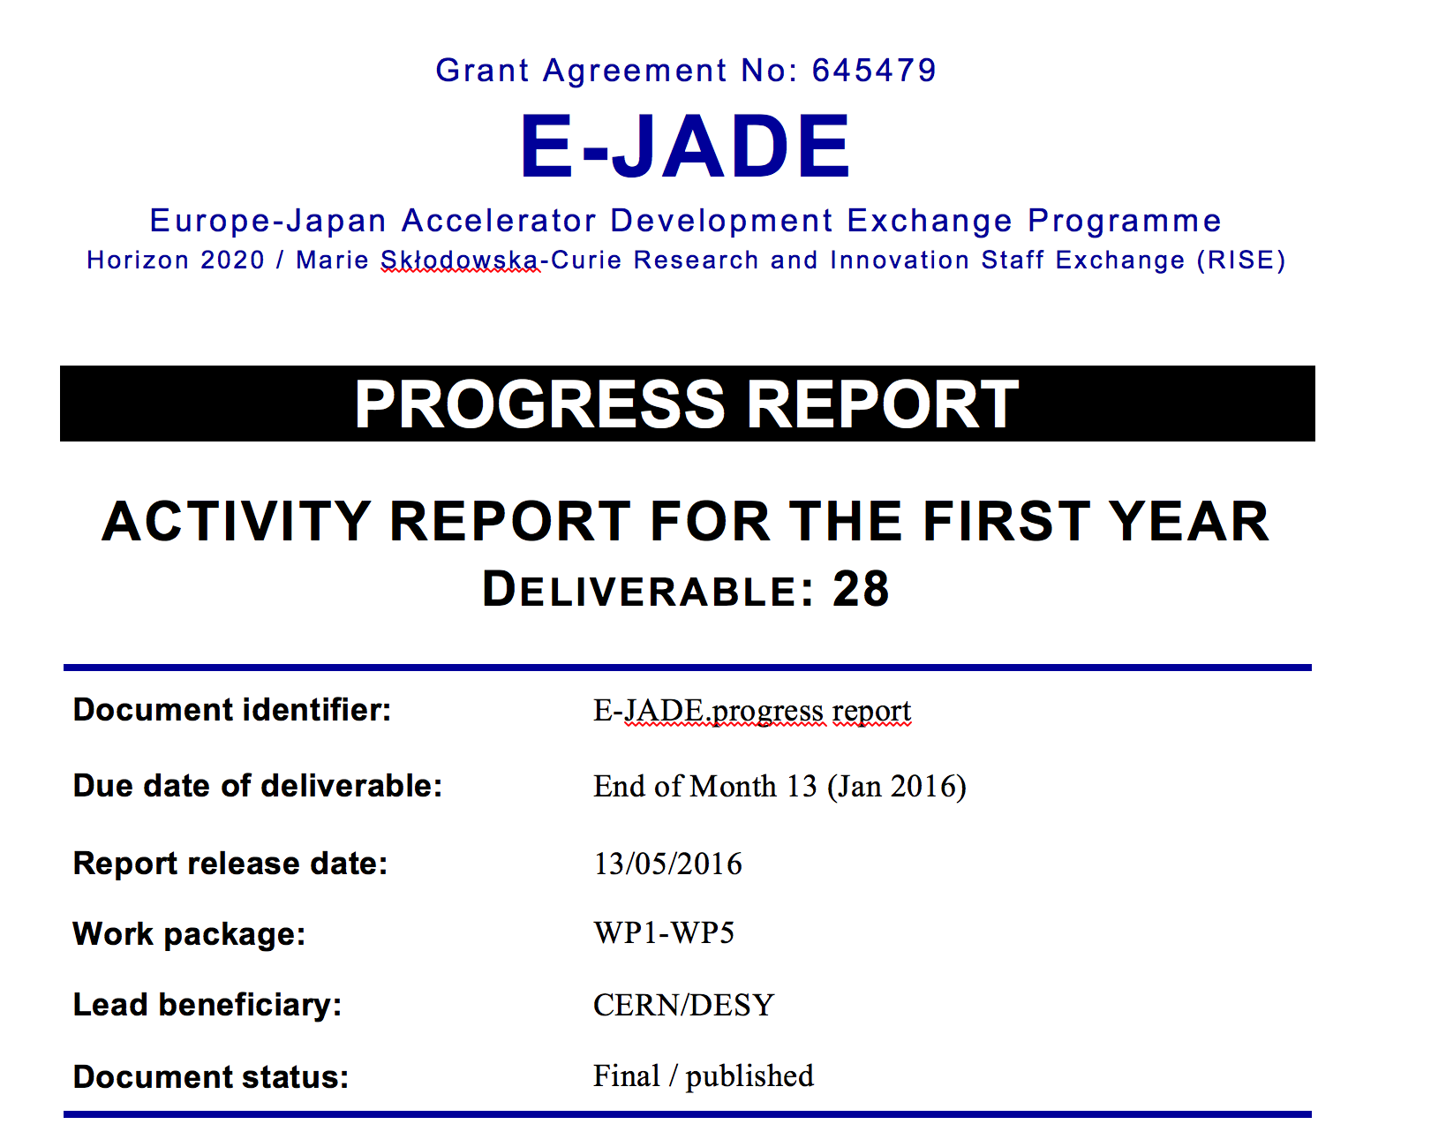
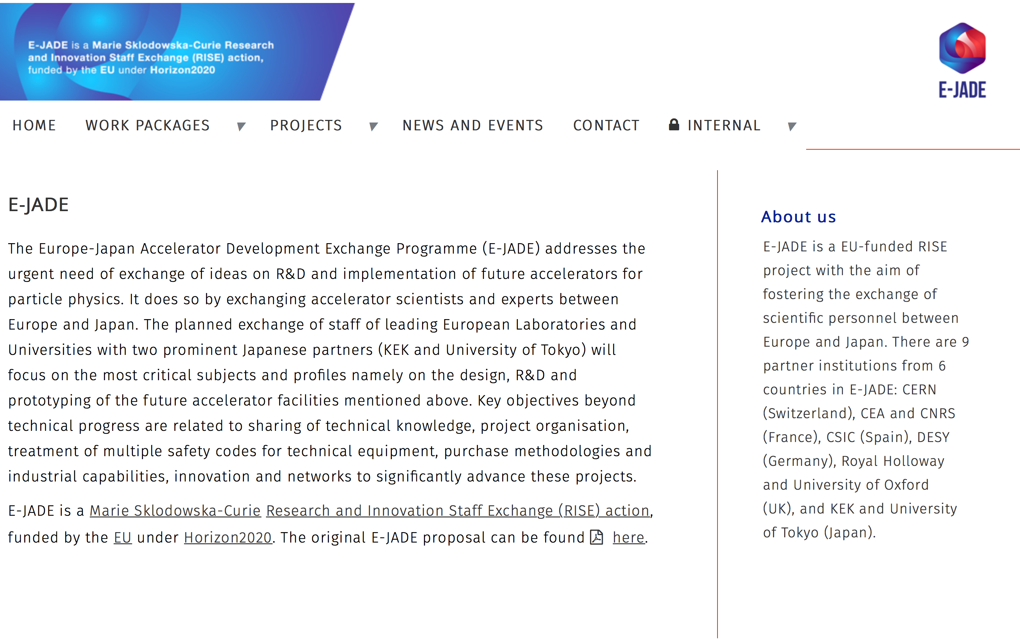
WP 4: Deliverables and Status
Kick-off and second
general meeting:
CERN-KEK Offices:
  CERN office at KEK: Building 3-403 (not permanently manned)
  KEK office at CERN: Building 30-6-021 (administrative trainee M. Watanabe half time)
Overall – WP 4 well on track
  Next step: Deliverable CommStrgy
  See dedicated WP4 talk
Annual
report
Web
pages

Slide 24
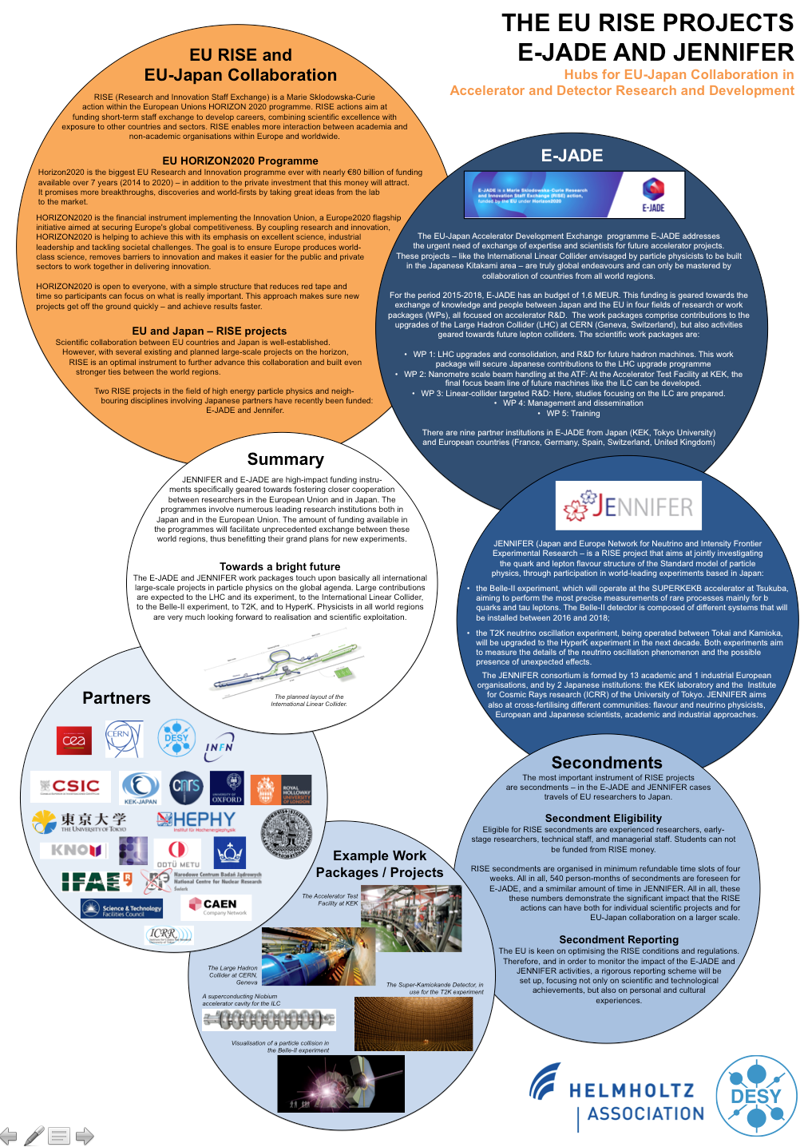
WP 4 - Dissemination
All E-JADE partners use their established PR mechanisms to promote E-JADE
  Newsletters
  Days of open doors
  Other public events
Nice example: Japan Science Agora 2015
  E-JADE featured prominently

Slide 25
WP 5: Training and Knowledge Transfer
Tasks
  5.1 - training: All beneficiaries and partners will provide an extensive, relevant and high-quality schedule of training courses, individual coaching sessions and research experience periods to the researchers to be exchanged. These efforts will be directed towards the exchange of knowledge and expertise available at project partners, for the benefit of visiting and resident researchers. A detailed description can be found under section 4.3.1.
  5.2 - evaluation: In order to achieve the objective of increasing skills, knowledge and experience of the staff exchanged, the knowledge transfer schedule must be fully implemented (see Task 5.1). In parallel, as also described in WP 4, the consortium will develop and approve at the kick-off meeting an evaluation framework that will monitor the implementation of the knowledge transfer, and evaluate with individual participants to what extent the efforts conducted have been successful, meeting the individual and overall goals, and where/when any adjustments or improvements are necessary.

Slide 26
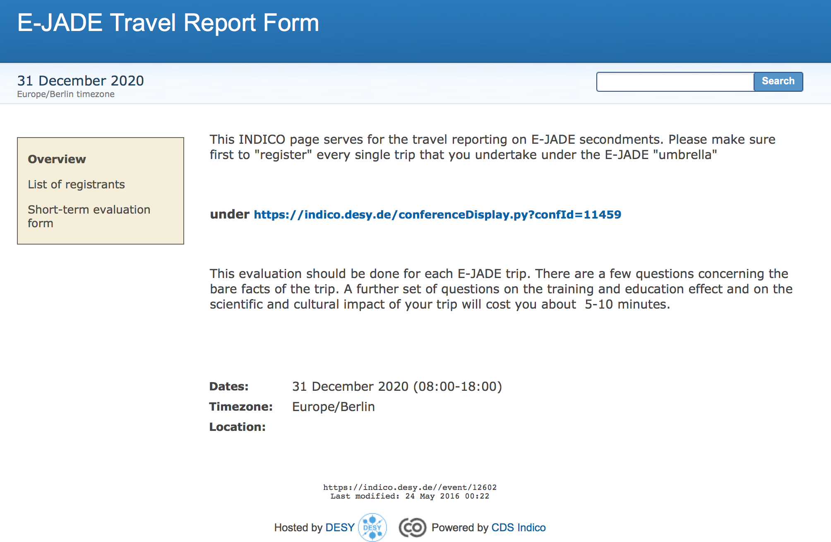
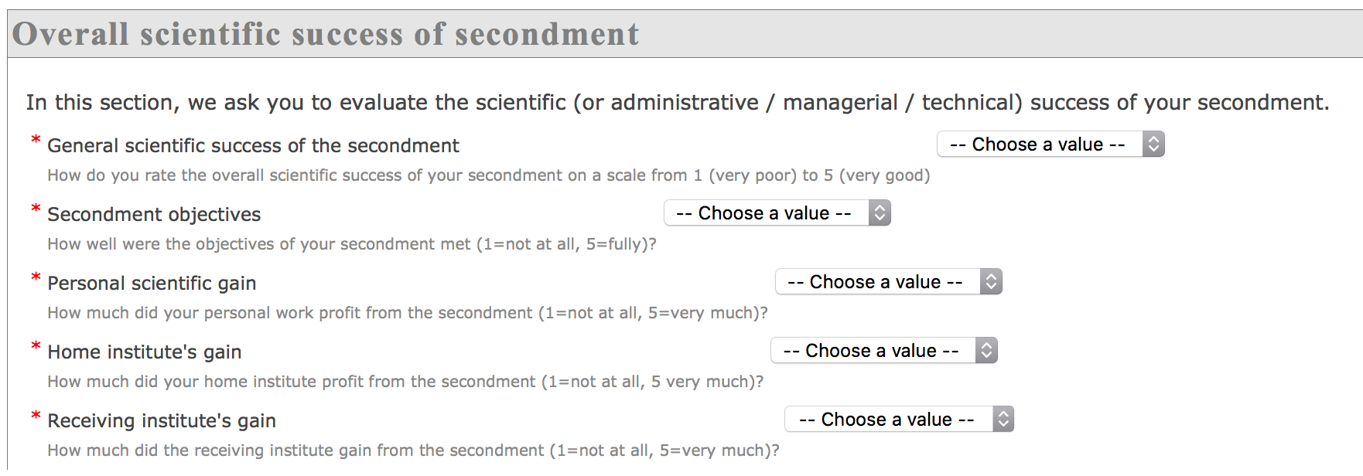
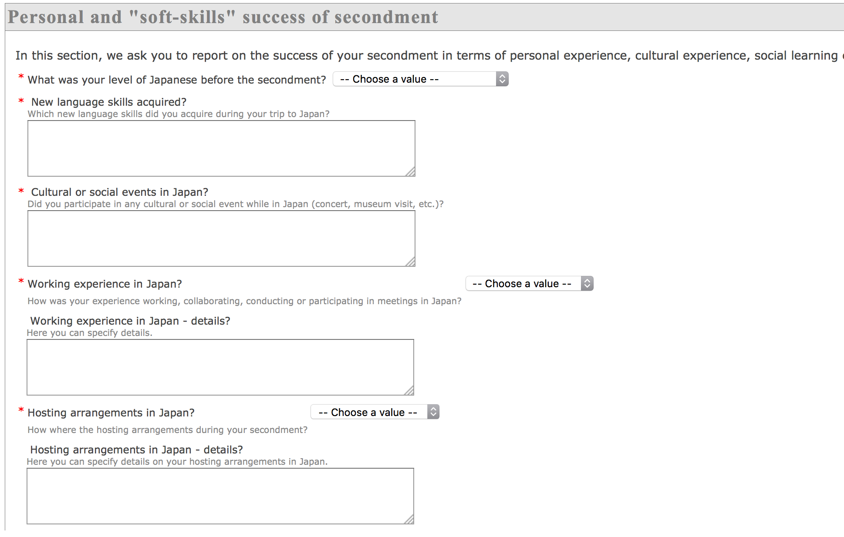
WP 5: Training and Knowledge Transfer
Deliverable KTTTool – evaluation framework
  First look at “data” planned for second annual report

Slide 27
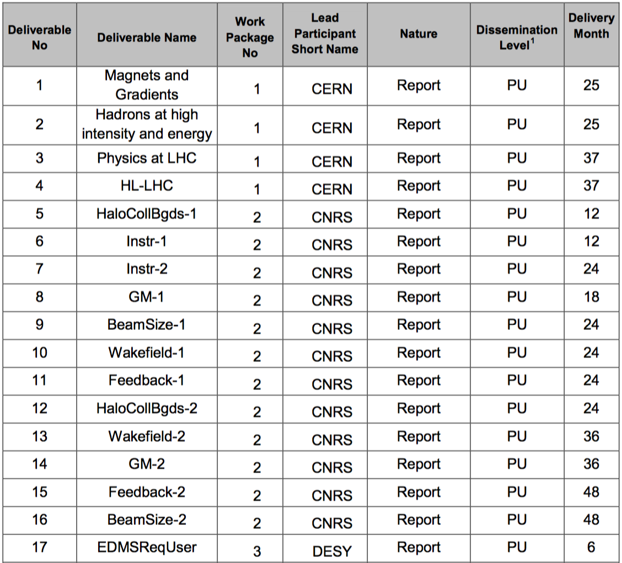
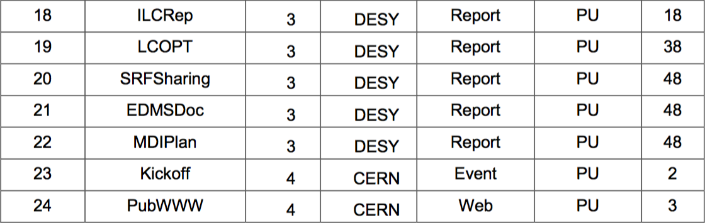
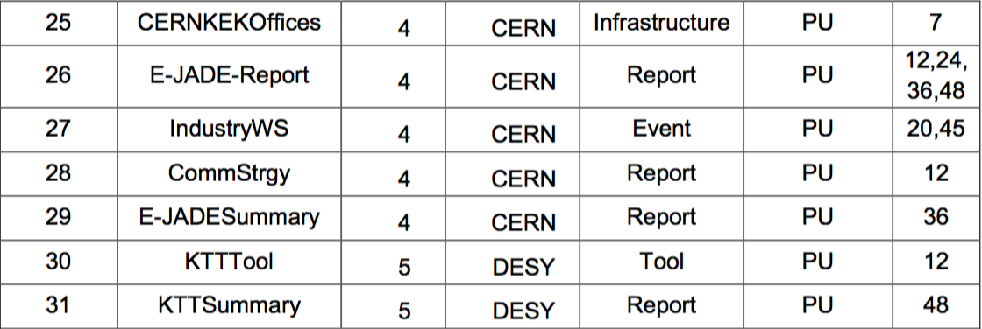
All Work Packages: Deliverables
Overall E-JADE work progress well on track.

Slide 28
Overview
The E-JADE project – science
The E-JADE project – organisation
The work packages – quick overview
Status of secondments
Feedback to EU
Conclusions and outlook

Slide 29
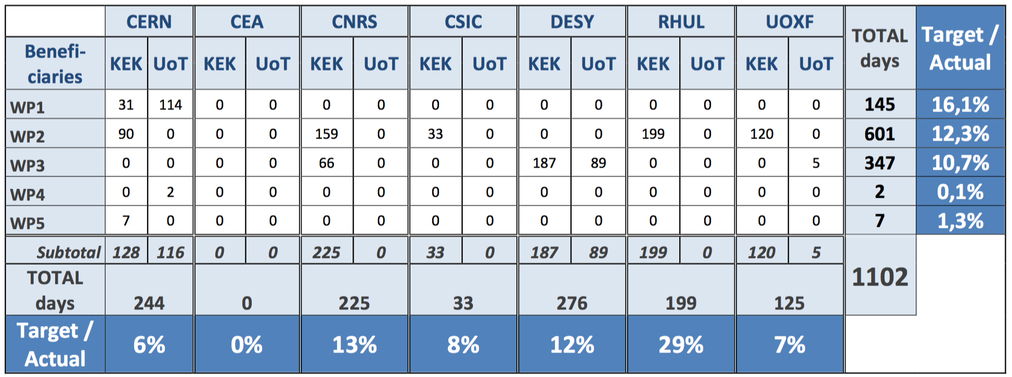
Status of Secondments
Shown are the days travelled on E-JADE funding until last week
Japanese secondments → talk by Katsuo-san later

Slide 30
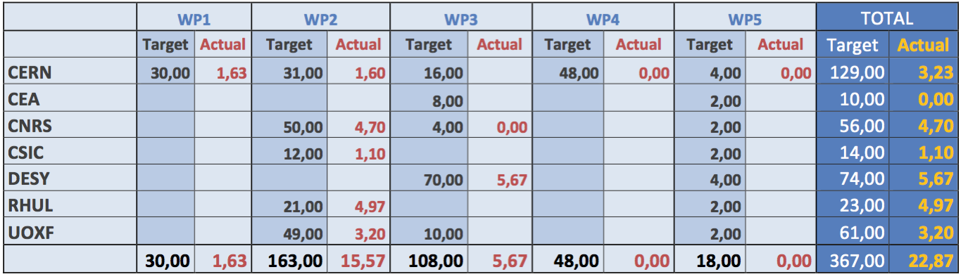
Status of Secondments
View of seconded months after first complete month
Numerous secondments not yet adding up to one month
  Many will be completed soon → “threshold effect”
Underspending becomes very visible
Remedies → next slide

Slide 31
Status of Secondments
The overall secondment situation is below expectation
  Roughly 10% of target after 30% of project time
Reasons
  Delayed schedule of ILC due to on-going in-depth official review process in Japan: In contrast to expectations at the time of writing the E-JADE proposal, there is no formal project ➔ WP3,5
  Mitigation: difficult
  Significant reduction (factor 2) of beam time at KEK for ATF2 ➔ WP2
  Mitigation: Expect much larger beam operation time in future; increased CERN contributions to ATF
  Absence of key persons ➔ all WPs, specifically WP1,3,4
  Mitigation: Transition mastered
  Slow ramp-up of some activities
  Mitigation: Now ramping up (e.g. injector activities in WP 1, positron injection / polarisation in WP 3, …)
  Unclear situation with eligibility criteria, and more problems than expected for senior researchers to spend long secondments
  Mitigiation: eligibility situation now clearer
  Rather ambitious initial planning
  Mitigiation: exploit scientific / technological developments arisen during the project to maximise secondments ➔ next slide
Notes:
Need to wait for input Eckhard

Slide 32
Additional work within tasks
Nanometre scale beams at SuperKEKB
  SuperKEKB has recently started beam operation → ideal and unforeseen new testbed for important aspects of WP2 on “Nanometre scale beam handling at the ATF”
  Suggest to extend WP2 to include additional work on “Tests of optical tuning methods and luminosity optimization techniques at SuperKEKB”
  SuperKEKB fits naturally between low-energy small-scale ATF2 and “the real thing” (ILC)
  Benefit also for WP3
  See additional document / WP2 presentation
ILC Project at KEK
  KEK proposed follow-up works of the KEK-ILC action plan in a framework of collaboration between Europe and Japan.
  Work towards “ILC action plan in Europe” plus initiate more technical work, supported by E-JADE: SRF (WP 3), nanobeam technology (WP 2), beam dump system engineering, civil engineering (both WP 3)
  More details in WP 3 talk
Natural and easy ways to maximise secondments.
Notes:
Need to wait for input Eckhard

Slide 33
Overview
The E-JADE project – science
The E-JADE project – organisation
The work packages – quick overview
Status of secondments
Feedback to EU
Conclusions and outlook

Slide 34
A Word on ECAS / Continuous Reporting
Rather impractical tool – download and bookkeeping of numbers not possible
  ➔ keeping our own separate book-keeping tool; doubles the work
From Grant Agreement: “the obligation of the researcher to complete and submit at the end of the training the evaluation questionnaire and two years later follow-up questionnaire provided by the Agency”
  Not implemented in ECAS
Researcher declaration: Function and definition of “Family charges” information unclear
  What if family status changes?
Secondment declaration: If one person travels in two WPs, there is no way to distinguish which secondment was done for which WP.
  ➔ Define additional “WP” column for each secondment
  Also give additional column “Days” for each secondment – to facilitate our book-keeping and cross-checking.
In pop-up window “Edit researcher declaration” (clicking on researcher name): always “DESY” as “sending organisation”
Notes:
Need to wait for input Eckhard

Slide 35
Eligibility Criteria
Different situation of e.g. Ph.D. students at different institutes
  Some with direct contract
  Some with contract with central funding agency
  Some with scholarships
  Some from foreign institutes, but on MoU with European institute with full national European social security coverage, residence permit etc.
Obviously different treatment of (also seemingly similar) cases at different partner institutions.
Are there
  … different rules for these different cases?
  … different interpretations of the rules for similar cases at the various partner institutes?
Question requires advice from EU; a clear guideline would be helpful.
Besides this point: Criterion of 1 month minimum secondment extremely difficult, especially for senior people.
Notes:
Need to wait for input Eckhard

Slide 36
Overview
The E-JADE project – science
The E-JADE project – organisation
The work packages – quick overview
Status of secondments
Feedback to EU
Conclusions and outlook

Slide 37
Conclusions and Outlook
E-JADE is an excellent opportunity to promote EU-Japan collaboration and push common projects
E-JADE can serve as a testbed for increased exchange and large common projects in Japan or the EU (e.g. ILC)
All E-JADE work packages are well on track
  Some delay e.g. in WP 3 – ILC has not turned into a project yet
Delays in secondments
  Reasons understood
  Numerous mitigation measures envisaged and defined
  Some necessity for discussion with EU
    Broadening of tasks, i.e. nanometre beam studies at SuperKEKB, ILC project management at KEK
    Moderate extension of E-JADE running period?
All in all E-Jade is the right tool at the right time; long-felt profits still to be earned.

Slide 38

Thank you very much for your attention!
Mid-Term Review
This project is funded by the European Union under Grant Agreement no. 645479

