Slide 1
LHC consolidation, upgrades and R&D for future hadron machines
Steinar Stapnes/ WP 1

Slide 2
CERN scientific roadmap
Full exploitation of the LHC:
Run 2 started last year → goal this year is L=10³⁴ at √s =13 TeV, ~25 fb⁻¹
building upgrade of injectors (LIU), collider (HL-LHC) and detectors (Phase-1 and Phase-2)
Diversity programme serving a broad community:
ongoing experiments and facilities at Booster, PS, SPS and their upgrades (ELENA, HIE-ISOLDE)
participation in accelerator-based neutrino projects outside Europe (presently mainly LBNF in
the US) through the CERN Neutrino Platform
Preparation of CERN’s future:
vibrant accelerator R&D programme exploiting CERN’s strengths and uniqueness
(including superconducting high-field magnets, AWAKE, etc.)
design studies for future accelerators: CLIC, FCC (includes HE-LHC)
future opportunities for scientific diversity programme (new)
F.Gianotti April 2016

Slide 3
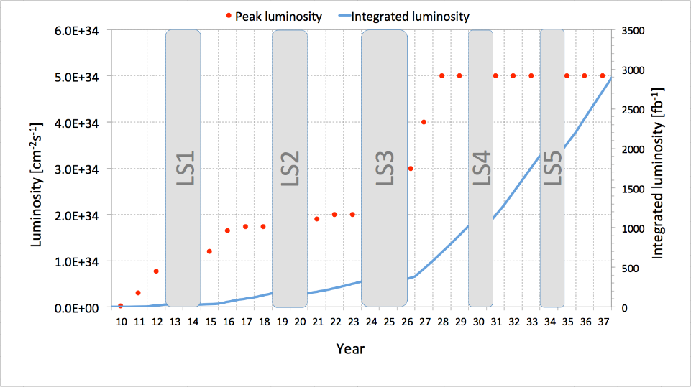
LHC and HL-LHC
F.Gianotti April 2016
7-8 TeV
13-14 TeV
HL-LHC
Run 1
Run 2
Run 3
~3000 fb⁻¹
Splices
fixed
Injectors
upgrade
New
low-β*
quads
~300 fb⁻¹
~100 fb⁻¹
LHC is today’s most powerful collider → full exploitation (√s ~ 14 TeV, 3000/fb) is mandatory:
If new physics discovered in Run 2-3:
→ first detailed exploration of new physics with well understood machine and experiments
while building next accelerator
If no new physics in Run 2-3:
→ extend direct discovery potential by ~ 20-30% (up to m ~ 10 TeV)
In either case: measure H couplings to few percent (including 2nd generation: Hμμ)

Slide 4
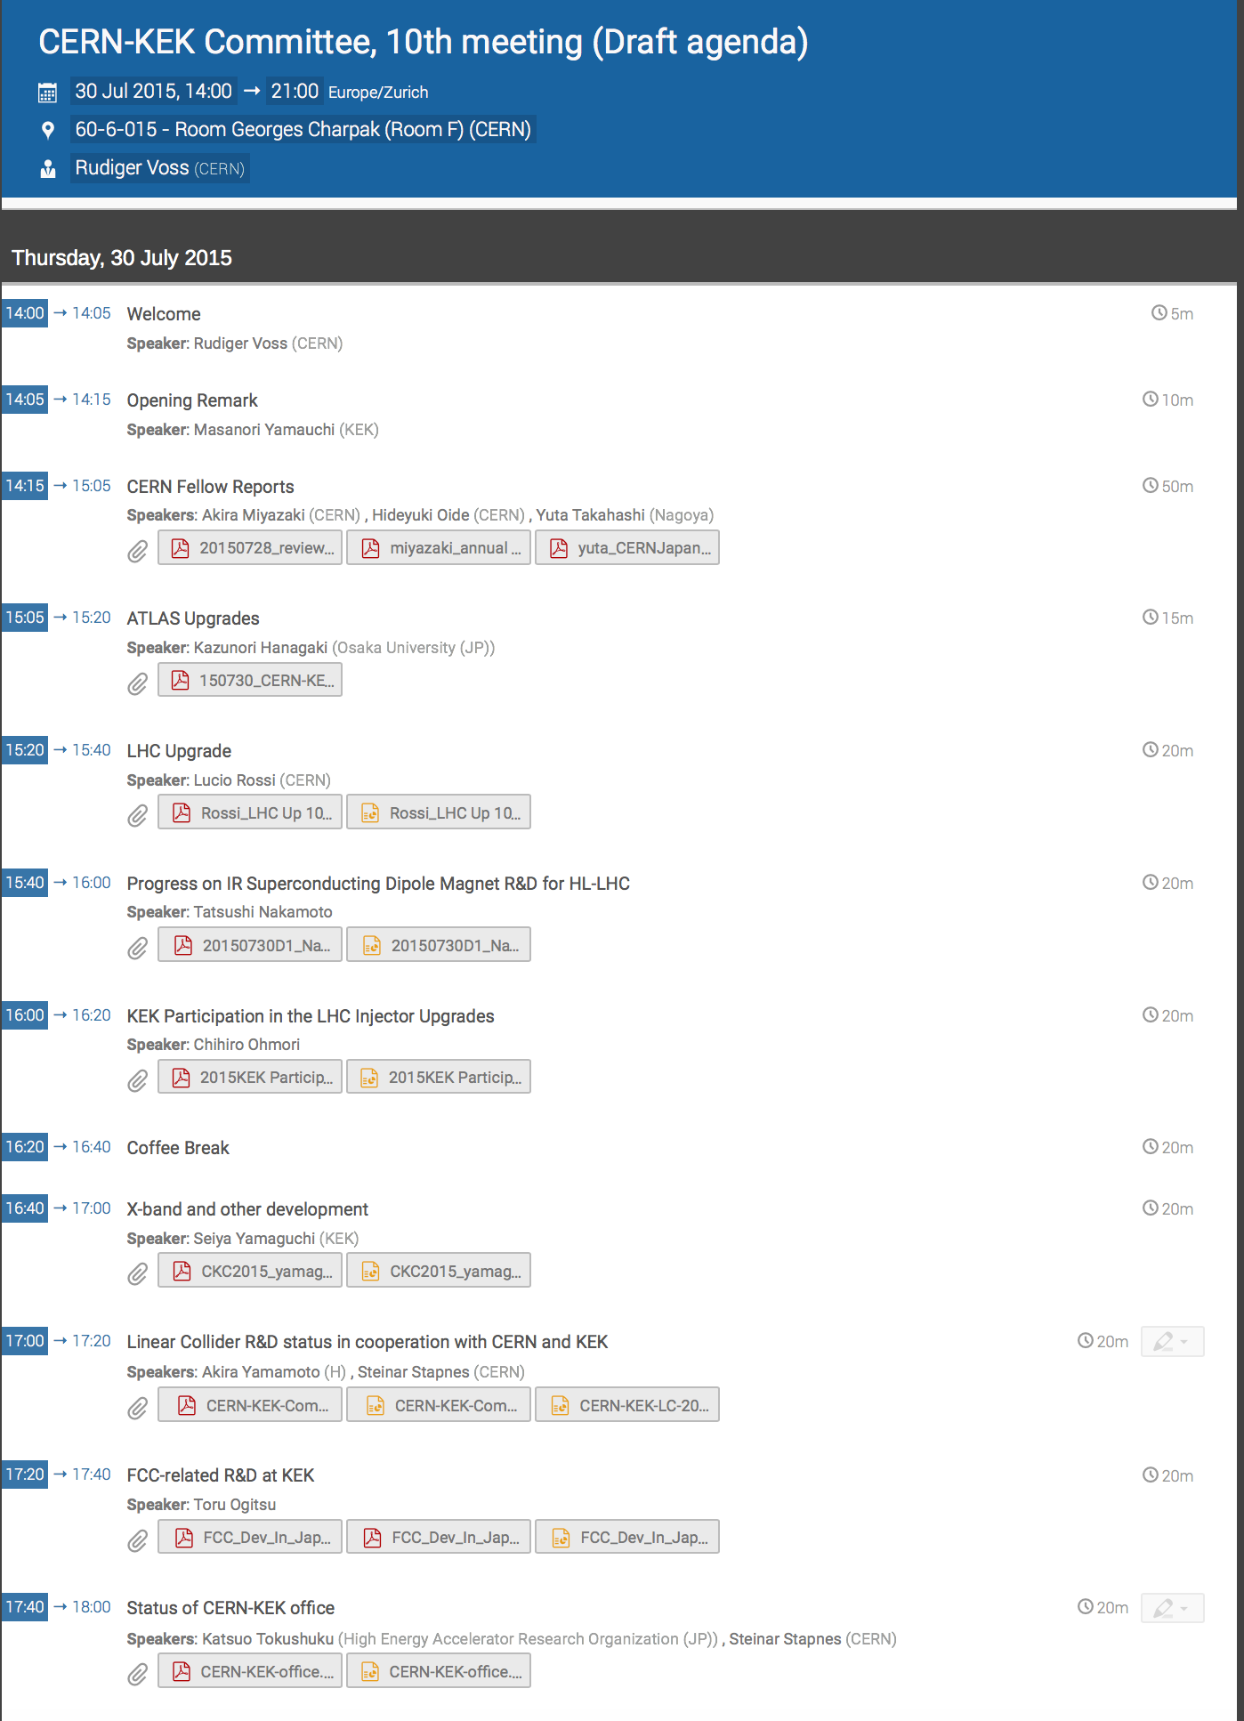

Slide 5
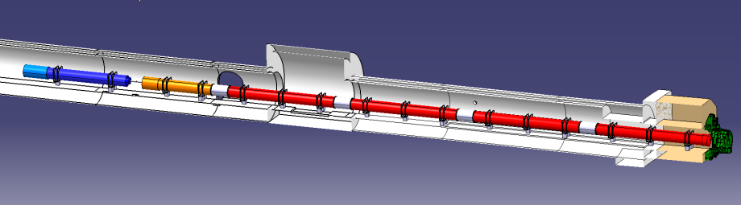





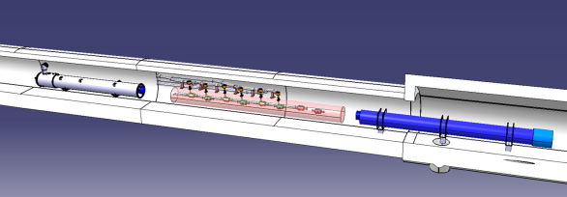


In-kind contribution and Collaboration for HW design and prototypes
ATLAS
CMS
Q1-Q3 : R&D, Design, Prototypes and in-kind USA
D1 : R&D, Design, Prototypes and in-kind JP
MCBX : Design and Prototype ES
HO Correctors: Design and Prototypes IT
Q4 : Design and Prototype FR
CC : R&D, Design and in-kind USA
CC : R&D and Design UK
Slide from L.Rossi

Slide 6

Magnetic Alloy-FINEMET® loaded wideband cavities for CERN PSB and PS in the frame of the LHC Injector UpgradeCollaborative Work ICA/JP/0103
RF Collaboration for LHC Injector Upgrade
Objectives
Consolidation/upgrade of the PSB RF systems possibly using wideband, multi-harmonic, solid-state driven Magnetic Ally loaded cavities
Development and installation of a longitudinal damper in the PS
Core Technology :
Wideband Cavity using Magnetic Alloy,Finemet-FT3L
Use of Solid State Amplifiers
Collaboration activities
Studies on the PSB multi-gap wideband cavity-beam interactions
  Beam Studies at J-PARC MR during LS1 & PSB
Study radiation damage on solid-state RF amplifier
  Radiation damage test at J-PARC MR
Study, design and prototype a longitudinal damper for the CERN PS
  Wideband cavity system to damp the longitudinal coupled bunch instability
Collaboration on the conceptual design of feed-forward beam compensation schemes for FINEMET® cavities
  J-PARC wideband cavities handles 1E14 ppp in MR with Feed Forward compensation in LS1

Slide 7
WP1
Description of Work
The LHC accelerator will run at its full energy from 2015 and Japanese researchers participate in operation, analysis and upgrade projects for both accelerator and detectors. R&D on high field magnets and wideband magnetic alloy RF systems is a key ingredient for upgrading the LHC, and its injectors through the LIU project, and for reaching the goals of the High Luminosity LHC project. These studies are also relevant for the J-PARC accelerators and for a potential very large collider as studied in the context of the FCC programme.
Objectives
Execution of an intensified Japanese programme at LHC in preparation for future accelerator programmes
Advance the preparation for and execution of the European-Japanese collaboration on the High Luminosity LHC upgrade and associated R&D
Strengthen the R&D on High field magnets and RF systems for future or upgraded energy- and/or intensity-frontier hadron machines.

Slide 8
WP 1:
Tasks:
  Task 1.1: LHC operation and analysis (CERN, KEK & UoT): Integrate Japanese efforts in operation of LHC machines and detectors at full energy; expected to provide important guidance for future accelerator developments in Europe and Japan.
  Task 1.2: The HL-LHC project (CERN & KEK): Engineering design and validation of two short prototype separation superconducting dipoles (D1) followed by construction preparation, construction and test of the 4 final (plus two spare) D1 dipoles for the upgraded LHC insertion regions. Studies for the crab cavities (CC) for the LHC luminosity upgrade, benefitting from operational experience of CC at KEK.
  Task 1.3 High field magnet R&D and preparation of future hadron injectors and colliders (CERN & KEK): R&D on the viability of HTS magnets of accelerator/collider quality. Enhance the exchange of staff between CERN and KEK in the context of the LIU project and the J-PARC intensity upgrade studies. Technologies of special interest are Wideband Cavities using Magnetic Alloy, Solid State Amplifiers and Low Level RF.

Slide 9
WP 1
Deliverables
  Month 25 Magnets and Gradients: Report on common R&D results on high field magnets and high gradient structures.
  Month 25 Hadrons at high intensity and energy: Report describing R&D results on FCC and J-PARC related activities.
  Month 37 Physics at LHC: Report covering main findings at LHC with relevance for future energy frontier accelerator projects.
  Month 37 HL-LHC: Status report and final plan of the Japanese contribution to HL-LHC.

Slide 10
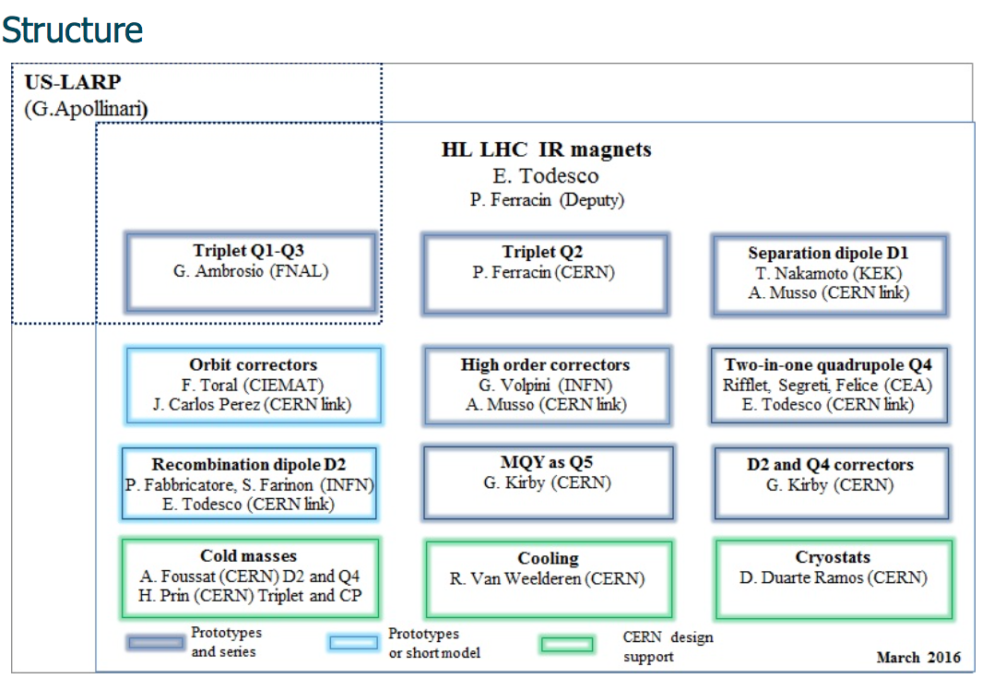
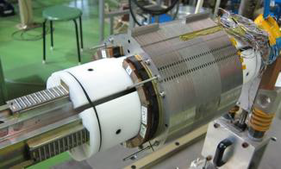
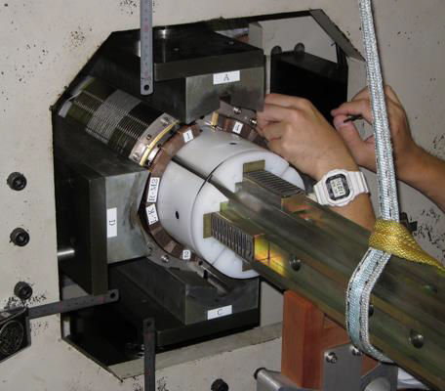
HL-LHC
Secondments/travels currently mostly linked to preparation (prototyping) of the separation dipoles for HL-LHC
Testing of 2m prototyping ongoing this week (A.Musso currently at KEK)

Slide 11
Advantages of Magnetic Alloy (Finemet®) Cavity for PSB/PS Case
RF cavity loaded with magnetic alloy cores
High field gradient ->
Replacement of PSB cavities
Enough voltage to damp coupled bunch instability at PS
Wideband system ->
dual harmonic acceleration for PSB
compensation of multi-harmonics for PS
  Stable/medium impedance
  Compact RF system driven by solid state amplifiers
Multi-cell structure (24-36 cell / PSB ring, 24 is enough)
Reduction of down time
Cost reduction: no bias PS, no tube, no anode PS

Slide 12
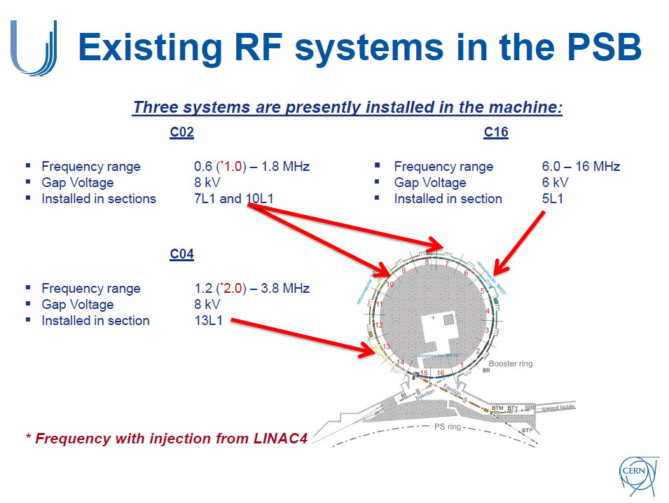
Finemet cavities may (will) work as C02 & C04 systems
M. Poluzzi @ Finemet review

Slide 13
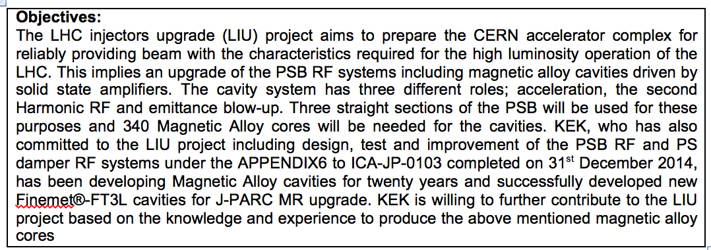
LHC Injector Upgrade

Slide 14
R&D Status
FCC relevant R&D
Two projects on going (Founded by JST and AMED)
  JST: Med Field HTS Mag. For Small Acc.; ~1MCHF/y * (5+5)y
  AMED: Med Field HTS Mag. for Medical Acc.; ~1MCHF/y * 3y
Several Proposals to JSPS
  JSPS: Advanced Conductor Development for High Field App.
    Nb3Sn and HTS; ~3MCHF/y * 5y
  JSPS: HTS High Field Magnet Development for Future Acc.
    ReBCO cable; ~2MCHF overall 5y
Nb3Sn Development Efforts by Private Companies
  KSL/JASTEC, SH Copper, and Furukawa
Toru Ogitsu, CERN-KEK meeting

Slide 15
Key points
Projects and tasks nicely on track
Secondments for LHC operation (task 1)-> talk of K.Tokushuku
Secondments for task 2 started and will be important in the coming years (follow the dipoles)
For task 3 the work well underway and agreements are (being) put in place, secondments being defined in more detail. Efforts are being made to making best possible use of EJADE to increase impact.

Slide 16


Thank you very much for your attention!
Mid-Term Review
This project is funded by the European Union under Grant Agreement no. 645479

