Slide 1
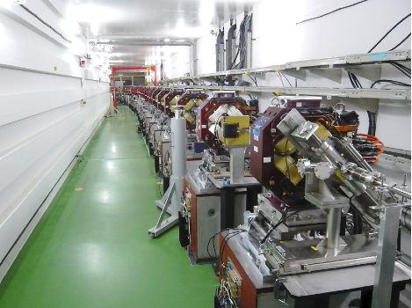
Nanometre scale beam handling at the ATF
ATF2 @ KEK (Japan)
Philip Bambade / WP2

Slide 2
WP 2: ATF ↔ Linear Collider
Accelerator Test Facility
Energy: 1.3 GeV
Repetition: 3.12 Hz
Intensity: 1-2x10¹⁰ e-/bunch
1~20 bunches/pulse
Design emittance:
1 nm(H) / 10 pm(V), Achieved 4 pm(V)
ATF2 beamline: Nano-meter beam R&D
Final focus system development
Technologies to maintain the luminosity at ILC
Beam size: 37 nm (design), 44 nm (achieved)
Beam stabilization via feedback: achieved 67 nm
Beam instrumentation development
Damping Ring (∼ 140m)
Low emittance beam

Slide 3
History of minimum beam size in ATF2
44 nm achieved in June 2014
still being improved
Fast recovery of small
beam sizes <50 nm
after shutdown
Good reproducibility
and stability confirmed

Slide 4
WP2: organization, objectives and tasks
Participant Short Name | CERN | CNRS | CSIC | KEK | RHUL | UoO | UoT
 | R. Tomas | P. Bambade | A. Faus-Golfe | N. Terunuma | P. Karataev | P. Burrows | S. Komamiya
Person-months per Participant: | 31 | 50 | 12 | 13 | 21 | 49 | 2
Objectives Achievement and maintenance of nanometre scale beam size Measurement and feedback to stabilise beam position at nanometre level Development of advanced beam diagnostics instrumentation Control of beam halo and background mitigation Training of junior scientists and students in accelerator science
Task 2.1 Beam Size Minimisation (CERN, CNRS, KEK & UoT)
Task 2.2 Wake Field (CERN, CSIC, KEK & RHUL)
Task 2.3 Ground Motion (CERN, CNRS & KEK)
Task 2.4 Halo Collimation and Backgrounds (CNRS, CSIC, KEK & RHUL)
Task 2.5 Beam Instrumentation and control (CNRS, KEK, RHUL, UOXF & UoT)
Task 2.6 Beam Position Feedback (KEK & UOXF)

Slide 5
WP2: schedule and deliverables
2 deliverable reports submitted : HaloCollBgds-1, Instr-1
1 deliverable report under preparation : GM-1
→ OK
Month 12 HaloCollBgds-1: Report on halo measurement and control using diamond sensor and collimators Month 12 Instr-1: Report on performance optimisation of installed high resolution beam position and size instrumentation Month 24 Instr-2: Design report of optical transition/diffraction radiation combined measurement station including initial beam tests Month 18 GM-1: Reports on synchronisation of GM and orbit measurements and on new GM sensor performance Month 24 BeamSize-1: Report on performance of installed octupole magnet pairs in correcting 3rd order optical aberrations Month 24 Wakefield-1: Report on wakefield simulation and measurements including mitigation plans and implications for the Linear Collider Month 24 Feedback-1: Report on operation of collision point feedback system Month 24 HaloCollBgds-2: Report on integrated simulation and evaluation of beam transport including beam instrumentation and charged particle backgrounds Month 36 Wakefield-2: Report on wakefield free steering performance to mitigate wakefields Month 36 GM-2: Final report on correlation between GM and orbit measurements and implications for GM based feed-forward Month 48 Feedback-2: Final report on performance of interaction-point feedback system, and implications for its implementation in the Linear Collider Month 48 BeamSize-2: Final report on beam size minimisation in horizontal and vertical dimensions using optimised optics, and implications for the Linear Collider

Slide 6
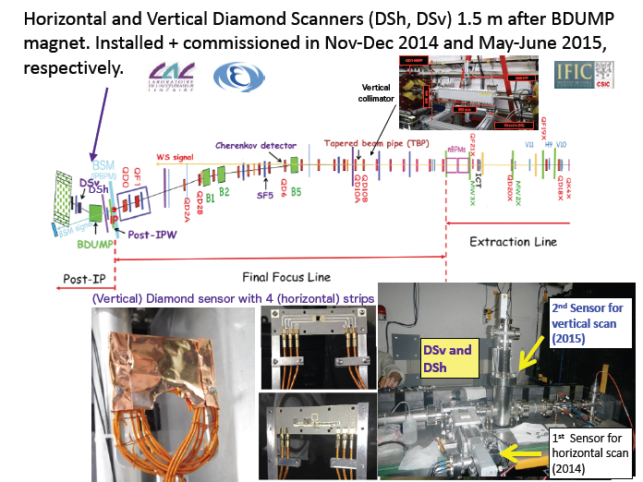
WP2 deliverable : HaloCollBgds-1 (1)

Slide 7
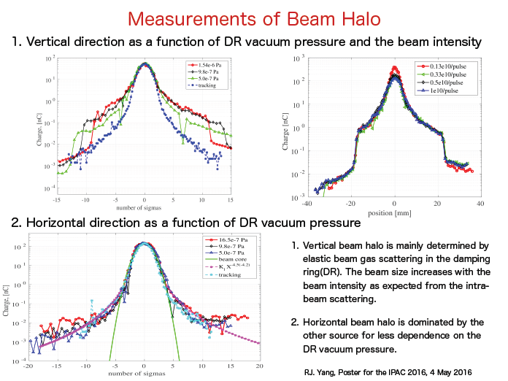
WP2 deliverable : HaloCollBgds-1 (2)

Slide 8
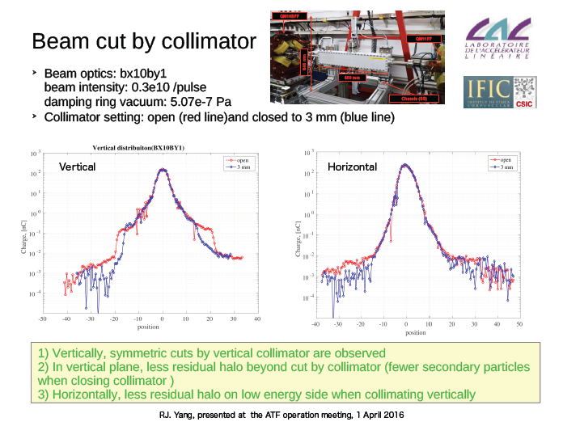
WP2 deliverable : HaloCollBgds-1 (3)

Slide 9


2nd bunch IPBSM measurement (Task 2.1)
WP2 deliverable : Instr-1(1)
Laser
Detector signal
$$e^{−}$$
$$e^{−}$$
~200 ns
Fringe phase
Timing of the IPBSM laser is matched to 2nd bunch timing
Beam size measurement is done by measuring 100-200 pulses
It is not possible to measure the beam size of 1st&2nd bunch at the same time

Slide 10
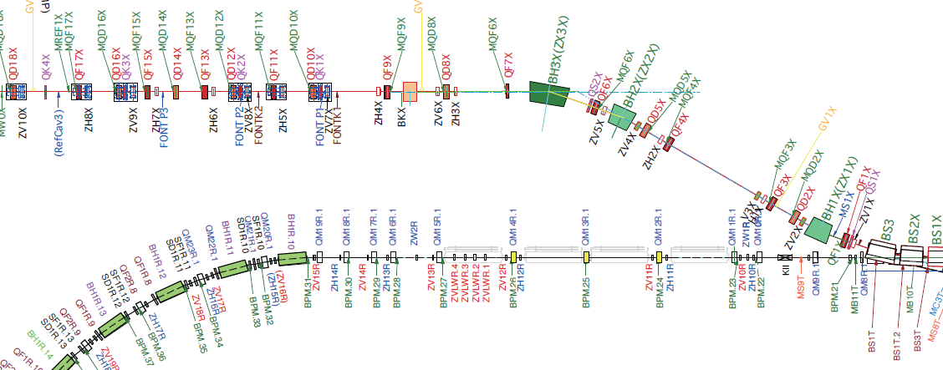
FONT upstream feedback (Task 2.6)
WP2 deliverable : Instr-1(1)
Vertical steering magnets
Extraction line
FONT stripline BPMs and kickers
Damping Ring

Slide 11
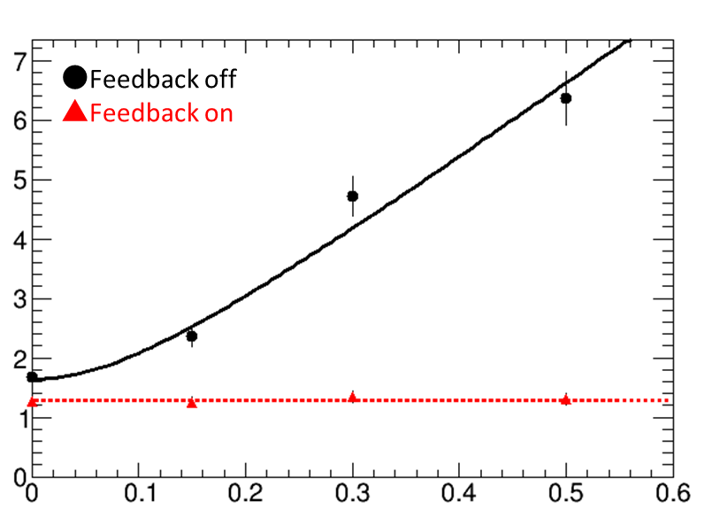
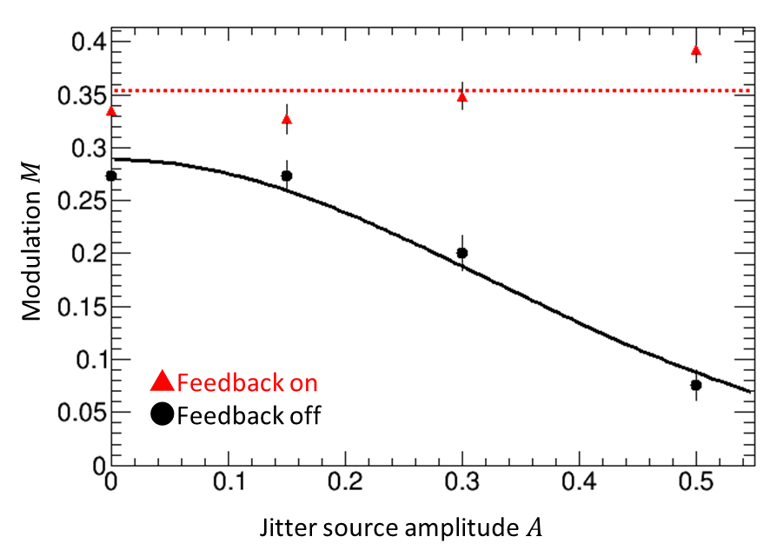
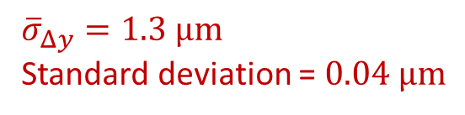

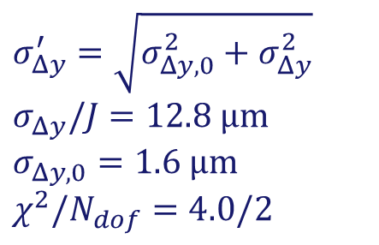


Position jitter at FONTP3
WP2 deliverable : Instr-1(3)
2nd bunch beam position measurement with/without FONT feedback
with respect to varying artificial input jitter
$$Bar=jitter/\sqrt{2\left(100−1\right)}$$
$σ_{Δy}^{′}=\sqrt{σ_{Δy,0}^{2}+σ_{Δy}^{2}}$
$σ_{Δy}/J=12.8 μm$
$σ_{Δy,0}=1.6 μm$
$χ^{2}/N_{dof}=4.0/2$
Position jitter at FONTP3 $[μm]$
${\overline{σ}}_{Δy}=1.3 μm$
Standard deviation = $0.04 μm$
Jitter source amplitude $J$

Slide 12
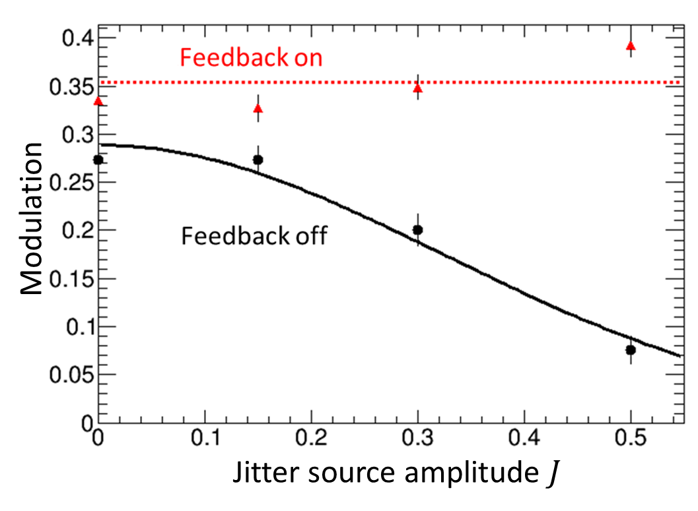

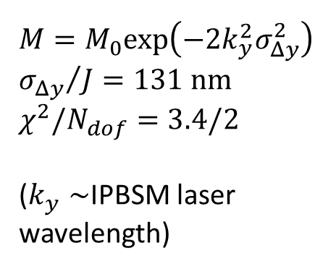
WP2 deliverable : Instr-1(4)
2nd bunch beam size measurement with/without FONT feedback
with respect to varying artificial input jitter
$$Bar = fit error$$
Standard deviation= 0.03
$M=M_{0}exp\left(−2k_{y}^{2}σ_{Δy}^{2}\right)$
${σ_{Δy}}/J=131 nm$
$χ^{2}/N_{dof}=3.4/2$
($k_{y}∼$IPBSM laser wavelength)
Notes:
M=0.29+-0.01

Slide 13
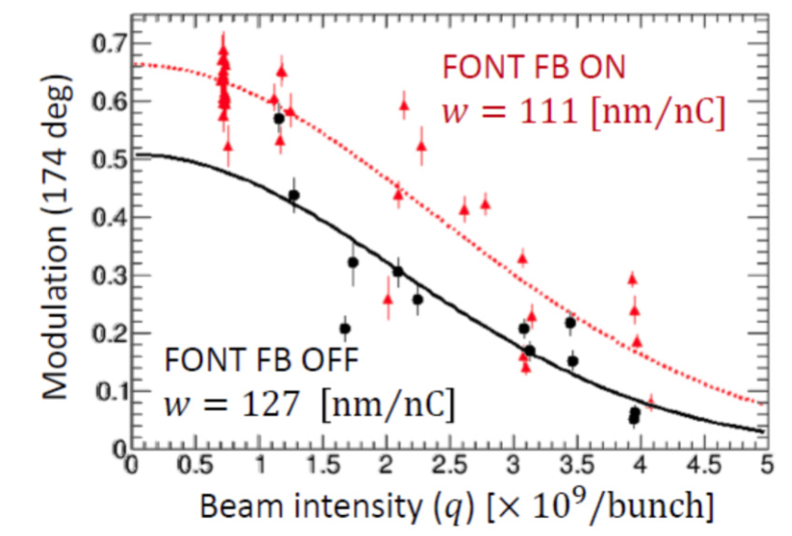
WP2 : Recent progress
2nd bunch beam size measurement with/without FONT feedback
in the presence of natural beam jitter

Slide 14
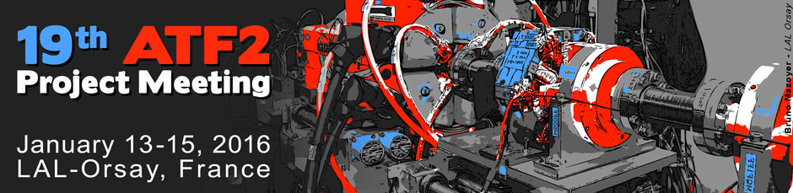
https://agenda.linearcollider.org/event/6939/
⇒ E-JADE WP2 annual workshop
Wednesday 13
- Status of beamline alignment, hardware and software at ATF
- 19th Technical Board & System Group Coordinator Session
Thursday 14
- Status of beam tuning for 37nm beam (Goal-1)
- Beam size tuning at the nominal beam intensity, wakefield issues
Friday 15
- IP beam stabilization at nanometer level (Goal-2)
- Future Plans

Slide 15
Participants
* ARAKI Sakae, KEK Japan
* BAMBADE Philip CNRS LAL IN2P3 France
BERGAMASCHI Michele CERN Switzerland
* BETT Douglas CERN Switzerland
* BLASKOVIC KRALIEVIC, Neven Oxford University U.K
* BROMWICH Talitha University of Oxford U.K
BURROWS Philip Oxford University U.K
FAUS-GOLFE Angeles IFIC - LAL Spain
* FUSTER Nuria IFIC Spain
* JANG, Si-Won KNU Korea
* JEREMIE, Andrea CNRS LAPP IN2P3 France
* KANO, Yuya University of Tokyo Japan
* KIEFFER Robert CERN Switzerland
* KUBO, Kiyoshi, KEK Japan
* NAITO Takashi, KEK Japan
* OKUGI, Toshiyuki KEK Japan
* PATECKI Marcin CERN Switzerland
* PLASSARD Fabien CERN Switzerland
SCHUETZ Anne DESY Germany
* TAUCHI Toshiaki KEK Japan
* TERUNUMA Nobuhiro KEK Japan
TOMAS Rogelio CERN Switzerland
* WALLON Sandry CNRS LAL IN2P3 France
WHITE Glen SLAC USA
YAMAMOTO Akira KEK & CERN Japan
YANG Renjun CNRS LAL IN2P3 France
on-going or recent ATF2 graduate student
remote participant
* speaker

Slide 16
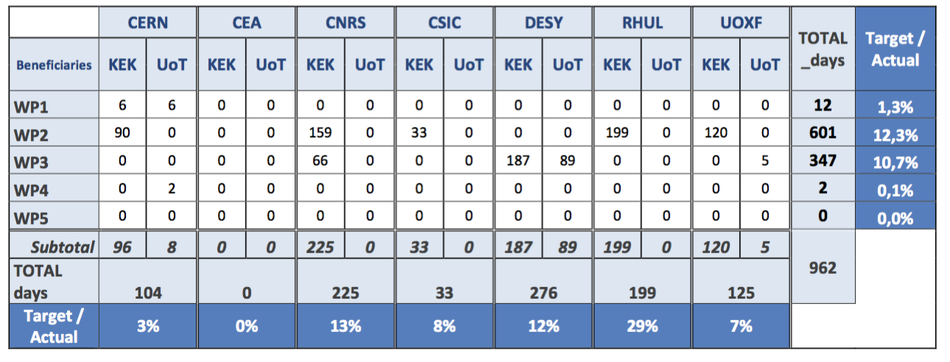
WP2 : Secondment report
Total in contract = 163 months → have used 12.3 % so far, less than ∼ 30% expected…
Explanations :
- slow start
- about 50% less ATF beam time in 2015, limited by electricity cost → 11 / 21-23 weeks
- eligibility criteria lack clarity and are interpreted non uniformly…
Mitigation :
- extend scope to include research on “nanobeams” at SuperKEKB → next slides
- secure sufficient budget for ATF beam time in 2017-2018 ?
- clarify eligibility criteria ? → for discussion

Slide 17
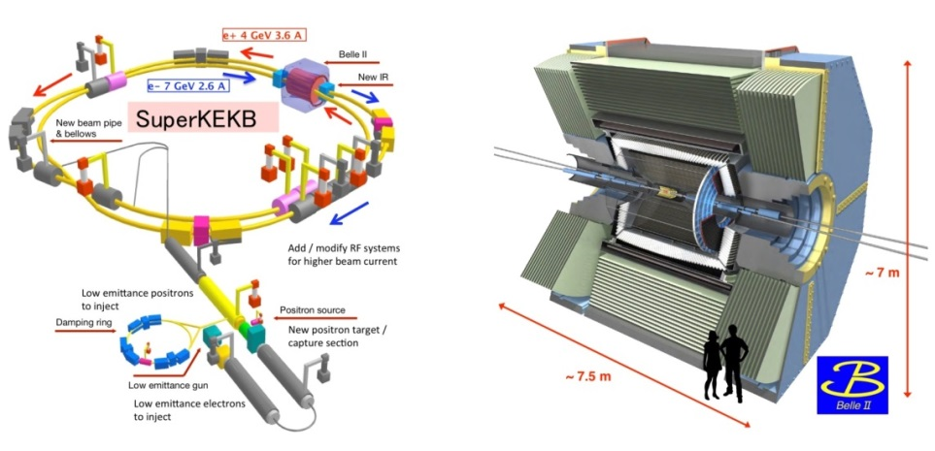
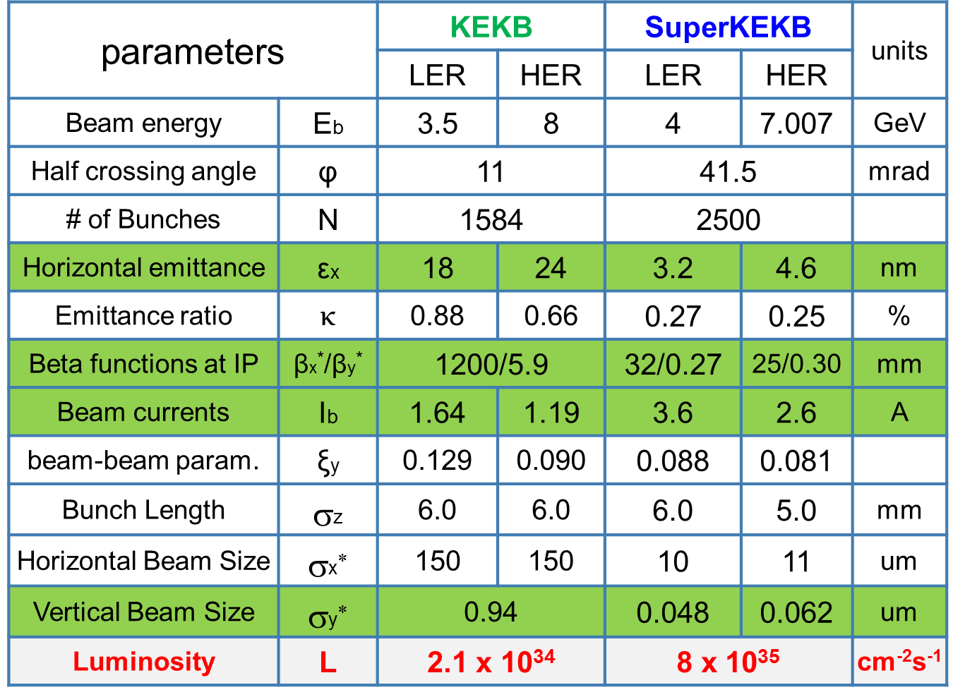
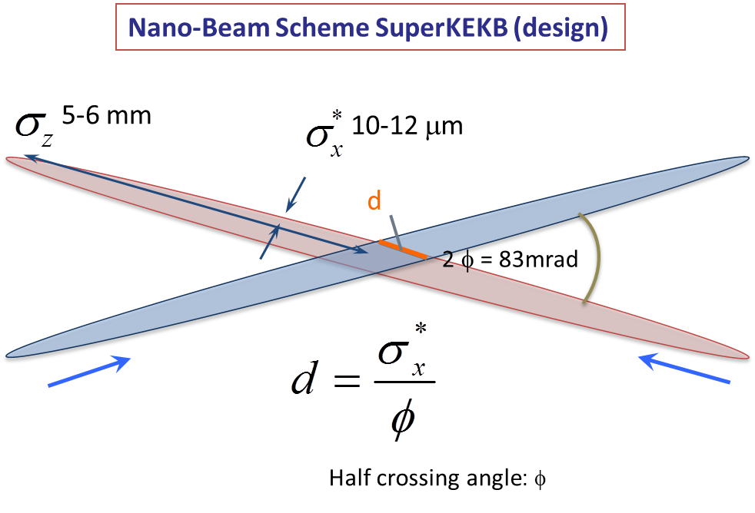
WP2 : Extension of scope (1)
Luminosity tuning & optimization
Beam halo/loss modeling & monitoring
1) Phase 1 : 2016/Feb. → Jun.
- single beam commissioning, vac. scrubbing
- no luminosity (no final focus), no detector
2) Phase 2 : 2017/Nov. → 2018/Mar.
- colliding beam commissioning, no vertex detector
3) Phase 3 : from 2018/autumn
- full luminosity for physics running
Tests of optical tuning methods and luminosity optimization techniques at SuperKEKB
β_{y} = 300 μm
d = 300 μm
SuperKEKB uses novel “nanobeam” scheme
→ mitigates beam-beam and hour-glass effects…
→ Lumi × 40

Slide 18
WP2 : Extension of scope (2)
Task 2.7 (new): Tests of optical tuning methods and luminosity optimization techniques at SuperKEKB
ATF2 & Linear Colliders ↔ SuperKEKB
Instrumentation for beam loss monitoring*
Beam halo modeling*
Optimization of collimation*
Ground motion measurements, modeling and mitigation techniques
Feedback to stabilize the transverse positions of the beams at the IP*
Optical tuning to minimize the vertical beam size the IP
*active European contribution
(additional resources)
Fits well into steps defined to achieve overall WP2 goals → cross-fertilization
E-JADE covers the successive SuperKEKB commissioning phases
SuperKEKB = high priority KEK project → some WP2 scientists already contribute

Slide 19
WP2: Conclusions and prospects
Nanobeam handling techniques are a crucial aspect of future linear colliders such as ILC and CLIC
Also of utmost importance for circular e+e− colliders (e.g. SuperKEKB, and CEPC / FCC-ee in the future)
ATF @ KEK (Japan) is unique in the world for R&D on nanobeam technologies
E-JADE/WP2 takes full advantage of ATF to develop technical / scientific knowhow and train the next generation of accelerator experts
ATF dedicated session tomorrow → Audiencia Reina
→ major contribution to the development of human resources and skills
in Europe, at the state of the art in the field of accelerator science
Deliverables in 2016 → 1 in June 2016 + 5 in December 2016
Delay with secondments → expect to catch up
  allocated beam time ILC agenda in Japan
  clarification of eligibility criteria
  extension of scope to include SuperKEKB nanobeams (priority project at KEK)

Slide 20
EXTRA SLIDES

Slide 21
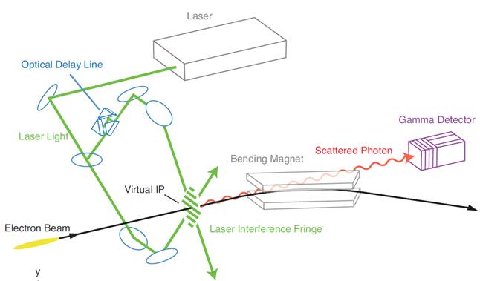
Setup of IPBSM
Scheme of Interaction Point Beam Size Monitor

Slide 22
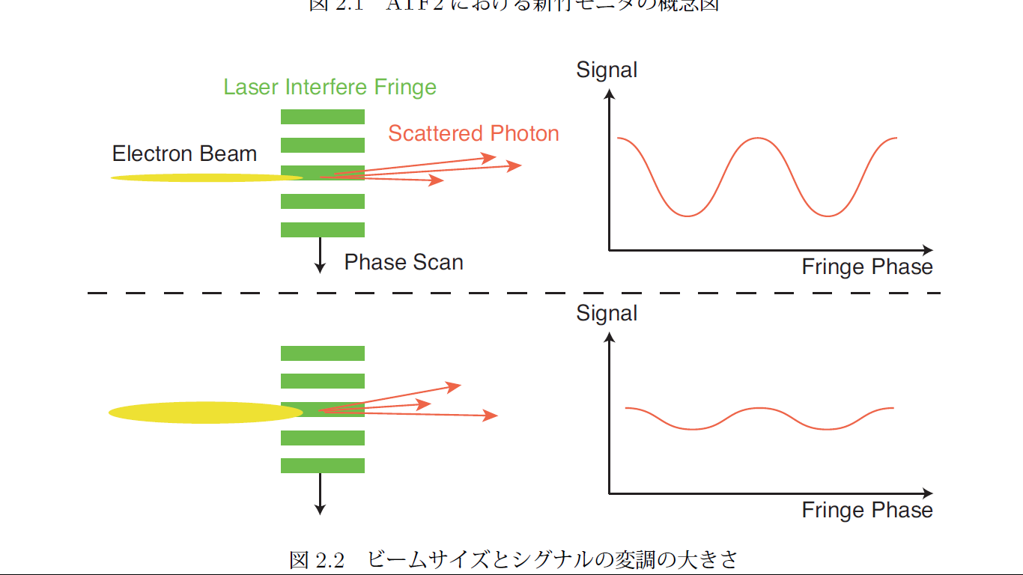
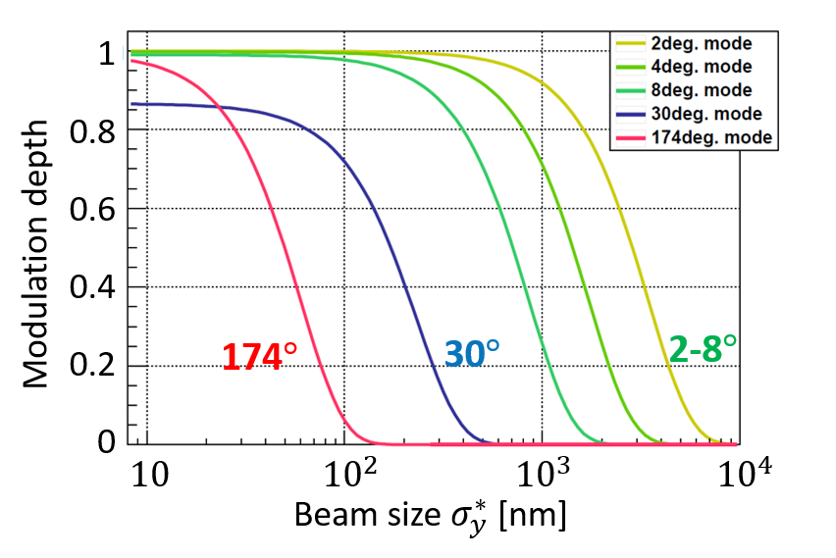





Concept of IPBSM
$$N_{+}$$
Small beam size $⇒$ large $M$
$$N_{−}$$
Large beam size $⇒$ small $M$
Modulation depth$M=\frac{N_{+}−N_{−}}{N_{+}+N_{−}}$

