Slide 1
E-JADE and the ATF beam stability goal
Neven Blaskovic Kraljevic / WP2

Slide 2
About me
Neven Blaskovic Kraljevic, postdoctoral research assistant in Accelerator Physics
2011: MPhys degree in Physics at Oxford
2015: DPhil degree in Accelerator Physics at Oxford
Working on the Feedback on Nanosecond Timescales (FONT) project to ensure successful bunch collisions at a future linear collider by steering the beams into collision
Testing our FONT prototype at the Accelerator Test Facility (ATF) at KEK in Japan: a prototype of the International Linear Collider (ILC)
In E-JADE working on WP2: Nanometre-scale beam handling at the ATF
E-JADE secondments to ATF (KEK): so far 7 weeks in 4 trips

Slide 3
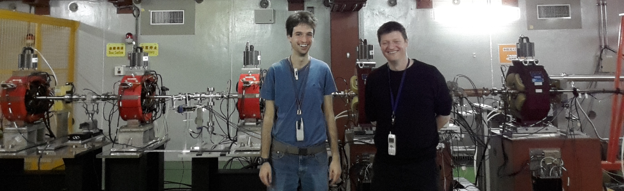
Research at ATF
beam
Monitor P3
Monitor P2
Kicker K2
Kicker K1
Processor
Processor
Amplifier
Amplifier
FONT5 digital board

Slide 4
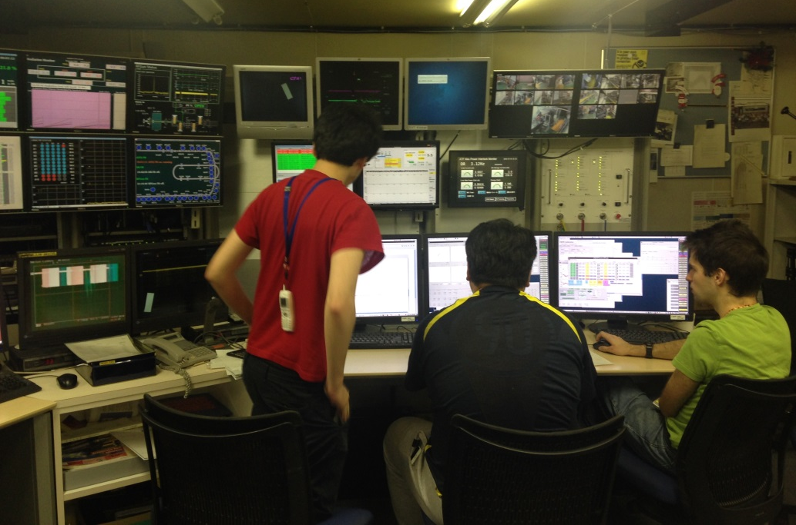
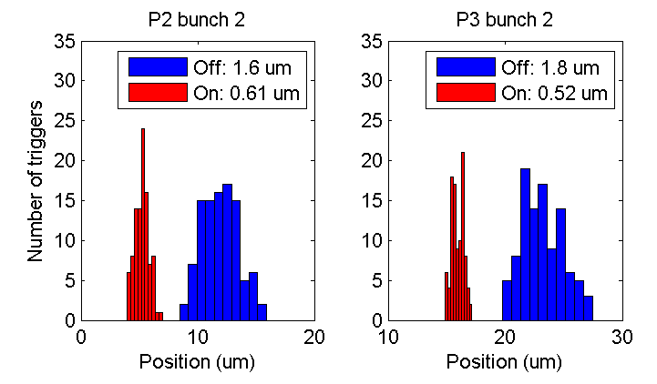
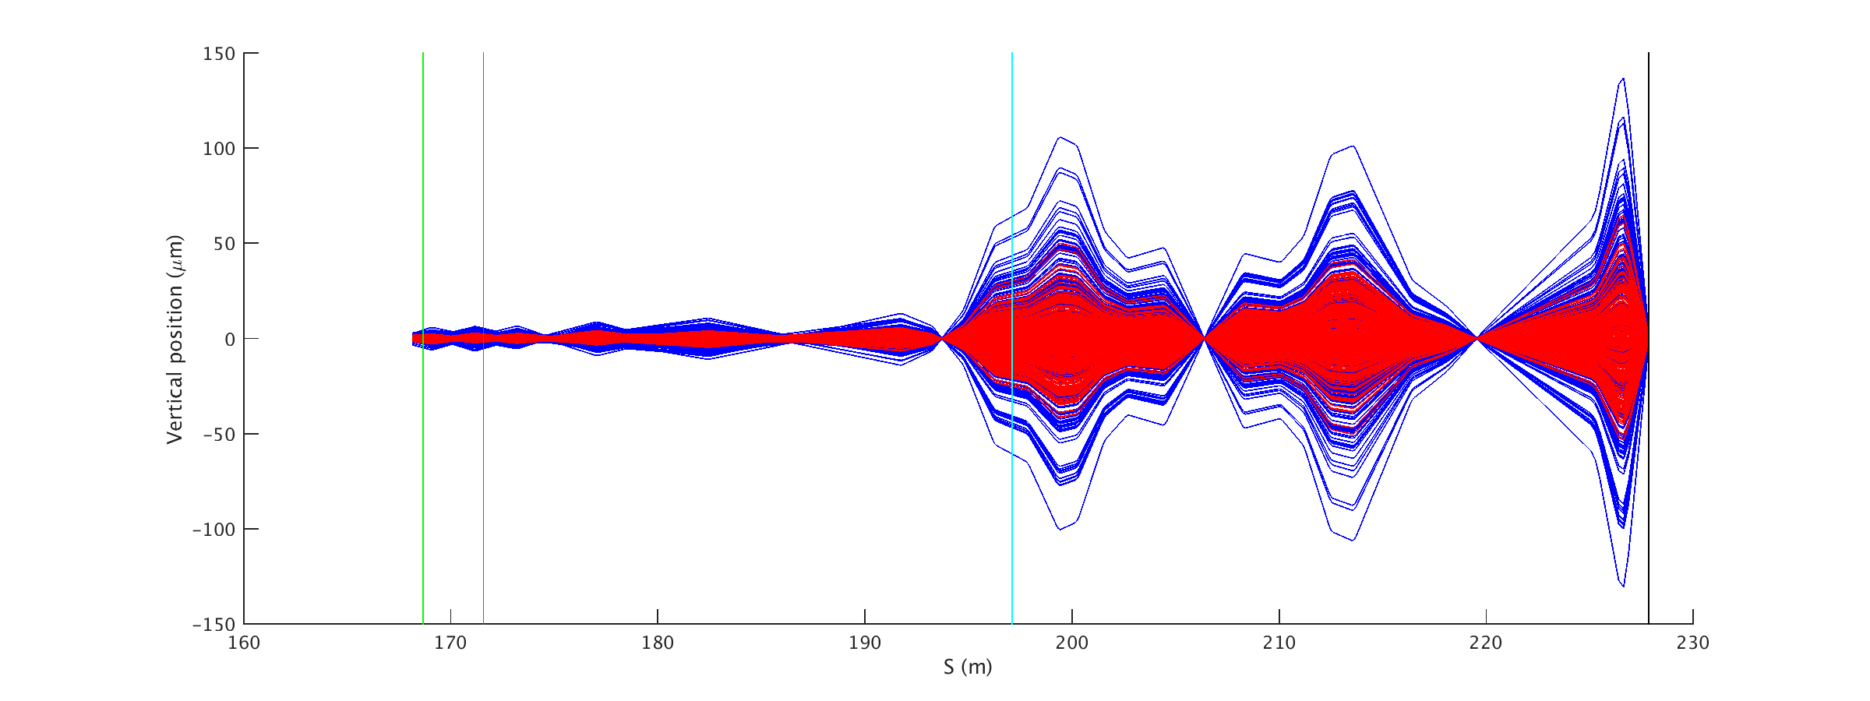
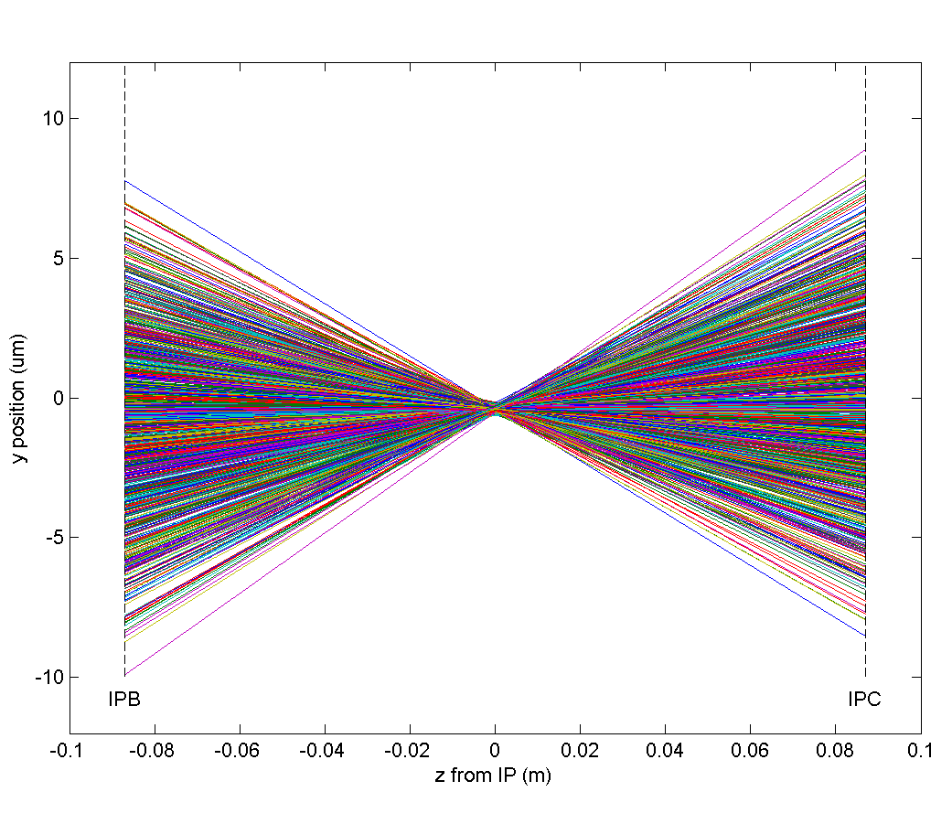
Results at ATF
① Stabilising the beam to under a micron
① Propagating results using the model
① Measured positions

Slide 5
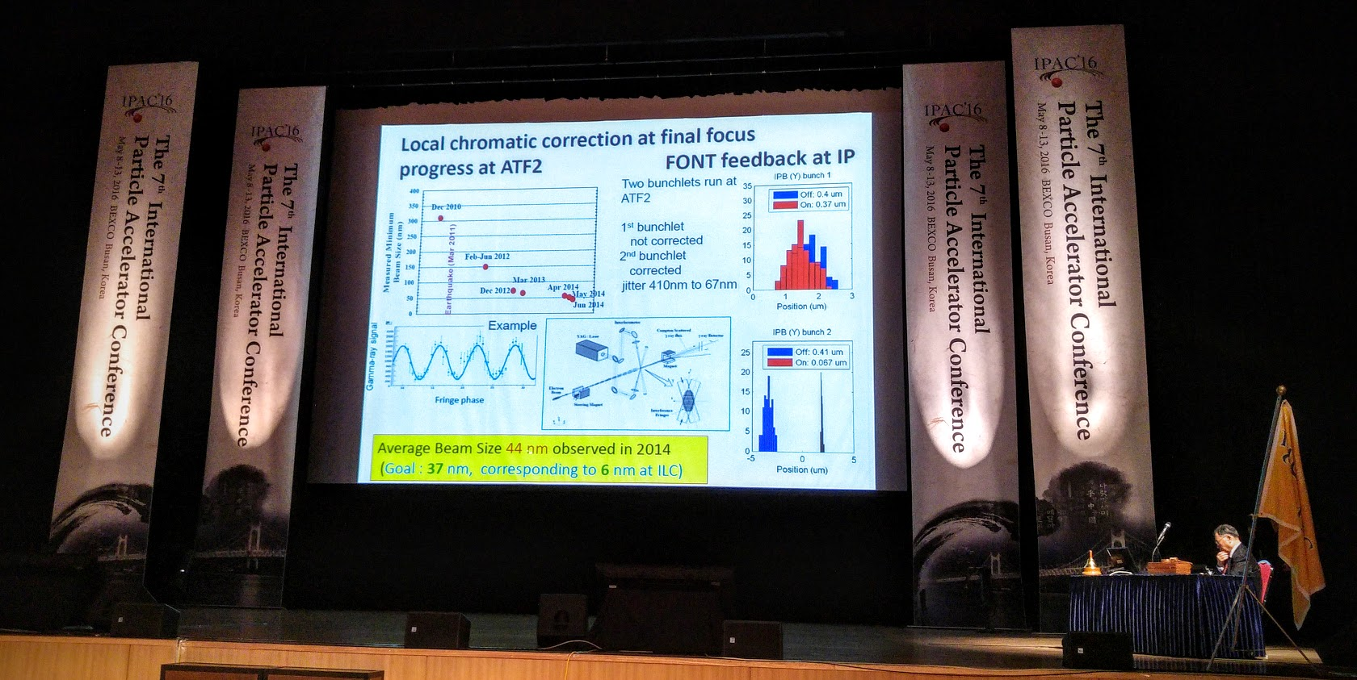
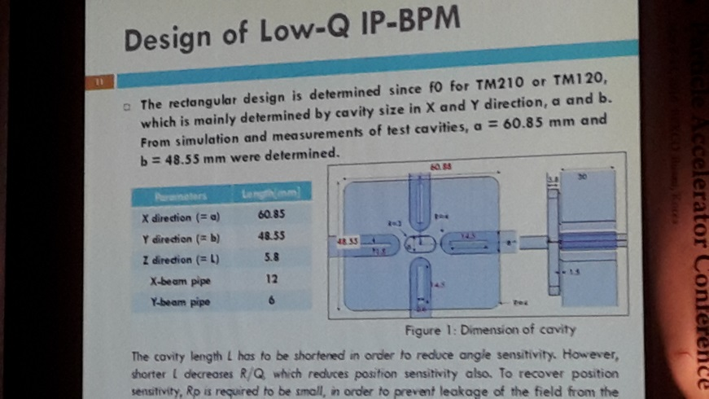
Talks
Our results!
① Opening invited talk by Sachio Komamiya at the International Particle Accelerator Conference (IPAC), 2016
④ Contributed talk by Siwon Jang (Korea) with Japanese, UK and French colleagues at IPAC, 2016

Slide 6
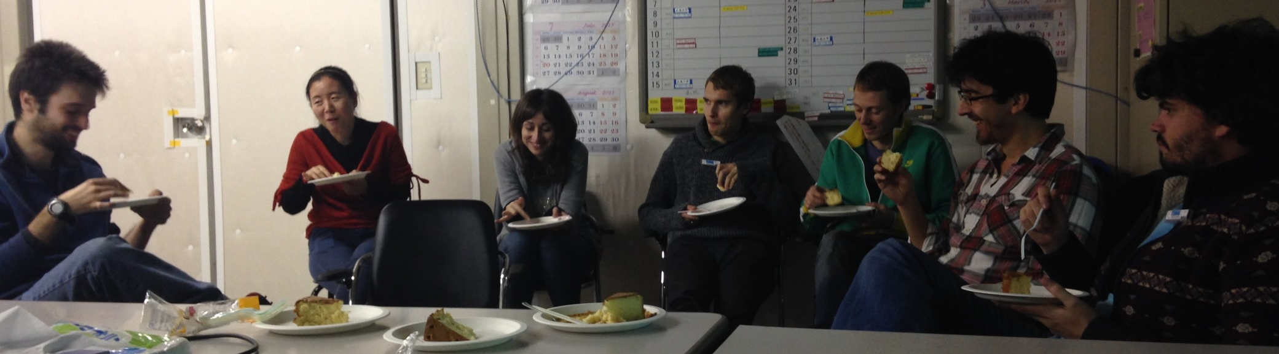
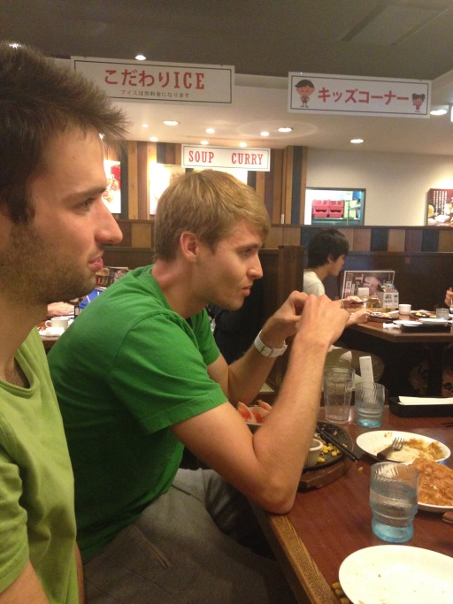

Time off shift
Ki zzu kō nā
Kids’ corner

