Slide 1
Management and Dissemination
Andrea Latina / WP 4

Slide 2
WP 4: Management & Dissemination
Tasks
    4.1 Scientific and Financial Management (CERN & KEK): The management of the programme involves the organisation of programme events, managing the secondments of researchers and the financial planning, execution and reporting to the EU.
    4.2 CERN & KEK Offices (CERN & KEK): Permanent offices at CERN and KEK will be set up, which will support the researchers during the duration of their secondment.
    4.3 Communication (CERN & KEK): The Communication of E-JADE achievements experiences and results within the E-JADE programme will ensure most efficient sharing of knowledge and expertise of the seconded researchers. Annual meetings of all E-JADE participants will be organized as well as topical workshops as described in B4.3.1
    4.4 Dissemination (CERN & KEK): A program for dissemination of information from E-JADE will be setup. This involves setting up public web pages and social media accounts as well as providing information for media and general public. The publication of results in scientific journal articles and participation in international conferences will also be monitored

Slide 3
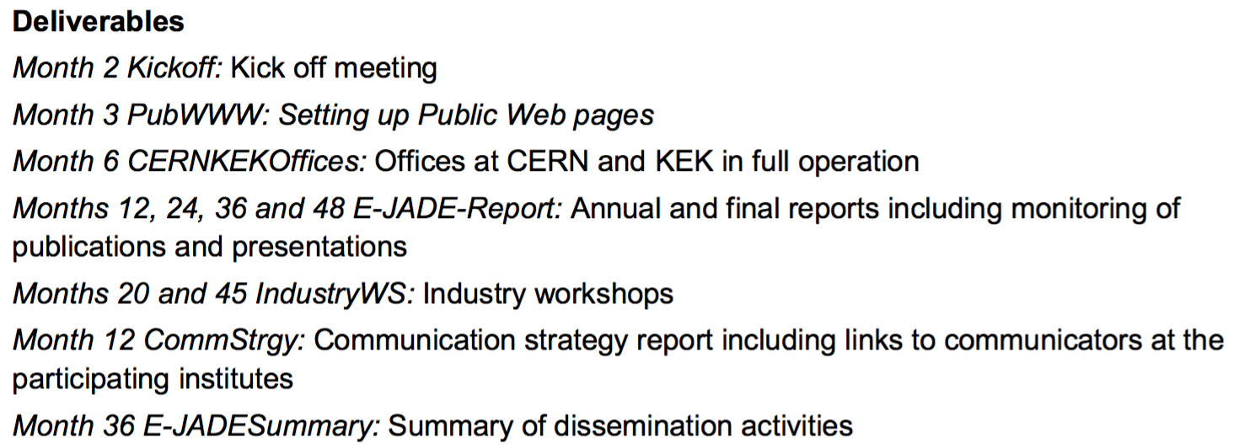
WP 4: Management & Dissemination
Notes:
Everything more or less OK. Except for Month 12 CommStrategy: slightly behind, but it’s on going

Slide 4
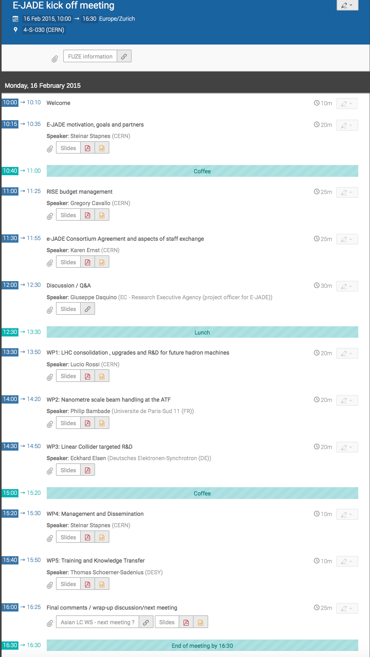
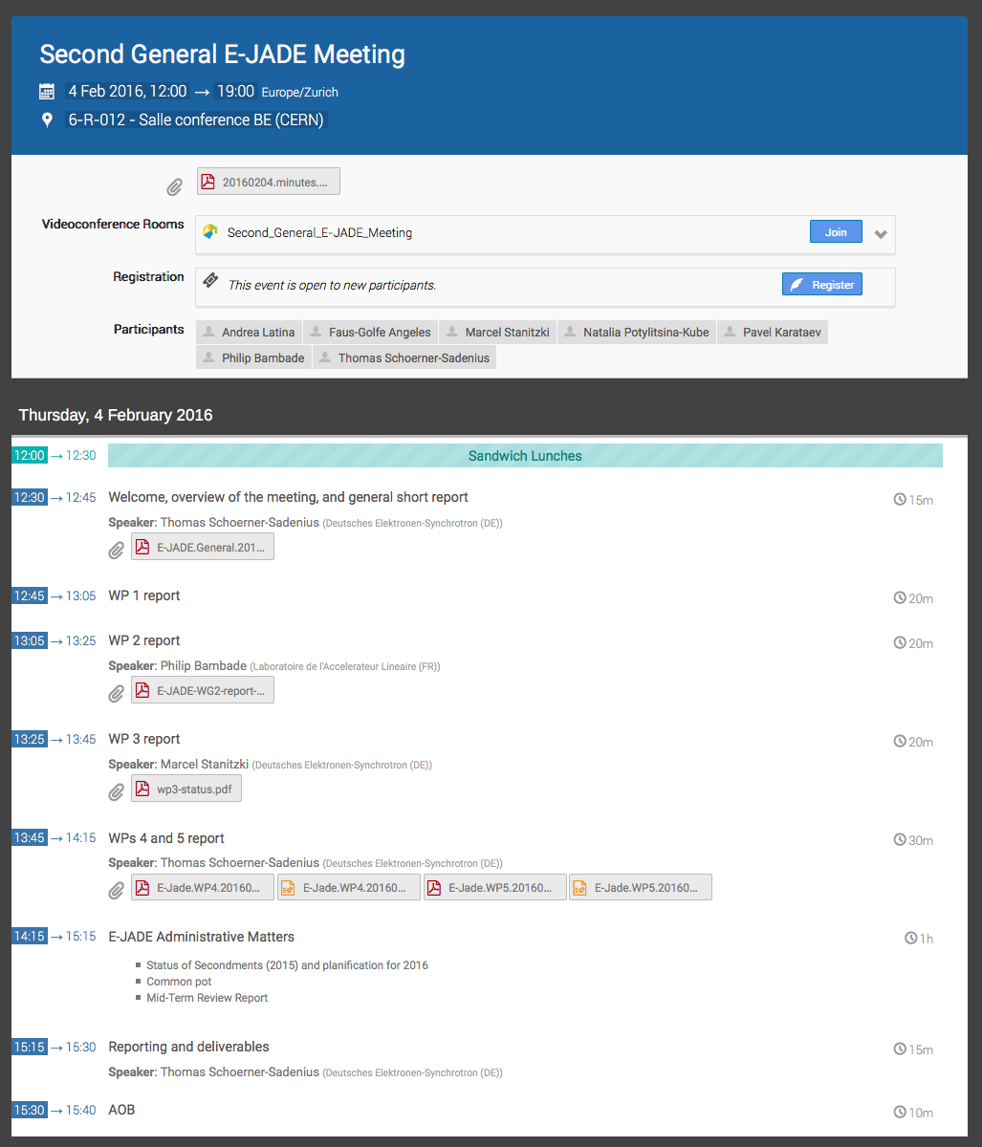
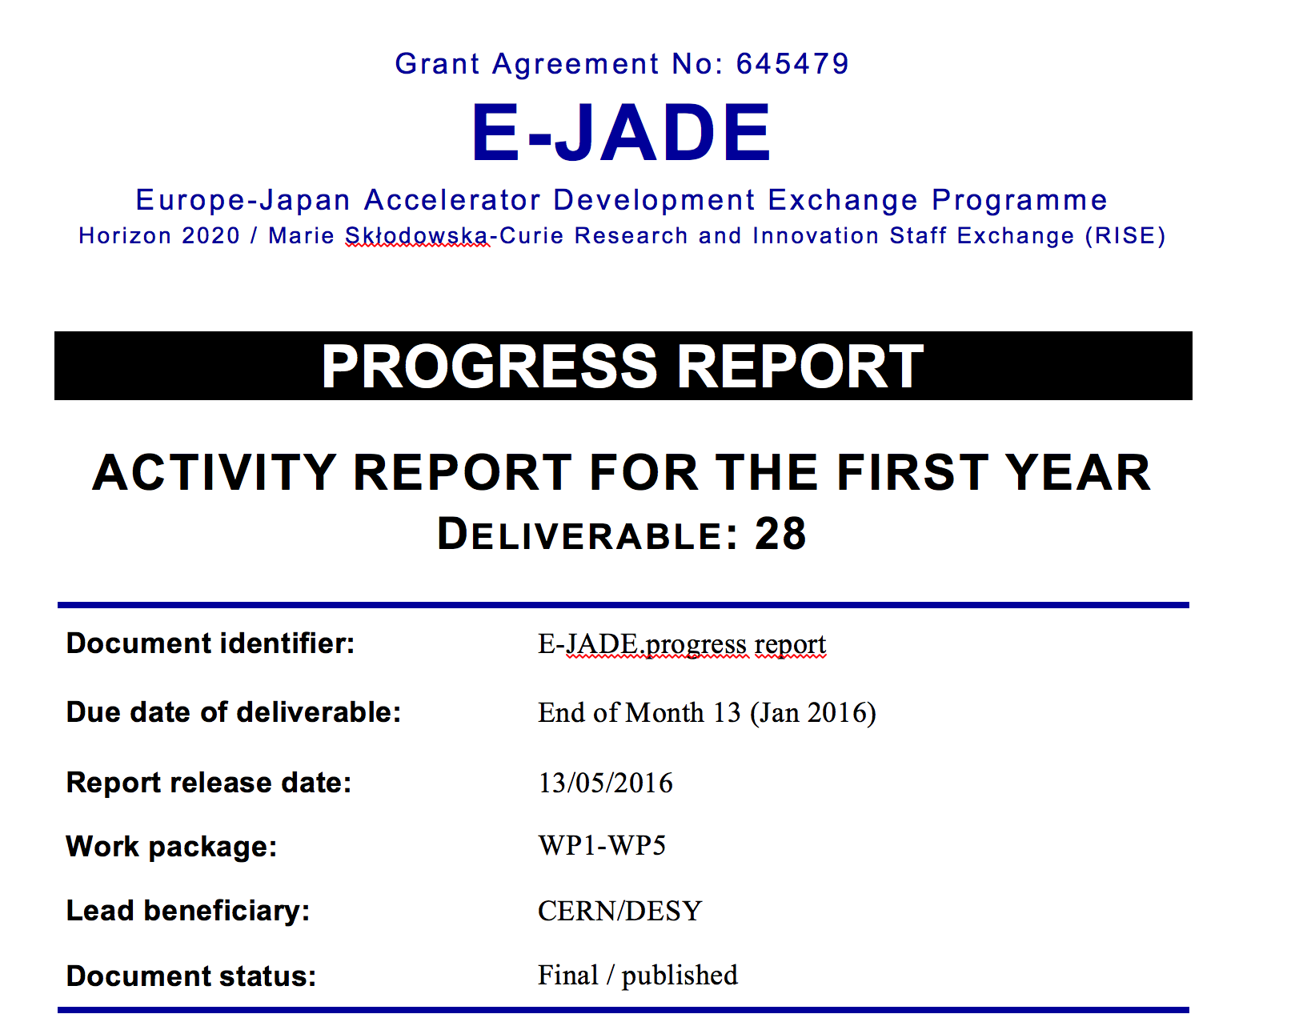
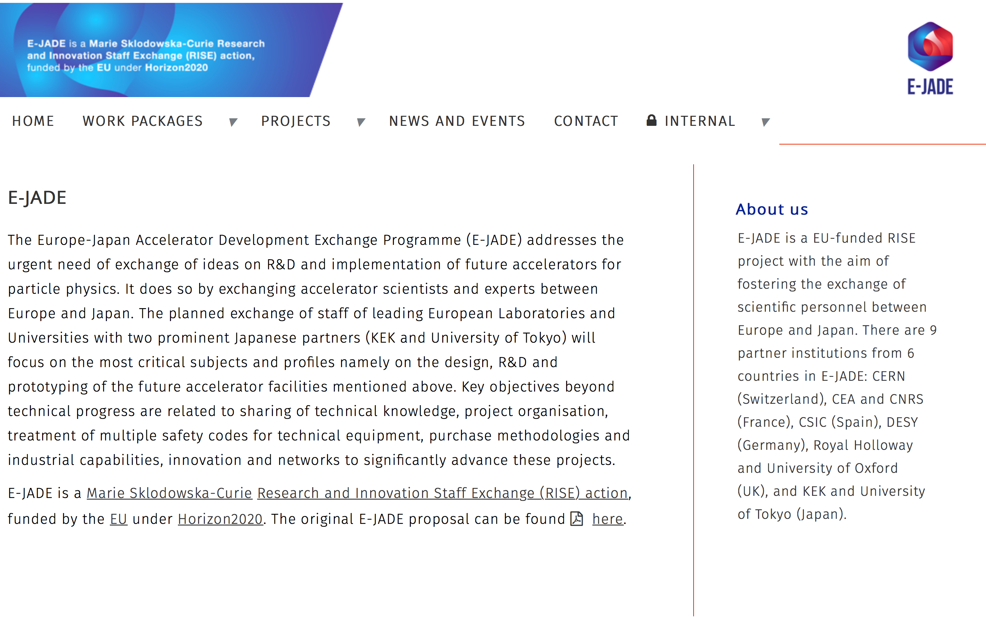
WP 4: Deliverables and Status
Kick-off and second
general meeting:
Annual
report
Web
pages
http://www.e-jade.eu/

Slide 5
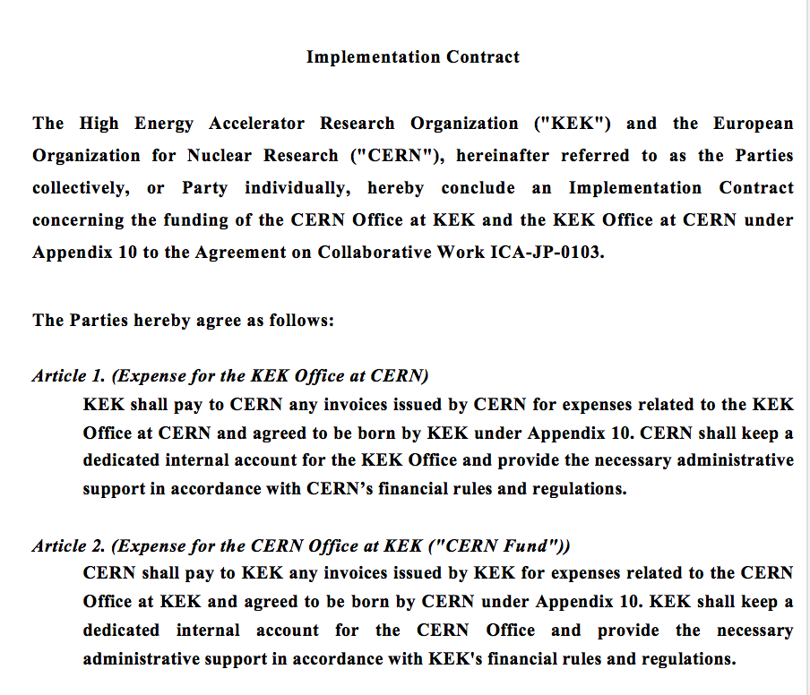
WP 4: Deliverables and Status
CERN-KEK Offices:
  CERN office at KEK: Building 3-403 (not permanently staffed)
  KEK office at CERN: Building 30-6-021 (administrative trainee M. Watanabe half time)
  Agreement between CERN and KEK about the offices, and about procedures to have local operation budgets
  Difficult to use E-JADE to staff office
  Next goal:
    Put scientific staff into office, ~50% of the time managing the visitors, responsible for an upgraded ATF2 effort from CERNs side
    Linked to plans to increase ATF2 effort from CERN’s side
    Will consider similar actions for other work-packages as needed
Notes:
Difficult to use E-JADE to pay locla staff ; rigid rules of E-JADE

Slide 6
WP 4: Deliverables and Status
Industry workshops
  Ideas followed: connect to conference/meeting (as discussions with Spanish Industry in this workshop (Wednesday))
  Possibilities: IEEE November, LC WS in Japan in December, CLIC WS in Spring, IPAC 2017
  Will explore and discuss these ideas during this workshop
Notes:
No resources to organize a workshop, but try to link to existing conferences and workshops,

Slide 7
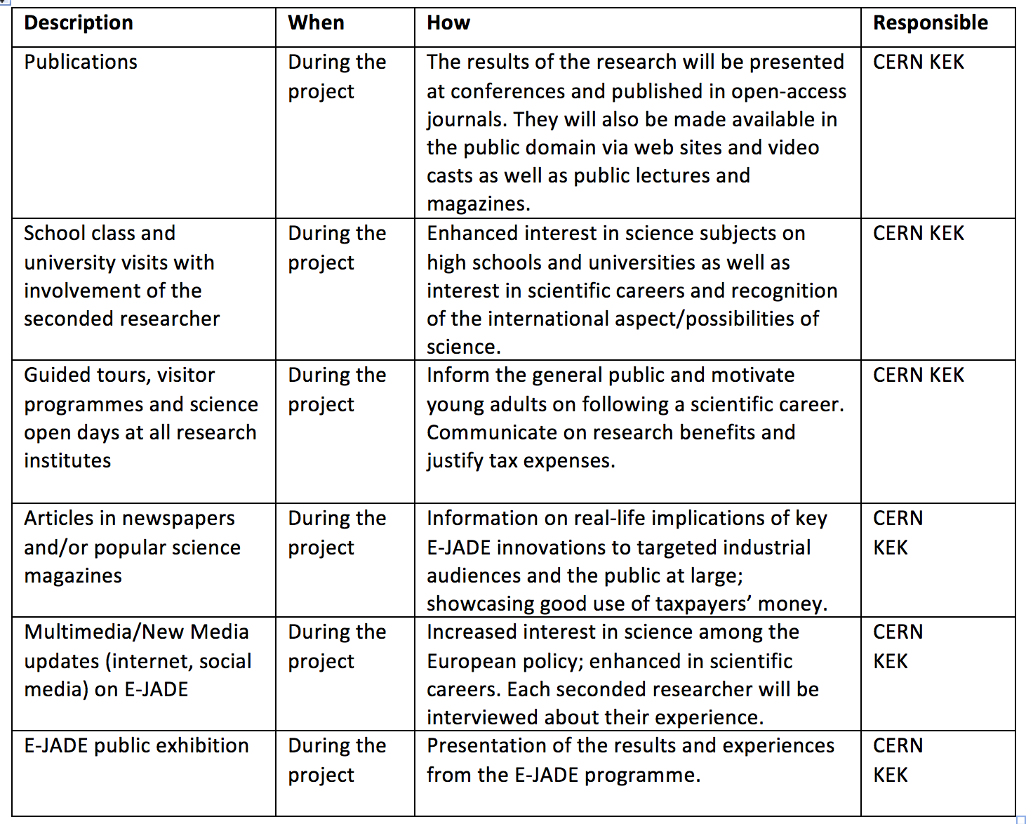
WP 4: Deliverables and Status
Communication plan:
  Draft summer 2015
  Key elements to substantiate
Notes:
Reorgazination of cern communication, took long time, new DG, change of CERN management

Slide 8
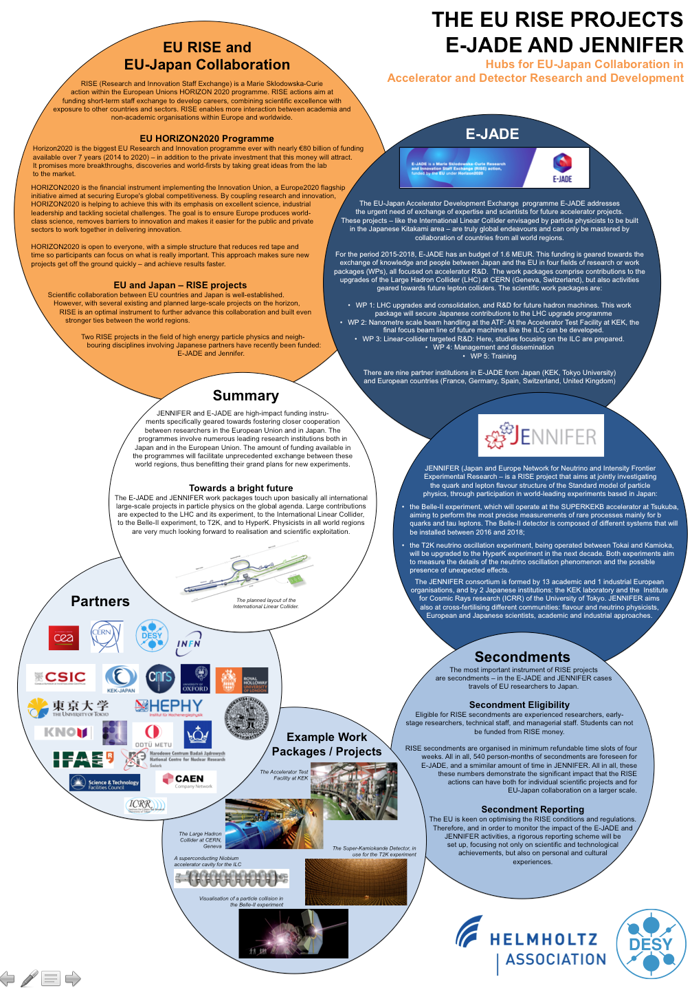
WP 4 - Dissemination
All E-JADE partners use their established PR mechanisms to promote E-JADE
  Newsletters
  Days of open doors/labs
  Other public events
Nice example: Japan Science Agora, Nov 2015
  E-JADE featured prominently
  Planned with KEK together with EU delegation in Tokyo (Leonidas Karapiperis Minister Counsellor, Head of Science and Technology Section)
Notes:
Up to each institutes ; CERN: Article on CERN Bulletin ; this poster translated in Japanese
Leonidas

Slide 9
Key points
First milestones passed on time
Key challenges now:
  Staffing of CERN office at KEK using E-JADE
  Turning communication plan into actions
  Industry workshop (discussed this week) – plan to link to conference/meeting where we add support

Slide 10


Thank you very much for your attention!
Mid-Term Review
This project is funded by the European Union under Grant Agreement no. 645479

