Slide 1

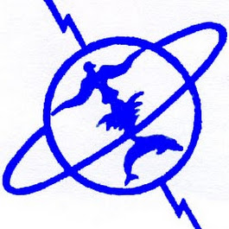
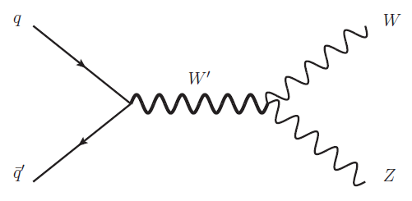
Search for resonant
Mohamed V University
Faculty of Sciences
Rabat
WZ l ν l’l’
S. DAHBI , Y. TAYALATI ( Mohamed V University Rabat)

Slide 2
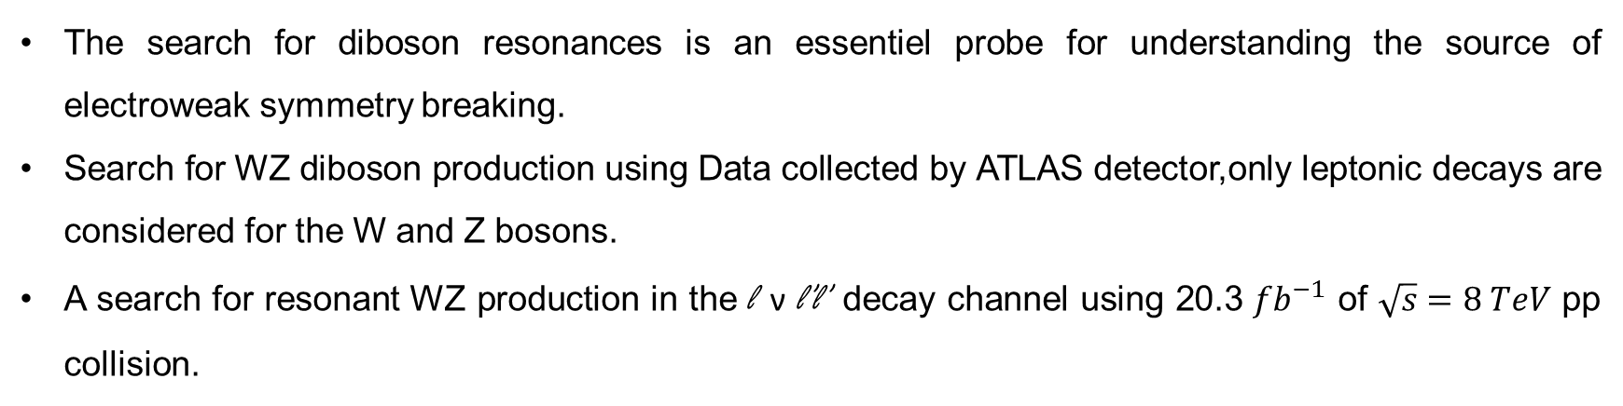
Introduction
The search for diboson resonances is an essentiel probe for understanding the source of electroweak symmetry breaking.
Search for WZ diboson production using Data collected by ATLAS detector,only leptonic decays are considered for the W and Z bosons.
A search for resonant WZ production in the l ν l’l’ decay channel using 20.3 ${fb}^{−1}$ of $\sqrt{s}=8 TeV$ pp collision.

Slide 3
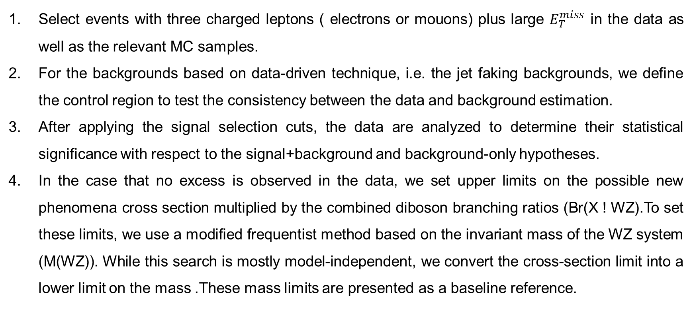
Analysis Strategy
Select events with three charged leptons ( electrons or mouons) plus large $E_{T}^{miss}$ in the data as well as the relevant MC samples.
For the backgrounds based on data-driven technique, i.e. the jet faking backgrounds, we define the control region to test the consistency between the data and background estimation.
After applying the signal selection cuts, the data are analyzed to determine their statistical significance with respect to the signal+background and background-only hypotheses.
In the case that no excess is observed in the data, we set upper limits on the possible new phenomena cross section multiplied by the combined diboson branching ratios (Br(X ! WZ).To set these limits, we use a modified frequentist method based on the invariant mass of the WZ system (M(WZ)). While this search is mostly model-independent, we convert the cross-section limit into a lower limit on the mass .These mass limits are presented as a baseline reference.

Slide 4
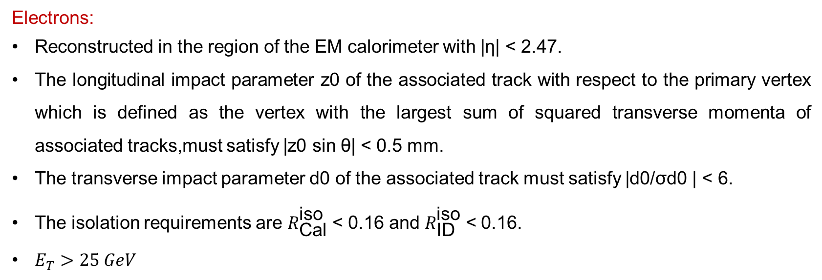
Object reconstruction
Electrons:
Reconstructed in the region of the EM calorimeter with |η| < 2.47.
The longitudinal impact parameter z0 of the associated track with respect to the primary vertex which is defined as the vertex with the largest sum of squared transverse momenta of associated tracks,must satisfy |z0 sin θ| < 0.5 mm.
The transverse impact parameter d0 of the associated track must satisfy |d0/σd0 | < 6.
The isolation requirements are $R_{\text{Cal}}^{\text{iso}}$ < 0.16 and $R_{\text{ID}}^{\text{iso}}$ < 0.16.
$E_{T}>25 GeV$

Slide 5
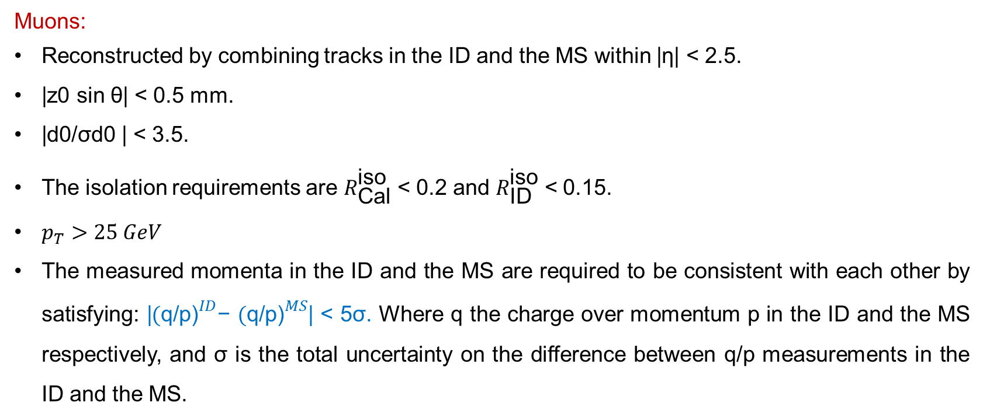
Object reconstruction
Muons:
Reconstructed by combining tracks in the ID and the MS within |η| < 2.5.
|z0 sin θ| < 0.5 mm.
|d0/σd0 | < 3.5.
The isolation requirements are $R_{\text{Cal}}^{\text{iso}}$ < 0.2 and $R_{\text{ID}}^{\text{iso}}$ < 0.15.
$p_{T}>25 GeV$
The measured momenta in the ID and the MS are required to be consistent with each other by satisfying: |${(\text{q}\text{/}\text{p}\text{)}}^{ID}$− ${(\text{q}\text{/}\text{p}\text{)}}^{MS}$| < 5σ. Where q the charge over momentum p in the ID and the MS respectively, and σ is the total uncertainty on the difference between q/p measurements in the ID and the MS.

Slide 6
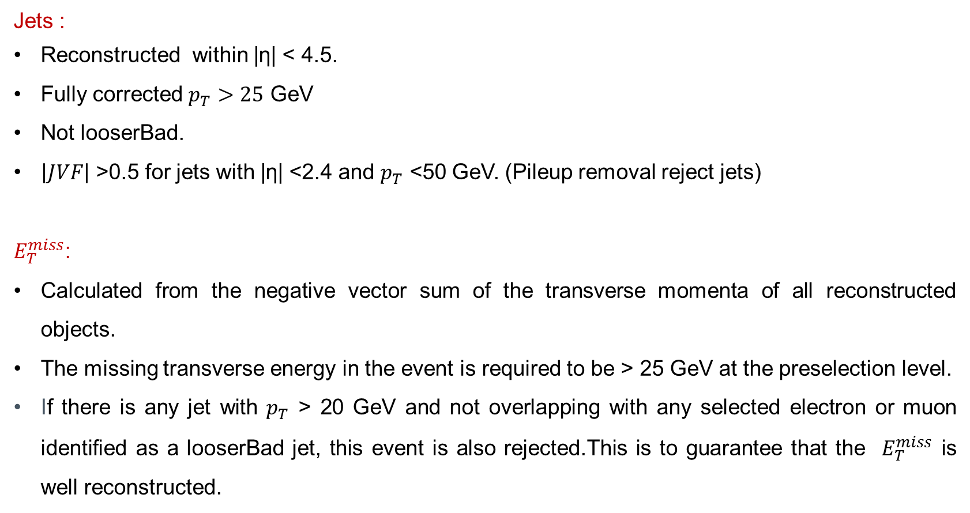
Object reconstruction
Jets :
Reconstructed within |η| < 4.5.
Fully corrected $p_{T}>25$ GeV
Not looserBad.
$\left|JVF\right|$ >0.5 for jets with |η| <2.4 and $p_{T}$ <50 GeV. (Pileup removal reject jets)
$E_{T}^{miss}$:
Calculated from the negative vector sum of the transverse momenta of all reconstructed objects.
The missing transverse energy in the event is required to be > 25 GeV at the preselection level.
If there is any jet with $p_{T}$ > 20 GeV and not overlapping with any selected electron or muon identified as a looserBad jet, this event is also rejected.This is to guarantee that the $E_{T}^{miss}$ is well reconstructed.

Slide 7
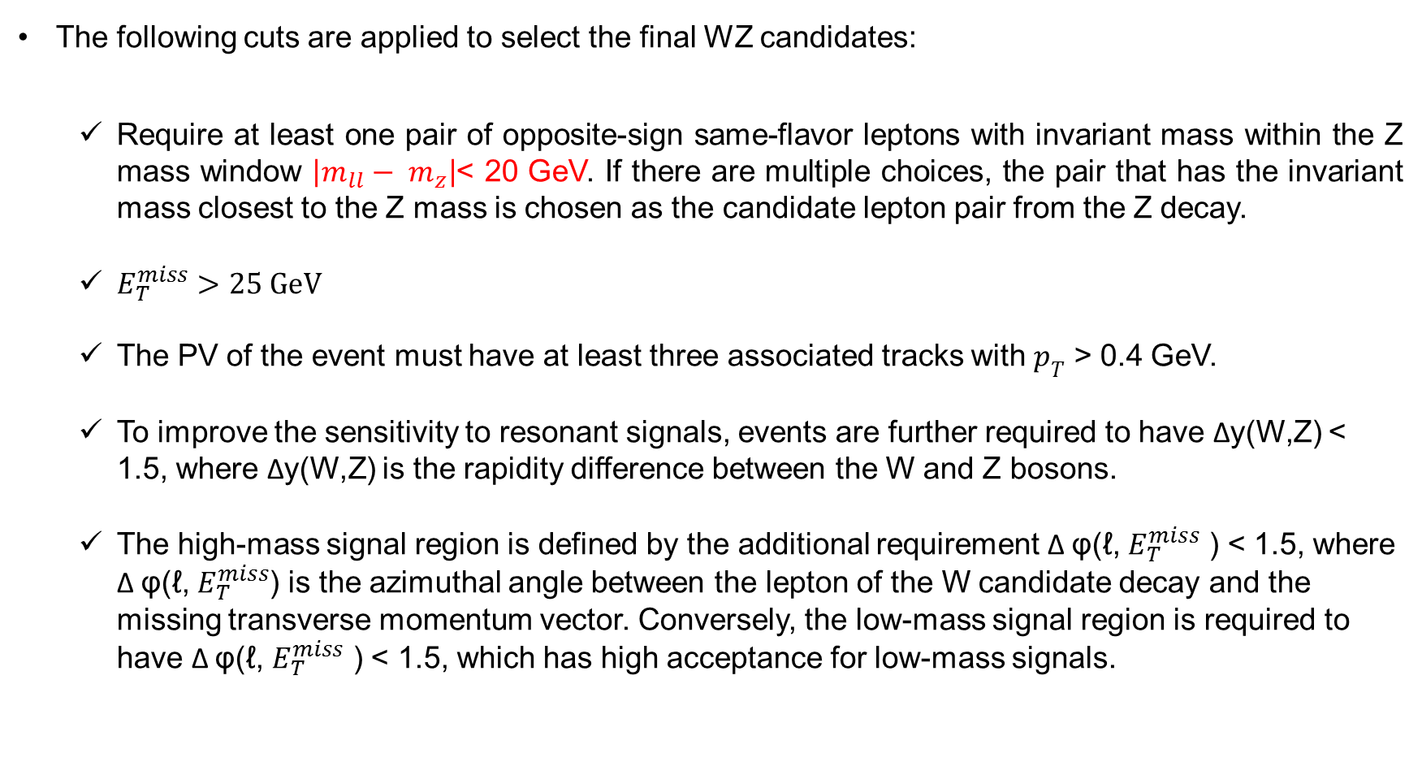
Event selection
The following cuts are applied to select the final WZ candidates:
  Require at least one pair of opposite-sign same-flavor leptons with invariant mass within the Z mass window $\left|m_{ll}− m_{z}\right|$< 20 GeV. If there are multiple choices, the pair that has the invariant mass closest to the Z mass is chosen as the candidate lepton pair from the Z decay.
  $E_{T}^{miss}>25 GeV$
  The PV of the event must have at least three associated tracks with $p_{T}$ > 0.4 GeV.
  To improve the sensitivity to resonant signals, events are further required to have Δy(W,Z) < 1.5, where Δy(W,Z) is the rapidity difference between the W and Z bosons.
  The high-mass signal region is defined by the additional requirement Δ φ(ℓ, $E_{T}^{miss}$ ) < 1.5, where Δ φ(ℓ, $E_{T}^{miss}$) is the azimuthal angle between the lepton of the W candidate decay and the missing transverse momentum vector. Conversely, the low-mass signal region is required to have Δ φ(ℓ, $E_{T}^{miss}$ ) < 1.5, which has high acceptance for low-mass signals.

Slide 8
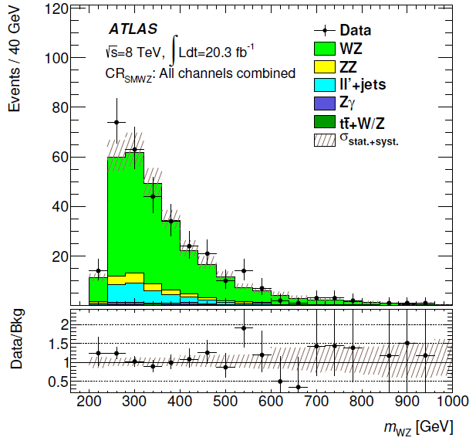
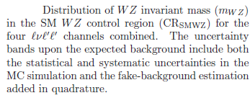
Background Estimation
The background estimation is based on MC simulation for prompt backgrounds (WZ, ZZ, Zγ and tt¯+ V) and data-driven estimates for jet fake backgrounds (ll’+jets(Z+jets, tt¯, Wt, WW), l +jets(W+jets,single top s and t channels), and QCD multijet).

