Slide 1
ATLAS Data Analysis Ontology: ontological representation of investigations
DKB Meeting

Slide 2
PanDA Workshop Apr 21-22 2016 at CERN
Goals of DKB:
  This was in the context of a conversation on whether we can/should work to capture and present the whole process from physicist idea ➡ production intent ➡ production request ➡ production status ➡ completion of the full processing chain ➡ available data
    With ability to drill down within that chain for processing status, data availability, configuration and so on, drawing on content in prodsys, AMI, Rucio etc
Data Sources:
  PanDA/JEDI, DEFT, Rucio, AMI, AGIS, JIRA, googledocs, ...
Currently R&D project, proceed to realistic use cases after a May technical/planning meeting at CERN

Slide 3
CISP: Core Information about Scientific Papers
EXPO: Ontology of scientific experiments
Identifies the main components of scientific investigations
Metadata about the content of scientific papers
CISP classes:
  Goal of Investigation
  Motivation
  Object of investigation
  Research Method
  Experiment
  Observation
  Result
  Conclusion
A very complete ontology about scientific experiments proposed proposed at the University of Wales, Aberystwyth
~200 concepts to allow providing a formal description of experiments for efficient analysis
EXPO classes:
  Experimental design strategy
  Fact
  Field of study
  Procedure
  Variable
  Experimental technology
  Scientific activity
  Hypotesis forming
  Interpreting results

Slide 4
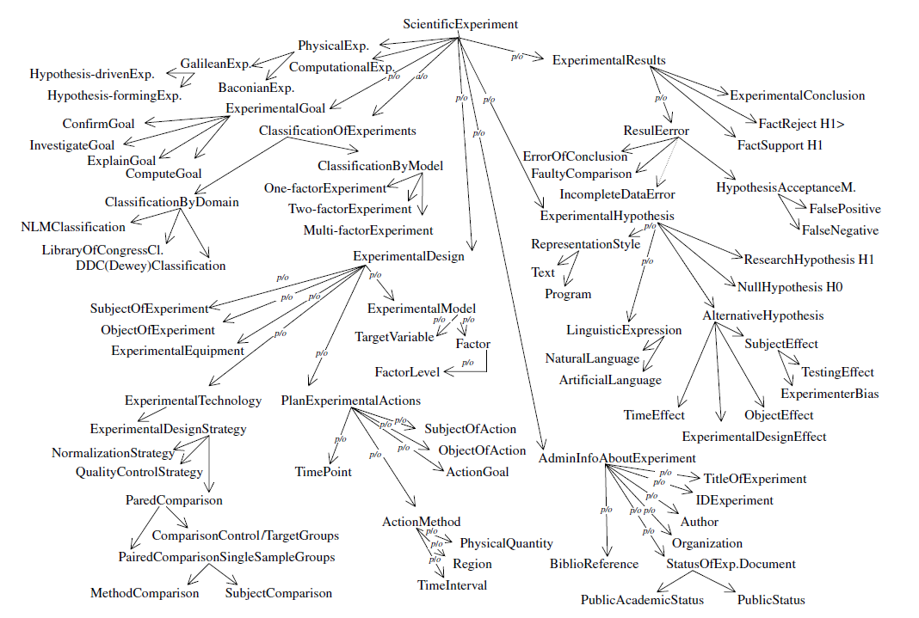
EXPO fragment

Slide 5
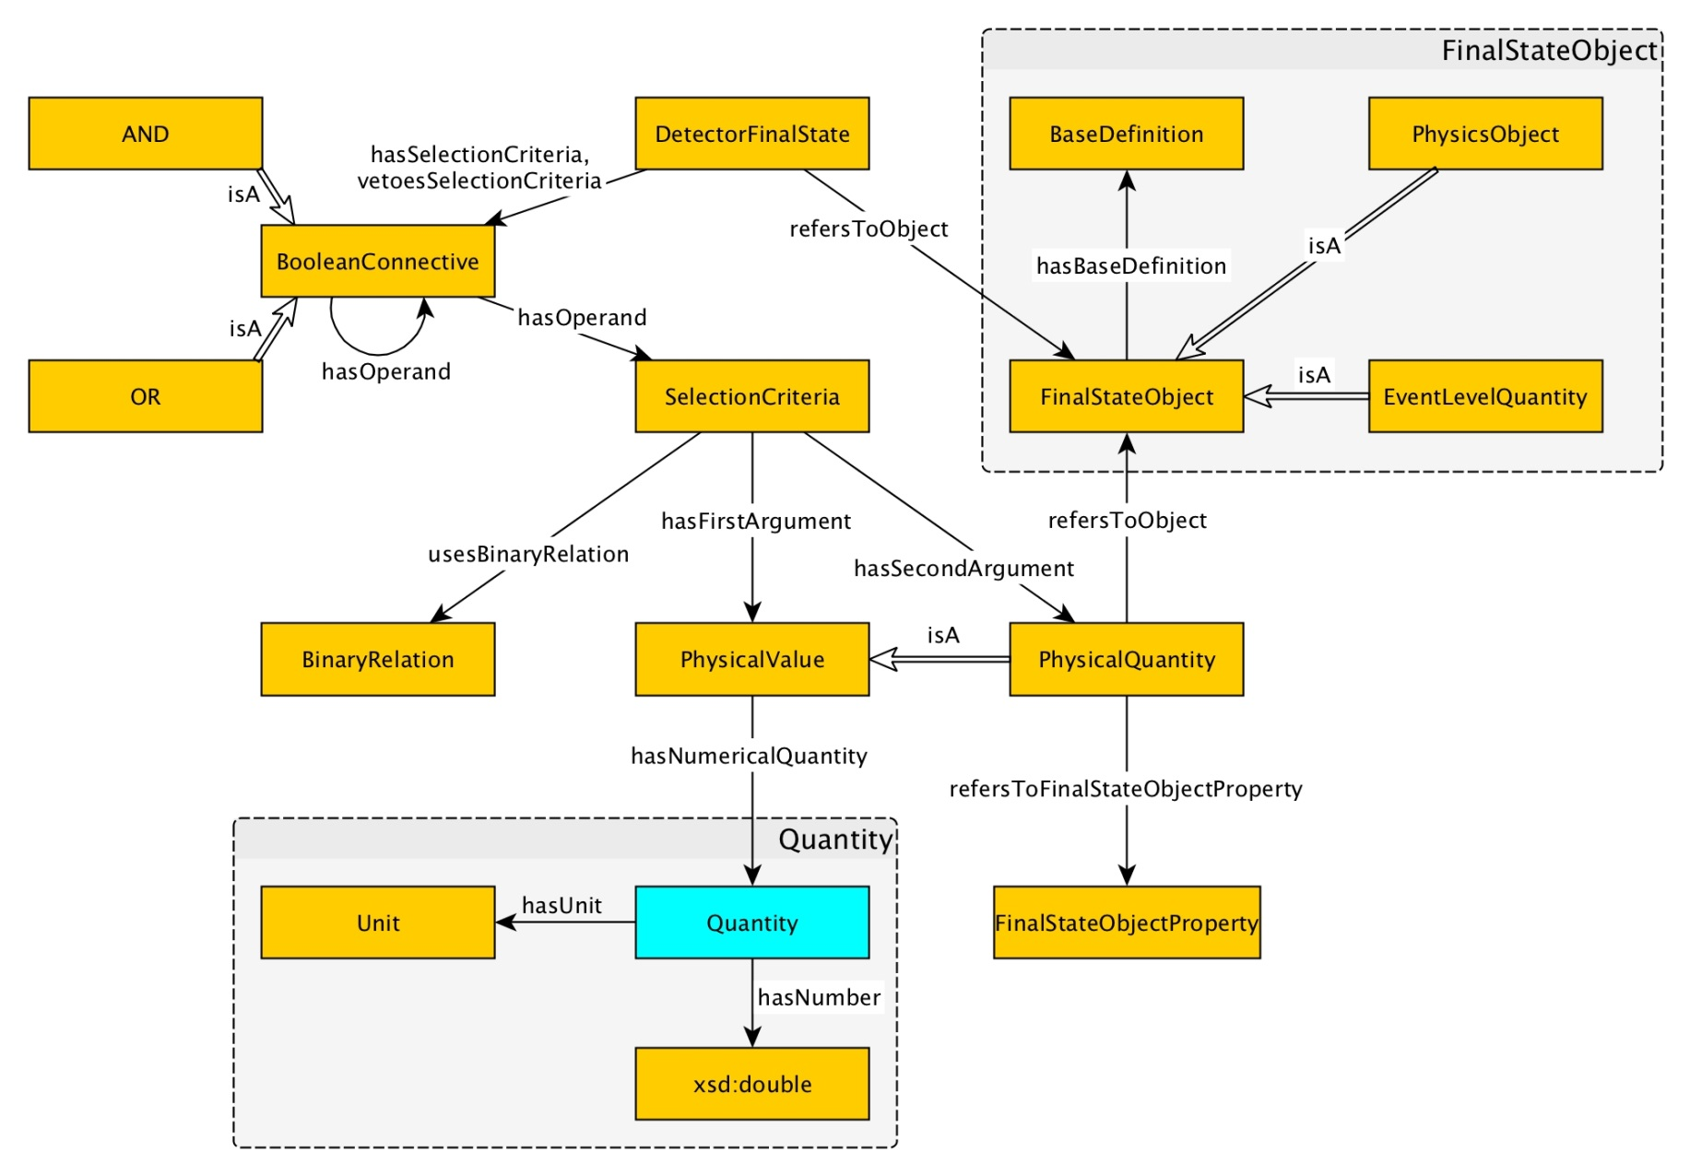
Detector Final State

Slide 6
ATLAS Data Analysis Ontology Classes
Data Analysis Description:
  Data Analysis Unique Identifier [Ref.Code from GLANCE “TOPQ-2016-03”]
  Short Title [“MS dilepton top mass at 8 TeV”]
  Full Title [“Measurement of the Top Quark Mass in the dilepton channel from 8 TeV ATLAS Data”]
  Analysis Team
  Status (active, finished,…)
Experimental model:
  Detector Final State:
    Luminosity [8 TeV, …]
    Energy [20 femtobarn⁻¹, …]
    Data Used [Run 1, Run 2, …]
    Year [YYYY]
    Other parameters
  SW Release
  ATLAS Data Samples
    Monte Carlo data samples
    LHC Data Samples
  Data Processing Chain
    LHC Data Processing
    Monte-Carlo Data Processing
Data analysis is classified by the following categories:
  Physical topics (Standard Model physics, Higgs physics, SUSY, B-physics and light states, Exotics, Top physics, …)
  Physical groups (FTAG, BPHY, REPR, TOPQ, ANALYSIS, Exotics, etc)
  Sub Groups
  Project (mc12_8TeV, mc12_13TeV, data10_7TeV, data11_2p76TeV, …)
  Campaign/subcampaign
  Domain of experiment (NML Classification, Library of Congress, DDC (Dewey) Classification)
Experimental Results
  Publications & Conf Notes

Slide 7
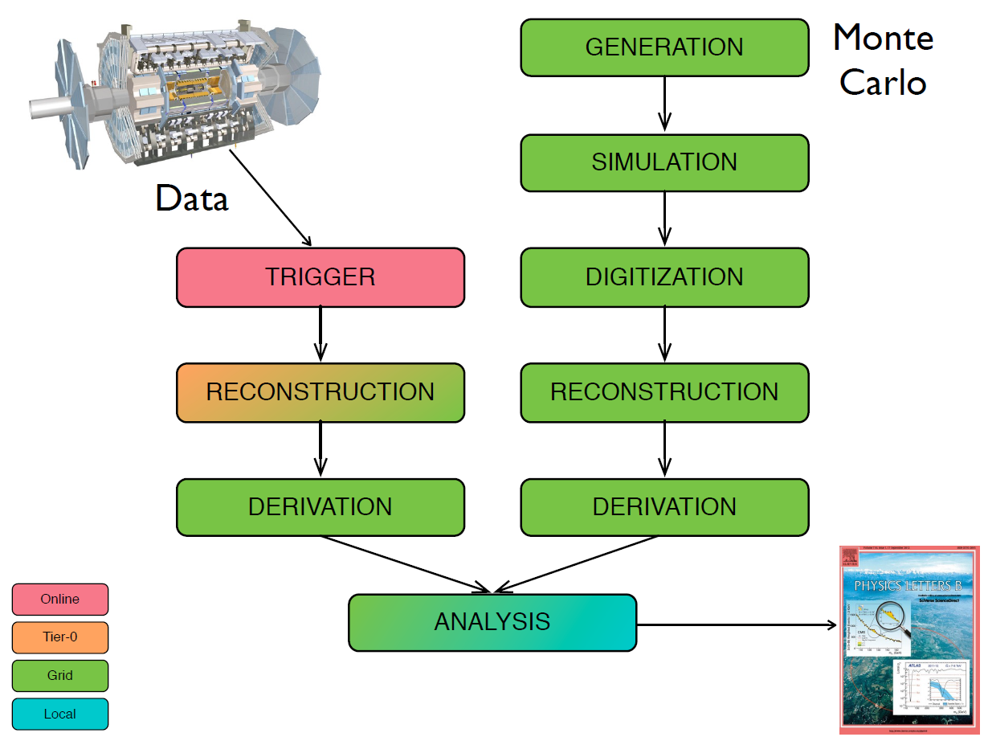
Experimental model
Detector Final State:
  Luminosity
  Energy
  Data Used
SW Release
Data Processing Chain
  LHC Data Processing
    Trigger
    Reconstruction
    Derivation
  Monte-Carlo Data Processing
    Generation
    Simulation
    Digitization
    Reconstruction
    Derivation
We can use DetectorFinalState ontology, proposed in this paper:
http://dase.cs.wright.edu/sites/default/files/WOP2015_pattern_abstract_5.pdf

Slide 8
ATLAS Data Samples
Data Samples attributes:
  Dataset ID
  Dataset type
  Project
  Stream
  Generator
  Data format
  Production step
  Number of files
  Number of events
  Total size
Data formats
  RAW
  ADO
  DADO
  EVNT
  HITS
Dataset types
  Real Data
  Monte Carlo (MC)
Triggers
  The first level trigger (LVL1)
  the second level trigger (LVL2)
  the High Level Trigger (HLT)
Streams
  Muon
  Egamma
  …
Data samples
  Signal
    Production (ggF, VBF, VH, ttH)
    Decay
  Background
    Category (Top, WW, ZV, ZX, Higgs)
    Process (t¯t+ boson, t + boson, WW, ZZ, …)
    Generator (MADGRAPH, POWHEG, SHERPA, Pythia, Pythia8)

