Slide 1
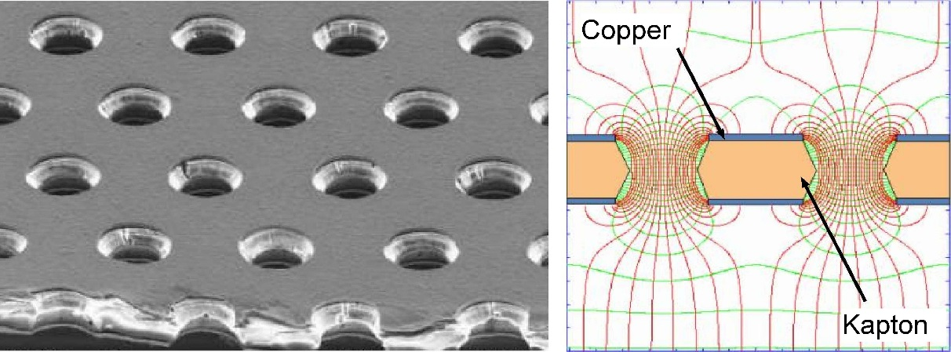
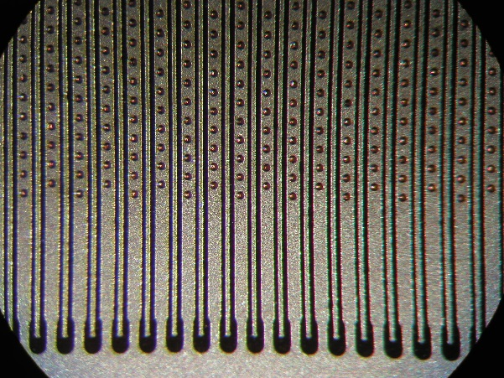
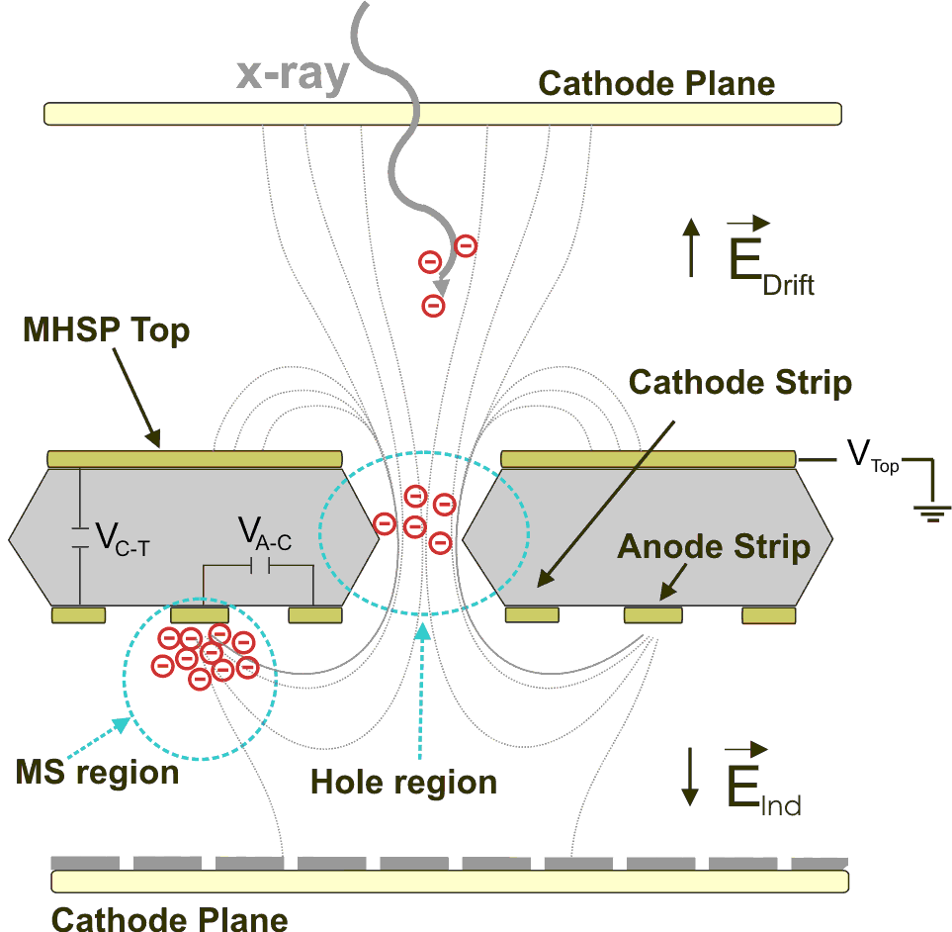
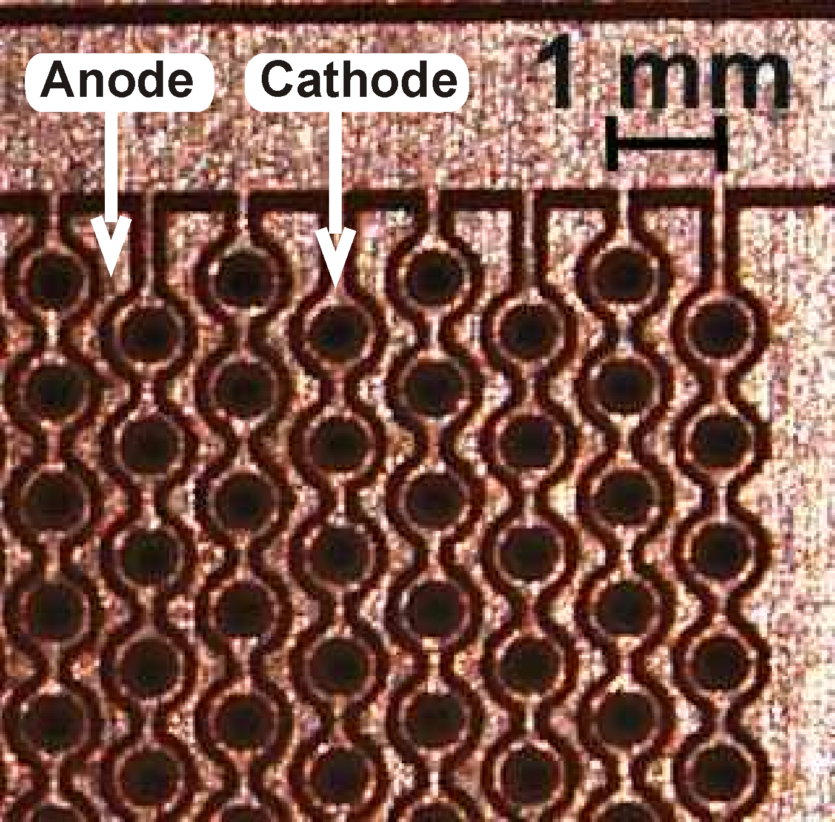
MPGD structures for reducing IBF
Fernando Amaro
LibPhys – Coimbra University
18th RD51 Collaboration Meeting, 12th - 16th of September 2016 Aveiro, Portugal

Slide 2
Ion Back Flow
Gaseous Detectors
High gains (up to 10⁶)
Back flowing ions
(move slowly)
charge build up and field distortion in the drift region (not good for TPC’s, specially high rate)
impact of ions on the surfaces : ions may trigger secondary avalanches and/or damage photocathodes (Gaseous Photomultipliers with visible photocathodes)
IBF is defined as the fraction of ions produced that reaches a region of interest in the detector (usually the drift region)
18th RD51 Collaboration Meeting, 12th - 16th of September 2016 Aveiro, Portugal

Slide 3
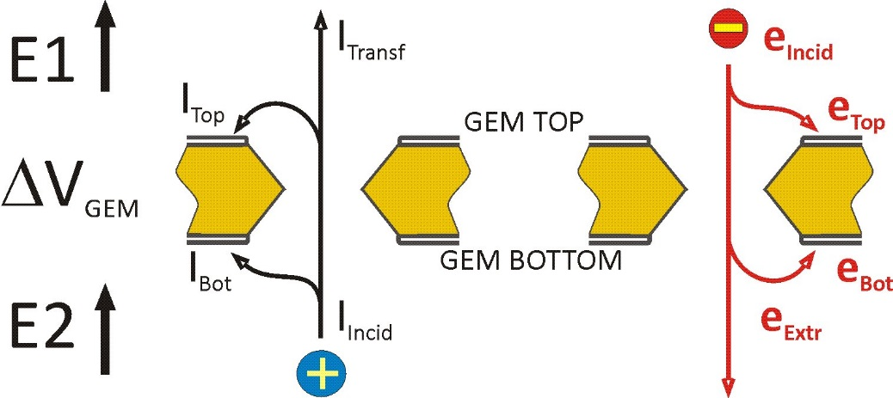
Ion Back Flow
In “open” type detectors (Proportional counters) IBF = 1.
All ions eventually reach the cathode.
A gate is needed! But only works up to a certain rate… noise and instabilities increase.
Micro patterned Gaseous Detectors (GEM, MicroMegas, MHSP, COBRA) are game changers :
IBF is controlled by the electric fields: ΔV_{GEM}, E₁ and E₂.
Cascading several GEM reduces the IBF to values of few %.
18th RD51 Collaboration Meeting, 12th - 16th of September 2016 Aveiro, Portugal

Slide 4
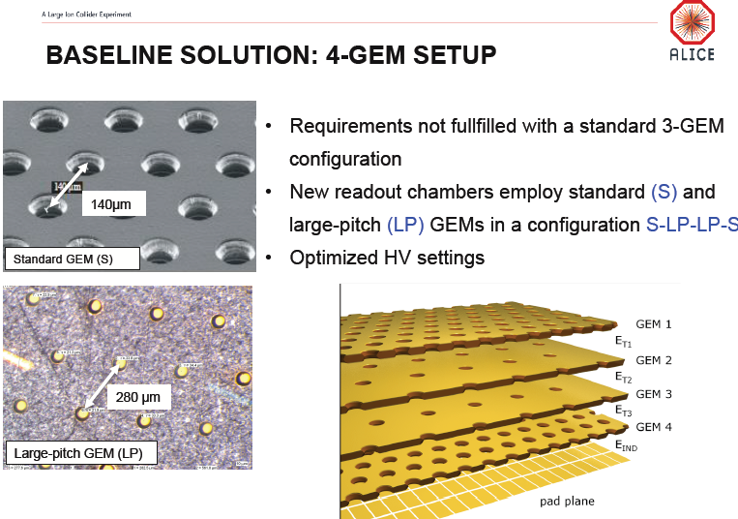
ALICE TPC upgrade
Needs continuous readout (50 kHz)
IBF < 1% at a gain of 2000 (20 ions / primary electron)
Energy Resolution 12% (⁵⁵Fe)
Ne-CO2-N2
Solution was a cascade of 4 GEM with different pitch size
For the future ?
(ILC)
[Piotr Gasik, for the ALICE Collaboration “FROM GATED TO CONTINUOUS READOUT- an upgrade of the ALICE TPC”, VCI 2016]
18th RD51 Collaboration Meeting, 12th - 16th of September 2016 Aveiro, Portugal

Slide 5
Gaseous Photomultipliers
Drift Field is higher than in TPC’s
Photocathode can be damaged by ion impact
Secondary emission from photocathode
IBF increases linearly with drift field
GPM’s require higher drift fields (>0.5 kV/cm) to ensure proper photo-electron extraction
Optimization of IBF is detector/application specific.
[A. Bondar, et al., Study of ion feedback in multi-GEM structures, Nucl. Instr. And Meth. A 496 (2003) 325]
18th RD51 Collaboration Meeting, 12th - 16th of September 2016 Aveiro, Portugal

Slide 6
Alternative Solutions with the Micro Hole and Strip Plate
Reversed/Flipped Reversed MHSP
[J.F.C.A. Veloso, F. D. Amaro, J.M. Maia, A. Breskin, A. Lyashenko, R. Chechik, J.M.F dos Santos, O. Bouianov, M. Bouianov “MHSP in reversed-bias operation mode for ion blocking in gas-avalanche multipliers” Nuclear Instruments and Methods in Physics Research A 548 (2005) 375–382.]
[A. Breskin, D. Mörmann, A. Lyashenko, R. Chechik, F.D. Amaro, J.M. Maia, J.F.C.A. Veloso, J.M.F. dos Santos “Ion-induced effects in GEM & GEM/MHSP gaseous photomultipliers for the UV and the visible spectral range” Nucl. Instrum. Meth. A 553 (2005) 46.]
[A.V. Lyashenko, A. Breskin, R. Chechik, J.F.C.A. Veloso, J.M.F. Dos Santos, F.D. Amaro “Advances in ion back-flow reduction in cascaded gaseous electron multipliers incorporating R-MHSP elements” 2006 JINST 1 P10004]
[A.V. Lyashenko, A. Breskin, R. Chechik, J.F.C.A. Veloso, J.M.F. Dos Santos, F.D. Amaro “Development of high-gain gaseous photomultipliers for the visible spectral range” 2009 JINST 4 P07005.]
[A. Lyashenko, et al. Nuclear Instruments and Methods in Physics Research Section A 610 (2009)] hole - multipliers” 2007 JINST 2 P08004]
[J.F.C.A. Veloso, C. Santos, F. Pereira, C. Azevedo, F.D. Amaro, J.M.F. dos Santos, A. Breskin, R. Chechik “THCOBRA: Ion back flow reduction in patterned THGEM cascades ” Nuclear Instruments and Methods in Physics Research A 639 (2011) 134–136]
Use of the secondary scintillation to propagate the signal in the detector
[J.F.C.A. Veloso, F. D. Amaro, J.M.F dos Santos, A. Breskin, A. Lyashenko, R. Chechik “The Photon-Assisted Cascaded Electron Multiplier: a concept for potential avalanche-ion blocking” JINST 1 P08003]
[F. D. Amaro, J. F. C. A. Veloso, J. M. F. dos Santos, A. Breskin, R. Chechik, A. Lyashenko “The Photon-Assisted Cascaded Electron Multiplier operation in CF4 for ion backflow suppression” IEEE Transactions on Nuclear Science 55-3 (2008) 1652-1656.]
[F. D. Amaro, J. F. C. A. Veloso, J. M. F. dos Santos, A. Breskin, R. Chechik, A. Lyashenko; “High pressure operation of the Photon-Assisted Cascaded Electron Multiplier” IEEE Transactions on Nuclear Science 56-3 (2009) 1097-1101.]
[F. D. Amaro et al. “Zero Ion Backflow electron multiplier operating in noble gases”, 2014_JINST_9_P02004]
18th RD51 Collaboration Meeting, 12th - 16th of September 2016 Aveiro, Portugal

Slide 7
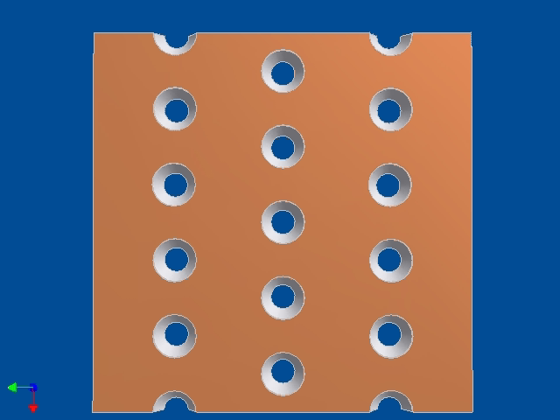
Micro Hole and Strip Plate
Same technology as GEM but with 2 sets of electrodes in one of the sides (the bottom)
Normal mode of operation: the extra strips are used for electron multiplication, resulting in high gains and relatively low operation voltages. V_{T} < V_{C} < V_{A}
[J. F. C. A. Veloso, J. M. F. dos Santos, C. A. N. Conde, "A proposed new microstructure for gás radiation detectors: The microhole and strip plate” Rev. Sci. Instrum. vol. 71 (2000) 2371-2376.]
18th RD51 Collaboration Meeting, 12th - 16th of September 2016 Aveiro, Portugal

Slide 8
Micro Hole and Strip Plate – Reversed mode operation
Same technology as GEM but with 2 sets of electrodes in one of the sides (the bottom)
Reversed mode operation: (for ion trapping) the anodes are at lower potential than the cathodes and are used to trap the back flowing ions. V_{T} < V_{C} > V_{A}
18th RD51 Collaboration Meeting, 12th - 16th of September 2016 Aveiro, Portugal

Slide 9
Micro Hole and Strip Plate – Reversed mode operation
The polarization of the strips was effective in trapping the ions. 2 orders of magnitude reduction was measured.
A large drop on the gain was also recorded. V_{AC} = -140 V (Ar/10% CH₄ at atmospheric pressure)
18th RD51 Collaboration Meeting, 12th - 16th of September 2016 Aveiro, Portugal

Slide 10
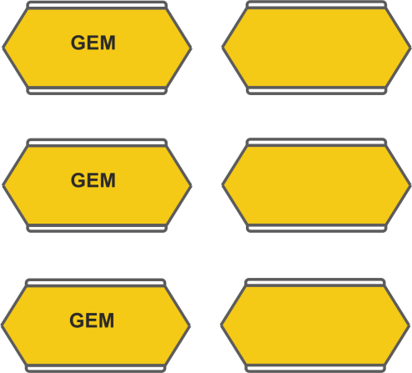
Micro Hole and Strip Plate – Reversed mode operation
Standard Cascaded Electron Multiplier
Electric Field Optimization
IBF = 0.5% at a gain of 10⁴.
50 ions/primary electron
18th RD51 Collaboration Meeting, 12th - 16th of September 2016 Aveiro, Portugal

Slide 11
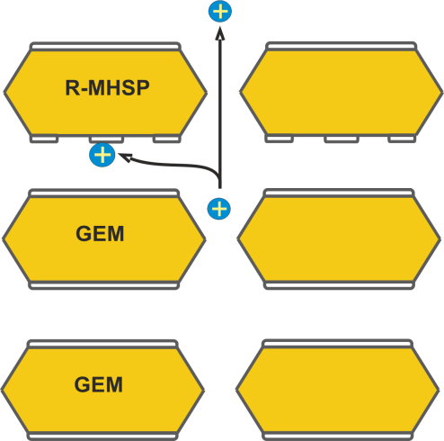
Micro Hole and Strip Plate – Reversed mode operation
Ar/CH4
Standard Cascaded Electron Multiplier
“Reversed” MHSP
Electric Field Optimization
IBF = 0.5% at a gain of 10⁴.
50 ions/primary electron
Trapping of ions at the strips of the MHSP
IBF = 0.06% at a gain of 10⁴.
6 ions/primary electron
IBF is dependent on gain
18th RD51 Collaboration Meeting, 12th - 16th of September 2016 Aveiro, Portugal

Slide 12
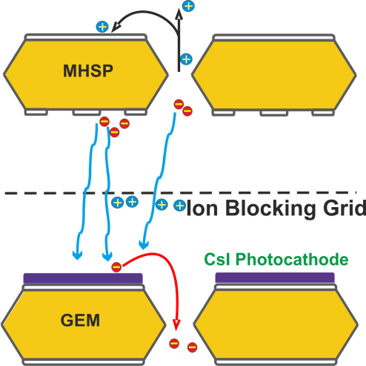
The Photon Assisted Cascaded Electron Multiplier
Ar/CH4
Noble gases and CF₄
Standard Cascaded Electron Multiplier
“Reversed” MHSP
PACEM
Electric Field Optimization
IBF = 0.5% at a gain of 10⁴.
50 ions/primary electron
Trapping of ions at the strips on the MHSP
IBF = 0.06% at a gain of 10⁴.
6 ions/primary electron
Secondary scintillation emitted by the MHSP
propagates the signal in the cascade
IBF independent on GAIN
2 ions/primary electron (CF₄)
18th RD51 Collaboration Meeting, 12th - 16th of September 2016 Aveiro, Portugal

Slide 13
The Photon Assisted Cascaded Electron Multiplier
Ar/CH4
Noble gases and CF₄
IBF is no longer dependent on gain
The gain bellow the Ion Blocking Grid can be increased without any influence of the total IBF
Standard Cascaded Electron Multiplier
“Reversed” MHSP
PACEM
Only the first stage contributes to the IBF
Focus is now on minimizing the IBF of the first stage while maximizing the optical gain
Electric Field Optimization
IBF = 0.5% at a gain of 10⁴.
50 ions/primary electron
Trapping of ions at the strips on the MHSP
IBF = 0.06% at a gain of 10⁴.
6 ions/primary electron
Secondary scintillation emitted by the MHSP
propagates the signal in the cascade
IBF independent on GAIN
2 ions/primary electron (CF₄)
Voltages do not increase along the cascade: the ion blocking grid is at ground.
18th RD51 Collaboration Meeting, 12th - 16th of September 2016 Aveiro, Portugal

Slide 14
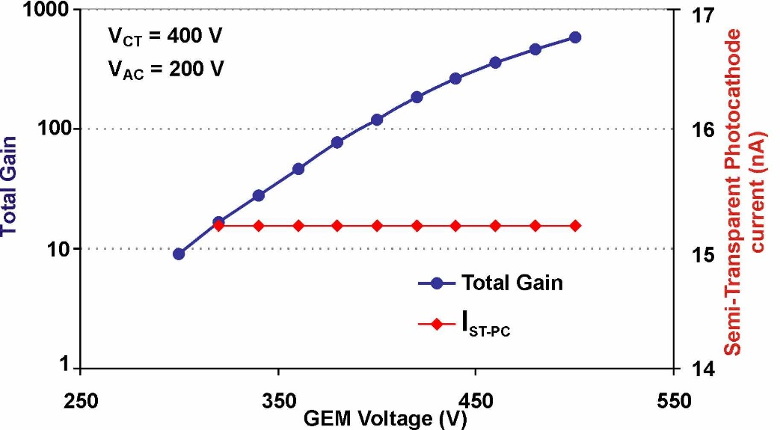
The Photon Assisted Cascaded Electron Multiplier
The second stage can be composed by any kind of gaseous electron multiplier (GEM, GEM cascade, MHSP, COBRA)
IBF and gain are independent!
PACEM with 2 MHSP : Voltages on top MHSP are the same as on the bottom.
No loss of information between stages.
18th RD51 Collaboration Meeting, 12th - 16th of September 2016 Aveiro, Portugal

Slide 15
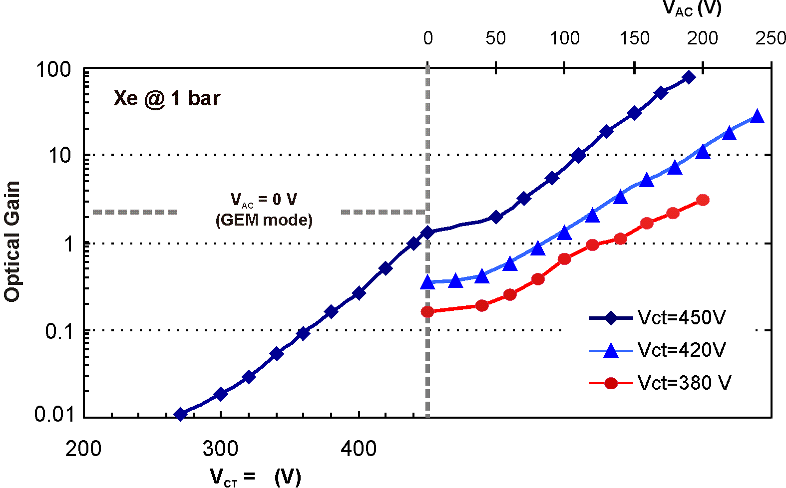
The Photon Assisted Cascaded Electron Multiplier
Xenon
7 ions per primary electron at an optical gain of 10 (3x3 cm² photocathode). E_{Drift} = 0.5 kV/cm
2 ions per primary electron at an optical gain of 10 (3x3 cm² photocathode). E_{Drift} = 0.1 kV/cm
Polarization of the strips leads to an optical gain increase by 2 orders of magnitude
18th RD51 Collaboration Meeting, 12th - 16th of September 2016 Aveiro, Portugal

Slide 16
The Photon Assisted Cascaded Electron Multiplier
CF4
2 ions per primary electron at an optical gain of 10 (3x3 cm² photocathode). E_{Drift} = 0.1 kV/cm
12 ions per primary electron at an optical gain of 10 (3x3 cm² photocathode). E_{Drift} = 0.5 kV/cm
18th RD51 Collaboration Meeting, 12th - 16th of September 2016 Aveiro, Portugal

Slide 17
The Photon Assisted Cascaded Electron Multiplier
Xe - CF₄ mixtures
2 ions per primary electron at an optical gain of 10 (3x3 cm² photocathode). E_{Drift} = 0.1 kV/cm
18th RD51 Collaboration Meeting, 12th - 16th of September 2016 Aveiro, Portugal

Slide 18
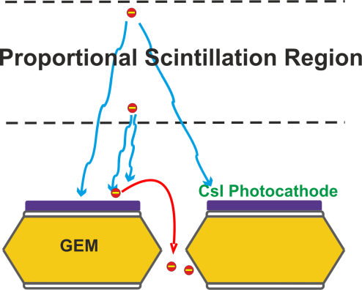
Zero Ion Back Flow
Ar/CH4
Noble gases and CF₄
Noble gases
Standard Cascaded Electron Multiplier
“Reversed” MHSP
PACEM
ZERO IBF
Electric Field Optimization
IBF = 0.5% at a gain of 10⁴.
50 ions/primary electron
Trapping of ions at the strips on the MHSP
IBF = 0.06% at a gain of 10⁴.
6 ions/primary electron
Use of secondary scintillation on MHSP
To propagate the signal
IBF independent on GAIN
2 ions/primary electron
NO ions produced in the proportional scintillation region
0 ions/primary electron
(only primary ionization)
18th RD51 Collaboration Meeting, 12th - 16th of September 2016 Aveiro, Portugal

Slide 19
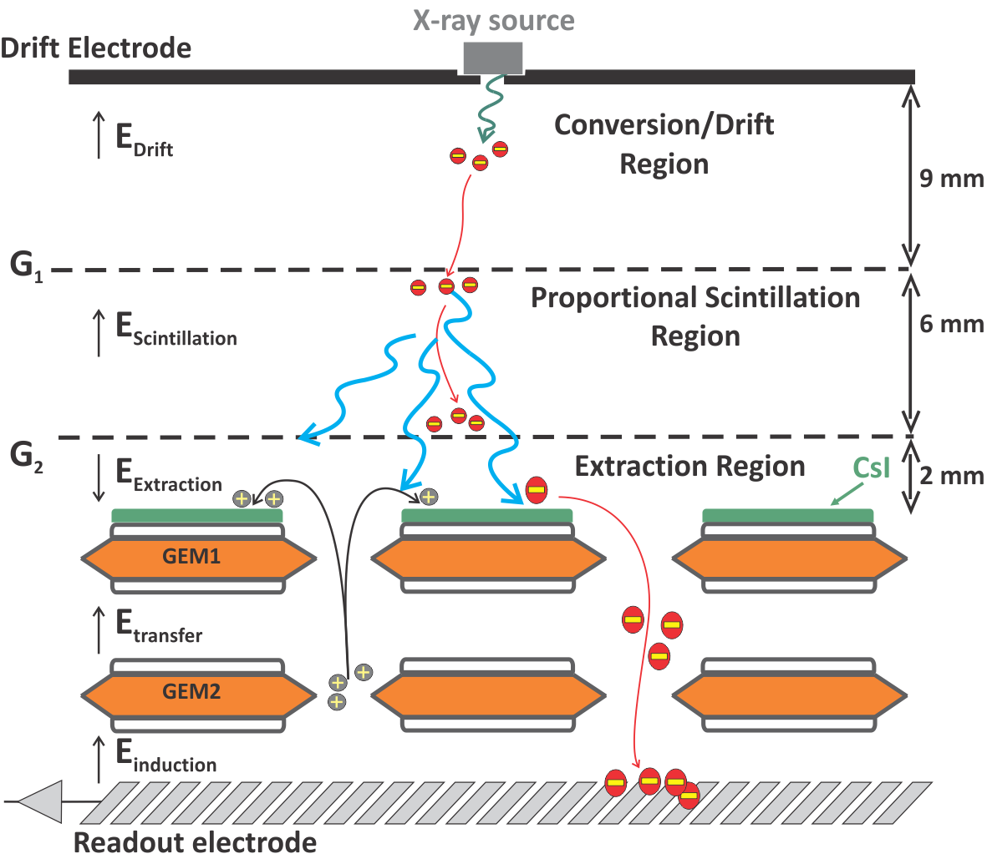
Zero Ion Back Flow
Proportional scintillation region:
Primary electron cloud drifts under an electric field below the threshold for ionization. No secondary charges are created. Secondary scintillation is produced and emitted isotropically.
Gaseous Photomultiplier:
Collects a fraction of the secondary scintillation.
Only the primary ions are present on the conversion region. The primary electron cloud is amplified and no secondary ions return to the conversion region.
18th RD51 Collaboration Meeting, 12th - 16th of September 2016 Aveiro, Portugal

Slide 20
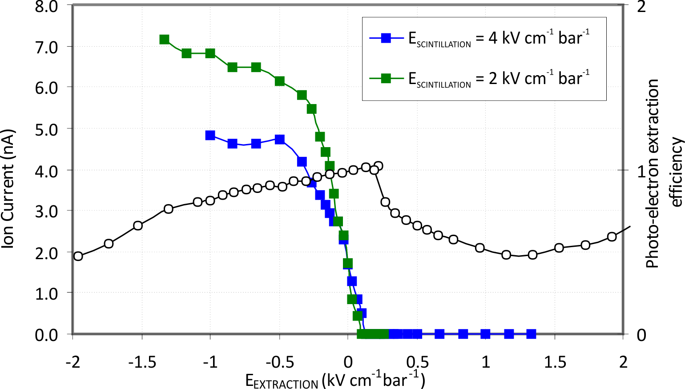
Zero Ion Back Flow
Extraction field plays a critical part on ion back flow suppression as well as in photo-electron extraction
18th RD51 Collaboration Meeting, 12th - 16th of September 2016 Aveiro, Portugal

Slide 21
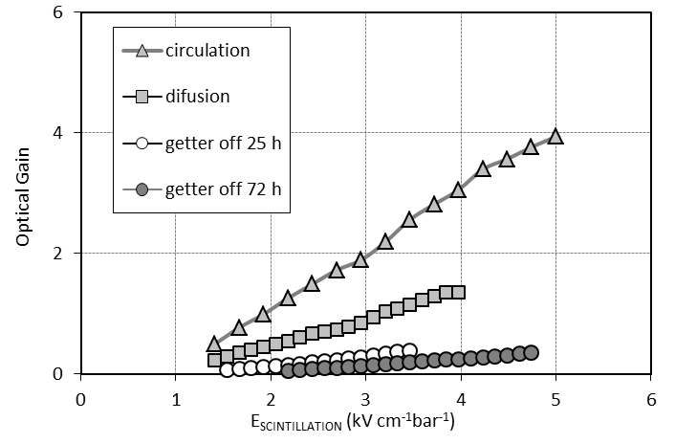
Zero Ion Back Flow
The optical gain is strongly dependent on the gas purity.
Detector was operated in sealed mode, with the purification done by circulating the gas through non-evaporable getters.
Some geometrical factors that influence the optical gain:
  proportional scintillation region size (current setup was 6 mm). Increase to 10 mm would increase the optical gain from 4 to ~ 6
  Larger solid angle (photocathode area was was 28x28 mm²)
18th RD51 Collaboration Meeting, 12th - 16th of September 2016 Aveiro, Portugal

Slide 22
Conclusions
The presence of ions is an inevitability in gaseous detectors. The higher the gain and rate, the more problematic they become.
MPGD provides us several solutions to decrease the IBF to acceptable values.
 | GEM Cascade | Reversed MHSP | PACEM | ZERO IBF
Current Status | 4 GEM - ALICE upgrade | . Successful operation of Visible Sensitive GPM | Novel Solution | Operation in noble gases and Mixtures
Strengths | GEM are solid and well established technology | Extra strips makes it versatile | . Gain can be increased without affecting IBF . Low Voltages | IBF at the level of the primary ionization
Limitations | . IBF dependent on GAIN | . IBF dependent on GAIN . Not yet produced in large areas | Noble gases/CF4 mixtures (purification) | Noble Gases (purification)
Future Developments | Misalignment / different pitch GEM | Large Area MHSP | Double PACEM (?) | Test beam
18th RD51 Collaboration Meeting, 12th - 16th of September 2016 Aveiro, Portugal

