Slide 1
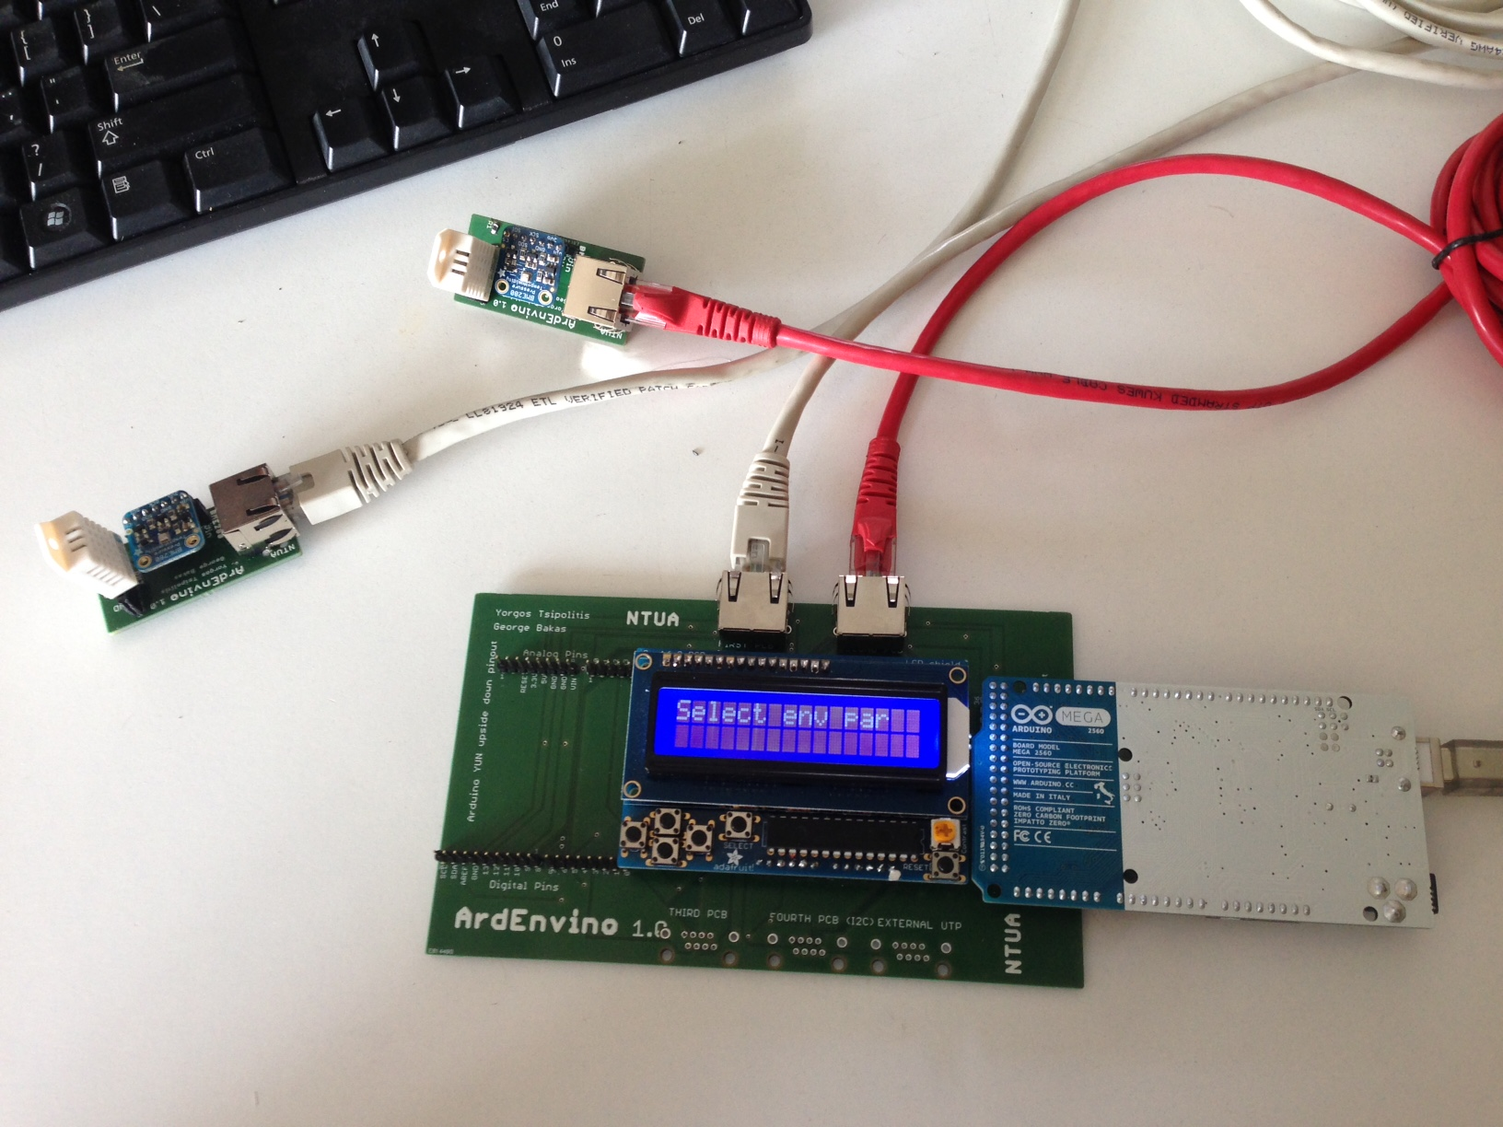
National Technical University of Athens
DEVELOPMENT OF MEASURING SYSTEM FOR ENVIRONMENTAL CONDITIONS BASED ON ARDUINO YUN/MEGA AND WIN_CC OA
George Bakas
Giannis Papakrivopoulos
Yorgos Tsipolitis

Slide 2
Introduction
Arduino
Sensors
OPC Server
WinCC_OA
Conclusions

Slide 3
Introduction
The project aims to develop a low cost system, capable of measuring the environmental parameters using commercial sensors
The Arduinos Mega and Yun microcontrollers were used
WinCC_OA was used for data monitoring and elaboration
Integration of the system into the RD51 SLow Control SYstem

Slide 4
Arduino
Microcontroller → Input and Output pins
Variety of Arduino Boards (Mega, YUN, etc)
Arduino Mega:
  54 digital pins
  16 analog pins
  USB port , power jack
  5,5V , 3.3V GND
  The Arduino Mega → used with Ethernet Shield
  Ethernet shield: allows to connect with Internet via RJ45 connection

Slide 5
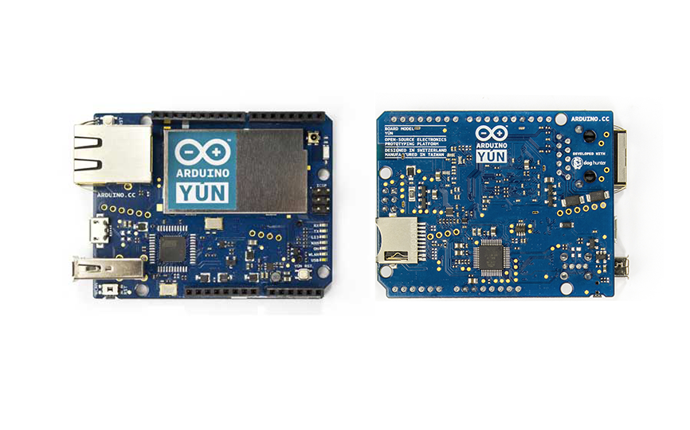
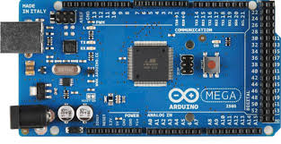
Arduino
Arduino Yun:
  13 digital pins
  6 analog pins
  USB and micro USB connection
  WiFi and Ethernet connectivity
Arduino YUN
Arduino Mega

Slide 6
Sensors
Total of 5 sensors was used
  1 Digital Temperature, Humidity and Pressure Sensor
  (BME280)
  2 Digital Temperature and Pressure Sensors (BMP085, MPL3115A2)
  1 Analog Pressure Sensor (MPX5700AP)
  1 Digital Temperature and Humidity Sensor (DHT22)

Slide 7
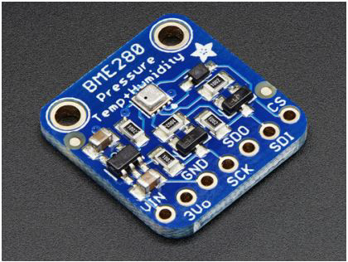
BME280 Sensor
Digital Sensor: Pressure, Temperature and Humidity
High Precision: Temperature±0,5 C, Pressure ±10 Pa , Humidity ±2%
Low Cost: ~14 Euros/ sensor
Communication via I²C Protocol and SPI

Slide 8
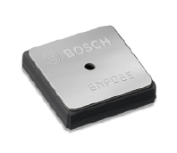
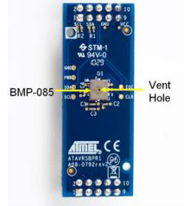
BMP085 Sensor
Digital Sensor: Pressure and Temperature
High Precision: Pressure ±1 mbar, Temperature ± 1 ⁰c
Communication via I²C protocol
Here we used the Atmel AVR4201 board

Slide 9
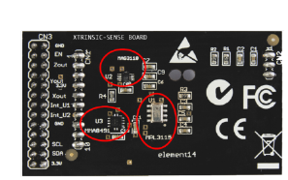
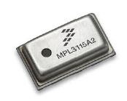
MPL3115A2 Sensor
Digital sensor pressure and temperature
High Precision: Pressure ±4 mbar, Temperature ± 1 ⁰c
Communication via I²C protocol
Here we used the Xtrinsic Sensor Board by Element14

Slide 10
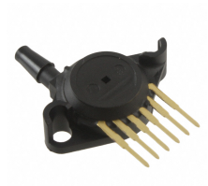
MPX5700AP
Analog Pressure Sensor
Accuracy: ±2,5% V_{FSS}
5v Operating voltage
Transfer function, conversion voltage
to pressure

Slide 11
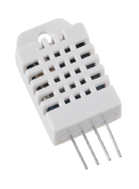
DHT22 Sensor
Digital Temperature and Humidity Sensor (also analog connection)
High Precision: Temperature: ±0,5 ⁰C , Humidity: ±2%
Long-term stability, long transmission
distance
5V Power Supply

Slide 12
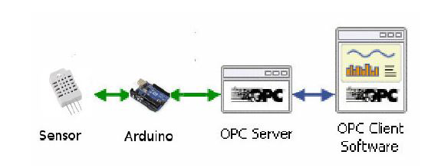
OPC Protocol
Open Platform Communication (Server/Client)
OPC DA → read and write data in real time
Ability to use multiple Arduino boards of any type simultaneously
Serial, Wifi and Ethernet Communication
Communication with Arduino via OPC.h library

Slide 13
WinCC_OA
SCADA (Supervising Control and Data Acquisition)
A tool for the development of control system:
  Database
  GEDI (Graphics Editor)
  Control Scripts
  Connection with Hardware devices (OPC)
  JCOP (Joint Controls Project) framework

Slide 14
Conclusions for Arduino/Sensors
DHT22 sensor used for relative measurements
BME280 used at last as a main sensor for the project
  Pressure, Temperature, Humidity data given by 1 sensor
  Low cost and easy connection with Arduino (digital and I²C)
Final 2 Configurations
  Arduino YUN: using WiFi connection
  Arduino Mega: using Ethernet connection
Arduino YUN memory very small ➔ limited abilities

Slide 15
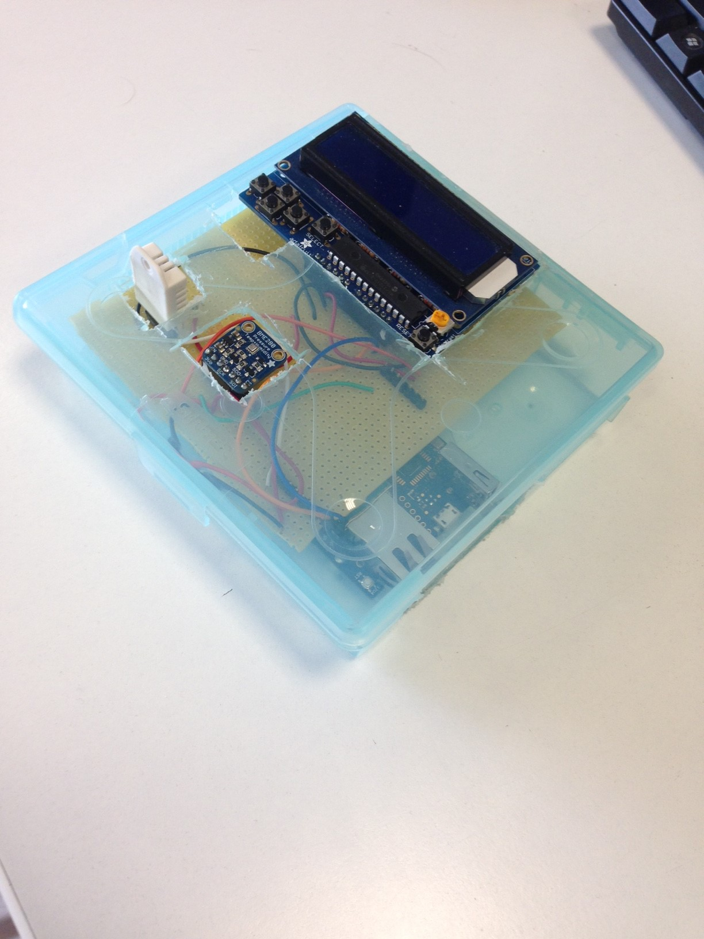
Data 5/2016 during test beam
Arduino YUN
LCD Screen
BME280
DHT22

Slide 16
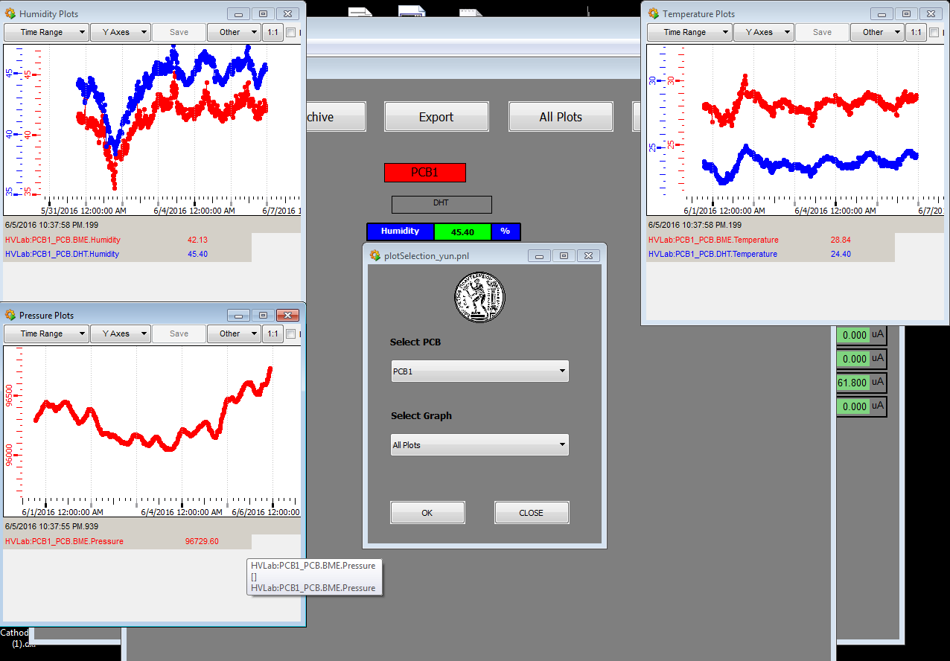
WinCC_OA Panels Online

Slide 17
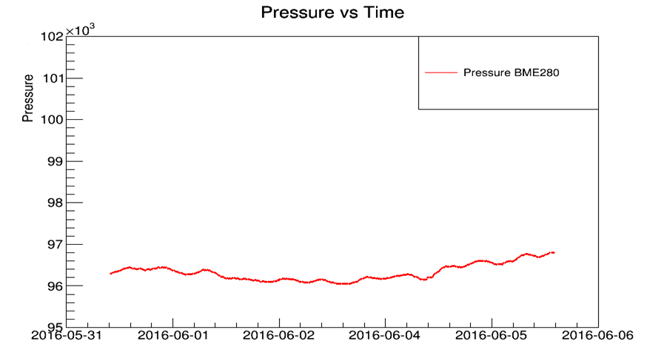
Data offline during May/June TB

Slide 18
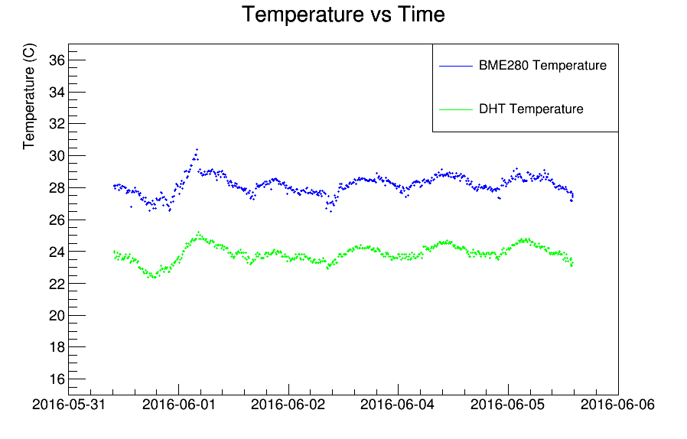
Data offline during May/June TB

Slide 19
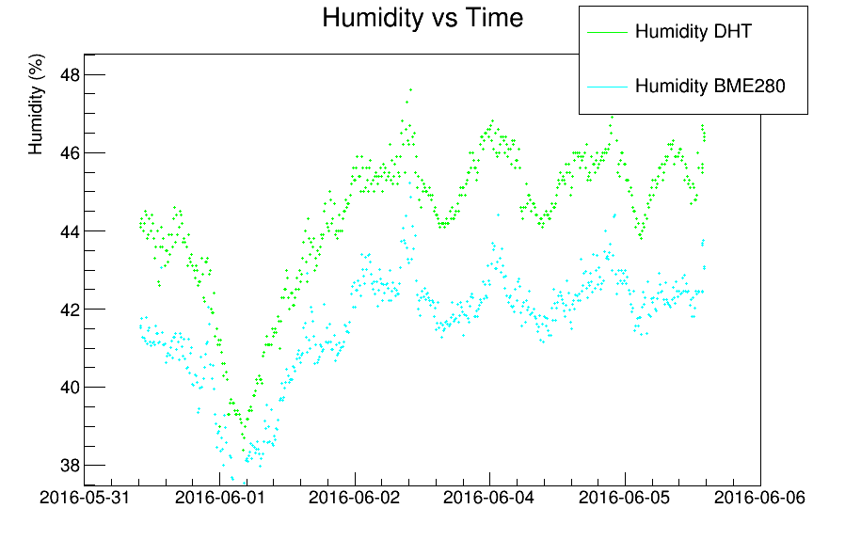
Data offline during May/June TB

Slide 20
Printed Circuit Board
The 2 boards were designed with EAGLE by Cadsoft
2 Boards used:
  ArdEnvino Main Board equipped with
    Pins for Aruino Mega or YUN Connection
    Pins for LCD Screen
    4 RJ45 adaptors that connect with smaller boards (sensor boards) and 1 RJ45 for external connection
  ArdEnvino sensor board equipped with
    1 BME280 Sensor (Temperature, Pressure, Humidity)
    1 DHT22 Sensor (Temperature, Humidity)
    1 RJ45 Adaptor so that the sensor board is connected to the main board

Slide 21
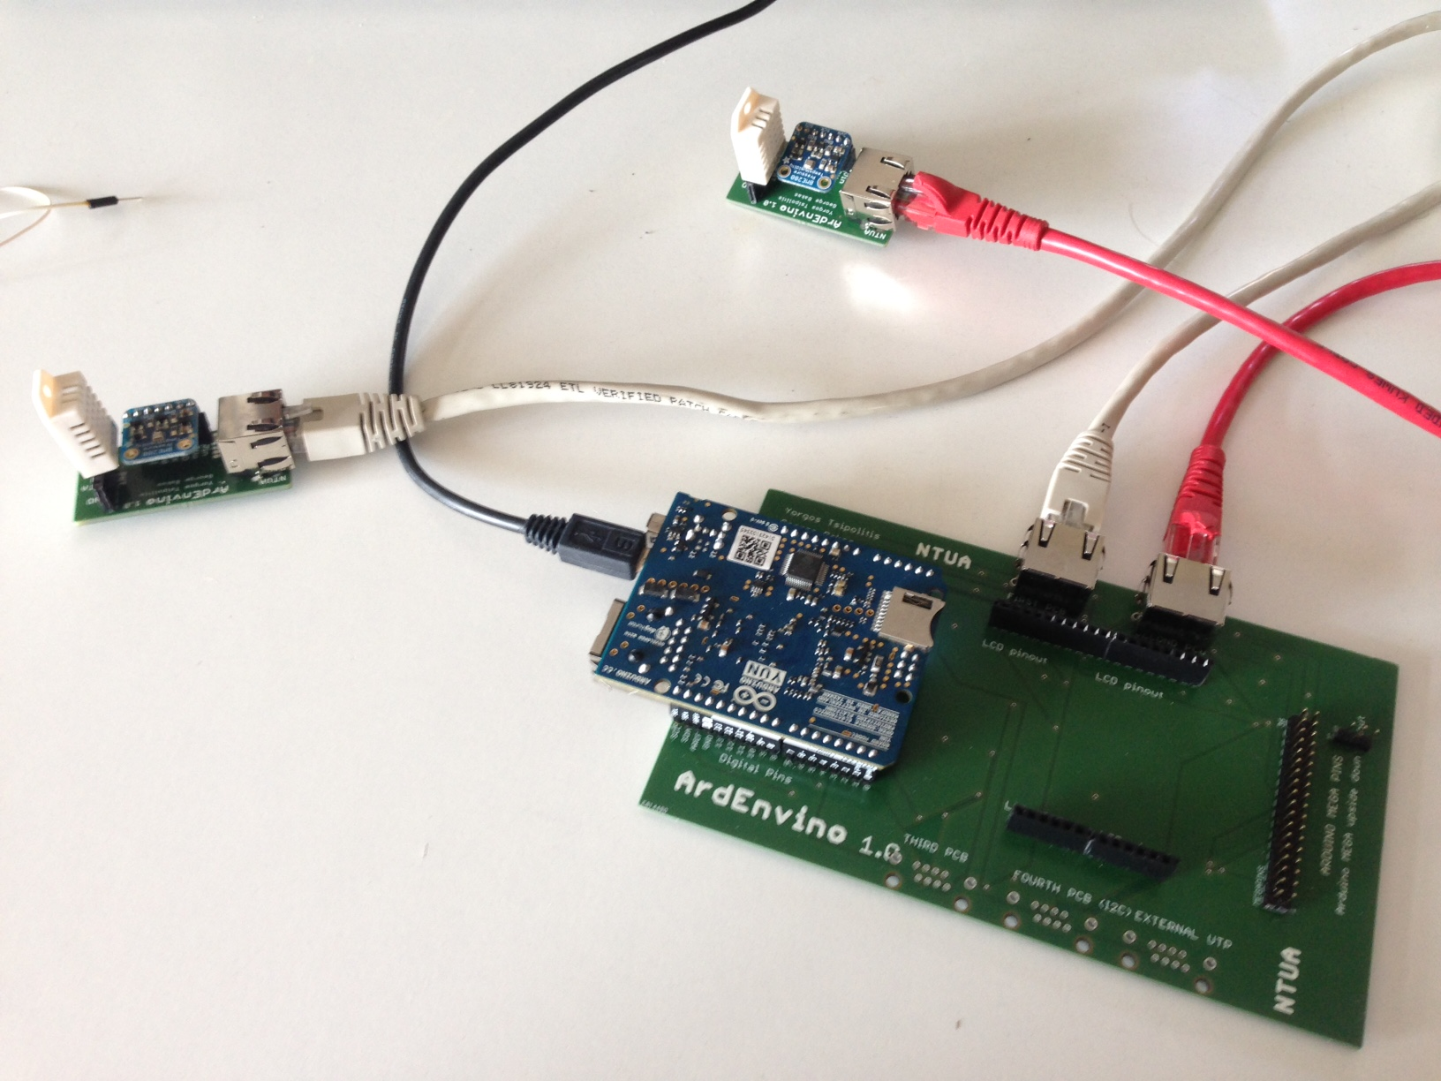
ArdEnvino

Slide 22
ArdEnvino

Slide 23
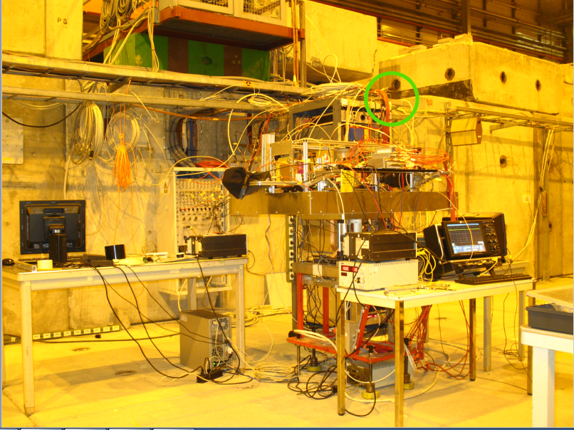

Slide 24
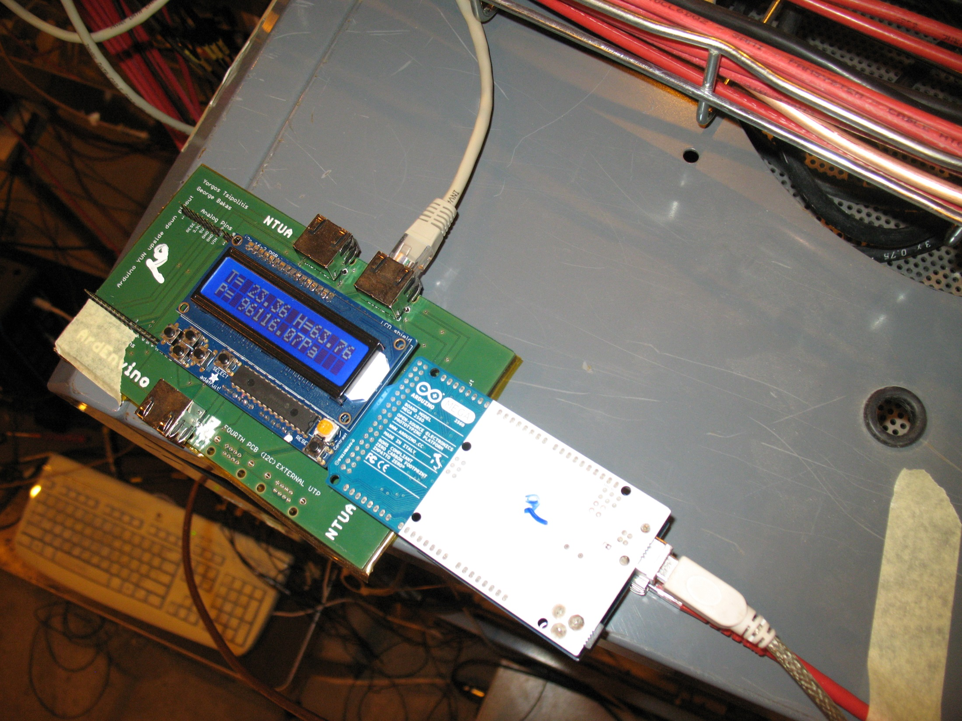

Slide 25
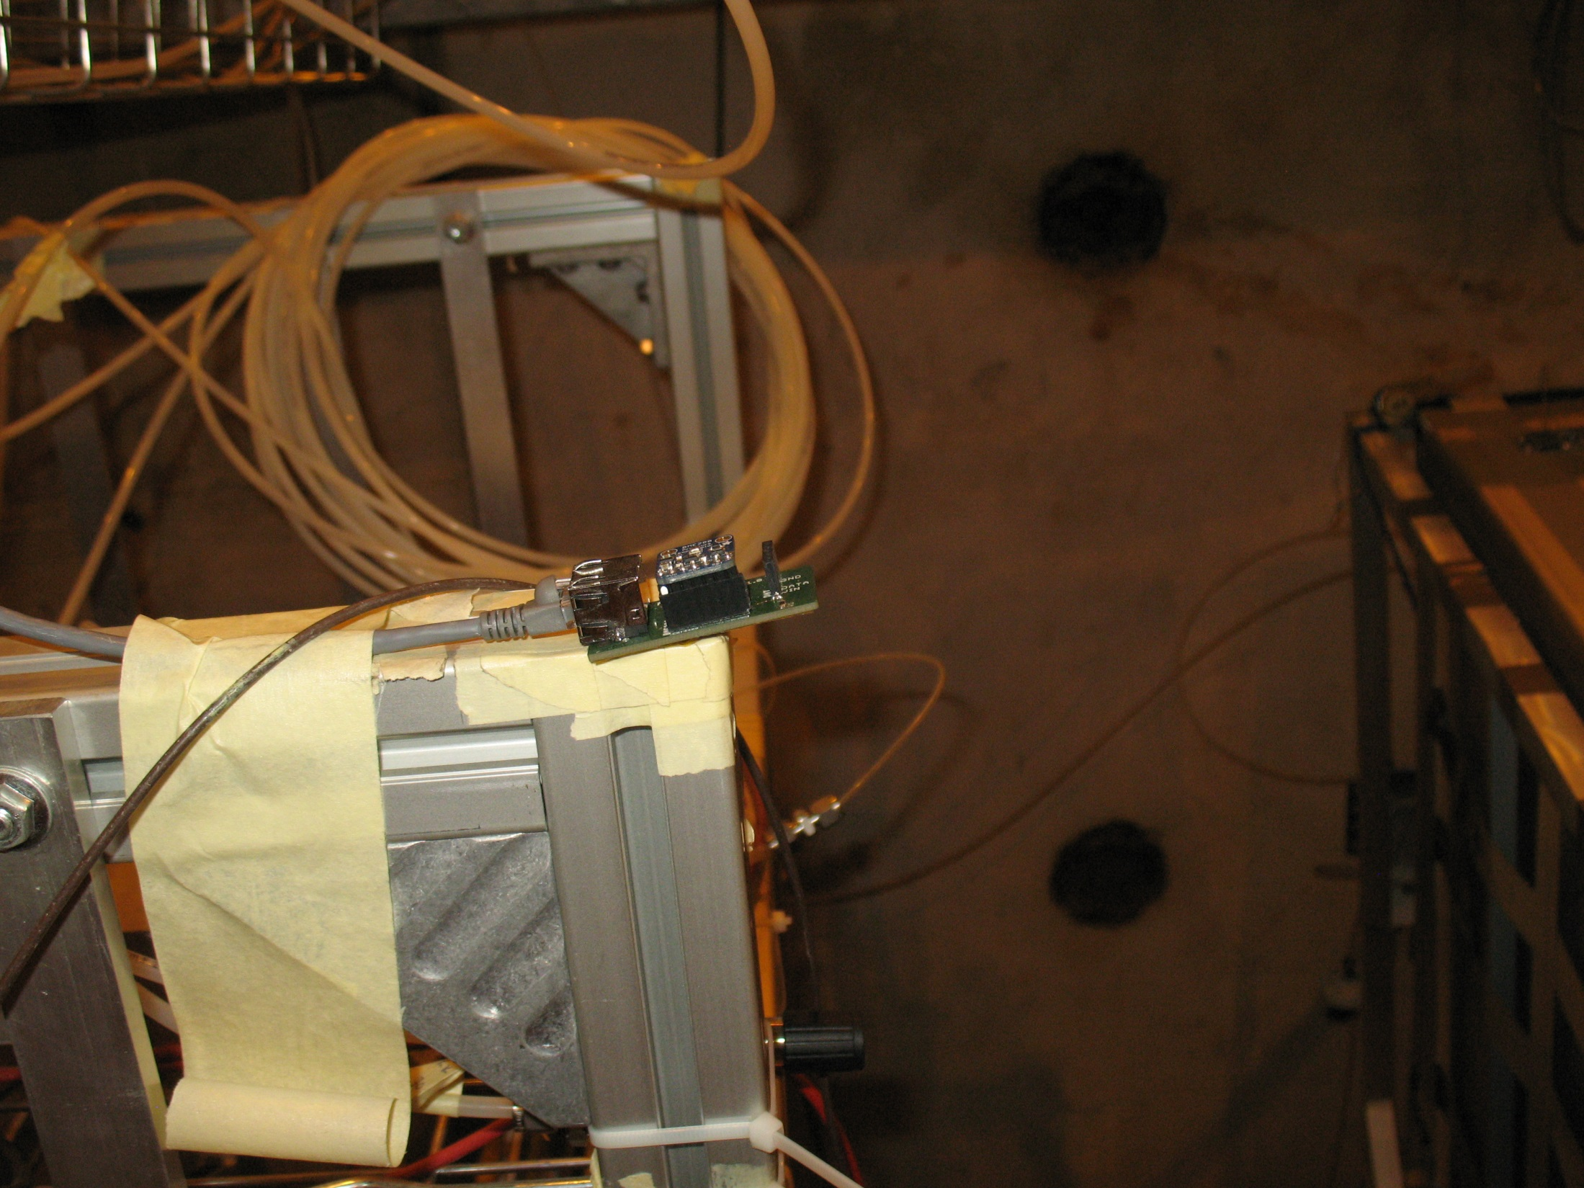

Slide 26
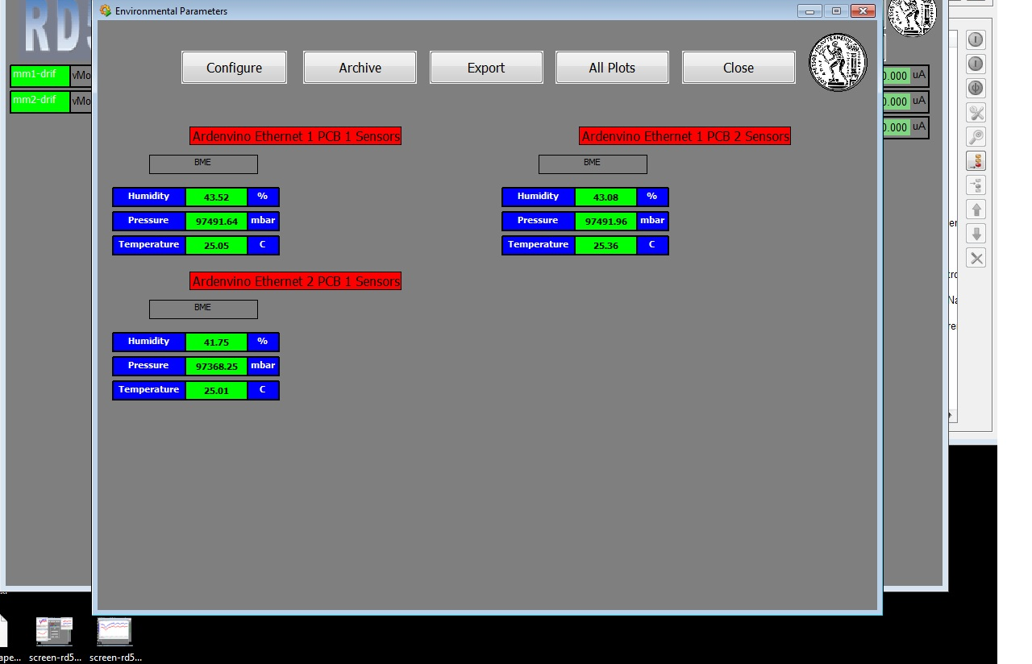
WinCC_OA Panels (August 2016 Test Beam)

Slide 27
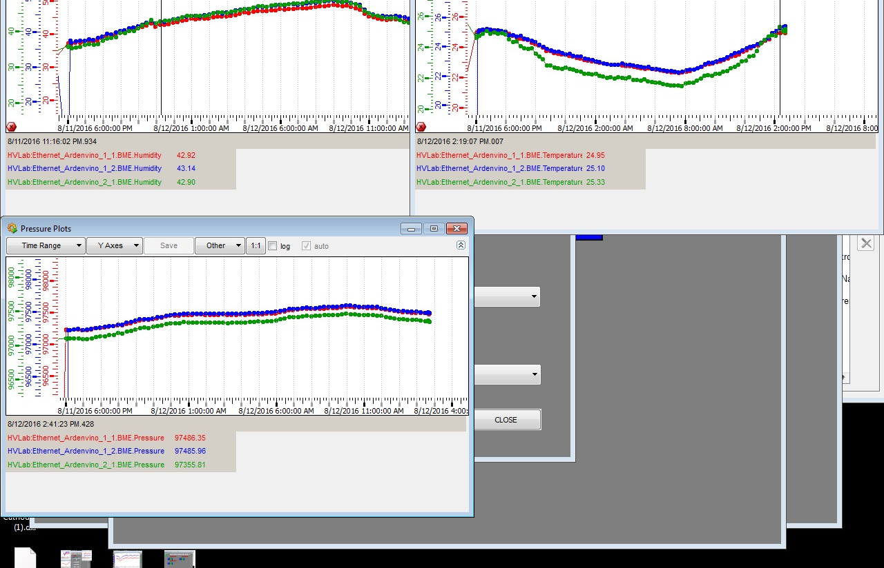
WinCC_OA Panels (August 2016 Test Beam)

Slide 28
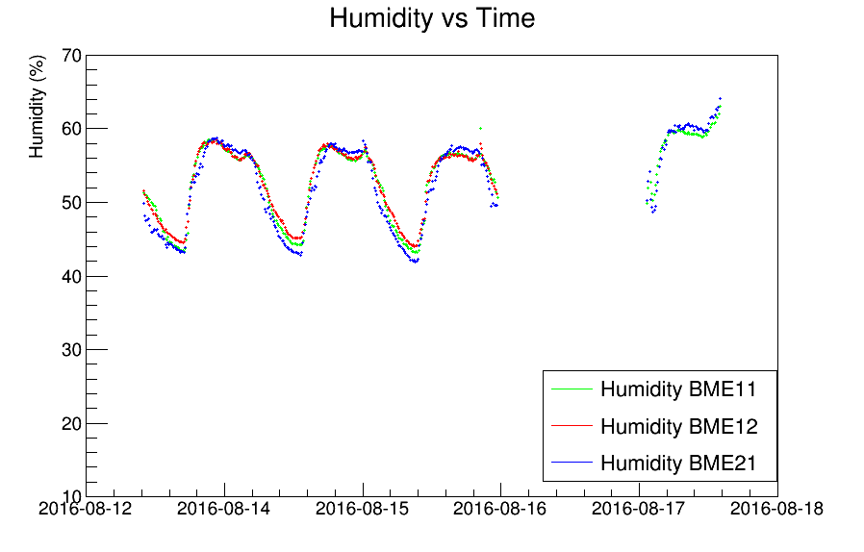
WinCC_OA Panels (August 2016 Test Beam)

Slide 29
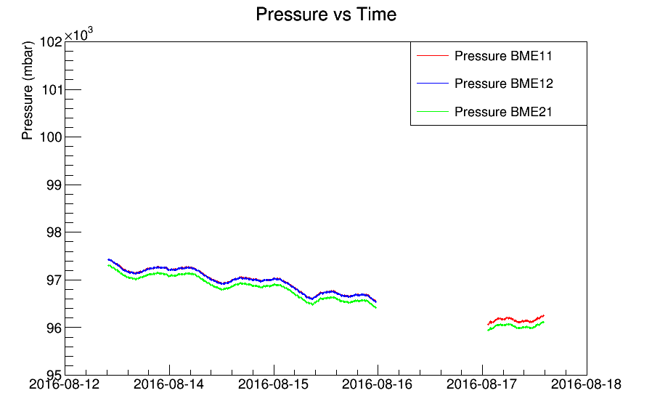
WinCC_OA Panels (August 2016 Test Beam)

Slide 30
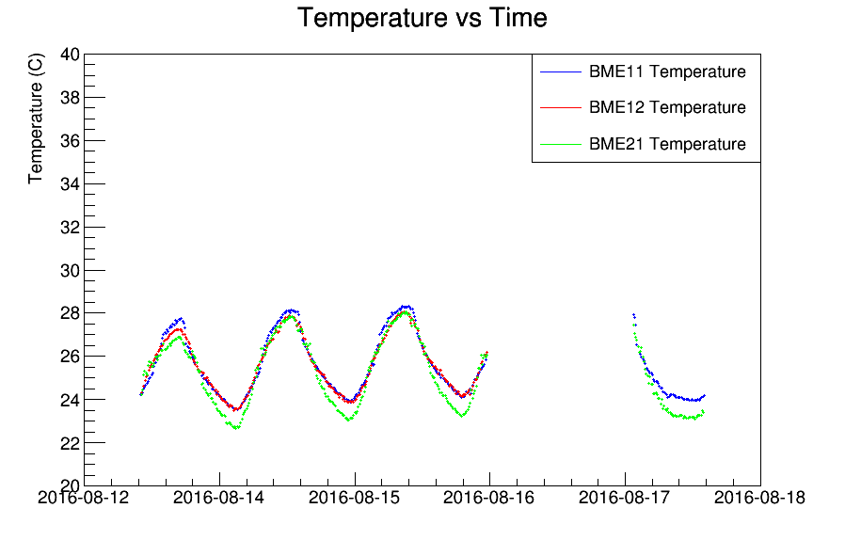
WinCC_OA Panels (August 2016 Test Beam)

Slide 31
Conclusions
A low cost system capable of monitoring the environmental parameters in several places using commercial sensors
Support of two Arduino Types (Mega and YUN)
Support of 2 sensors measuring pressure, temperature and humidity
Completely dynamic
The System has been fully integrated in the RD51 SLow Control SYstem and is available for any member of RD51
A RD51 note will be ready soon

Slide 32
Future of ArdEnvino
The Arduino YUN although was ideal at the beginning because of the WiFi connectivity → memory problems → Arduino Mega only
Plans for ArdEnvino v 2.0 with Arduino Mega and WiFi Shield
  No cables (WiFi connection with OPC)
  Memory
Plans for similar system using Raspberry Pi

