Slide 1


Institute of Nuclear and Particle Physics
Tests of a MM octant prototype towards
a Micromegas TPC Polarimeter
for srEDM
George Fanourakis¹, Spyros Tzamarias²
¹N.C.S.R. “Demokritos”
²Aristotle University of Thessaloniki

Slide 2
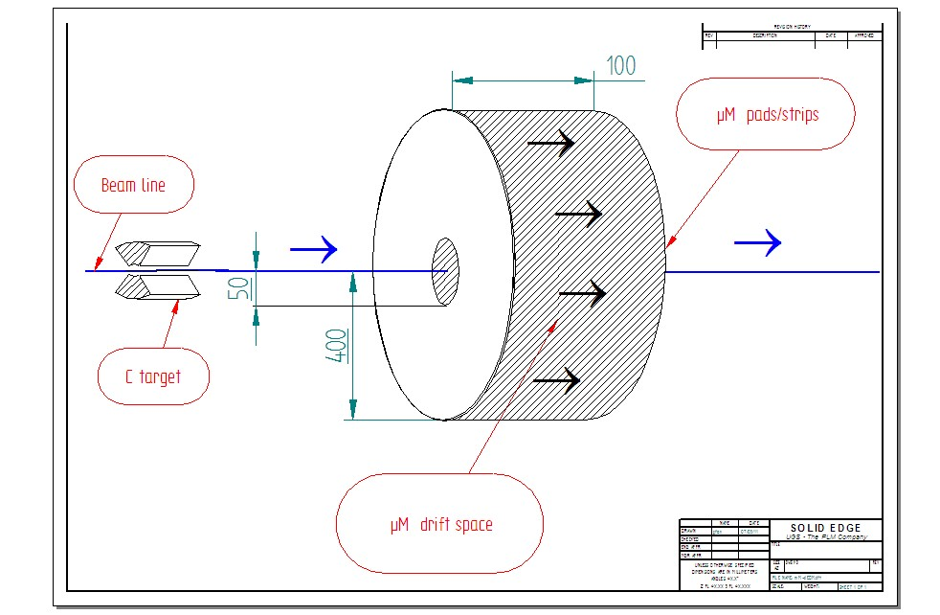
Designing the srEDM MM polarimeter
Units in mm - Not to scale
For 5º-20º scattering angle

Slide 3
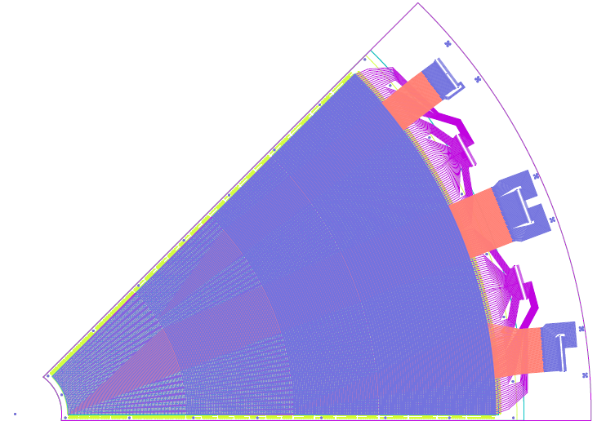
A prototype octant design
Initially configured as normal tracking chambers (not as TPC) for testing purposes with a
5mm drift/conversion space)
The r and phi strips are read by 5 Panasonic connectors (128 pins, not all the pins are used). A total of 442 channels.
The readout is protected for sparks by
a resistive layer

Slide 4

r-strips
110 inner r-strips with 1 mm pitch (50mm-160mm)
67 next r-strips with 1.5 mm pitch(160mm-260mm)
40 next r-strips with 2 mm pitch (260mm-340mm)
44 outer r-strips with 2.5 mm pitch (340mm-450mm)
261 R-strips,
4 sections

Slide 5

phi-strips
23 inner phi-strips with 1.96º pitch (0.2mm-2mm,)
+23 next phi-strips with 0.98º pitch
+45 next phi-strips with 0.49º pitch
+90 outer phi-strips with 0.25º pitch
181 phi-strips,
4 sections

Slide 6
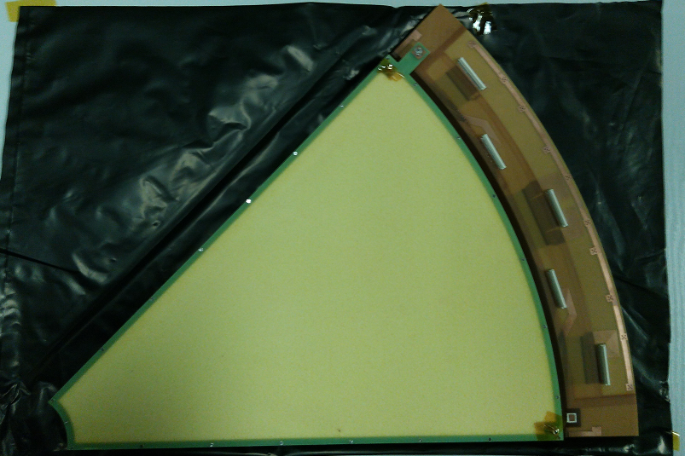
Testing the prototype octant
Two r-phi prototype octants have been ordered and constructed in the electronics lab of CERN (Rui)
Resistive layer HV connection
Drift layer HV connection
Connectors
Gas inlet
G10-Rohacell casing
Mesh HV connection
Drift electrode layer, below Rohacell plane
Read out strips layer
Gas inlet

Slide 7
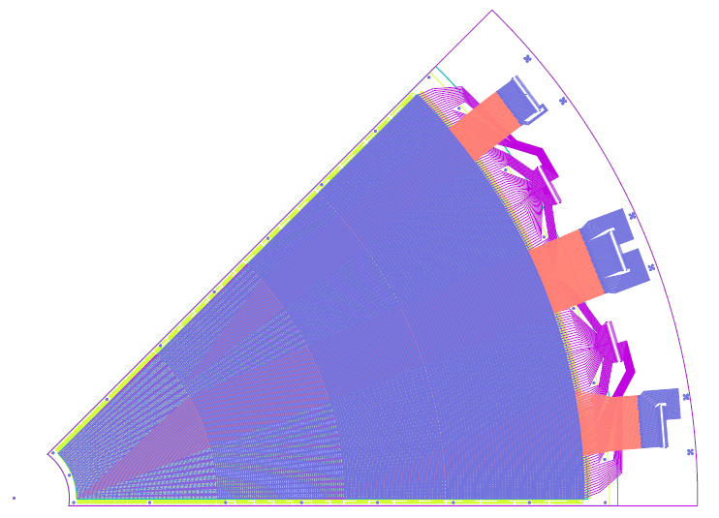
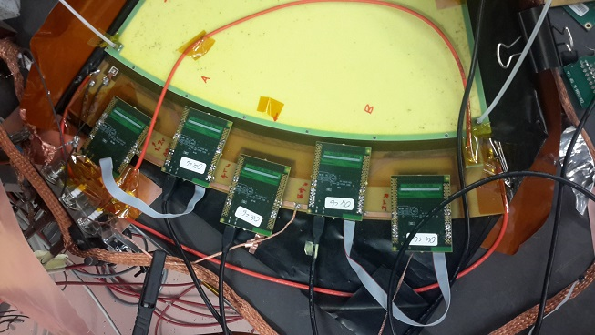
At RD51 lab (with Eraldo)
The one r-phi octant was read via the SRS readout system using the APV chips, developed by the RD51 collaboration. This system reads both the charge and the time of the pulse from each strip. The initial tests were done at RD51 lab with Fe55 and Sr90 sources. We used the mesh signal to trigger and the MMDAQ readout software developed by ATLAS. The gas used was Ar/CO2 (93%/7%)
R₃
Φ_{B}
R₄
Φ_{A}
R_{1,2}

Slide 8
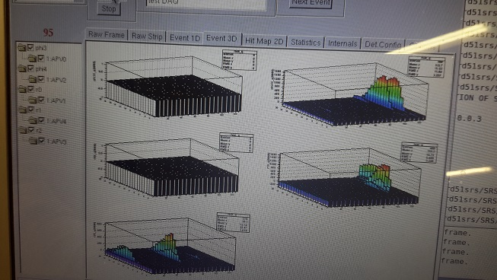
At RD51 lab (with Eraldo)
MMDAQ screen dump – with Sr90 source
Φ_{A}
Φ_{Β}
Φ_{A}
Left phi
Right phi
1-2 th Outer R
Inner R
3rd Outer R
Φ_{Β}
R_{1,2}
R_{1,2}
r₄
r₃
r₃
r₄

Slide 9
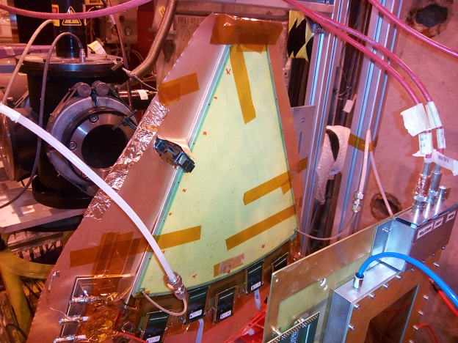
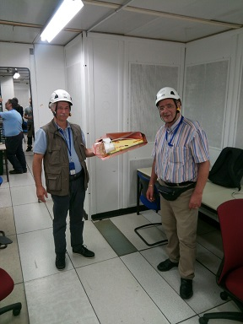
At RD51 Test beam (H4)
The one r-phi octant was read via the SRS readout system using the APV chips. We used scintillator counters (setup by Amos group) to trigger and the MMDAQ readout software on Eraldo’s laptop, controlled via TeamViewer. We took lots of data (HV scans at various spots)

Slide 10
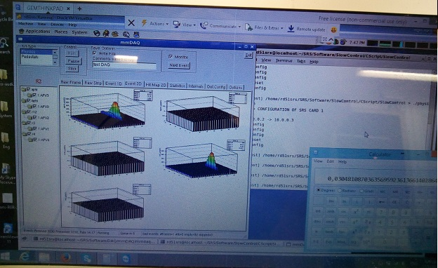
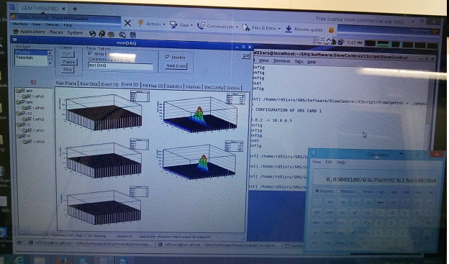
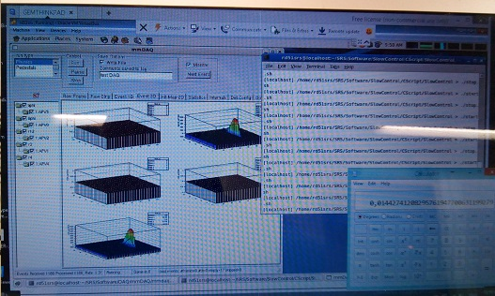
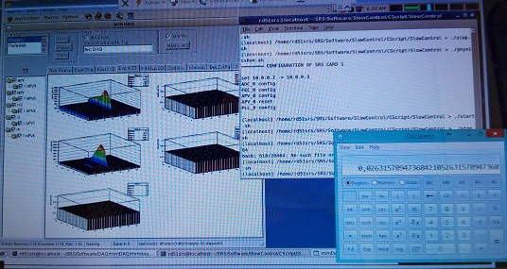
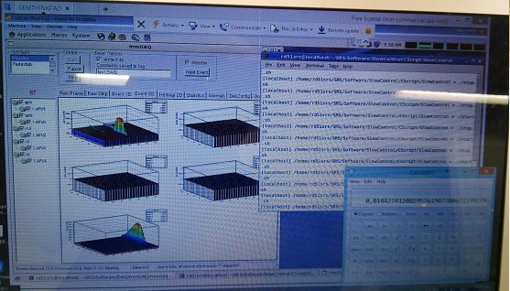
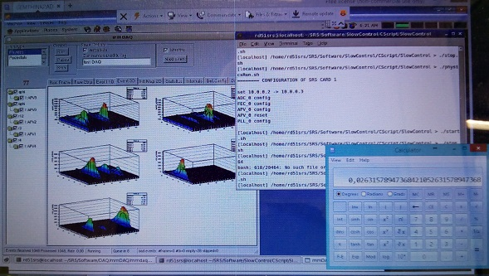

Slide 11
Preliminary analysis results
Established the mapping of strip-to-APV-channel (almost).
No clustering as yet.
Efficiency ~99% (after using gravity to obtain uniform gas flow)
Expect hits at R4, some R3 and A-Phi, B-Phi strips
Beam trigger area

Slide 12
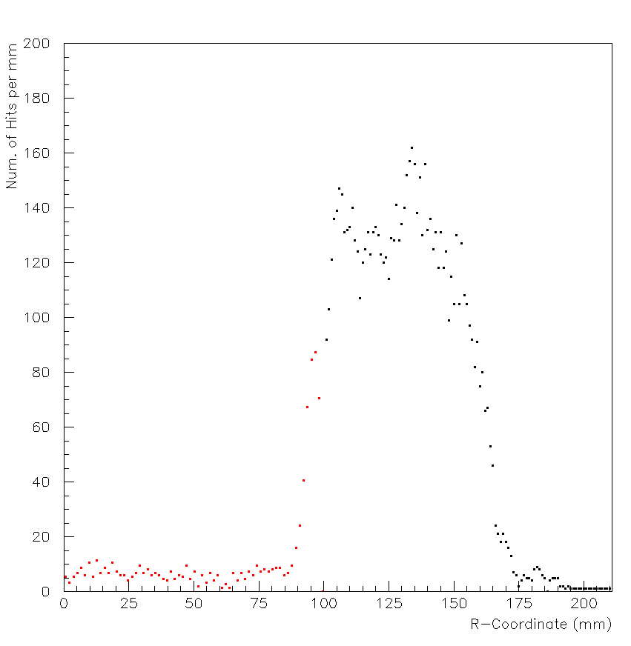

Slide 13
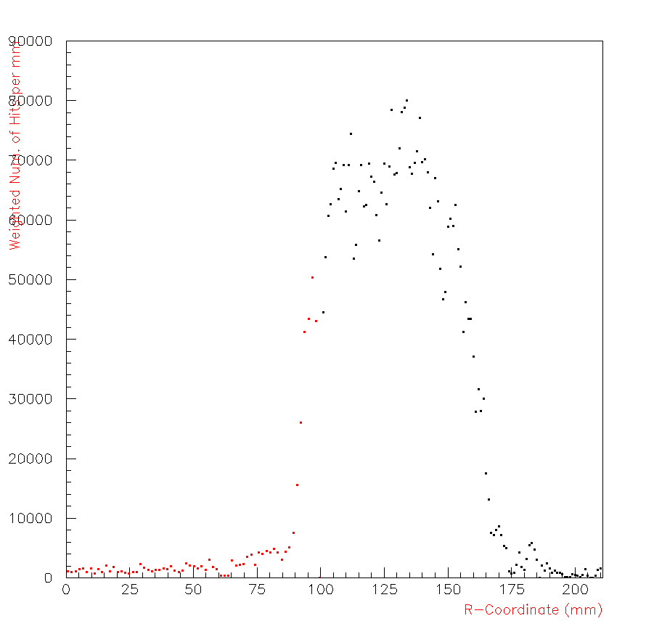

Slide 14
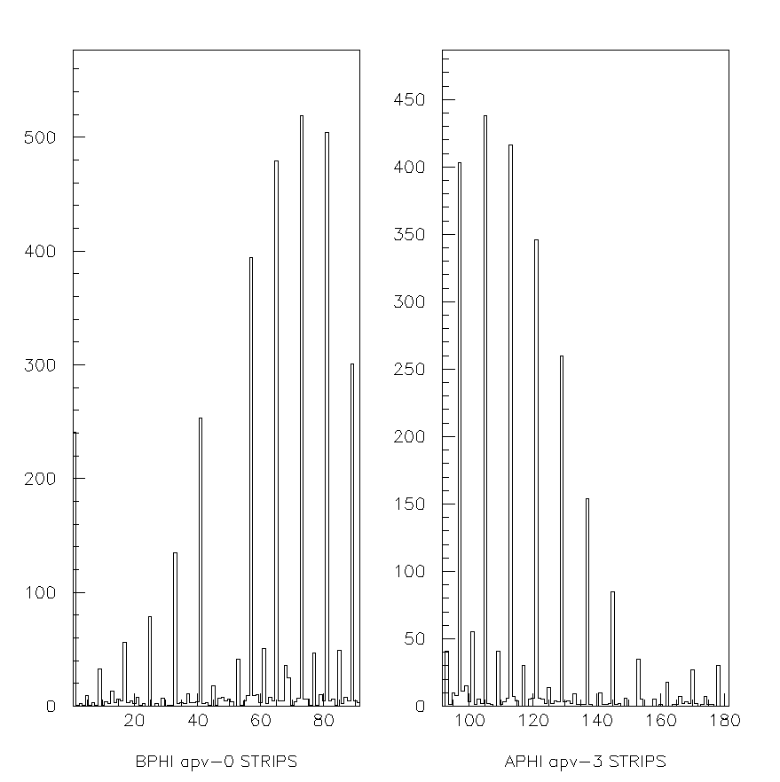

Slide 15
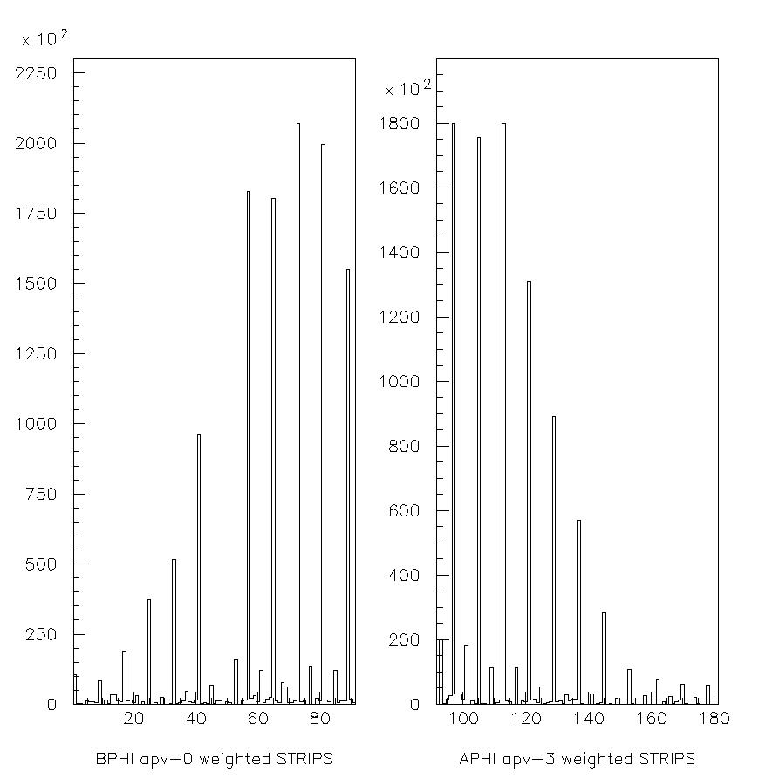

Slide 16
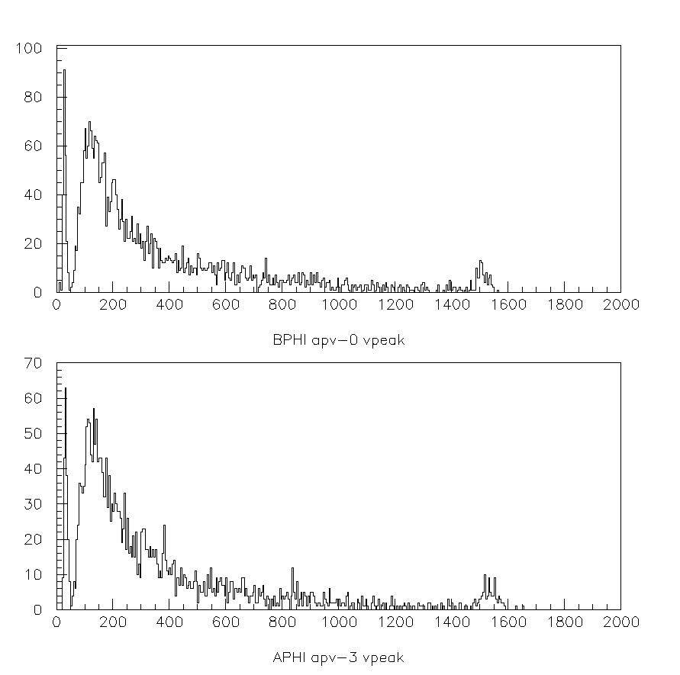

Slide 17
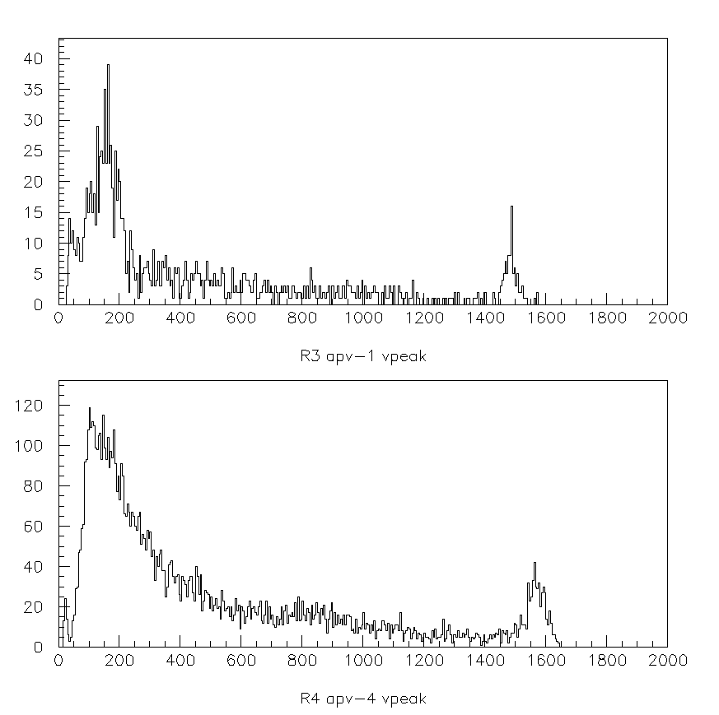

Slide 18
Plans for September tests
Request beam time for the 2nd week of beam tests
Spyros and I plan to arrive on Monday the 3rd of October, prepare for installation and install on Wednesday morning.
Use two R-Phi octants and measure efficiency relative to each other
The second octant has been modified (by Rui) to guarantee uniform gas flow
Take data with a beam telescope (if possible)
(If ready) try another type of large area (50x50 cm) MM detector with 128 pads (1.5x12cm)
Many thanks to Eraldo and Yorgos for the support and to the Weizmann group colleagues for the cooperation and help.

