Slide 1

Gentner Programme
Started October 2007
    after CERN visit of State Secretary Meyer-Krahmer from German BMBF (Federal Ministry of Education and Research)
  special German Doctoral Student Programme
    in addition to the existing CERN Doctoral Student Programme
    (almost) identical conditions except funding (subsistence) by BMBF, also extra funds for travel to Germany
  mid- and long term goals
    better usage of CERN resources by Germany
    better connection between German Universities and CERN
    long-term: more German staff at CERN
      presently only ~7.0% German staff (177/2525), but 20.5% contribution of DE to CERN budget
      IT: 11.4% (11.0% contribution), GB: 8.2% (14.7% contribution), ES: 6.1% (7.6% contribution)
3 parties involved: CERN – BMBF – DESY
    Programme Coordination by DESY (Manfred Fleischer)
    + local Coordinator at CERN (MH)

Slide 2
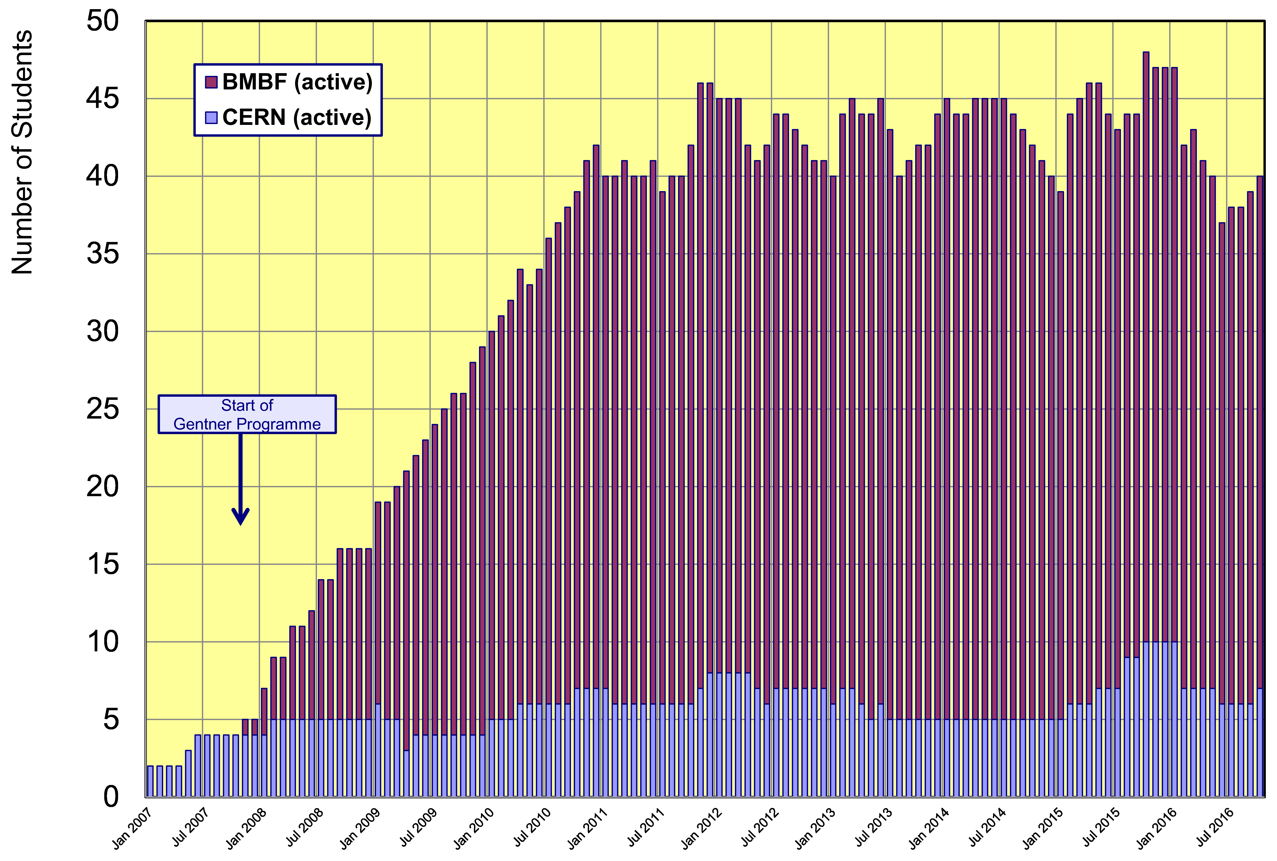
Status Gentner Programme
Presently 33 active Gentner Students (11 female = 33%)
    + 7 Germans in regular CERN Programme
    Number of Students ~stable since 2011
Slight drop in 2016
because of EUR/CHF
exchange rate

Slide 3
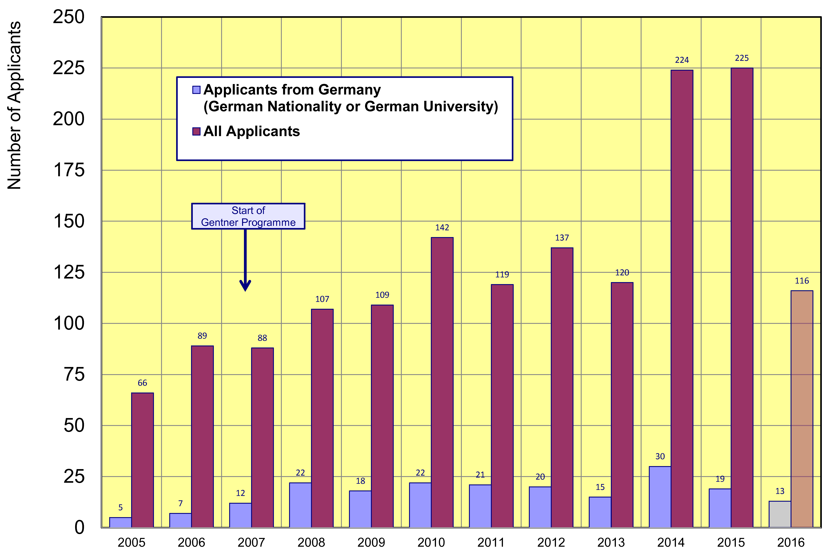
Doctoral Student Applications
Typically ~21 applicants/year from Germany (~stable since 2008)
    but overall number of applications is raising → fraction of DE applications goes down
only one selection
board in 2016 so far
21

Slide 4
Dresden Information Event
(Karrierechancen am CERN für MINT-Studierende der TU Dresden + Gespräche bei Bier & Brezeln)
Held at Dresden Technical University on 13 July 2016
    initiative by Michael Kobel (Prof. at TU Dresden)
    similar events at RWTH Aachen (2008) and Wuppertal University (2014)
Agenda
      Welcome by Pro-Rektor Research
      CERN Introduction (MH), TU Dresden involvements at CERN (Michael Kobel, TU Dresden)
      Opportunities for engineers at CERN and Technical Student Programme (Christine Völlinger, CERN)
      Gentner Programme (MH)
      Experience by TU Dresden Gentner Students (Andree Welker, Stefanie Morgenstern)
      Bier & Bretzel…
Unfortunately, only ~10 Students attended
  two main reasons
    most students didn’t know of CERN as a technology lab and of many engineering and technical opportunities outside “finding the Higgs”
      general perception in Germany of CERN as a place of “weird scientists”, not of technology
    bad timing
      last week of semester with lots of exams for that week and the week after

Slide 5
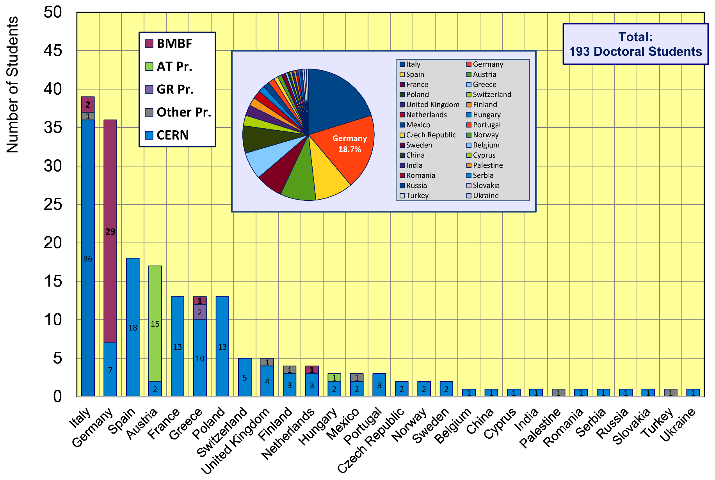
CERN Doctoral Students
Nationalities of all Doctoral Students at CERN
  Italians (39 Students) + Germans (36 Students) are dominating

Slide 6
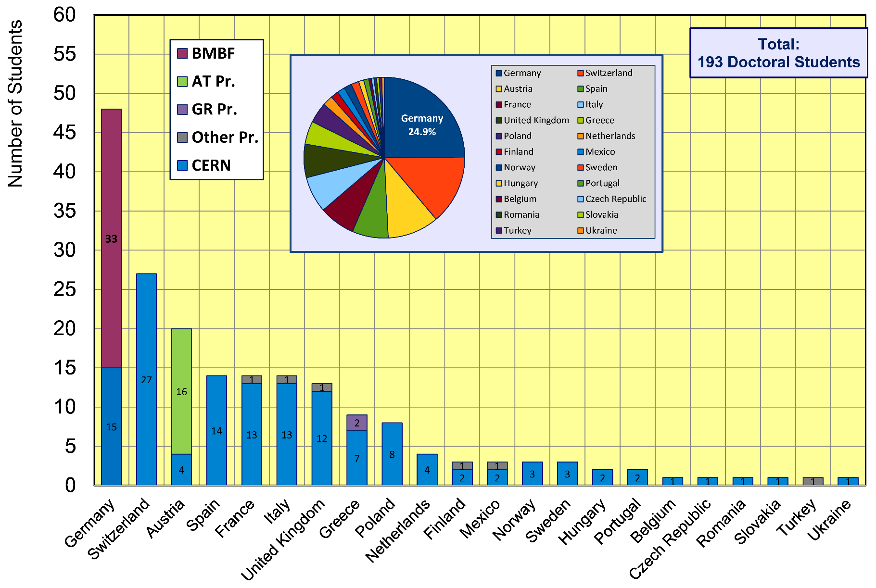
CERN Doctoral Students
Institute Country of all Doctoral Students
  47 Students enrolled at German Universities (~25%)

Slide 7
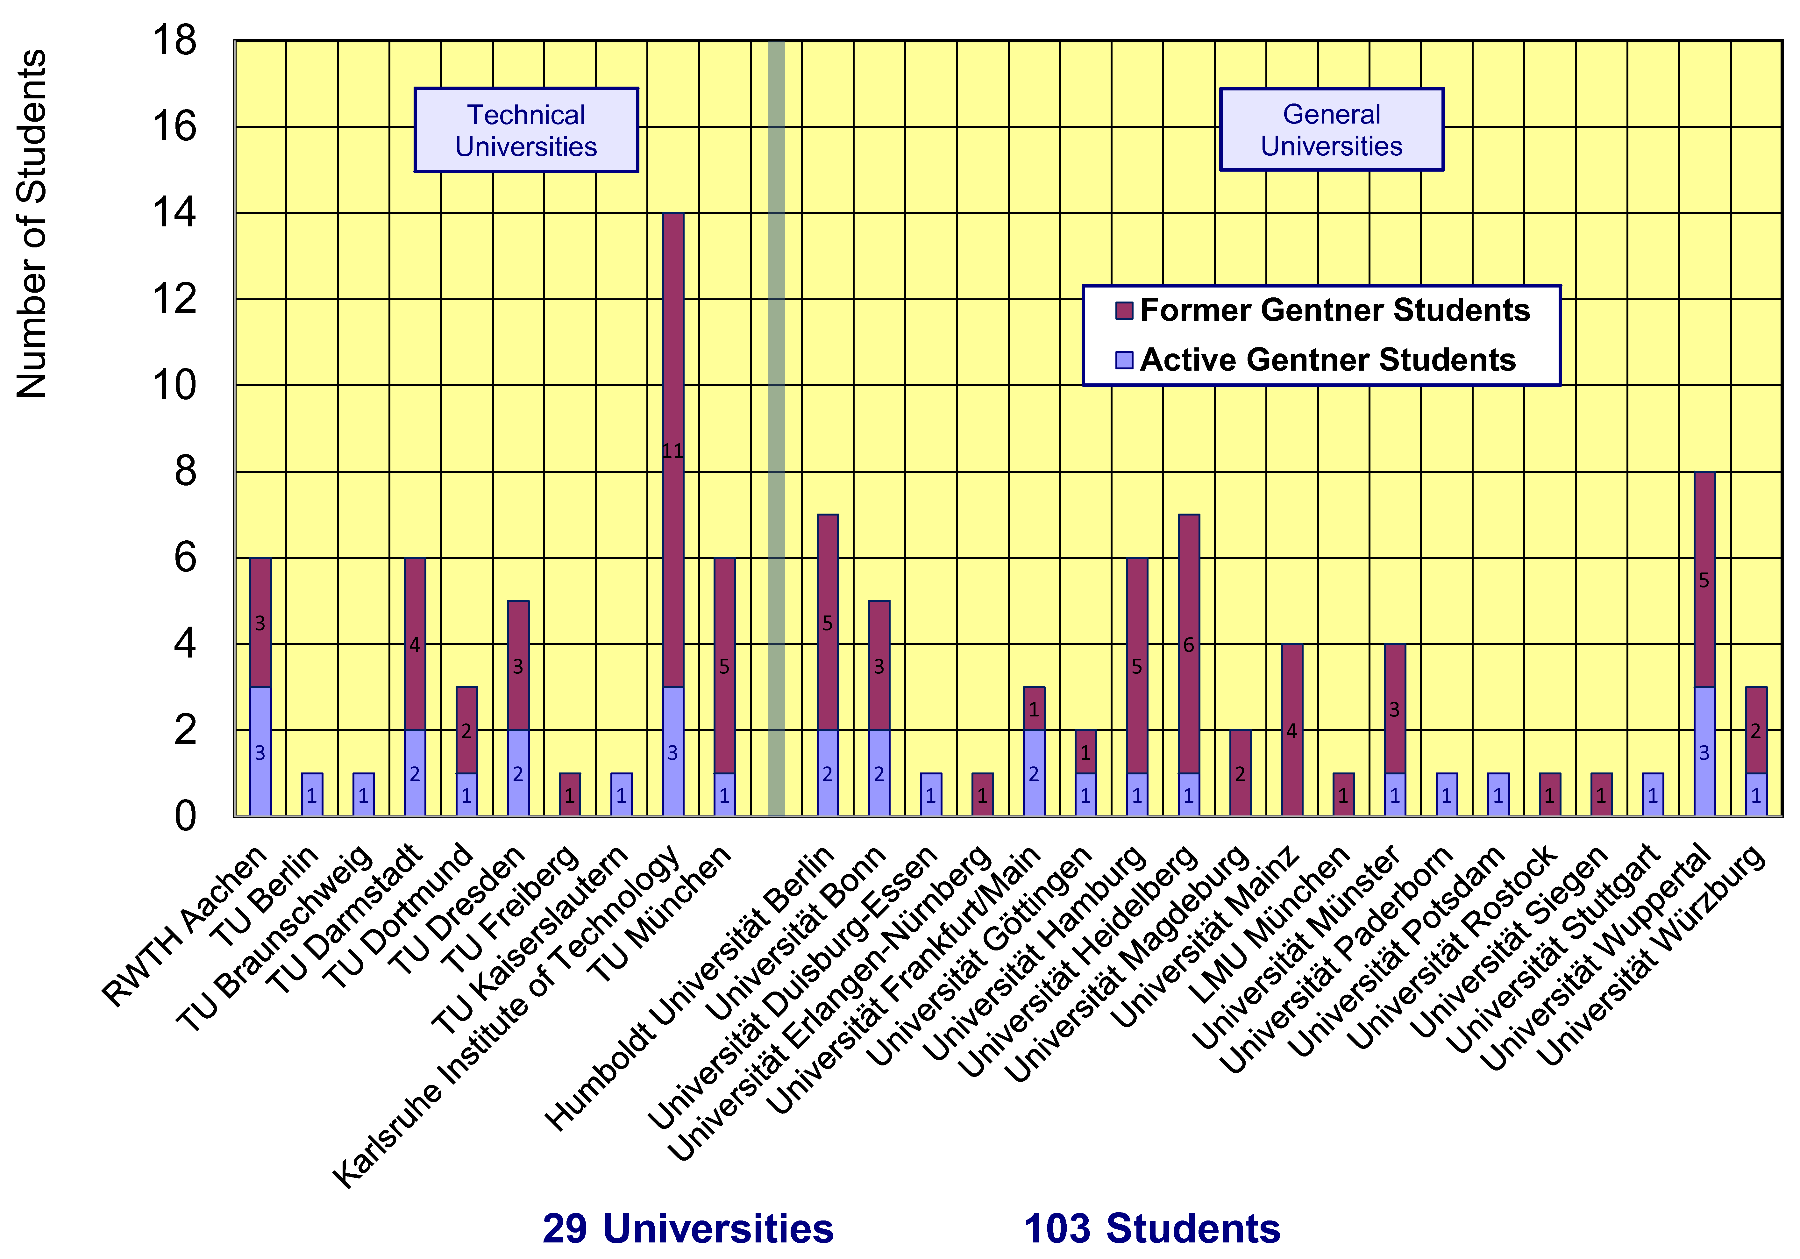
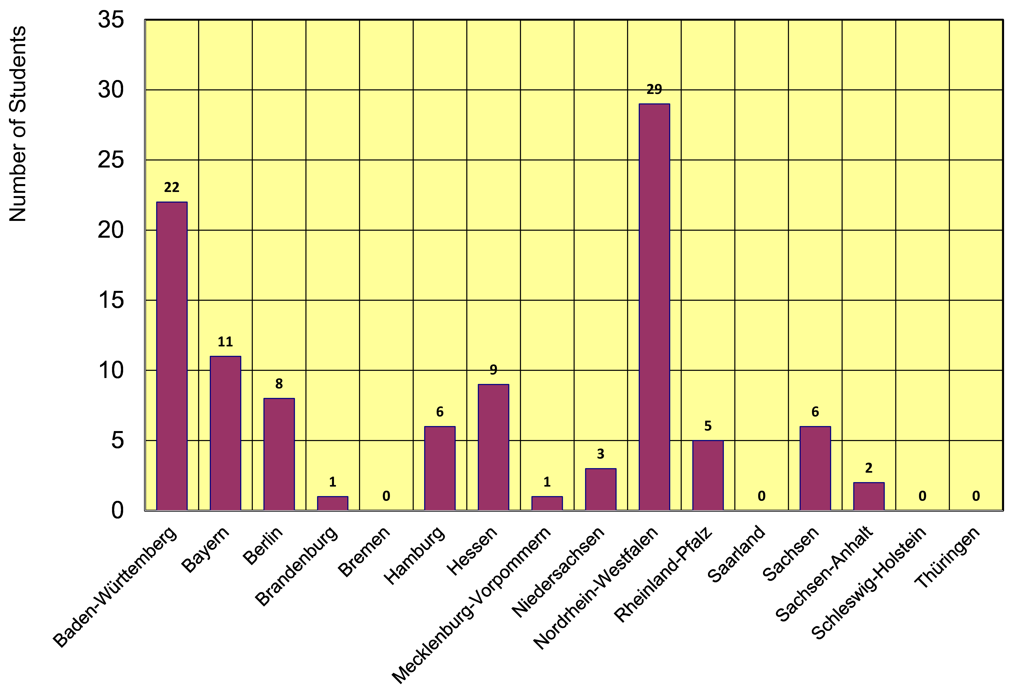
Gentner Students
  coming from 29 different Universities in DE
    also from university groups without or with little CERN contacts beforehand
  43% of Gentner Students from Technical Universities
NEW:
  12 German States
    NRW and BW are dominating
    only a few small(er) States are missing

Slide 8
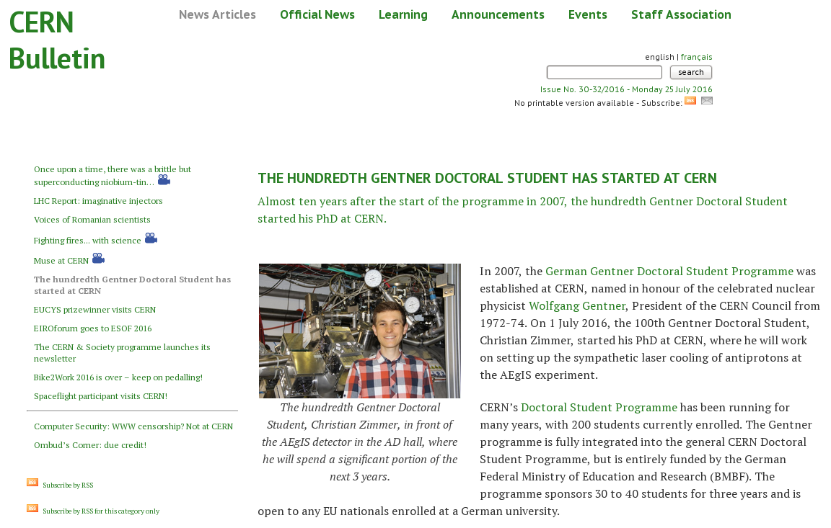
The 100th Gentner Student
Bulletin article in July 2016

Slide 9
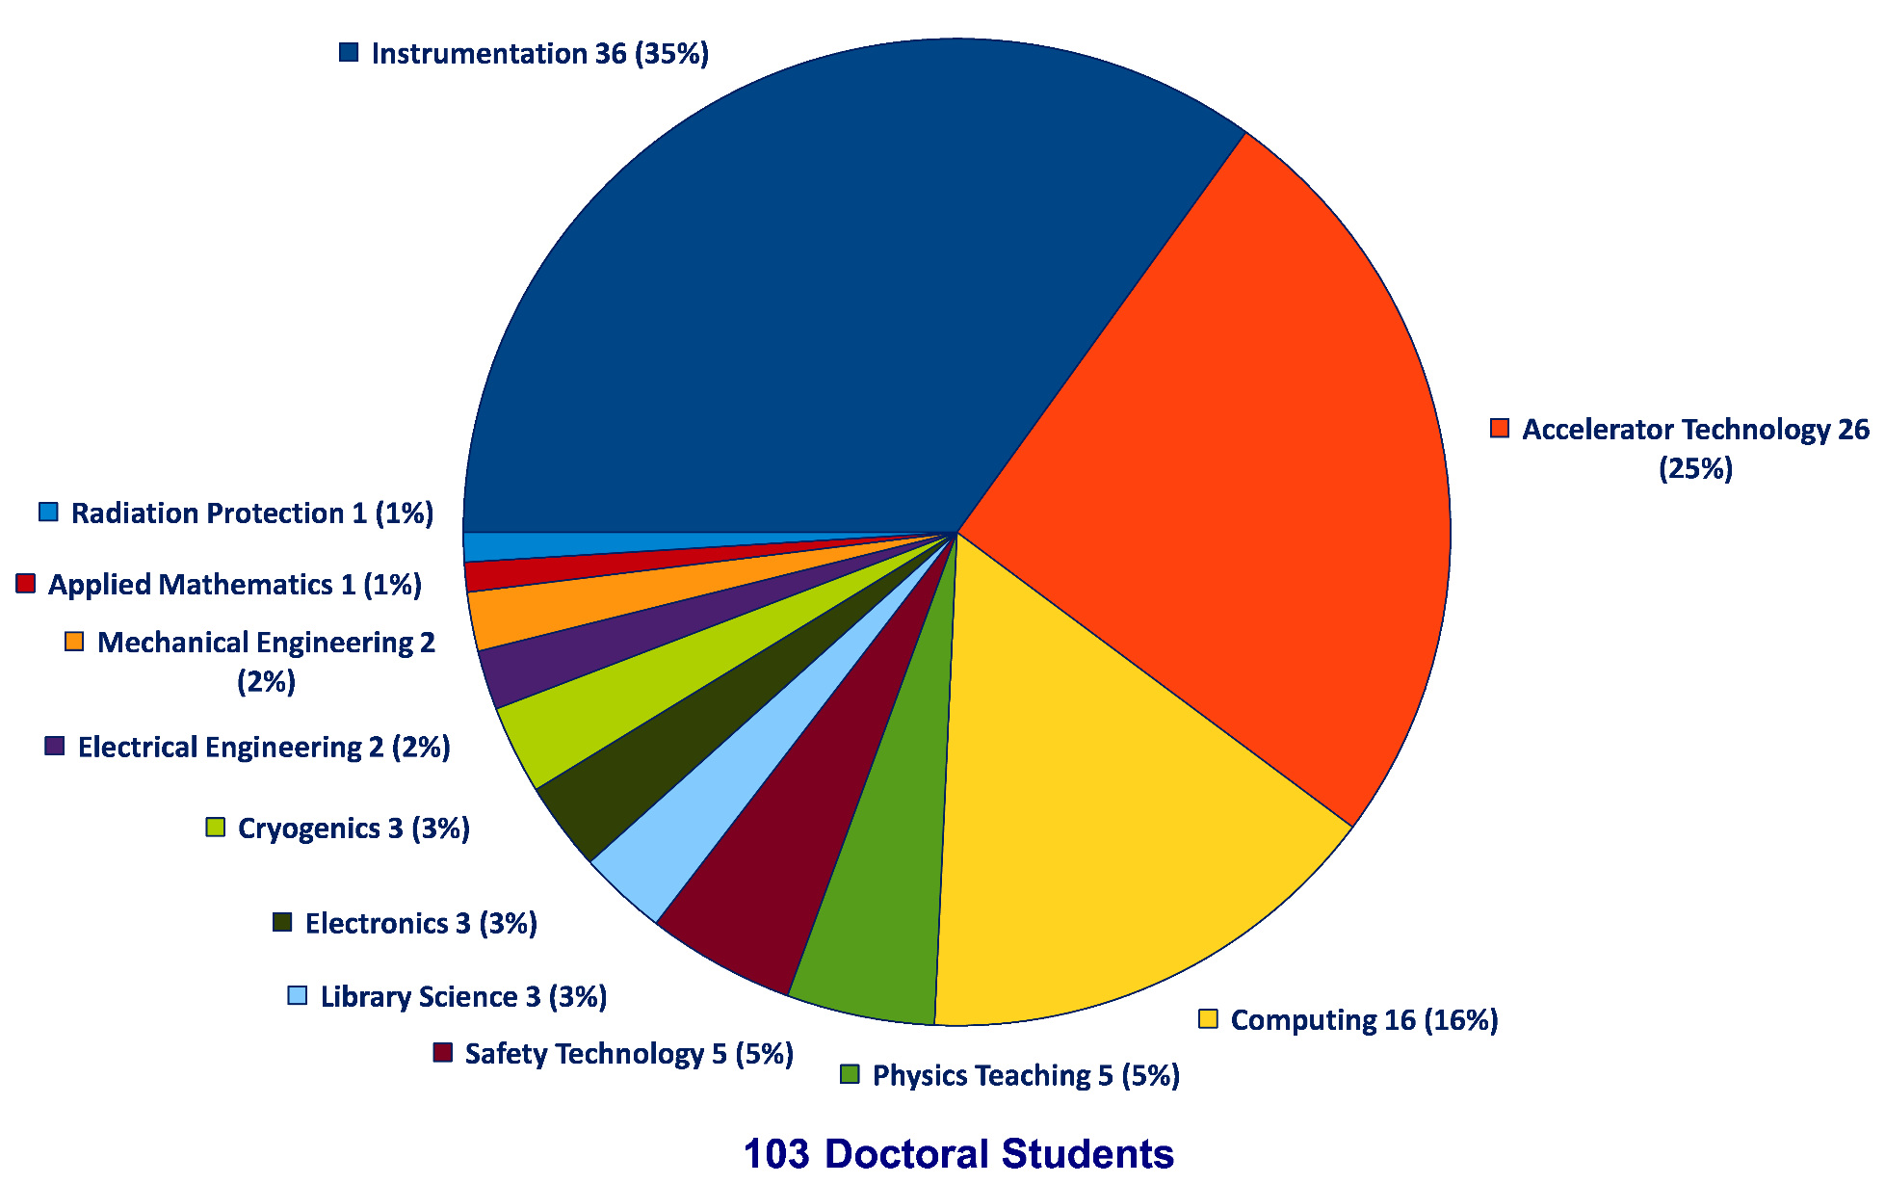
Thesis Topics of Gentner Students
(active + former)
Majority of topics in Instrumentation (35%), Accelerator Technology (25%), Computing (16%), stable since many years

Slide 10
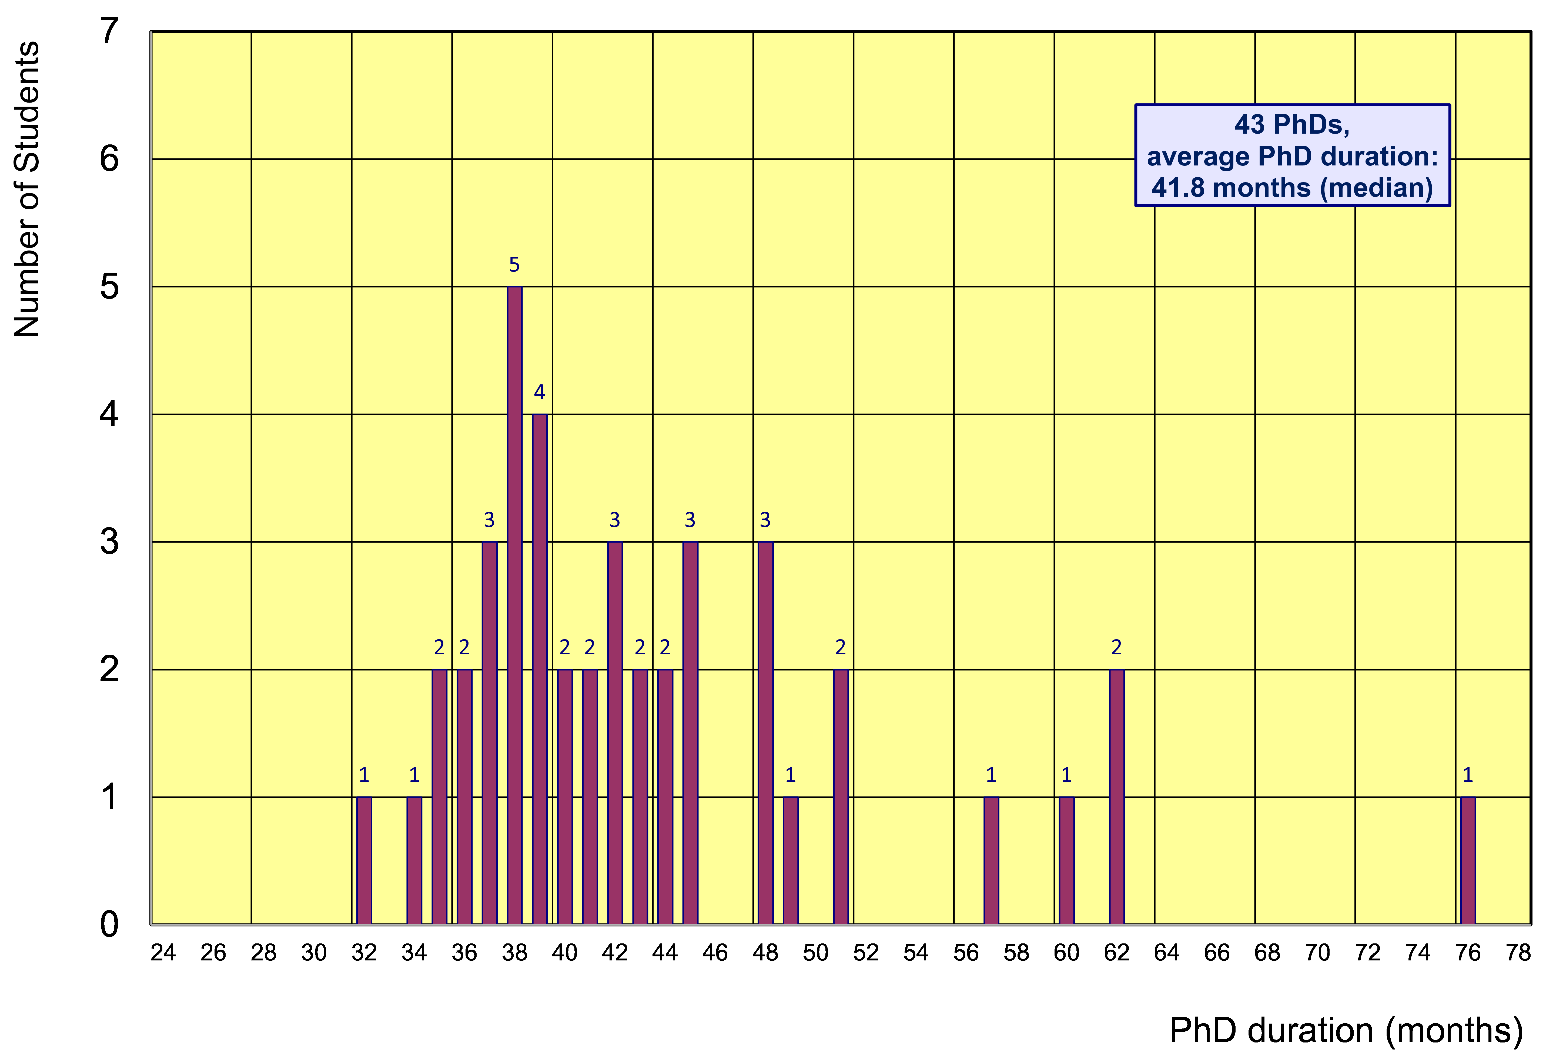
Former Gentner Students
43 PhDs so far (11 female = 26%), 6 Students have cancelled their PhD
    average age at PhD (defense): 30.7 years (median)
    average duration of PhD: 41.8 months (median) = 5.8 months after end of CERN 3-years contract
Physics PhDs in Germany (2015)
19% female PhDs students
30.2 years (median) at PhD
50.4 months (median) duration of PhD

Slide 11
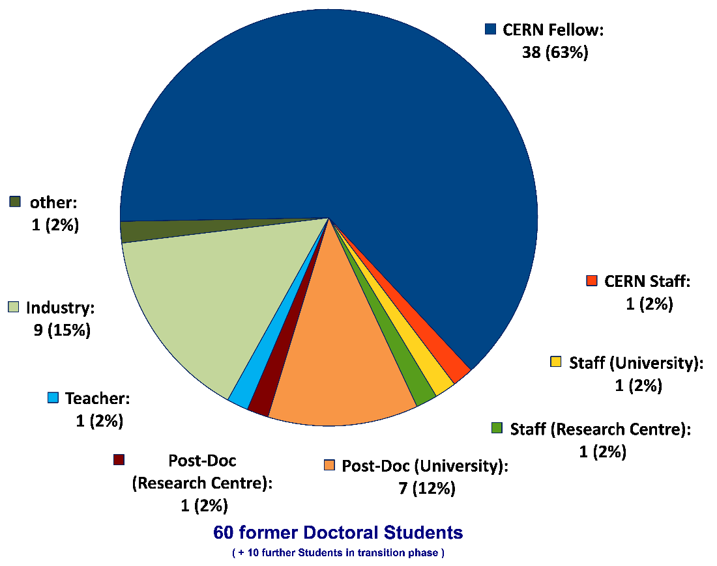
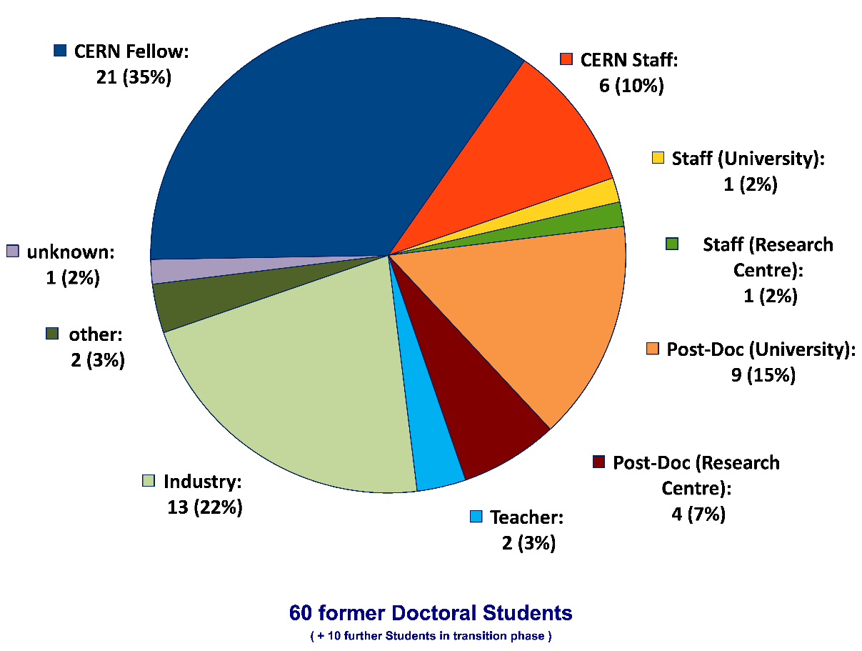
Whereabouts of Gentner Students
  First employment of ~2/3 of the Gentner Students: CERN Fellow(!)
First Employment
Present Employment
presently 6 CERN Staff Members,
1 with indefinite contract (since 1 April 2016)

Slide 12
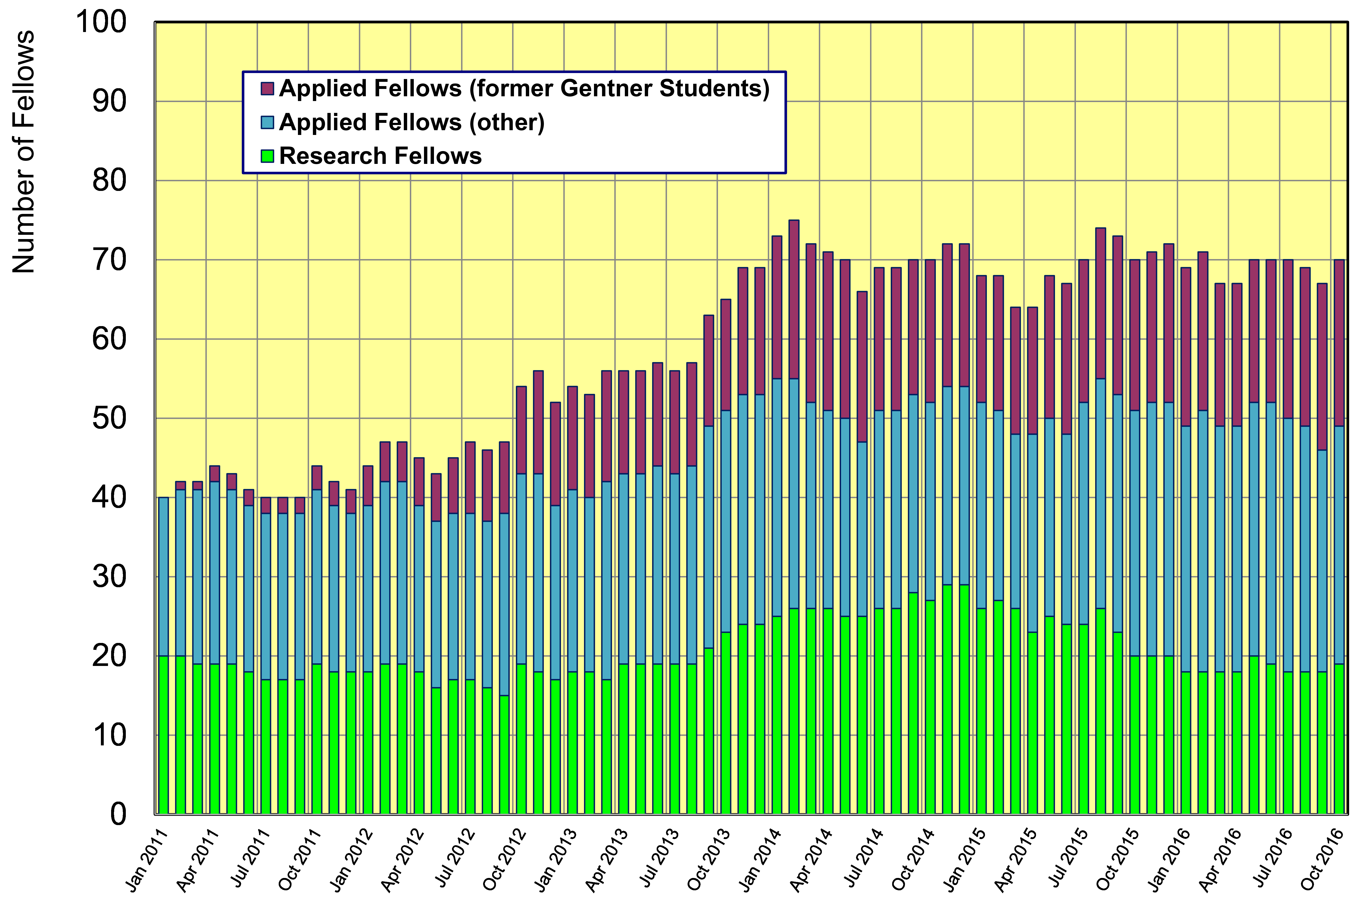
Gentner Students → Fellows
  significant increase of DE Fellows by former Gentner Students
    about 40% of German Applied Fellows are former Gentner Students

Slide 13
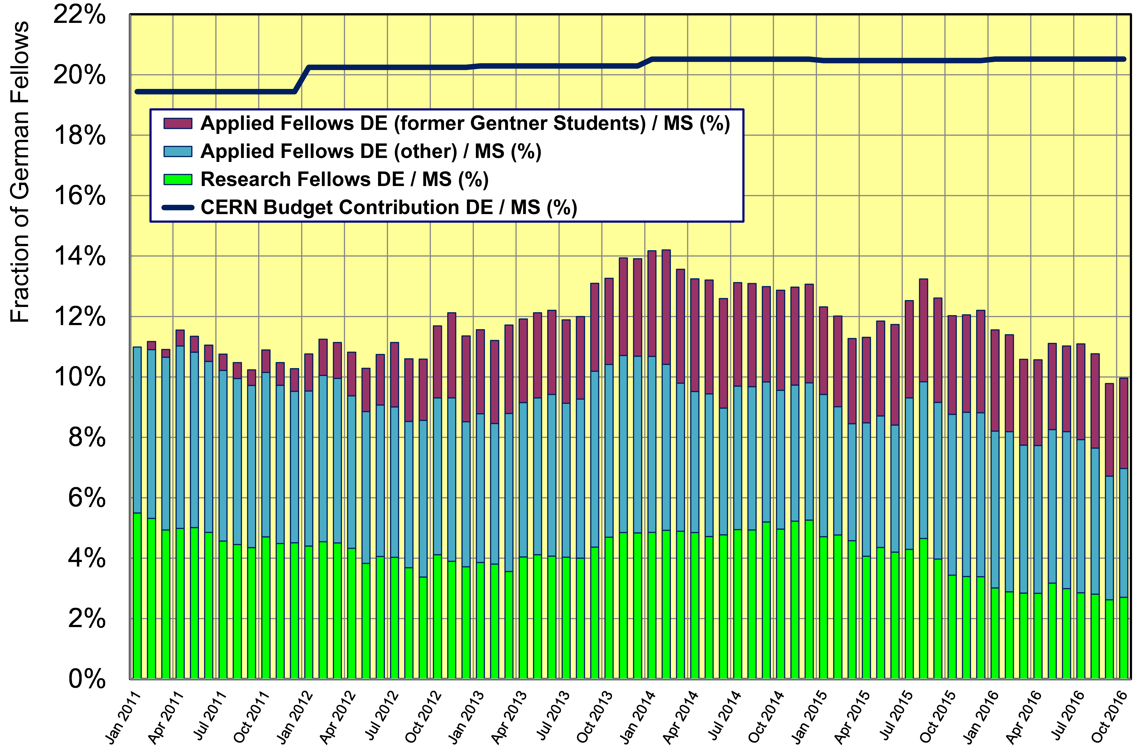
Gentner Students → Fellows
  without additional former Gentner Students → fraction of German Fellows w.r.t. to all Member States would be < 8% now

Slide 14
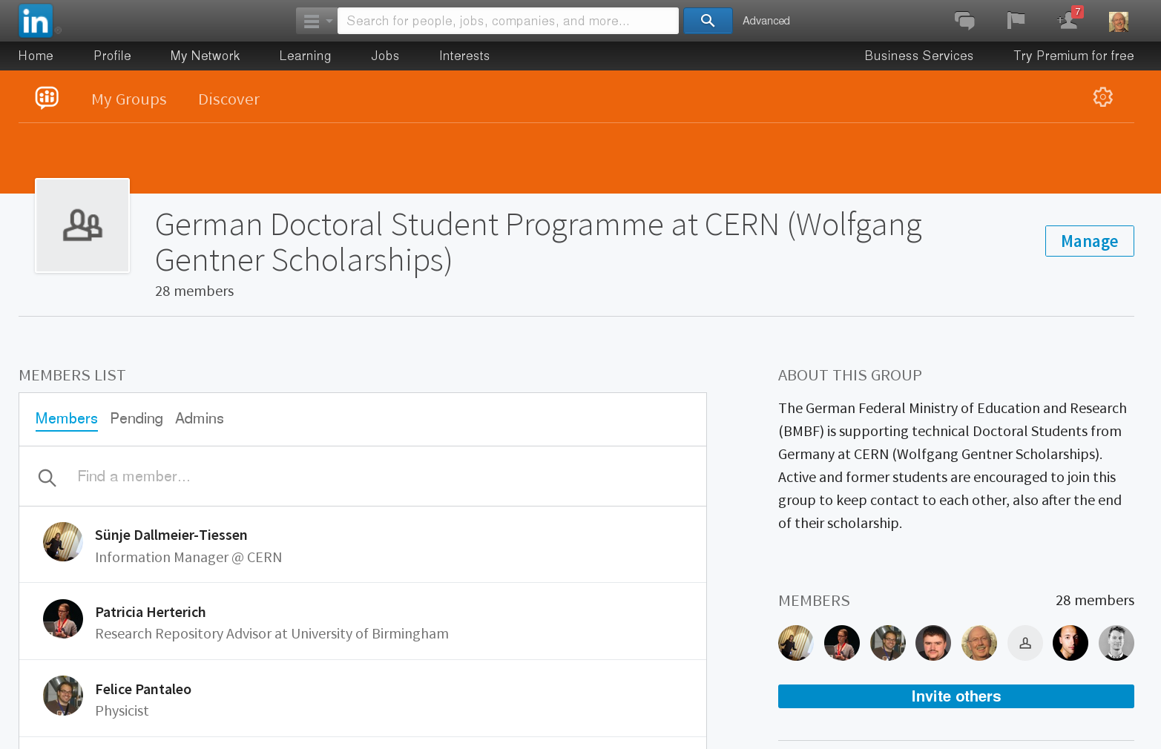
Gentner LinkedIn Group
Gentner Group @ LinkedIn (active + former Students)
  48 of 103 active + former Students are at LinkedIn professional network
    presently 30 Students in Gentner Group, more to come
    important to follow whereabouts of former Students (feedback to BMBF!)
    + good way to stay connected

Slide 15
Gentner Programme Continuation
Funding secured until end of 2017
  funding in 2015 - 2017: 5.15 M€ (1.72 M€/year)
  funding request was based on 1 € = 1.20 CHF, sufficient for (on average) 39 Students
Problem in 2015: discontinuation of CHF–EUR minimum exchange rate by Swiss National Bank
  no extra funding from BMBF to mitigate impact
  had to slightly adapt/reduce average number of Students (39 → 35)
    will carefully follow situation depending on future development of CHF–EUR exchange rate
Contract renewal needed after 2017
  renewal process to be started soon
      no consequences to present Students if Programme would terminate end-2017: noone will be “fired”, support for present students continues beyond end of 2017

Slide 16
General News and Remarks
Travel
  travel to home university constantly used (stable over years)
  last + this year:
    ~25% less travel to DPG Physical Society Spring Meetings + other national society meetings
    please make use of these opportunities, funding available and should be used!
Advertisement
    no. of applicants from Germany ~stable, but more applicants welcome
  distribute brochures + posters when travelling to home university
    pick-up in my office
Very important
  when finishing → please keep me informed on your further whereabouts + upload your thesis to CDS
  key figures needed for BMBF indicating the Programme success!

Slide 17
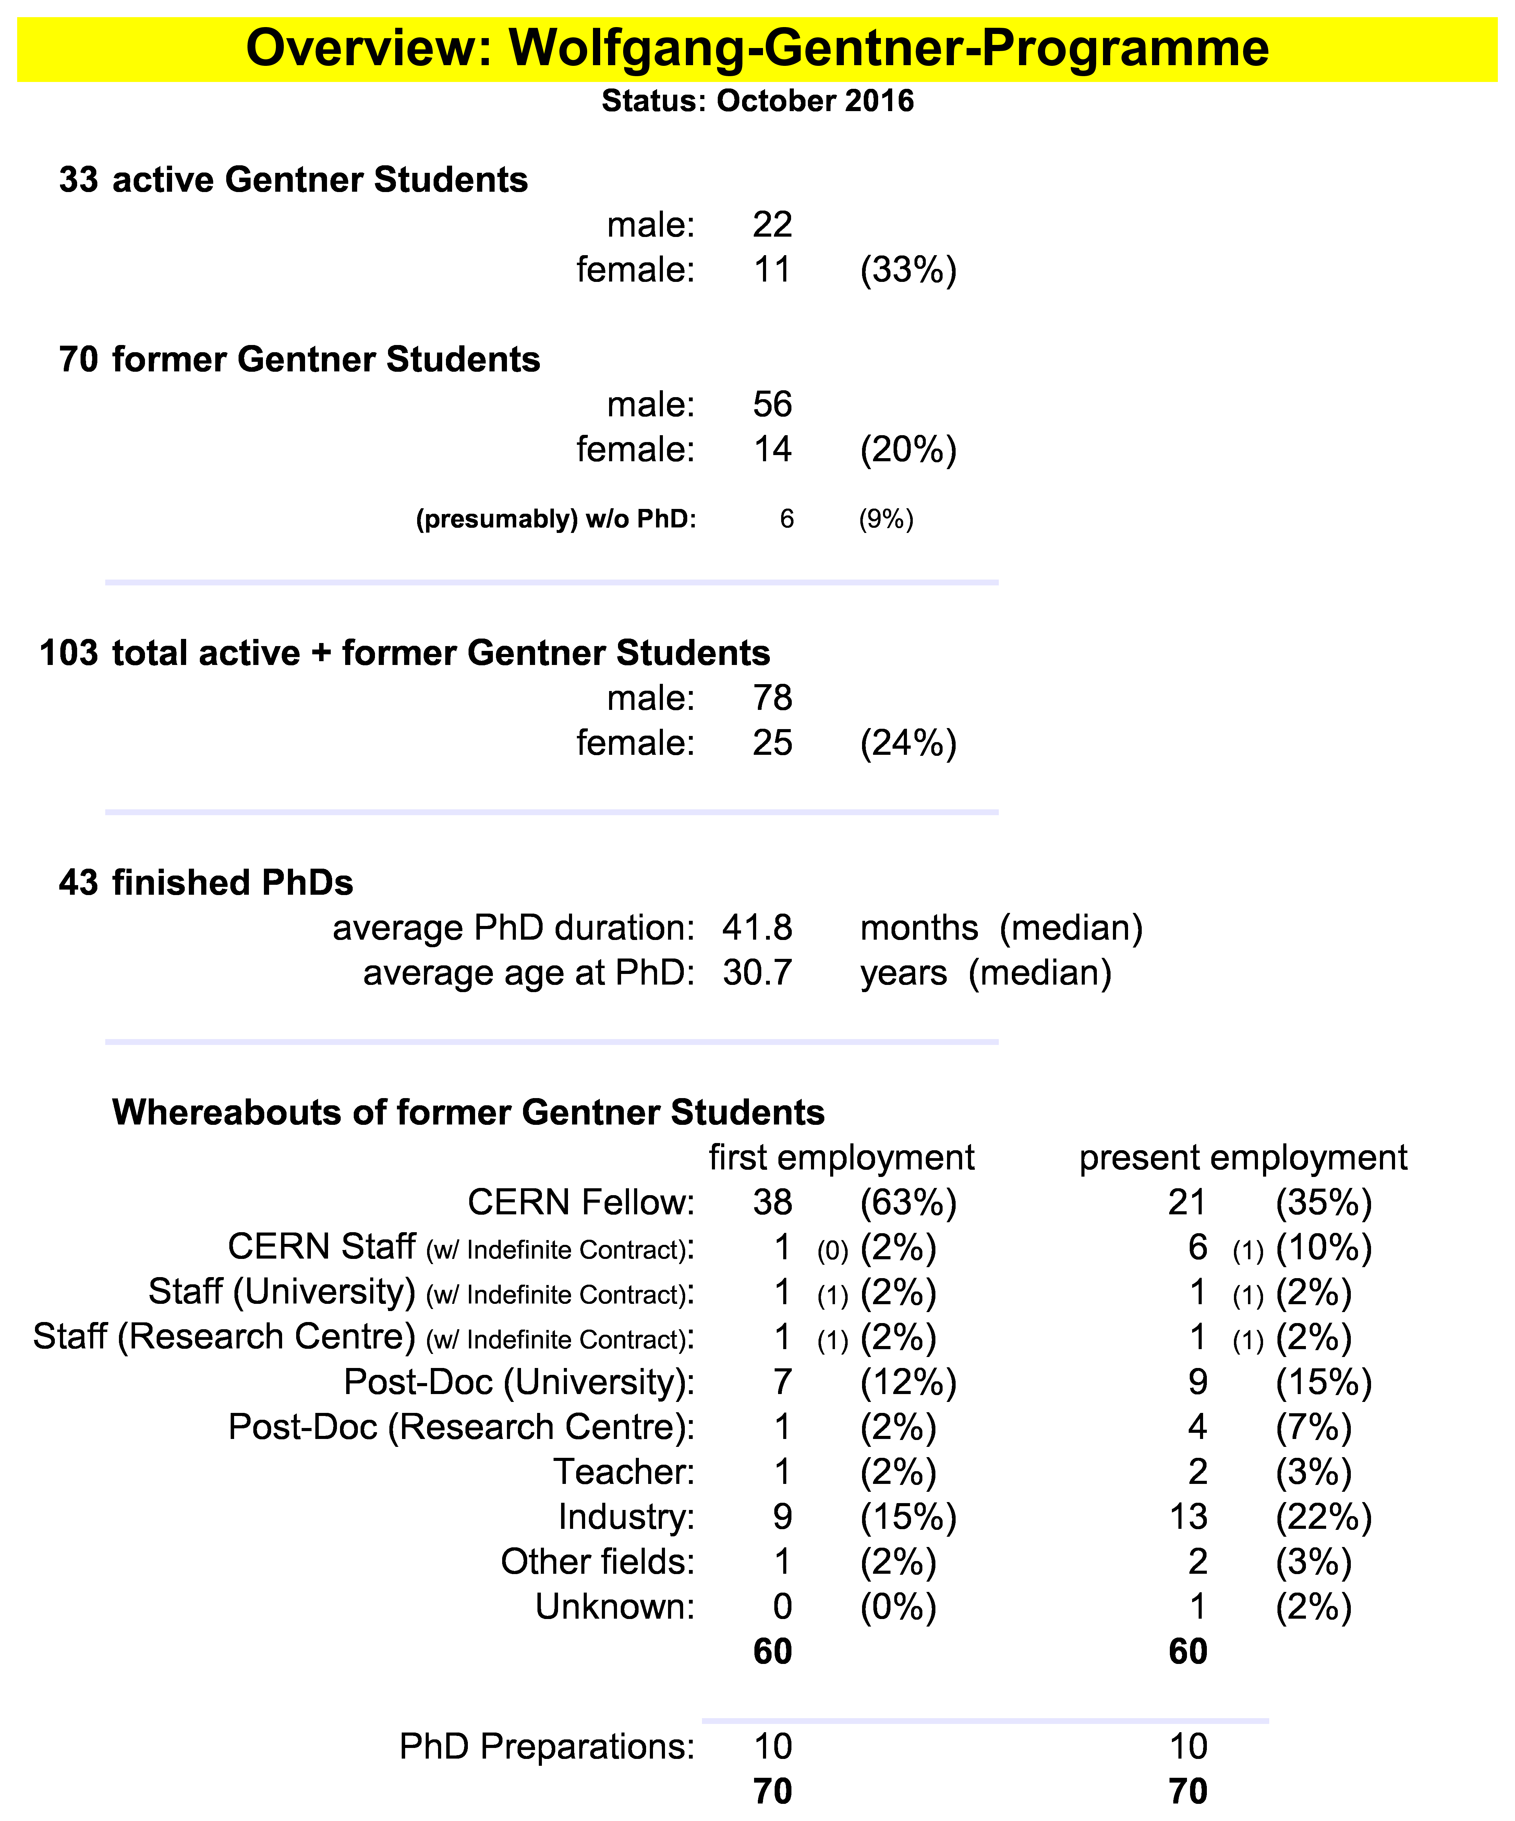
Summary Gentner Programme
Next Gentner Day:
26 April 2017 (tbc)
Physics PhDs in Germany (2015)
19% of PhDs students female
30.2 years (median) at PhD
50.4 months (median) duration of PhD
CERN Fellows
≈ 40% of German Applied Fellows
are former Gentner Students

