Slide 1



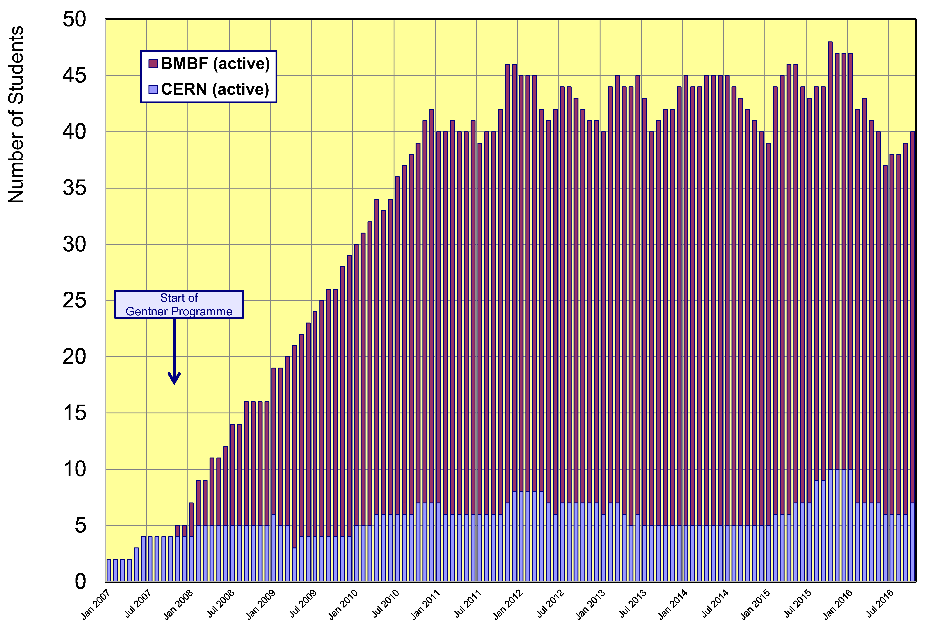
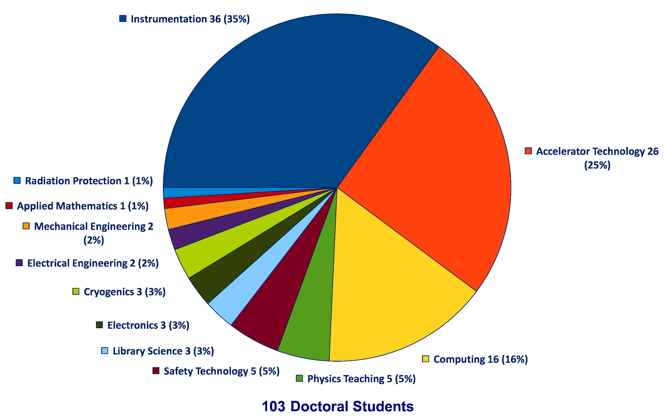
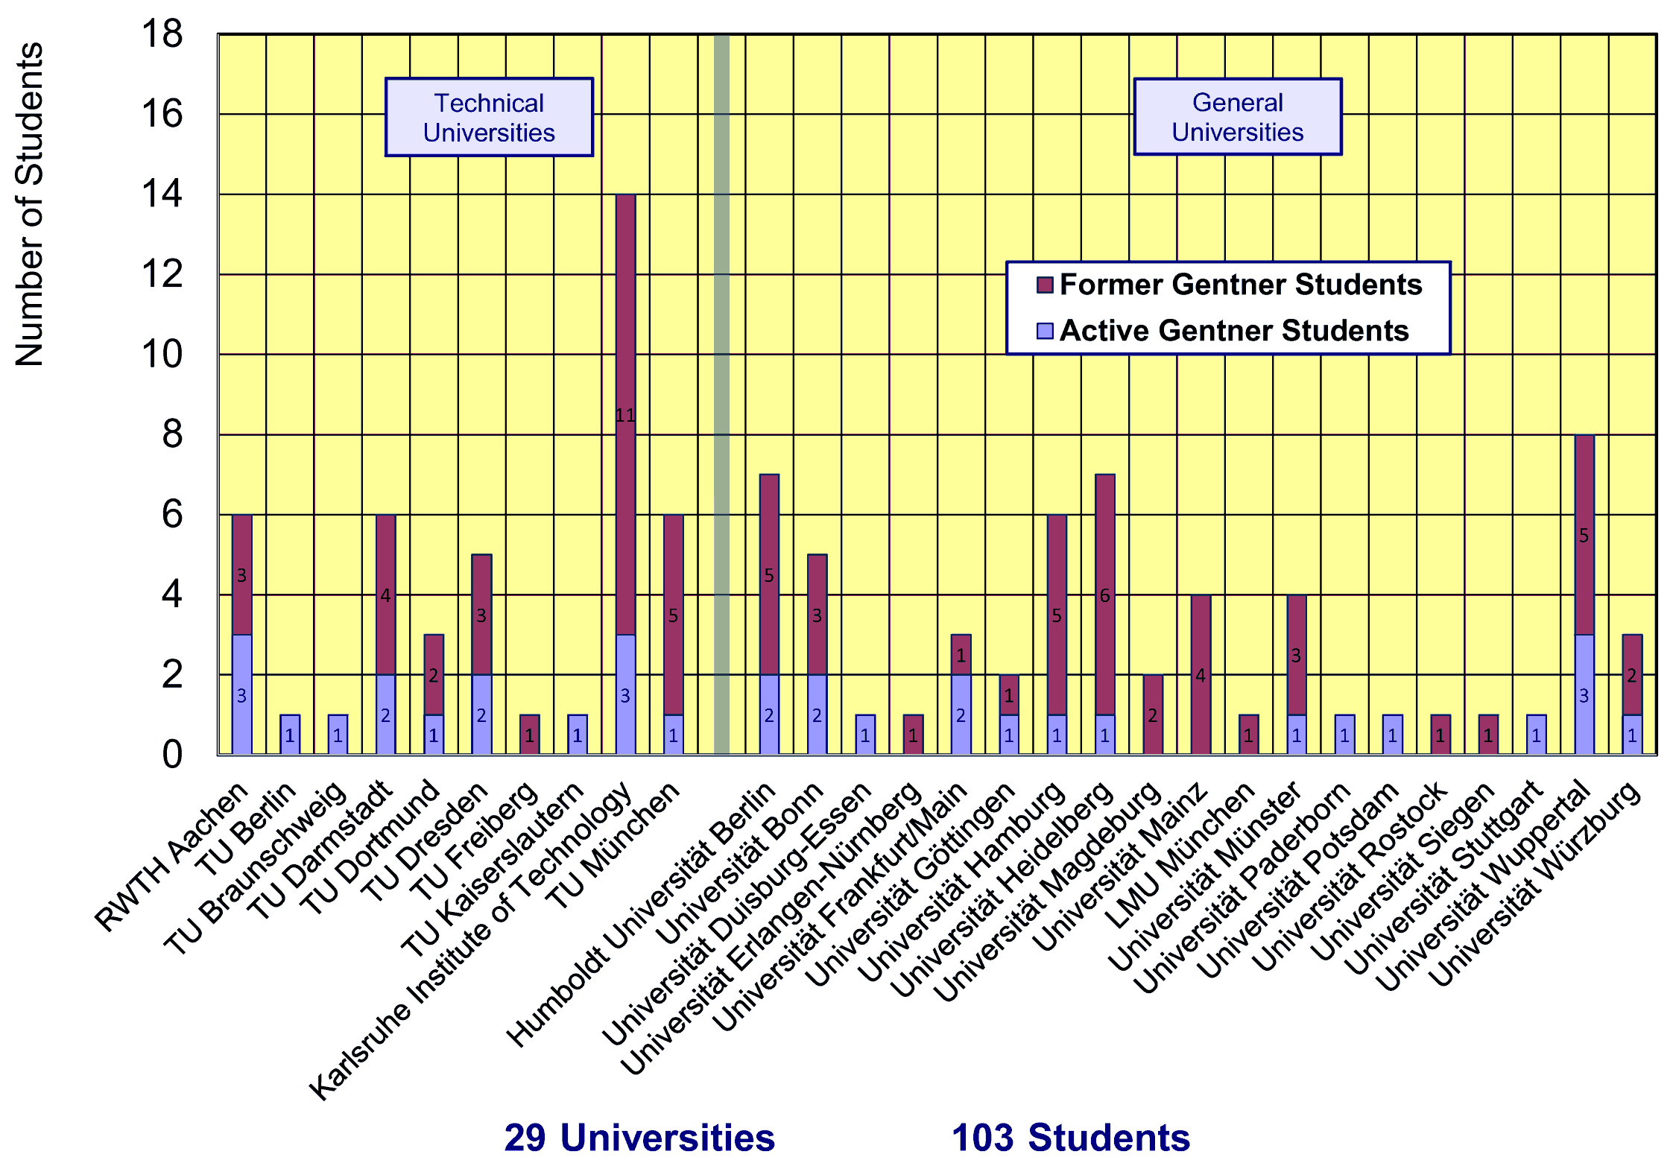

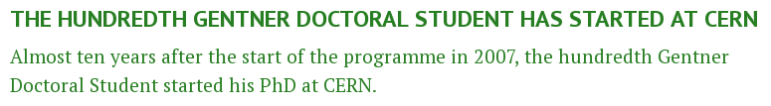
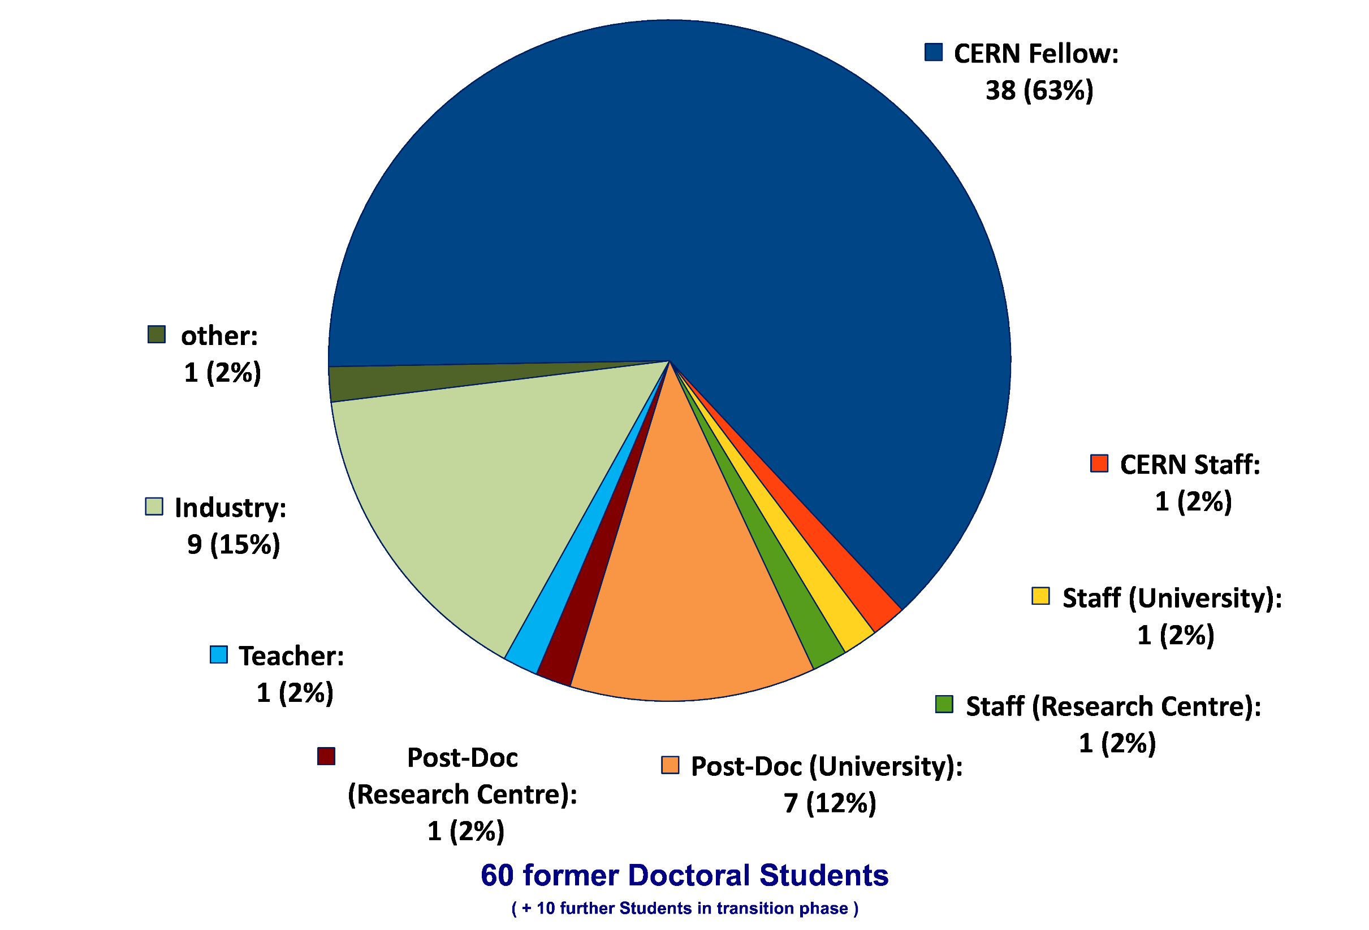
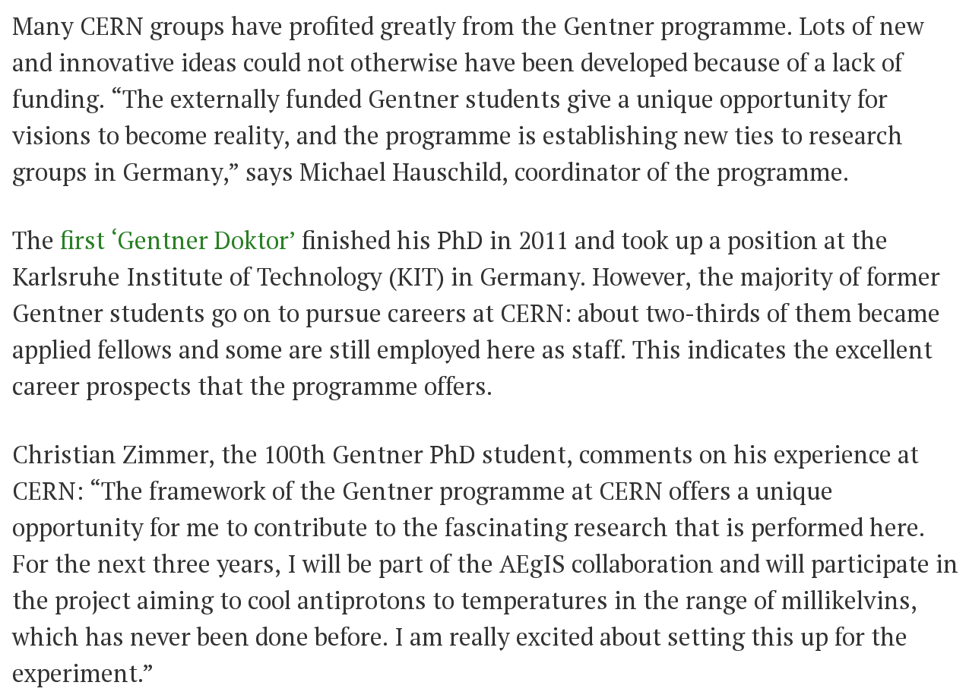


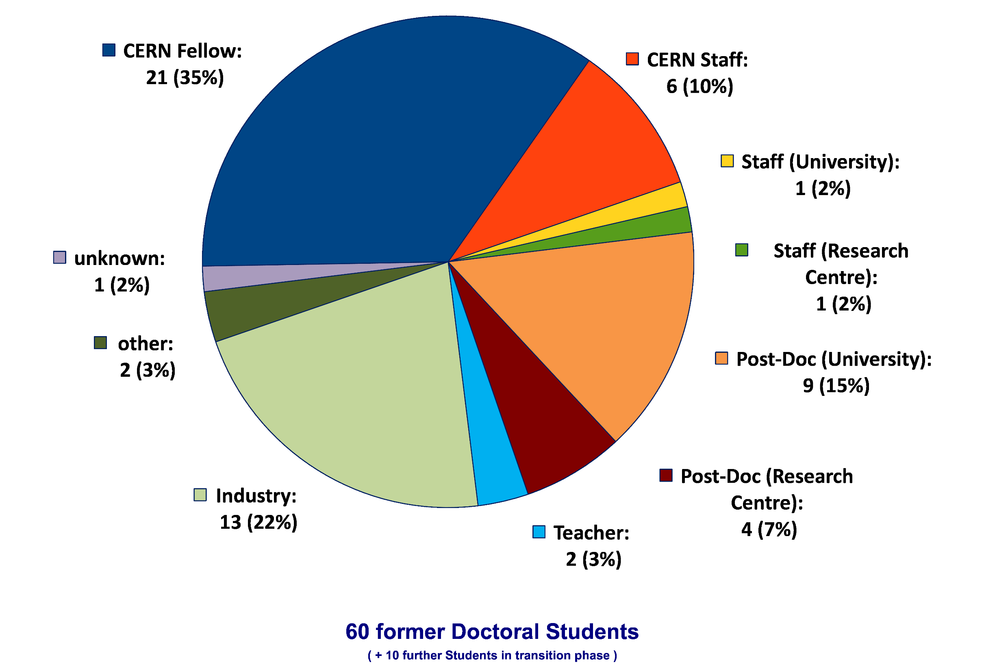
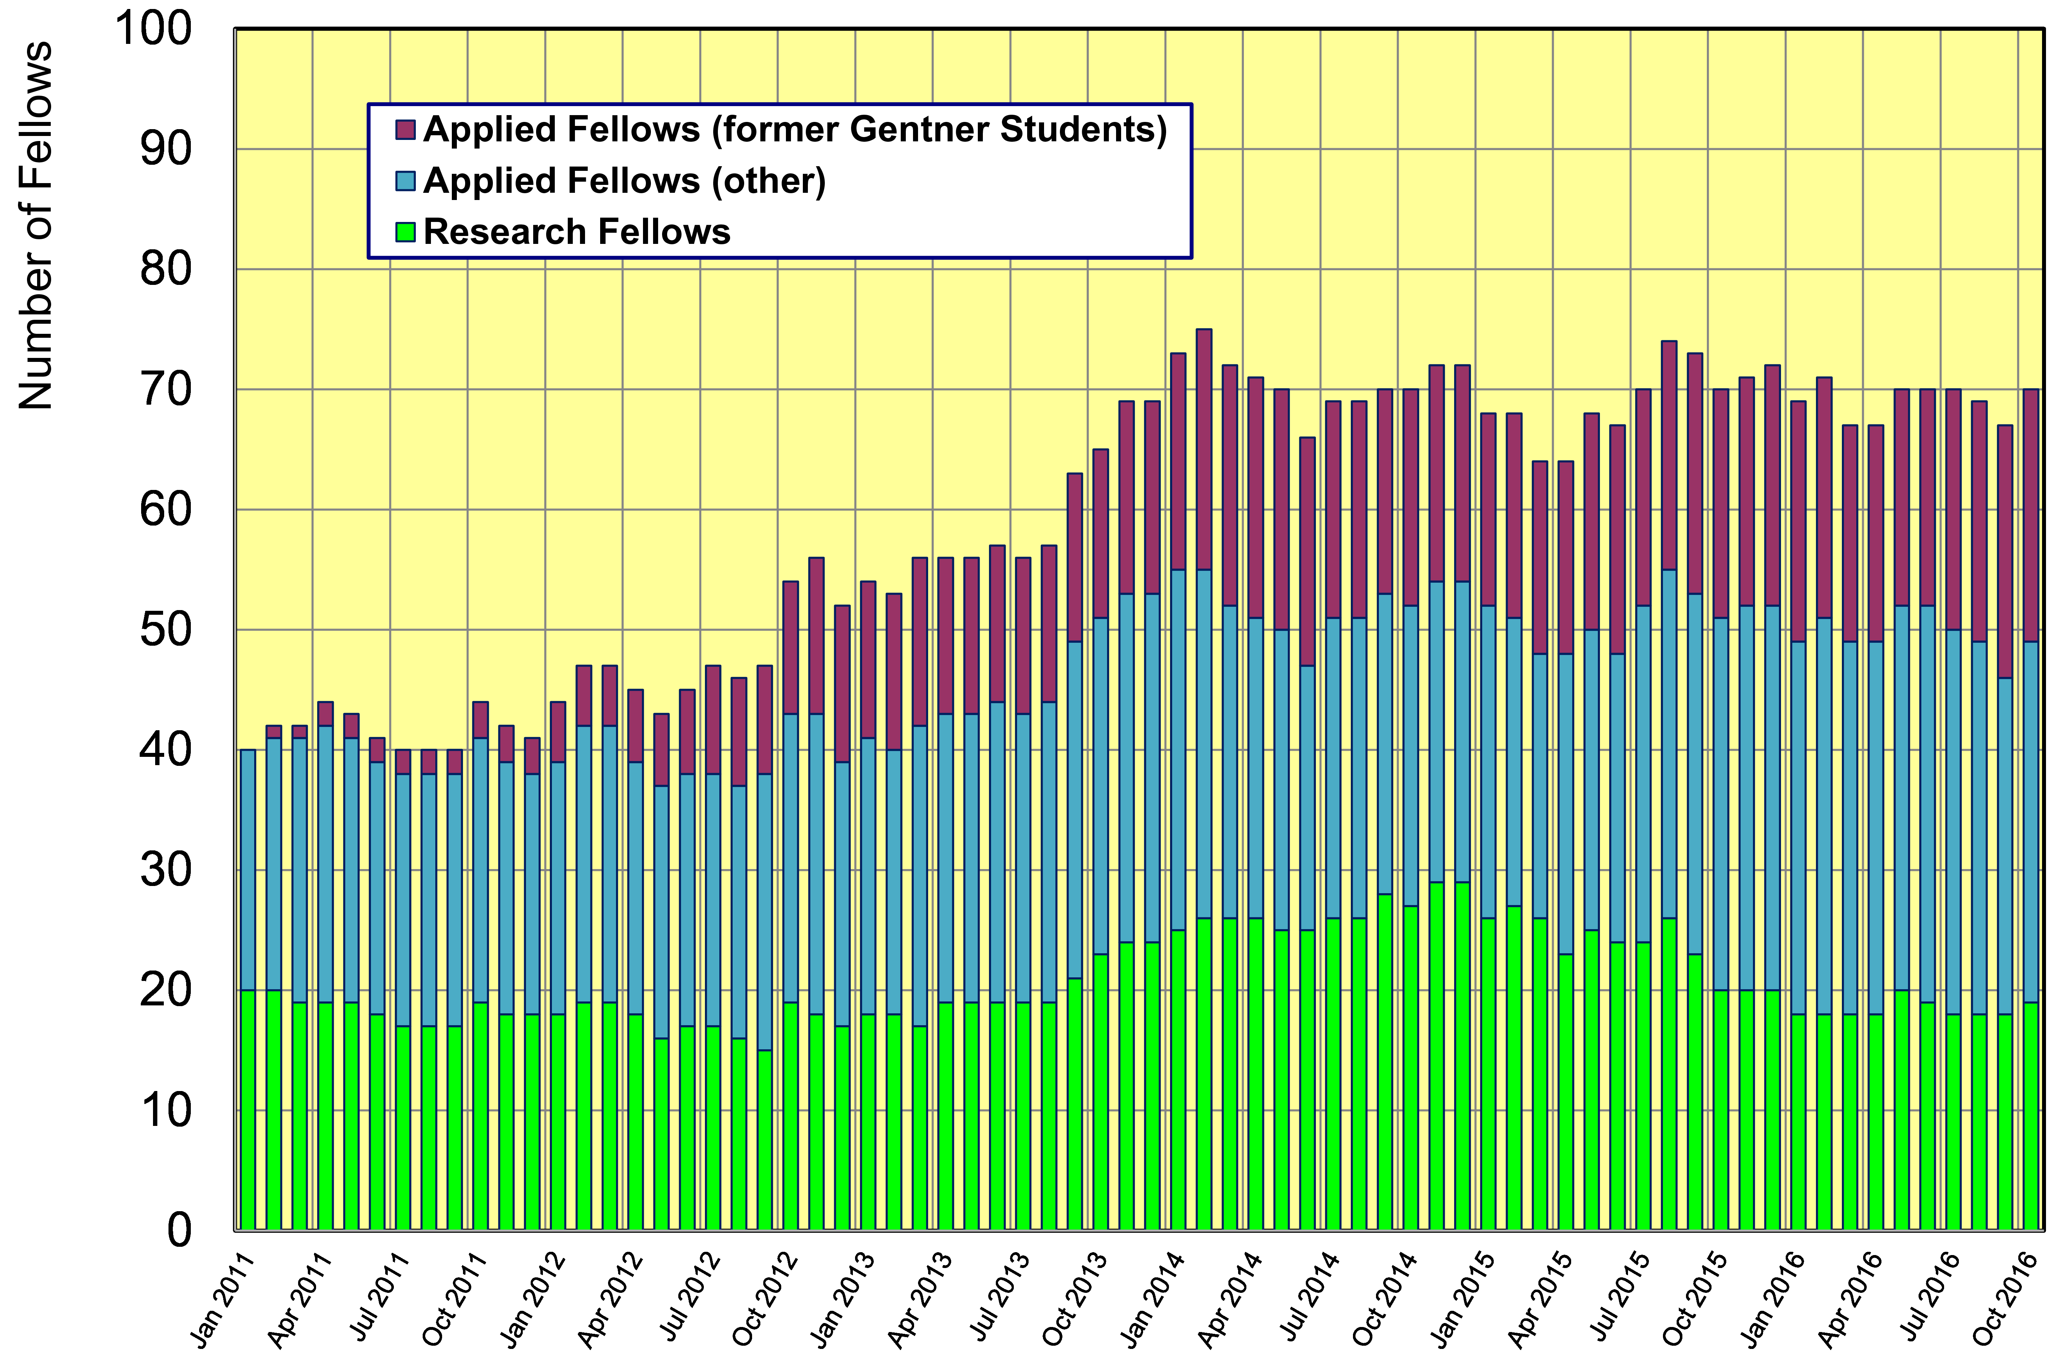
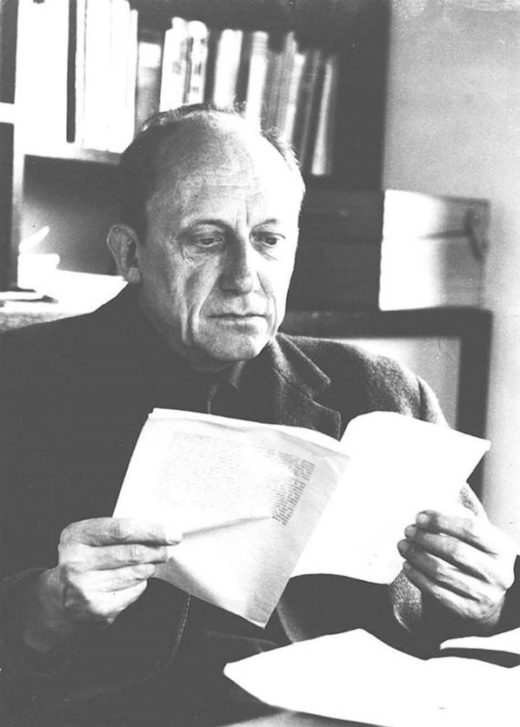

The German Doctoral Student Programme at CERN (Wolfgang Gentner Scholarships)
Manfred Fleischer (DESY), Michael Hauschild (CERN)
The German Federal Ministry of Education and Research (BMBF) is supporting technical Doctoral Students from Germany at CERN for a period of up to 3 years (Wolfgang Gentner Scholarships). Goal of the program is to train students from German universities in an international, world-class high-tech environment with close links to industry. The German Doctoral Student Programme is fully integrated into the general CERN Doctoral Student Programme under the same employment conditions, but funded by the BMBF. Additional funds are available to support students’ travelling to Germany.
Key figures of the Gentner Programme
Evolution of Technical Doctoral Students from Germany since 2007
Thesis Topics of active and former Gentner Doctoral Students
The Gentner Programme is a three-party agreement between the BMBF, CERN and DESY.
All doctoral students from EU Member States registered at German Universities are eligible to apply under this agreement.
Breakdown of cost sharing:
BMBF (Gentner Programme)
Monthly subsistence allowances for up to 3 years stay at CERN
Travel expenses for the doctoral students to travel back to their home university
Travel expenses + fees for the doctoral students to attend a suitable German national symposium
Travel expenses for supervisors for certain events (e.g. “Gentner Day”, thesis defense)
CERN
Miscellaneous integration costs (travel to/from CERN upon contract start/termination, language course, work equipment)
Travel expenses + fees for the doctoral students to attend an international conference or workshop to present their work results
Invitation of the university supervisor to CERN
Between 30 and 40 Doctoral Students per year are funded by the Gentner Programme through the BMBF. About one-third of them are female students.
The majority of students work in the fields of instrumentation, accelerator technology and computing. Among the remaining fields are also library science and physics teaching indicating the wide range of topics of the Gentner Programme.
Home Universities of active and former Gentner Doctoral Students
The 100th Gentner Student started in July 2016
Whereabouts of former Gentner Doctoral Students
First employment
Students come from 29 universities all across Germany. New ties were established with university groups, who never had any contacts with CERN before.
Present employment
Wolfgang Gentner
Evolution of German Fellows
Wolfgang Gentner (1906-1980) was a German nuclear physicist with significant work in the fields of nuclear photoeffect, gamma radiation, biophysics and archae-ometry. After 1951 he represented, together with Werner Heisenberg, (West) Germany in the negotiations leading to the founding of CERN.
From 1954 to 1959 Wolfgang Gentner was Research Director and Director of the CERN Synchrocyclotron Division. Later he initiated the CERN Fellowship Pro-gramme for young post-docs, was chair of the CERN Scientific Policy Committee and President of the CERN Council from 1972-74.
About two-thirds of all former Gentner Doctoral Students became CERN Fellows as their first employment.
Some are CERN Staff and at present, 22% of the former students are working in industry.
About 40% of all German Applied Fellows at CERN are former Gentner Students.
Work sponsored by the Wolfgang Gentner Programme of the Federal Ministry of Education and Research:
http://cern.ch/gentner

