Slide 1


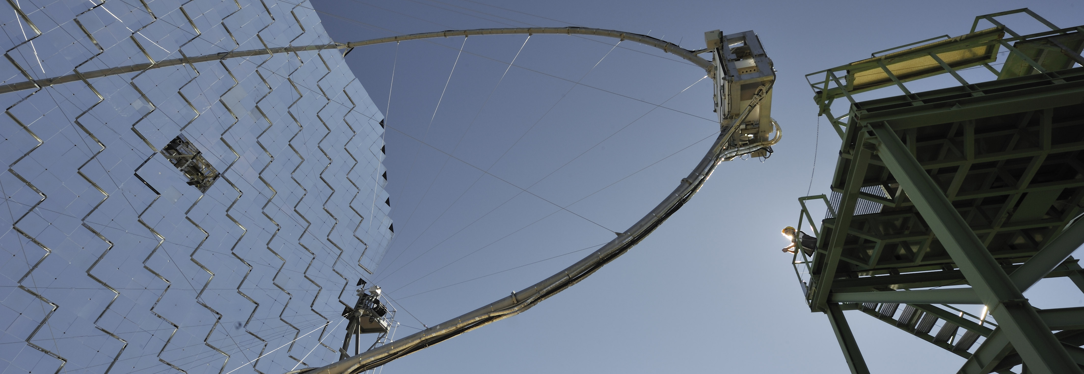

SNSF-Funded Projects in Physics and Gender Equality at the SNSF
François Baumgartner

Slide 2
OVERVIEW
1. SNSF - Facts and figures
        Institutional measures to promote gender equality
3. Specific measures in research funding

Slide 3
OVERVIEW
1. SNSF - Facts and figures
2. Institutional measures to promote gender equality
3. Specific measures in research funding

Slide 4

The SNSF – Facts and figures
promotes scientific basic research on behalf of the Confederation
invests in young scientists
enables research stays abroad
promotes international
co-operation
promotes gender equality

Slide 5
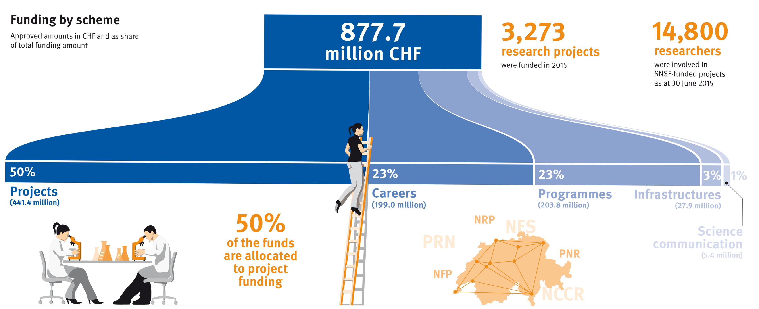
The SNSF in numbers 2015

Slide 6
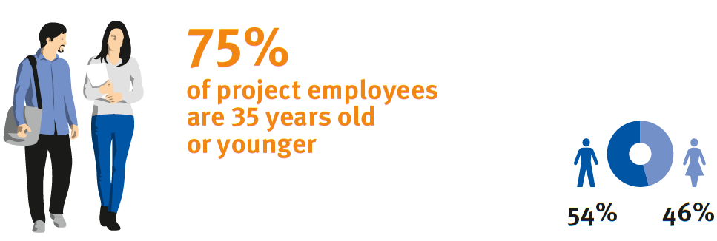
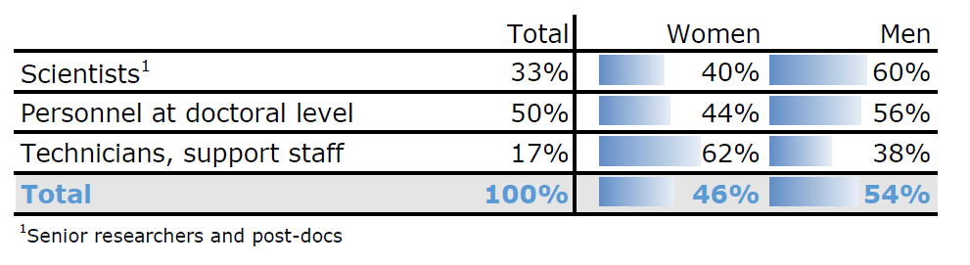
Personnel in research projects 2015

Slide 7
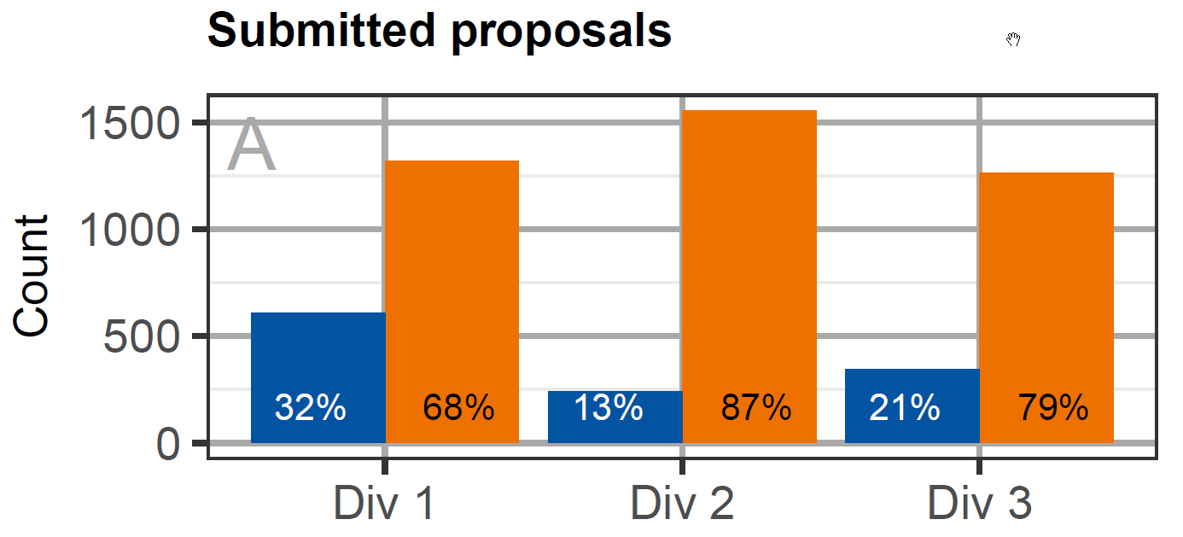

Submissions 2014-2016
Women
Men

Slide 8
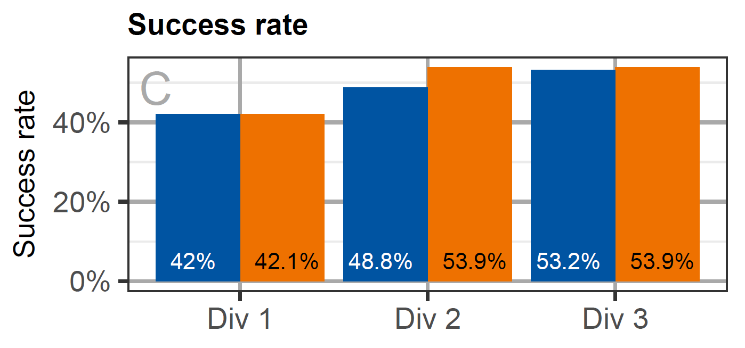
Success rates
Women
Men

Slide 9
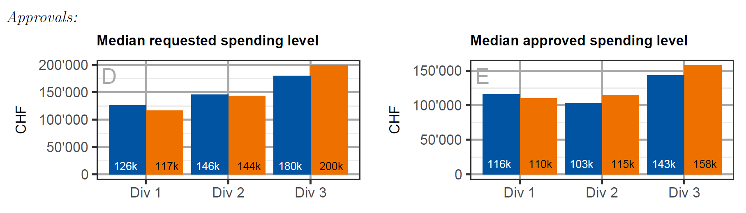
Requested and granted amounts
Women
Men

Slide 10
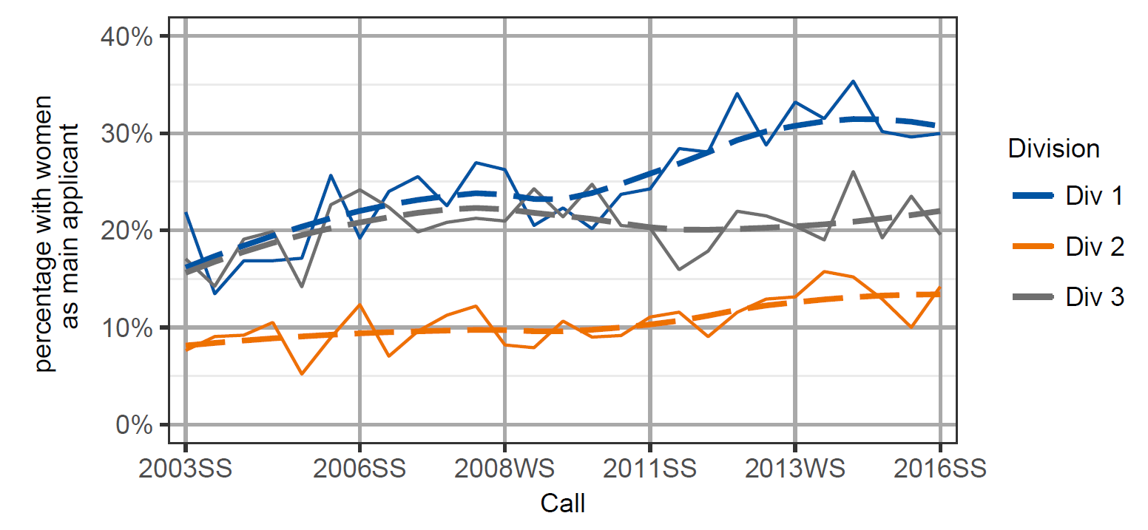
Women as PIs:
Trends in submission by division

Slide 11
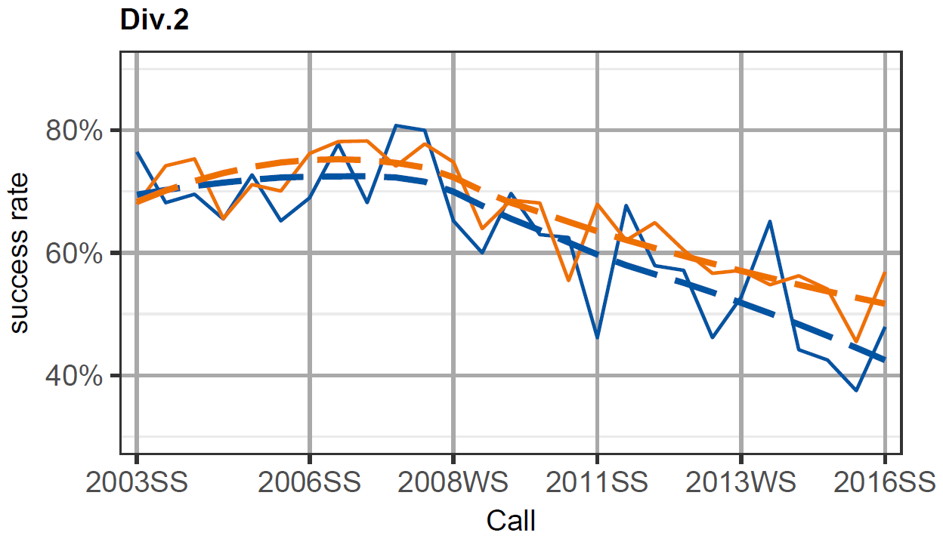

Div. 2: Trends in success rates
Women
Men

Slide 12
Projects – Women in Physics

Slide 13
OVERVIEW
1. SNSF - Facts and figures
Institutional measures to promote gender equality
3. Specific measures in research funding

Slide 14
Institutional measures to promote gender equality
SNSF Mission Statement on Equality between Women and Men
Gender Equality Commission and Office
Gender mainstreaming
Targets in career instruments
Gender monitoring (will be multi-variate)
Publication of sex-disaggregated data
Preferential rule for elections in the Research Council
New: 40% women quota in the Foundation Council

Slide 15
OVERVIEW
1. SNSF: Facts and Figures
2. Institutional measures to promote gender equality
3. Specific measures in research funding

Slide 16
Gender Equality Measures by the SNSF
The SNSF offers career specific support
Gender action plans in the NCCRs
Special programme for women: Marie-Heim-Vögtlin grants (to be replaced by PRIMA Promoting Women in Academia)
Exceptions concerning academic age (benchmark)
Support for researchers with family commitments (120% support grant)
Gender Equality Grant
Financial support of existing mentoring programmes at universities
Nominations for AcademiaNet

Slide 17

Do you have any questions?

