Slide 1
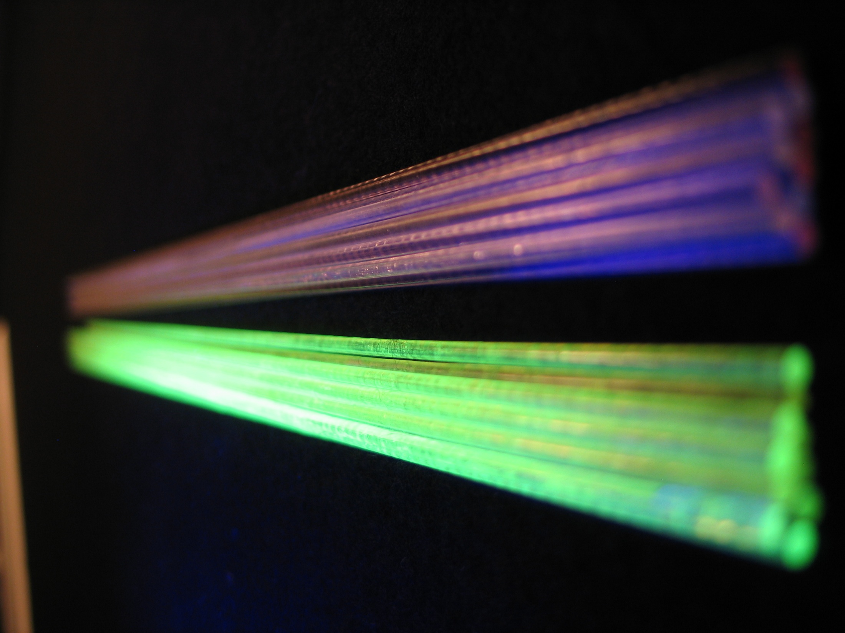
Heavy Scintillating Crystal Fibers for calorimetry
E. Auffray, P. Lecoq, CERN, Geneva

Slide 2
Proposal
New technologies in the production of heavy scintillators open interesting perspectives for calorimetry in future colliders :
  Design flexibility: detector granularity
  Functionality: extract more information than simple energy deposit
The concept of this proposal is based on metamaterials with dual/triple readout capability
  Scintillating cables made of heavy scintillating fibers of different composition ➱ quasi-homogeneous calorimeter
  Fiber arrangement in such a way as to obtain 3D imaging capability
  Fiber composition to access the different components of the shower

Slide 3
Concept of meta-cable
Select a non-intrinsic scintillating material (unlike BGO or PWO) with high bandgap for low UV absorption
The undoped host will behave as an efficient Cerenkov: heavy material, high refraction index n, high UV transmission
Cerium or Praesodinum doped host will act as an efficient and fast scintillator
  ≈ 40ns decay for Ce
  ≈ 20ns decay for Pr
If needed fibers from neutron sensitive materials can be added:
  Li Tetraborate: Li₂B₄O₆
  LiCaF: LiCaAlF₆
  elpasolite family (Li or B halide of Rb, Sc and rare earth)
All fibers can be twisted in a cable behaving as a pseudo-homogeneous active absorber with good position and energy resolution and particle identification capability
Readout on both sides by SiPMT’s

Slide 4
Concept of a Meta-cable for HEP
SiPMTs
MOEMS diffractive optics
light concentrator
MOEMS diffractive optics
light concentrator
SiPMTs

Slide 5
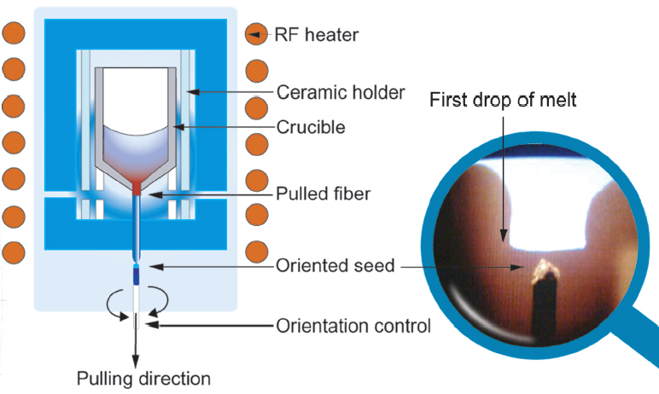
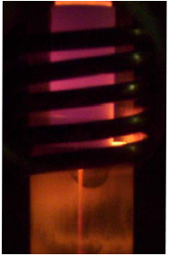
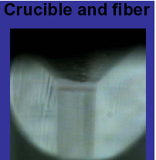



Micro-pulling-down crystal fiber growth
BGO
Φ=400μm
YAG:Ce
Φ=1mm
LYSO:Ce
Φ=2mm
YAP:Ce
Φ=2mm
Courtesy Fibercryst, Lyon

Slide 6
Lutetium Aluminum Garnet
LuAG (Lu₃Al₅O₁₂)
Physico-chemical properties
Optical properties
Structure / Space group | Cubic / Ia3d
Density (g/cm³) | 6.73
Zeff | 62.9
Radiation length X₀ (cm) | 1.41
Interaction length (cm) | 23.3 LuAP: 19.8 Fe: 17
Hardness (Mohs) | 7.5 PWO: 3 BGO, glass: 5
Fracture toughness (Mpa.m^{1/2}) | 1.1
Cleavage plane / H₂O solubility | No / No
Melting point (°C) | 2260
Thermal expansion @ RT (°K⁻¹) | 8.8 10⁻⁶
Thermal conductivity @ RT ( W/m°K) | 31
Light yield: Ce or Pr doped (ph/MeV) | 20’000 1/2 NaI(Tl)
d(LY)/dT | ?
Emission wavelength (nm): Ce doped Pr doped | 535 290, 350
Decay time (ns): Ce doped Pr doped | 70 20
Refractive index @ 633nm (isotropic) n²= 3.3275151 - 0.0149248 λ² | 1.842 Quartz: 1.55
Fundamental absorption undoped (nm) | 250
Max. Cerenkov 1/2 angle | 57°
Total reflexion 1/2 angle | 33°
Cerenkov threshold e energy (KeV) | 97

Slide 7
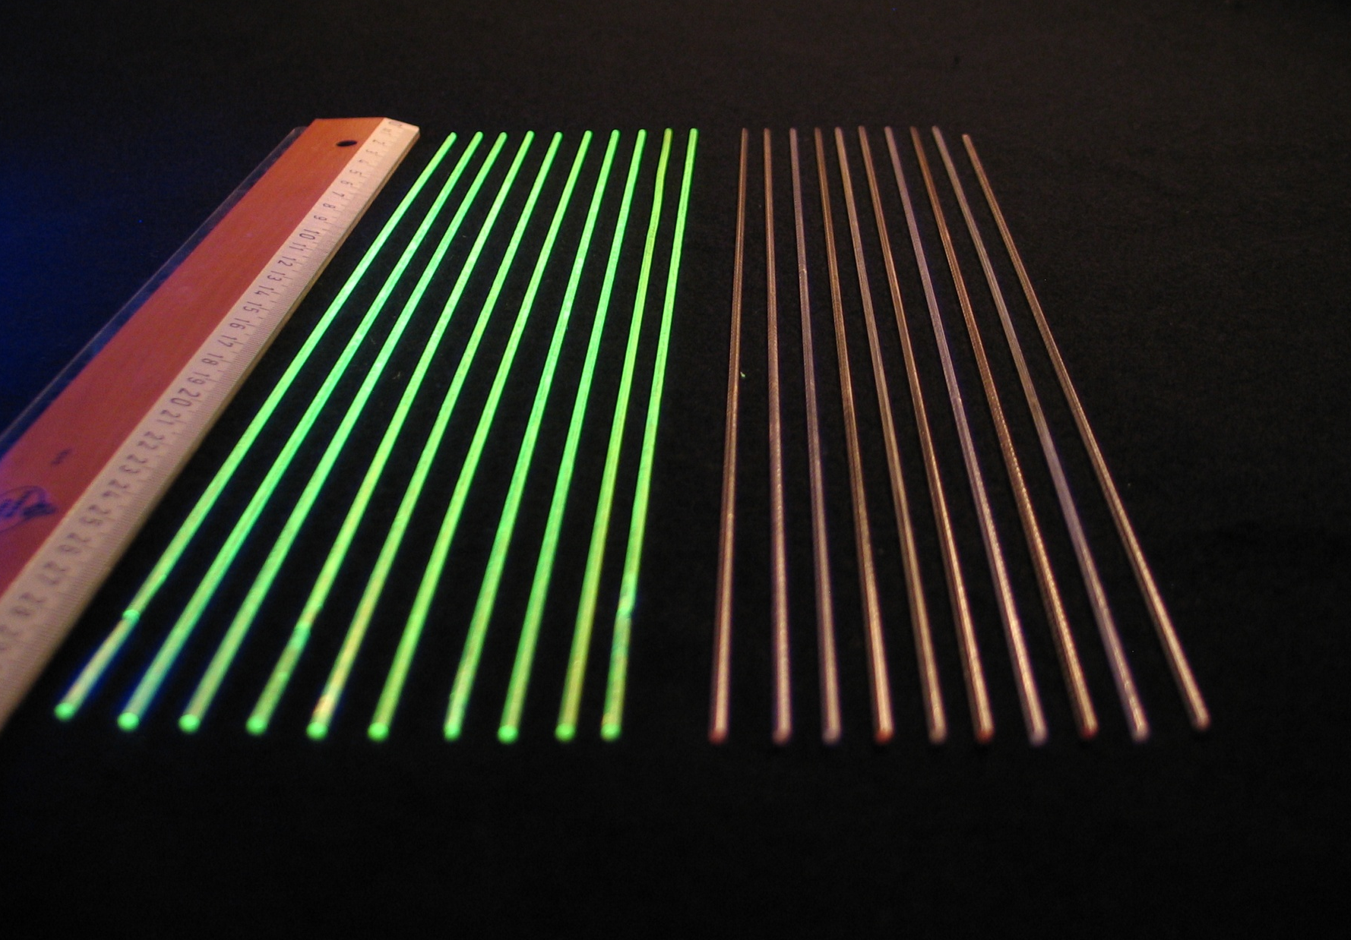
1st fibres received in Sept08
Ø 2mm
30cm
Ce doped LuAG
undoped LuAG

Slide 8
Status of the development
Optical characterisation
  (Attenuation, Light Yield, Decay time)
Test readout with SiPMT and diffractive optics
Material optimisation in Collaboration with Company
Preparation of new test beam for 2009 with bigger cable (size comparable to a CMS PWO crystal (2x2x23cm)
Simulation studies to determine and optimise the detector geometry and granularity needed for a precise determination of the electromagnetic fraction of the energy deposition in jets both at SHLC in the forward region and at CLIC energies.

