Slide 1


23rd CATIA FORUM
Introduction

Slide 2

PLEASE SWITCH OFF YOUR PHONE

Slide 3
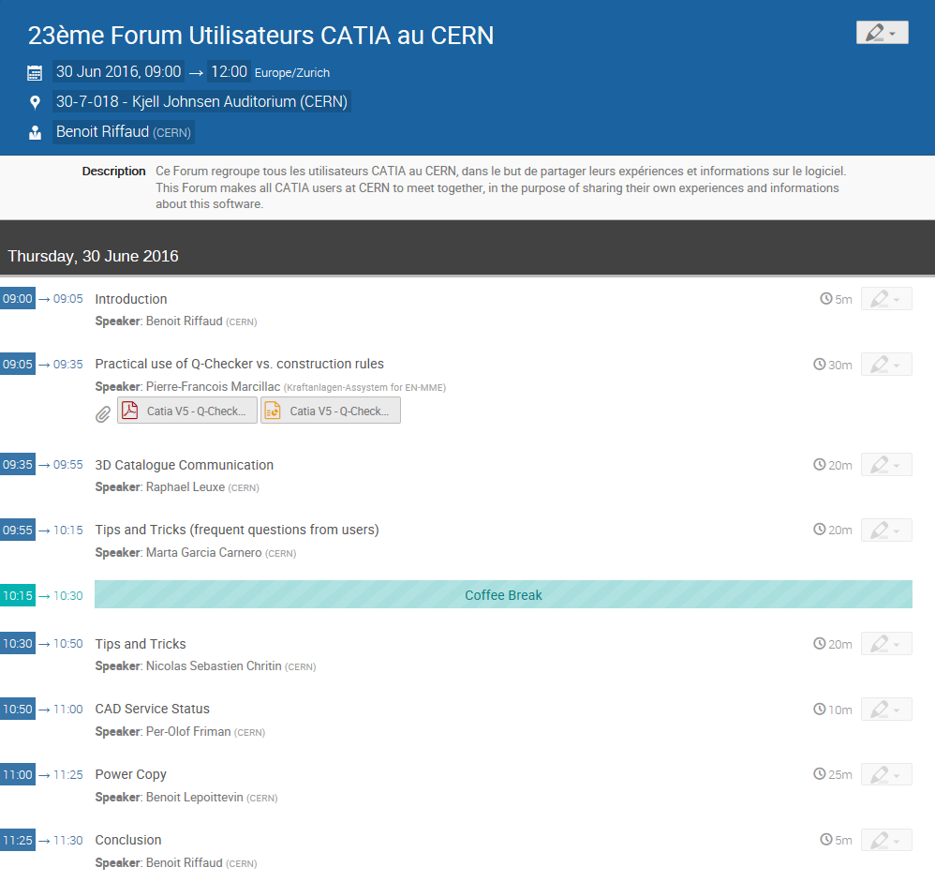
https://indico.cern.ch/event/525796/

Slide 4

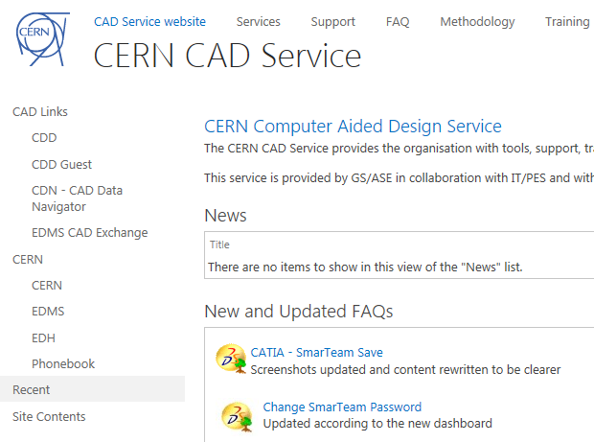
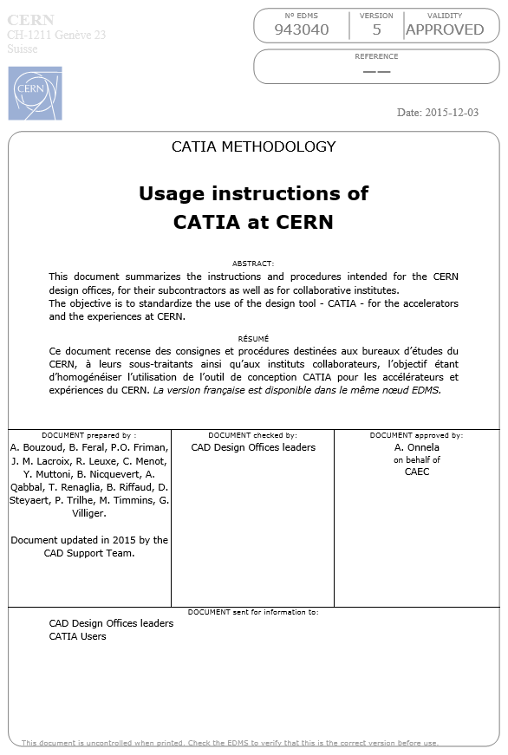
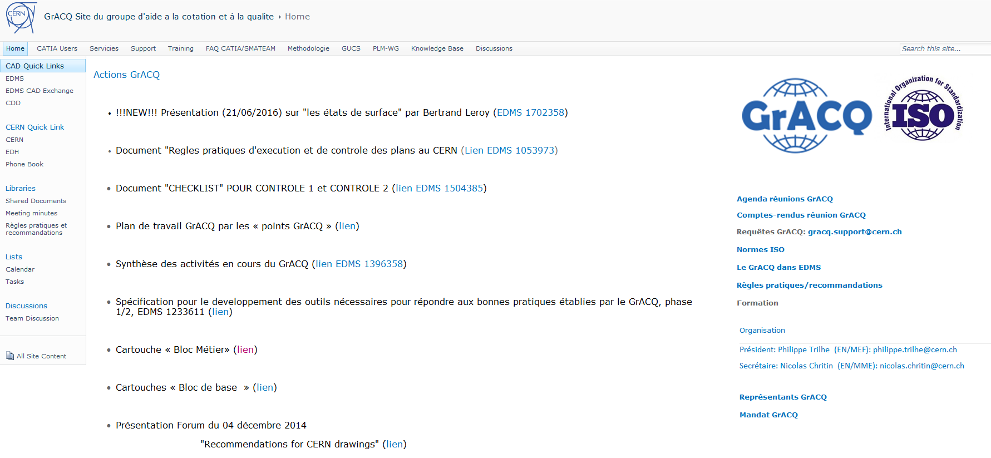
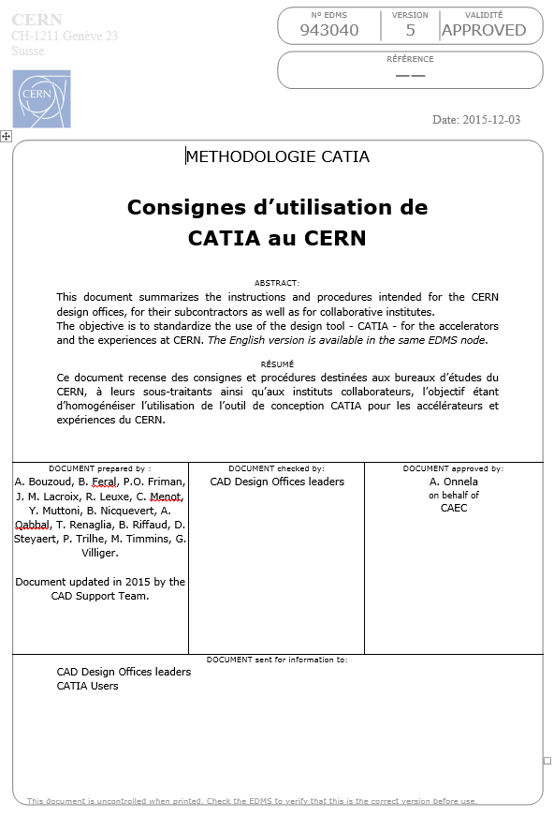
WHERE TO FIND HELP ON METHODOLOGY ?
CERN CAD SERVICE
WEB PAGE
CATIA USAGE
INSTRUCTIONS
GRACQ
WEB PAGE
70 CATIA construction rules
43% checked by Q-Checker
12% solved by Q-Checker
https://espace.cern.ch/GrACQ
https://cad-support.web.cern.ch
https://edms.cern.ch/document/943040/5

Slide 5

THE CATIA USER FORUM IS YOUR FORUM !
……
85 USERS IN AVERAGE PARTICIPATE TO THE FORUM
……
MORE THAN 200 CATIA USERS ARE REGISTERED AT CERN
BUT
LESS THAN 10% OF THEM MADE PRESENTATIONS AT THE FORUM
……
NO PRESENTATIONS = NO FORUM
……
DO NOT HESITATE TO PROPOSE IDEAS OR TO SHARE YOUR EXPERIENCE
PLEASE CONTACT Benoit.Riffaud@cern.ch

