Slide 1
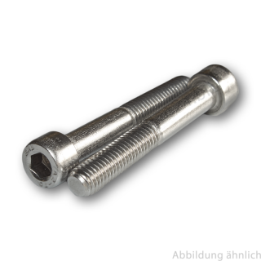
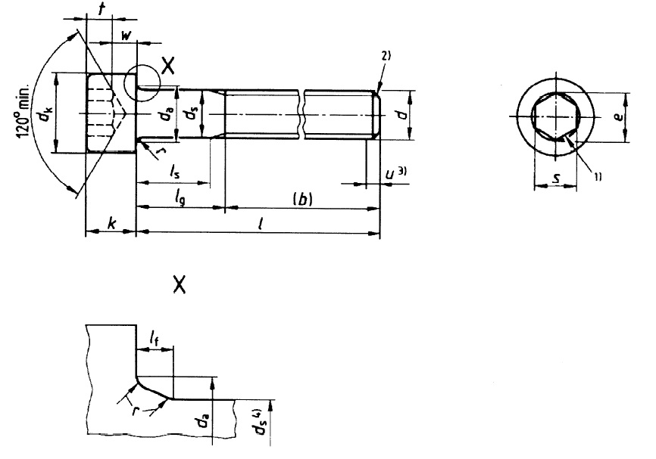
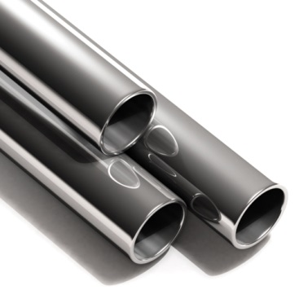
Updates on screws + materials

Slide 2
ISO 4762-A4 screw modifications
Material updates
Reminder about material in CATIA
How to adjust material density

Slide 3
  Unused elements
  Invisible threaded length
  Issues in Assemblies
  Added Screws (new length)
  Limitations
  Most used family

Slide 4
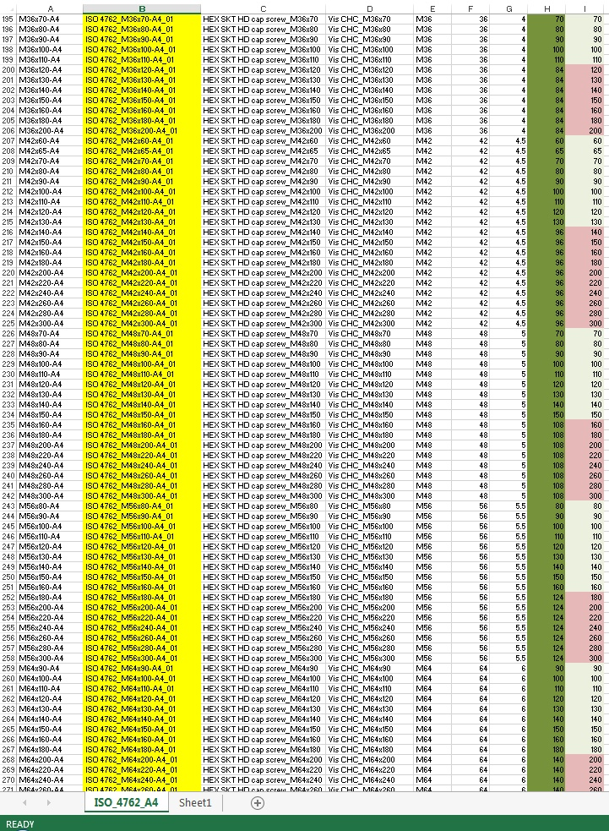

  unused elements since 10 years have been deleted:
All Ø > M30 were unused until now:
M36, M42, M48, M56, M64
82 elements in total

Slide 5
  In case you need one deleted screw in the future:
  Create it yourself and send a request to add to catalog.
  We’ll add these «exotic» elements 1 by 1 if several use cases
  Goal: decrease number of elements and make easier the search.

Slide 6
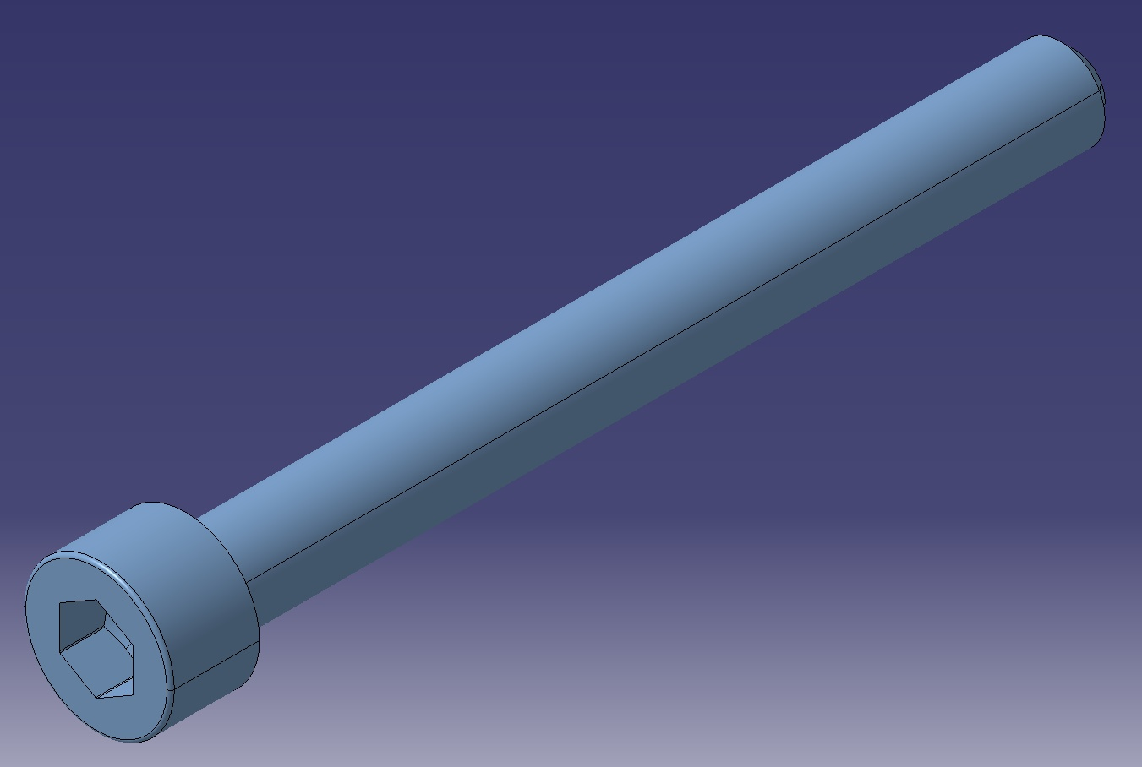
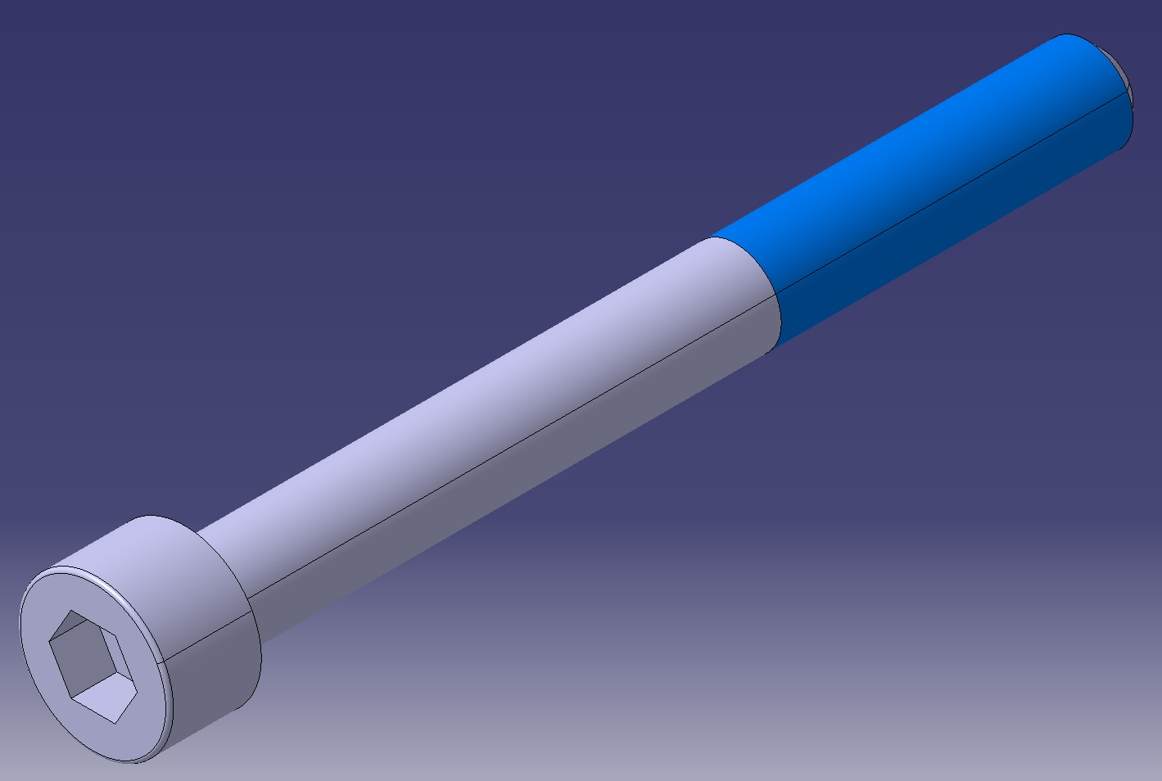
  Invisible threaded length:
Before 2016-06-25
After 2016-06-25

Slide 7
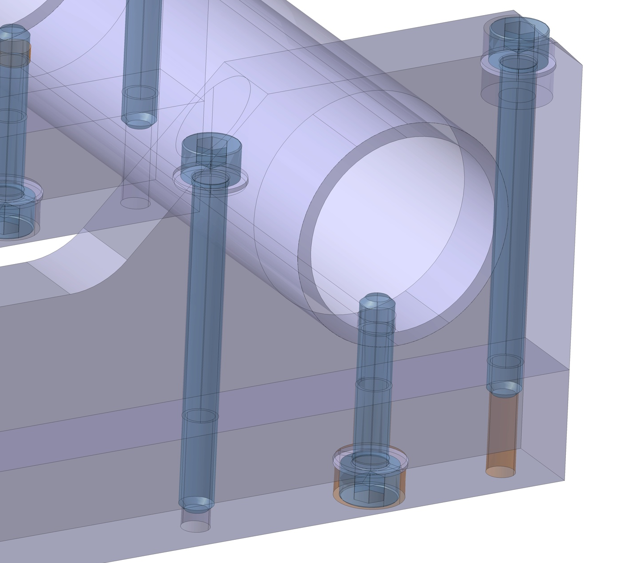
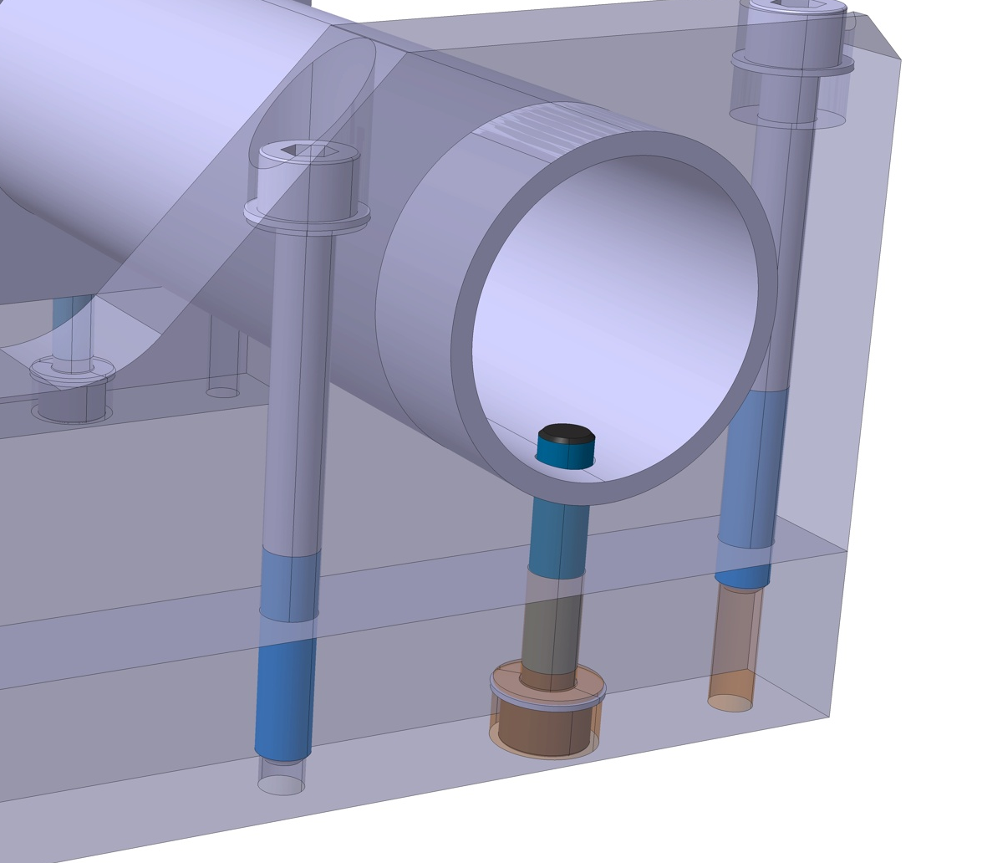
  Assembly visibility improved:
Before 2016-06-25
After 2016-06-25

Slide 8
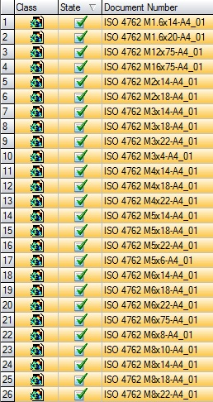
  Added Screws (Bossard and SCEM):
26 new elements created
Most of them in common Ø
(M3, M4, M5, M6, M8)

Slide 9
Limitation:
  Threaded length is not the nominal one for full threaded screws
  Reason: CATIA is lost if we don’t always have 2 areas (1 threaded, 1 normal)
  This limitation turns into being an advantage as you get the minimum threaded length

Slide 10
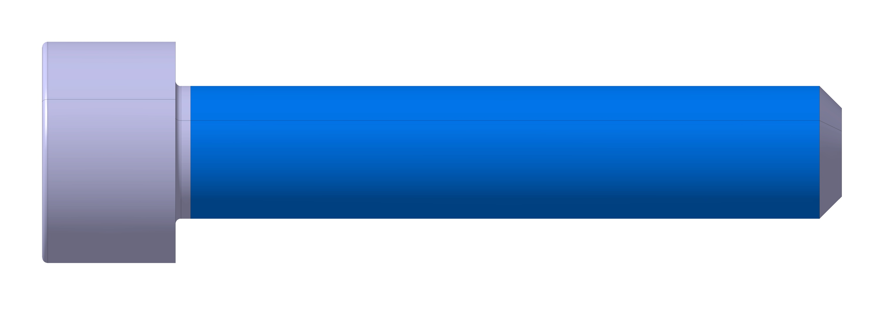
Limitation:
30 mm
Example: M6x30 A4
3D threaded length = 29.32mm (according to ISO)
Instead of 30mm

Slide 11
  31 new materials added in 10 monthes
  Steels, Copper Alloys, Bronze, Brass, Aluminium Alloys, Standard Parts Material, Other Metals, Ceramics, Composites, Polymers, Civil Engineering, Other

Slide 12
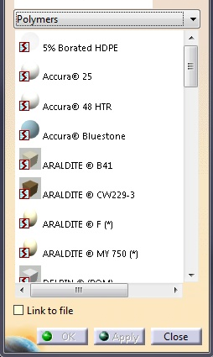
  Steel YUS 130S (LHC dipole collar)
  Bronze C91700 (CuSn12)
  Alu EN AW-2024 (T4)
  St. Steel A4 BUMAX
  Titanium Gr.2, Gr.5, Gr.6
  Inconel X-718® EN 2.4668
  Niobiums (EDMS spec)
  Accura (CERN 3D printing)
  St. Steel EN 1.4404 or 1.4435 (316L)

Slide 13
  How to apply material properly
  How to add new material in catalog

Slide 14
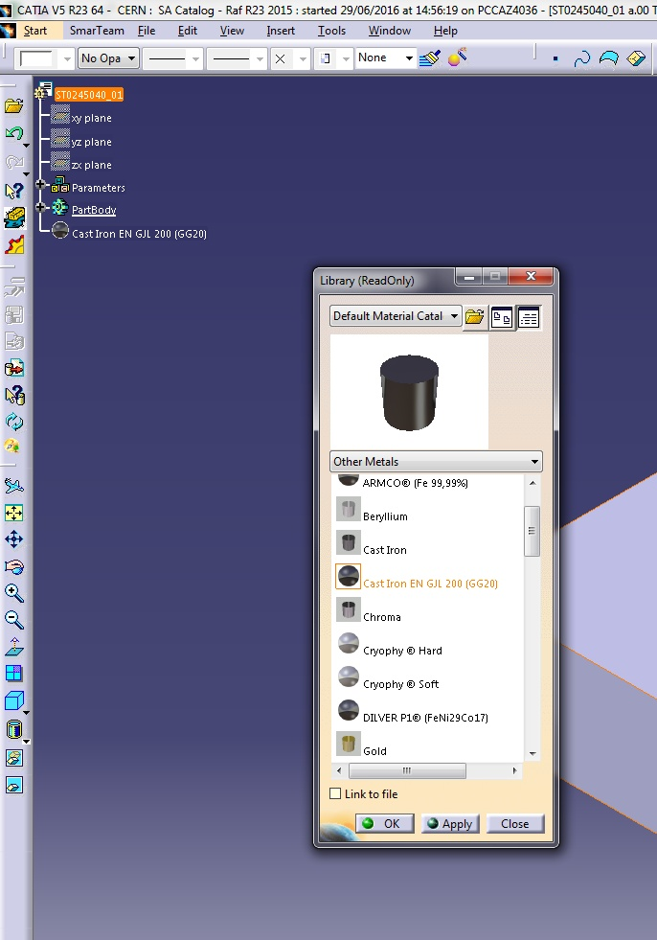

  How to apply material properly?
  Open your CATPart
  Click on the tree top
  Launch Material Catalog
  Browse in desired family
  Select the material you need
  Click OK button
  Smarteam Save
2
7
4
5
  FAQ
!!! NEVER SELECT «Link To File» !!!
6
3

Slide 15
  How to add new material in catalog?
  Define the exact name
  Collect some datas (mechanical properties)
  Send a mail to:
  with all infos you found
  Wait…
  …few days to few weeks…
catia-catalogs@cern.ch
SPECIAL CASES

Slide 16
  Sometimes you need to modify material density:
  Check that the material is not linked
  Double Click on the material
  Go to Tab «Analysis»
  Modify the «Density» value
  Click OK
  Check you have the desired mass
  Save your CATPart
MUST BE DONE FOR EXCEPTIONNAL CASE

Slide 17
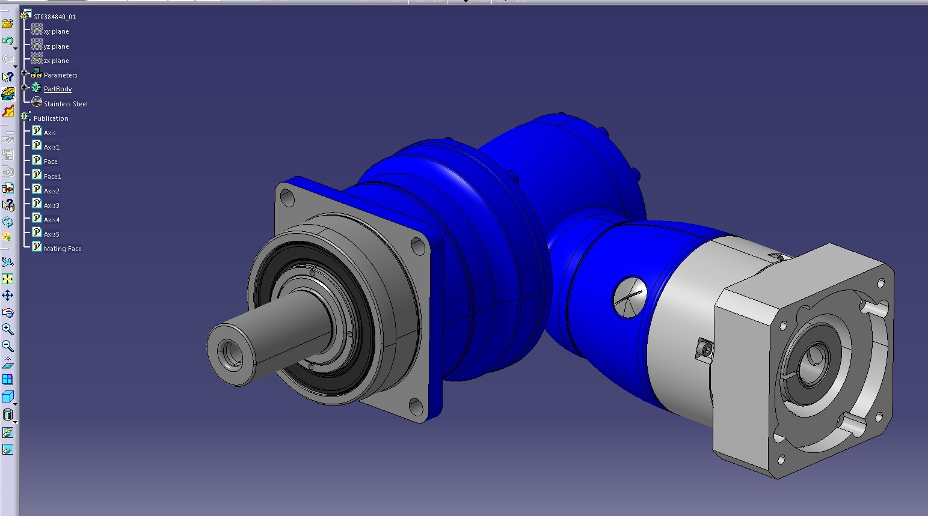
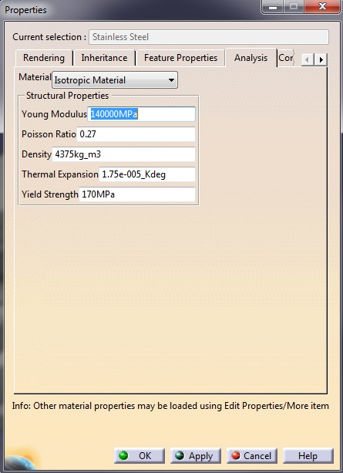
  Example of a gearhead:
3
2
4
5

Slide 18
Now you know all about:
ISO 4762-A4 screws modifications
Material updates
Reminder about material in CATIA
How to adjust material density

Slide 19
Thanks with help of Marta Garcia Carnero
Catia-catalogs@cern.ch

