Slide 1
FCC week summary and next Steps
May 11th 2016
W. Riegler
Presenters at the Rome FCC meeting:
Martin Aleksa, Ilaria Besana, Sergei Chekanov, Dmitri Denisov, Zbynek Drasal, Benedikt Hegner, Clement Helsens, Julia Hrdinka, Ashutosh Kotwal, Matthias Mentink, Dave Newbold, Estel Perez, Walter Snoeys, Ian Shipsey, Hans Kristian Soltveit, Herman Ten Kate, Marianna Testa, Georg Viehhauser, Anna Zaborowska,

Slide 2
Baseline Parameters for the FCC-hh Machine
5 year long operation periods
3.5 years operation periods with
1.5 year shutdown
2 periods at baseline parameters (10 yrs) Phase1
Peak luminosity 5x10³⁴cm⁻²s⁻¹ , 25ns, pileup 170
Total of 2.5ab⁻¹ (per detector)
3 periods at ultimate parameters (15 yrs) Phase 2
Peak luminosity <=30x10³⁴cm⁻²s⁻¹ , 25(5)ns, pileup 1020(204)
5ab⁻¹ per period total of 15ab⁻¹
Although some of us are confident about prospects of being able to deal with high pileup, the 5ns option should be considered ‘at least with equal priority’ as 25ns.
The transition from Phase1 to Phase2 luminosity is not related to major hardware changes in the accelerator, so it may be continuous. Important aspect for experiment strategy.

Slide 3
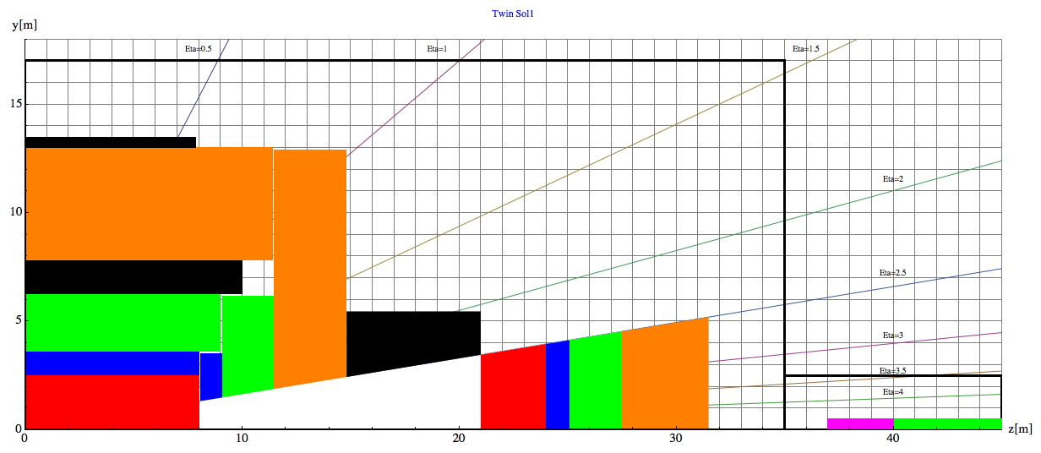
Baseline Geometry used up to now , Twin Solenoid, 6T, 12m bore, 10Tm dipole
Barrel:
Tracker available space:
R=2.1cm to R=2.5m, L=8m
EMCAL available space:
R=2.5m to R= 3.6m → dR= 1.1m
HCAL available space:
R= 3.6m to R=6.0m → dR=2.4m
Coil+Cryostat:
R= 6m to R= 7.825 → dR = 1.575m, L=10.1m
Muon available space:
R= 7.825m to R= 13m → dR = 5.175m
Revision of outer radius is ongoing.
Coil2:
R=13m to R=13.47m → dR=0.475m, L=7.6m
Endcap:
EMCAL available space:
z=8m to z= 9.1m → dz= 1.1m
HCAL available space:
z= 9.1m to z=11.5m → dz=2.4m
Muon available space:
z= 11.5m to z= 14.8m → dz = 3.3m
Forward:
Dipole:
z= 14.8m to z= 21m → dz=6.2m
FTracker available space:
z=21m to R=24m, L=3m
FEMCAL available space:
Z=24m to z= 25.1m → dz= 1.1m
FHCAL available space:
z= 25.1m to z=27.5m → dz=2.4m
FMuon available space:
z= 27.5m to z=31.5m → dz=4m

Slide 4
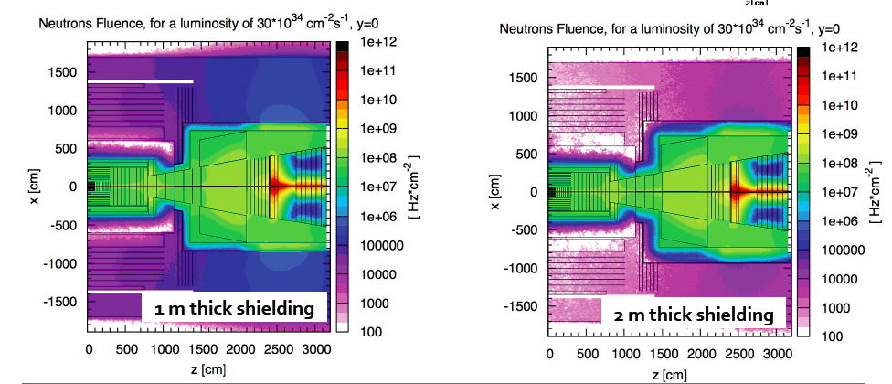
Radiation Calculations
In the central tracker, close to the beampipe, the radiation is dominated by the primary hadrons.
In the forward tracker there is in addition a significant neutron flux from the calorimeter.
Ilaria Besana

Slide 5
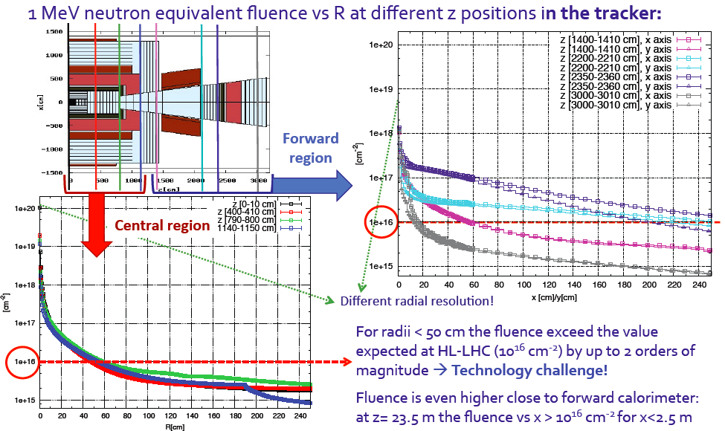
Radiation Calculations
Note: For 10¹⁶-10¹⁸ cm⁻² the sensor technology does not yet exist
Ilaria Besana

Slide 6
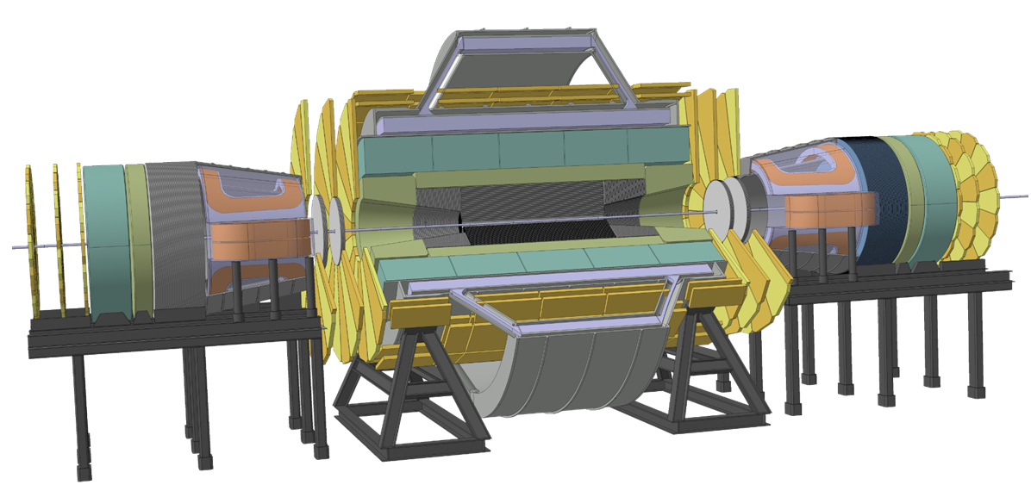
Twin Solenoid 6T, 12m bore, Dipoles 10Tm
Herman Ten Kate, Matthias Mentink

Slide 7
Development of ‘Detector Baseline’
Considering that the experiment cost should be a reasonable fraction of the accelerator cost one could naively assume a very large budget for the detectors.
The magnet group studied the 6T, 12m bore, 10Tm dipole as engineering challenge.
This geometry allows comfortably a 2.4m tracker cavity, 2.4m HCAL for 12 lambda.
Considering that such a magnet system costs on the order of 0.7-0.9 BEuros, and that for a reasonable balance the magnet system should represent between 20-30% of the detector cost, we are talking about a multi Billion cost for such a detector.
Scaling down the magnet system to 4T/10m and 4Tm dipoles reduces the cost by about a factor 2 to 0.35 to 0.45 BEuros, which brings the detector cost closer towards the ‘one Billion’ range.
We should therefore think about a more realistic baseline for the 2018 report.

Slide 8
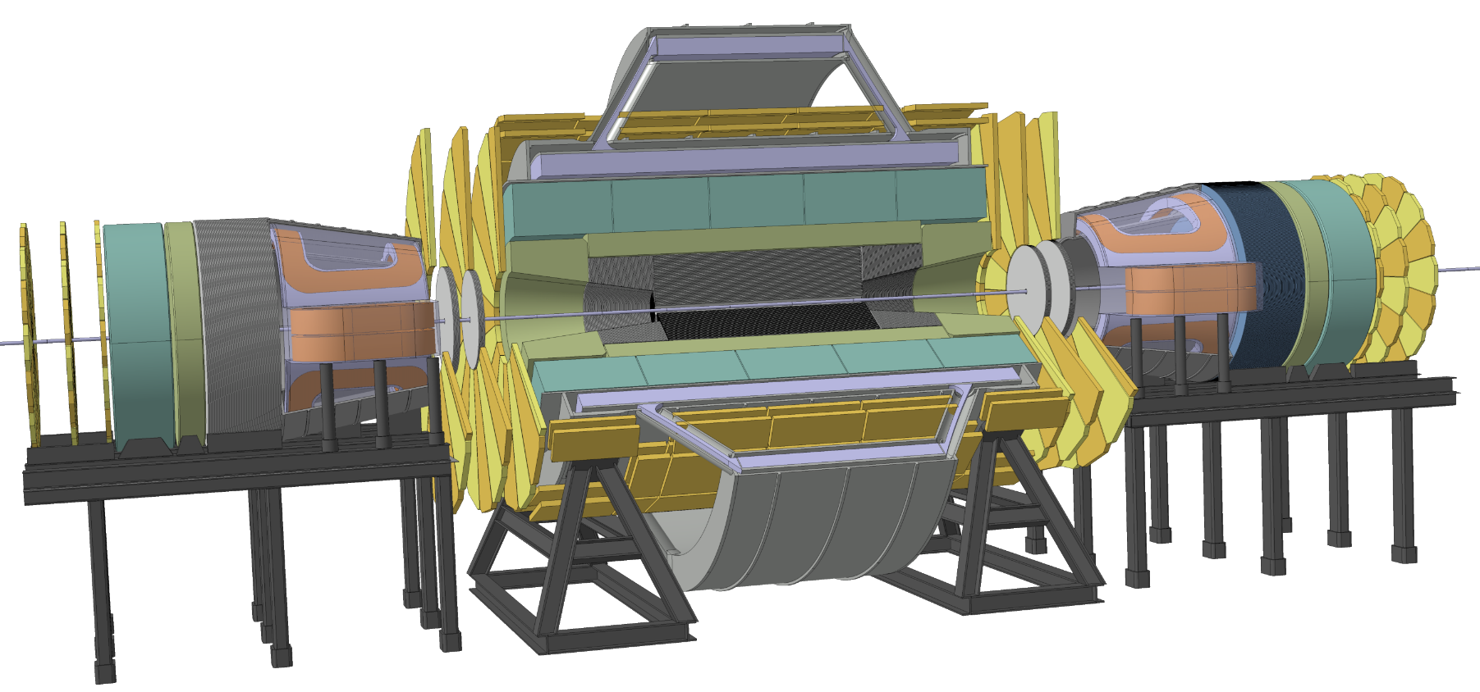
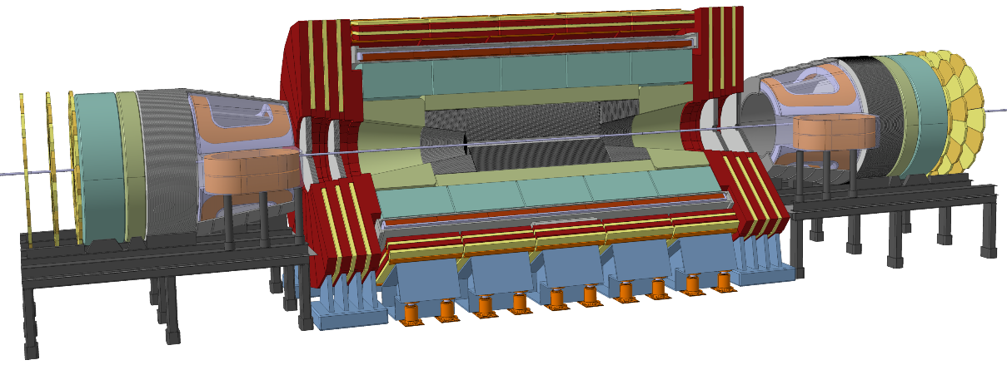
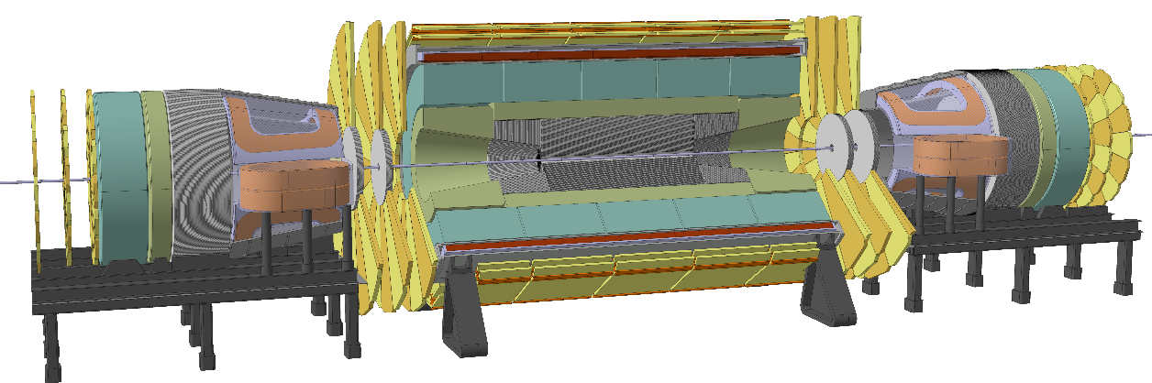
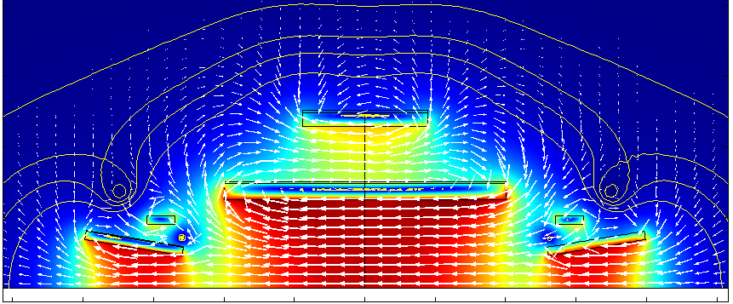
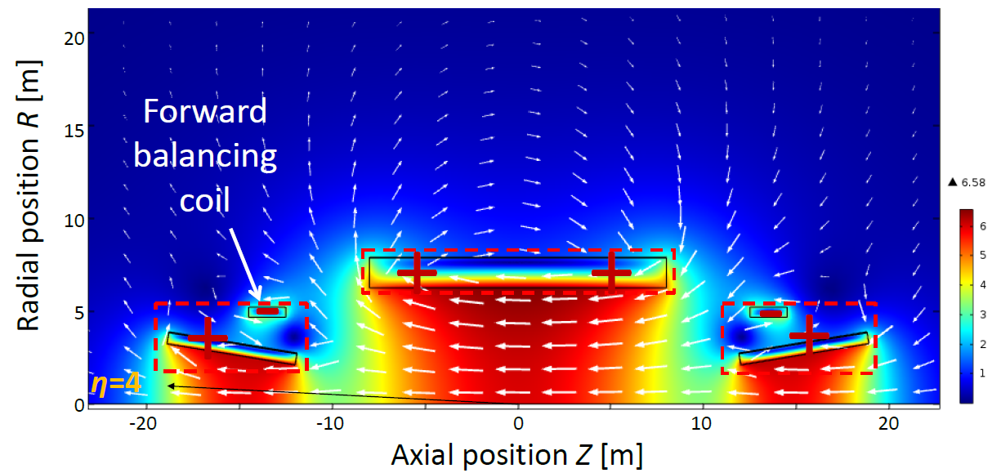
Magnet systems under consideration
Twin solenoid with dipoles
(min. shaft diameter 27.5m)
Partially shielded solenoid with dipoles
Unshielded solenoid with dipoles
(min. shaft diameter 16.3m, if rotated under ground)
Twin solenoid with balanced conical solenoid
Unshielded solenoid with balanced conical solenoid
Herman Ten Kate, Matthias Mentink

Slide 9
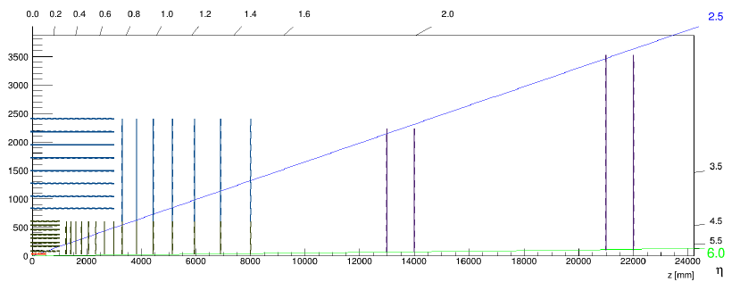
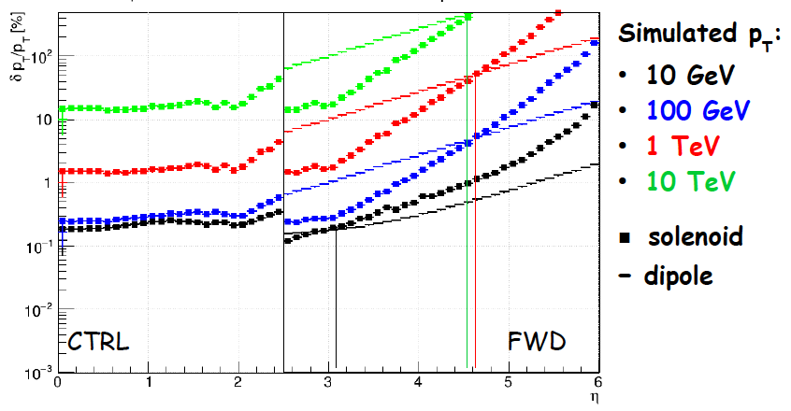
Tracking Resolution for Dipole and Solenoid
Zbynek Drasal

Slide 10
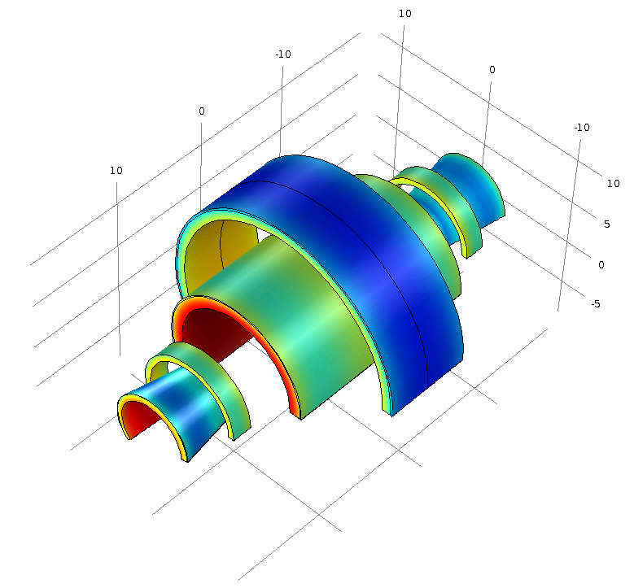
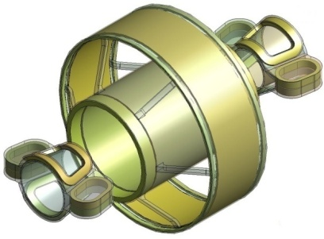
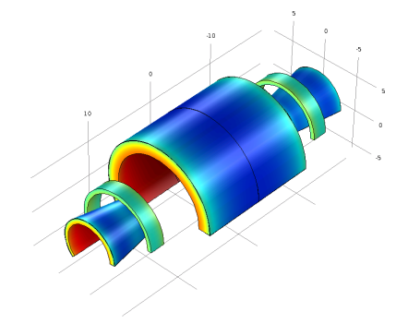
Advantages of a Forward Solenoid
Construction is easier
No need for compensation in the machine
Keeping the rotational symmetry is a big advantage (Missing E_{T} etc.)
Some more performance parameters have to be understood before deciding on the ‘reference design’.
Herman Ten Kate, Matthias Mentink

Slide 11
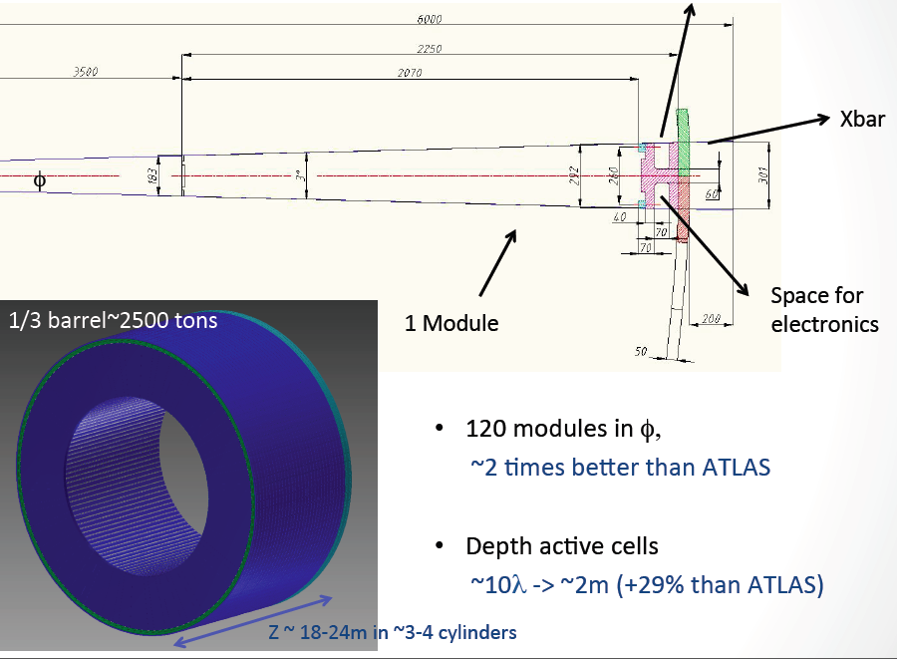
HCAL Studies
Clement Helsens

Slide 12
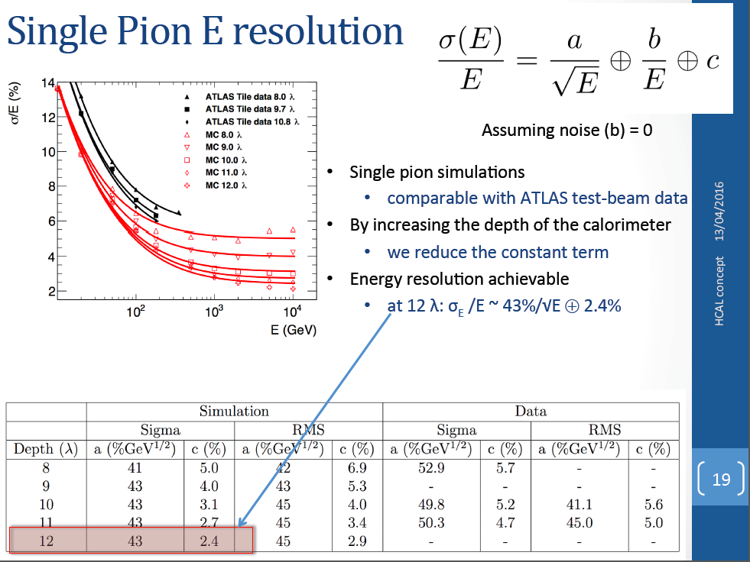
Calorimeter Studies
Clement Helsens

Slide 13
Common Detector Technologies

Slide 14
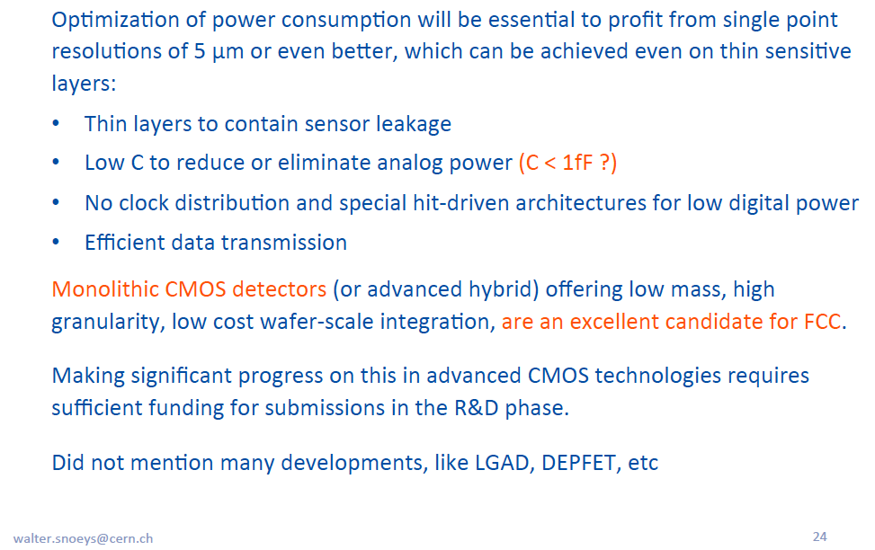
Comments on Future of MAPS
Walter Snoeys

Slide 15
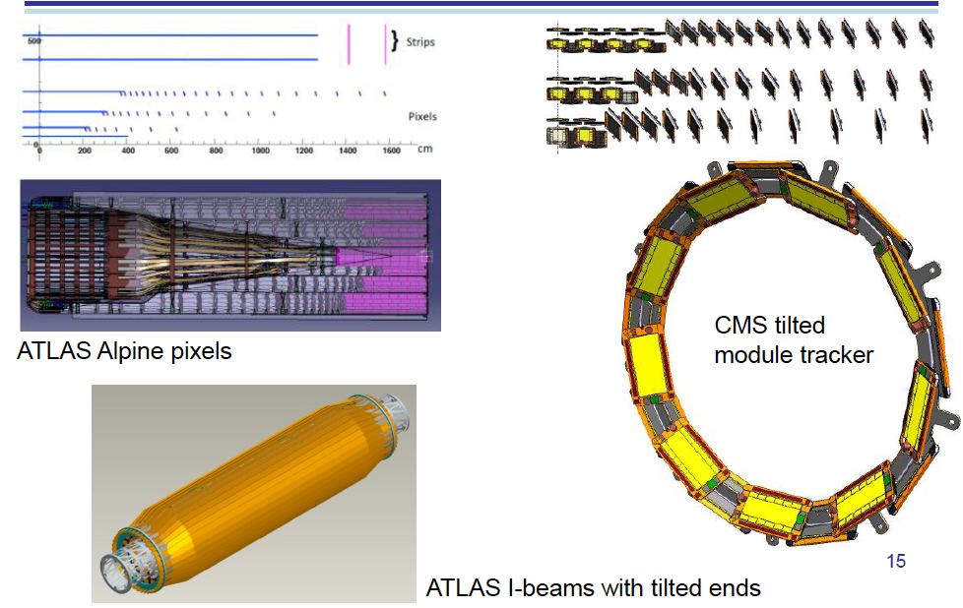
Tracker Mechanics
We should study alternatives to the traditional tracker layouts.
Georg Viehhauser

Slide 16
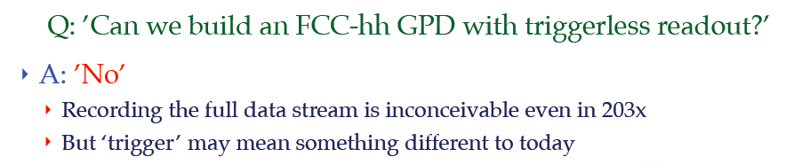
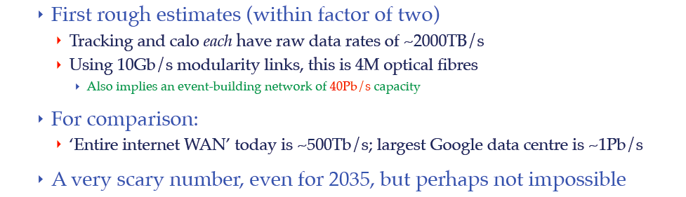
Dave Newbold

Slide 17
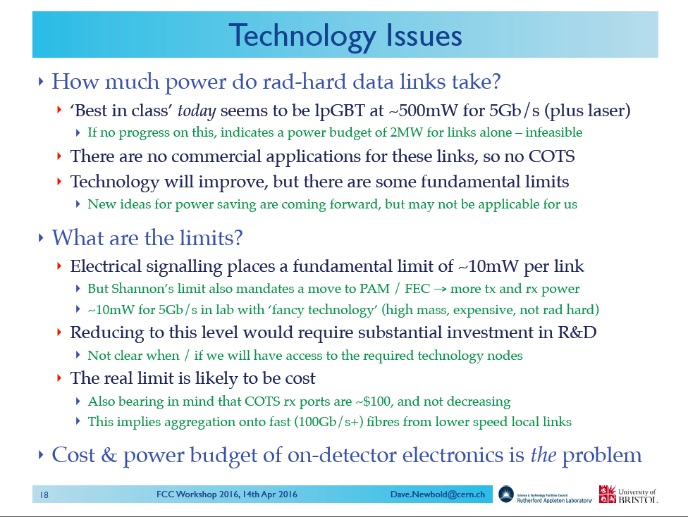
Dave Newbold

Slide 18
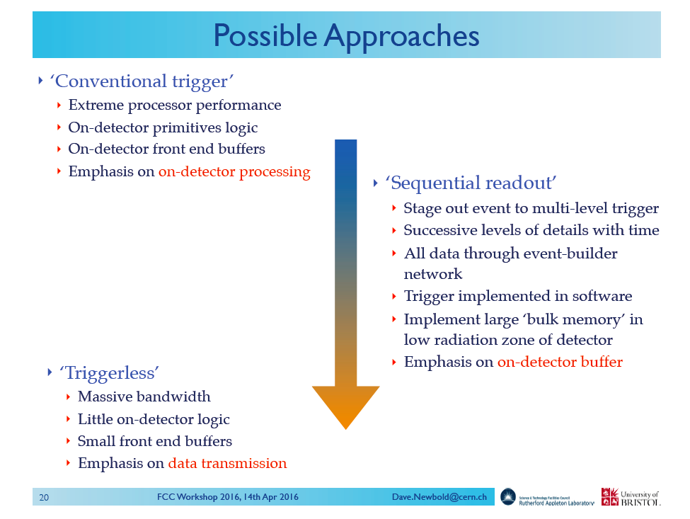
Dave Newbold

Slide 19
Concluding Remarks
A lot of of progress since the last FCC week.
A few reality checks required rescaling of some ‘dimensions’.
The FCC hadron detector studies can heavily draw from the LHC experiments and their upgrade plans.
It is very important to plant the thinking about pp physics at 100TeV into the heads of people who work on the 14TeV physics analysis.
The FCC hadron detectors require significant R&D on detectors and electronics. Once the LHC Phase II R&D is finished, which is soon, we must install dedicated R&D programs.
Access to state of the art electronics processes for readout electronics and sensor (e.g. MAPS) is very expensive, so this R&D will require significant funding.
The FCC project is an excellent environment to transfer the vast amount of knowledge and experience in the field to the young generation.

Slide 20
How to proceed from here ?
We need a reference design for which we make a consistent study of magnet, performance, radiation levels, installation, machine detector interface, costing.
The physics studies with parametrized detector performance will of course vary the detector around this reference.
Possibly we need two reference designs to compare from the start some key differences.
Definition of distribution of space between Tracker, ECAL, HCAL inside 5m bore are the prime consideration.
Some reminders on material properties:

Slide 21
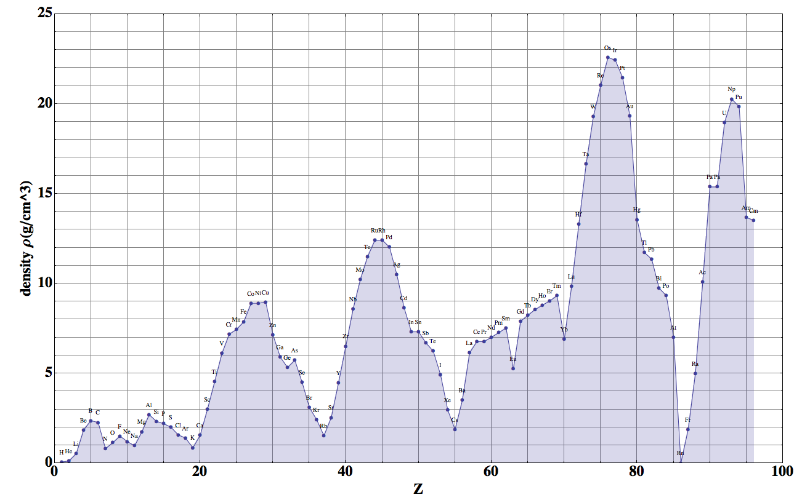
Density

Slide 22
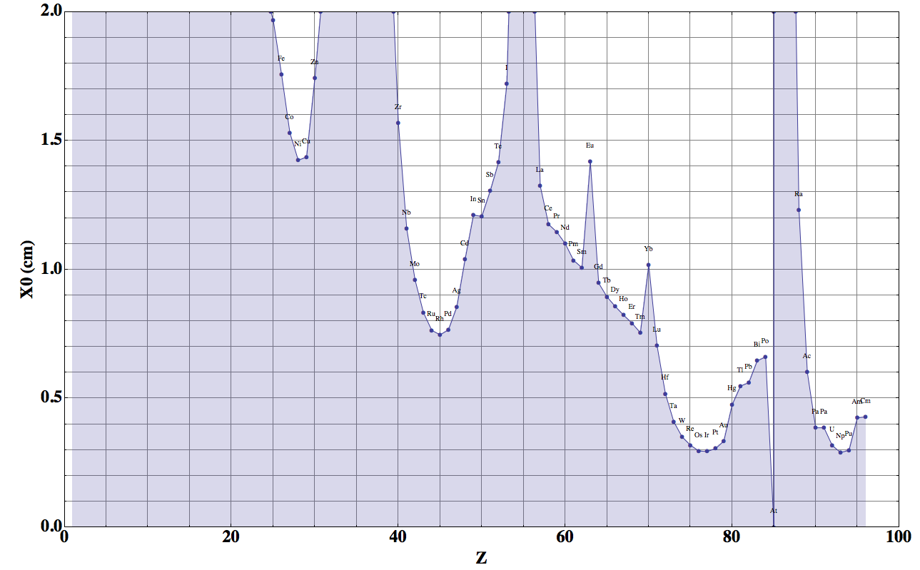
Radiation Length
Fe: 1.76cm
Cu: 1.44cm
W: 0.35cm
Pb: 0.56cm

Slide 23
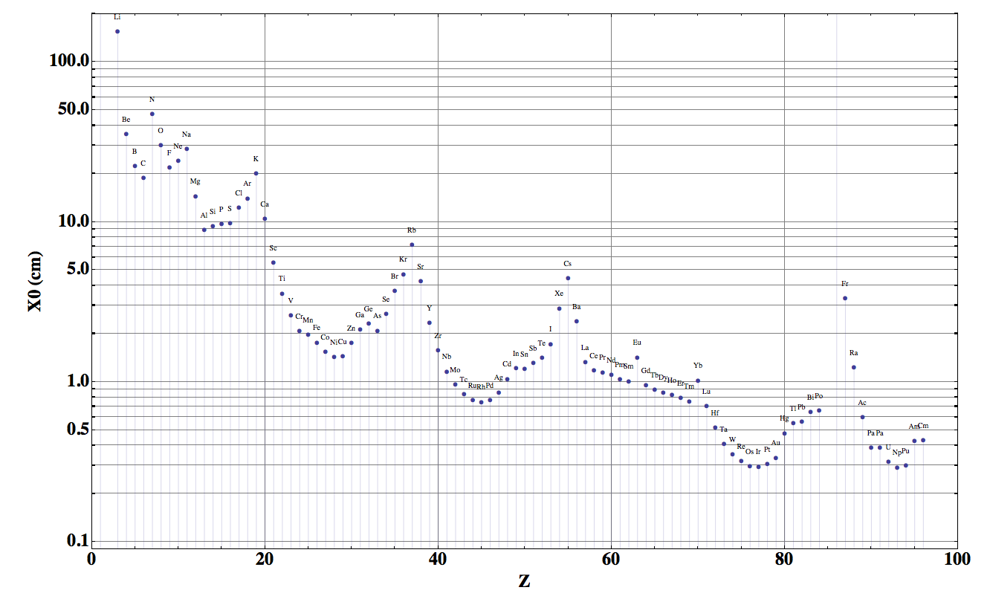
Radiation Length

Slide 24
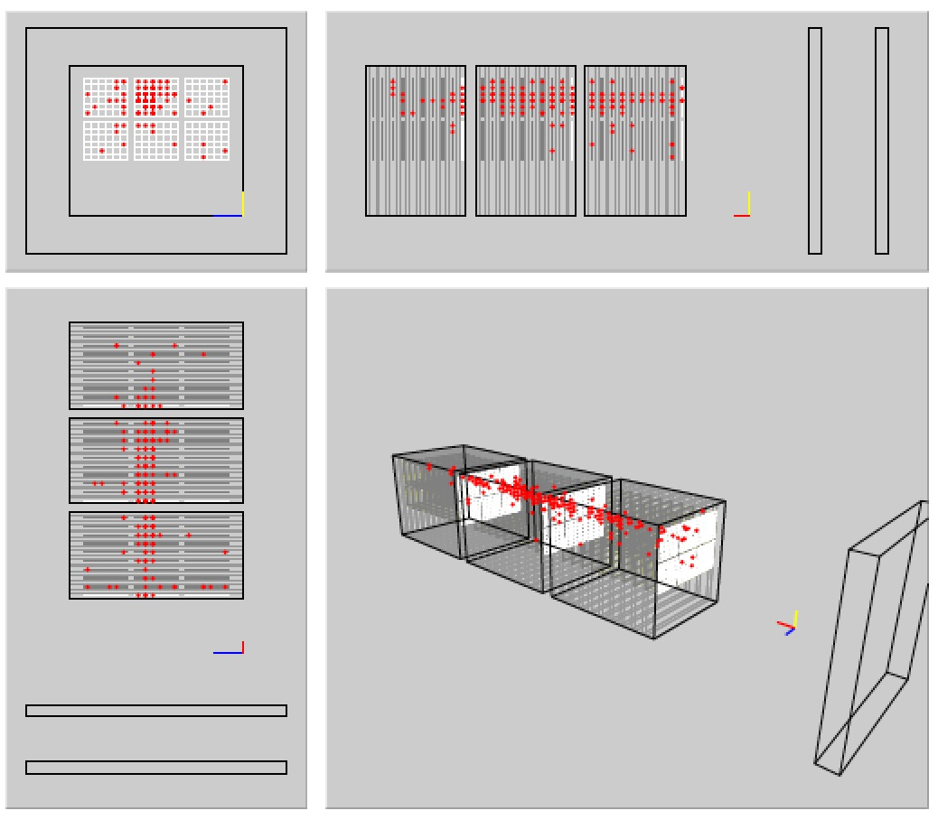
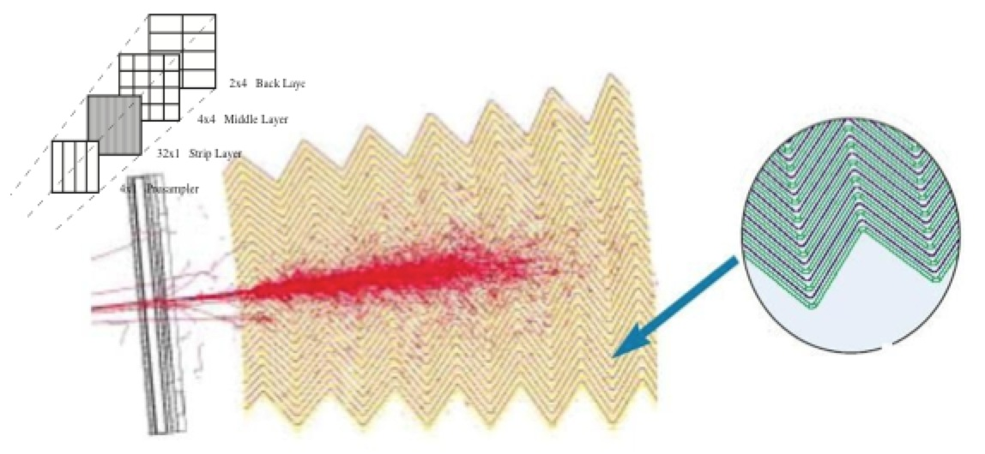
Some Examples
Si/W (CALICE type)
525µm Si (1x1cm²), W absorbers with changing thickness t_{abs}, 30 layers
e.g. testbeam module:
  t₁₋₁₀=1.4mm, t₁₁₋₂₀=2.8mm, t₂₁₋₃₀=4.2mm
  24X₀ in 10cm thickness
  a_{meas}=16.6%, c_{meas}=1.1%
e.g. FCC barrel, 30X₀, 1λ (r=2.6m, Δr=12.5cm, length=16m):
  8000m² Si in barrel only (80M channels) in 30 layers
  ≈30m³ of W (≈600t) → 14MCHF for W (23CHF/kg)
  Challenging: Huge surface Si sensors, many channels
LAr/Pb (ATLAS type)
4mm LAr, 2mm Pb/steel absorbers
  a_{meas}=10%, c_{meas}=0.7%
  22X₀ in 50cm thickness
e.g. FCC barrel, 30X₀, 1.5λ (r=2.7m, Δr=60cm, length=16m):
  ~500k channels (2x2 granularity with respect to ATLAS)
  ≈45m³ Pb (≈500t), ≈15m³ stainless steel (≈120t), ≈120m³ LAr (≈170t)
  Challenging: Low-material cryostat and feed-throughs!

Slide 25
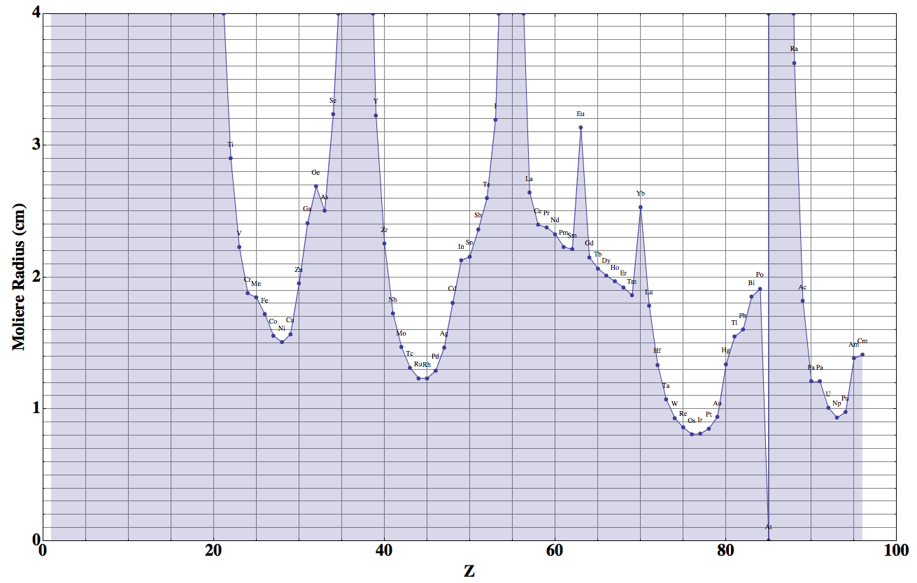
Moliere Radius
W: 0.93cm
Pb: 1.6cm

Slide 26
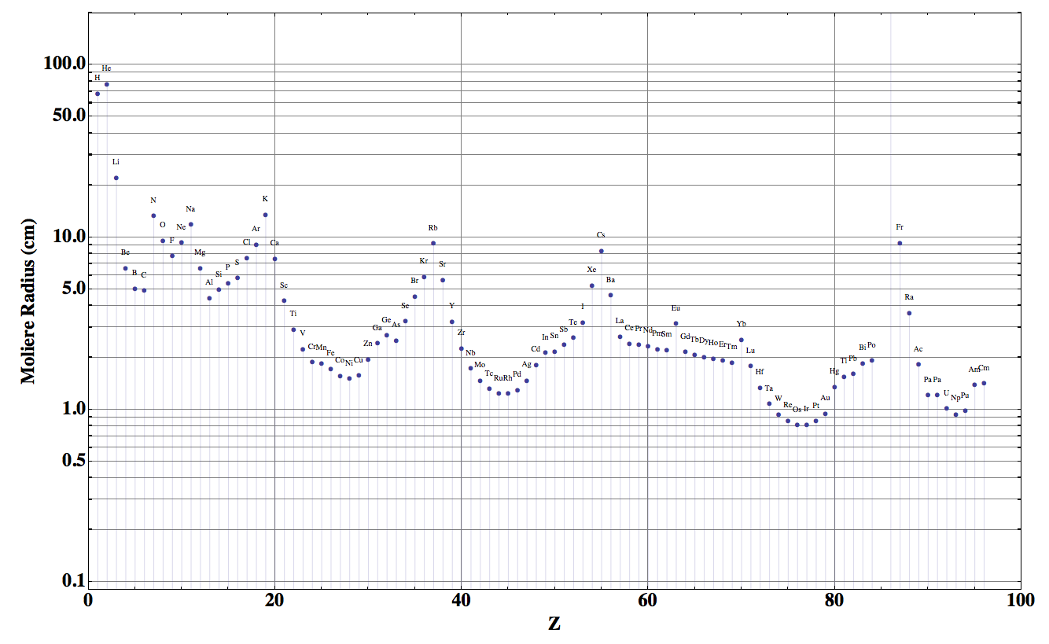
Moliere Radius

Slide 27
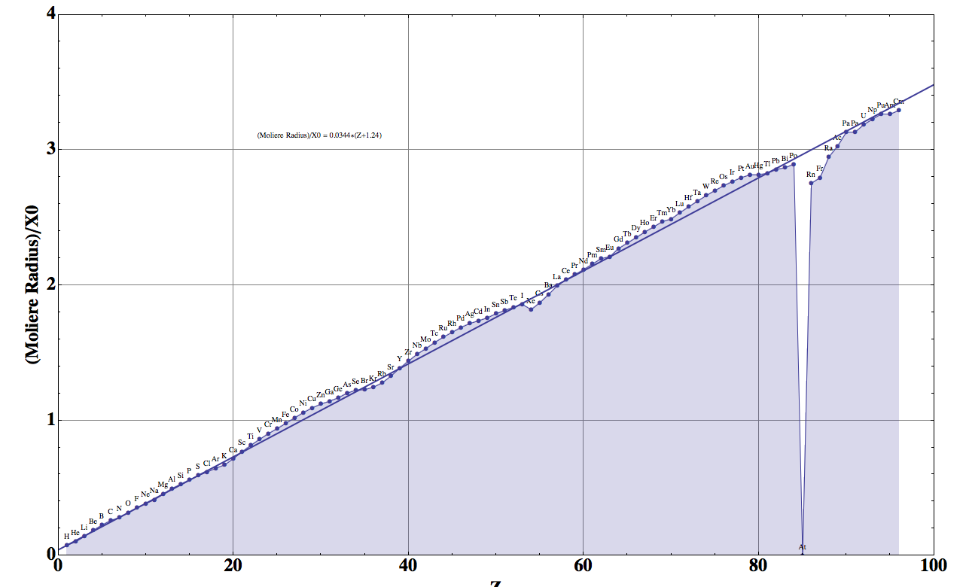

Slide 28
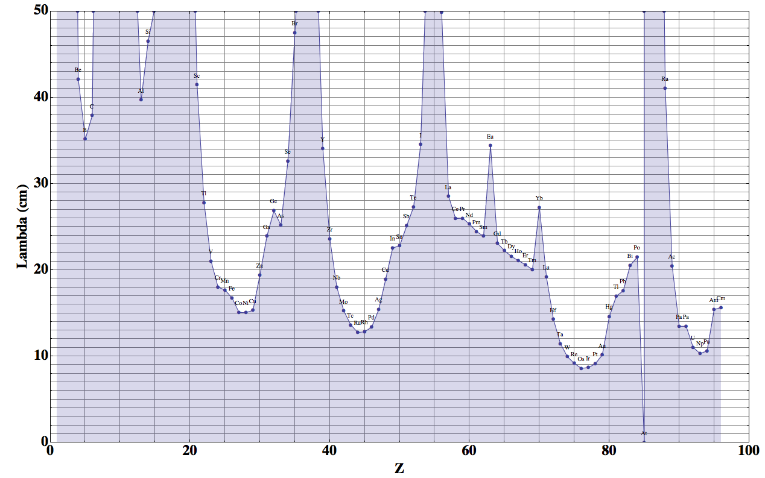
Nuclear Interaction Length
Fe: 16.77cm
Cu: 15.32cm
W: 9.95cm
Pb: 17.59cm

Slide 29
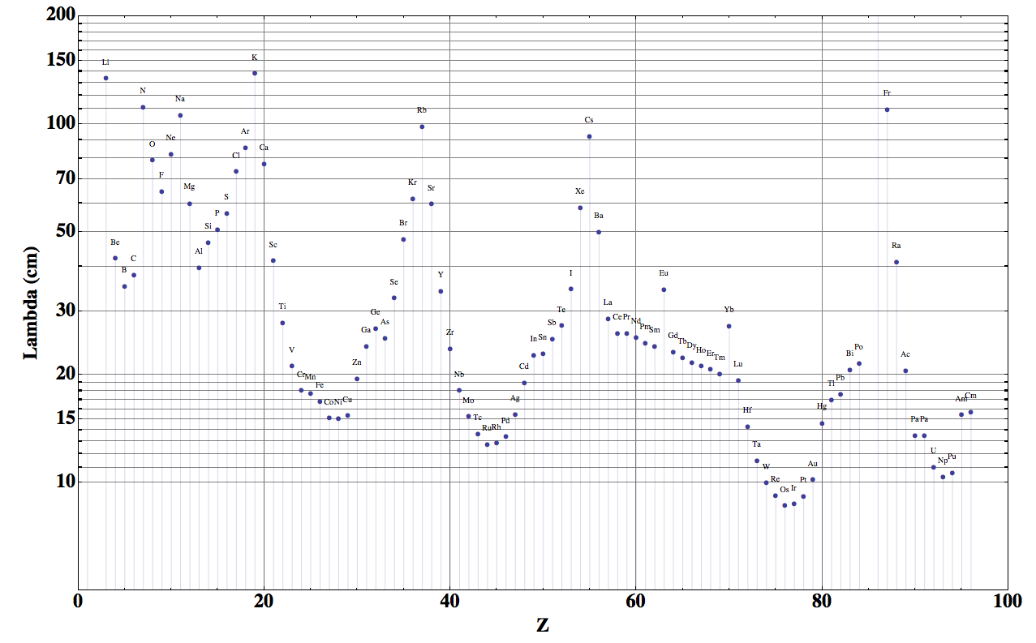
Nuclear Interaction Length

Slide 30
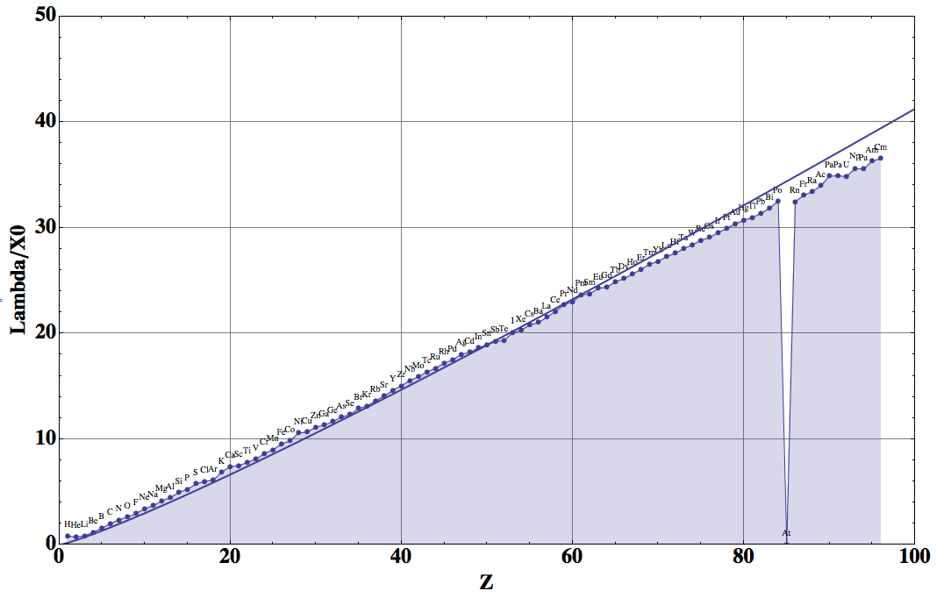

Slide 31
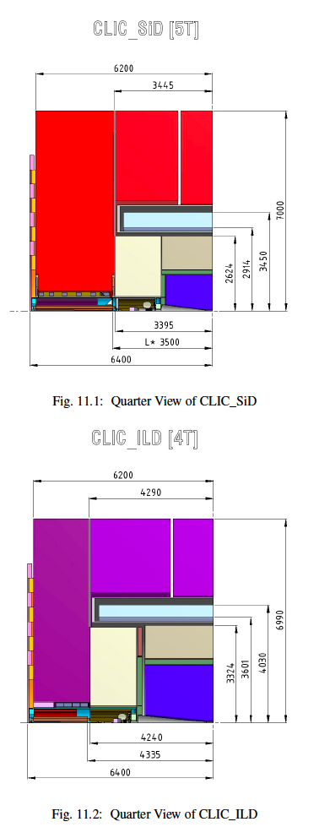
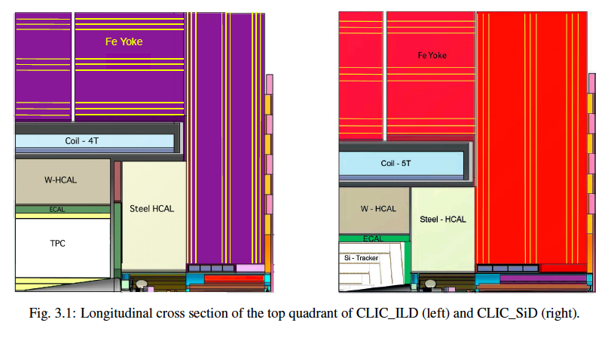
CLIC detector parameters,
2 reference designs

Slide 32
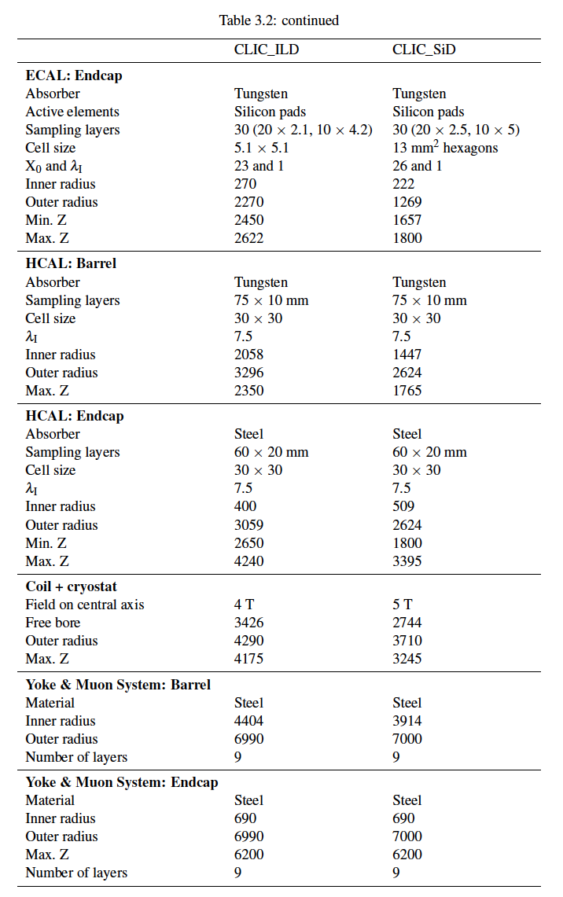
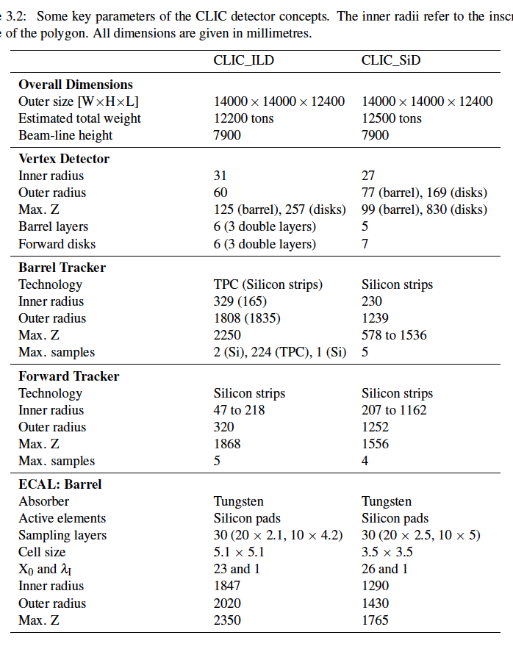
CLIC detector parameters,
2 reference designs
dR≈1.238m
dR≈1.187m
dR≈0.173m
dR≈0.14m

Slide 33
Baseline Geometry used up to now , Twin Solenoid, 6T, 12m bore, 10Tm dipole
Barrel:
Tracker available space:
R=2.1cm to R=2.5m, L=8m
EMCAL available space:
R=2.5m to R= 3.6m → dR= 1.1m
HCAL available space:
R= 3.6m to R=6.0m → dR=2.4m
Coil+Cryostat:
R= 6m to R= 7.825 → dR = 1.575m, L=10.1m
Muon available space:
R= 7.825m to R= 13m → dR = 5.175m
Revision of outer radius is ongoing.
Coil2:
R=13m to R=13.47m → dR=0.475m, L=7.6m
Endcap:
EMCAL available space:
z=8m to z= 9.1m → dz= 1.1m
HCAL available space:
z= 9.1m to z=11.5m → dz=2.4m
Muon available space:
z= 11.5m to z= 14.8m → dz = 3.3m
Forward:
Dipole:
z= 14.8m to z= 21m → dz=6.2m
FTracker available space:
z=21m to R=24m, L=3m
FEMCAL available space:
Z=24m to z= 25.1m → dz= 1.1m
FHCAL available space:
z= 25.1m to z=27.5m → dz=2.4m
FMuon available space:
z= 27.5m to z=31.5m → dz=4m

Slide 34
Two reference designs, with large and small tracker radius ?
We could use two reference designs, one with large tracker radius and W HCAL and one with small tracker radius and Fe HCAL, e.g.
2.5m (tracker cavity) + 1m ECAL (1 lambda + supports) + 1.5m (9 lambda W + supports)
1.5m (tracker cavity) + 1m ECAL (1 lambda + supports) + 2.5m (9 lambda Fe + supports)
This would be two very interesting limiting cases that show the influence of tracking performance, radial distance of the calorimetry, Bremsstrahlung & ECAL, Radiation load when comparing W and Fe etc.
We have to come up with two proposals for the next hadron detector meeting in about 4 weeks time.

Slide 35
Magnet systems under consideration
Twin solenoid with dipoles
(min. shaft diameter 27.5m)
Partially shielded solenoid with dipoles
Unshielded solenoid with dipoles
(min. shaft diameter 16.3m, if rotated under ground)
Twin solenoid with balanced conical solenoid
Unshielded solenoid with balanced conical solenoid
Herman Ten Kate, Matthias Mentink

Slide 36
Magnet Systems
Concerning the shielded and unshielded options we still have to evaluate the muon performance ! Clearly the unshielded version is preferred in terms of cost and shaft size.
The decision on how to proceed with the forward solenoid and dipole is difficult.
It is clear that the forward solenoid is preferred in terms of construction, and it also preserves the phi symmetry which is crucial.
Specifically the MET trigger performance, that is crucial for dark matter search, will be very complex without phi symmetry.
We should probably first evaluate the performance of the forward solenoid version and then try to understand where the dipole could give the improvement ?

Slide 37
Trigger versus continous readout
Continuous readout of the tracker will be very challenging, so we also must investigate a scheme using a first level ‘hardware’ trigger.
Sampling the Calorimeters at the full bunch crossing rate might be in reach, since this is already done e.g. for the ATLAS EMCAL and HCAL for Phase II.
Are Calorimeter and Muon Triggers then sufficient to bring down the tracker readout rates to acceptable levels e.g. to 1MHz ?
CMS will use a track trigger at 40MHz for PhaseII, but ATLAS does not, so we have to look into the specific reasons and difference in order to establish a baseline strategy for an FCC detector.
Probably this will result in a specification on the Calo and Muon resolution at L1, so we could envisage as a baseline for the triggered readout:
Full digitization of calorimeters and muons to arrive at a tracker readout rate of 1MHz ?
→ Work with ATLAS/CMS trigger experts.

Slide 38
Proposal for next Step
Provide two detailed reference designs for the next meeting.
Provide a baseline triggering strategy (in addition to the continuous readout idea) for the next meeting.
Use forward solenoid geometry as a baseline.
Establish muon trigger performance (t.b.d. who/how).

