Slide 1
Cos-θ magnet status at CEA Saclay
Maria DURANTE, Clément LORIN
WP10 General Meeting
CERN, Vidyo, 03/05/2016

Slide 2
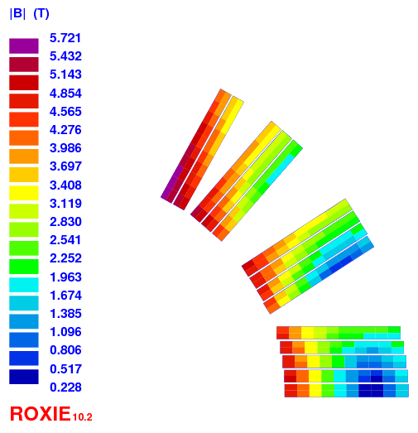
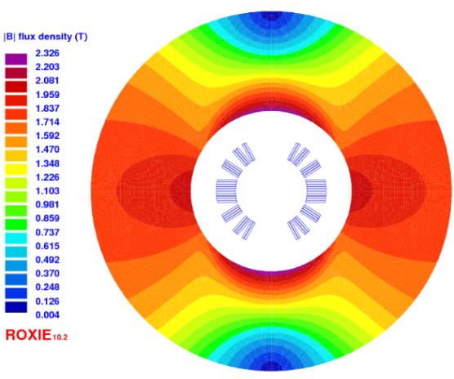
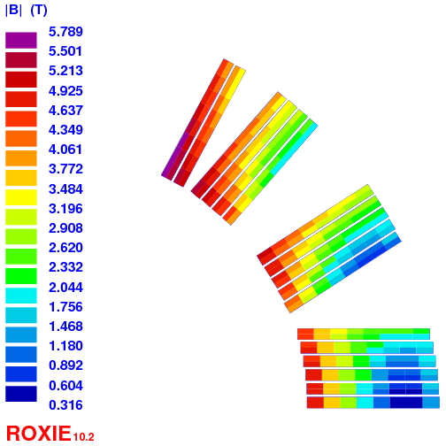
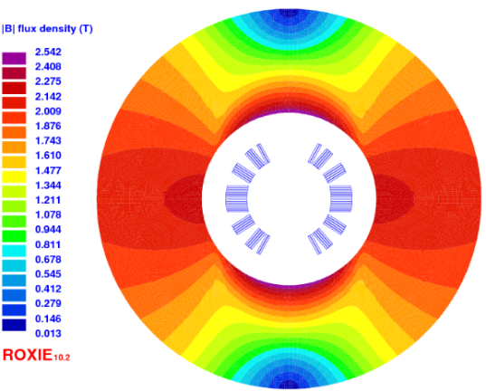
Cos-θ design
Design A - Cable A – « thick » cable : 12 x 1.2 mm² bare, 13 tapes Bruker 140-µm thick
Design B - Cable B – « thin » cable : 12 x 1.0 mm² bare, 15 tapes ép. 100 µm-thick
Cos-θ A : 1.2 mm + 2x100µm insulation, 14 turns
Layout | Unit | Cosϑ A | Cosϑ B
Iop | kA | 11.68 | 10.06
Bop | T | 5 | 5
Bpeak | T | 5.7 | 5.8
Ic | kA | 14.4 | 15.2
LL margin | (%) | 20 | 34
T margin | K | 20 | 30
Sd. inductance | mH/m | 0.49 | 0.73
coil inner radius | mm | 22 | 24
yoke inner raidus | mm | 50 | 50
yoke outer raidus | mm | 112 | 110
Nb. of turns | - | 14 | 17
Unit len. of cond. | m | 20 | 24
Cos-θ B : 1.0 mm + 2x125µm insulation, 17 turns

Slide 3
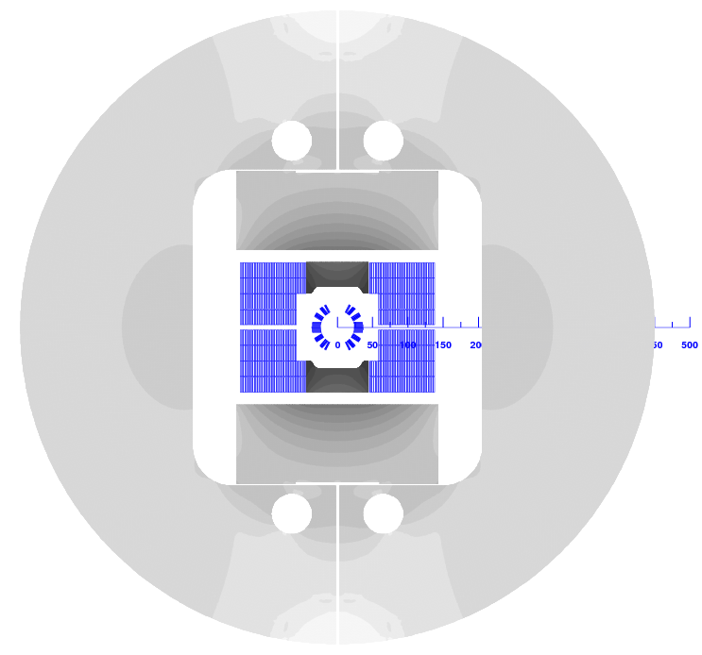
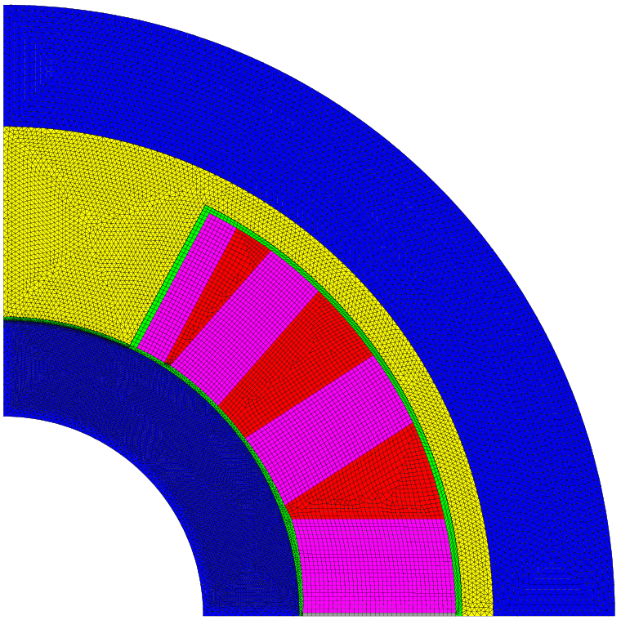
Cos-θ : Insert Mode
Layout | Unit | Cosϑ A | Cosϑ B
Iop | kA | 6.4 | 7.1
Bop | T | 2.1 + 13 | 2.6 + 13
Ic | kA | 7.1 | 7.9
LL margin | (%) | 10 | 10
T margin | K | 8 | 8
S. inductance | mH/m | 0.37 | 0.55
M. inductance | mH/m | 1.37 | 1.77
coil inner radius | mm | 22 | 24
inner tube th. | mm | 6 | 8
outer shell th. | mm | 12 | 10
Fx per ½ coil | kN/m | 1226 | 1669
Fy per ½ coil | kN/m | -60 | -95
Fz | kN | 61 | 90
σ_{T} | MPa | 140 | 155
σ_{R} | MPa | 75 (~50) | 110 (~70)
azi. deflection | µm | 125 | 140
von Mises inner | MPa | 600 | 760
von Mises outer | MPa | 240 | 250
Insert Mode
Layout | unit | Cosϑ A & B
bore radius | mm | 16
external radius | mm | 49
pad (collar) th. | mm | 2.5

Slide 4
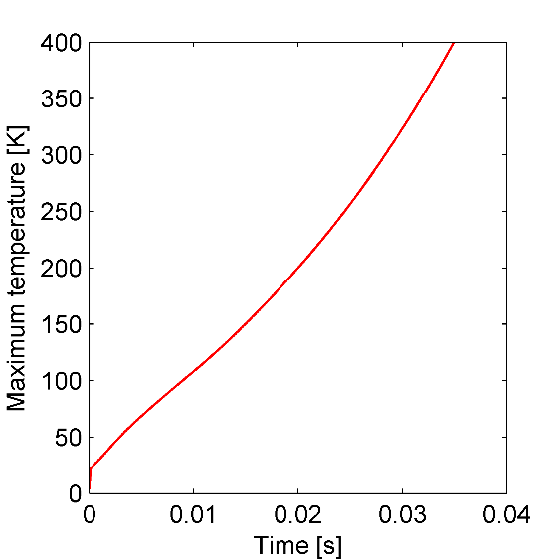
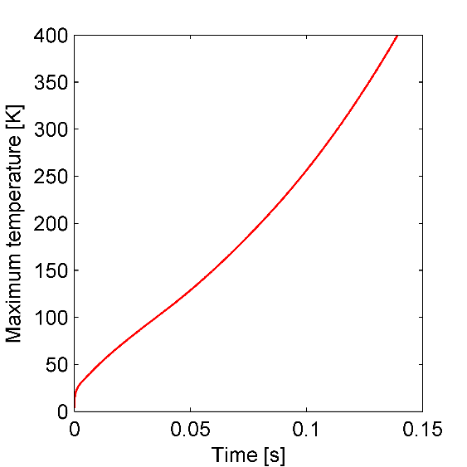
Cos-θ : Quench protection
Quench analysis by Erkki Härö and Antti Stenvall (TUT)
    DESIGN A, done
      Standalone: very challenging
      Insert mode: ok
    DESIGN B, to be done ?
Standalone
Insert Mode

Slide 5
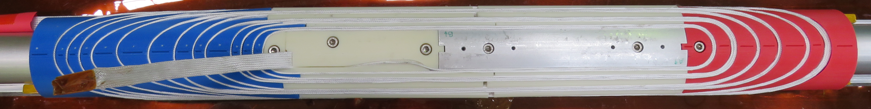
Cos-θ : Magnet ends
Two end designs
  One spacer per cable turn
  (ew: 7.6 mm, hw: 2 m)
  Conventional design, 2/3 cable blocks
  (ew: 7.3 mm, hw: 22 cm)
Winding test with SS dummy Roebel cable
  Similar behavior for both ends
  → Keep the conventional way as baseline

Slide 6
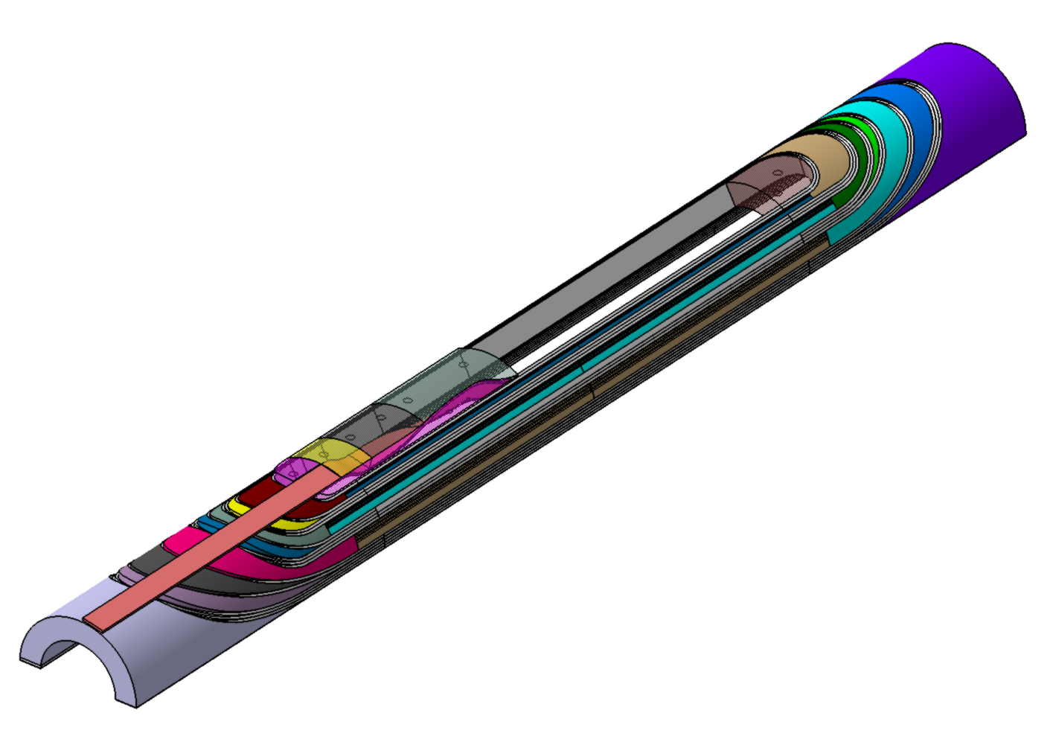
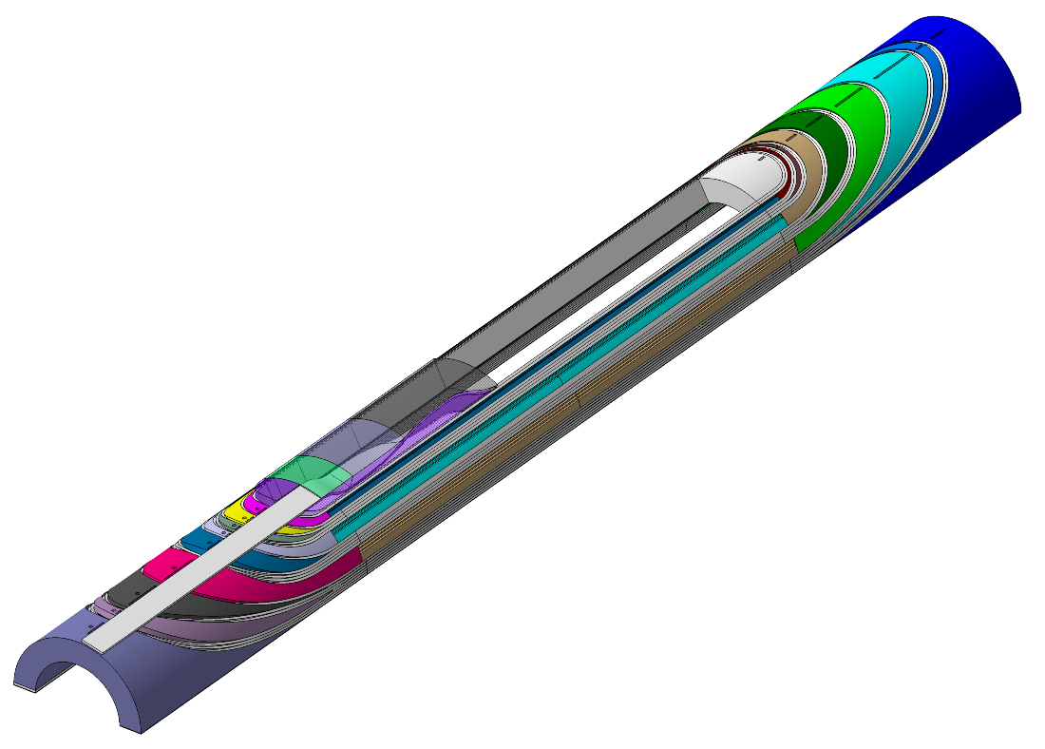
Cos-θ : Coil 3D design
Design A coil
  Straight section = 200 mm
  Total length = 670 mm
  Cable unit length : 17 + 3 m
Design B coil
  Straight section = 200 mm
  Total length = 700 mm
  Cable unit length = 21 + 3 m

Slide 7
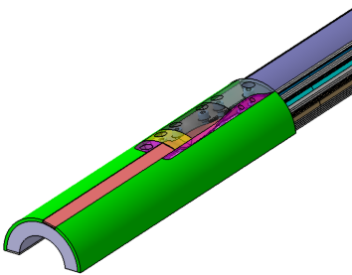
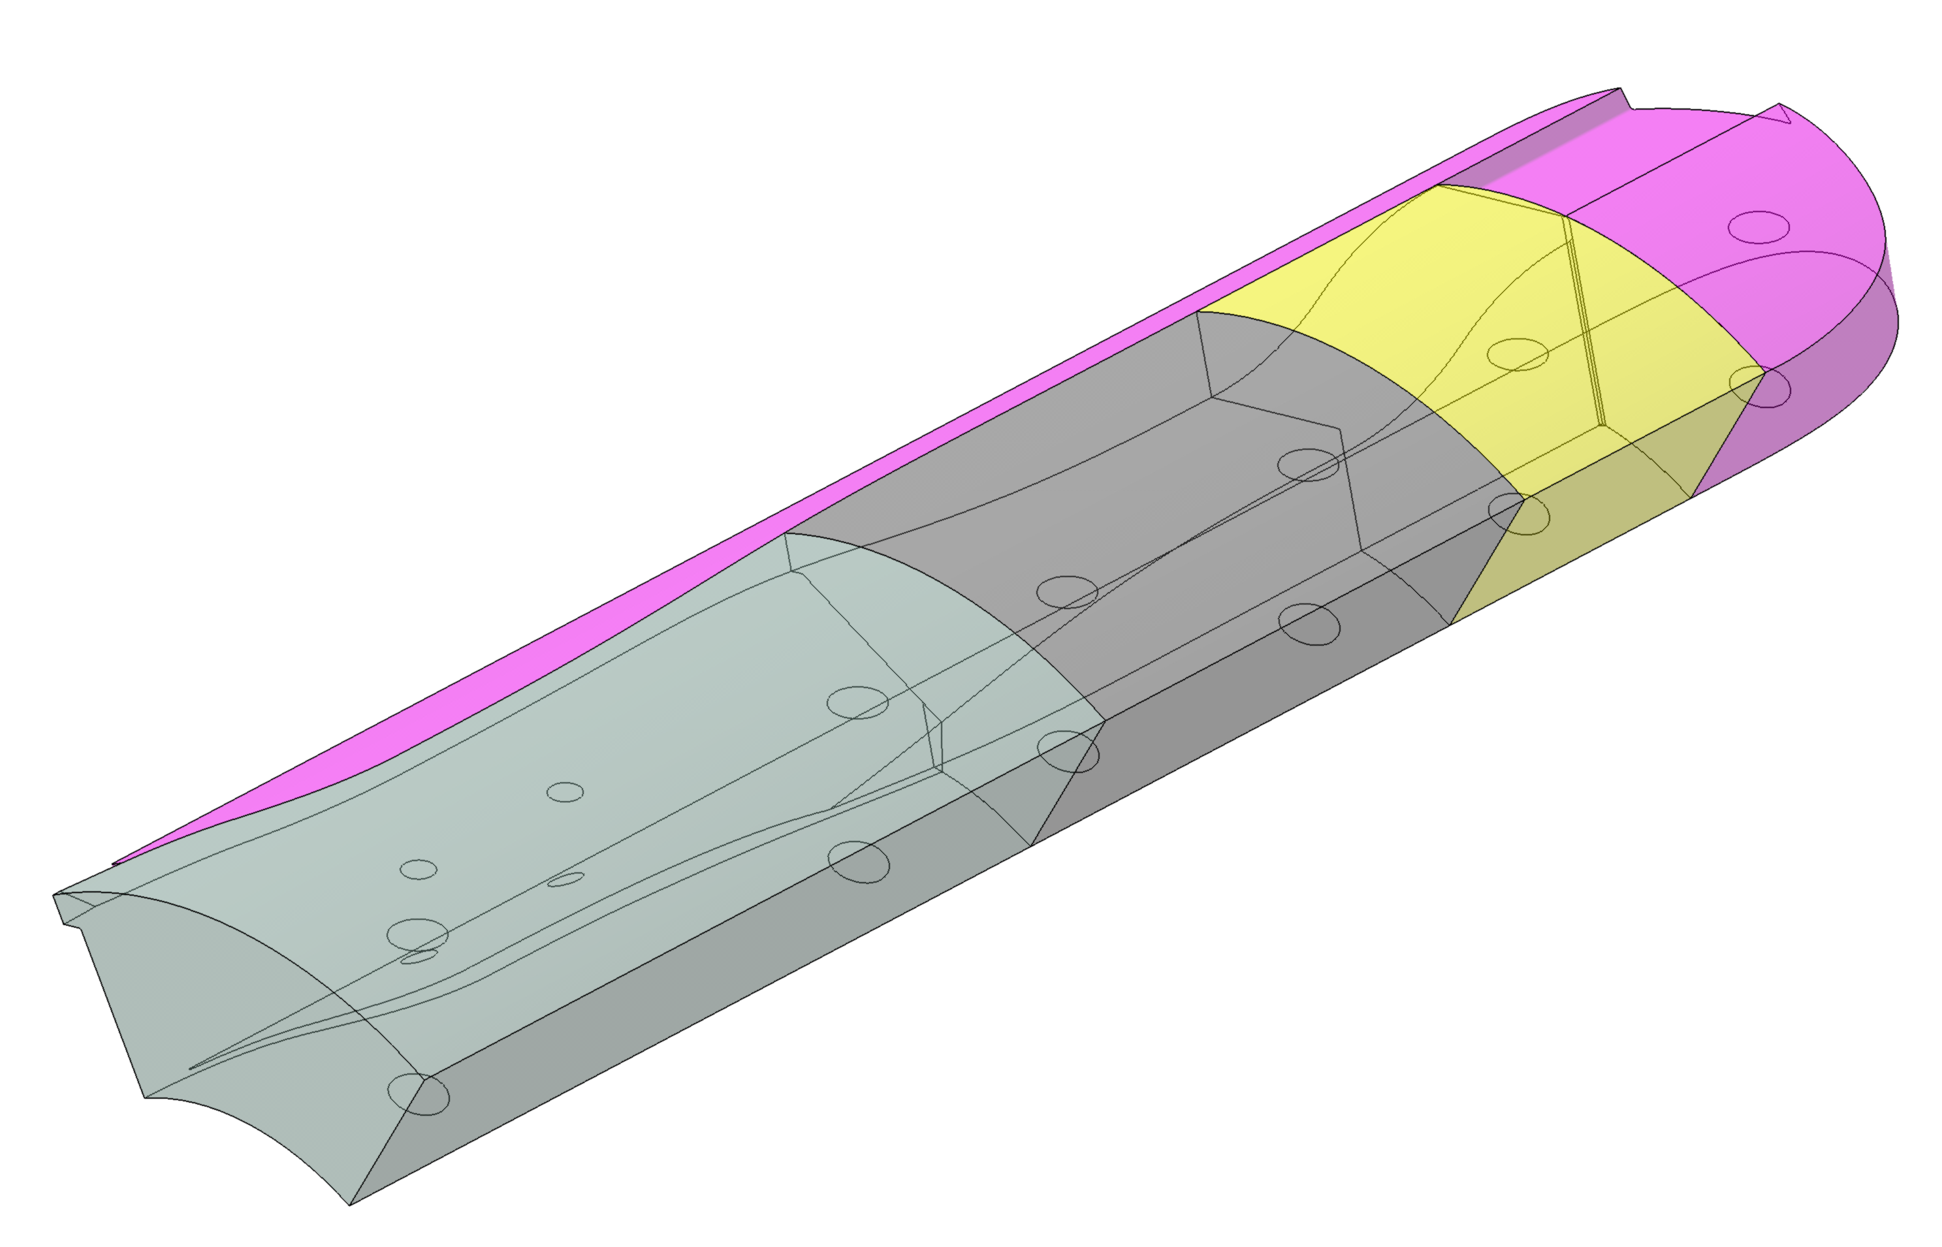
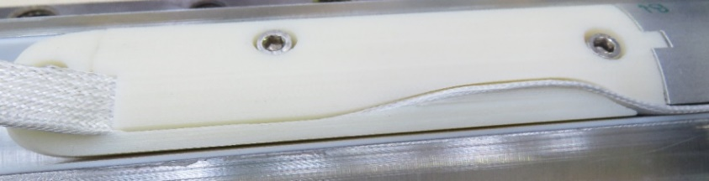
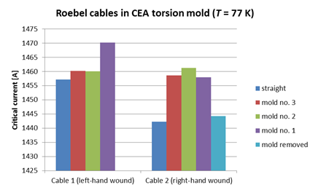
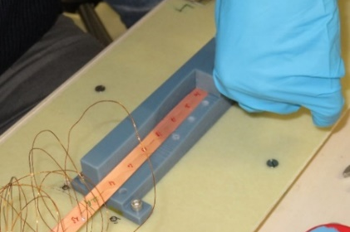
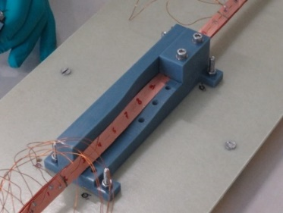
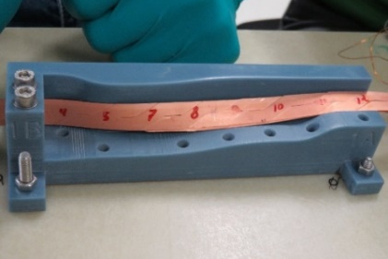
Cos-θ : Magnet ends
Innermost turn path outwards the magnets
  Winding tests → improved support for the final coil
  →
  Tests in collaboration with KIT on Desing B→ OK !
Mold 3 : twist 75° x 110 mm
Mold 2 : twist 75° x 80 mm
Mold 1 : S1 + twist + S2

Slide 8
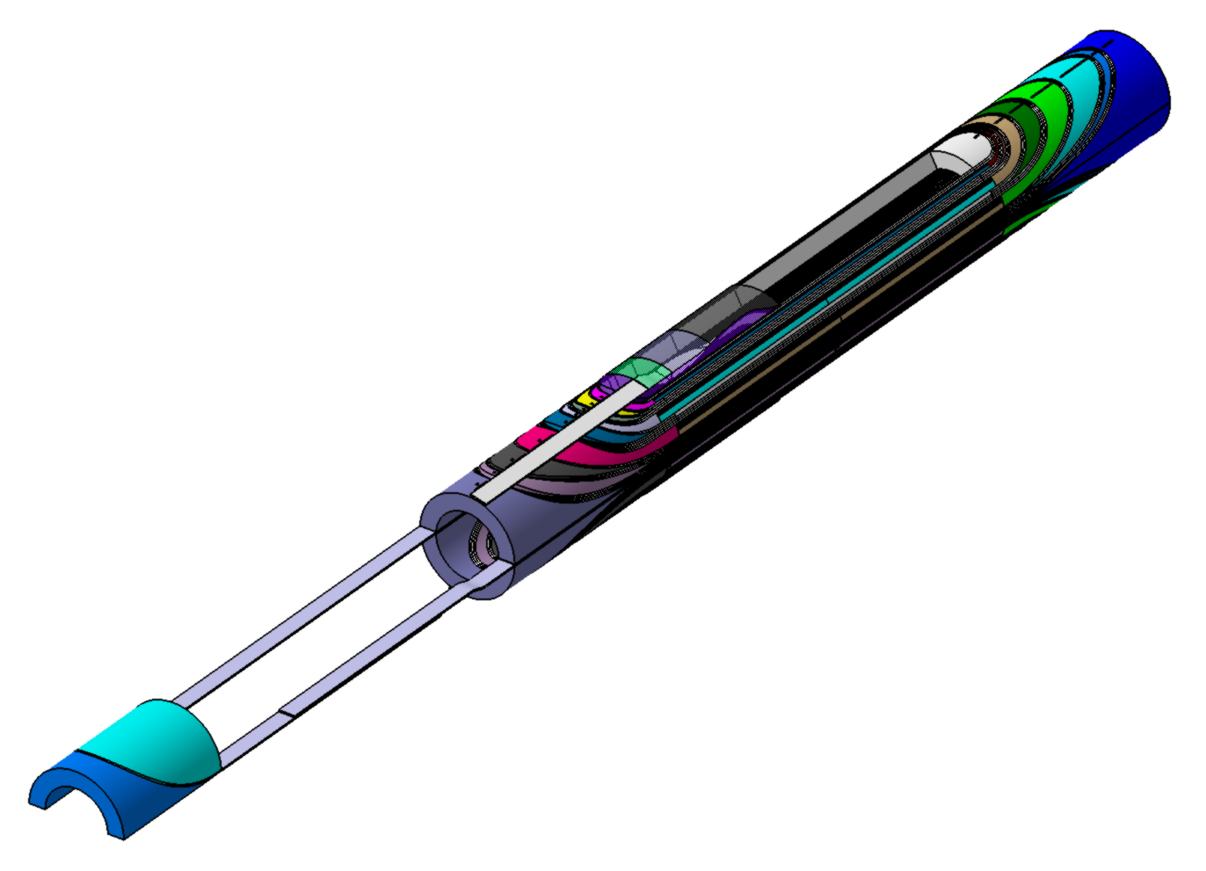
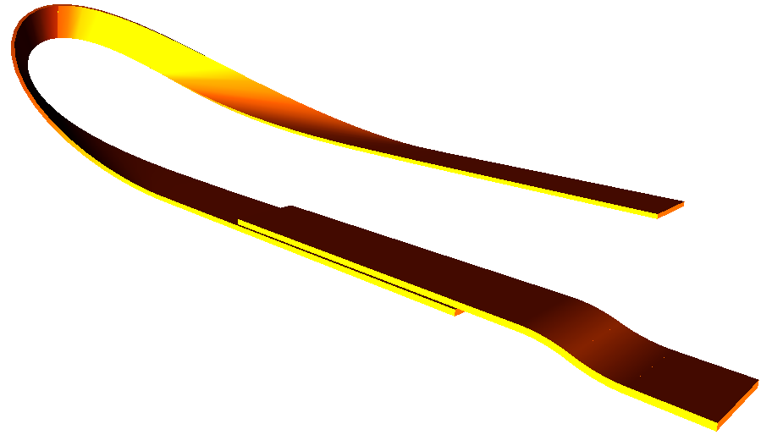
Cos-θ : Internal connexions
Superconductor side
Superconductor side
SC side
SC side
SC side

Slide 9
Cos-θ : Instrumentation
Voltages taps
  Central wire co-wound to cancel inductive effects ?
Temperature sensors
  Strips inside the cable going out from the winding on the outer surface
  Long strips on the outer surface of each coil block
Trace development started

Slide 10
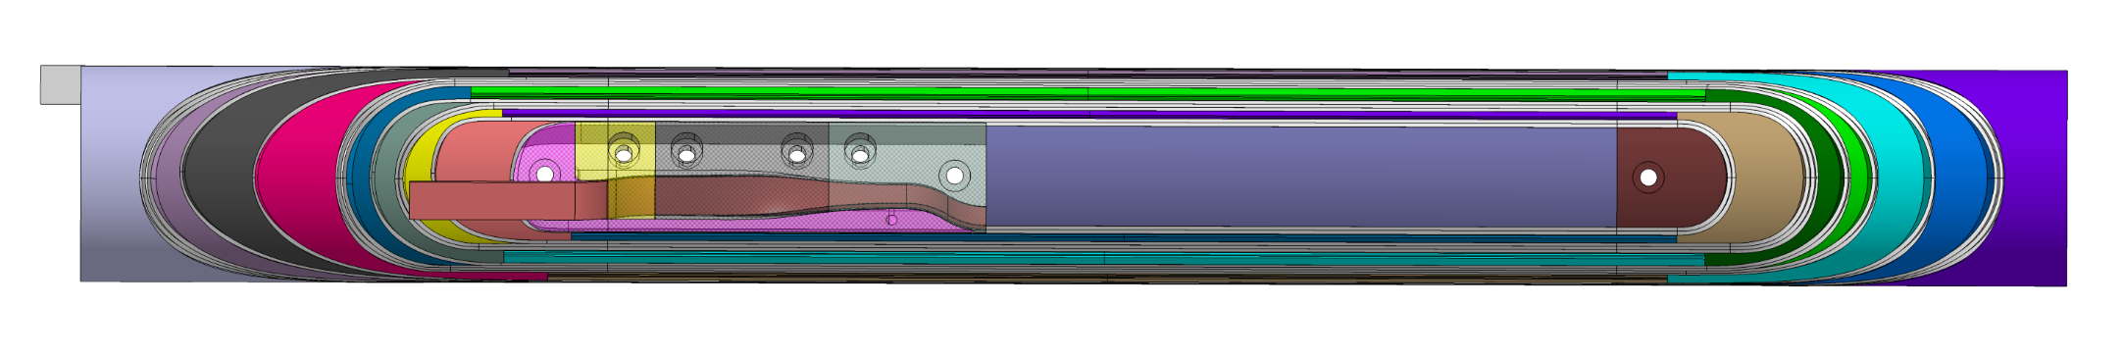
Cos-θ : End spacers
Prospecting for 3D printing of end spacers started
  Visit of 3T RPD, UK (Thanks, Glyn !)
    Tolerance: +/-0.2 mm (possibility to go down to +/- 0.1 mm)
    Roughness: Ra = 5 µm on surfaces in contact with cable, 50 µm elsewhere
    Spacer slit in the z-direction
    Two options : Solid or Hollow pieces (2-mm-wall thickness)
  An offer from 3DSystems, FR
  PRODWAY, FR to be contacted
z direction

Slide 11
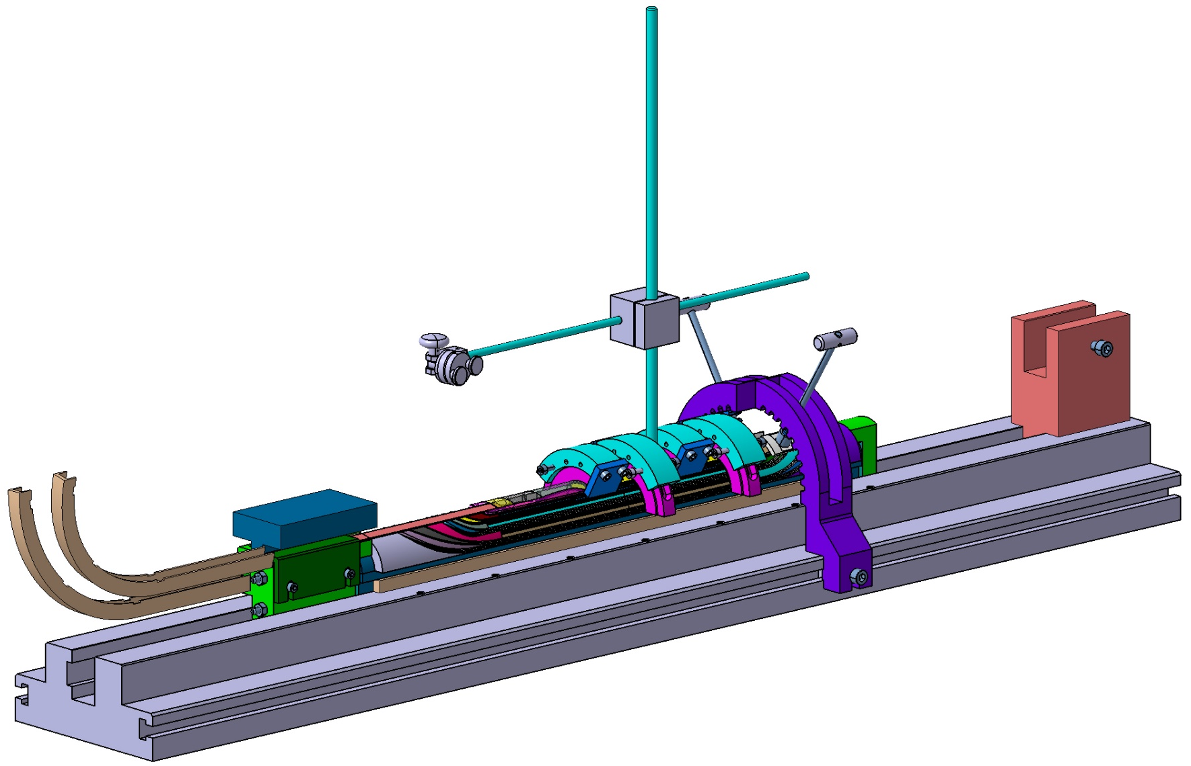
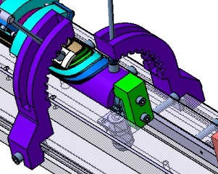
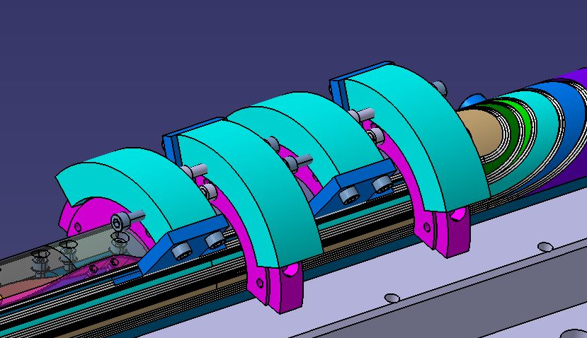
Cos-θ : Tools 1/2
Coil winding tools

Slide 12
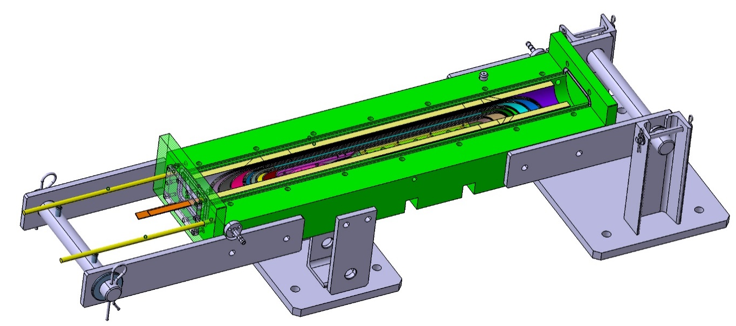
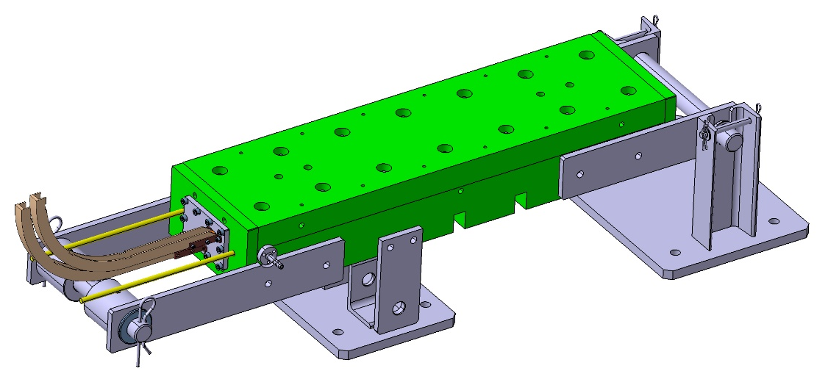
Cos-θ : Tools 2/2
Coil Impregnation tools
Call for tender launched for design A tools
Detailed studies for Design B tools is ongoing

Slide 13
Cos-θ : Schedule
Procurements : mid-end of June 2016
Dummy cable: 2 x 20 m – mid of June 2016
Dummy coils (winding-impregnation): July-August 2016
Dummy magnet assembling: September-October 2016
Superconducting cable: 3 x 20 m – End of September 2016
Start working of SC magnet: October-November 2016

