Slide 1
Pulsed Laser Deposition

Slide 2
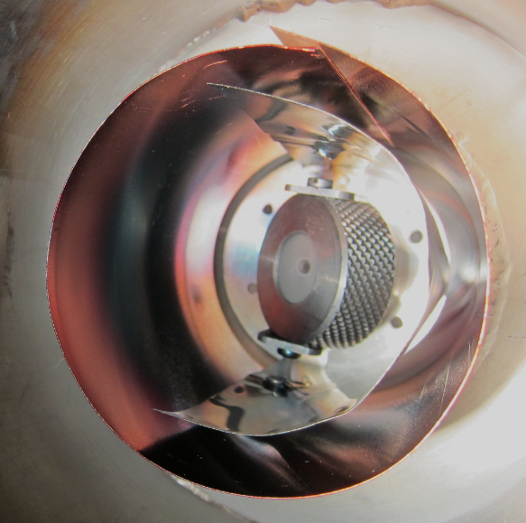
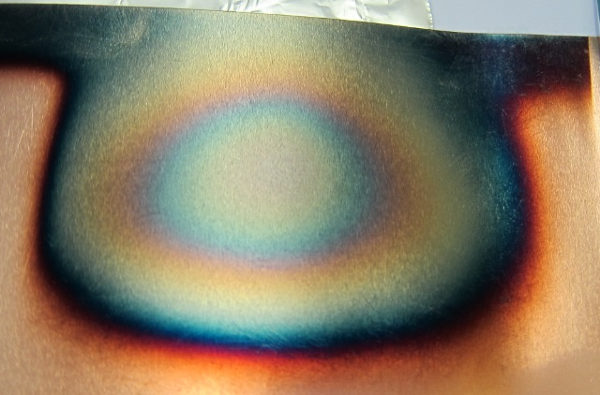
Pressure tests
1
Laser fluence Φ = 2.2 to 2.5 J/cm²
Substrate : rolled St. St. or Cu foil
Deposition duration : 15 min
2
3
Name | Substrate | Pressure N₂ (Pa) | Average δ_{max}
PLD_aC_09_1 | Cu | Vacuum (<5.00E-7) | 1.24
PLD_aC_06_1 | St St | 2 | 1.04
PLD_aC_07_1 |  |  | 1.17
PLD_aC_08_1 |  |  | 1.17
PLD_aC_09_2 | Cu |  | 1.2
PLD_aC_10_2 | Cu | 4 | 0.971
PLD_aC_11_2 |  |  | 0.97
PLD_aC_12_1 |  |  | 0.964
PLD_aC_14_2 |  |  | 0.98
PLD_aC_10_1 | Cu | 8 | 0.912
PLD_aC_11_1 |  |  | 0.953
PLD_aC_12_2 |  |  | 0.954
PLD_aC_14_1 |  |  | 0.969
PLD_aC_13_2 | Cu | 15 | 0.956
PLD_aC_13_1 | Cu | 20 | 0.986

Slide 3
Pressure tests
Different δ_{max} in 1 sample
3
2
1
45°
Laser 248 nm
+ Optics
Copper content at higher pressures
Point 1 : 1.5 % of Cu : carbon layer non homogeneous

Slide 4
Influence of the base pressure
Name | Subs. | Base pres. (mbar) | Pres. N₂ (Pa) | Average δ_{max}
PLD_aC_10_2 | Cu | < 5.00*10⁻⁹ | 4 | 0.971
PLD_aC_11_2 |  |  |  | 0.97
PLD_aC_12_1 |  |  |  | 0.964
PLD_aC_14_2 |  | 6.7*10⁻⁷ |  | 0.98
PLD_aC_10_1 | Cu | < 5.00*10⁻⁹ | 8 | 0.912
PLD_aC_11_1 |  |  |  | 0.953
PLD_aC_12_2 |  |  |  | 0.954
PLD_aC_14_1 |  | 6.7*10⁻⁷ |  | 0.969
δ_{max} not sensitive to the base pressure up to 7*10⁻⁷ mbar

Slide 5
Air exposure
Name | Subs. | Base pres. (mbar) | Pres. N₂ (Pa)
PLD_aC_10_1 | Cu | < 5.00*10⁻⁹ | 8
Conditions | δ_{max}
1h air exposed + 4 days in vacuum | 0.910
17 days air exposed in Al foil | 0.998
+10%

Slide 6
Electron energy loss spectroscopy
δ_{max} decreases = intensity at 290 eV (C1s peak) increases
+ losses intensity increases

Slide 7
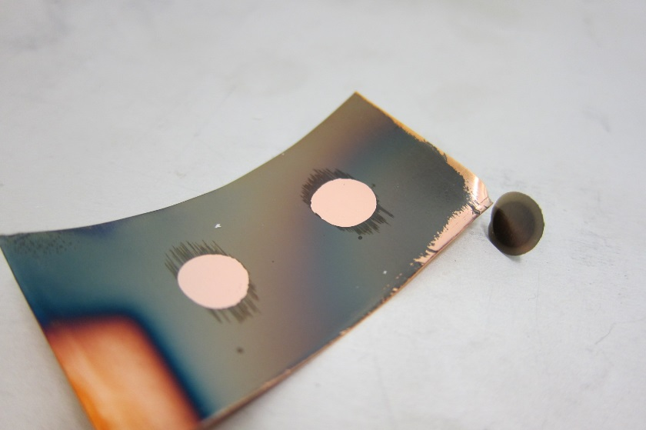
Adhesion test
Evaluate the adhesion of the layers
Effect of the pressure
Name | Substrate | Pressure N₂ (Pa) | Average δ_{max}
PLD_aC_09_1 | Cu | Vacuum (<5.00E-7) | 1.24
PLD_aC_12_1 | Cu | 4 | 0.964
PLD_aC_12_2 | Cu | 8 | 0.954
PLD_aC_13_1 | Cu | 20 | 0.986
For all the samples : very low adhesion (dollies removed without pulling them off)
-> try adhesion tests on samples with stainless steel substrate

Slide 8
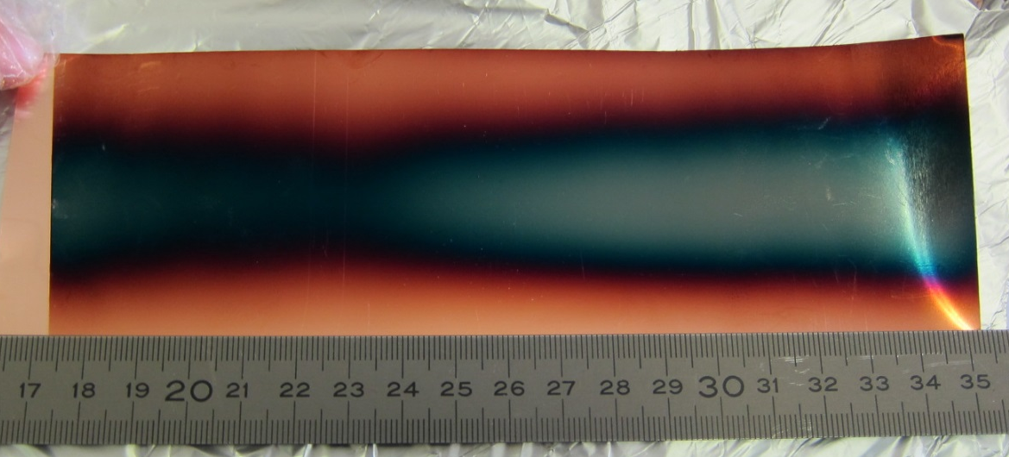
Deposition in a full tube
Experimental setup :
Rolled Cu foil
Target manually rotated
Deposition duration : 30 min
8 Pa of N₂
15_2
15_1
Inhomogeneity of the width : geometrical effect
Plasma plume disappears during the deposition : ablation rate non constant ?

