Slide 1



Desperately Seeking SUSY
Searches Beyond the Standard Model @ the LHC
Albert De Roeck
CERN, Geneva, Switzerland
Antwerp University Belgium
UC-Davis California USA
NTU, Singapore
24th June 2016

Slide 2
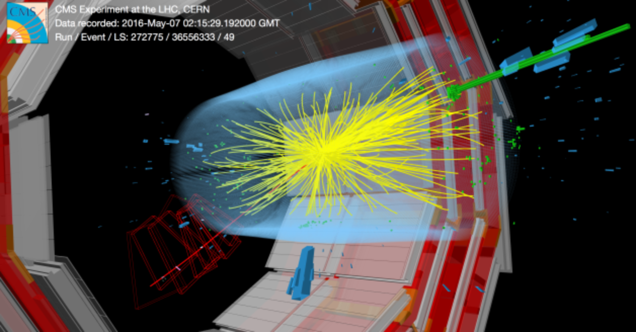
Outline
Supergravity and SUSY
Pre-LHC area
Searches for SUSY @ the LHC
Searches for New Physics @
the LHC
A bump at 750 GeV?
Summary
Collision at 13 TeV in CMS

Slide 3

Celebrating 40 years of Supergravity
Key theoretical Insight: Gravity + supersymmetry
Strong impact on string theory developments
Strong impact on SUSY phenomenology: minimal SUGRA (mSUGRA) corresponds to softly broken local supersymmetry. It is what remains at low energy after spontaneous breaking of SUSY
Physics searches beyond the Standard Model @ colliders
  Supersymmetry
  Extra dimensions
  …

Slide 4
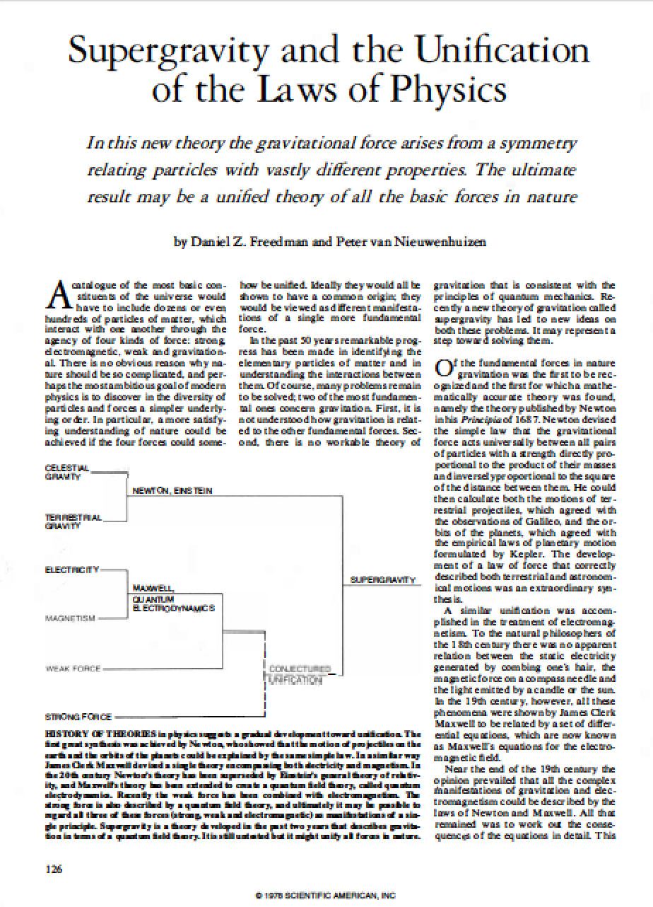
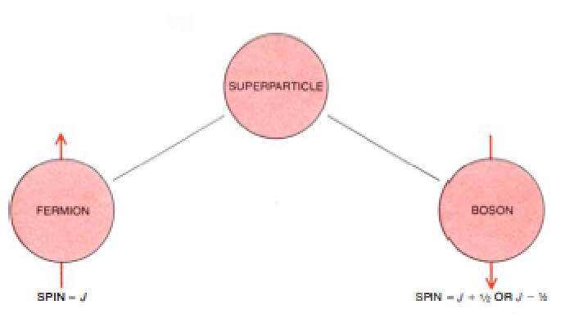
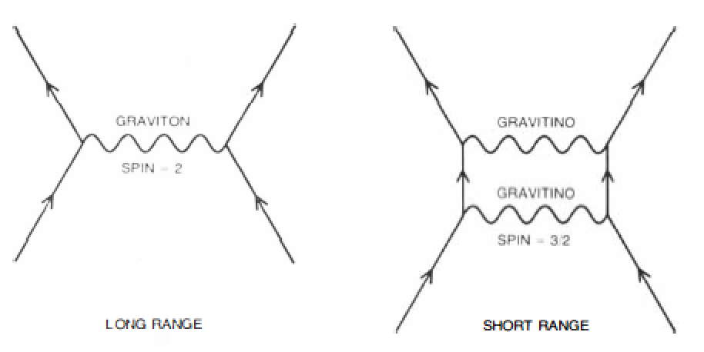
Supergravity
1978: Scientific American
Gravity, supersymmetry, local symmetries,
superspace, gravitinos…
Spin 3/2
particle.
Yet to be
discovered!
Current price for this SA issue = 7.99 USD!

Slide 5
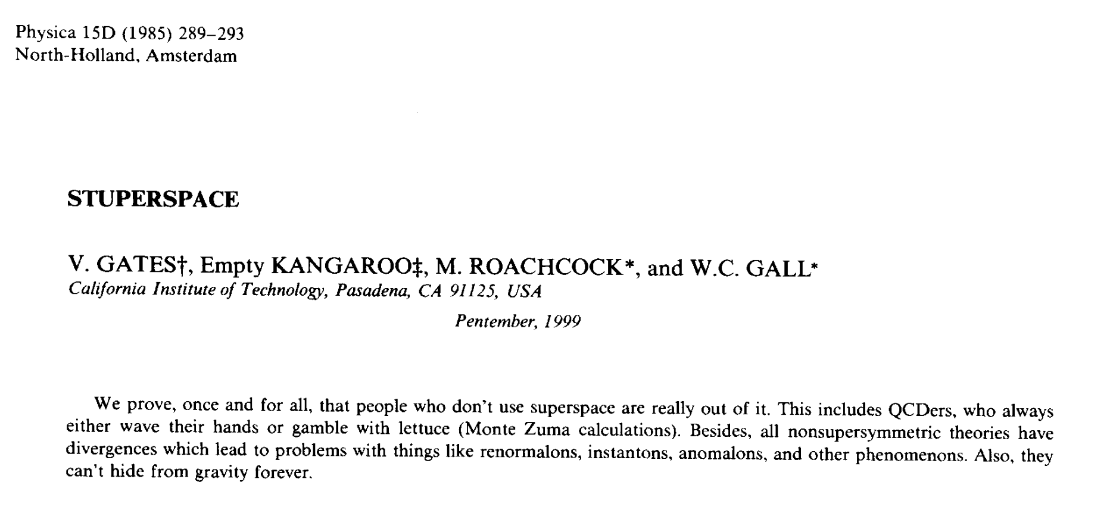
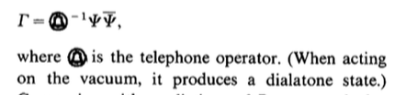
Alternatives to Superspace?
1985: Not yet everybody was taking
SUSY very seriously ☺
Example:

Slide 6
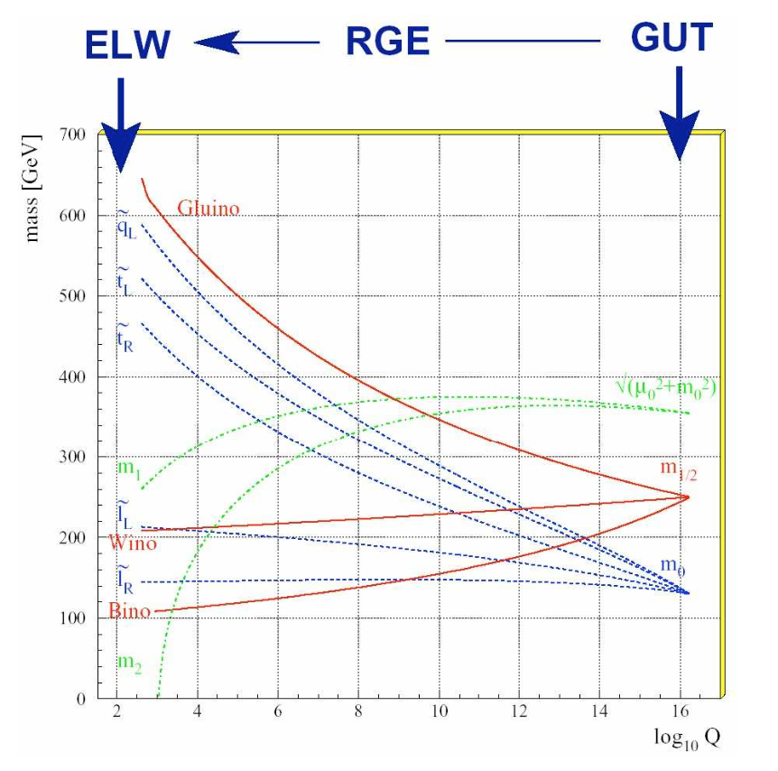
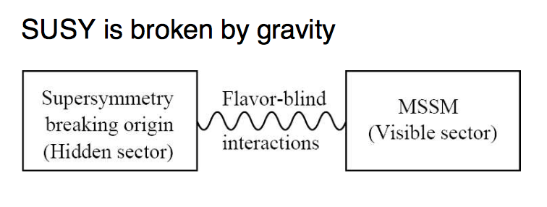
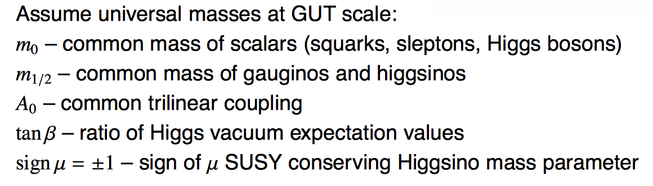
SUGRA<->mSUGRA
Gravity mediated supersymmetry breaking became one of the most popular models to interpret data at colliders such as LEP, Tevatron and HERA, in searches for SUSY.
We also started at the LHC
with mSUGRA
Now using more so called
simplified models
Note: CMSSM/mSUGRA subtle difference

Slide 7
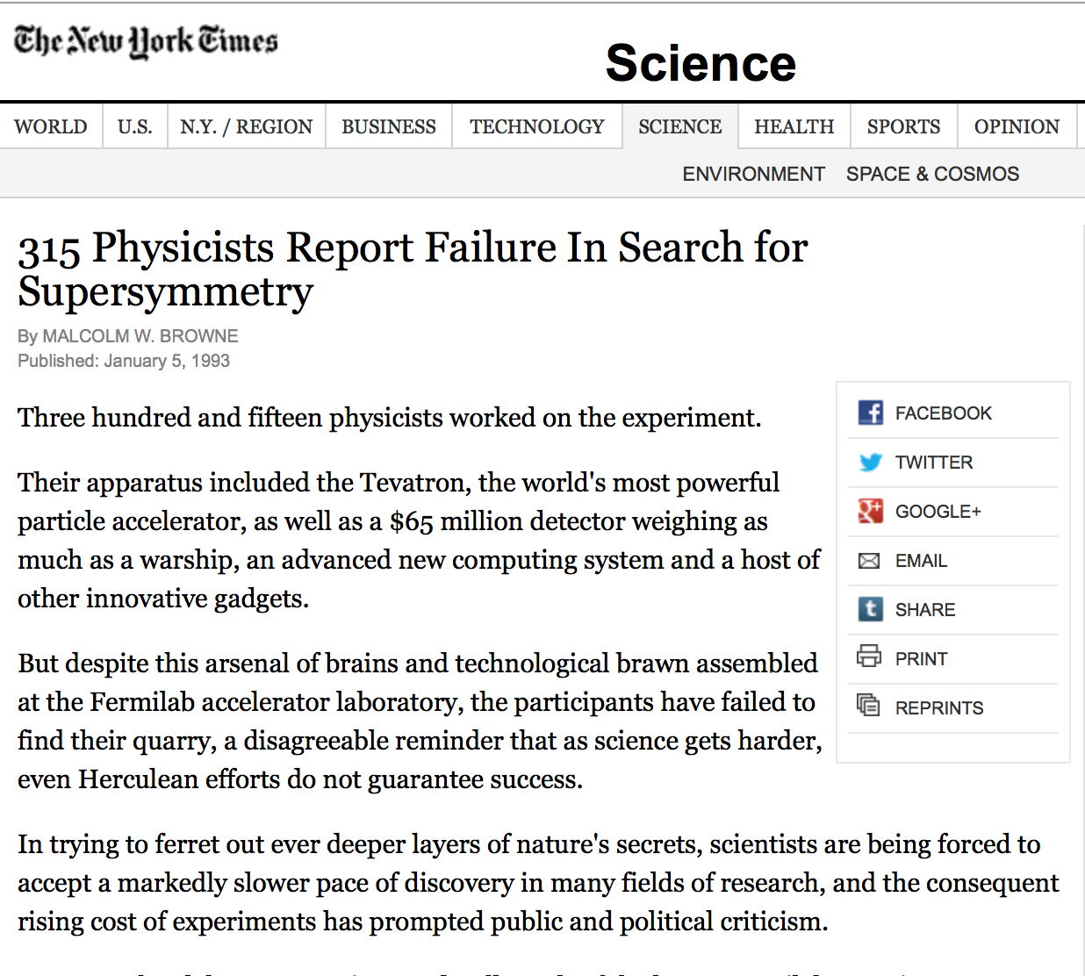
1993: Early Tevatron SUSY Searches

Slide 8
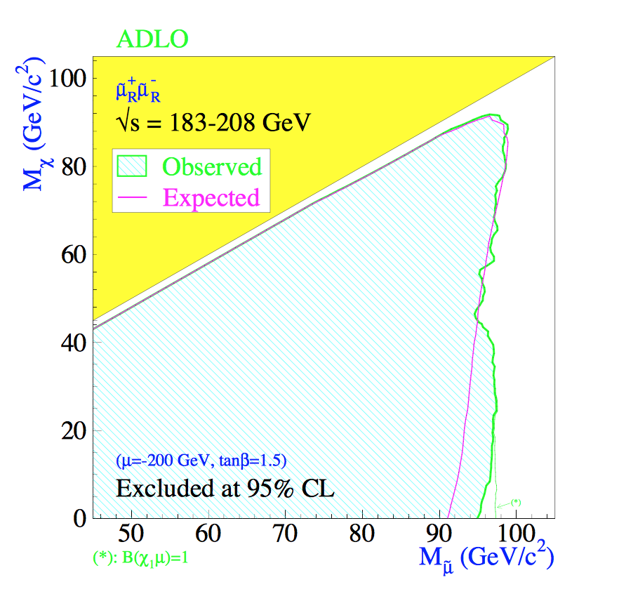
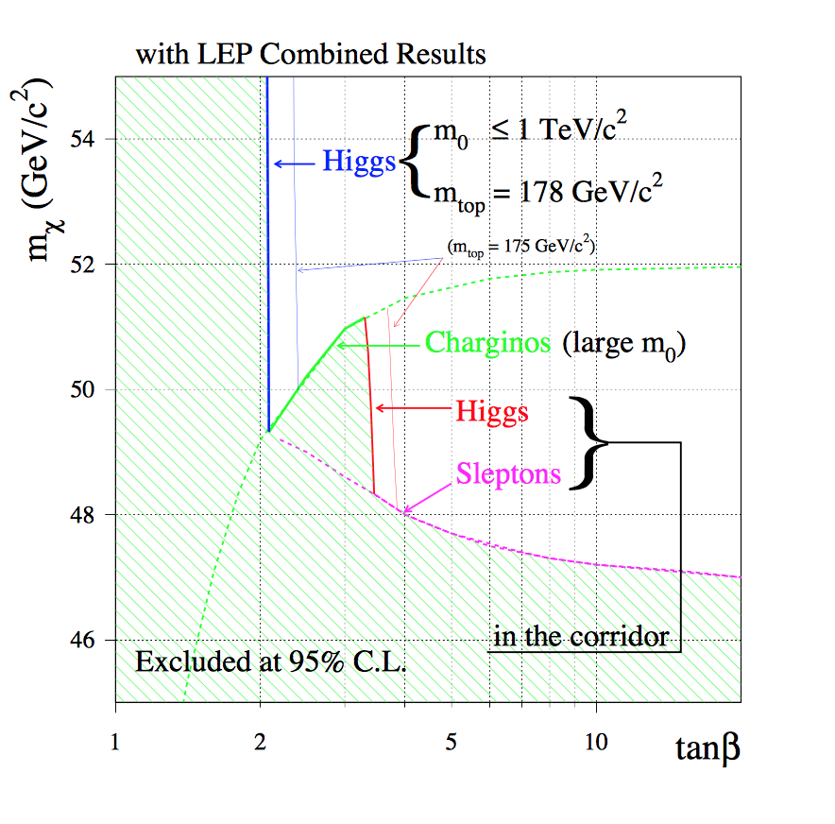
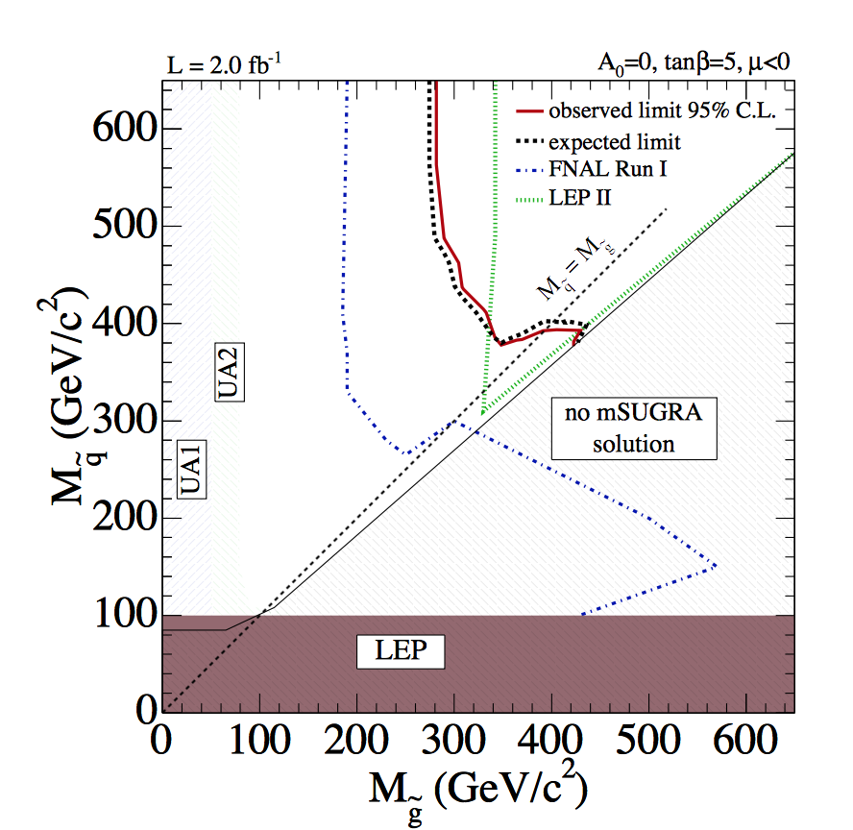
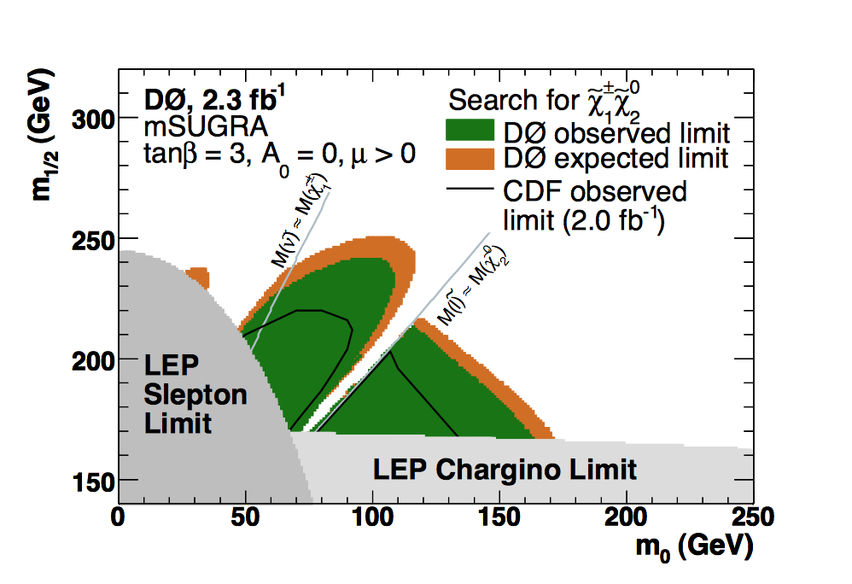
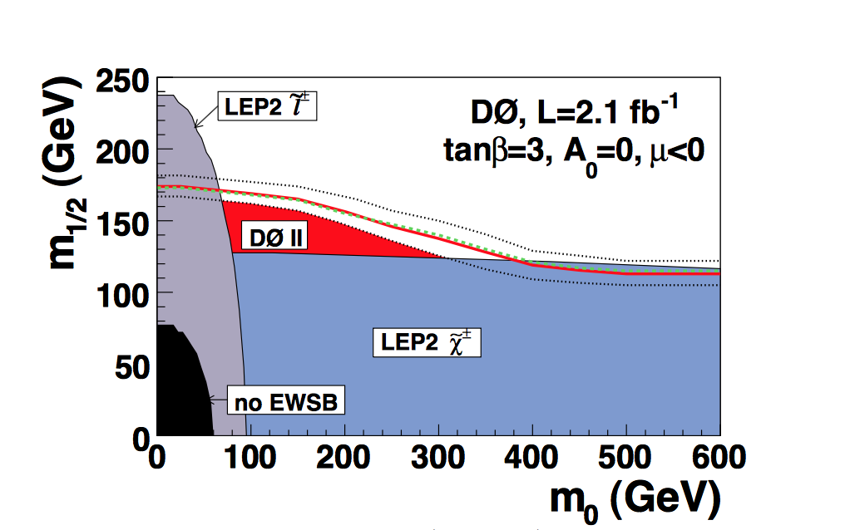
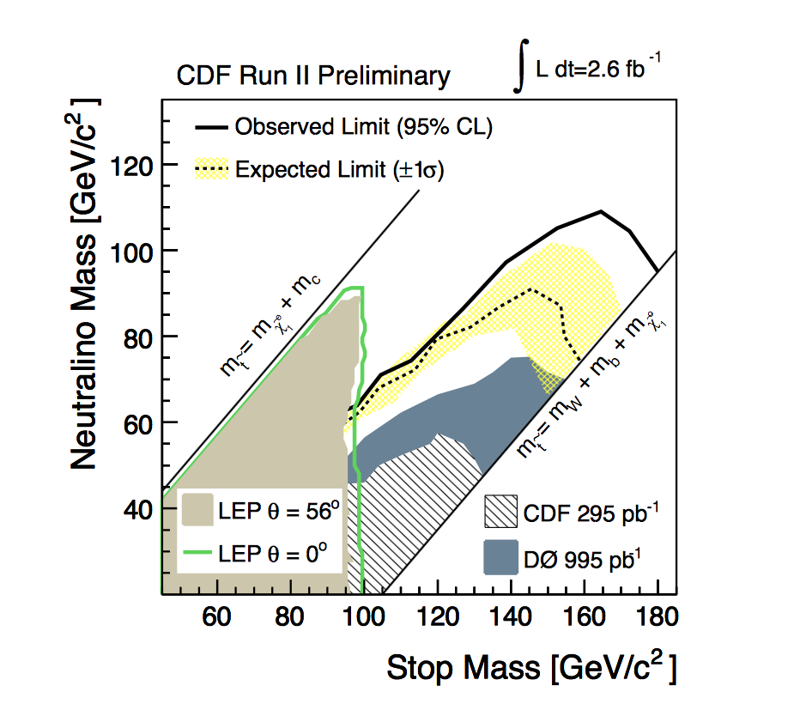
SUSY Searches in 2009: Pre-LHC
PDG 2009
LEP: mostly model
independent
Tevatron: mostly
mSUGRA interpret.
HERA: mostly RPV
Squark/gluino limits: 300-400 GeV
Electroweakinos (except LSP): >100 GeV

Slide 9
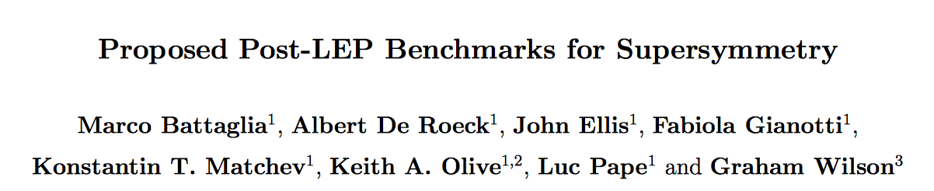
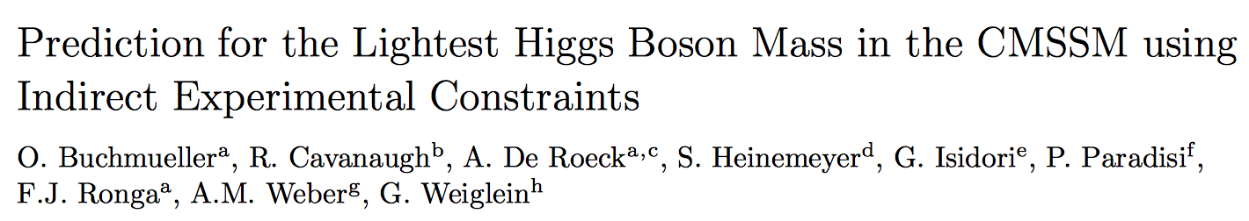
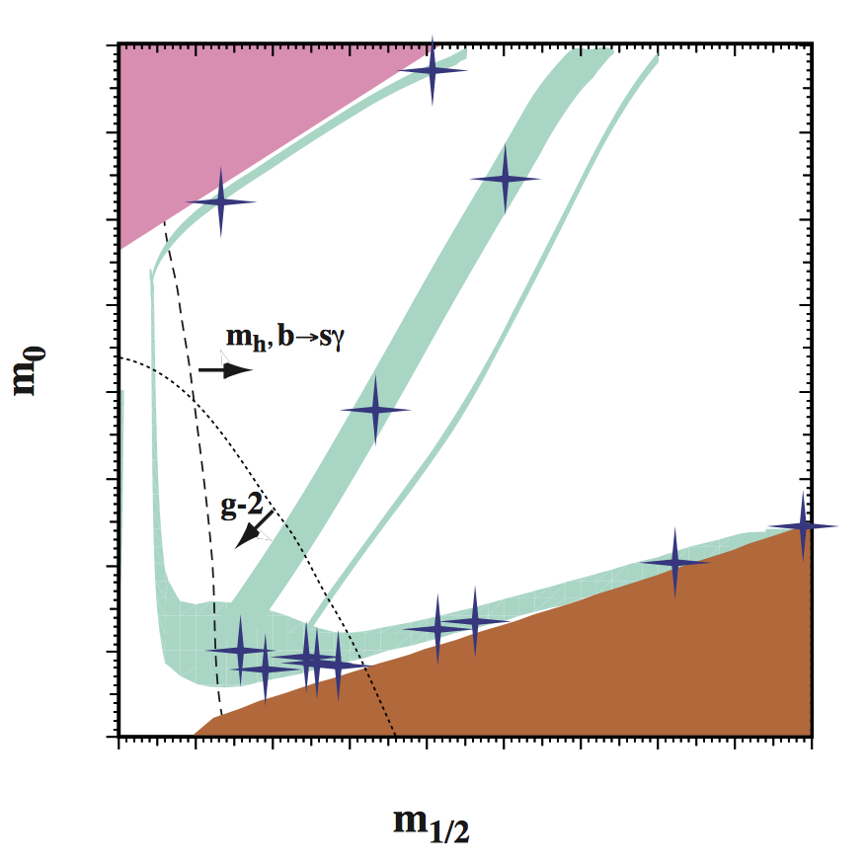
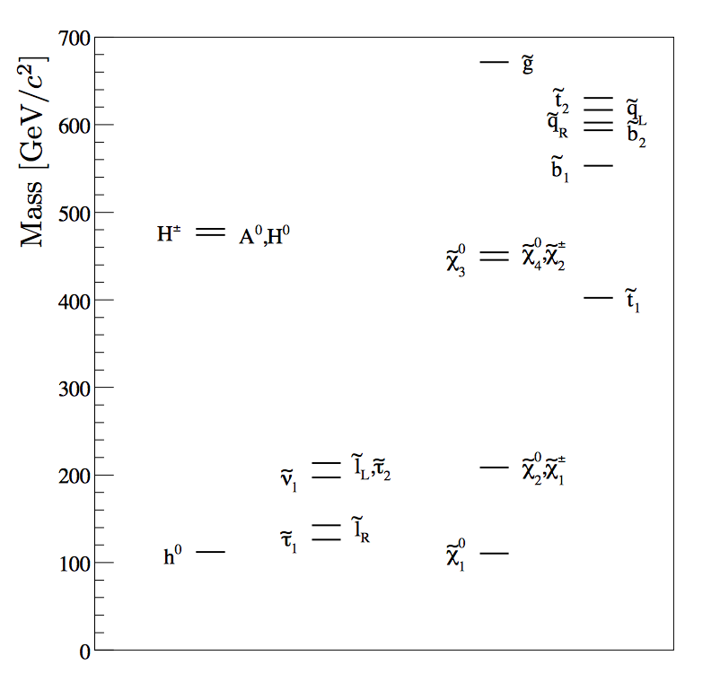
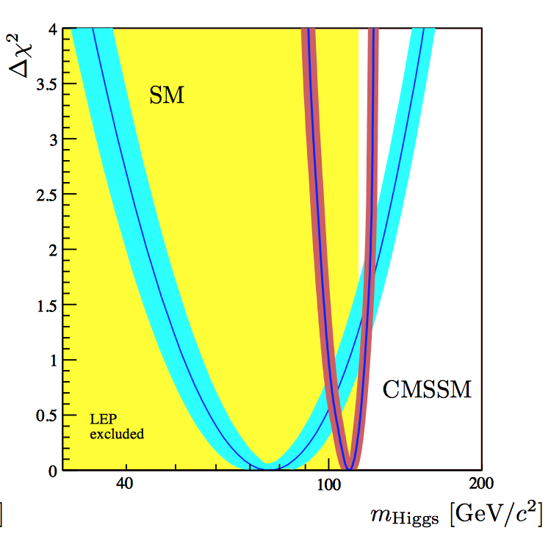
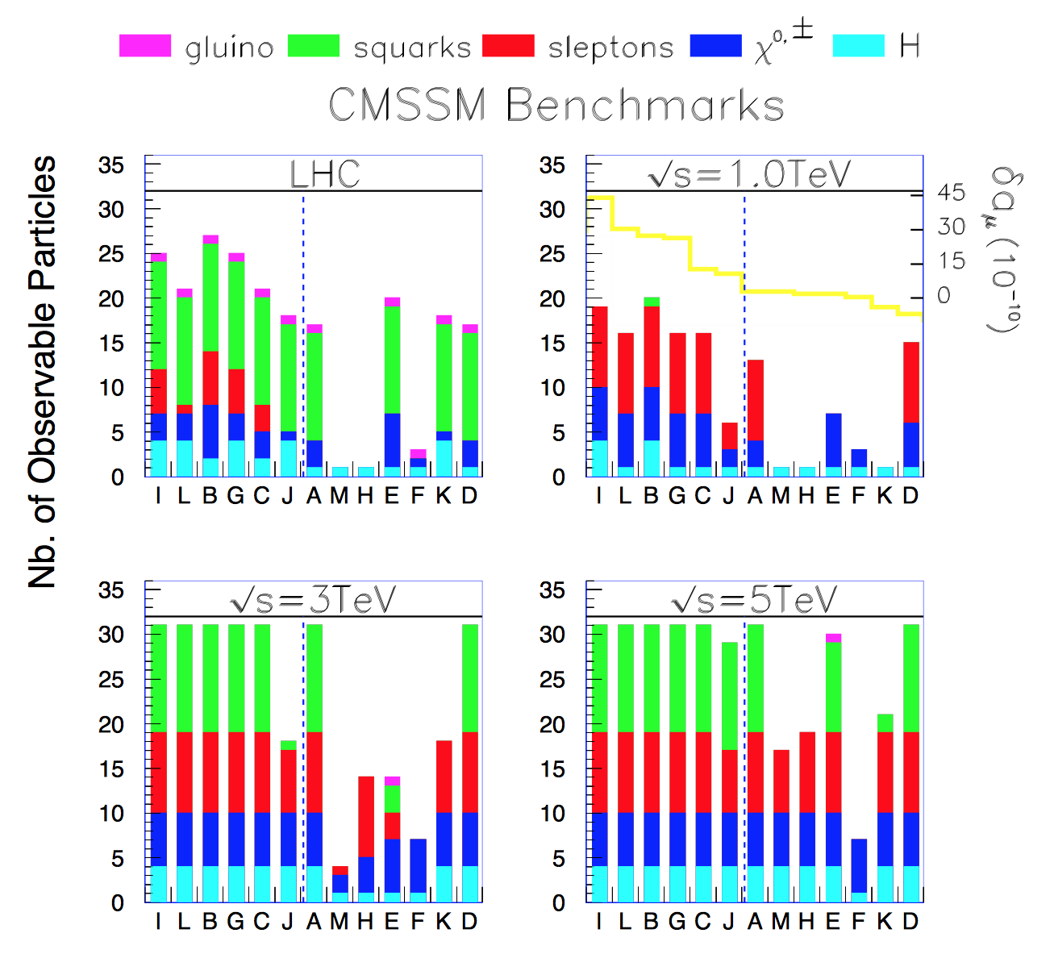

Playing with mSUGRA/CMSSM
hep-ph/0106204
arXiv:0707.3447
Became the Mastercode collaboration
Ok within 2σ ☺
Using constraints
of all available data
(measurements,
limits…)
Is SUSY around the
corner??
Turn on the LHC!

Slide 10
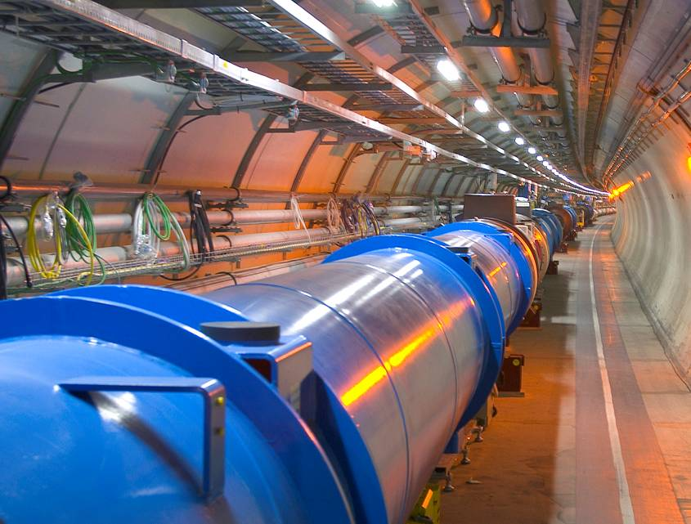
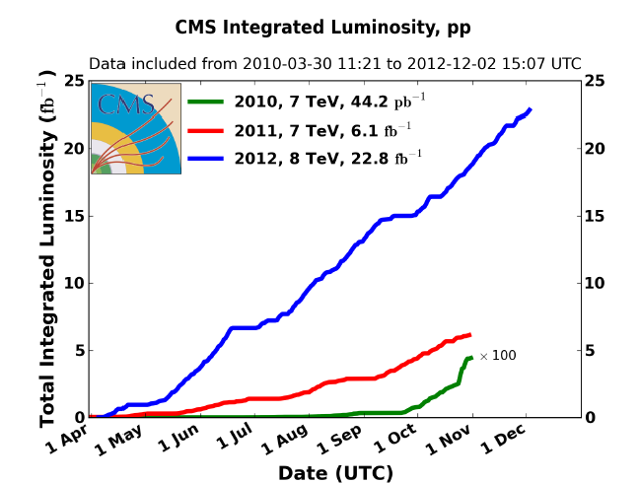
8 TeV
7 TeV
Run-1: LHC did very well in 2011/2012
2011: luminosity 3 . 10³³ cm⁻² s⁻¹ ⇒ 5 fb⁻¹ collected in total
2012: luminosity 7.8 . 10³³ cm⁻² s⁻¹⇒ 20 fb⁻¹ collected in total
LHC was shut down in 2013-2014 for ‘upgrade’ to 13/14 TeV

Slide 11

This is what we do!
proton proton
…40 Million times a second - 24/7 (if we could)
Out comes the new physics (or not)

Slide 12

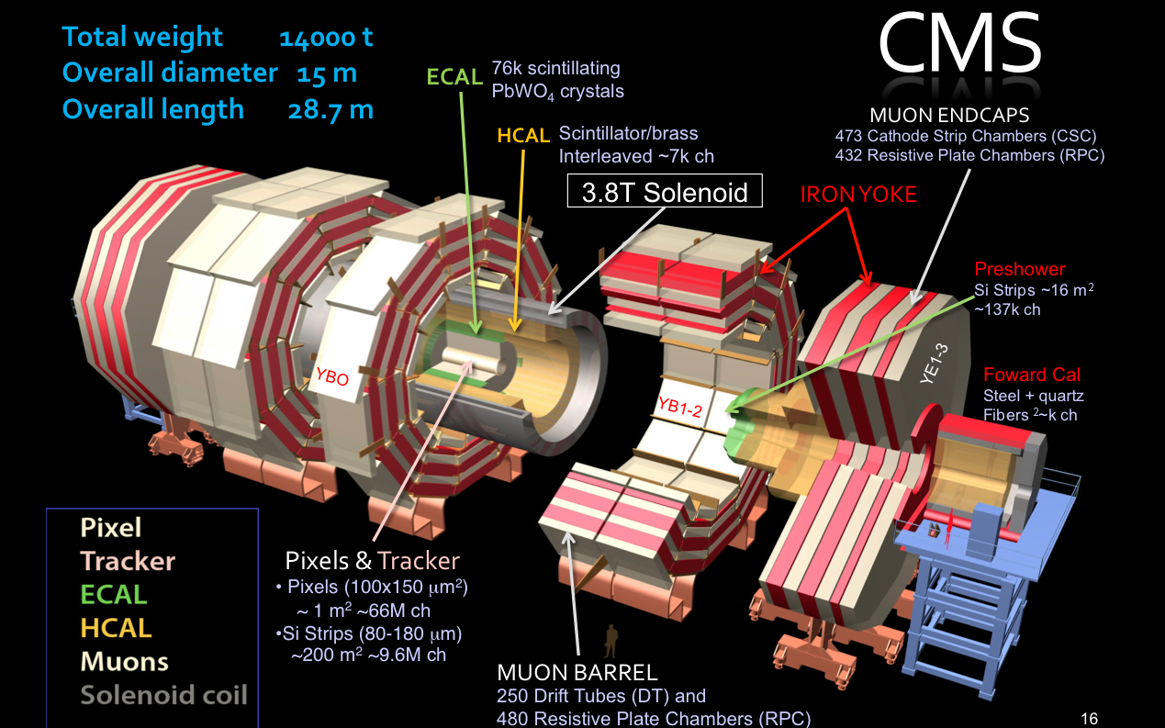
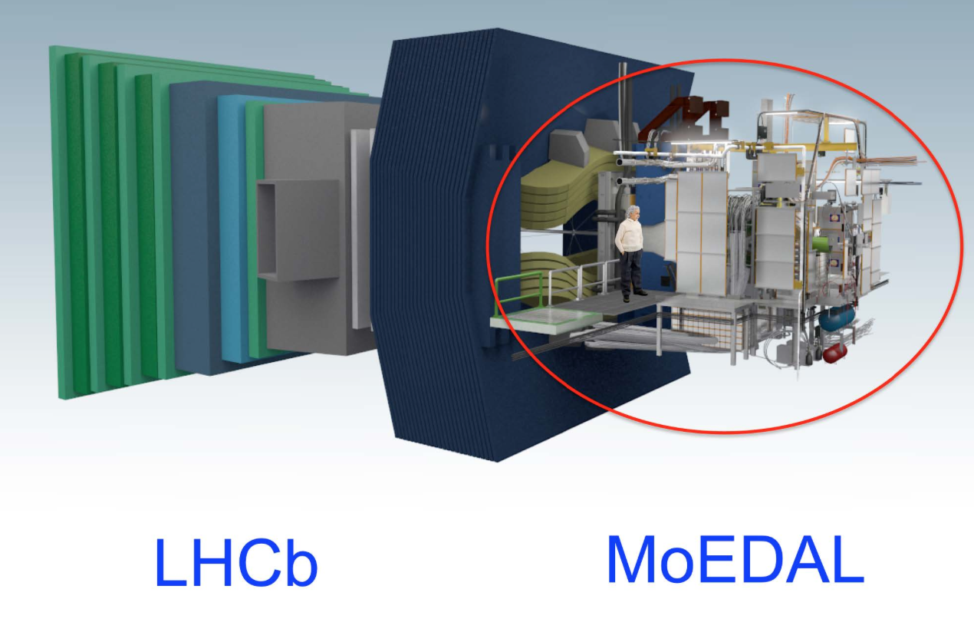
New Physics Hunters @ the LHC
The ATLAS experiment
The CMS experiment
…And also LHCb and MoEDAL

Slide 13
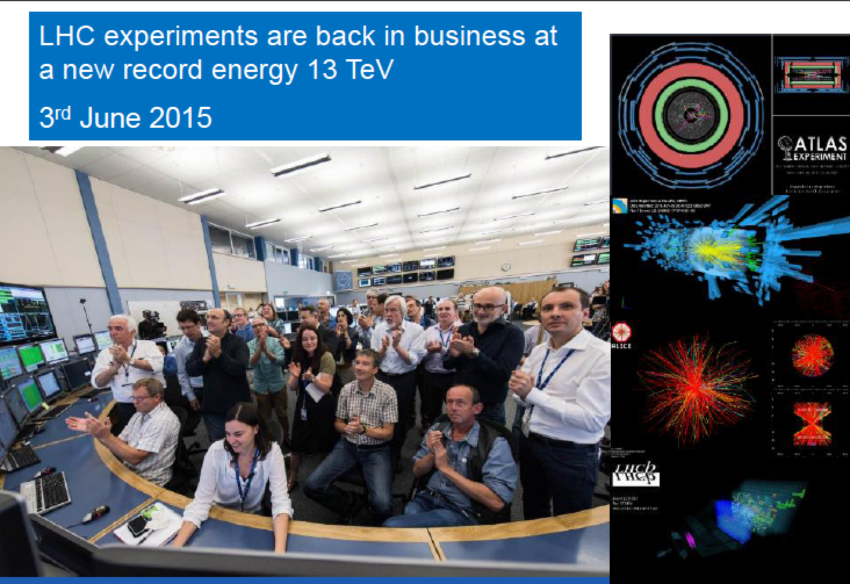
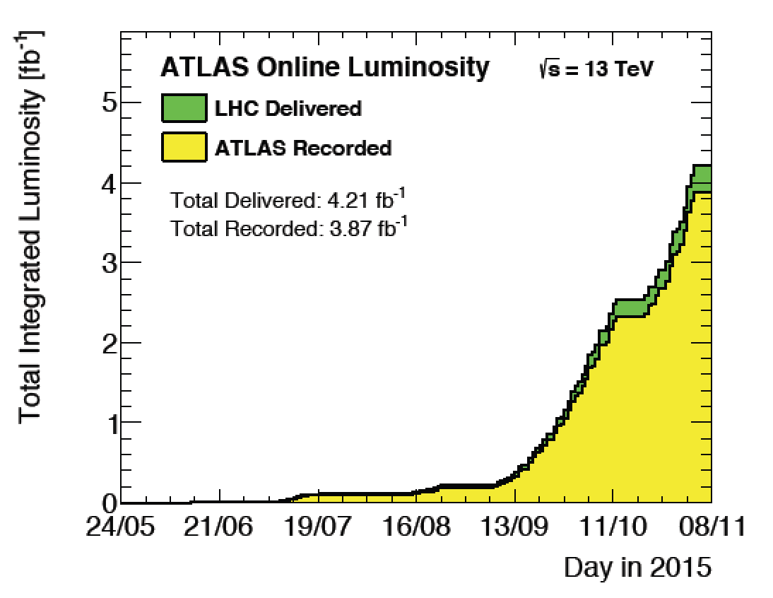
A
~15% of the run-1
Luminosity!
ATLAS and CMS collected data
with an efficiency above 90%
About ¼ of the CMS data was with
magnetic field off ☹

Slide 14



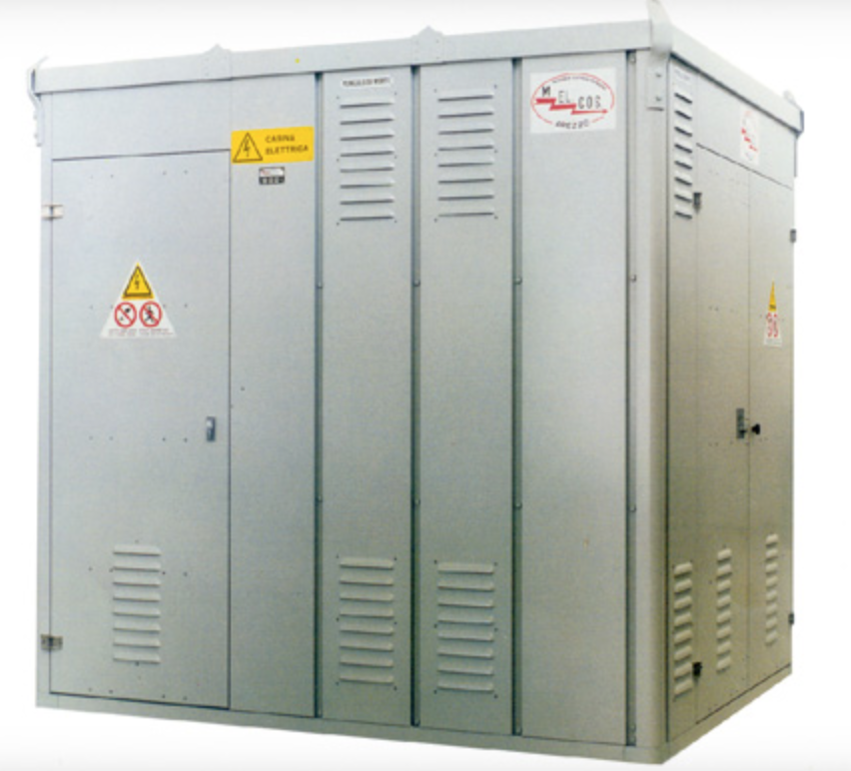
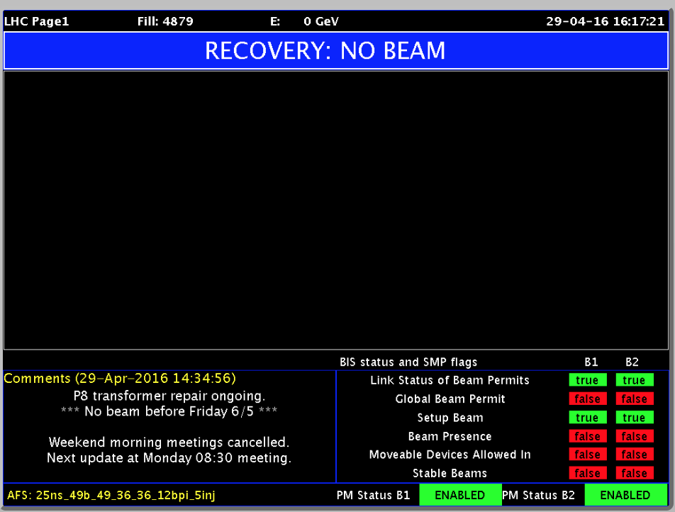

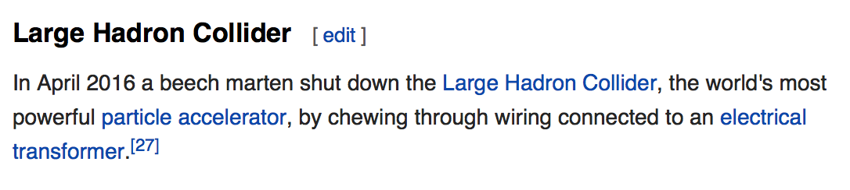
LHC 2016 Startup
2016 LHC Startup: Thursday 28/4 10:40 PM
But…Friday 29/4 5:32 AM
Fouine/Beech Marten
(Martes Foina)
HV transformer…
18kV -> 66 kV
LHC off for a
week ☹
https://en.wikipedia.org/wiki/Beech_marten
Next: issues with a SPS beam dump
(may reduce lumi expectations) and
recently issues with the main power
supply in the PS
“Good news” travels fast

Slide 15
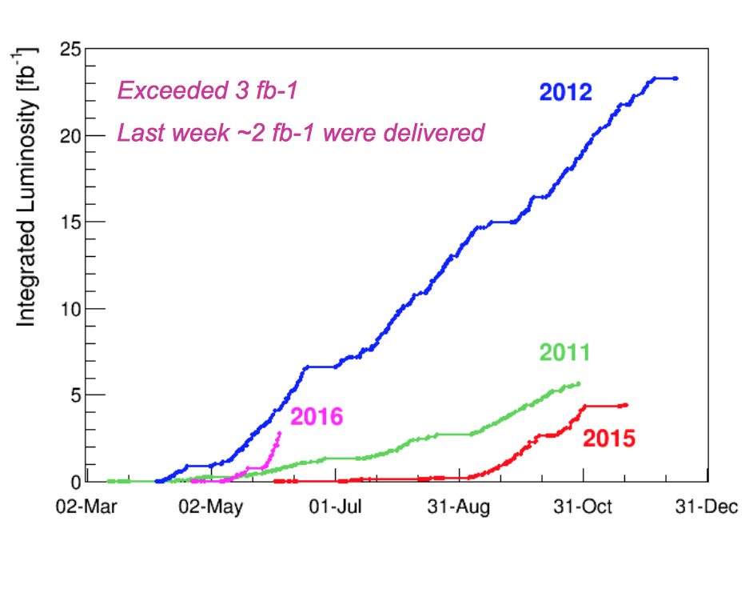
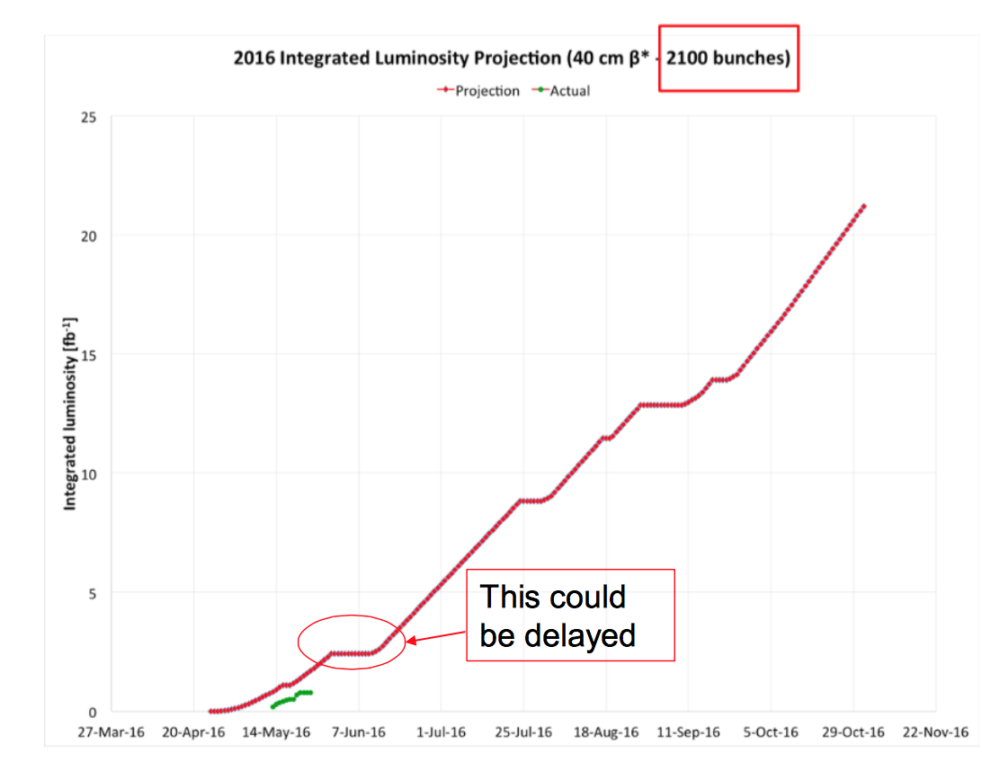
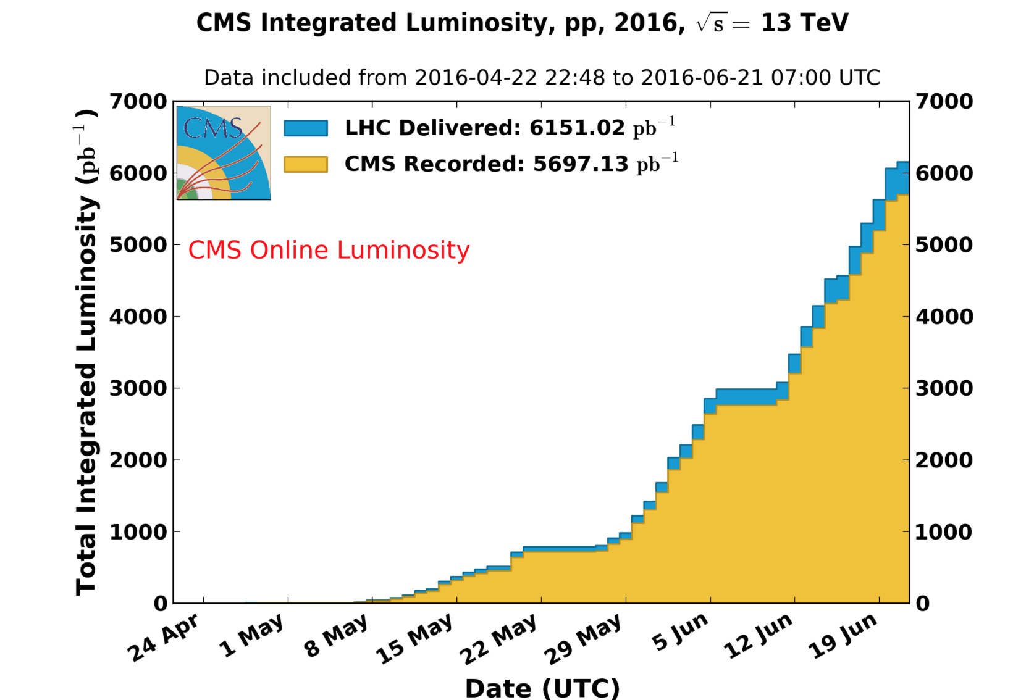
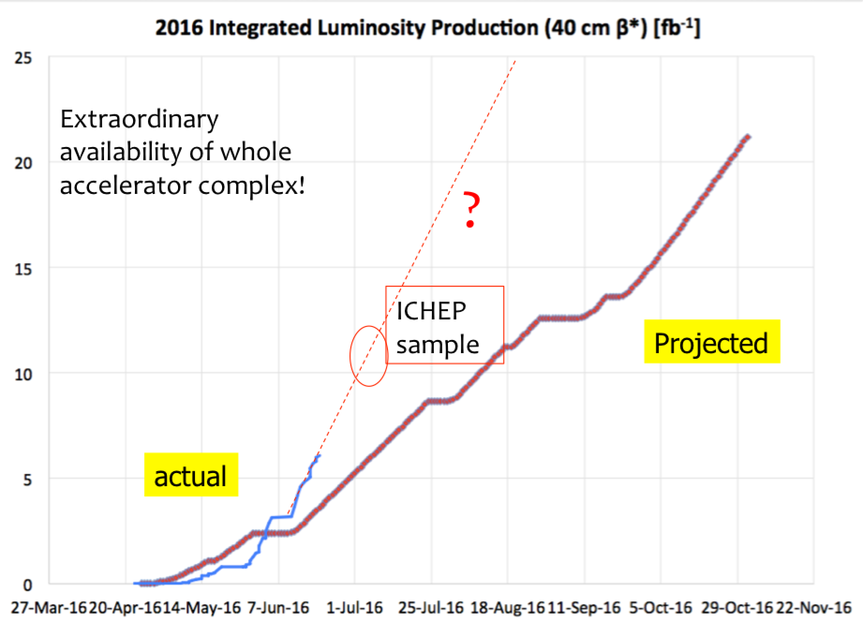
Expected and Collected Lumi 2016
•To date ~ 6 fb⁻¹ recorded on tape for analysis
•Possible by ICHEP2016: ~10 fb⁻¹
Bumpy start but
fantastic reprise!
100 fb⁻¹ for Run-2 still on target

Slide 16

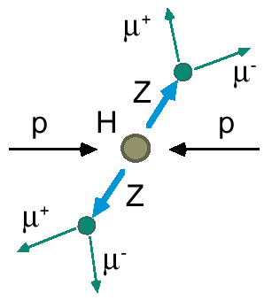
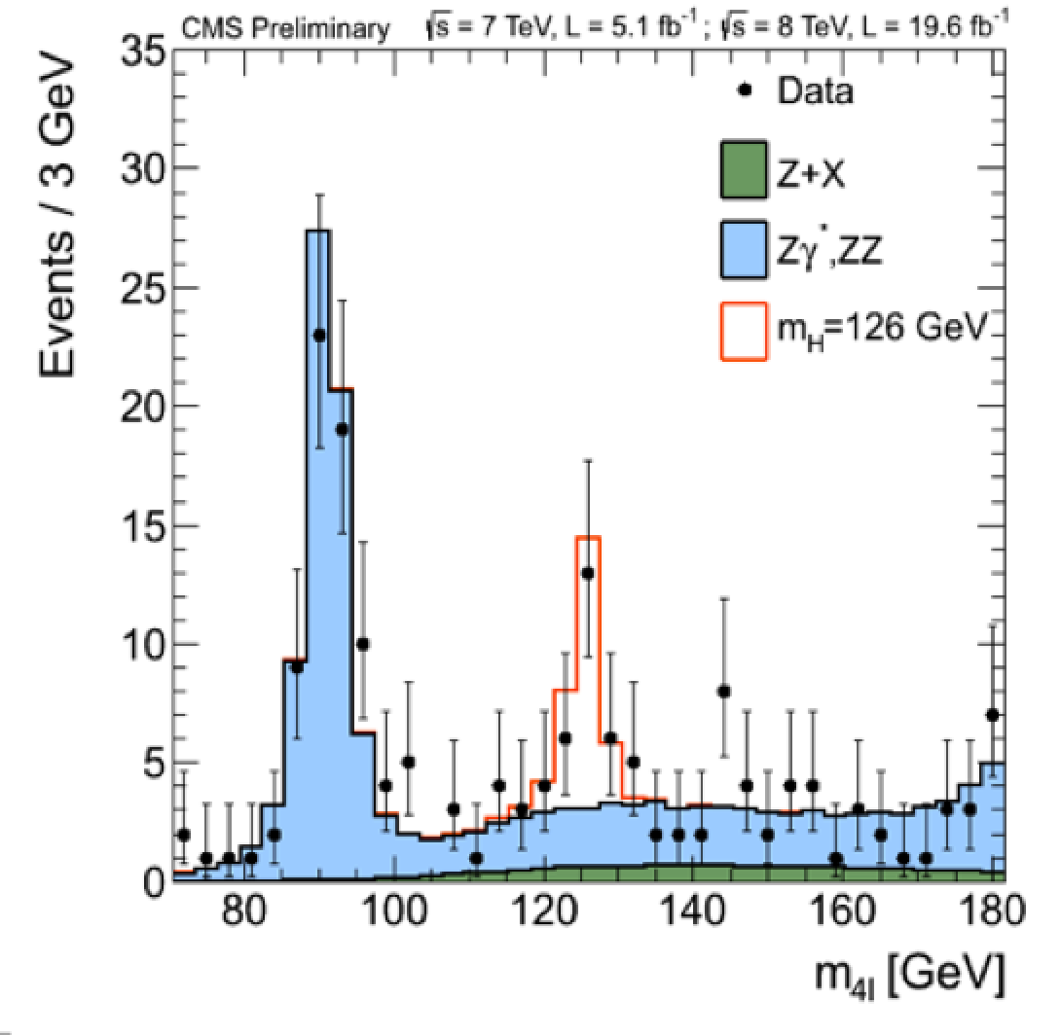

2012: A Milestone in Particle Physics
Observation of a Higgs Particle at the LHC, after about 40 years
of experimental searches to find it
proton
proton
2013
The Higgs particle was the last missing particle in the Standard Model
and possibly our portal to physics Beyond the Standard Model

Slide 17
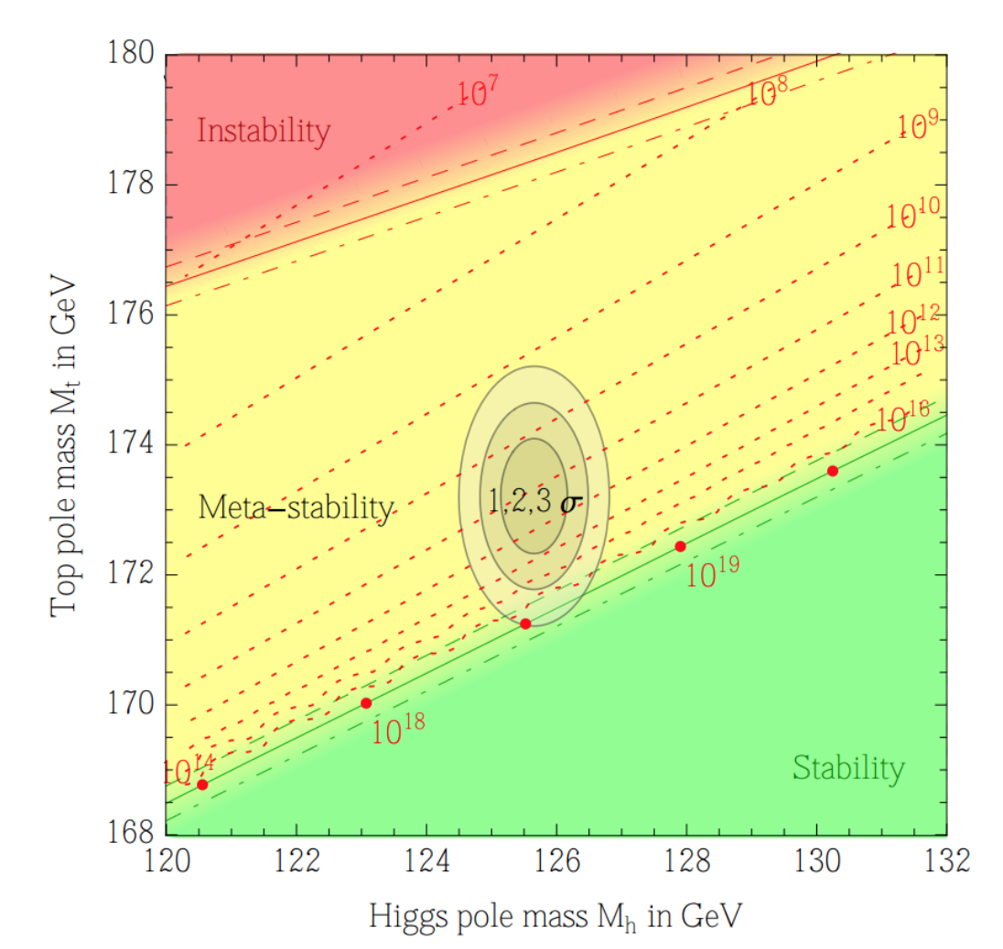

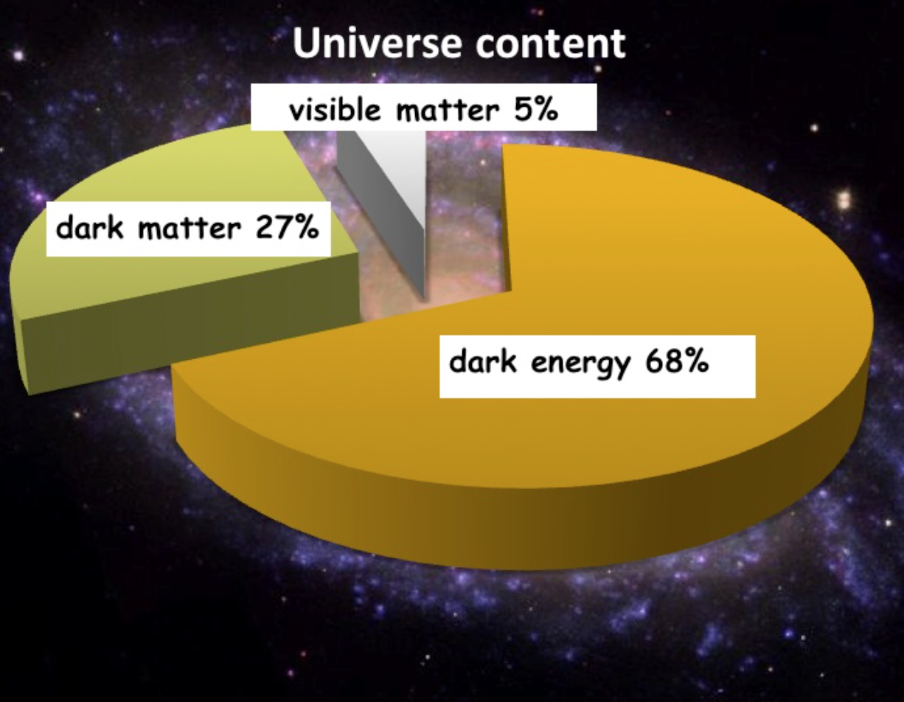

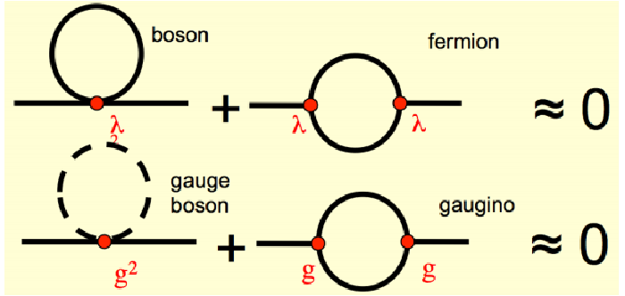
Physics Beyond the Standard Model?
A Higgs at 125 GeV
Precise measurements
of the top quark and the
Higgs mass:
arXiv:1403.6535
We also know that:
New Physics inevitable?
But at which scale/energy?
N. Arkani-Hamed

Slide 18
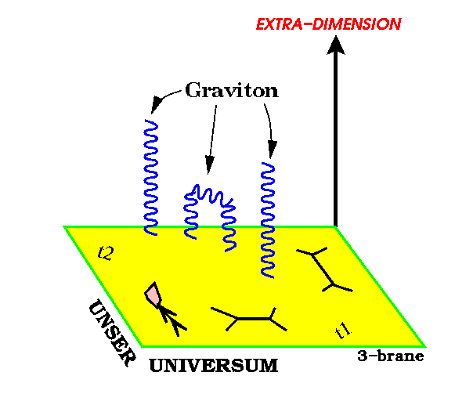
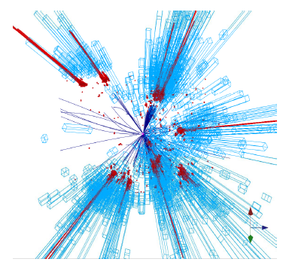
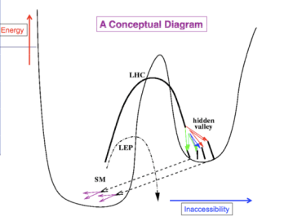
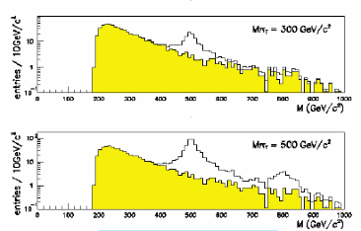
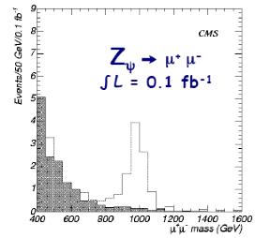
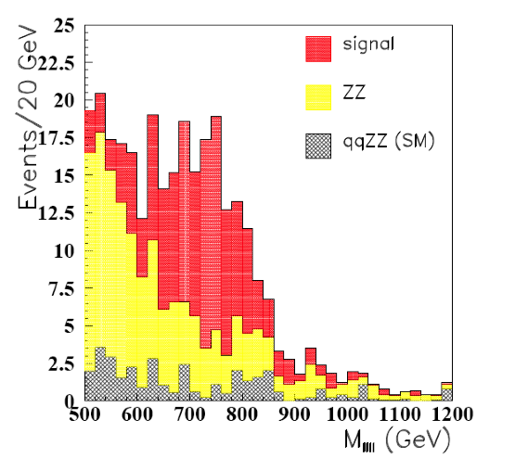
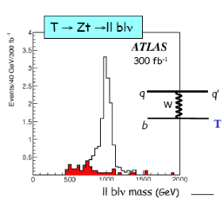
New Physics Signatures…
New Gauge Bosons?
Supersymmetry
ZZ/WW resonances?
Technicolor?
Little Higgs?
Extra Dimensions?
Hidden Valleys?
Black Holes???
A large variety of possible signals. Experiments have to be ready for that
Notes:
17

Slide 19
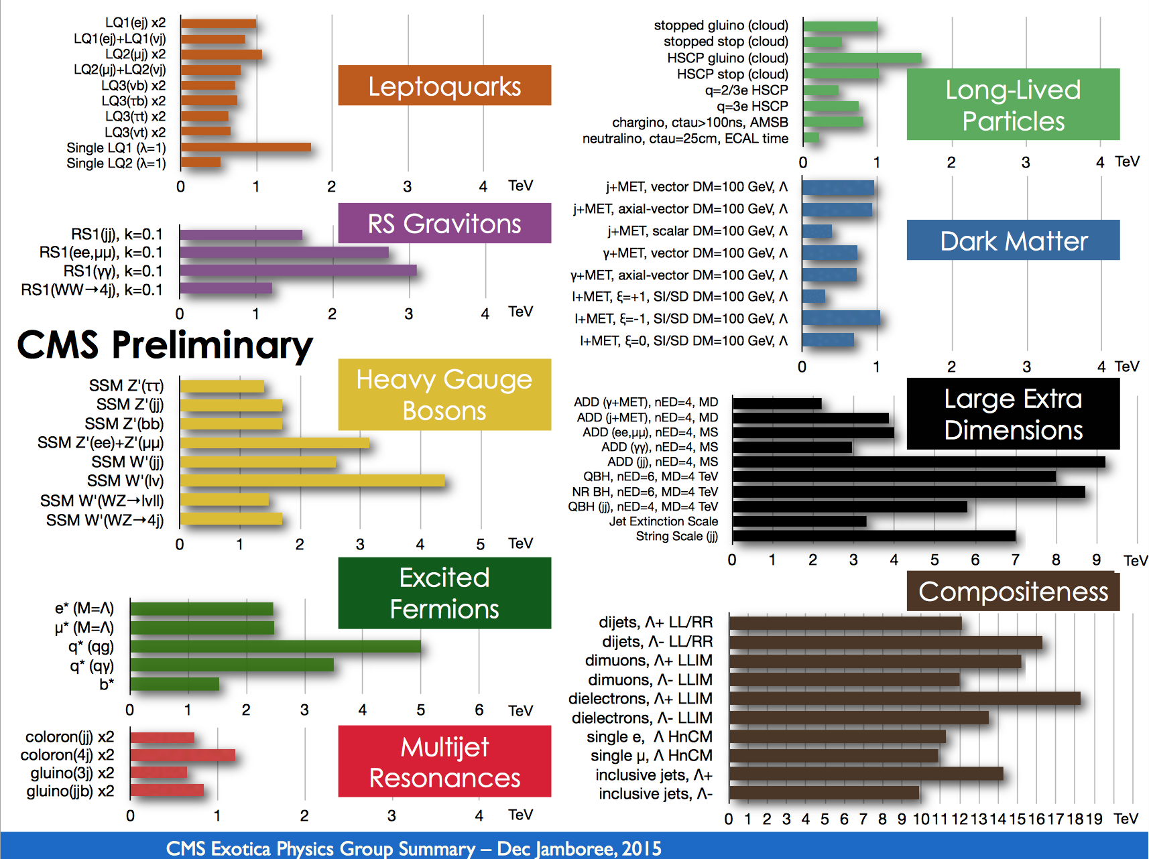
Summary of Run-1 Exotica Searches

Slide 20
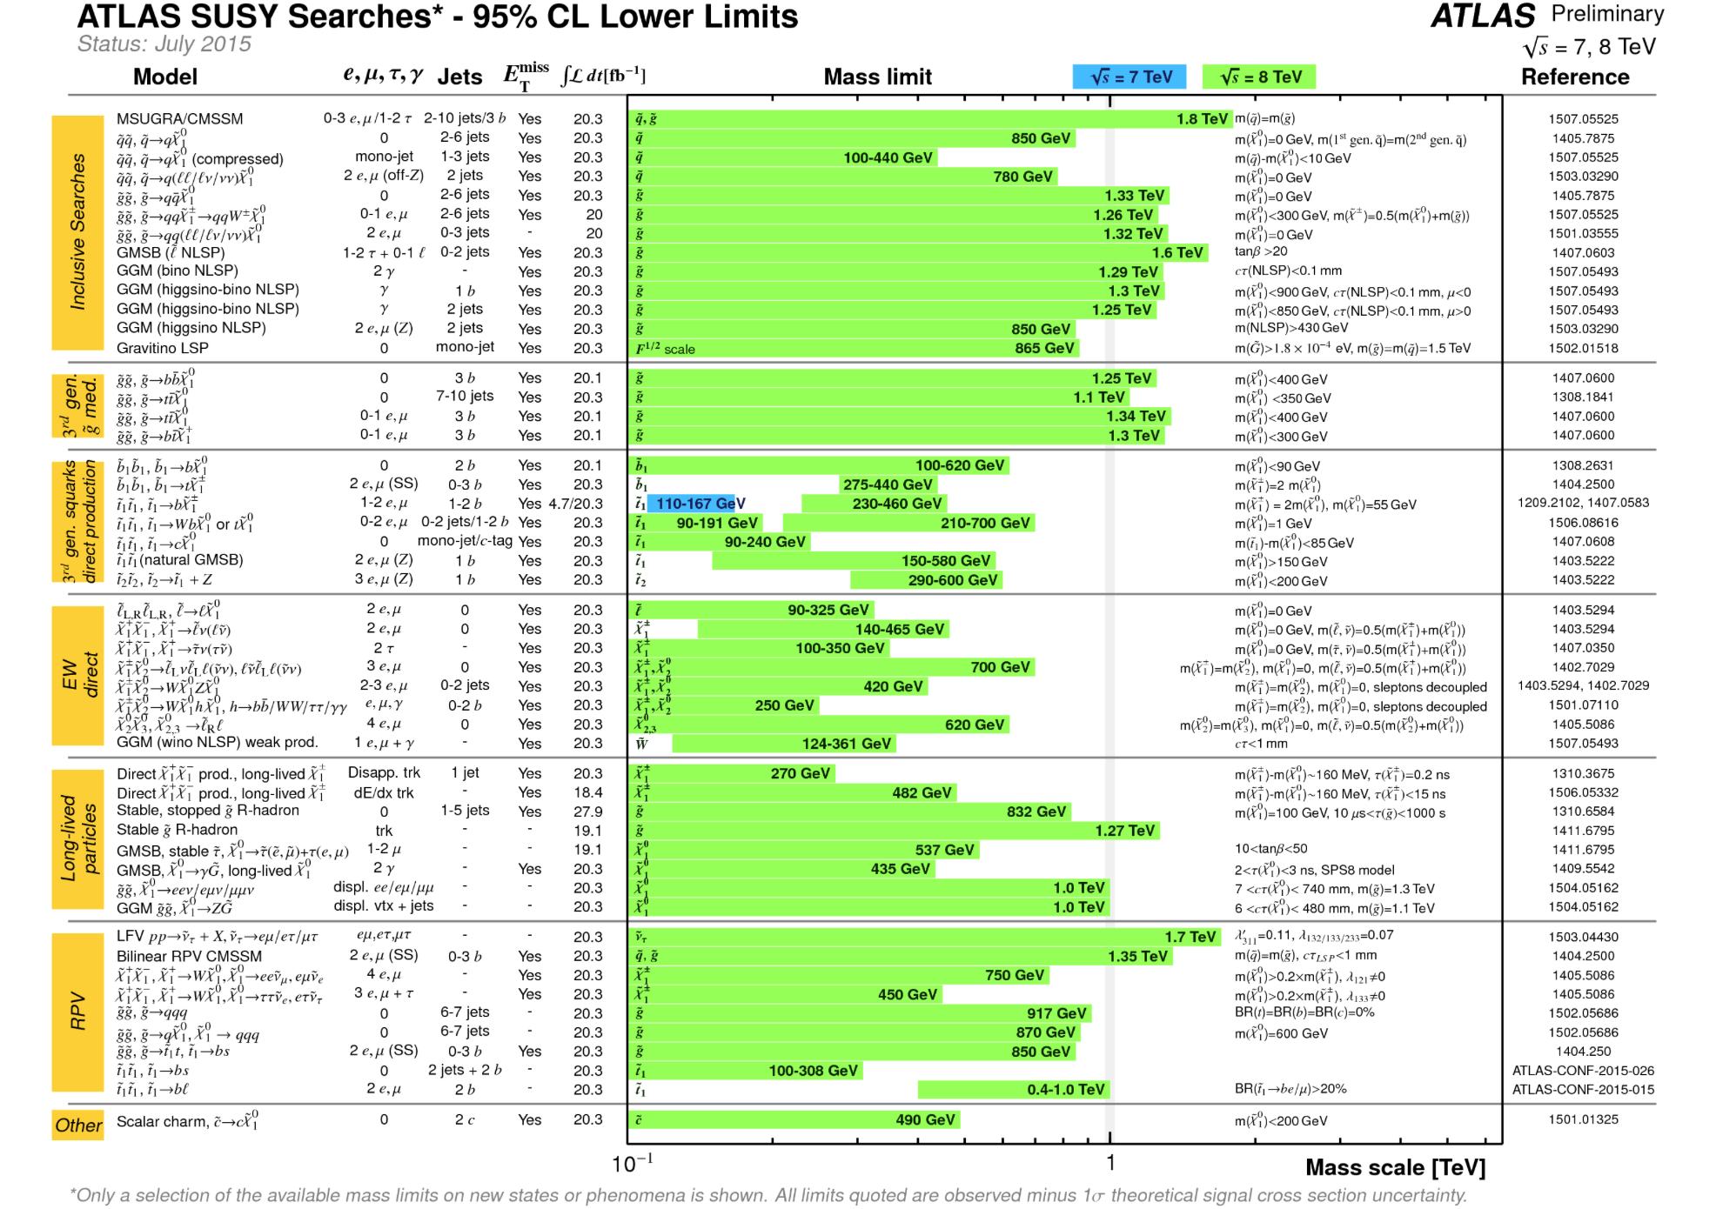
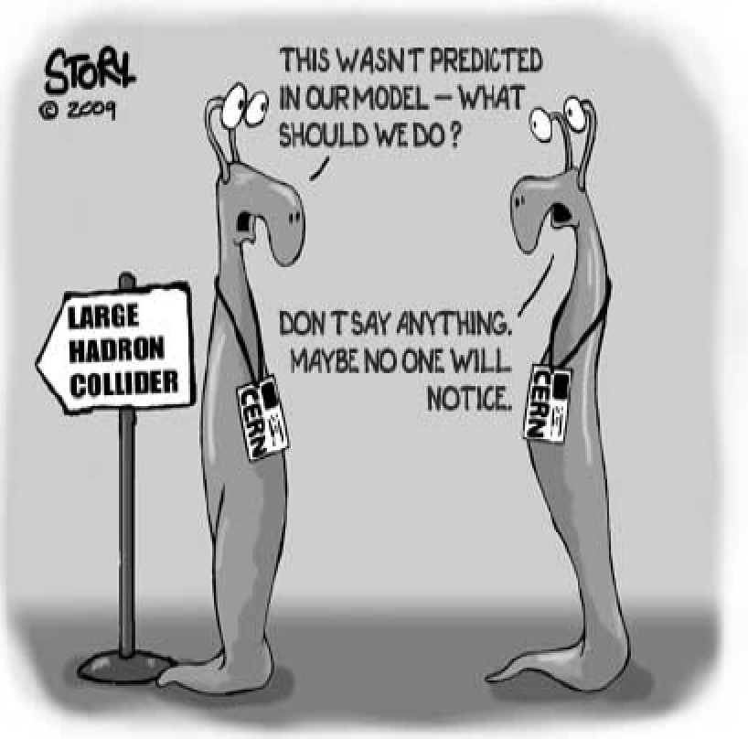
Summary of Run-1 SUSY Searches
In short: no sign of SUSY with the data collected in run-I (similar plot for CMS)

Slide 21

Run-1: We Observed Mild Deviations
B. Hooberman

Slide 22



New Physics Searches with 2015 Data
For searches above 1-2 TeV the 2015 data sample becomes already important

Slide 23


Run-II: From 8 TeV to 13 TeV

Slide 24




Higgs: ATLAS+CMS Combination
The Run-1 Higgs Legacy!
Vector Boson Fusion production
mechanism and H-> tau tau decays
established with 5σ significance in
combination
arXiv:1606.02266
Signal strength/SM:

Slide 25






Brief Higgs Summary from Run-1
We know already a lot on this Brand New Higgs Particle!!
Mass = CMS+ATLAS
125.09 ±0.21(stat)
±0.11(syst) GeV
Width
< 24 MeV
(95%CL)
Couplings are
within ~20% of
the SM values
Spin =
0⁺⁽⁺⁾ preferred
over 0⁻,1,2
SM-like behaviour for most properties, but continue to look for anomalies,
i.e. unexpected decay modes or couplings, multi-Higgs production…

Slide 26

The Higgs is Back @ 13 TeV
Luminosity in 2016 is too low for a clear Higgs observation,
but the Higgs is still there!

Slide 27



Beyond the Higgs Boson
Supersymmetry: a new symmetry in Nature?
Candidate particles for Dark Matter
⇒ Produce Dark Matter in the lab
SUSY particle production at the LHC

Slide 28

SUSY in run-1: No Significant Signals
Status with run-1
•So far NO clear signal of
supersymmetric particles
has been found
•We can exclude regions
where the new particles
could exist.
•Searches now continue with
the higher energy in Run-2
allowed
excluded
Plenty of searches ongoing: with jets, leptons, photons, W/Z,
top, Higgs, with and without large missing transverse energy
Also special searches for more contrived model regions
CMS-SUS-11-015

Slide 29

Inclusive SUSY Searches by 2013
Msq = 1800 GeV
Mg = 1400 GeV
CMSSM Landscape in 2013:
Example ATLAS (CMS similar)

Slide 30

Inclusive SUSY Searches by 2013
Msq = 1800 GeV
Mg = 1400 GeV
Compared
to 2009…
CMSSM Landscape in 2013:
Example ATLAS (CMS similar)
LEP &
Tevatron
The LHC has pushed the mass scale in constraint SUSY models
to a new level!

Slide 31




Run-2: All Hadronic Searches
•Gluino searches with all hadronic final states, ie jets + Missing E_{T}
•Several different methods are used, with different background systematics
Popular presentation of data:
Simplified ModelS (SMS)
13 TeV Limits, with 2.3 fb⁻¹ only, are 200-400 GeV better than the 8 TeV ones

Slide 32

What is really needed from SUSY?
End 2011: Revision!
N. Arkani-Ahmed
CERN Nov 2011
Papucci, Ruderman,
Weiler arXiv:1110.6926
LHC data end 2011
Stops > 200-300 GeV
Gluino > 600-800 GeV
Moving away from
constrained SUSY models
to ‘natural’ models
Natural SUSY survived
LHC so far, but we
are getting close to
push it to its limits!

Slide 33



Stop Searches @ 8/13 TeV
The 13 TeV analyses getting as
sensitive as the higher lumi 8 TeV

Slide 34


ATLAS Gluino and Stop Searches

Slide 35





Phenomenological MSSM analysis
mSUGRA/CMSSM too constraining? SMS don’t always fully cover signatures ?
-> the 19 parameter phenomenological MSSM (pMSSM) analyses
arXiv:1606.03577
gluinos
squarks
stop
10⁸ points sampled: one gets softer limits on the sparticles masses
Gluinos > 500 GeV, stops > 250 GeV -> there is still low mass phase space left!

Slide 36

Search in the Z+Jets+MET Channel
ATLAS-CONF-2015-082
Search for gluino or squark production with Z in decay chain
•In Run-1 ATLAS observed an excess in this
channel: 3 (1.7) σ excess in ee (μμ) channel
•Not observed in CMS in Run-1
Reproduce the Run-1 analysis:

Slide 37

Search in the Z+Jets+MET Channel

Slide 38

Opposite Sign Dilepton Analysis
CMS had “it’s own” mild excess in the run-1 dilepton analysis but in the region
below the Z peak at 8 TeV. The excess was 3.4σ
The 2015 data does not confirm this excess…

Slide 39
Many other searches for SUSY
Searches with many jets (8 or more)
Searches with hard photons
Searches for electorweakinos in multi-lepton final states
Searches fort sbottoms and staus
Specific analyses for compressed spectra
RPV analyses without missing E_{T} requirement
VBF production of sparticles
SUSY with long lived particles
…
-> So far no outstanding surviving signal!!

Slide 40



Long Lived Particles
Split Supersymmetry
The only light particles are the Higgs and the gauginos
- Gluino can live long: sec, min, years!
- R-hadron formation (eg: gluino+ gluon): slow, heavy particles
Gravitino Dark Matter and GMSB
In some models/phase space the gravitino is the LSP
⇒ NLSP (neutralino, stau lepton) can live ‘long’
⇒ non-pointing photons
Hidden Valley modes!…
Plethora of possibilities for long lived neutrals
EG: K. Hamaguchi,M Nojiri,ADR hep-ph/0612060
ADR, J. Ellis et al. hep-ph/0508198
Sparticles stopped in the detector, walls
of the cavern, or dense ‘stopper’ detector.
They decay after hours---months…
⇒Challenges to the experiments!

Slide 41



Long Lived Particles
arXiv:1501.05603
Cross reach
•Heavy stable charged particles
with de/dx measurements, or
stop-and-decay asynchronous
with the pp collisions.
•Special runs with detector
active and no-pp collisions
have been taken for that
Gluino > 1580 GeV
Mass reach
arXiv:1606.05129

Slide 42

Summary of SUSY Searches (2016)

Slide 43




Extra Space Dimensions
Problem:
EG: search for jets
or photons balanced
against graviton
The Gravitational force becomes strong!

Slide 44



Search for Large Extra Dimensions
Mono-jet final state +Missing E_{T} (ADD)
arXiv:1604.07773
Limits on M_{D}
between
~ 7 and 4 TeV
Lower limit on the Planck Scale
versus number of extra dimensions
p_{T} jet > 250 GeV
MET > 250-700 GeV

Slide 45



Search for Micro Black Holes
Extra Dimensions!
2015: 12 jet event with S_{T}=5.4 TeV
Planck scale
a few TeV?
CMS-EXO-15-007
Look for the decay producs
of an evaporating black hole
•Define S_{T} to be the scalar
sum of all high p_{T} objects
found in the event
•Look for deviations
at high S_{T}
Black hole mass excluded in range below ~8-9 TeV depending on assumptions

Slide 46



Dijet Resonance Search
The highest mass dijet events
recorded so far in run-II
Dijet invariant mass = 6.14 TeV
Dijet invariant mass = 7.9 TeV

Slide 47



Dijet Resonance Search
arXiv:1512.01224
2.4 fb⁻¹ limits from 13 TeV already
surpass the 20 fb⁻¹ limits from 8 TeV

Slide 48


Dark Matter Searches
Dark Matter hunt is one of the new main physics goals for the LHC!
•Mono-object searches are not yet giving better sensitivity compared to 8 TeV
•But new developments with Simplified Models, allow including many more
search channels such as dijets (aka “In Search for the Mediator”)
A promise for
future studies

Slide 49



High Mass Search: X → γγ ???
News from the 2015 data run in last December!!!
->Some excitement over and observed excess in both
experiments for a diphoton mass of around 750 GeV
ATLAS-CONF-2015-081
CMS EXO-15-004
A totally unexpected
new particle???
Statistical fluctuation? A new resonance? Excitement…!!

Slide 50

Diphoton Resonance Searches: CMS
arXiv:1606.04093
Find 2 isolated photons
with p_{T}> 75 GeV and
at least one of which is
in the barrel detector
(|η|<1.45)
Use both the 0T and
3.8T field data.
Analysed for
- spin-0 and spin-2
interpretation
Narrow and wide width
The narrow is preferred

Slide 51


Diphoton Resonance Searches: CMS
P-values: Significance of the 13 TeV data: 2.7σ (global)
Add (published) 8 TeV data
Significance if the 13+8 TeV data: 3.4 σ (global) and 1.6 σ (local)

Slide 52


Diphoton Resonance Searches: (ATLAS)
Two photons with sliding cuts: E_{T1}> 0.4m_{γγ} and E_{T2}> 0.3m_{γγ} (spin-0)
Analysis for both spin-0 and spin-2, and for narrow NW and wide width WW
arXiv:1606.04093
Total width of about 45 (57) GeV preferred for spin-0 (spin-2)
Global significance: 2.9 (3.3)σ for NW and 3.9 (3.8) for WW, for spin-0 (spin-2)
Local significance: 2.1 (2.1) for WW, for spin-0 (spin-2)

Slide 53


Diphoton Resonance Searches: (ATLAS)
Re-analysed 8 TeV data with most up to date 2012 calibration
Small excess in spin-0 around 750 GeV, of about 1.9σ (not in spin-2)
13/8 Tev data consistent at the 1.2(2.1)σ level for gg (qq) processes for spin-0

Slide 54

Anything special in these Events?
Compare the event characteristics in these events with the ones in
side-band bins in variables: m_{γγ} ,N_{jets}, p_{T}^{γγ}, E_{T}^{miss}, cosθ_{γγ}
No significant
differences
seen between
events from
central and side
band bins

Slide 55

This triggered >450 papers so far!!
Andre David: http://jsfiddle.net/adavid/bk2tmc2m/show/
24/6/2016
Some papers got submitted to
the arXiv during the CERN talks!!
(two papers appeared before…
in retrospect)

Slide 56



Search for Diphoton Resonances
Moriond 2016 conclusion
A bit early perhaps? ☺
Data are coming!! ☺☺
A Strumia :arXiv:1605.09401
•Collected about 6 fb⁻¹/experiment in 2016 so far
•Experiments monitor the data at regular intervals…
•Expect about 10 fb⁻¹ available for ICHEP2016 in August (if no furry animals…)
->Plan as it is today: publically release the data at or just before ICHEP2016
(recommendation: do not write papers on rumors… ☺)

Slide 57

Are we looking at the right place??

Slide 58


New Physics in Rare Decays?
Analysis of the B0→K*μ+μ- decay (full run-I data-set)
http://lhcb-public.web.cern.ch/lhcb-public/Welcome.html#P5p
arXiv:1512.04442
Angular
observable
2.9σ for each point
3.7σ naive combination
Mass of the μμ system

Slide 59





MoEDAL: Search for Monopoles
DC SQUID
Zurich
160 kg Magnetic Monopole Trapper prototype made of 198 aluminium rods of 2.5 cm diameter and 60 cm length (0.75 fb^{-1 @} 8 TeV)
No Monopole found yet-> Limits!
arXiv:1604.06645

Slide 60


Summary
The 13 TeV LHC run has entered a new territory. The increased CM system energy allows with modest luminosity already to surpass the 8 TeV run limits for high mass objects
So far, there is no clear sign of new physics yet from the 20 fb⁻¹ at 8 TeV and first data at 13 TeV. This cuts into ‘preferred regions’ for many models, like SUSY. No sign (yet?) of TeV scale extra dimensions. Some of the mild excesses seen in the Run-I have NOT been confirmed. But watch the 750 GeV bump in the diphoton mass spectrum! And perhaps the dilepton plus MET search, so far observed only in ATLAS…?
The LHC did its part so far with a great first run in 2011-2012, and we now expect a large luminosity sample in 2016-2018
We need only one significant deviation to show the way!
And maybe soon…

Slide 61
Backup

Slide 62


From my Friend Ken…
1994

Slide 63






More Searches
Heavy fermions EXO-16-001
Leptoquarks EXO-16-007
eμ resonances EXO-16-001
Dark Matter (Mono-j/V) EXO-16-017
Di-jets / data scouting
EXO-14-005
Dark Matter (Mono-γ) EXO-16-017

Slide 64






More Searches
Four tops ATLAS-CONF-2016-020
Extra Dimensions: jets+leptons
arXiv:1606.02265
Leptoquarks
arXiv:1606.02265
Extra Dimensions: photons
arXiv:1604.01306
Dijet resonances with b quarks
arXiv:1604.01306
Monojets arXiv:1604.07773

Slide 65

What can it be?
750 GeV resonance –if real-- either news spin-0 or spin-2 particle
Many ‘bets’ are on pseudoscalar. Fundamental or composite?
Important message from the >400 papers so far:
The 750 GeV resonance CANNOT be alone: there should be other
new particles in the range from 400 GeV to a few TeV, coloured and
charged, that can be searched for at the LHC (eg Vector-like quarks)

Slide 66





Resonances Decaying into VV
Search for heavy resonances decaying into VV jets
using boosted jets and jet substructure analysis
CMS
Jets start to merge for
X = 700-900 GeV
arXiv:1405.1994
ATLAS
arXiv:1506.00962
“boosted” analyses
will get even more
important at 13 TeV!!
Excess in WZ channel
of 3.4σ (2.5 with LEE)

Slide 67



Some Theorists are Believers!!
Ken Lane sent it to me on Oct. 30…
New weakly couple W’,Z’ ?
New triplet of ρ-like vector bosons?
… ?

Slide 68





Combining the Run-1 Data (?)
•There is no official run-1 data combination made between the experiments
•There is a private one…: arXiv:1512.03371
Combining the CMS
and ATLAS data keeps
an excess in the
1.9-2.0 GeV region

Slide 69

CMS 2015 Diboson Results
EXO-15-002
•CMS observed a 2σ excess near 1.8-2.0 TeV
•Run-II: repeat the search using the most
sensitive channels lνJ, JJ
•The analysis is categorized in dijet mass for
optimal sensitivity to WW, WZ, ZZ signals
•No excess is observed at 13 TeV in the region
of interest near 2 TeV!
•But more data are needed to fully exclude the
run-I excess… However it does not look good!
No particular enhancement around 2 TeV in the 2015 data so far!...

Slide 70

CMS 2012+2015 Diboson Results
B2G-16-007
Combining the search
from 8 and 13 TeV
Model dependent
Use here a Heavy
Vector Triplet model for
W’ and Z’ production
The significance around
2 TeV goes down to
0.9σ

Slide 71

ATLAS 2015 Diboson Results
•In run-I ATLAS had a modest excess of
3.4σ local and 2.5σ global at a mass of
about 2 TeV
•The run-II analysis is very similar to the
run-I analysis
•No significant excess is observed in 2015
but the sensitivity is not quite enough
for conclusively probing the run-I excess
ATLAS-CONF-2015-073

Slide 72

Vector–like Quark Searches

Slide 73



Any Sign in the Zγ Channel?
Analysis of the 8 TeV and the 13 TeV data
Z-> lepton channel
EXO-16-019
HIG-16-014
No clear signal as yet…

