Slide 1
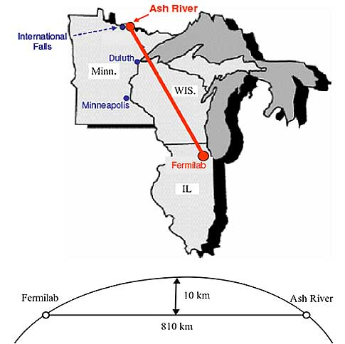
NOvA experiment at FNAL
NOvA experiment
Neutrino oscillation accelerator experiment with FD at Ash River
  Oscillation parameters
  CP violation
  …
FZU offers 1500 job slots on its Tier2
25% of computing capacity to NOvA
NOvA is taking data
First publications appearing
M. Locajicek

Slide 2
NOvA on LHCONE Update
Taipei LHCOPN/LHCONE meeting:
  M. Locajicek requests use of LHCONE for FZU <-> FNAL NOvA traffic
  Endorsed by LHCOPN/LHCONE group
  P. DeMar charged with drafting letter to WLCG requesting approval for NOvA
5/11/2016 - NOvA request letter sent through Edoardo to WLCG:
  Primary use of LHCONE will be FZU <-> FNAL (estimated 3-5Gb/s peak)
  Use by other NOvA sites not expected, but not excluded
6/7/2016 - NOvA collaboration info provided for LHCONE twiki
  NOvA web site, spokespeople, sites, security policies, contacts
6/22/2016 - Response from Edoardo – NOvA approved to use LHCONE

Slide 3
Current Status of NOvA traffic on LHCONE
None yet
FZU negotiating with CESnet on increasing LHCONE b/w
FNAL completed data center modifications to accommodate NOvA traffic on LHCONE
Still need to do before/after performance studies

Slide 4
Future non-LHC petitions to use LHCONE
From Edoardo:
FYI: the WLCG Management Board has proposed that the LHCONE community makes the decision whether a collaboration can join LHCONE or not, and just inform the WLCG boards of the outcome. A process has been drafted here and will be discussed at the next LHCONE meeting in Helsinki:
https://twiki.cern.ch/twiki/bin/view/LHCONE/LhcOneAup#Procedure_to_include_additional

