Slide 1
Data Knowledge Base Highlights
NRC-KI progress report
Maria Grigorieva

Slide 2
Data Knowledge Base goals
One of the main goals - to equip scientific community with a knowledge-based infrastructure providing fast access to relevant scientific information, it will facilitate the access to information which is currently scattered around different services for each experiment.
The DKB is supposed to be capable of automatic acquisition of knowledge from heterogeneous and distributed sources, including archives of scientific papers, research groups wiki pages, tutorials, conference and workshop information, and link these information with well-structured technical data about the experiment (datasets, analysis code, various metadata information on all used signal and background samples).
DKB should provide a holistic and integrated view of the experiment life-cycle.
Possible DKB usage:
  Assist scientists when customizing their experimentation environments
  Preservation of the data analysis process and reproduce the results of analysis (i.e. for collaborators outside the original team)
    “Often the only people that can realistically reproduce the results are those that were part of the original analysis team. This poses a potential problem for long-term preservation, in the case that people take on different responsibilities in the collaboration or even leave the field entirely” (K. Cranmer, L. Heinrich, R. Jones, D.South. Analysis Preservation in ATLAS // Journal of Physics: Conf.series 664 (2015) 032013)
  The prevention of deletion of datasets, used in publications during analysis and journal review periods
  Discovering Similar / Related datasets that have a large probability of containing data that is required for a specific purpose, ranked by that probability

Slide 3
ATLAS Metadata Sources
  Data Processing:
    Rucio (ATLAS DDM)
    ProdSys (DEFT + JEDI)
    JIRA ITS (Issue Tracking Service)
    Analysis Code Repositories (ATLAS policy required all analysis code to be checked into version control systems to preserve it for the latter reference)
    Google docs (datasets lists)
    ATLAS virtual machine (VM) images (preserving exact SW and hardware configurations)
  Scientific analysis:
    Indico (manage complex conferences, workshops and meetings)
    CERN Document Server
    CERN Twiki
    ATLAS Supporting documents (Internal Notes)
    AMI (Atlas Metadata Interface)
    GLANCE (search engine for the Atlas Collaboration)
Despite the available documentation, it is in practice often quite involved to trace exactly how a given result was produced. The necessary information is scattered over many different repositories, such as the metadata interface, the various source code repositories, internal documents and web-pages. We need to present the whole process of data analysis life cycle from physicist idea to data processing chain and resulting publications.

Slide 4
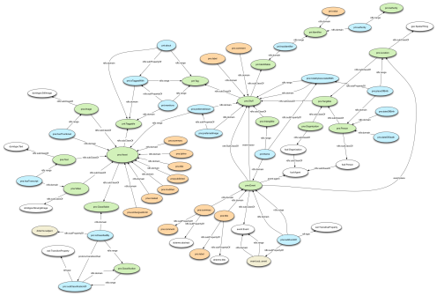




DKB Development Directions
1
Formalization of the ATLAS data analysis – development of the ontology (OWL) for ATLAS
Implementers: M. Grigorieva (NRC KI),
M. Gubin (TPU)
Ontology storage Virtuoso
Implementers: M. Gubin (TPU)
D. Laykom (TPU) ?
1.1
2
ATLAS metadata processing and aggregation in Hadoop data lake
Implementers: M. Golosova (NRC KI),
A. Alexeev (TPU)
2.1
M. Golosova (NRC KI)
2.2
Apache Spark
A. Alexeev (TPU)
3
Information extraction from ATLAS Supporting documents
Implementers: V. Aulov (NRC KI),
V. Osipova (TPU)
3.1
Machine Learning
3.2
Regular Expressions
3.3

Slide 5
1. ATLAS Data Analysis Ontology
Despite a lot of papers published in ATLAS collaboration, there is still “no formal way of representing or classifying experimental results – no metadata accompanies an article to formally describe the physics result therein” [D. Carral, M. Cheatham. An ontology Design Pattern for Particle Physics Analysis].
Ontology is a domain-specific dictionary of terms and definitions, it can also captures the semantic relationships between the terms, thus allowing logical inferencing about the entities represented by the ontology and by the data annotated using the ontology’s terms.
The ontology-based approach to knowledge representations offers many significant opportunities for new approaches to data mining that go beyond the simple search for patterns in the primary data by integrating information incorporated in the structure of the ontology representation.
Ontological storage will provide linked representation of all elements of the ATLAS data analysis.

Slide 6
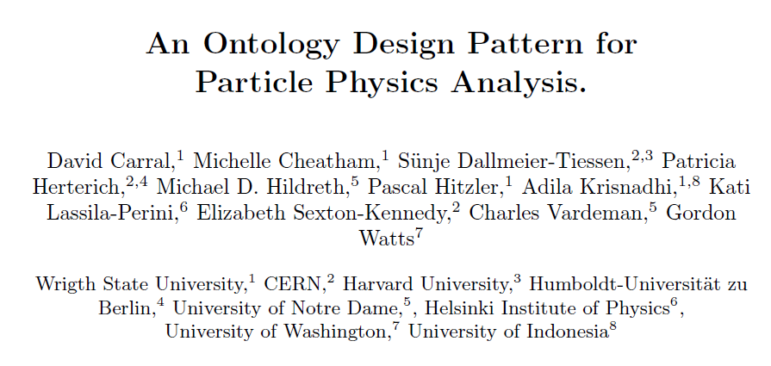
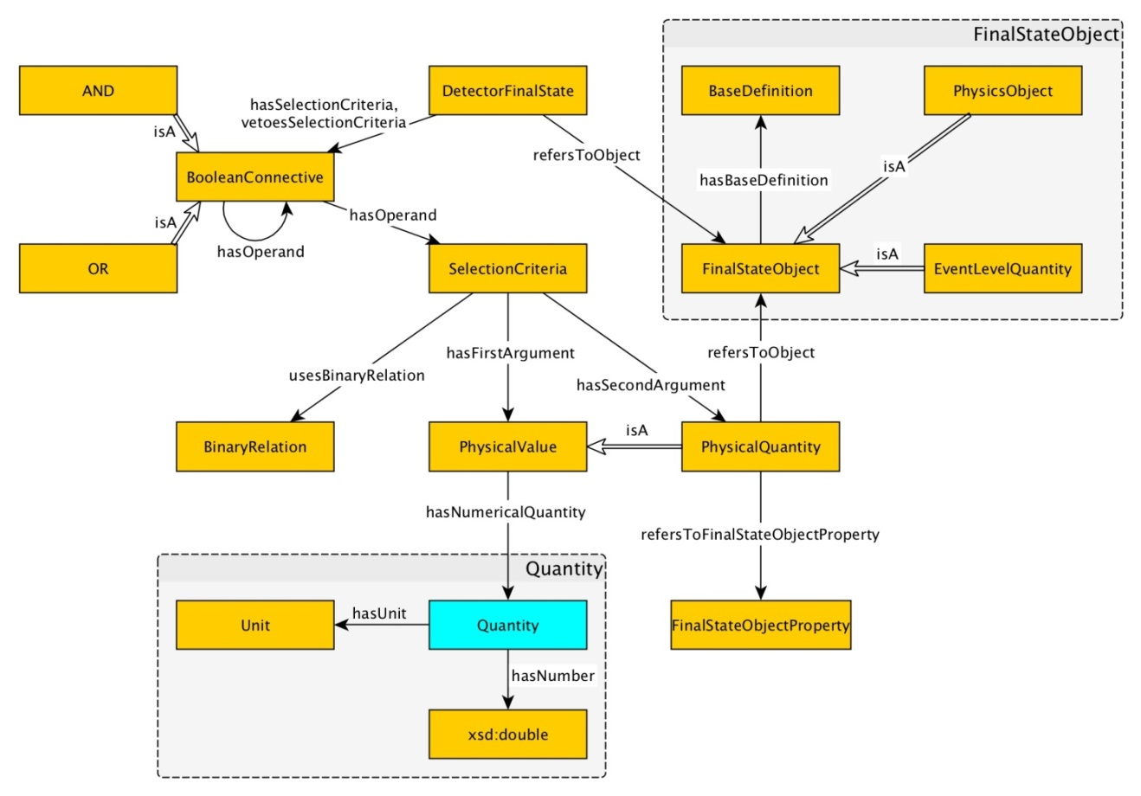
Detector Final State Pattern
“Results in particle physics take many forms, but all are based on the selection of a target set of characteristics, a detector final state that defines the ingredients of the measurement”

Slide 7
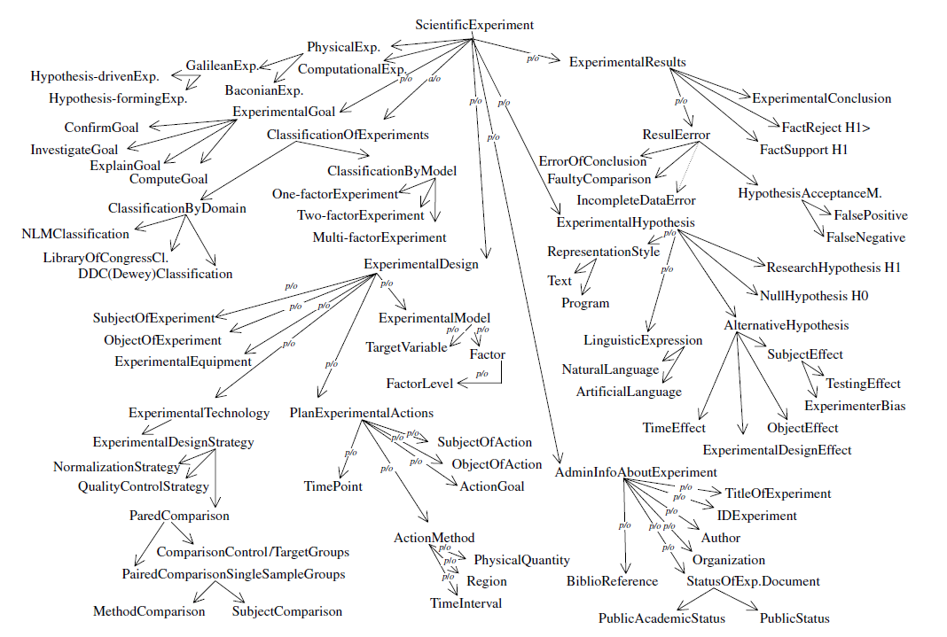
EXPO: Ontology of scientific experiments
A very complete ontology about scientific experiments proposed at the University of Wales, Aberystwyth. ~200 concepts to allow providing a formal description of experiments for efficient analysis.
EXPO classes:
  Experimental design
  strategy
  Fact
  Field of study
  Procedure
  Variable
  Experimental technology
  Scientific activity
  Hypotesis forming
  Interpreting results
Soldatova L.N., Clare A., Sparkes A. and King, R.D. (2006) An ontology for a Robot Scientist. Bioinformatics (Special issue ISMB) (in press).
Soldatova, LN & King, RD. (2006) An Ontology of Scientific Experiments. Journal of the Royal Society Interface (in press).
EXPO: An Ontology of Scientific Research by Ross D. King & Larisa N. Soldatova, Department of Computer Science, University of Wales, Aberystwyth.

Slide 8
ATLAS Data Analysis Ontology Classes
Data Analysis Description:
  Data Analysis Unique Identifier [Ref.Code from GLANCE “TOPQ-2016-03”]
  Short Title [“MS dilepton top mass at 8 TeV”]
  Full Title [“Measurement of the Top Quark Mass in the dilepton channel from 8 TeV ATLAS Data”]
  Analysis Team
  Status (active, finished,…)
Experimental model:
  Detector Final State:
    Luminosity [8 TeV, …]
    Energy [20 femtobarn⁻¹, …]
    Data Used [Run 1, Run 2, …]
    Year [YYYY]
    Other parameters
  SW Release
  ATLAS Data Samples
    Monte Carlo data samples
    LHC Data Samples
  Data Processing Chain
    LHC Data Processing
    Monte-Carlo Data Processing
Data analysis is classified by the following categories:
  Physical topics (Standard Model physics, Higgs physics, SUSY, B-physics and light states, Exotics, Top physics, …)
  Physical groups (FTAG, BPHY, REPR, TOPQ, ANALYSIS, Exotics, etc)
  Sub Groups
  Project (mc12_8TeV, mc12_13TeV, data10_7TeV, data11_2p76TeV, …)
  Campaign/subcampaign
  Domain of experiment (NML Classification, Library of Congress, DDC (Dewey) Classification)
Experimental Results
  Publications & Conf Notes

Slide 9
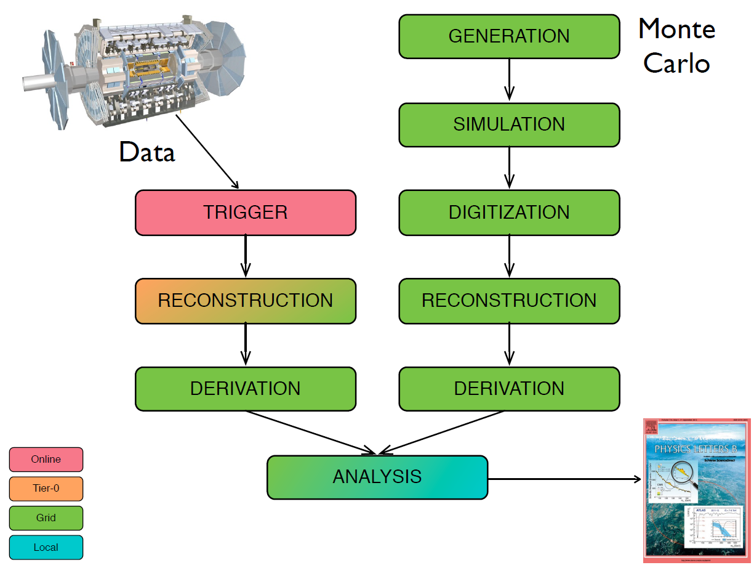
Experimental model
Detector Final State:
  Luminosity
  Energy
  Data Used
SW Release
Data Processing Chain
  LHC Data Processing
    Trigger
    Reconstruction
    Derivation
  Monte-Carlo Data Processing
    Generation
    Simulation
    Digitization
    Reconstruction
    Derivation
We can use DetectorFinalState ontology, proposed in this paper:
http://dase.cs.wright.edu/sites/default/files/WOP2015_pattern_abstract_5.pdf

Slide 10
ATLAS Data Samples
Data Samples attributes:
  Dataset ID
  Dataset type
  Project
  Stream
  Generator
  Data format
  Production step
  Number of files
  Number of events
  Total size
Data formats
  RAW
  ADO
  DADO
  EVNT
  HITS
Dataset types
  Real Data
  Monte Carlo (MC)
Triggers
  The first level trigger (LVL1)
  the second level trigger (LVL2)
  the High Level Trigger (HLT)
Streams
  Muon
  Egamma
  …
Data samples
  Signal
    Production (ggF, VBF, VH, ttH)
    Decay
  Background
    Category (Top, WW, ZV, ZX, Higgs)
    Process (t¯t+ boson, t + boson, WW, ZZ, …)
    Generator (MADGRAPH, POWHEG, SHERPA, Pythia, Pythia8)

Slide 11
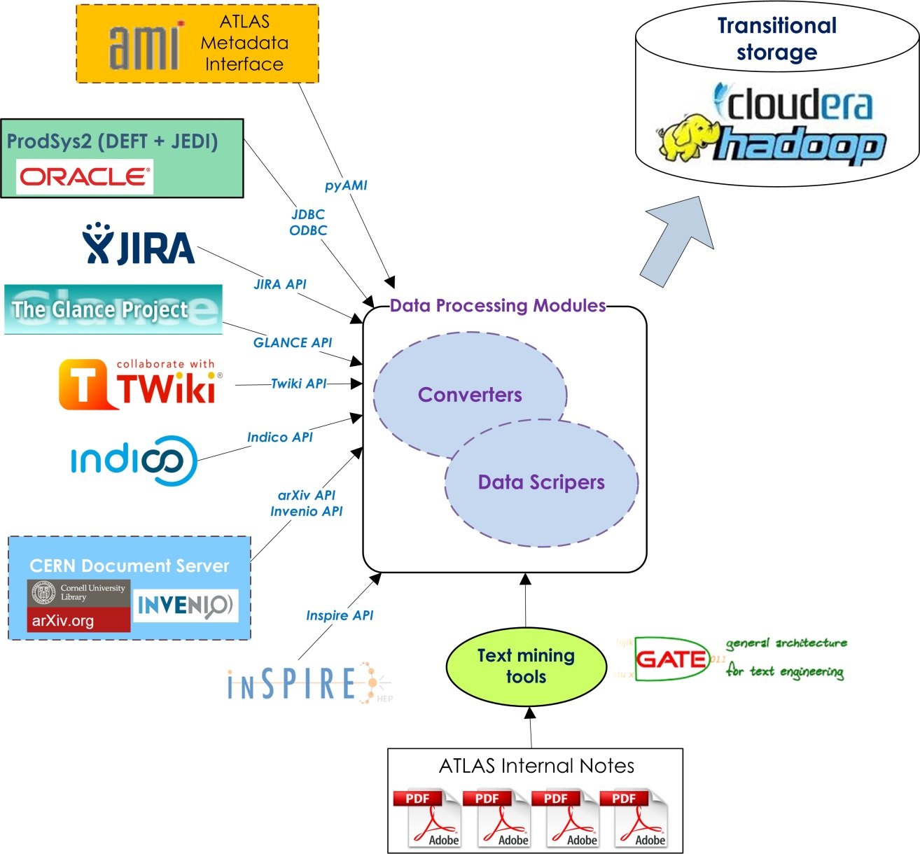
2. Aggregate metadata in Hadoop data lake

Slide 12
2. Aggregate metadata in Hadoop data lake
Currently DEFT from ProdSys1 & ProdSys2 is exported to NRC KI Hadoop data lake.
Short-term plan:
Represent metadata aggregations using Impala (NRC KI) and Spark (TPU)
Conduct comparative performance tests
Choose the most appropriate Hadoop technology
Long-term plan:
Develop aggregation strategies for different metadata sources using chosen technology
Test aggregation for DEFT
Phys Group
Project
Campaign / Subcampaign
RequestID
Production Step
2.1
2.2
Apache Spark
Task status
Task Timestamp
Dataset name
Timestamp
Dataset status
Task ID
Container
name
Timestamp
Container status

Slide 13
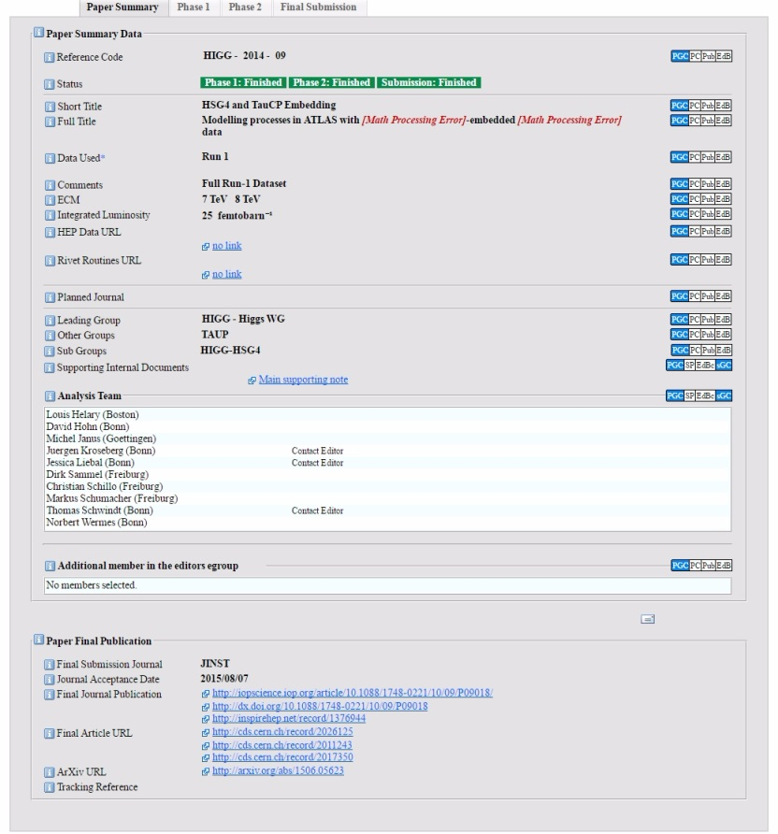
3. Information extraction from ATLAS Supporting documents
Reproduce manually a list of datasets relevant to publications:
  find paper in CDS
  find previous DRAFT version in CDS
  find ATLAS Internal Note
  find datasets in the Internal Note
ATLAS GLANCE
Text mining, NLP
Scientific papers are highly structured texts and display specific properties.

Slide 14
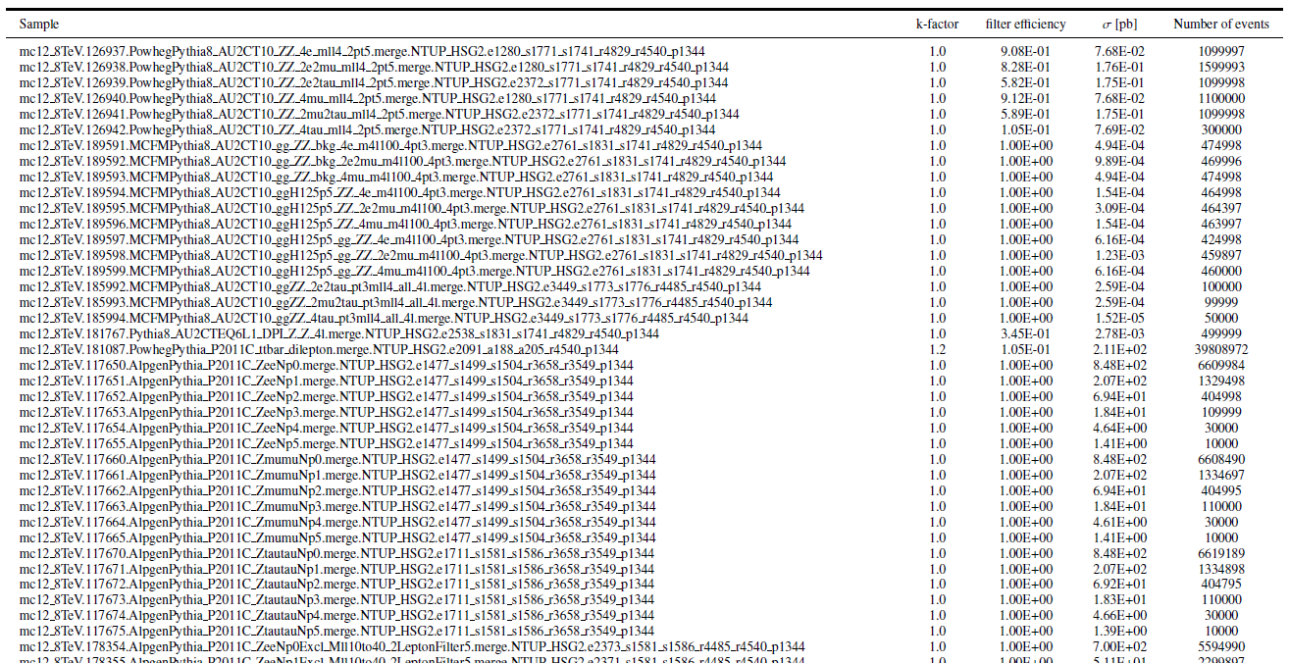
Data samples representation in ATLAS supporting documents
a list of datasets
a table of dataset attributes
a simple description - how the signal and the background data samples were obtained

Slide 15
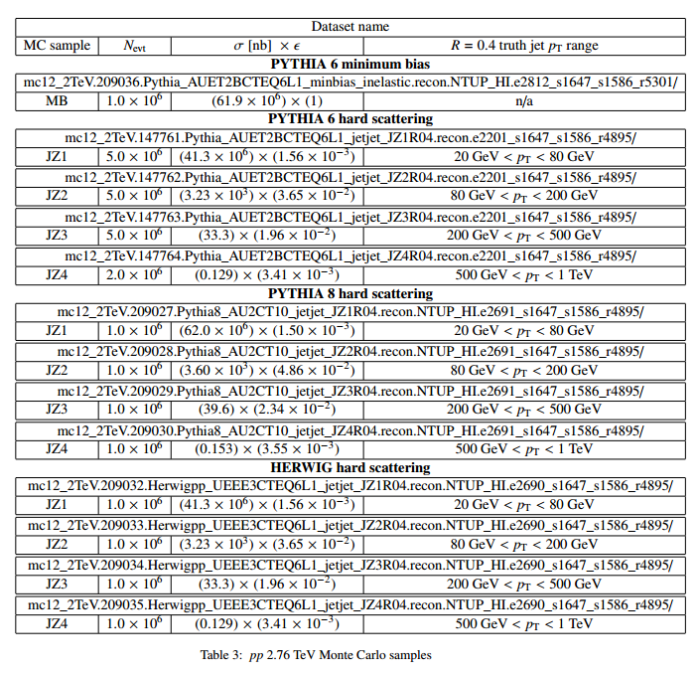
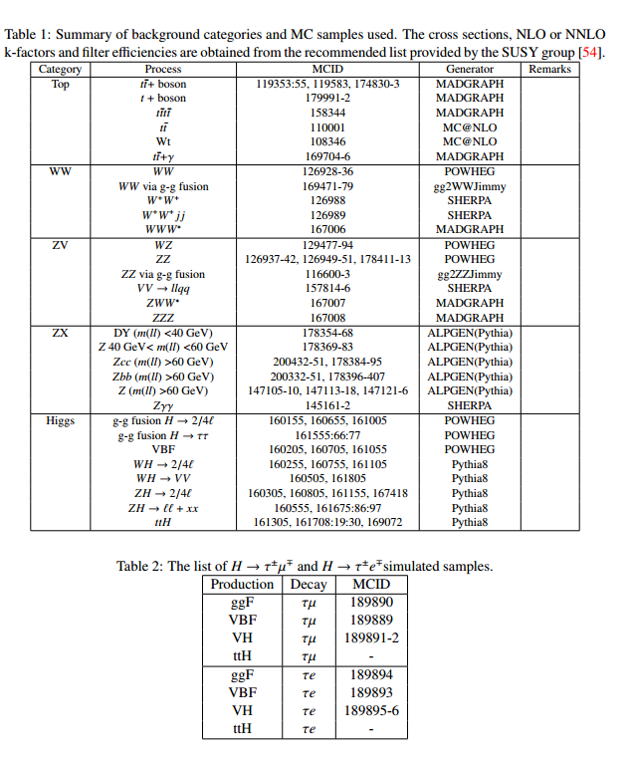
Data samples representation in ATLAS supporting documents

Slide 16
What metadata can be extracted from ATLAS Internal Notes:
Formalization of the data analysis description
Energy
Luminosity
Year, Run Number
Collisions type
Monte-Carlo generators
Triggers
Streams
Number of events
Datasets (data_, mc_)
  Signal
  Background
In general, the data analysis described in the Internal Note is well structured. The authors use a very definite sentences, words, phrases to describe how and on which datasets an experiment was conducted.
This will allow us to annotate the text with the knowledge base significant elements.
This, experiment specific metadata, can not be automatically derived from ATLAS paper & internal documents metadata, unless explicitly specified by scientists in AMI for a new data analysis.

Slide 17
ATLAS Internal Notes data mining workflows:
Define a list of tags, represented attributes of physical analysis
  <energy> 8 TeV </energy>
  <luminosity> 20.3 fb-1 </luminosity>
  <year> 2012 </year>
  <collision> proton-proton </collision>
  <mc_generator> PYTHIYA8 </mc_generator>
  <dataset_name> mc15_13TeV:mc15_13TeV.361091.Sherpa_CT10_WplvWmqq_SHv21_improved.merge.AOD.e4607_s2726_r7267_r6282/ </dataset_name>,
  <datasetID> 309523 </datasetID>
Parse PDF to some TXT representation
  PDFMiner, PDFBox
Markup text with these tags
  Search for low-mass and high-mass Higgs-like diphoton resonances with the ATLAS detector at √s = <energy> 8 TeV </energy>
  Abstract: we present the extraction of a 95% C.L. limit on the production cross-section of an additional narrow Higgs-like resonance decaying into two photons, in the 65-600 GeV invariant mass range. By restricting the results to a fiducial cross-section measurement, we provide model-independent limits that can be used to constrain theoretical models predicting additional Higgs-like particles with a narrow width. The dataset uses <luminosity> 20 fb−1 </luminosity> of <collision> proton- proton </collision> collision data recorded with the ATLAS detector in <year> 2012 </year>.

Slide 18
Markup text
    Regular expressions
    Machine Learning algorithms
    for the automatically text mark-up
Parameters | Search criteria
Energy (TeV) | …at the center-of-mass energy of XXX TeV, …data taking at = XXX TeV …data collected with the ATLAS experiment at = XXX TeV
Luminosity (fb-1) | Integrated luminosity of XXX fb
Collisions | proton-proton collisions, heavy-ion collisions
Year | …dataset available in YYYY, …ATLAS YYYY, …samples are obtained from or correspond to the configuration of the YYYY ATLAS data …data collected by ATLAS … in YYYY
Generator | …simulated by XXXX, …events are generated with XXXX… …samples are simulated using the XXXX generator
Dataset ID | MCID, DSID, MC_ID, DS_ID dataset ID
Mark-up ~50 documents by hand and use these documents to learn ML algorithm
Other documents will by marked-up automatically
As a result, we will have a corpus of documents, with annotated parameters of the physical analysis.

Slide 19
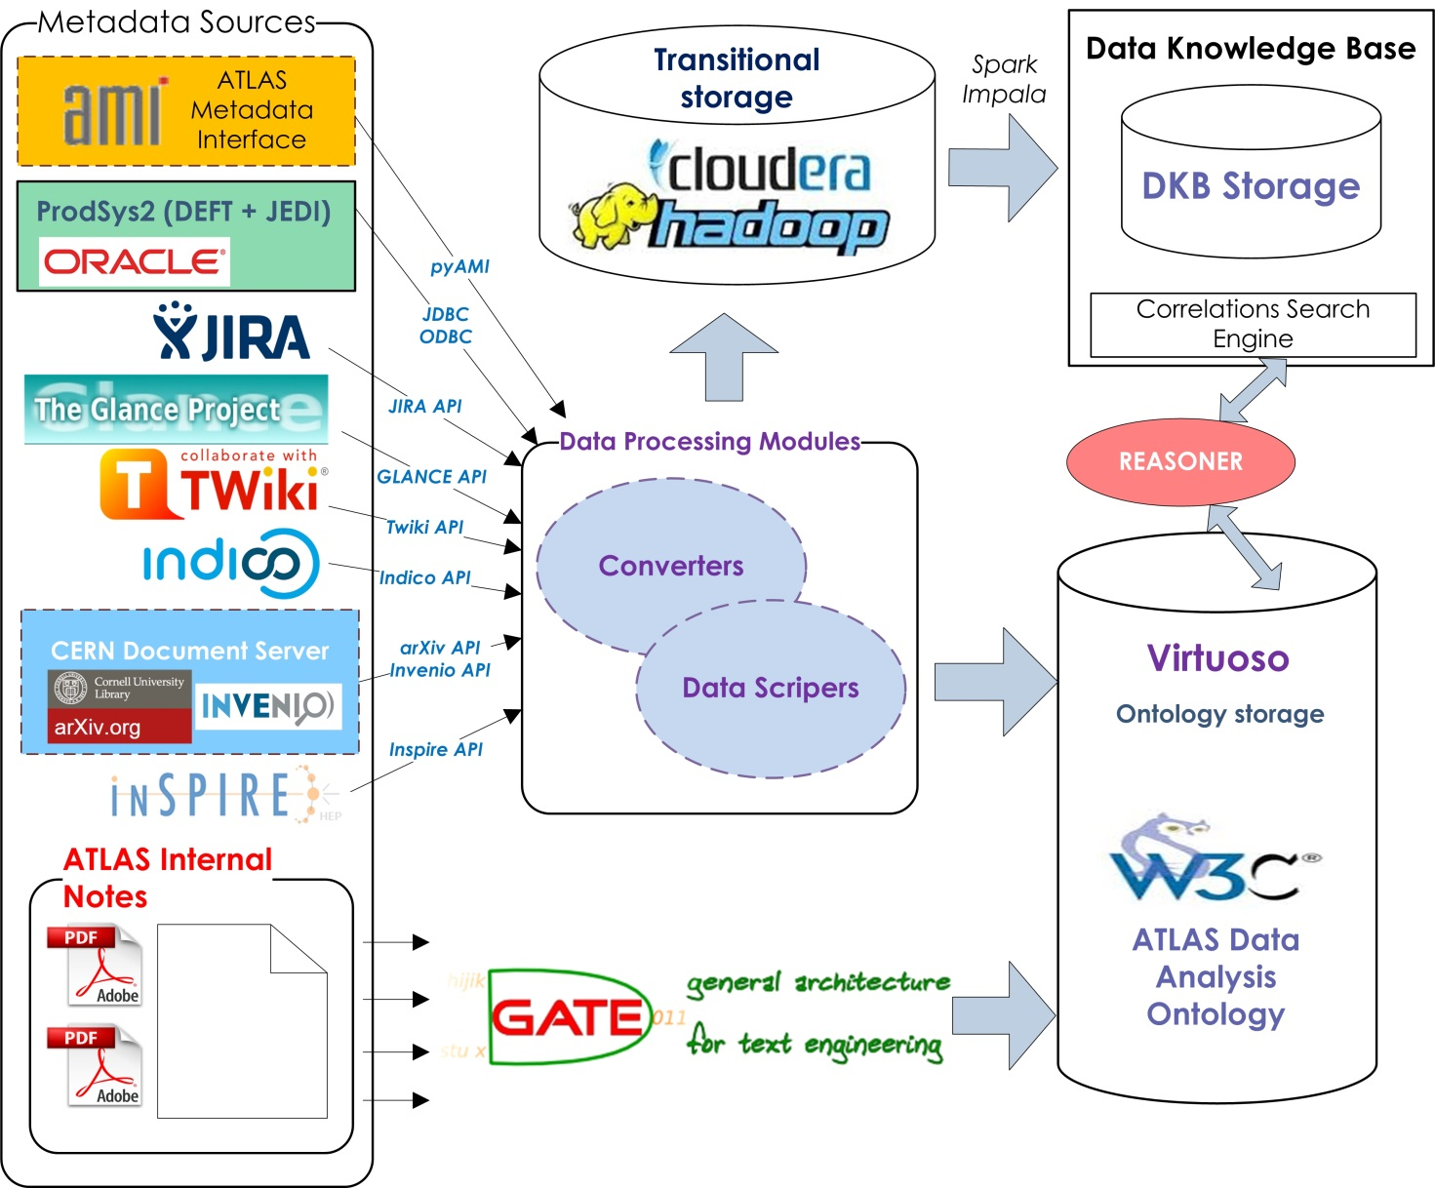
The prototype of the DKB architecture

Slide 20
Short-term plan:
Develop the prototype of the ATLAS data analysis ontology
Fill ontology storage (Virtuoso) with elements from several ATLAS Notes and DEFT (by hand)
Parse Internal Notes from PDF to TXT
Prepare TXT documents to analyze: clean from garbage text elements (line&page numbers, figures, etc), extract sections, containing required information
Annotate prepared TXT documents:
  Based on ~10 Notes formulate regular expressions, allowing uniquely identify required elements, and process the corpus of 50 Internal Notes to get annotated texts
  Mark-up ~20 Notes by hand. Then, use Machine Learning algorithms to annotate other 50 Notes.
  Compare the results of text annotating and choose the most appropriate method.
In Hadoop data lake:
  In NRC KI: use Impala to aggregate DEFT by different parameters
  In TPU: use Spark to aggregate DEFT by parameters
  Compare the results

Slide 21
Long-term plan:
What should be developed:
  The ATLAS data analysis ontology in OWL format
  Service which will export ATLAS Notes to Hadoop storage
  The method of ATLAS Notes information extraction and annotation, and a service to export annotated data to the ontology storage Virtuoso
  The services to export aggregated data from DEFT and other metadata sources to Virtuoso
  Web interface to represent the life-cycle of ATLAS data analysis

