Slide 1
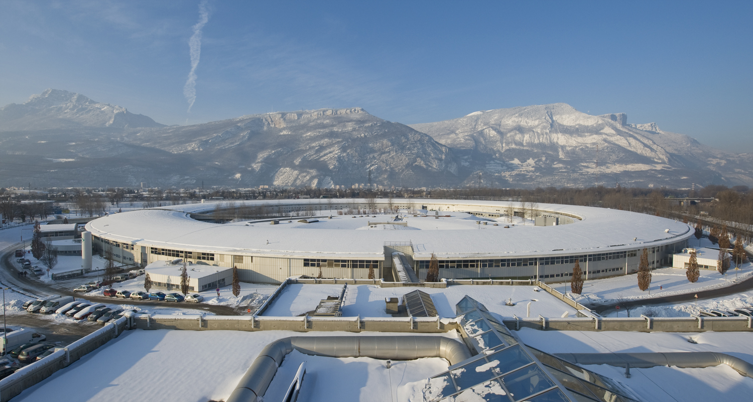

Beam loss monitor development at the ESRF
Friederike EWALD
ESRF
  ESRF – European Synchroton Light Source / Grenoble / France
  6 GeV electron energy
  200 mA stored current
  844 m circumference
  32 cells
  28 insertion device beamlines
  16 bending magnet beamlines

Slide 2
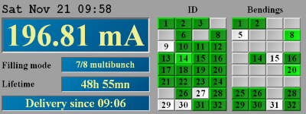
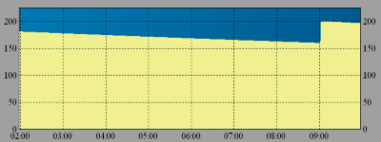
Reasons for beam loss:
Touschek scattering
Vacuum quality
(overal vacuum level, leaks, ...)
Limited apertures
(small undulator gaps, misaligned vacuum pipes,...)
Beam missteering
200mA stored
lifetime ~ 60hrs
~ 16 million 6 GeV electrons/s LOST

Slide 3
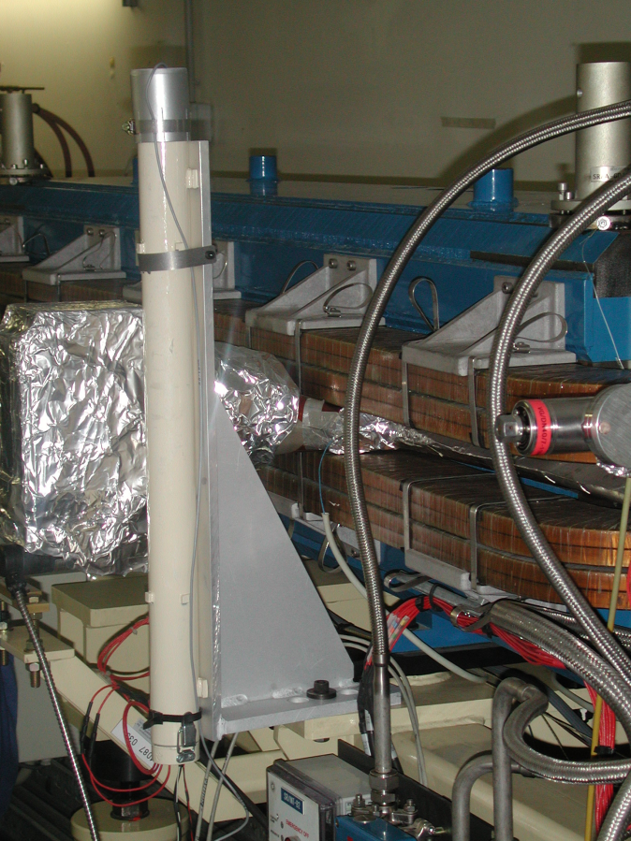
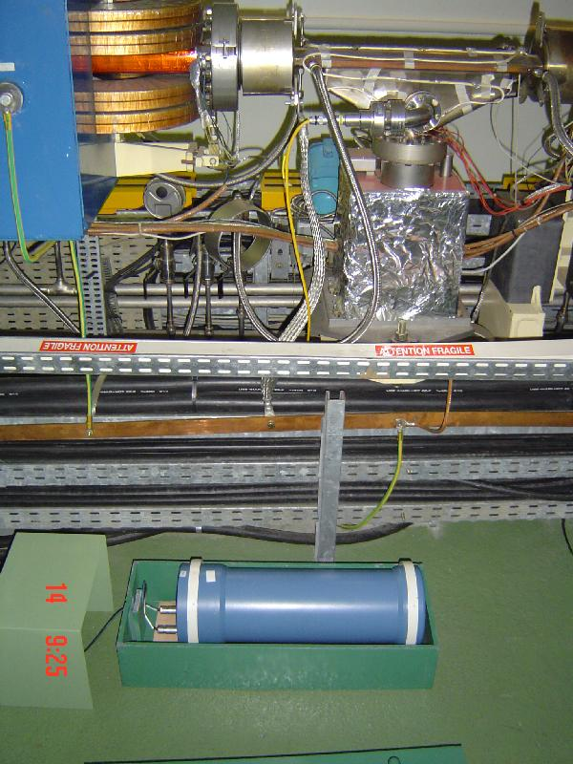
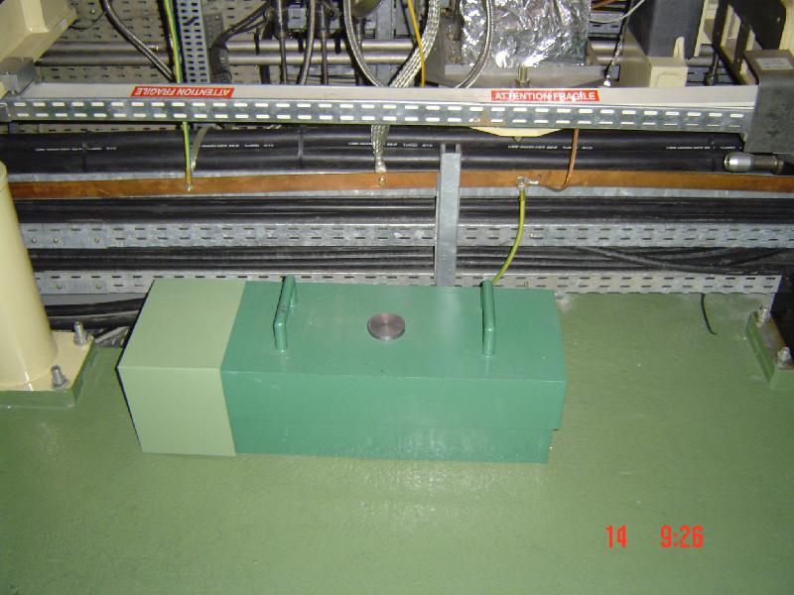
Loss monitors in one ESRF storage ring cell
Ionisation chambers
placed on the floor
heavy lead shield
~ 30 x 50 x 20 cm
Perspex rod + PMT
at beam height
shielded in 1 cm lead
~ 80 cm x 8 cm Ø
32 cells build the whole storage ring
==> 64 Perspex/PMT BLDs
64 ionisation chambers
---------------------------------------
128 beam loss measurements
Dipole magnets (bending magnets)
Quadrupoles
Sextupoles
Insertion devices (undulators, wigglers)

Slide 4

Outline
What happens when a 6 GeV electron is lost?
How can we detect such losses?
The new generation of beam loss detectors chosen for the ESRF
Results obtained with prototypes installed in the storage ring
1

Slide 5
Beam loss ? What happens when we loose a GeV electron?
ELECTRON
MATTER
(vacuum vessel, magnets,...)
γ -/ PARTICLE – SHOWER
Photonuclear
reactions
γ
Bremsstrahlung
Pair
production
n
e-
n
e-
γ
e-
γ
e+
e-
e-
etc.
γ
e-
γ
e+

Slide 6
Available particles and (some) detection methods
γ – photons
Electrons
Neutrons
conversion into
visible light
conversion into
electrical signal
Cherenkov
radiation
see
presentation of
J. Marroncle
(organic)
scintillators
e.g. EJ200
Ionisation chambers :
gas or solid state
(pin diodes, CVD)
e.g. pure quartz
Converter shapes: ○ rod
○ fiber
Light → electrical output : ○ photomultiplier tube (PMT)
  ○ diodes, MPPC

Slide 7
Scintillator versus Cherenkov radiation
Cherenkov-radiator versus Gamma-scintillator
Quartz-glass EJ-200 or BC-408
no need for Pb shielding - high light yield
since immune to X-rays (?) - cheap material
therefore : - less volume
- less weight
- compact
- low light yield needs Pb shielding
- more expensive - bulky & heavy (?)
PRO :
CONTRA:
We choose: BLD based on a small EJ-200 rod,
a small PMT (8mm window),
2mm of Pb shielding

Slide 8

Test of sensitivity of different geometrical configurations
γ – source : Cesium-137 (700 keV γ )
Scintillator:
different sizes
Aluminium reflector around scintillator
EJ-200
EJ-200
PMT
PMT
Aluminium housing
Hamamatsu PMT
Signal strength read out
1

Slide 9
Test of sensitivity of different geometrical configurations
L =100 mm
Ø = 8 mm
L =100 mm
Ø = 20 mm
L =100 mm
Ø = 22 mm
L =100 mm
Ø = 22 mm
not polished
L =130 mm
Ø = 22mm
tapered
EJ-200
EJ-200
EJ-200
EJ-200
EJ-200
PMT
PMT
PMT
PMT
PMT

Slide 10
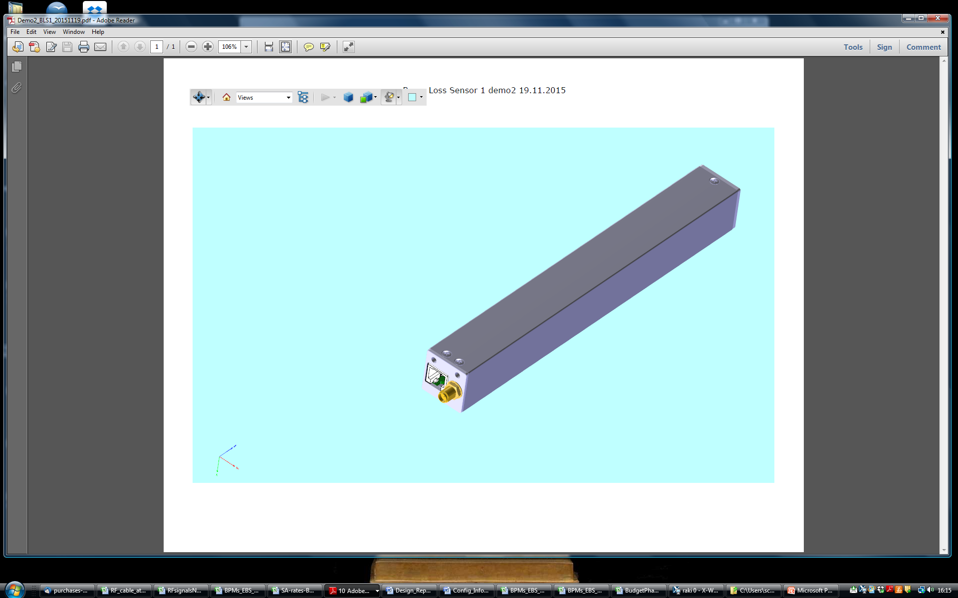
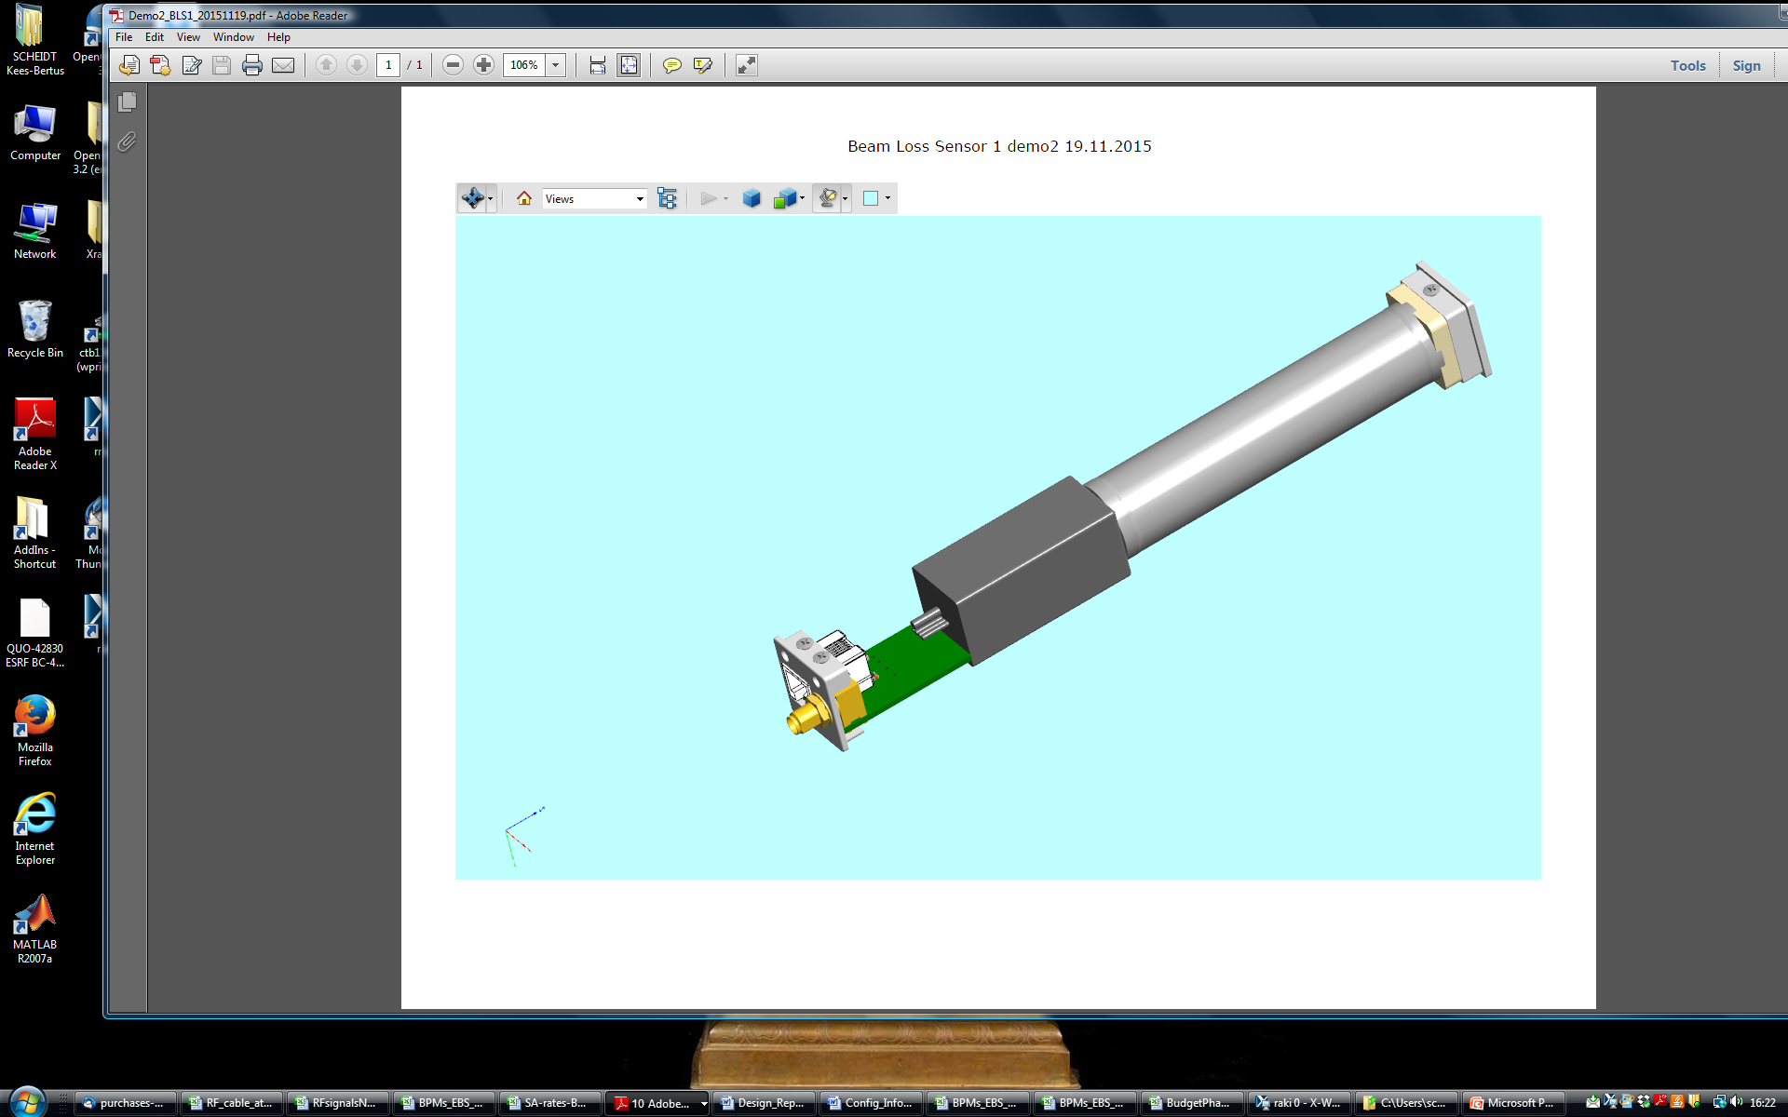
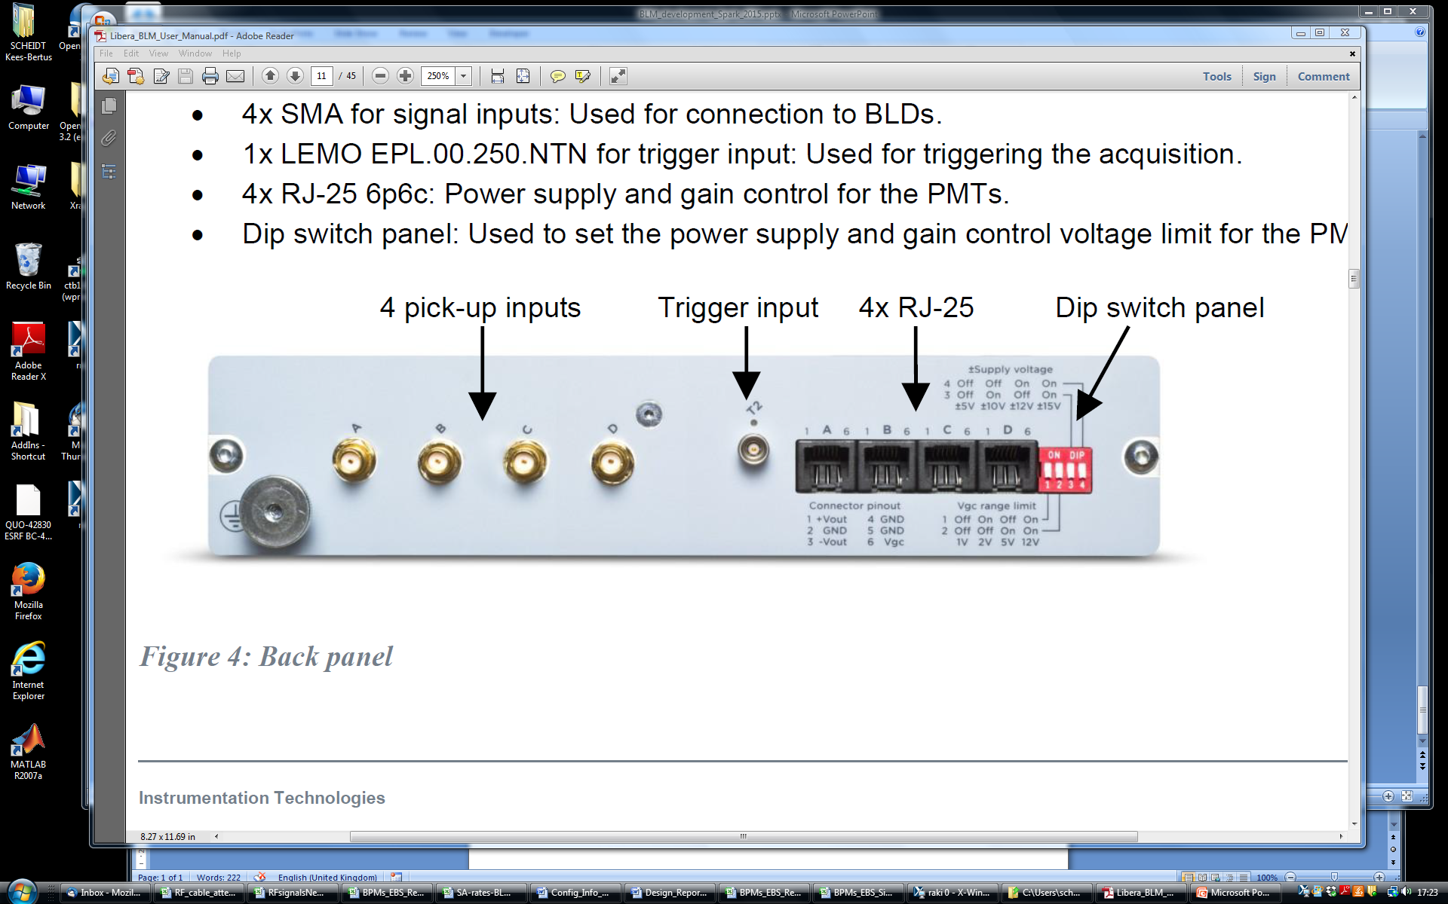
New ESRF beam loss monitors
BLD :
aluminium housing
200 x 25 x 25 mm
Scintillator
Connectors
SMA & RJ-25
PMT
Power-supply & gain-control
BLD-signal
BLM
(Libera-BLM)
1

Slide 11
New ESRF beam loss monitors
Scintillator :
EJ-200, 100 x 22 mm rod
wrapped in reflective Al-foil
PMT:
Hamamatsu H10721-110
8mm active photo-cathode
- powered (+5 V) & gain-controlled from BLM
- 3 orders of magnitude with 0-1V gain-control
- can drive 50 Ω load
Scintillator
Connectors
SMA & RJ-25
PMT
BLD-signal
BLM :
- 4 independent channels
- 14 bit ADCs, +/- 5 V to +/- 150 mV full-scale (adjustable)
- >10 MHz bandwidth
- 50 Ω or HiZ input
- PoE
- Embedded Tango-DS
Power-supply & gain-control
1

Slide 12
BLD “test bench” in the ESRF injection zone
Do the BLDs only see e- losses or also bending magnet radiation ?
Scraper
Septum
Dipole
Crotch
absorber
stored beam
Quadrupoles / Sextupoles
Injected beam
4 (5) different BLDs

Slide 13
Do the BLDs only see e- losses or also bending magnet radiation ?
Scraper
Septum
Dipole
Crotch
absorber
stored beam
Quadrupoles / Sextupoles
Stored current = 200 mA :
60 hours lifetime
→ 16 million 6 GeV electrons/sec lost
= ~ 2·10 ⁻¹¹ Watt/meter
(with 844 m of circumference)
Crotch absorber takes many kW from synchrotron light, ( E_{crit} ~ 20 keV )
a tiny fraction of that power converted into
back-scattered photons can create a
dominant signal in the BLD
Pb-shielding necessary to suppress
up to 200 keV X-rays
1

Slide 14
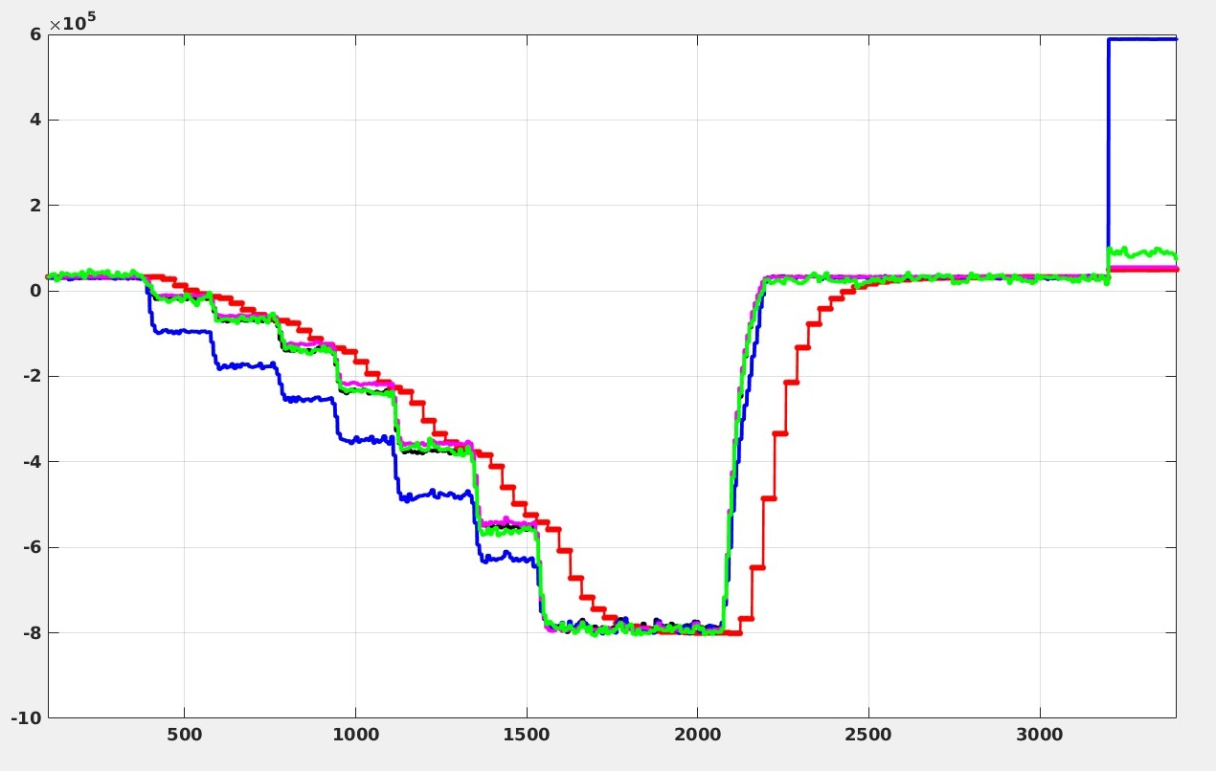
5 different BLDs tested for immunity against X-rays
200 mA
0 mA
10 mm Pb shielding = reference → no X-rays
EJ200 , 2 mm Pb, close to crotch
EJ200, 2mm Pb, middle of dipole
Cherenkov (ESRF)
Cherenkov (DESY)
2 mm of Pb shielding is only enough when the
BLD location is chosen in a region with low
synchrotron radiation level !!
BLD signals normalized [a.u.]
Time /a.u.

Slide 15
BLD “test bench” in the ESRF injection zone
“ Strong & Fast ” losses at injection (top-up)
Scraper → closed internally
Septum
Turns
1, 2, 3 etc.
Dipole
Crotch
absorber
Quadrupoles / Sextupoles
Injected beam
4 (5) different BLDs
1) done at each top-up
2) obtain time-resolved loss-patterns, at ADC-rate or T-b-T-rate (or slower)
3) vary numerous injection parameters, and see the effects on these loss-patterns
4) purpose : asses the BLD system on coping with (extreme) strong levels of losses

Slide 16
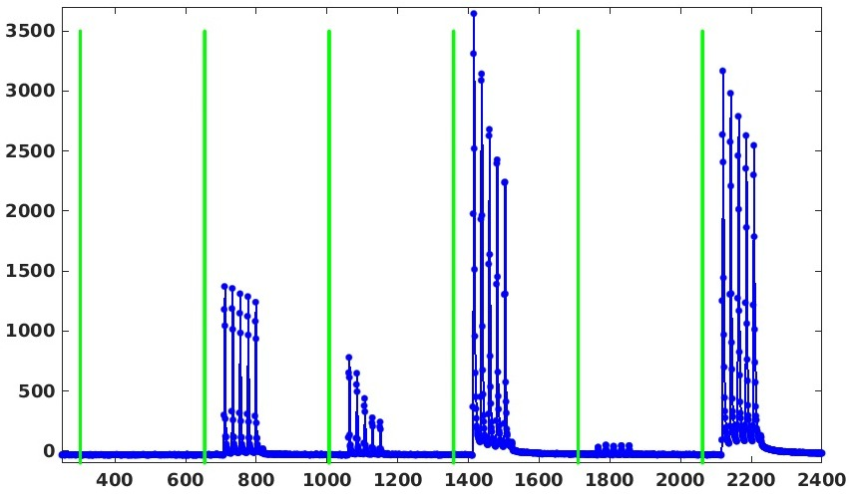
ADC buffer at injection of 5 bunches into the storage ring
Typical ADC data, 6 turns with 5 bunches injected:
Strongly varying loss level from turn to turn
1 Turn
ADC signal mV
ADC sample number
Data-rate is ADC : 125 MHz = 352 samples/turn
= 22 samples between bunches

Slide 17
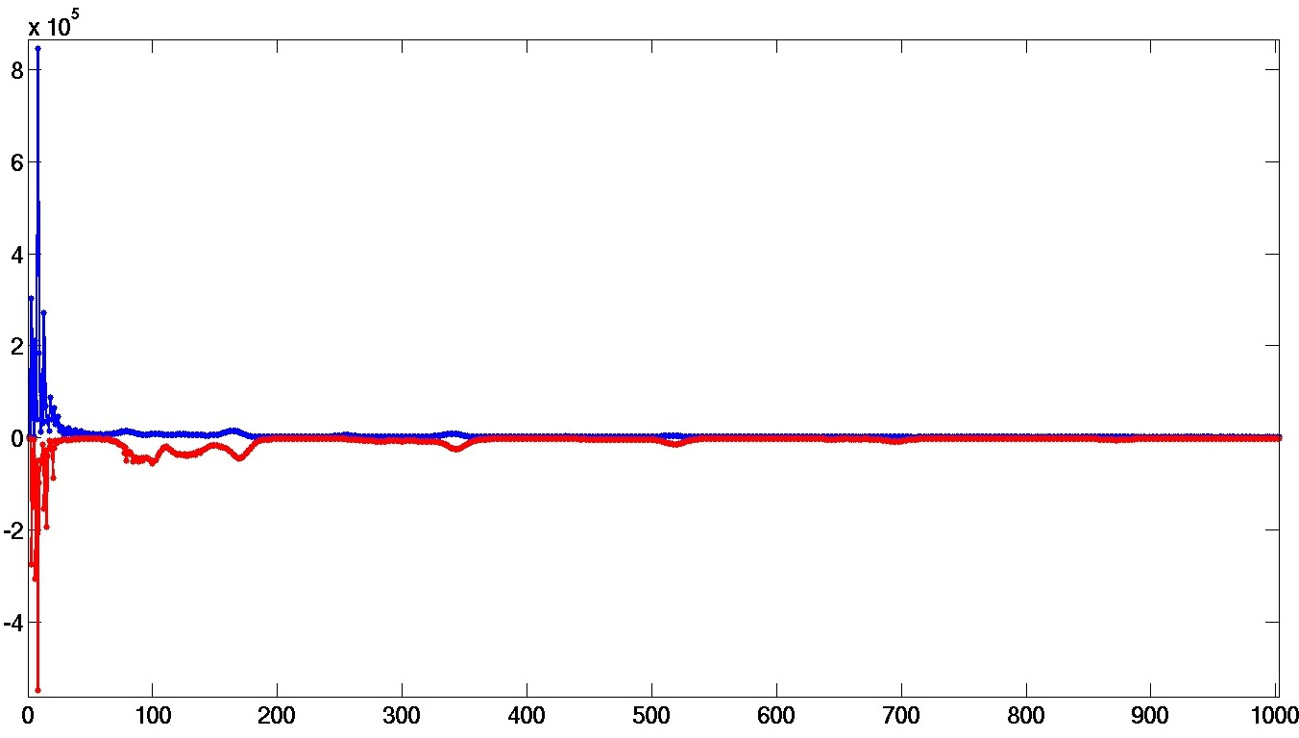
Time-resolved losses of injected beam at different RF phases :
nominal phase phase +30deg
“synchrotron”-losses : increase when out of phase
Loss signal [a.u.]
Data-rate is T-b-T ( 355 kHz, 2.8 us)
“betatron”-losses
Orbit turn number

Slide 18
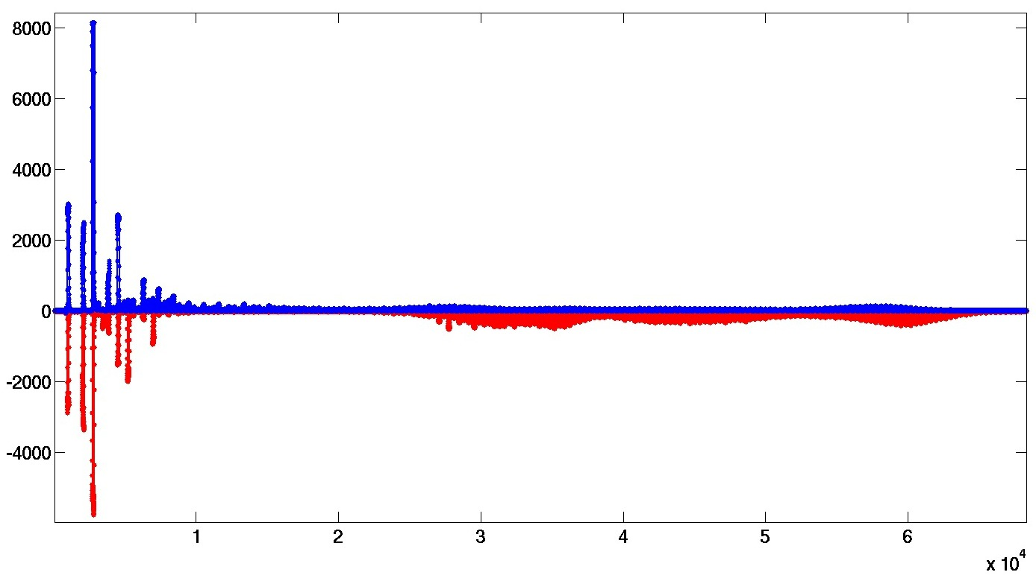
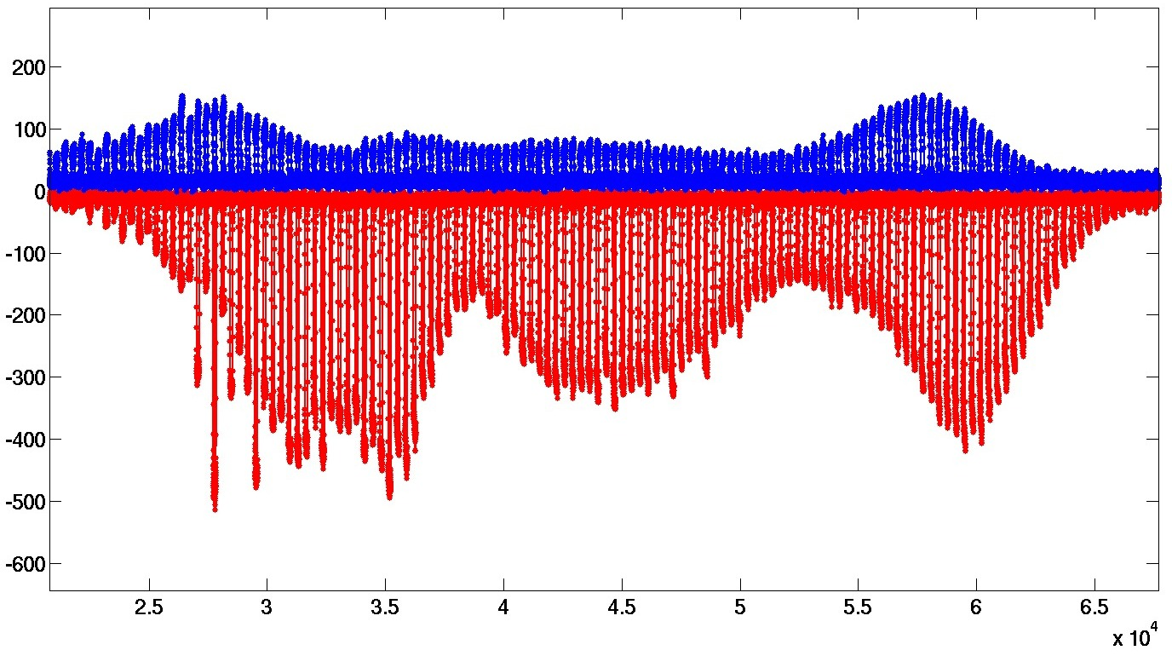
Time-resolved losses of injected beam at different RF phases :
nominal phase phase +30deg
“synchrotron”-losses
Loss signal [a.u.]
“betatron”-losses
Data-rate is ADC ( 125 MHz, 8 ns )
80 μs

Slide 19
Time-resolved losses of injected beam at different RF phases :
“synchrotron”-losses
nominal phase phase +30deg
Loss signal [a.u.]
Data-rate is ADC ( 125 MHz, 8 ns )
80 μs

Slide 20
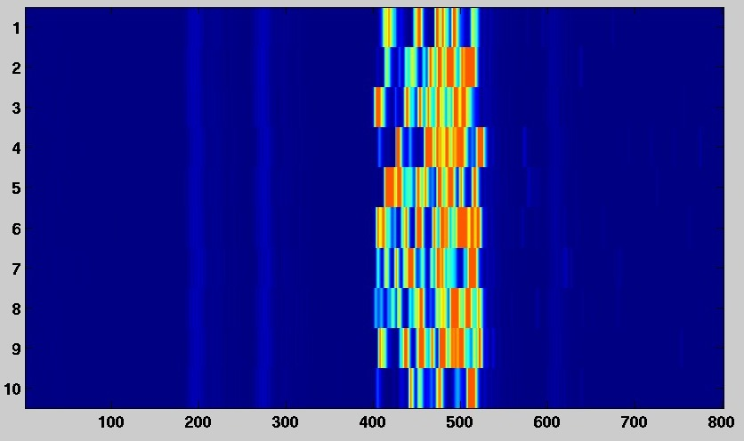
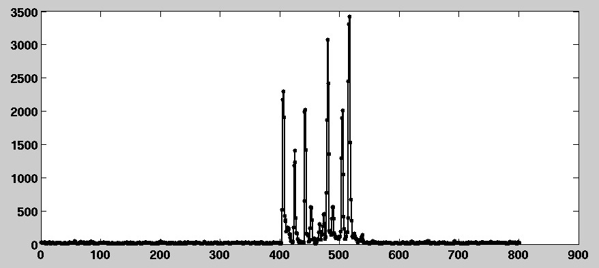
“ Single-electron ” losses by dumping injector’s dark current into scraper
Any lost electron will create a different shower, and thus signal strength.
profile of
shot #10
other extreme : high sensitivity
→ Single electron detectivity

Slide 21
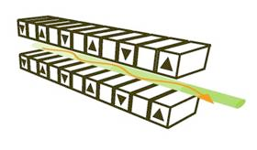


Beam loss measurements in the vicinity of in-vacuum undulators
Magnet arrays of in-vacuum undulators are very close to the electron beam :
The ‘gap’ can be as small as 5mm
        Gain in flux
but: scattered electrons now get lost on these magnets
→ Degradation of the magnets over less than a few years
This can be a real problem in rings with smaller beam-sizes (like ESRF-EBS …!)
more scattering = less lifetime = more losses . . .
less lifetime is compensated with more frequent refills → top-up
But any damage to In-Vacs is only felt after it is done
Solutions :
Add special & dedicated scrapers-collimators in that ring
the scattered electrons get lost there
Improved monitoring of losses to verify that these in-vacs are indeed protected.

Slide 22
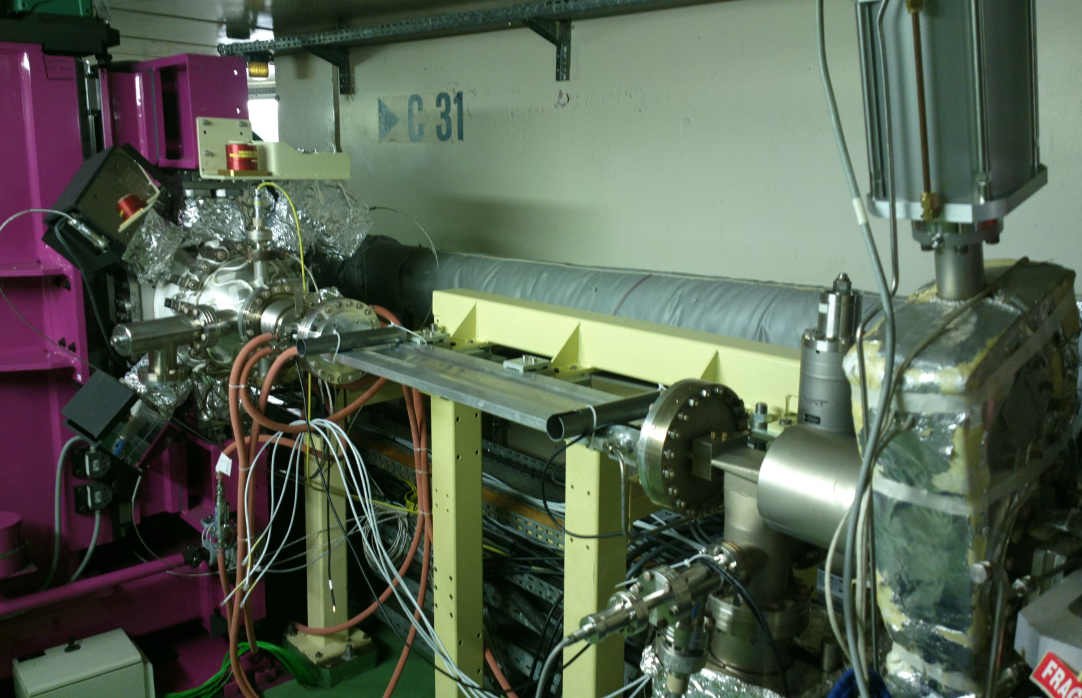
BLD installation at in-vacuum undulator
In-Vacuum undulator
BLD #1
BLD #2
e-beam

Slide 23
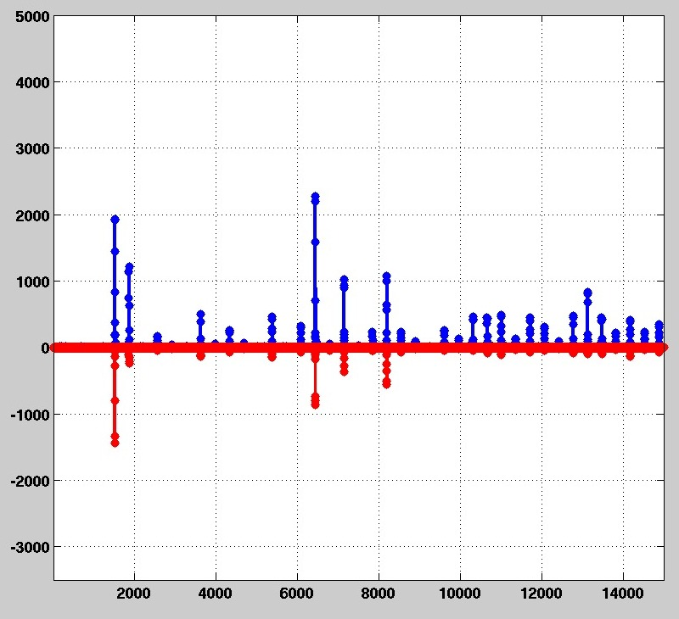
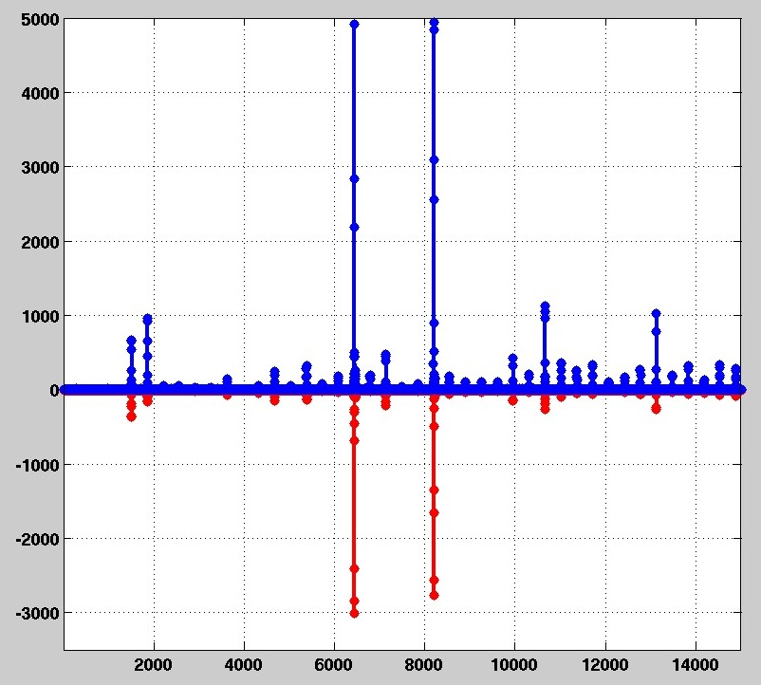
ADC data from 2 BLDs near in-vacuum undulator, at 2 different injections
one shot
another shot
Blue = down-stream detector
1 Turn
Red = up-stream detector
Registered losses depend on detector position.
Losses are not the same at each injection shot.

Slide 24
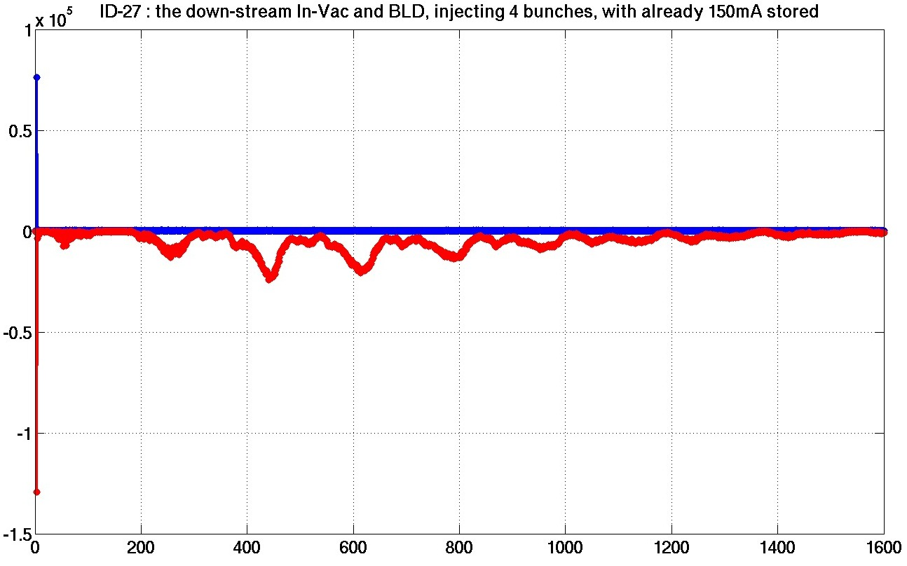
Beam loss at undulator with closed gap at injection
gap at 9 mm
gap at 7 mm
loss at injection turn
losses with
synchr. freq. signature
Turn number

Slide 25
Plans at the ESRF for adding a new BLM system now
Presently we have already :
  64 old BLDs (scintillator + PMT) that are heavy & big
with slow read-out electronics (<1Hz)
  64 Ionization chambers : even heavier, very big
128 BLDs of the new type and 40 BLM electronics
will be installed at strictly regular positions (4/cell)
32 more units will be installed at points of interest like
some in-vacuum IDs, injection zone, close to scrapers etc.
Commissioning of the new BLD/BLM system will start in early 2017.
In 2019/20 all of these devices will be transferred to the new storage ring.
The experience acquired in the present ring will be valuable for judging data taken
at the start-up of ESRF-EBS.

Slide 26
Acknowledgements and References
The BLD/BLM development as presented here is a collaboration between the ESRF (Kees Scheidt, Nicolas Benoist, Fouhed Taoutaou, Francis Epaud) and Instrumentation Technologies.
For a more detailed description of the BLD/BLM system:
K. Scheidt, F. Ewald, P. Leban et al. “Optimized beam loss monitor system for the ESRF”, IBIC2016 proceedings, MOPG20

