Slide 1


The New Beam Loss Monitoring System for CERN's Injector Complex
Topical Workshop on Beam Loss Monitors (15-16/09/2016)

Slide 2
Introduction
This project has undertaken the task to develop up-to-date
Beam Loss Monitoring System for the Injectors.
Mainly,
Build a generic, highly configurable and high-performing system
Acquisition part to accept several detector types
Use reprogrammable parts to target all injectors’ requirements
Team members (past and present):
BI-BL: M. Alsdorf, C. Arcola, B. Dehning, C. Hajdu, M. Kwiatkowski, O. Malnasi-Csizmadia,
W. Vigano, C. Zamantzas
and support from: E. Effinger, J. Emery, G. Venturini, E. Nebot Del Busto
BI-SW: E. Angelogiannopoulos, S. Jackson, L. Jensen, B. Kolad

Slide 3
Outline
Specifications
  Dynamic range, Measurements, Supervision, Interlocking
System overview
  Architecture, Cabling
Electronics
Examples of the installations in LINAC4, PSB and PS
Summary

Slide 4
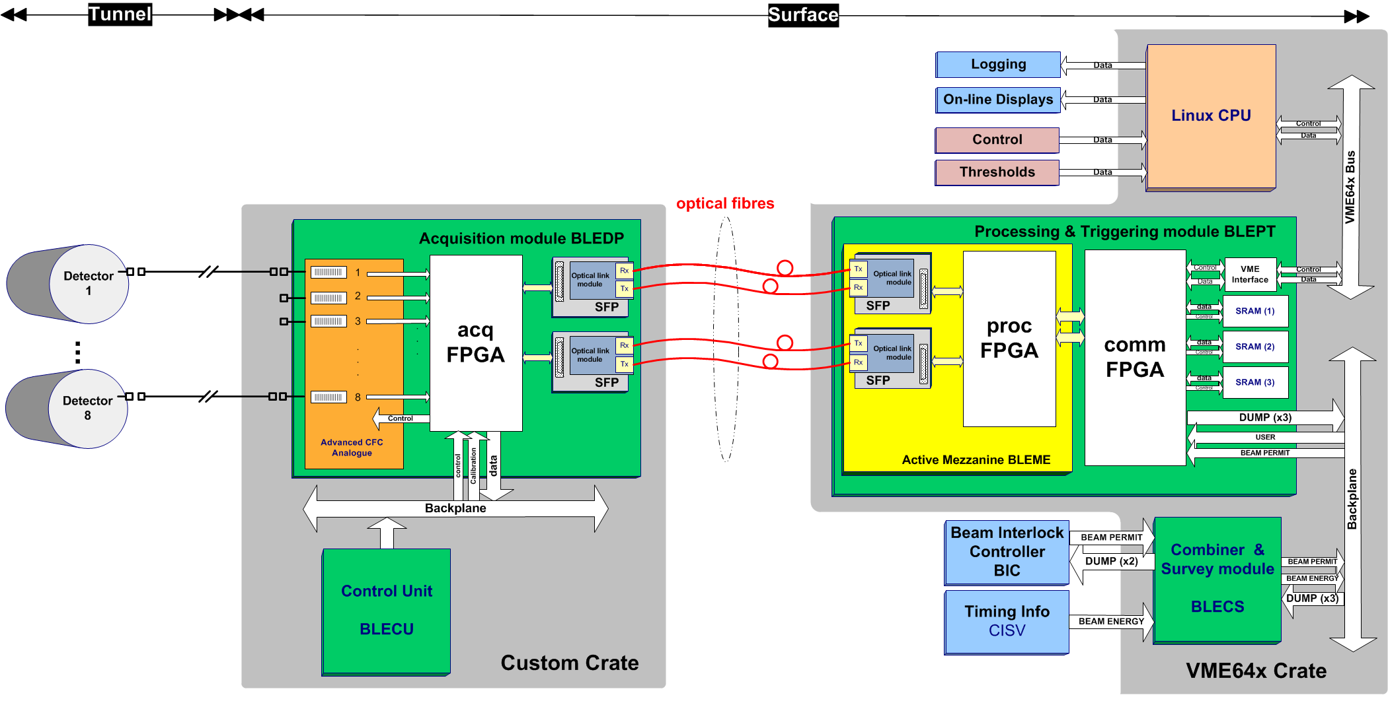
System Architecture

Slide 5
Specifications

Slide 6
Acquisition & Processing
Is timing/synchronisation at the acquisition and/or processing level necessary?
Synchronisation is required with the start of the cycle to
  Perform calculation of integration periods and
  Schedule comparisons with their corresponding threshold values
  Record high frequency observation data
  Schedule the data readout and publish by the CPU
Synchronisation is achieved by
  Use the ‘Start of Cycle’, ‘Beam In’ and ‘Beam Out’ events received through the timing system.
  Dedicated timing card with broadcast in the backplane.
  Sync is done at the processing level (i.e. 2 samples jitter between cards).

Slide 7
Integration Periods
Continuously the processing electronics calculate 4 integration period values for each channel:
2 μs, 400 μs, 1 ms and 1.2 s (machine basic period)
  Implemented as moving sum windows in the hardware
  Calculation is refreshed at acquisition frequency
Compare with predefined thresholds
  Machine protection with hardware implementation
  comparisons on each refresh
  Limit radiation levels with software implementation
  comparisons at end of cycle
  See also next slide.
Calculate for each channel the maximum values recorded on each integration period during the cycle
  Published for the online displays and
  Send to the long-term logging

Slide 8
Threshold Comparisons
Hardware implementation part:
All calculated integration period values, i.e from 2 μs to 1.2 s, will be constantly checked against their threshold values:
  4 threshold values, one for each of the integration periods.
  Comparisons happen at the refresh period – that is, every 2 μs
  In the case the measured values exceed those the beam permit signal will be removed for all users
  The blocked beam permit signal will be latched until an operator acknowledges.
The threshold values will be need to be set unique per channel:
  Each card will process 8 channels
Software implementation part:
All maximum integration period values recorded on the cycle will be checked against a second set of threshold values. The outputs will be used for repeated over threshold function
  Additional threshold values for the same integration periods will also be required.
  In the case found to be over threshold repeatedly n times it will be required to block that user’s injections.
  The blocked beam permit signal will be latched until an operator acknowledges.
  The repeat value n will be settable per monitor in the range of 1 to 16.
The threshold values will need to be unique per user and per channel:
  Each CPU will process 8 cards x 8 channels
  The information of the current user has to be obtained from the telegram per cycle -> dedicated timing card
  Memory for 32 users will be reserved.

Slide 9
Beam Permit Logic
System [HW and/or SW] will block injections
  i.e. “remove permit” if losses over threshold
System [SW] will remember if the user is allowed to have beam
  i.e. “give permit” if previous cycle for the user was ok (or previous interlocks were cleared)
The Beam Interlock Controller will be configured in the “Non-latch” mode.
  i.e. the system will need to follow timing and notify in advance.
Aiming to keep system latency (from measurement to output) small
  HW: The target for the fast integration periods is < 10 μs
  SW: Block on next cycle
Only data from the current cycle need to be considered.
  Timing in the electronics essential (i.e. possible failure mode)

Slide 10
Ambient Radiation Measurement
Calculate and log the ambient radiation measured at the end of each cycle
Processing electronics will provide two values:
  total accumulated in the cycle (already described) and
  total accumulated with beam present
Subtraction of the two values in CPU
Additional timing events to be used for the recording
Values will come together with number of samples used in the recording to allow accurate conversion to user-friendly units, i.e. Gy, Gy/s, …
Publish values for the online displays and the long-term logging

Slide 11
Evolution Over Time buffer
Record detailed observation data
  Publish on the online displays
  Log on demand
LINAC4:
  2 μs samples for 1 ms during beam presence
PSB:
  1 ms samples for 600 ms during beam presence
  2 μs samples for 1 ms with adjustable start (aka Capture)
Readout and transmission window by CPU during beam-out period

Slide 12
Evolution & Capture functions
Cycle n
Cycle n+1
SoC
SoC
2 μs integral x 500 samples
LINAC4
2μs integral x 500 samples [adjustable 1 ms window]
1 ms integral x 530 samples
PSB
0
Time [ms]
274
275
805
1200
274
recording window
transmission window

Slide 13
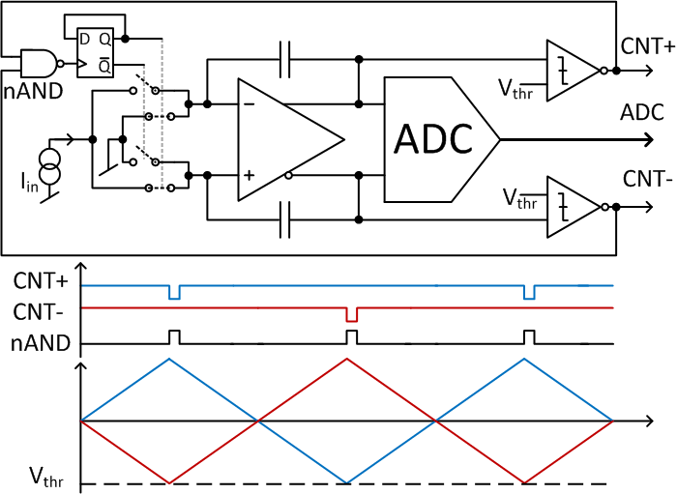
FDFC: Acquisition Principle
A status signal selects in which branch of a fully deferential stage the input current is integrated.
Two comparators check the deferential output voltage against a threshold, whenever is exceeded, the status signal changes to the complementary value (0 ! 1 or 1 ! 0) and the input current is integrated in the other branch.

Slide 14
FDFC: Data Pre-Processing
counts
thhigh
ADC values
thLow
0
2 μs
2 μs
2 μs
Time
The number of accumulated counts are combined with the ΔADC values to calculate the integrated loss over a 2 μs period.
Most of the operations are handled by the FPGA. That is,
  Defines start and stop of the acquisition period
  Keeps a count of the number of pulses occurred in the acquisition period,
  Clocks the ADC circuitries and makes differences of the recorded ADC values
  Finally, processes the data and provides the 2 μs integral per channel

Slide 15
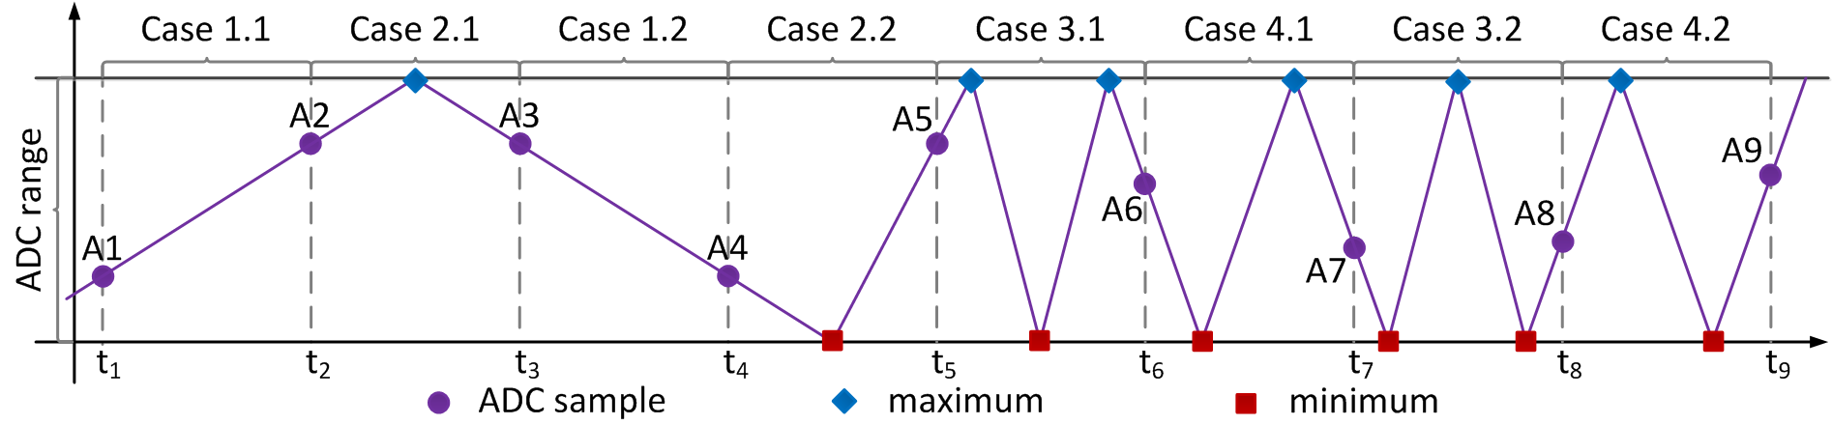
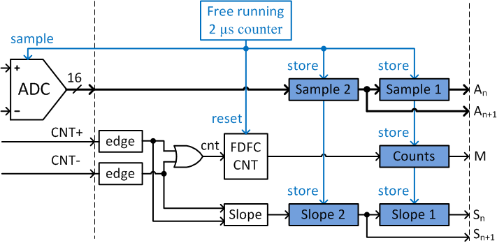
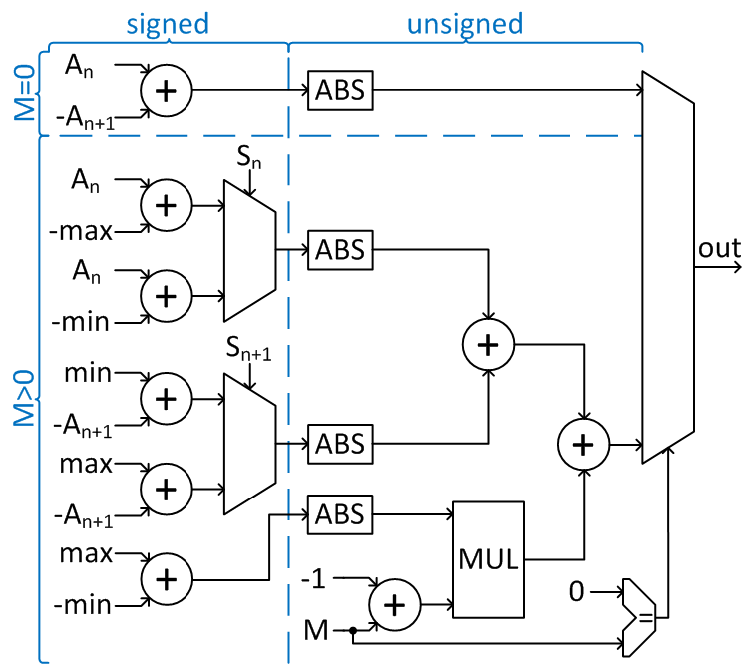
FDFC: Pre-Processing Algorithm
Case | Calculation
1.1 | A_{n+1}-A_{n}
1.2 | A_{n}-A_{n+1}
2.1 | (max-A_{n}) + (max-A_{n+1})
2.2 | (A_{n}-min) + (A_{n+1}-min)
3.1 | (max-A_{n}) + (max-A_{n+1}) + (M-1) * (max-min)
3.2 | (A_{n}-min) + (A_{n+1}-min) + (M-1) * (max-min)
4.1 | (A_{n}-min) + (max-A_{n+1}) + (M-1) * (max-min)
4.2 | (max-A_{n}) + (A_{n+1}-min) + (M-1) * (max-min)
In order to evaluate the integral between two samples the algorithm needs to cover eight cases.
By tracking the slope and using the absolute value of the differences the realisation in the FPGA is significantly optimised.
The above is for an ideal circuit. In reality an additional stage is introduced to compensate for component tolerances, switching delays, and other effects.

Slide 16
Acquisition channel Block Diagram

Slide 17
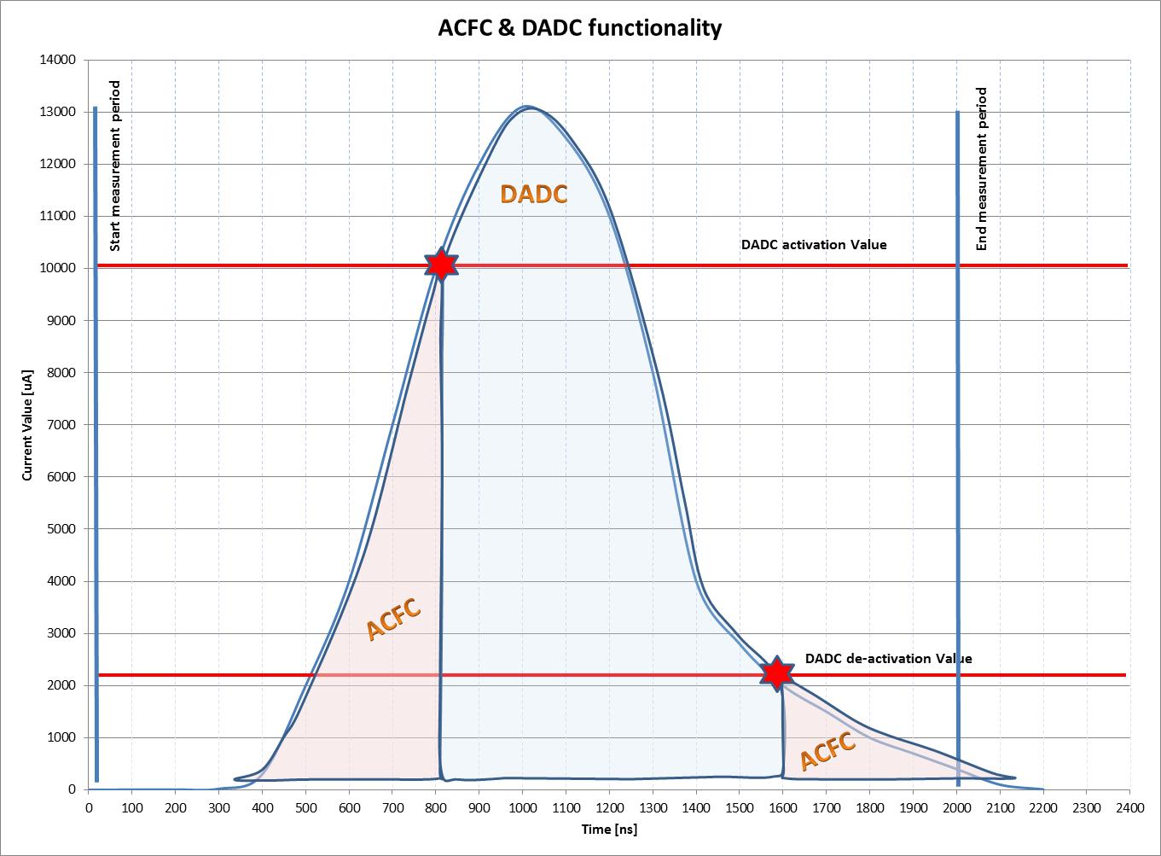
Acquisition principle (FDFC & DADC)
The input channel circuit is able to measure current input from 10pA to 200mA.
The measurement of the input current is performed by two techniques:
Dual Polarity Current to Frequency Converter (FDFC) operates in the range 10pA to 30mA
Direct ADC acquisition (DADC) usable in the range 20.3µA to 200mA
No gain change required:
The switch between the 2 ranges is managed by the FPGA.
If the maximum FDFC counts is reached, the FPGA switches the circuit to the DADC mode.
When the value of the DADC falls below a threshold, the FPGA switches the circuit to the FDFC mode.
The sum of all parts is calculated in the FPGA and transmitted as a 2 us sample.
DPFC
DPFC

Slide 18
System overview

Slide 19
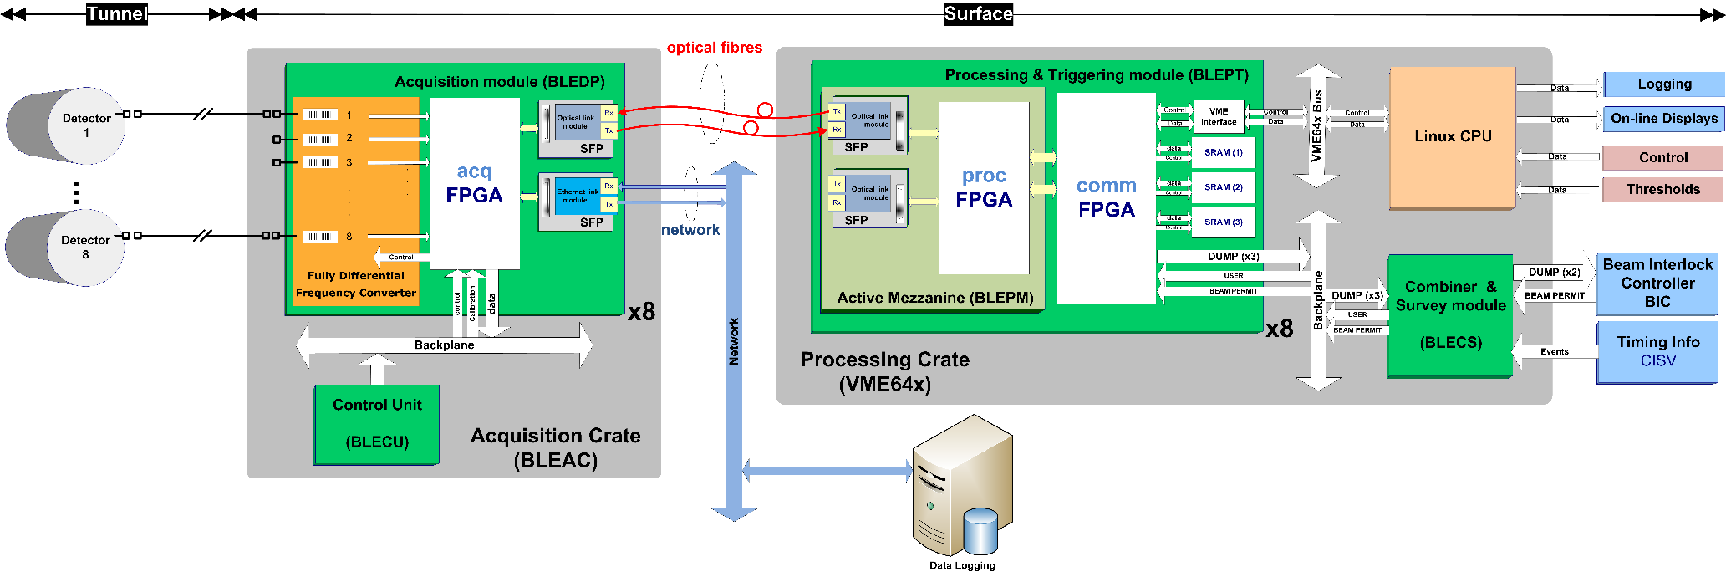
System Architecture

Slide 20
Cabling Overview
Connector Types:
enclosed in cable tray
tube
BNC
SMA
TRIAX
~ 1 m
~ 200 m
~ 5 m
HV Power
Supply
(~1500 V)
Fanout 1-to-64
CBH50
Ionization Chamber
Acquisition
Card
(BLEDP)
Signal
CKC50
Internal Screen 1
External Screen 2
Single HV cable to each detector using a fanout module.
Screen of detector power cable is open on the IC side to assure there is no ground loop.
Internal screen to shield low frequency noise (GND only on electronics side, IC is floating).
External screen to shield high frequency noise (and atm not grounded at tunel side).

Slide 21

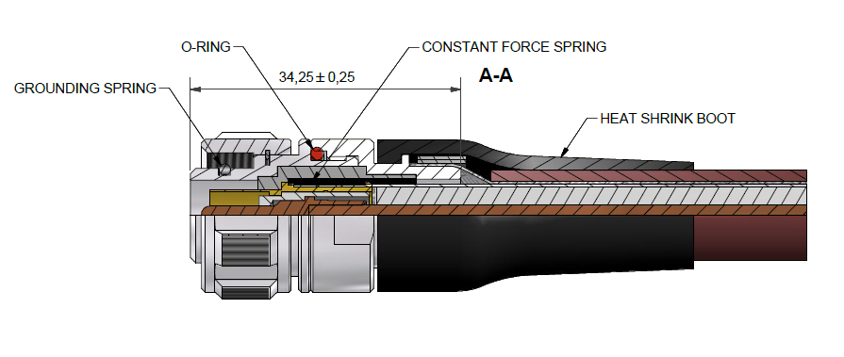
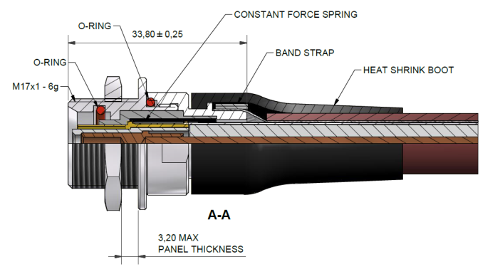
Cabling Overview
HV cable: CBH50
Signal cable: custom-made coaxial double shielded CKC50
Connectors/Plugs: custom-made triaxial

Slide 22
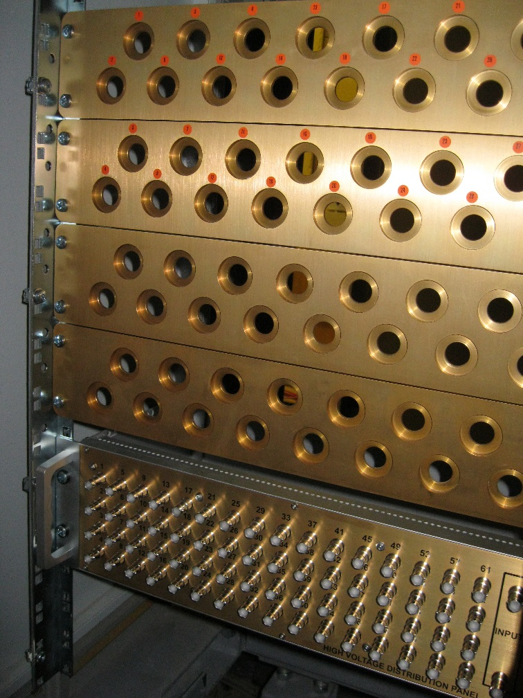
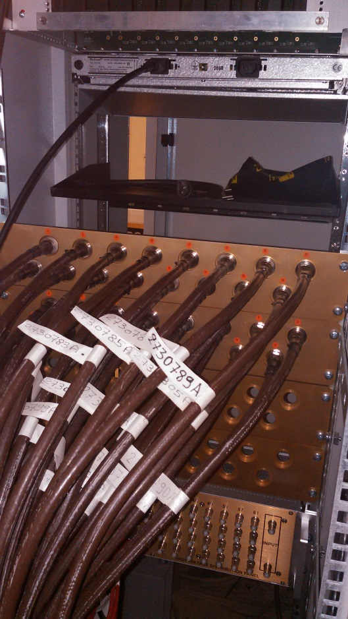
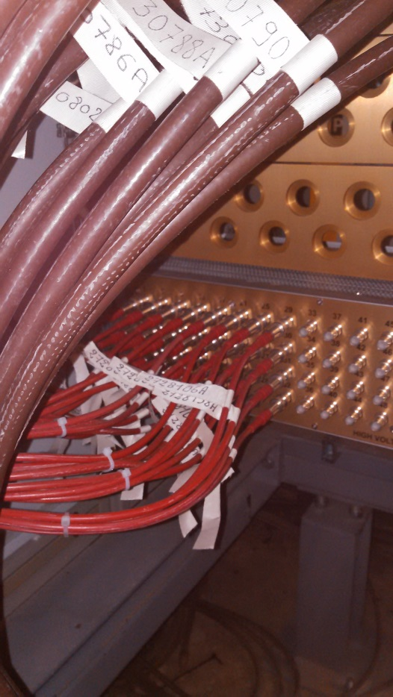
Cable Management
Signal Cables
HV Cables
Signal Cable panel &
HV distribution

Slide 23
Electronics

Slide 24
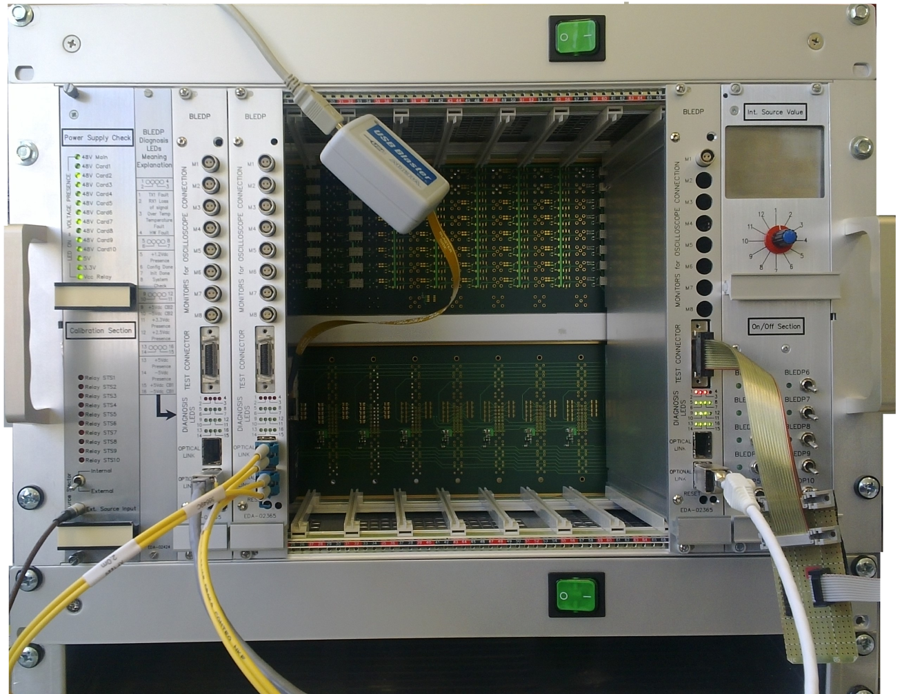
Acquisition Crate
Production completed
Custom Backplane
Support 64 connectors and relays for the input channels and distribute signals
Control Unit
Later version w/ advanced remote functions
Main panel
Ref. current Input
LEDs
Power switch
Acquisition module (BLEDP)
Up to 8 modules with
8 channel each

Slide 25
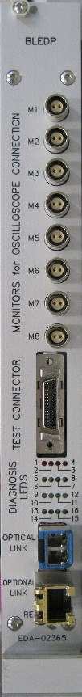
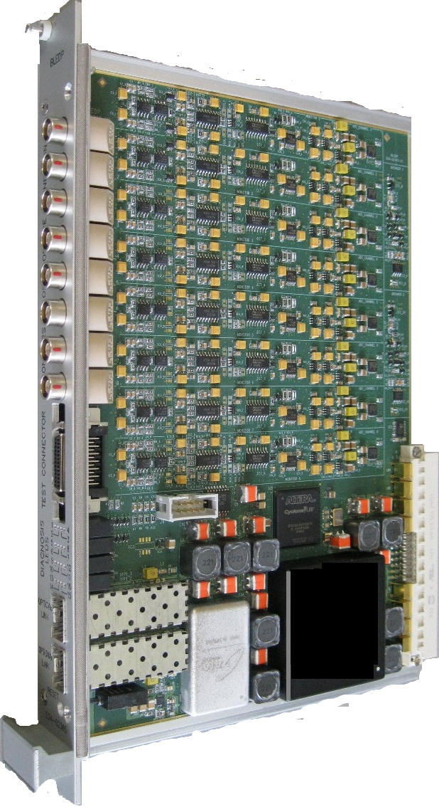
Acquisition module (BLEDP)
Currently in production
Acquisition
digitisation of 8 channels
FPGA
Altera Cyclone IV
JTAG connection
Local programming
and diagnostics
Backplane connection
Analogue inputs, power and control
SFP connectors
Gigabit optical and/or Ethernet links

Slide 26
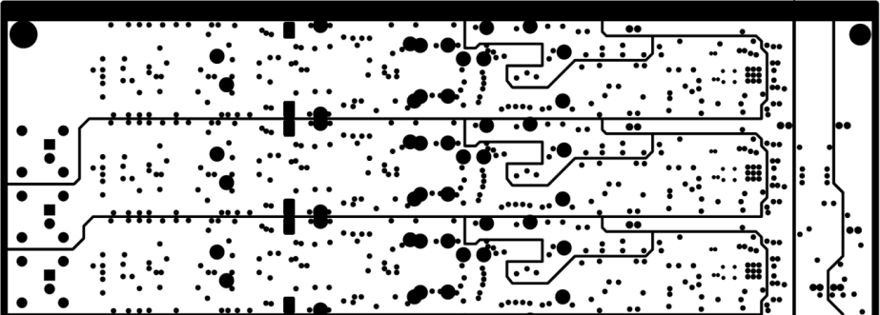
BLEDP Optimisation
Improve the insulation between input lines and other signals e.g. power supplies.
This has been done by:
  creating special VIAS,
  optimising routing paths and
  creating holes below the integration capacitor.
  several ground areas have been created.
Standard Vias and Through hole footprint
Modified Vias and Through hole footprint
Areas dedicated to the monitors
High Insulation Capacitor
Holes below integrator capacitors
Special insulated VIAS
Hole

Slide 27
Processing Electronics
Processing Mezzanine
  New design to match the acquisition modules
  2 SFP modules (gigabit Optical links and Ethernet)
  Cyclone IV (150K logic elements) FPGA
Carrier VME64x modules
  Generic BI card, i.e. DAB64x
VME crates with BI custom backplane
  Broadcast of timing events to the modules
  Daisy-chain of beam permit signals
  Same as LHC system

Slide 28
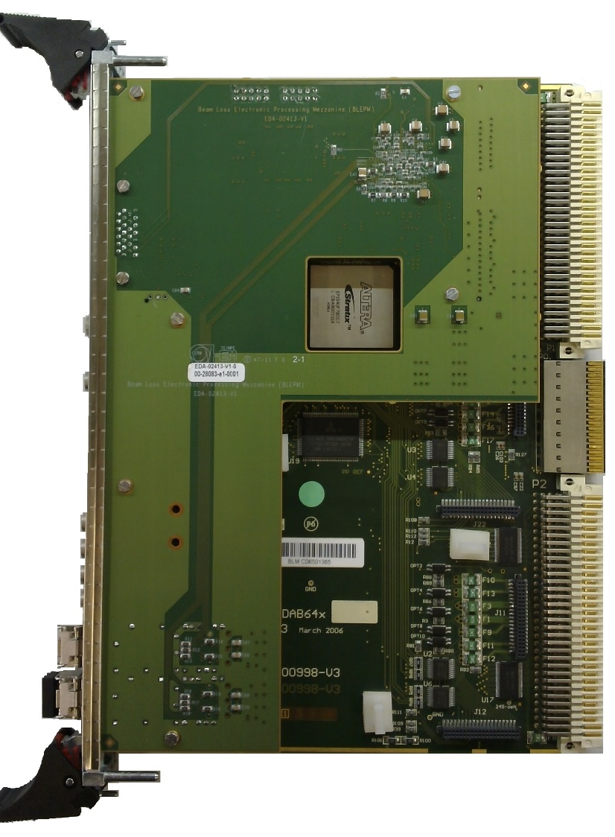
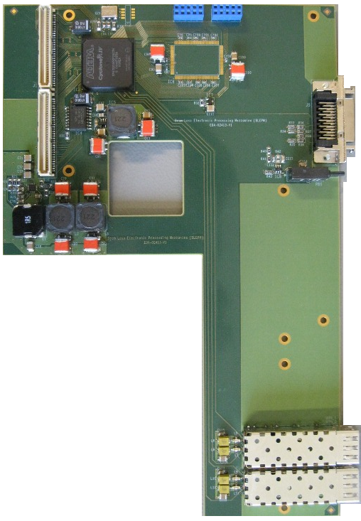
Processing & Threshold Comparator
JTAG connection
Local programming
and diagnostics
Connectors
to the
mainboard
FPGA
Cyclone IV 150K logic elements
2 SFP modules
Gigabit Optical links and Ethernet

Slide 29
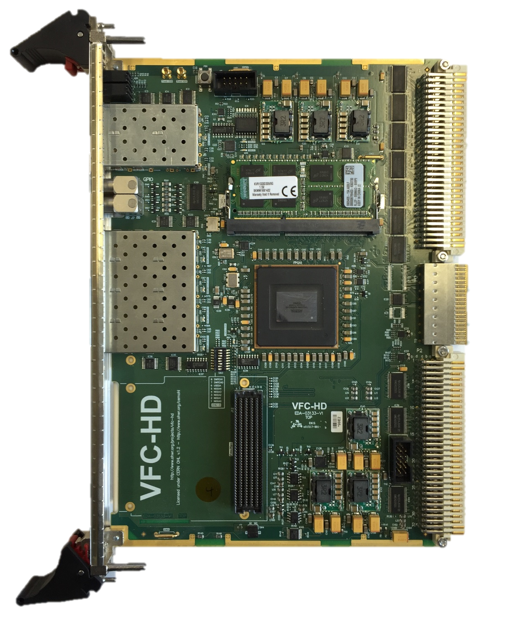
VFC-HD module
Next generation of generic CERN BI processing modules in production
Beam Synchronous Timing
DDR3
VME64x interface
Ethernet
P0 User defined connection
4 SFP for fast connections to the Front-ends
ARRIA V FPGA
Rear Transition Module connection
HPC-FMC slot
CERN Power Supplies

Slide 30
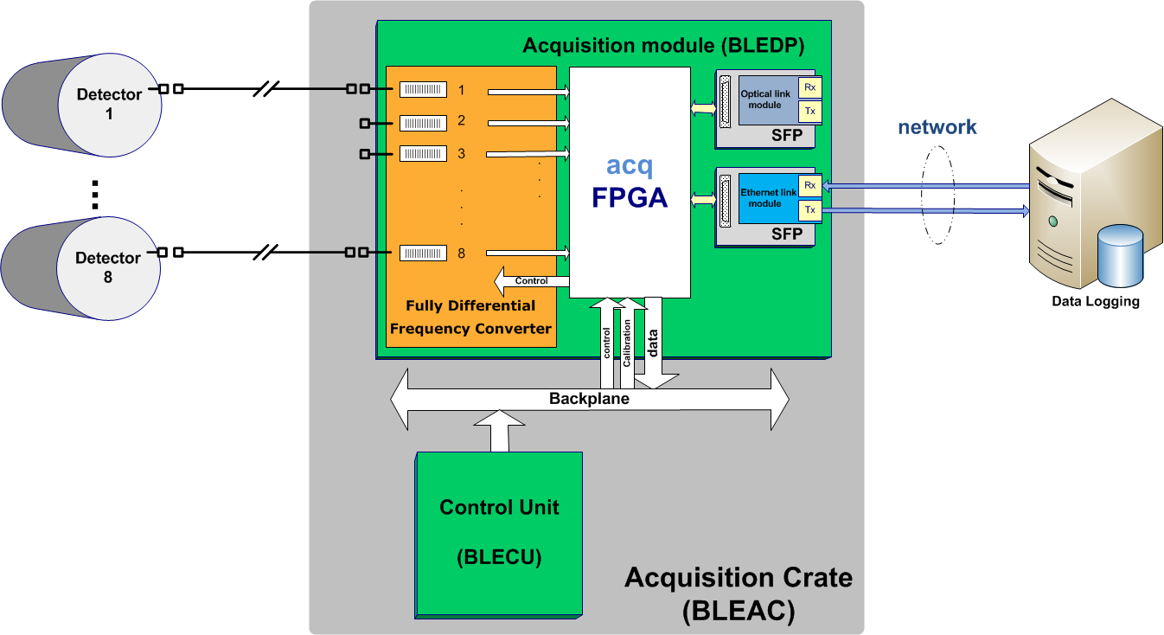
System for Verification
Need to record all raw data
Analyse data offline
Debug & optimise pre-processing algorithm
Characterise noise & analogue circuit.
Added a gigabit Ethernet module and connect to the network
Developed TCP/IP and UDP stacks in the FPGA firmware -> NIOSII softcore
Developed a server to be included in the FPGA -> compiled C++
  accept commands, prepare data requested and transmit
Developed client applications in Java, Python and C
  send commands, store and display data

Slide 31
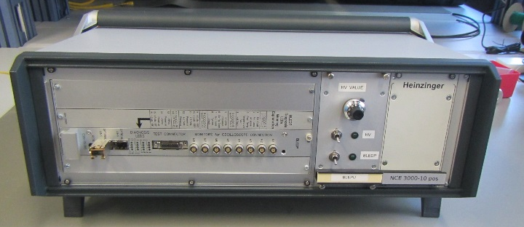
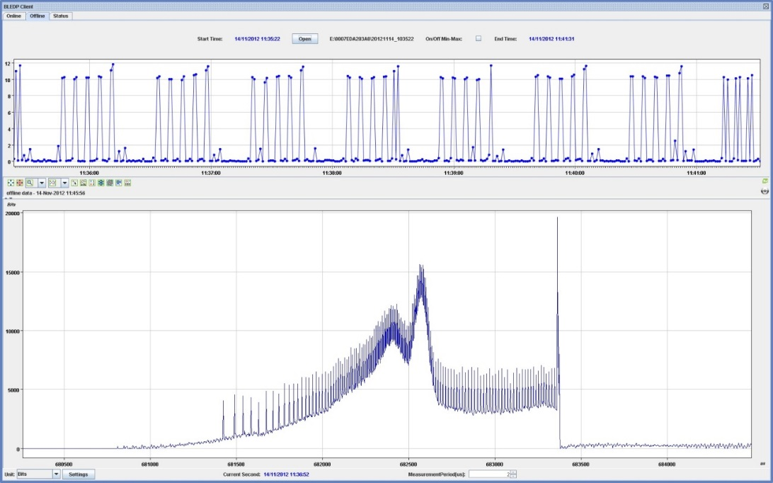
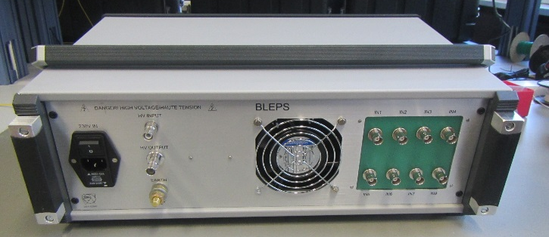
Stand-alone/Ethernet version
Ethernet-based version of the system
Very powerful for
  verification,
  commissioning and
  fine observations
Front view
Cycle selection
500,000 acquisition points
Rear view

Slide 32
Installation overview

Slide 33
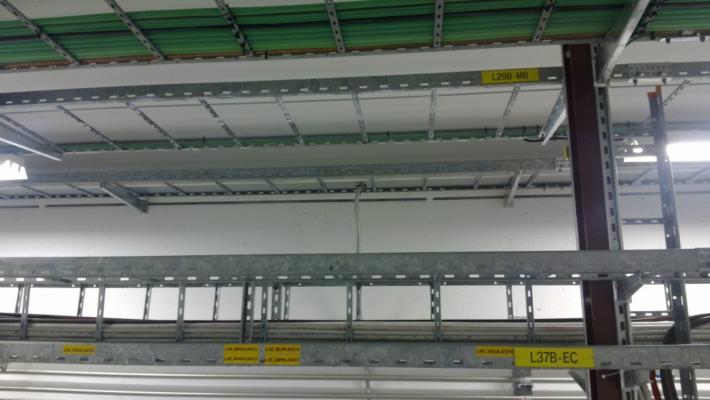
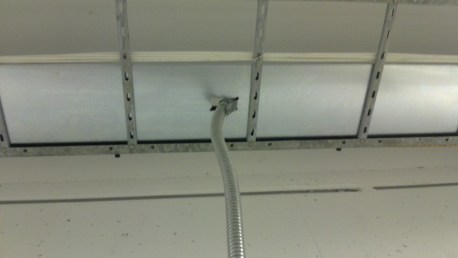
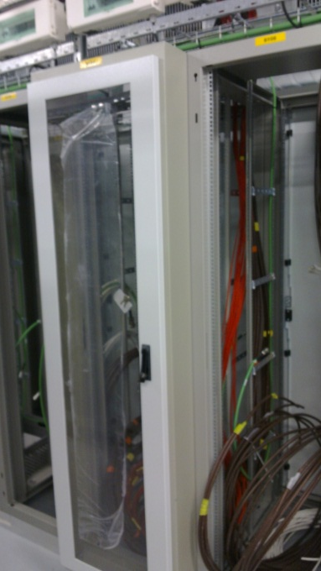
Pictures of the installation
Separated enclosed cable tray
Metallic cable tube
for the last few meters
Fans on the rack top
Enclosed and extended front for cables and fibres
Rack includes:
Acquisition crate
Processing (VME) crate
HV Power supply for the detectors
User Interface to BIS (i.e. CIBU)
Standard and Uninterrupted Power Supply connections

Slide 34
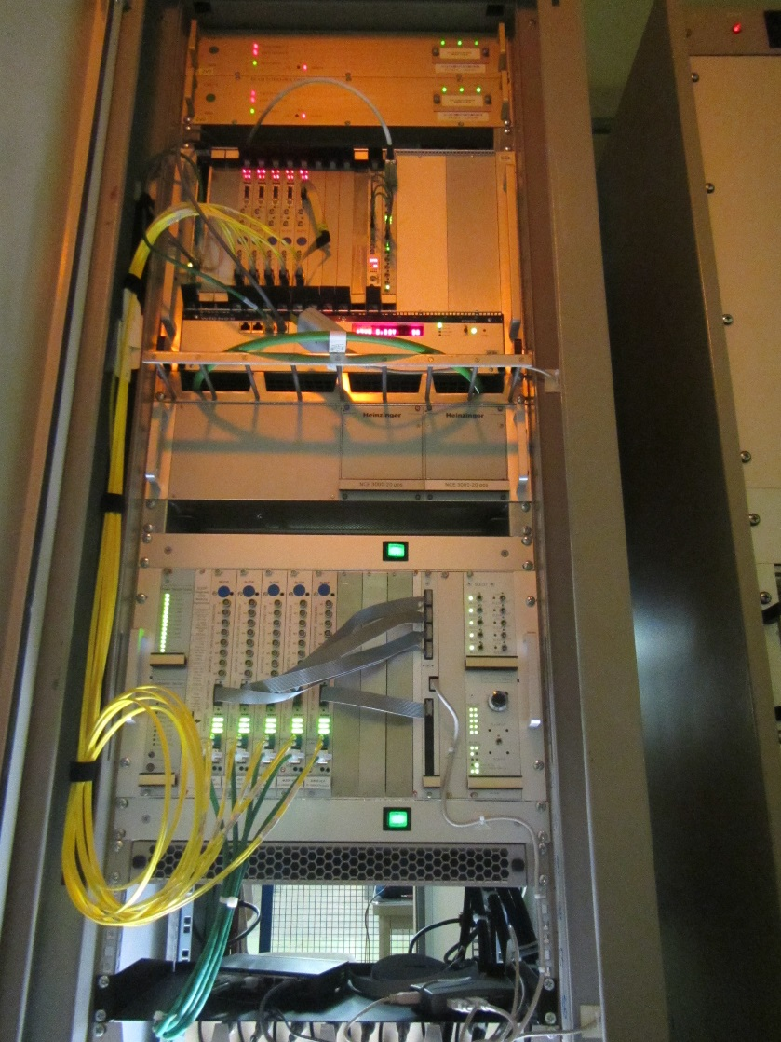
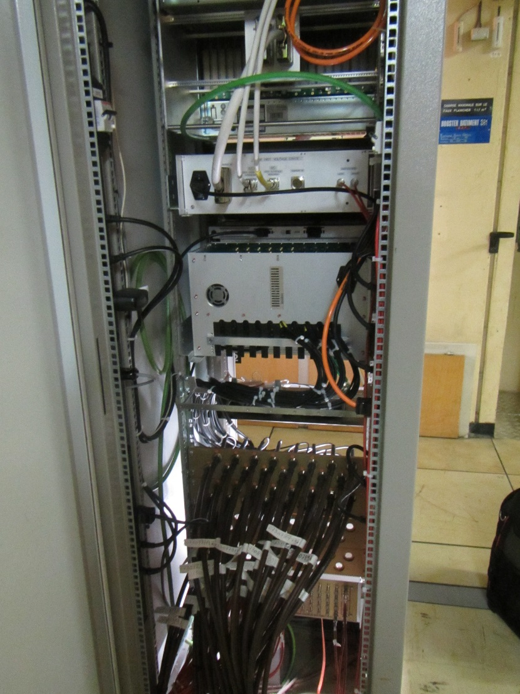
Rack Management

Slide 35
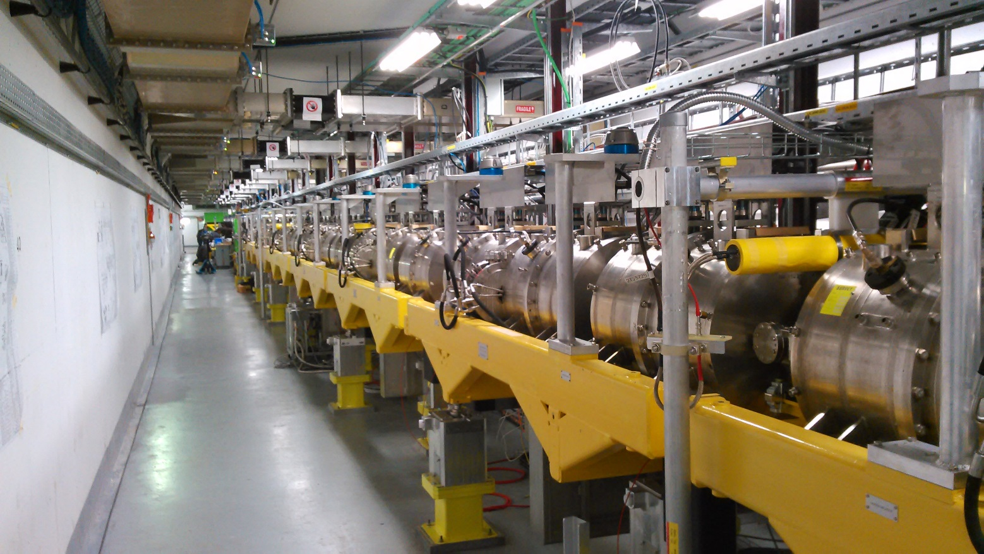
LINAC4: Info
11 ICs in the machine line and
14 ICs in the transfer line

Slide 36
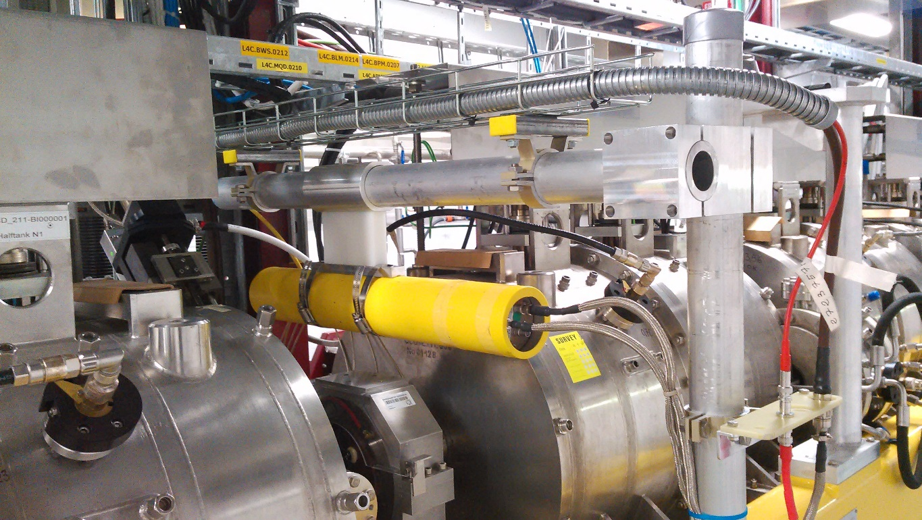
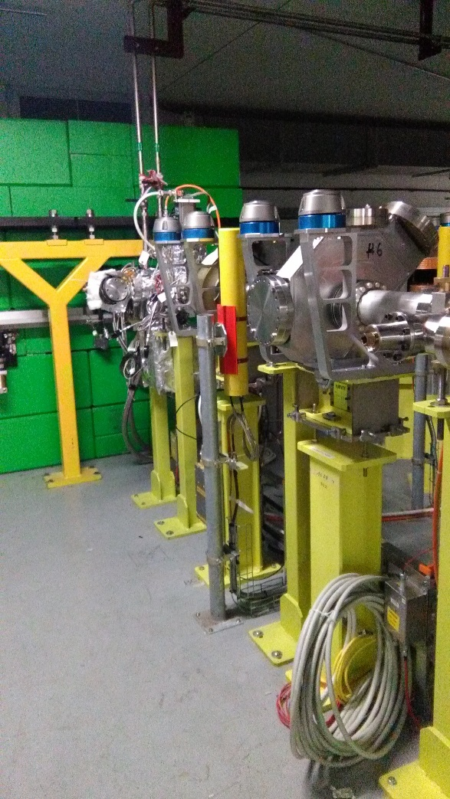
LINAC4: Supports
Machine line
Dump and Transfer line

Slide 37
PSB: Info
Machine/Area |  | Channels | Cables | Detector Type
PSB | Ring (L2 sections) | 32 | 64 | LHC-IC
 | Ring (L3 sections) | 32 | 64 | FIC
 | H- and BI lines | 18 | 36 | LHC-IC
 | H- | 8 | 40 | Diamonds
 | Extraction lines | 28 | 56 | LHC-IC
Detectors:
  8 Diamonds with amplification and splitter stages
  32 Flat Ionisation Champers (FIC)
  72 LHC-type Ionisation Champers
Cabling
  Ring L2 sections complete
  Remaining installation is planned for 2017
Supports:
  Common design for the H- detectors (ICs and Diamonds)
  Transfer lines have not been considered yet

Slide 38
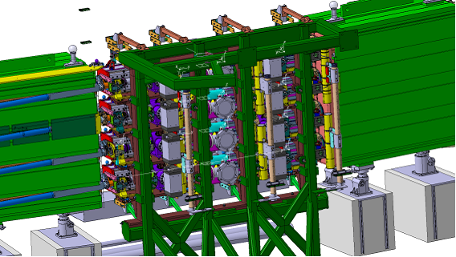
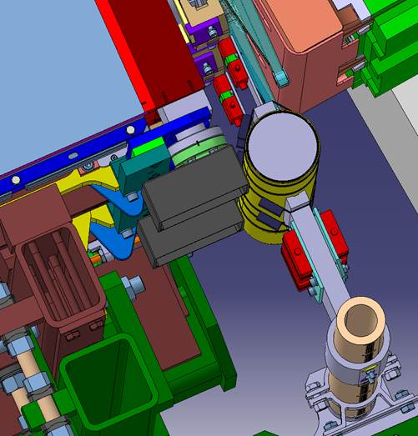
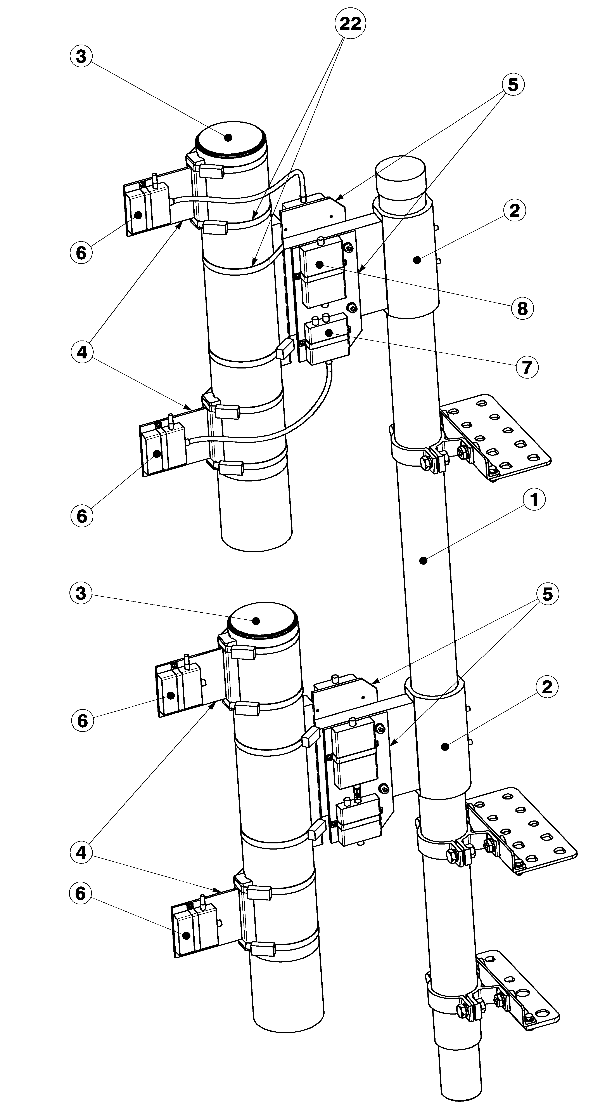
PSB Injection: IC & Diamond Support
The new H⁻ charge-exchange injection system

Slide 39
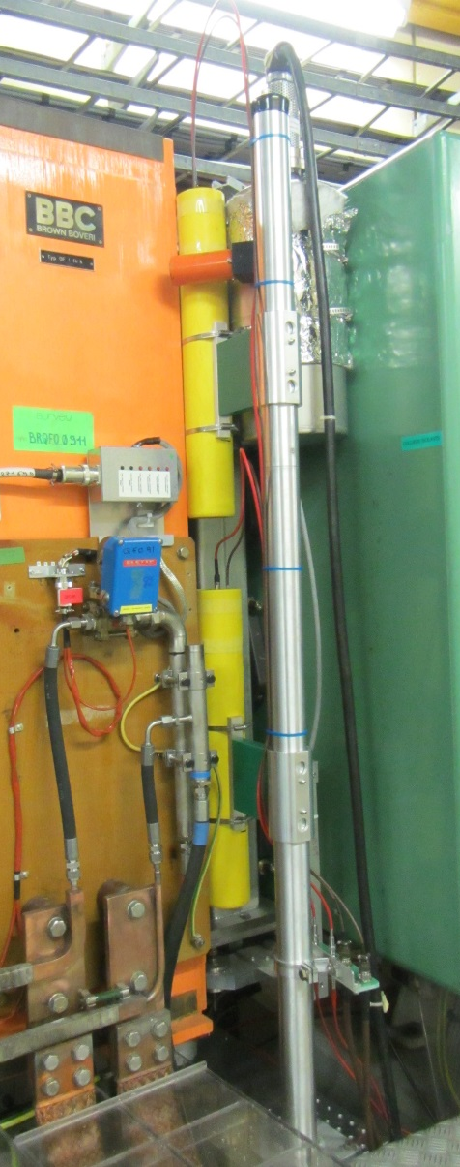
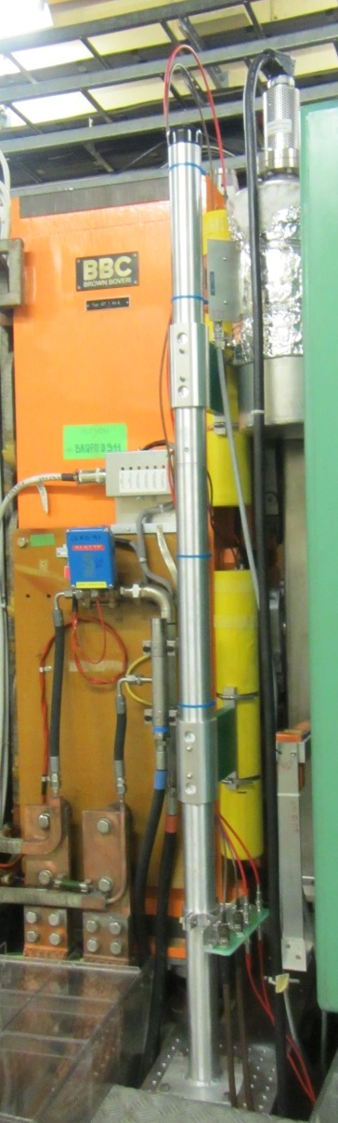
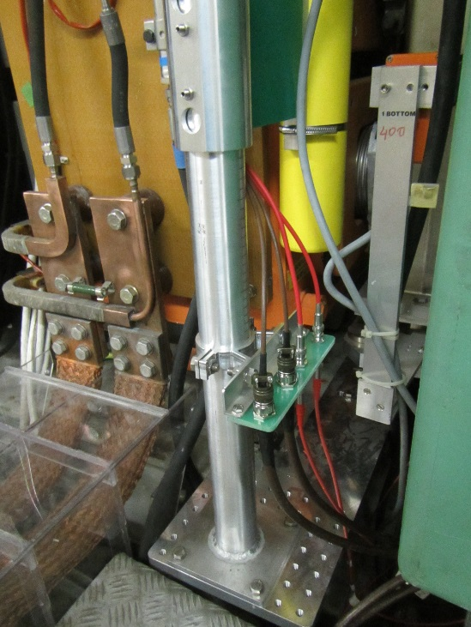
PSB Ring: IC Detector Support
Very tight integration.
Had to verify all locations;
no interference / obstruction to other systems.

Slide 40
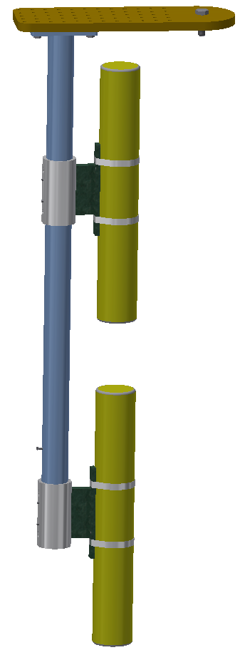
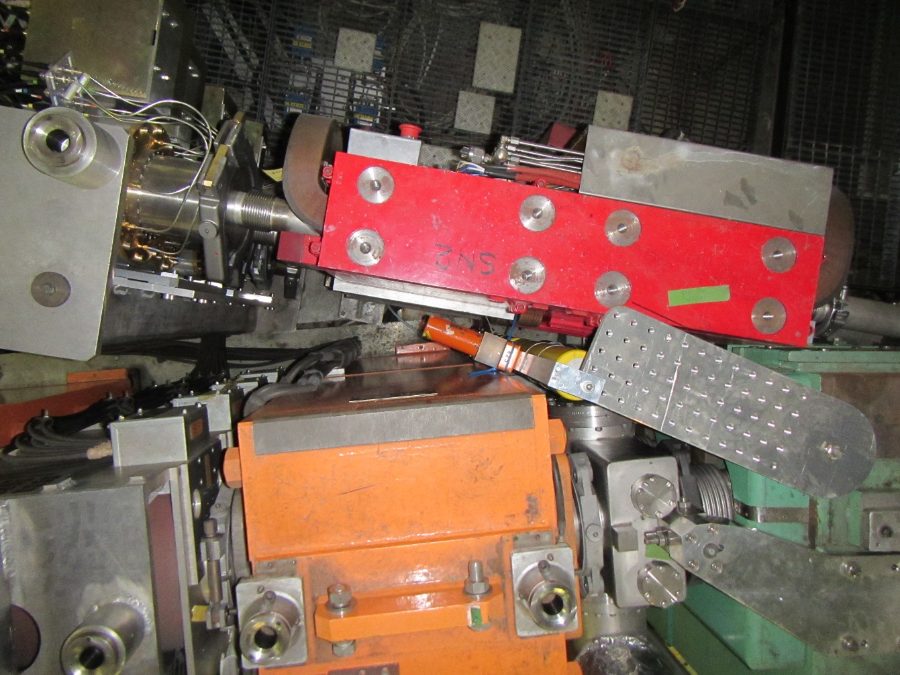
PSB Ring/Ejection: IC Custom support
No space to add the detector on the inside of the ring
ACEMs mounted on the same plate

Slide 41
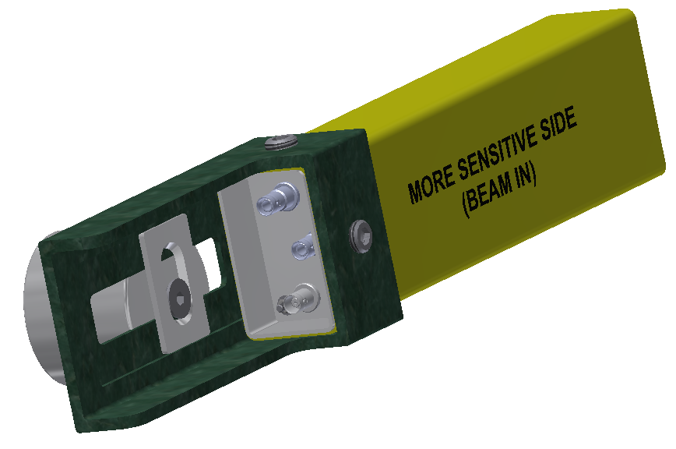
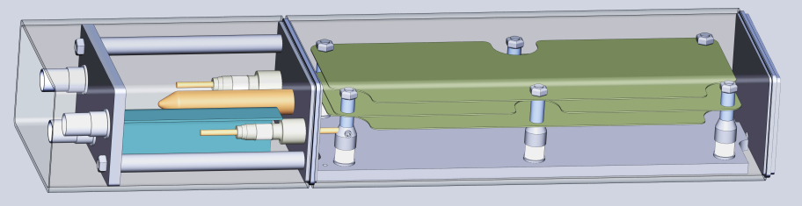
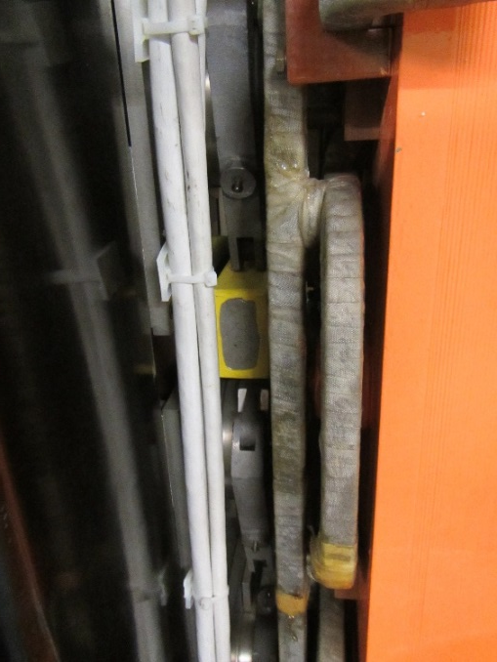
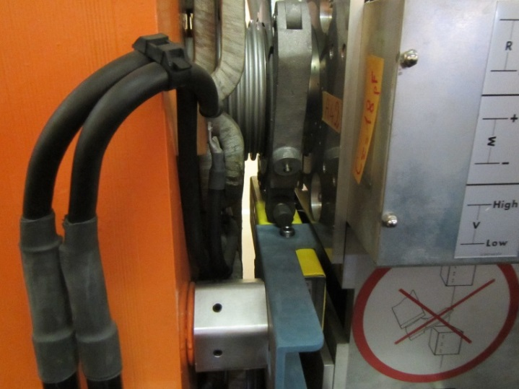
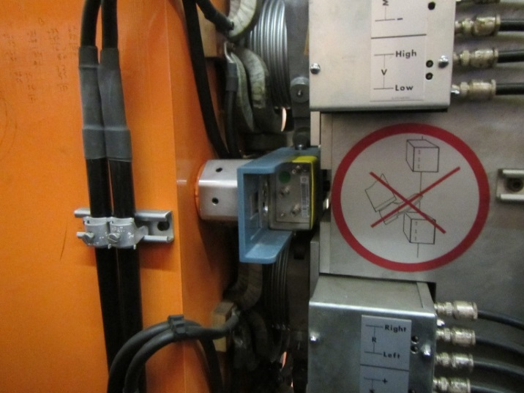
PSB Ring: FIC Detectors
Rectangular detectors (FIC) placed between beam pipes
Support mounts on the magnet
Isolation tests performed

Slide 42
PS Info
Machine/Area |  | Channels | Cables | Detector Type
PS | Ring | 100 | 200 | LHC-IC
 | Ring (observation) | 17 | 85 | Diamond
 | Transfer Lines | 51 | 102 | LHC-IC
Detectors:
  17 Diamonds with amplification and splitter stages
  151 ICs are in production (delivery expected end 2016)
Cabling installation is planned for 2017
Supports:
  Common design for the ring detectors (ICs and Diamonds)
  Transfer lines have not been considered yet

Slide 43
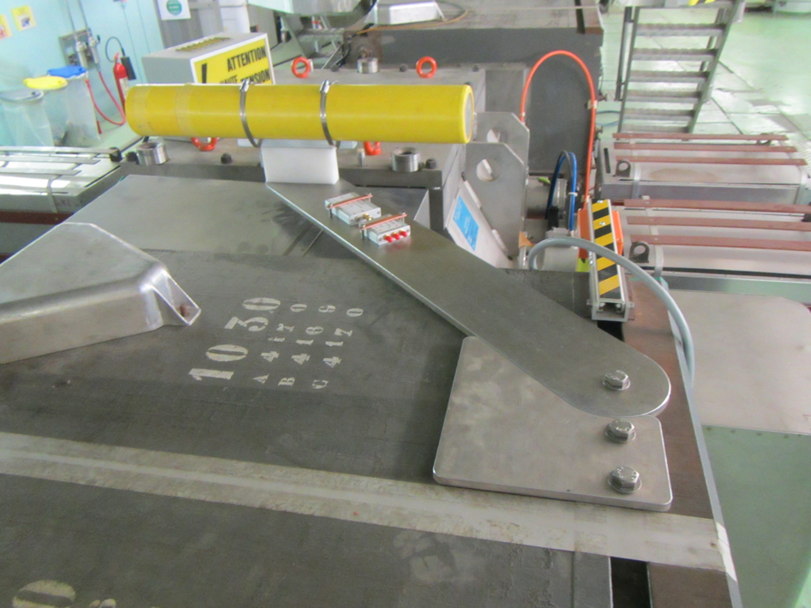
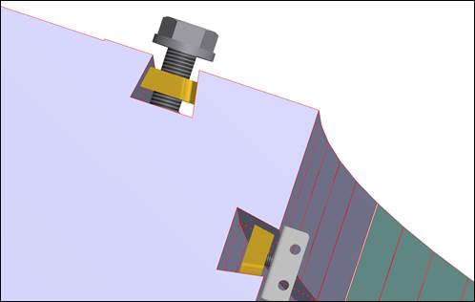
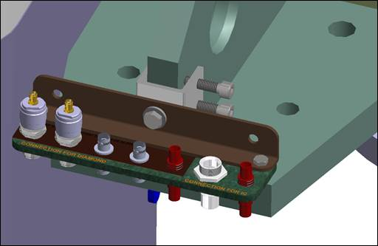
PS Ring Support
Common support for IC and Diamond

Slide 44
Summary

Slide 45
Summarising
Reliable tunnel installation
  Monitors will be mostly Ionisation Chamber type
  High immunity to EMI with special cables, connectors and enclosed cabletrays
  Special attention given to grounding and isolation
High performance acquisition electronics
  Automatic range selection
  Dynamic range = 10¹¹
  In-system calibration mode (will have remote execution in the future)
Modular processing electronics
  High availability of resources (~350’000 Logic Elements)
  Embedded bidirectional gigabit links
  Additional gigabit Ethernet link (for dedicated measurements)
  Future plan for upgrade using the new BI processing module
Production and installation is expected to be completed mid. 2017
Test-benches for verification, software development and measurements
Beam measurements in October

Slide 46
Thank you

Slide 47
Reserved slides

Slide 48
Status of Development
System Overview

Slide 49
Status of Development
FPGA Development
Acquisition & Control
on-going
Data Pre-Processing
complete
Gigabit Ethernet Link
complete
Stand-alone Application
complete

Slide 50
Status of Development
FPGA Development
Gigabit Optical Link
complete
VME Comm.
complete
FESA Class API
complete
Data Storage (SRAM)
complete

Slide 51
Status of Development
FPGA Development
Data Processing
Complete
Interlocks
On-going
CIBU Connection
Complete
Timing
Complete

Slide 52
Status of Development
FPGA Development
FESA Server
complete
Logging Database
complete
Thresholds Management
Not Started
System Supervision
On-going

Slide 55
Diagnostic Data Example

