Slide 2

Use of a Diamond BLM System in the LHC Ring
Chen Xu CERN BI-BL
Thanks to:
E. Griesmayer (CIVIDEC),
B. Dehning, C. Zamantzas, E. Effinger F.S. Domingues Sousa (CERN)
F. Burkart, M. Valette, O. Stein, G. Valentino (CERN)

Slide 3
Outline
dBLM@LHC
LHC beam operation experience (2016)
  Beam injection
  Multi-purpose measurements at the LHC primary collimator (TCP)
  Beam dump
Summary and outlook

Slide 4
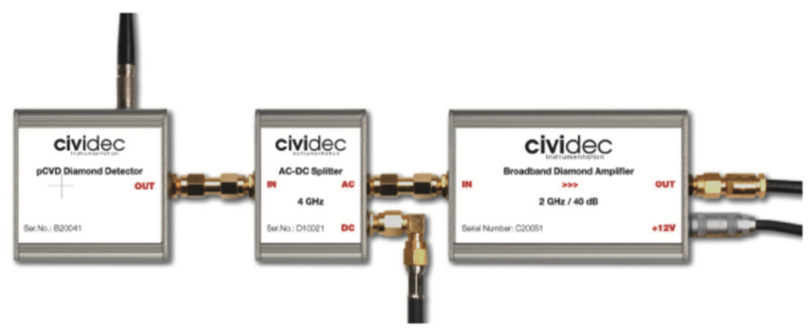
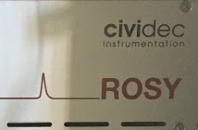
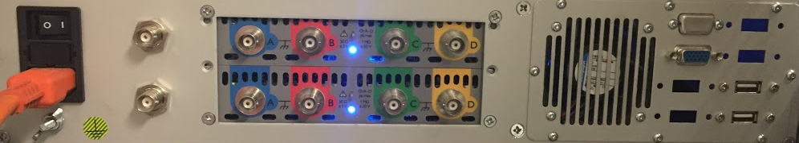
Acknowledgement
The diamond BLM (dBLM), amplifiers and ROSY® System are provided by CIVIDEC Instrumentation GmbH, Vienna, Austria.
Some of the results and plots presented are kindly provided by F. Burkart, M. Valette, O. Stein, G. Valentino

Slide 5
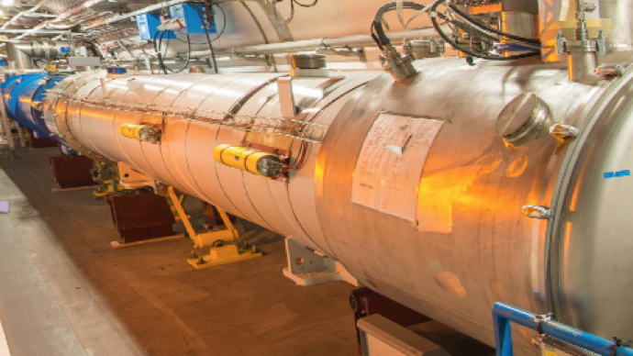
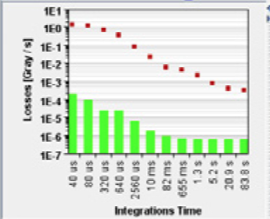
The BLM System in the LHC
Machine protection system component (3520 IC blms connected to beam interlock system)
Integrated current signal (minimum integration window 40 us)
Free running with 1 Hz data logging (maximum values)
Higher data rate (continues data buffer) are provided for dedicated purpose (injection, collimation alignment, UFO, PM)
Diamond BLMs are currently complementary devices to provide ns range time resolution data.

Slide 6
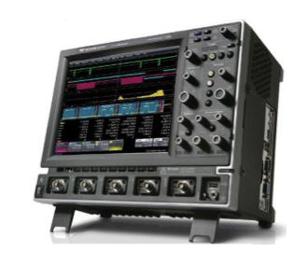
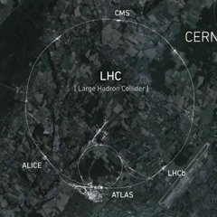
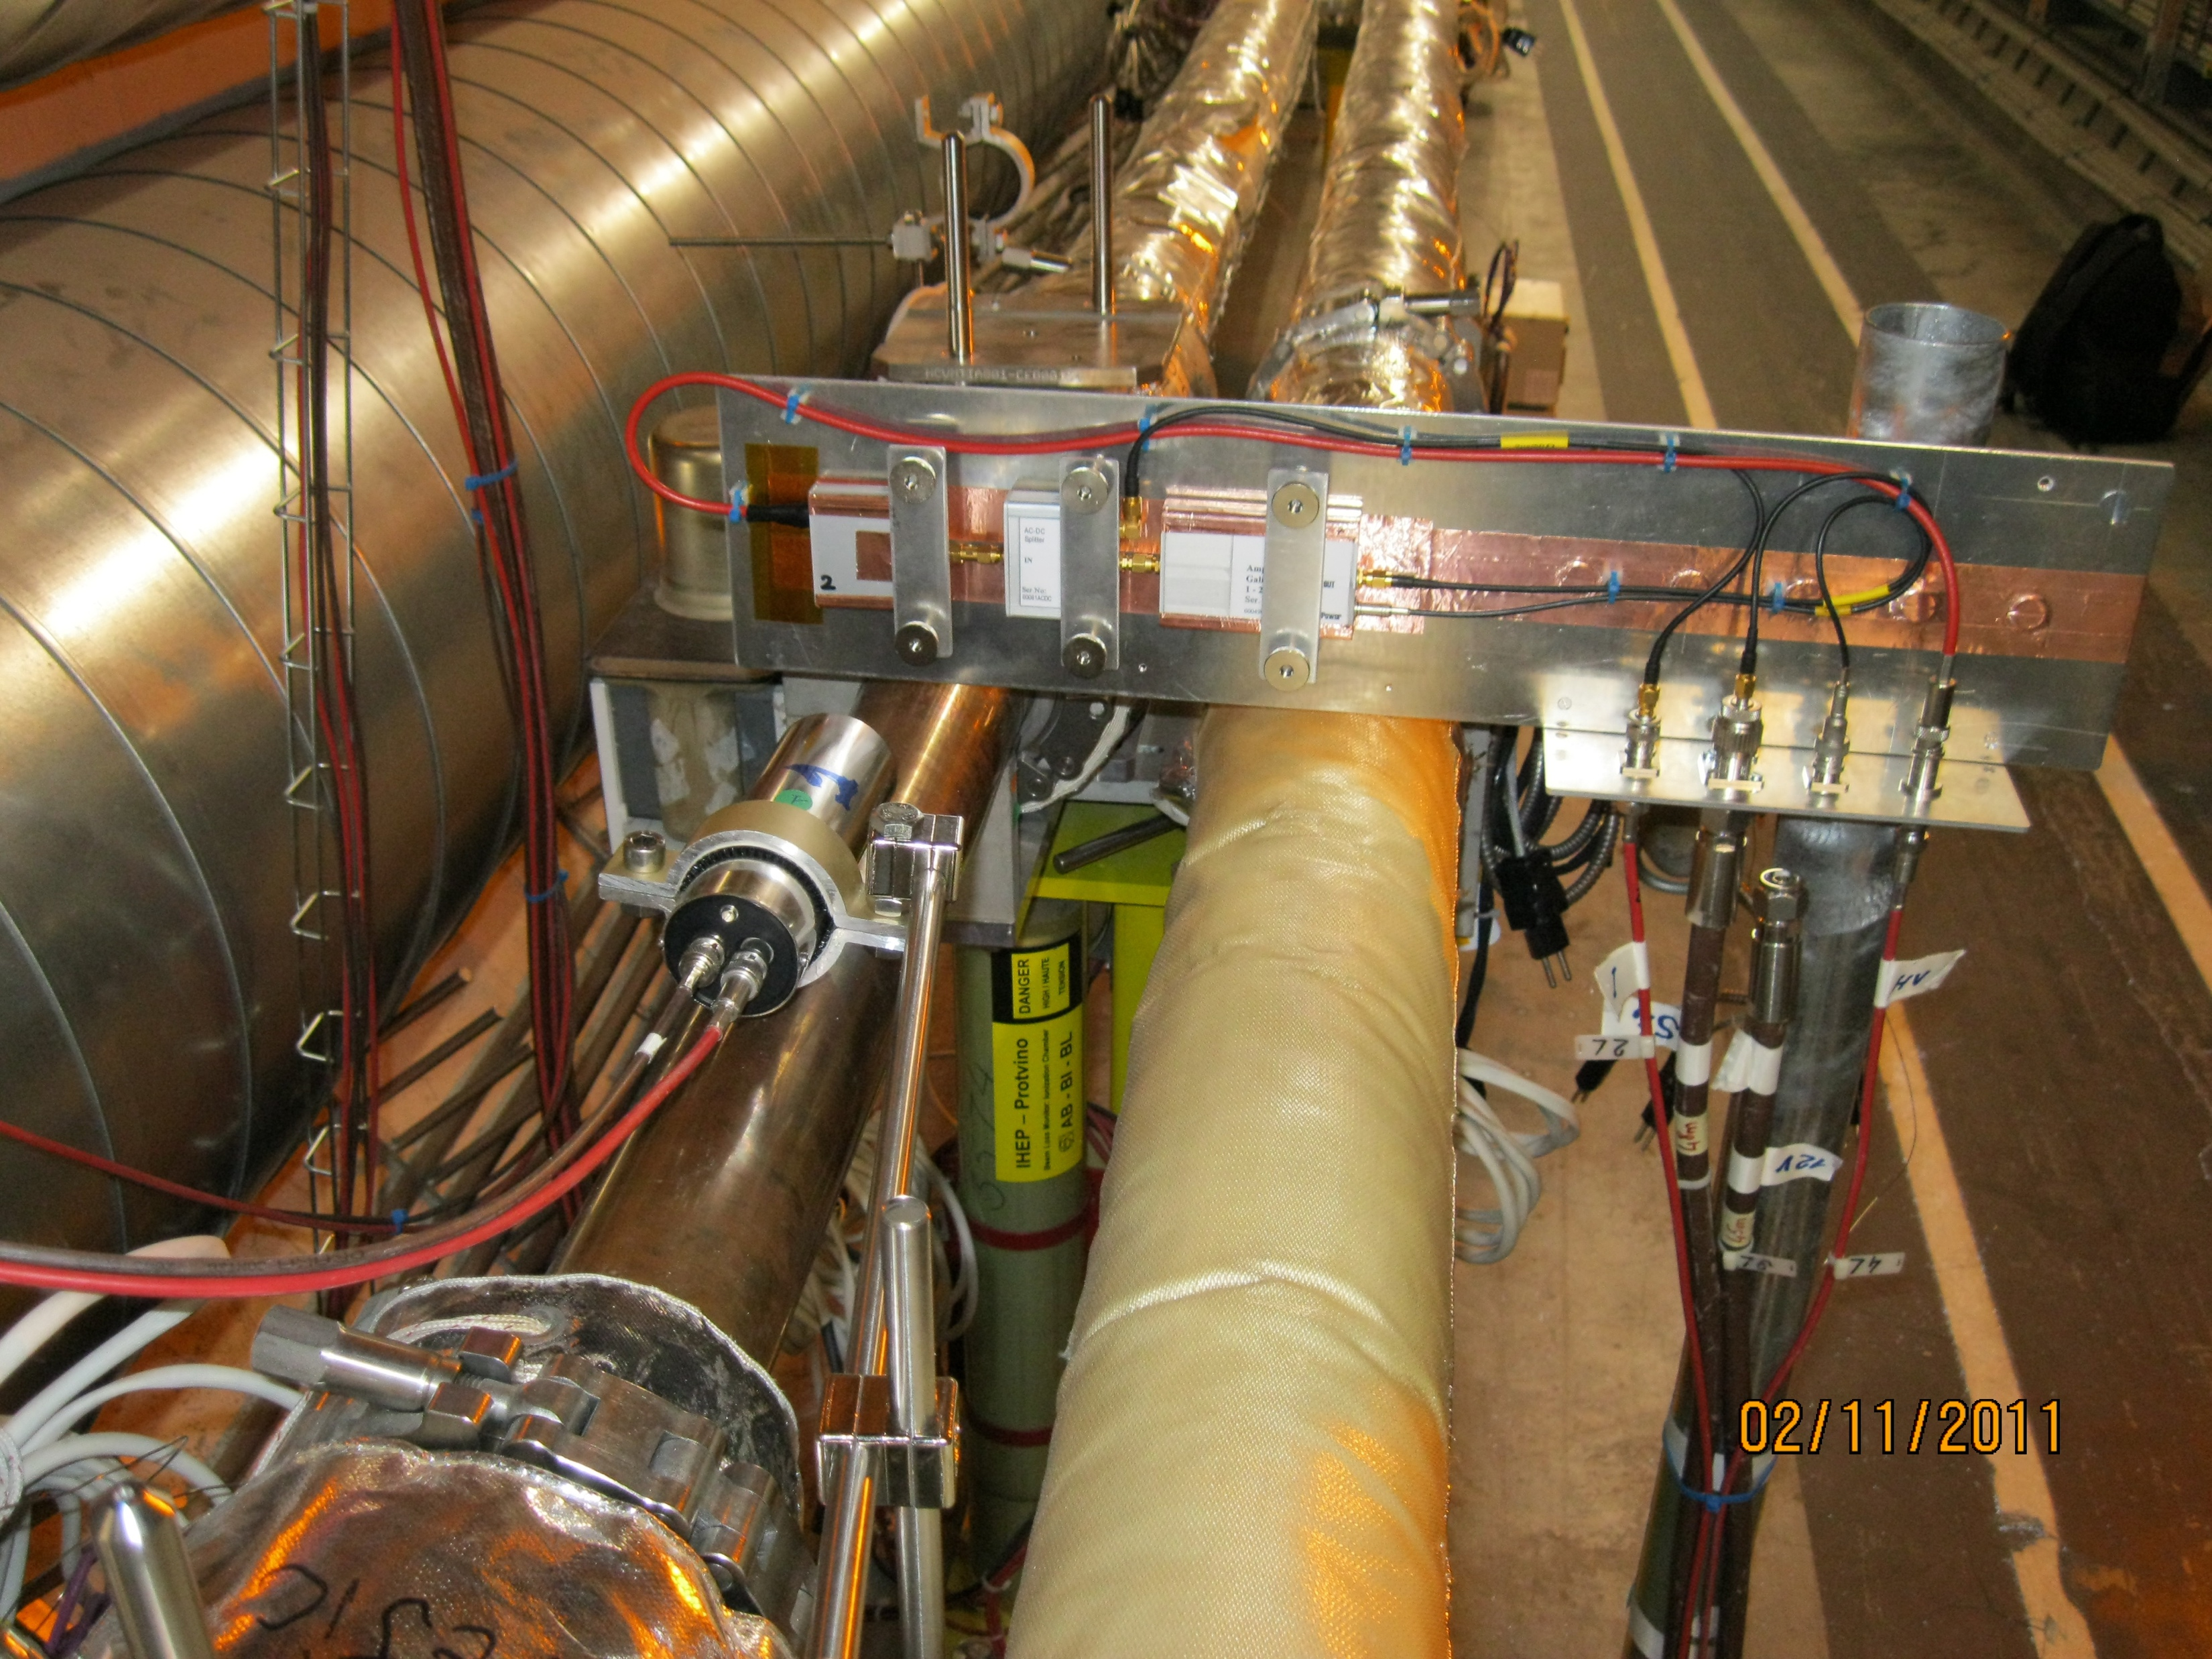
Diamond BLM @ LHC
Point 6
Beam extraction
Point 7
Primary collimators
Point 2
Beam1 injection
Point 8
Beam2 injection

Slide 7
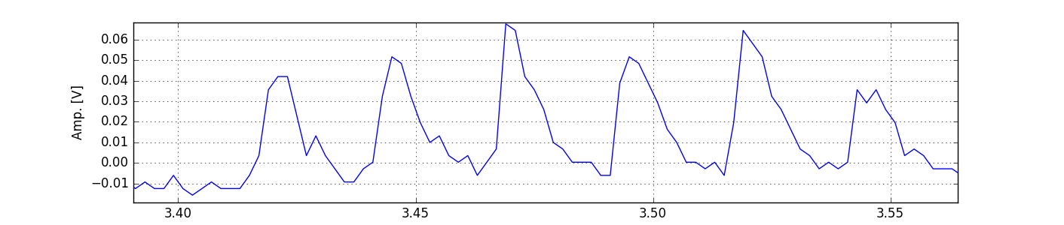
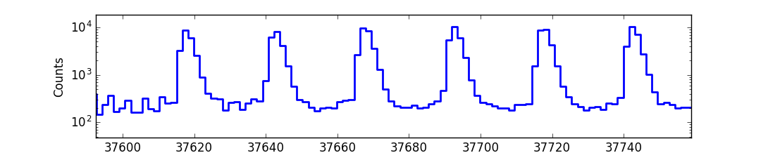
dBLM with ROSY® Readout
Time-Loss-Histogram: precise beam loss timing counts
Time
+1
+1
+1
+1
+1
+1
1.6ns

Slide 8
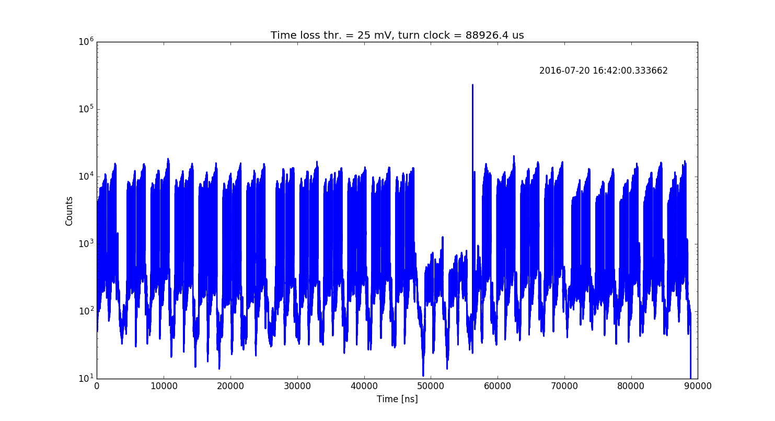
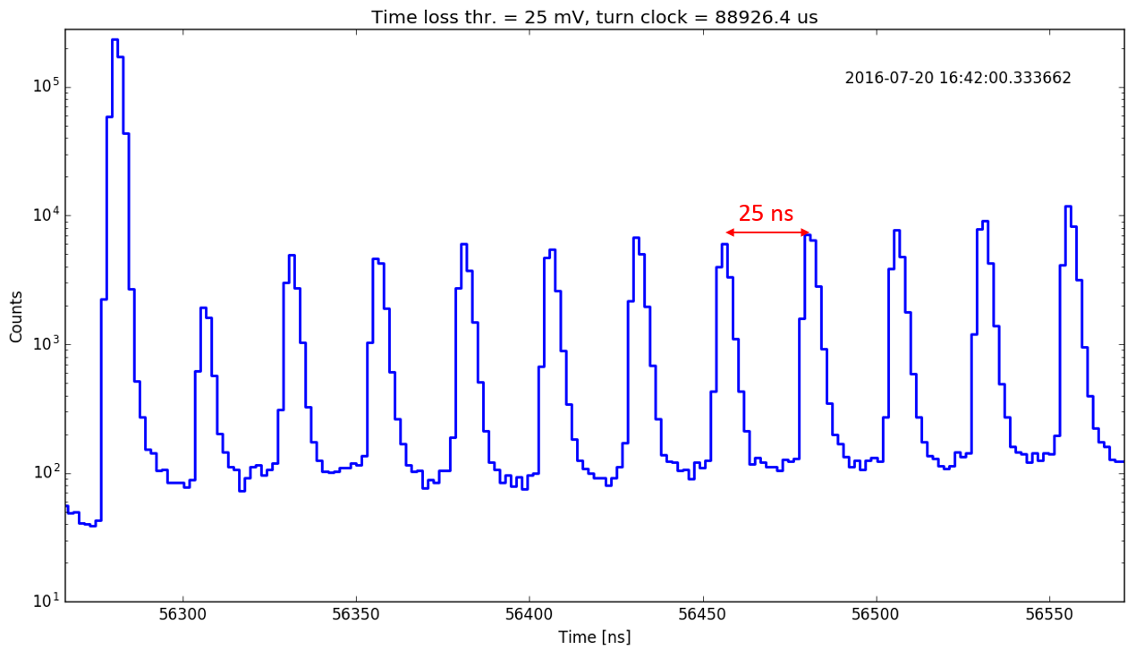
Time-loss-histogram with ROSY®
B1 TCP
LHC full machine with 2076 bunches
12b
injection gap
48b
96b
abort gap
b2
crosstalk
88.9 us

Slide 9
dBLM waveform
Configurations:
  Edge triggered with ROSY ®
  High sampling rate with large data buffer (4 channels shared 5Gs/s & 1e9 samples)
  Edge trigger or smart triggered with Lecroy scope
DAQ
  Using LHC event triggers
  Qualitative analysis at the moment
  Calibration with IC BLM or beam on going

Slide 10
dBLM data from 2016 LHC beams
LHC injection loss
Unidentified falling object (UFO) event
TCP beam scraping (beam halo population study)
LHC beam extraction

Slide 11
LHC injection loss
Extraction Kicker
SPS
Transfer line
LHC
Collimator
Injection Kicker

Slide 12
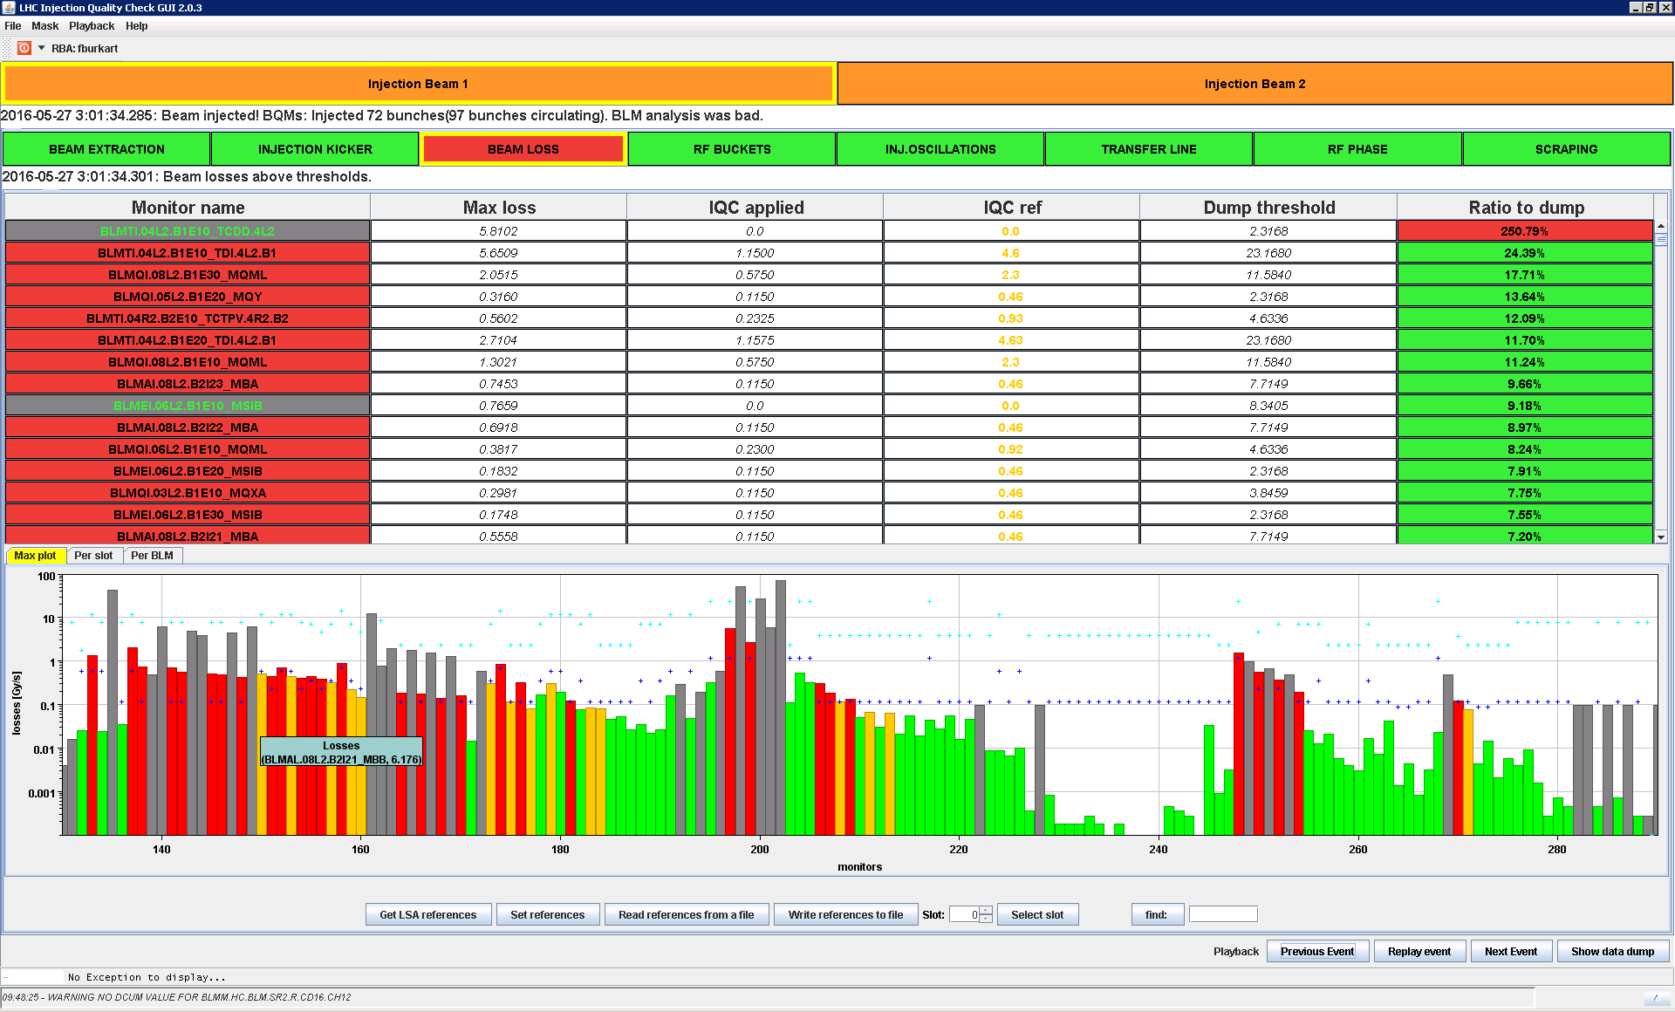
LHC injection loss
Extraction Kicker
SPS
Transfer line
LHC
Collimator
Injection Kicker

Slide 13
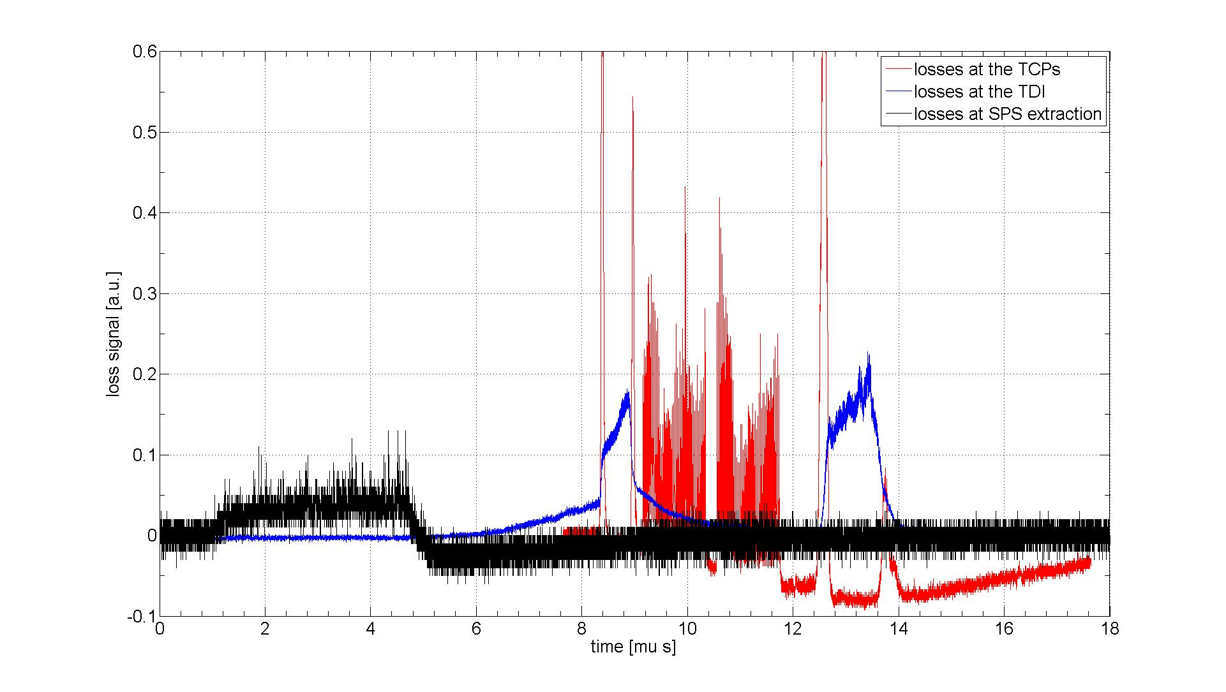
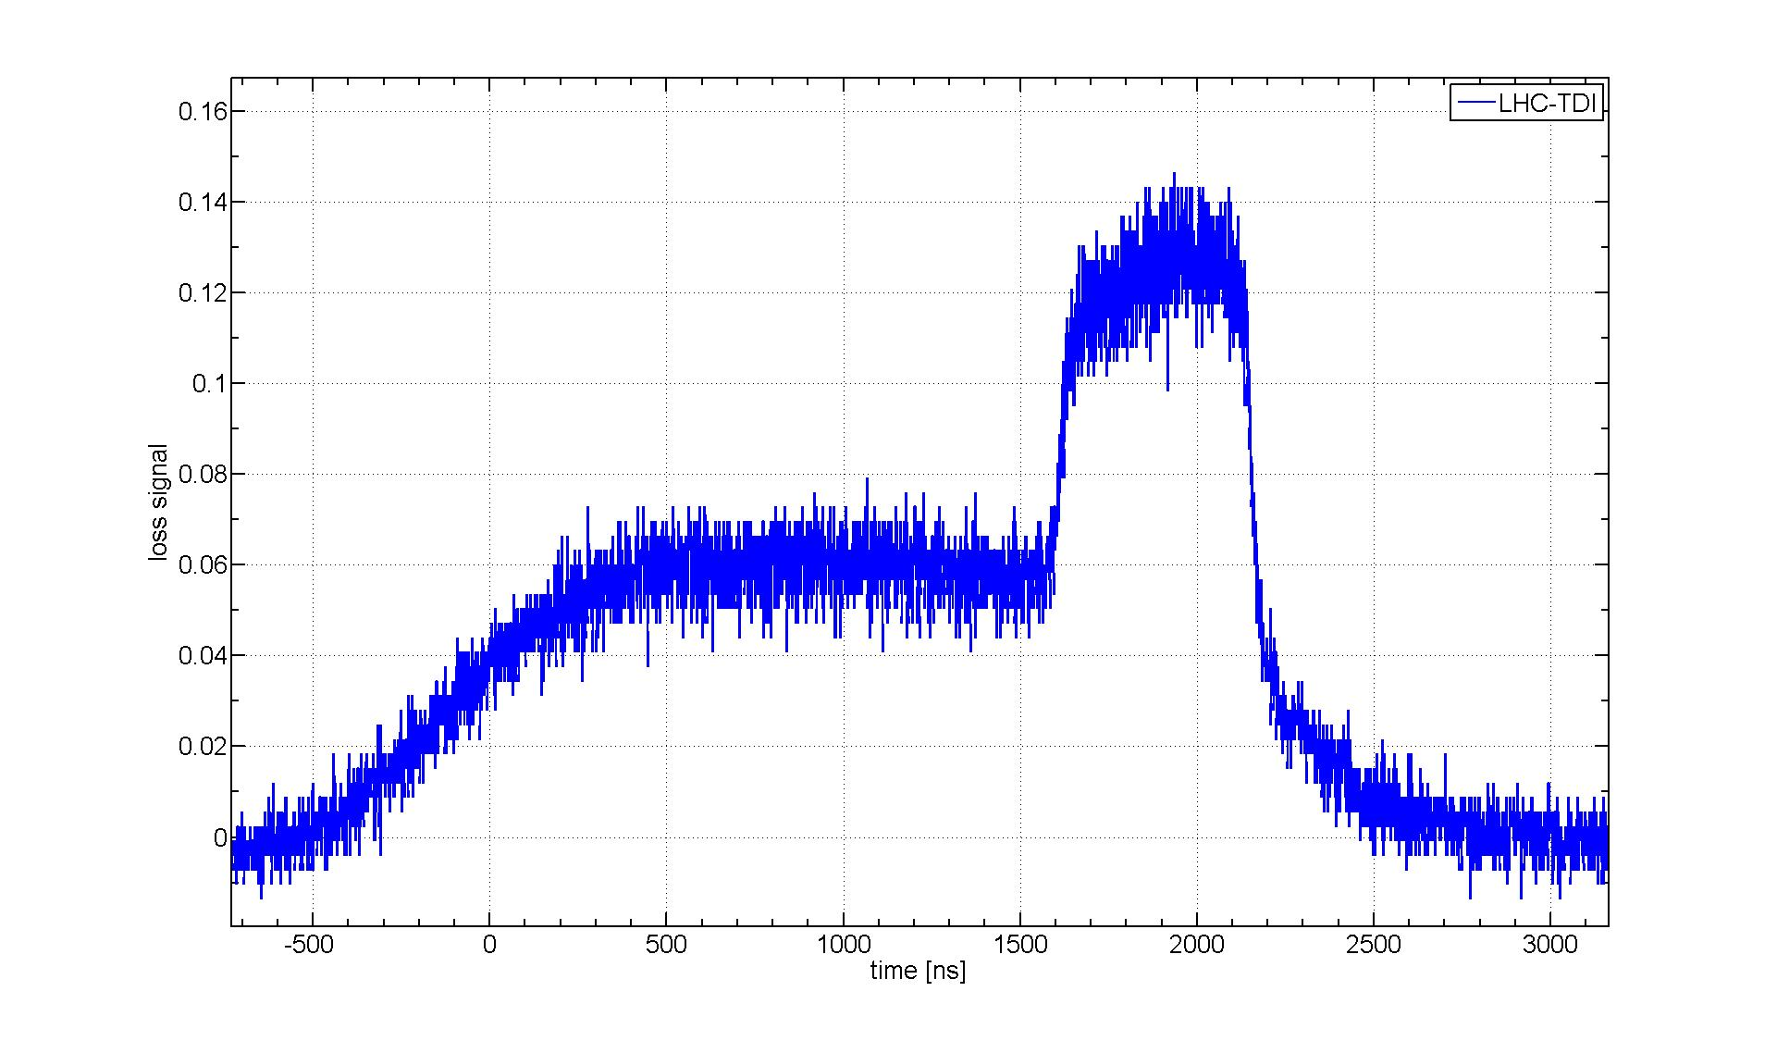
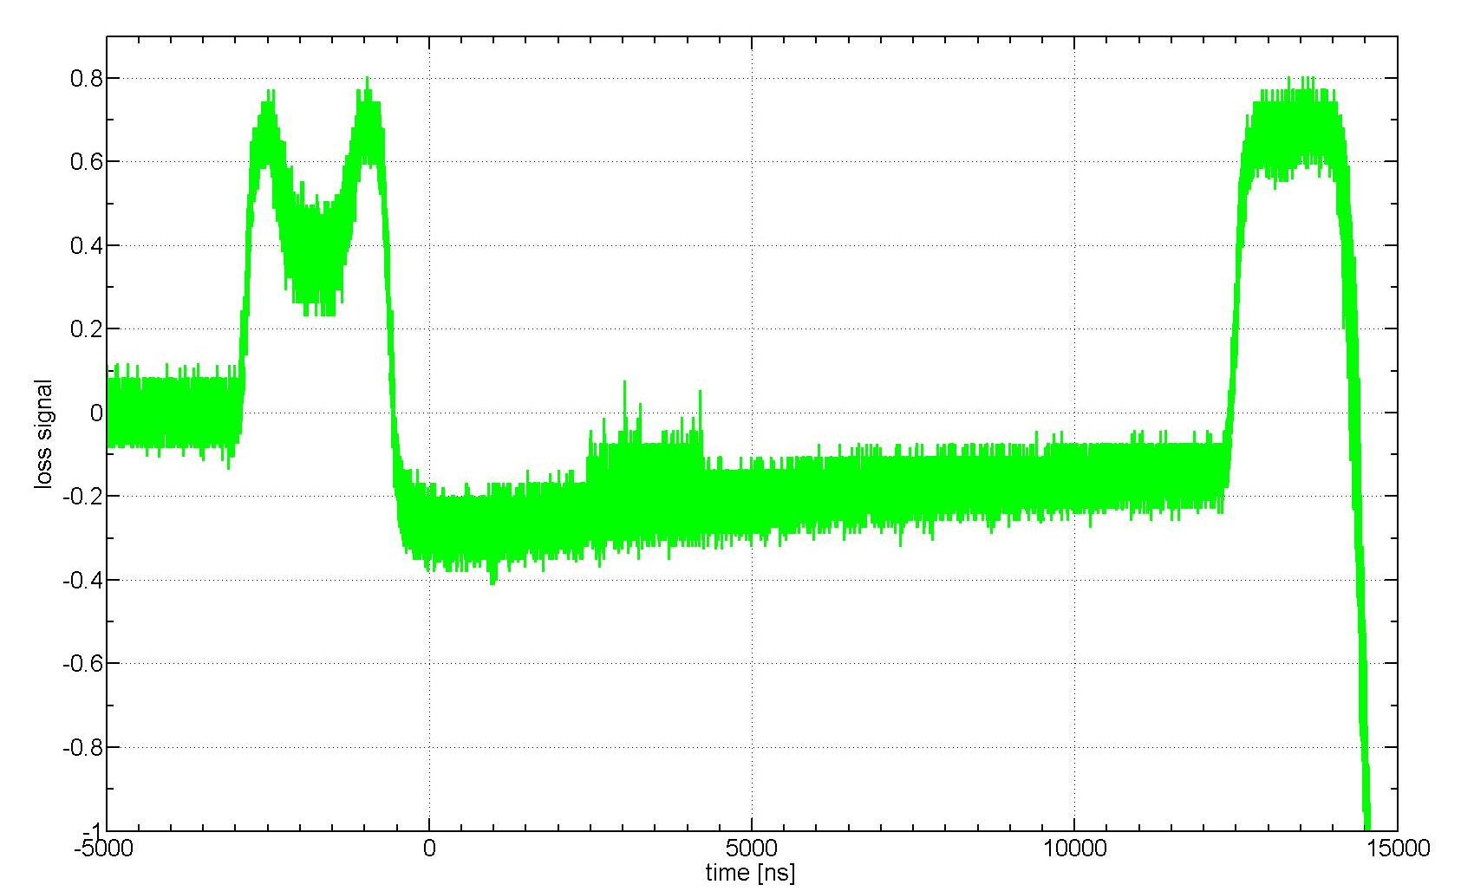
LHC injection loss
Unbunched beam
96b
Courtesy of F. Burkart

Slide 14
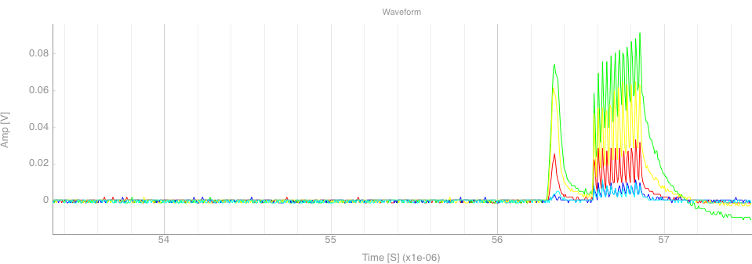
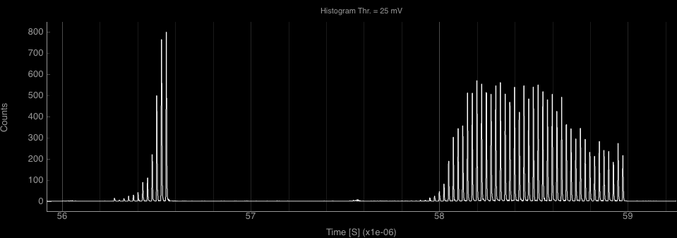
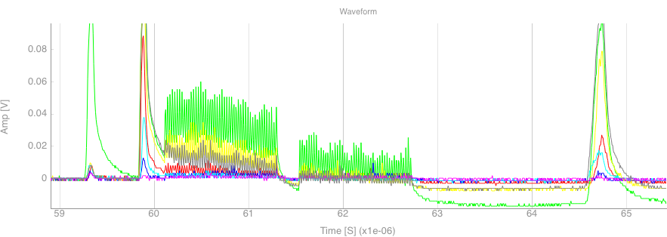
LHC injection loss
12b Injection
96b Injection
Histogram after injection finished (Accumulated losses)

Slide 15

dBLM data from 2016 LHC beams
LHC injection loss
Unidentified falling object (UFO) event
TCP beam scraping (beam halo population study)
LHC beam extraction

Slide 16
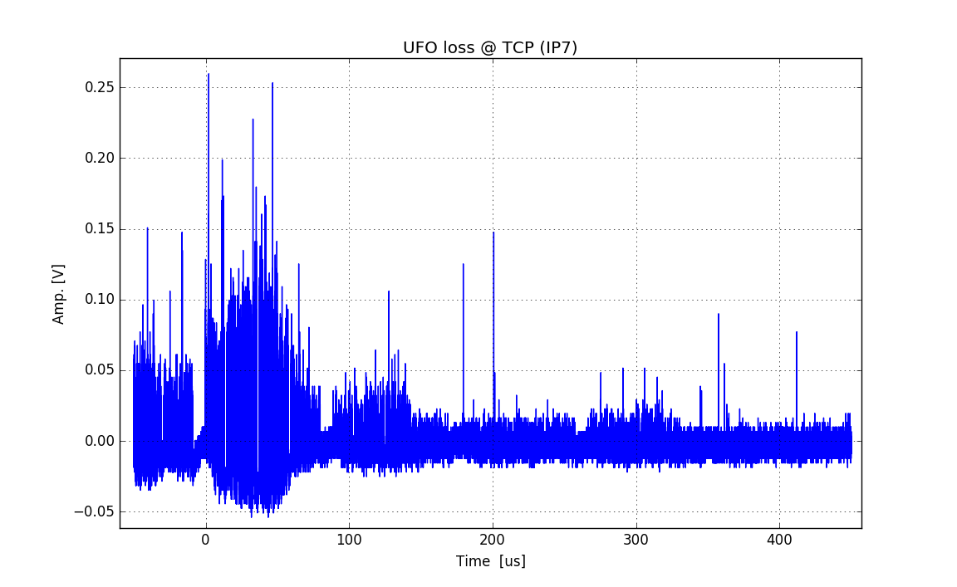
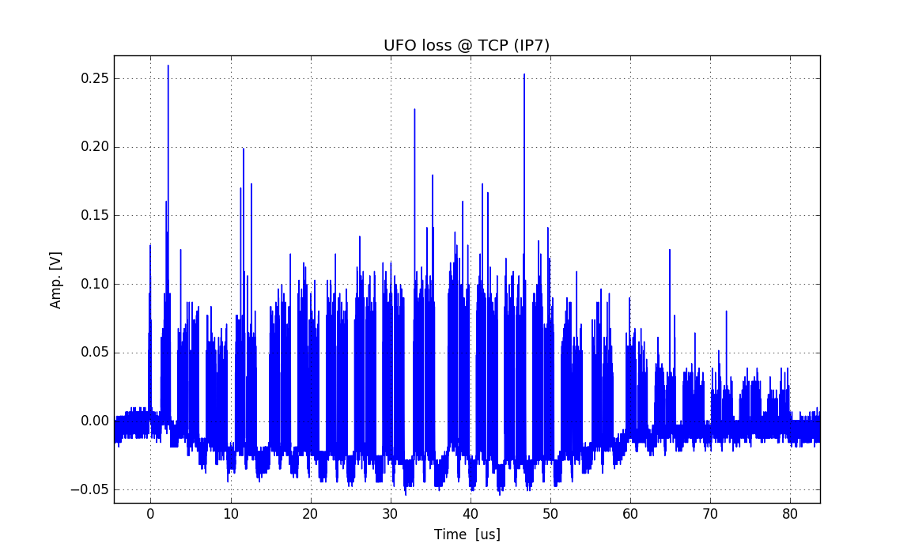
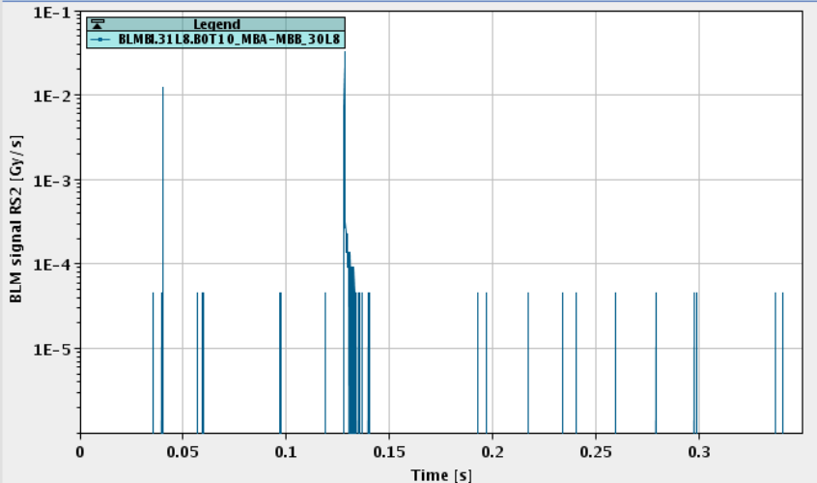
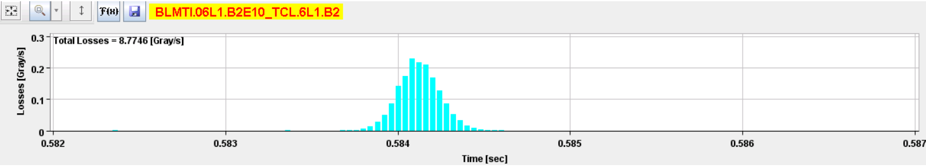
Beam UFO event study
Dust particles falling on to the beam creating fast beam loss (~ms)
  A few events with beam loss large enough to induce magnet quench
  Sometimes too fast to be dumped
UFO buster app
An UFO event seen by local IC BLM
shown in the post mortem BLM data
Waveform data of dBLM @B2 TCP during an UFO event
Data courtesy of O. Stein

Slide 17
dBLM data from 2016 LHC beams
LHC injection loss
Unidentified falling object (UFO) event
TCP beam scraping (beam halo population study)
LHC beam extraction

Slide 18
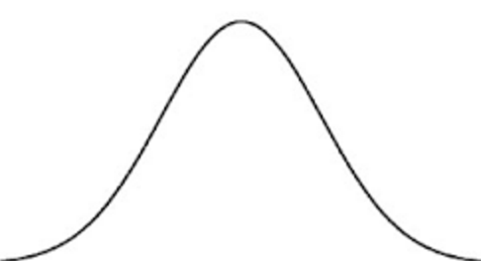
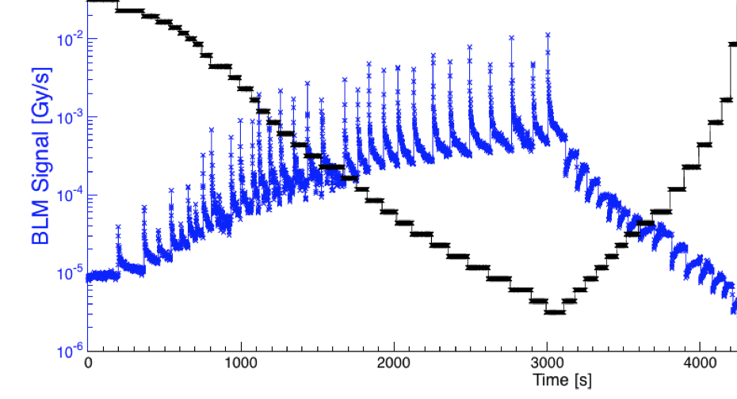
TCP scraping
The time evolution of losses during a collimator scan gives information on halo diffusion and population.
Collimator jaw position
IC BLM 100 Hz data
Courtesy of G. Valentino

Slide 19
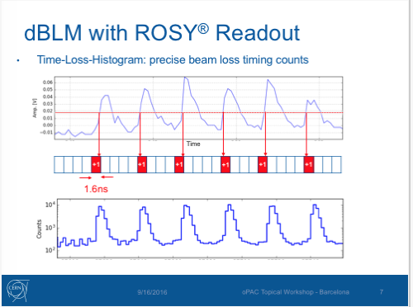
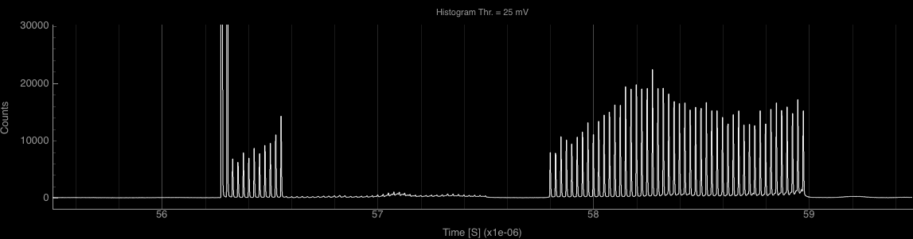
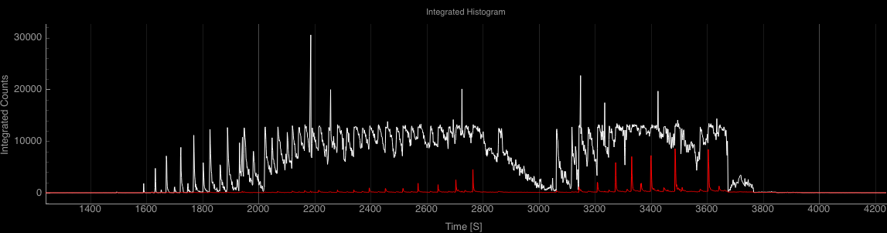
TCP scraping

Slide 20
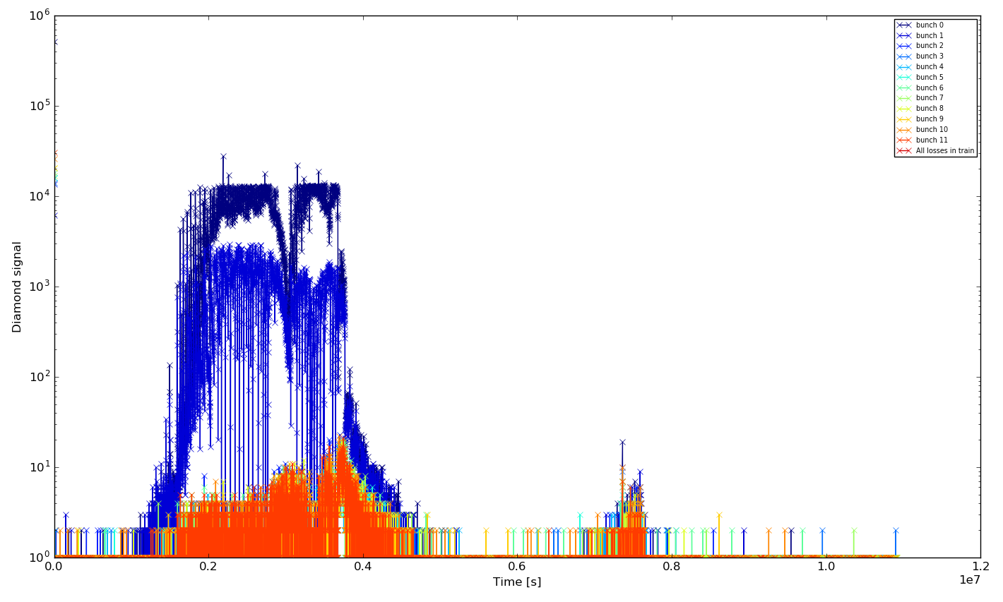
TCP scraping
1second/88.9us ~ 1.1e4 counts/seconds
Analysis of the waveform data is on going
Courtesy of G. Valentino

Slide 21
dBLM data from 2016 LHC beams
LHC injection loss
Unidentified falling object (UFO) event
TCP beam scraping (beam halo population study)
LHC beam extraction

Slide 22
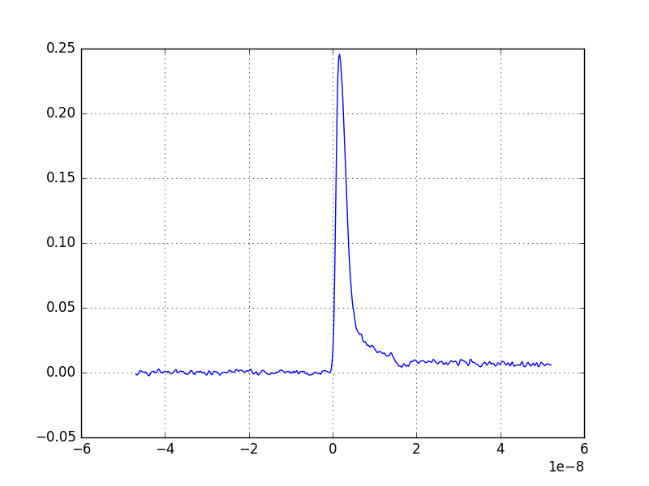
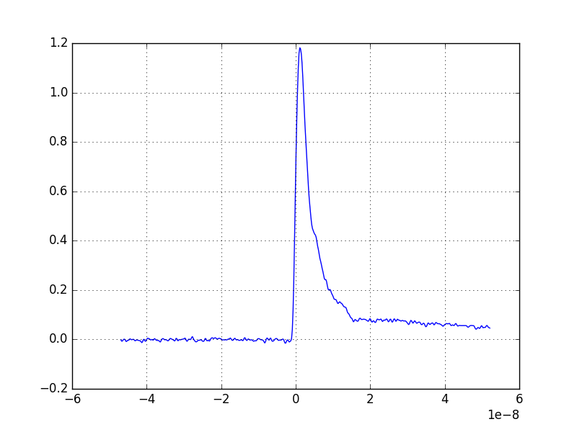
LHC Beam Extraction
TCDQ
Beam dump
LHC
TCDQ
Beam dump kicker
Estimate number of nominal bunches hitting the dump collimator in case of asynchronous beam dump
Preliminary results from a MD experiment (courtesy of M. Valette):
Pilot
(7e9)
Nominal (~3e10)

Slide 23
Summary and Outlook
dBLM can help resolving single bunch level beam loss signal
Good complementary to the LHC BLM system for beam loss diagnose
Work in progress for quantitative analysis (signal calibration & data processing tools)
Application-specific data acquisition and data logging
Thank you for your attentions !

