Slide 1

LA3NET Novel Accelerators Workshop, Paris 2016
Development of Diagnostics
for PW and multi-PW lasers
Jaroslav Moravec
FOTON, s.r.o.

Slide 2
LA3NET Novel Accelerators Workshop, Paris 2016
Why ? What ? Who ?
FOTON, s.r.o.
ELI Beamlines
PW diagnostics + Challenges
Institute of Physics, Prague
Bedrich Rus

Slide 3

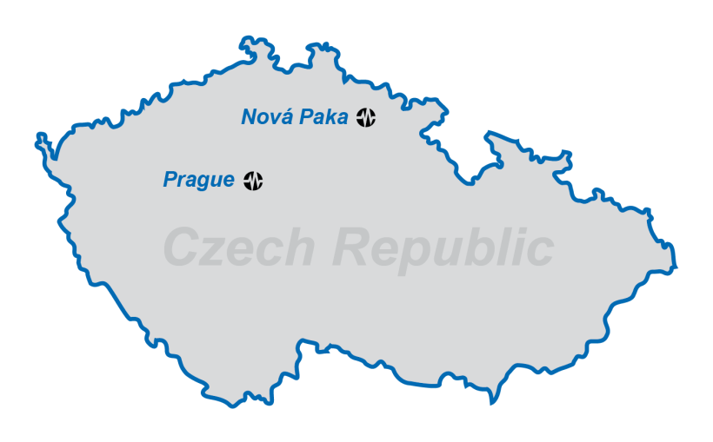

FOTON, s.r.o.
founded 2000
Czech private company (LTD)
Development and manufacturing of special electronic devices
Studénka 1
509 01 Nová Paka
Czech Republic www.fotons.cz

Slide 4
„From system design to k delivery of final product …”
Founded 2000
SME
PIC (FP7) : 968991880
Special innovative firm
R&D + manufacturing
Precision HV supplies
Micropositioning
Plasma diagnostics
Industrial control and measurement
Vacuum controllers
Design and development
Manufacturing
Testing
Installation
Service
Complex services for R&D

Slide 5
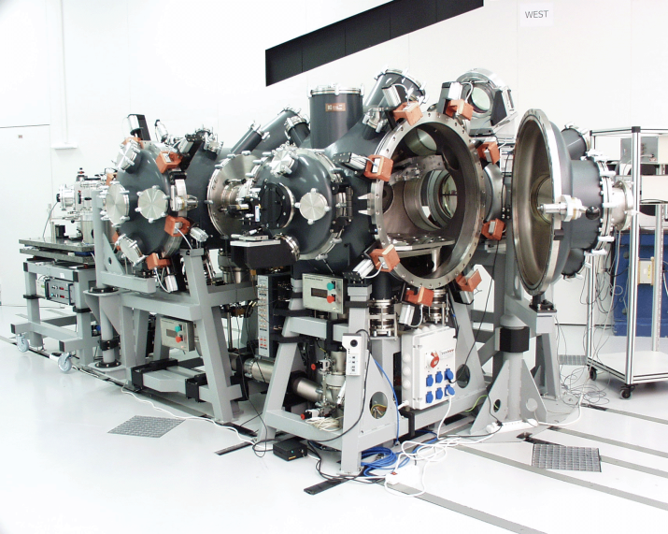
Company history
2000 FOTON founded, instrumentation for PALS
2001 X-ray laser instrumentation
2002 diagnostics for tokamaks
first high voltage supplies
Multidrive16
first exports
2007 Škoda Auto a.s.
2008 Joint Institute of Nuclear Research, Dubna, RF
2010 ELI – vacuum system
2011 LA3NET (Liverpool)

Slide 6
Products overview
nA-100s A uV-10s kV
uW-kW UV-IR
More than 140 prototypes during 15 years
High voltage supplies
Micropositioning
Optoelectronics
High temperature plasma diagnostics
Special systems
Current and voltage power supplies
Industrial control systems
Vacuum controllers

Slide 7
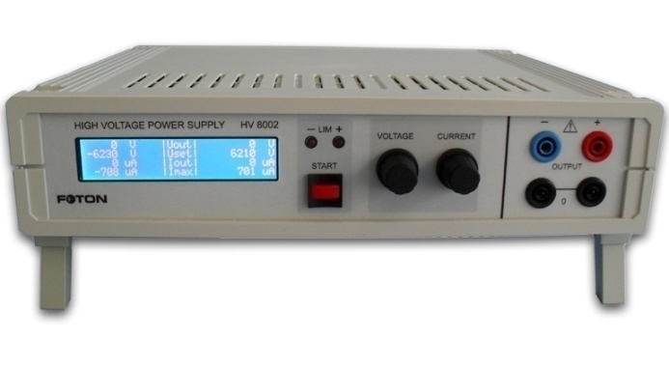
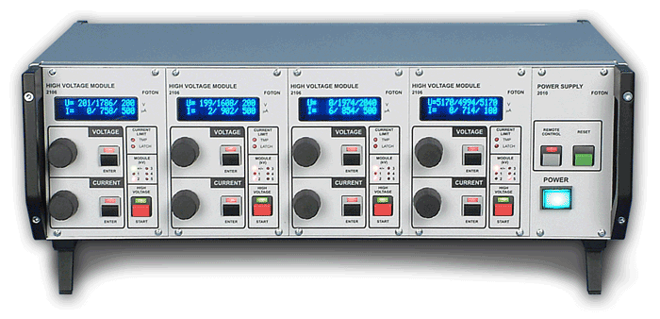
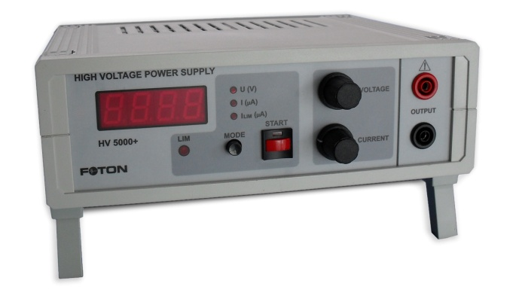
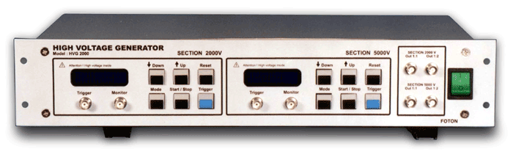
High voltage power supplies
Low – middle – high power, voltage up to 20kV (60kV)
HVS 04
HV 8002
HVG 2000
HV 5000+

Slide 8
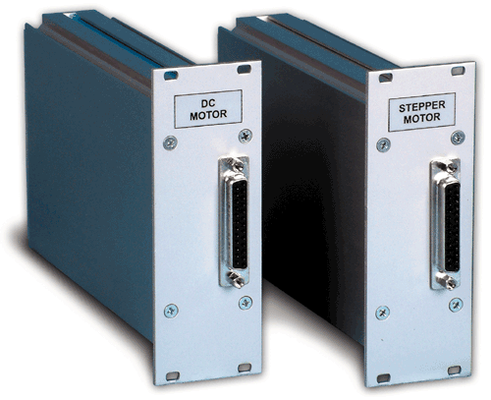
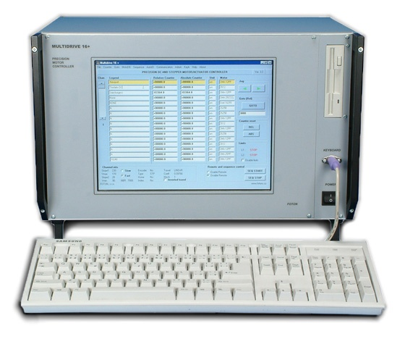
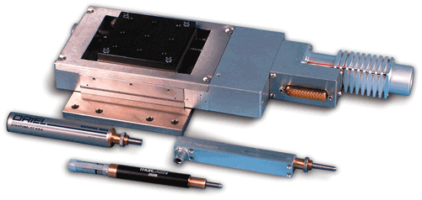
Micropositioning
System Multidrive 16+
Multidrive 16+

Slide 9
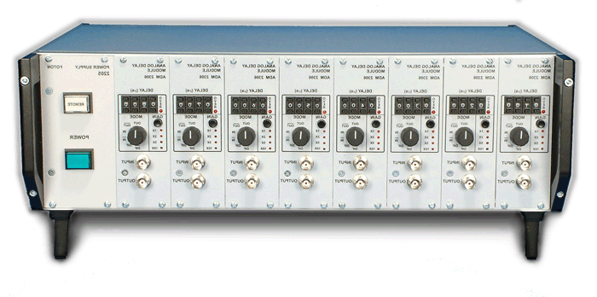
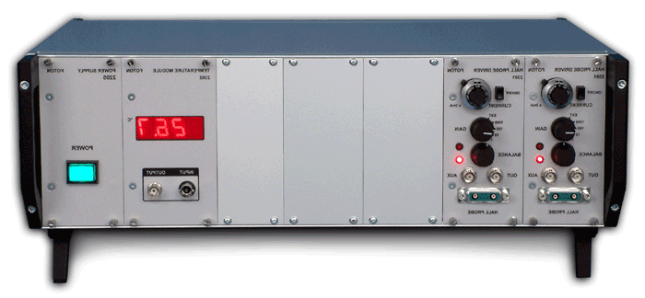
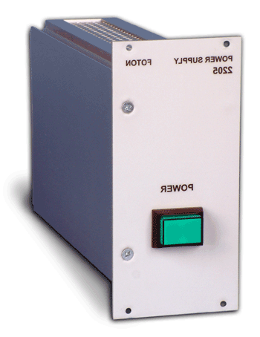
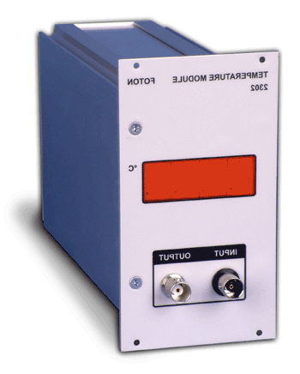
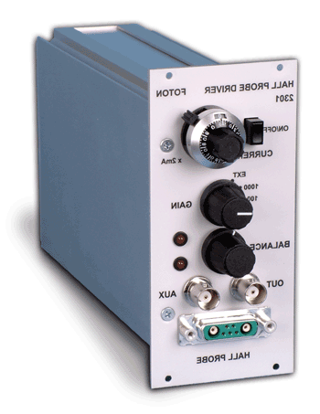
High temperature plasma diagnostics
Signal processing, generators and controllers for experiments
DLS 08
HPD 4.1

Slide 10
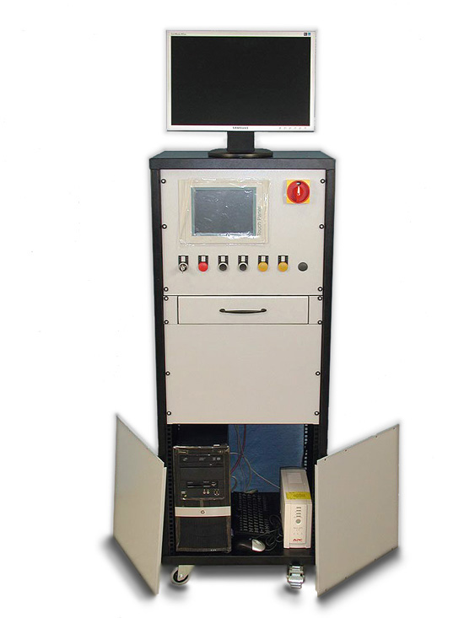
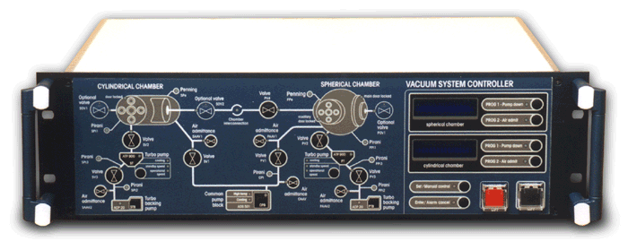
Vacuum control systems
High reliability control systems (HW, SW) for vacuum pumping
VCU 2000
ASU 2009

Slide 11
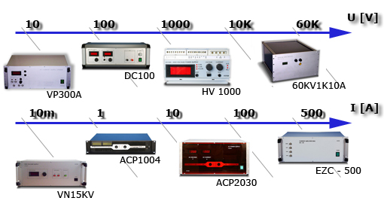
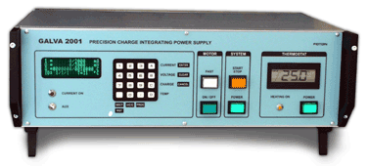
Voltage and current power supplies
DC – AC – waveform – programmable, up to 500 A, peak power 40 kW
Galva 2001

Slide 12
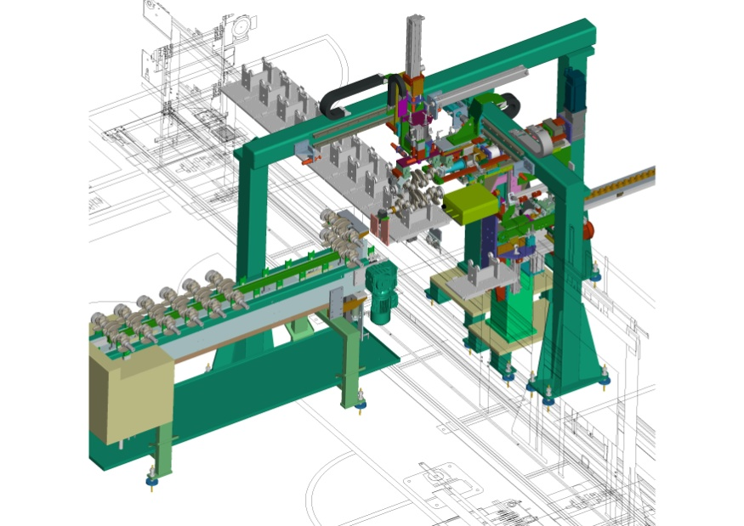
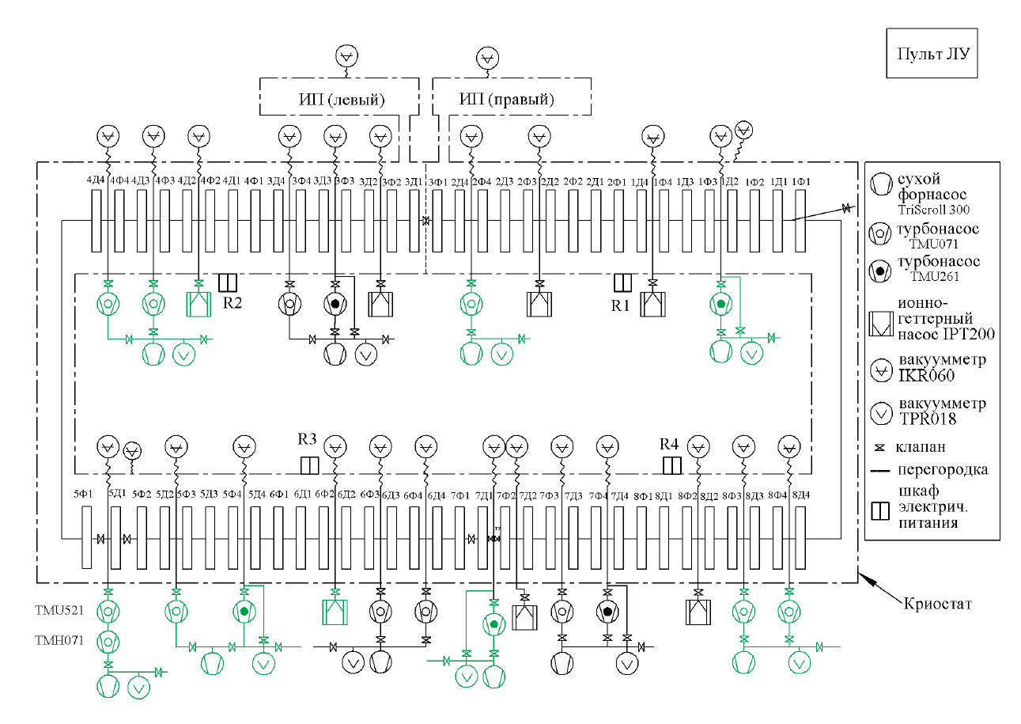
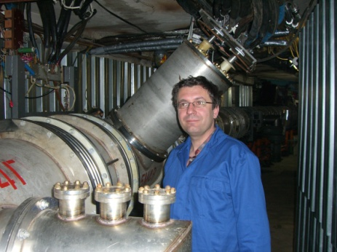
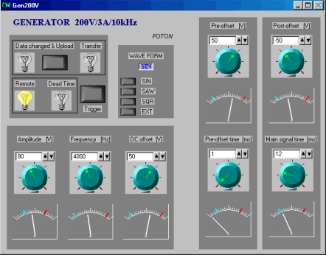
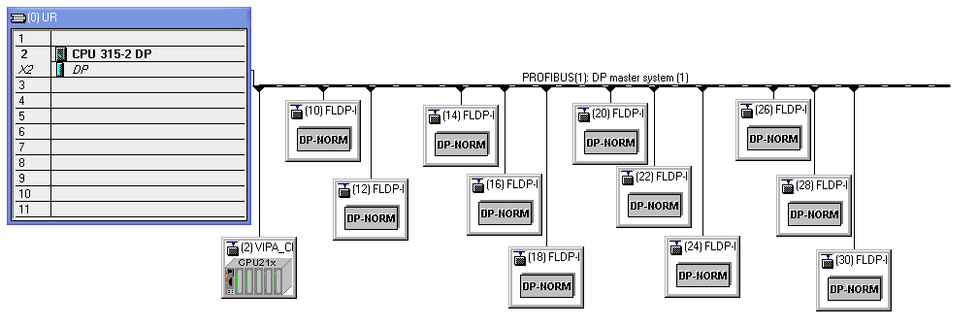
Automation and industrial process control
Industrial projects:
Large experiments:
Automatic pressure station
Particle accelerator

Slide 13
Do you need a solution ?
You know, WHAT, but you don’t know HOW?
Have you not power / capacity?
…contact FOTON

Slide 14
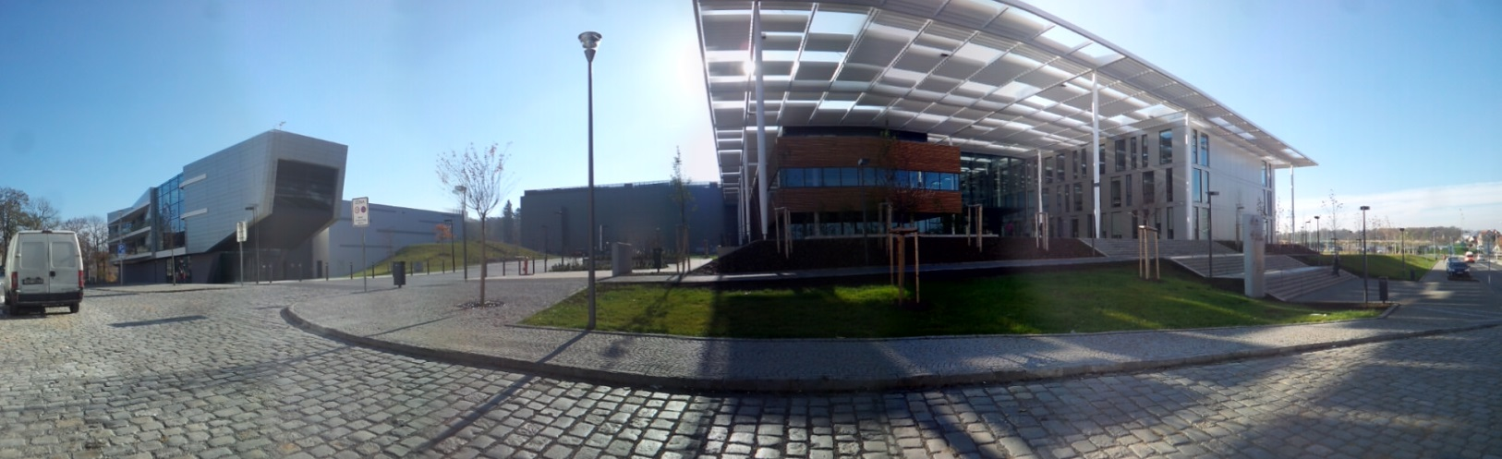
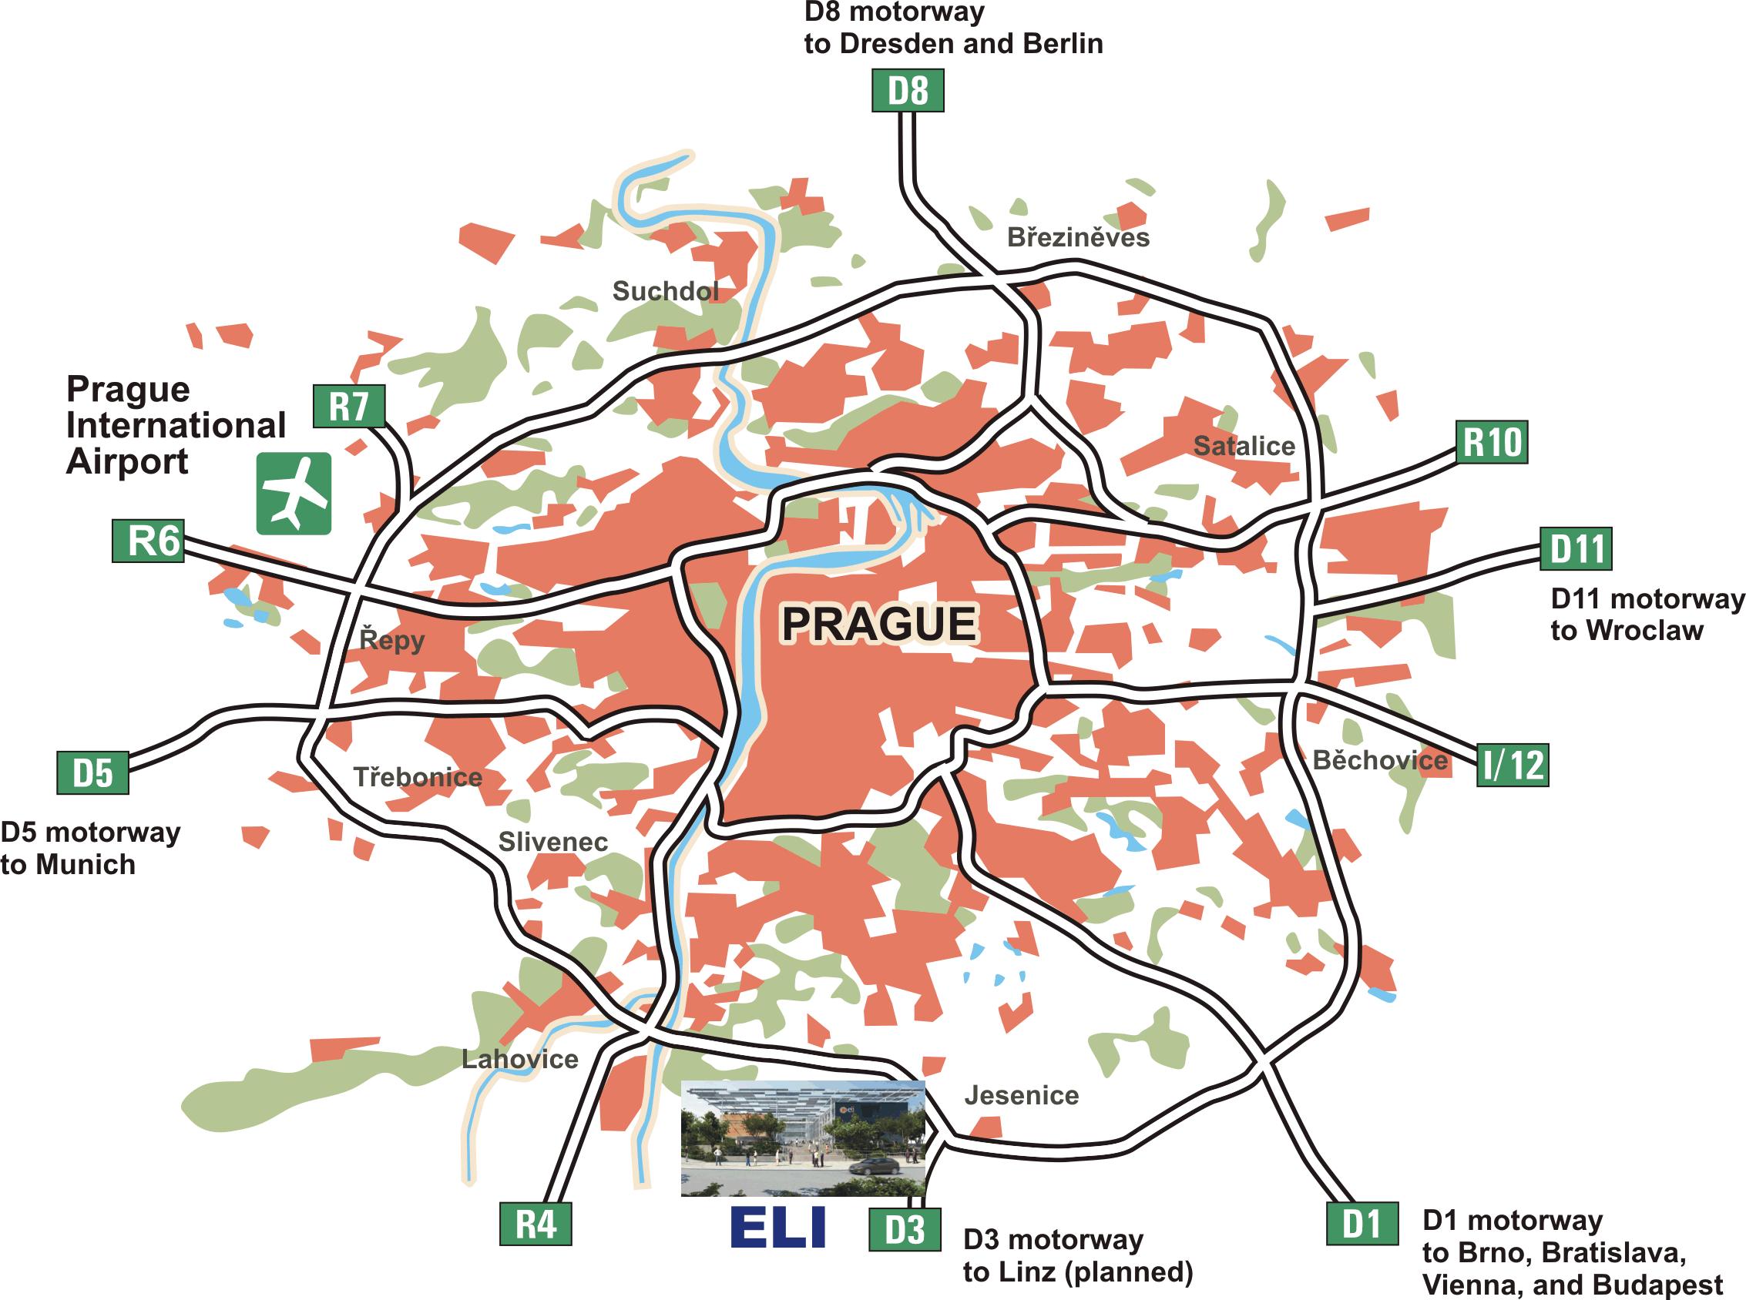
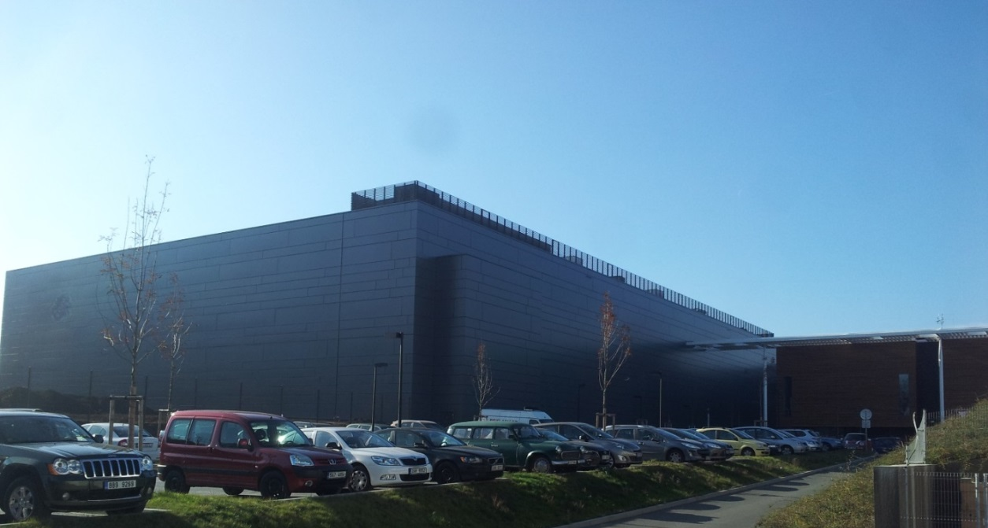
ELI-Beamlines: European laser research facility

Slide 15
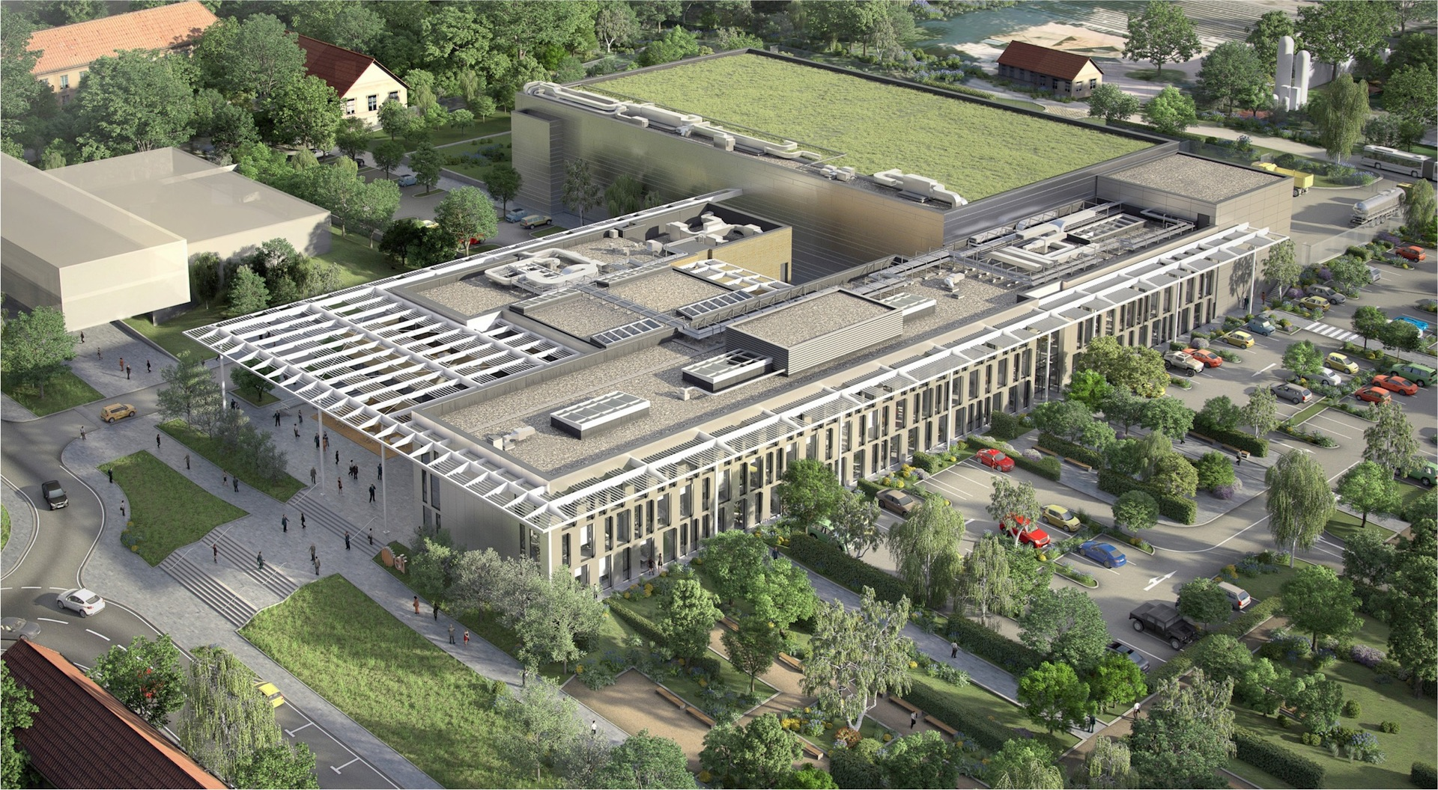
ELI-Beamlines aerial view – 2011 artist’s impression
Laser building
HiLASE
Laboratories
Offices and admin building

Slide 16
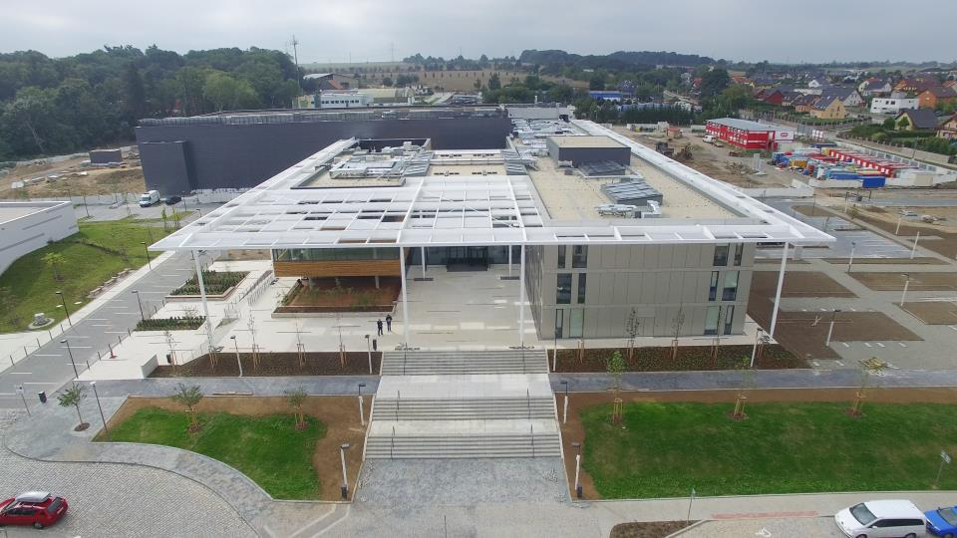
July 2015: building opened for technology installation

Slide 17
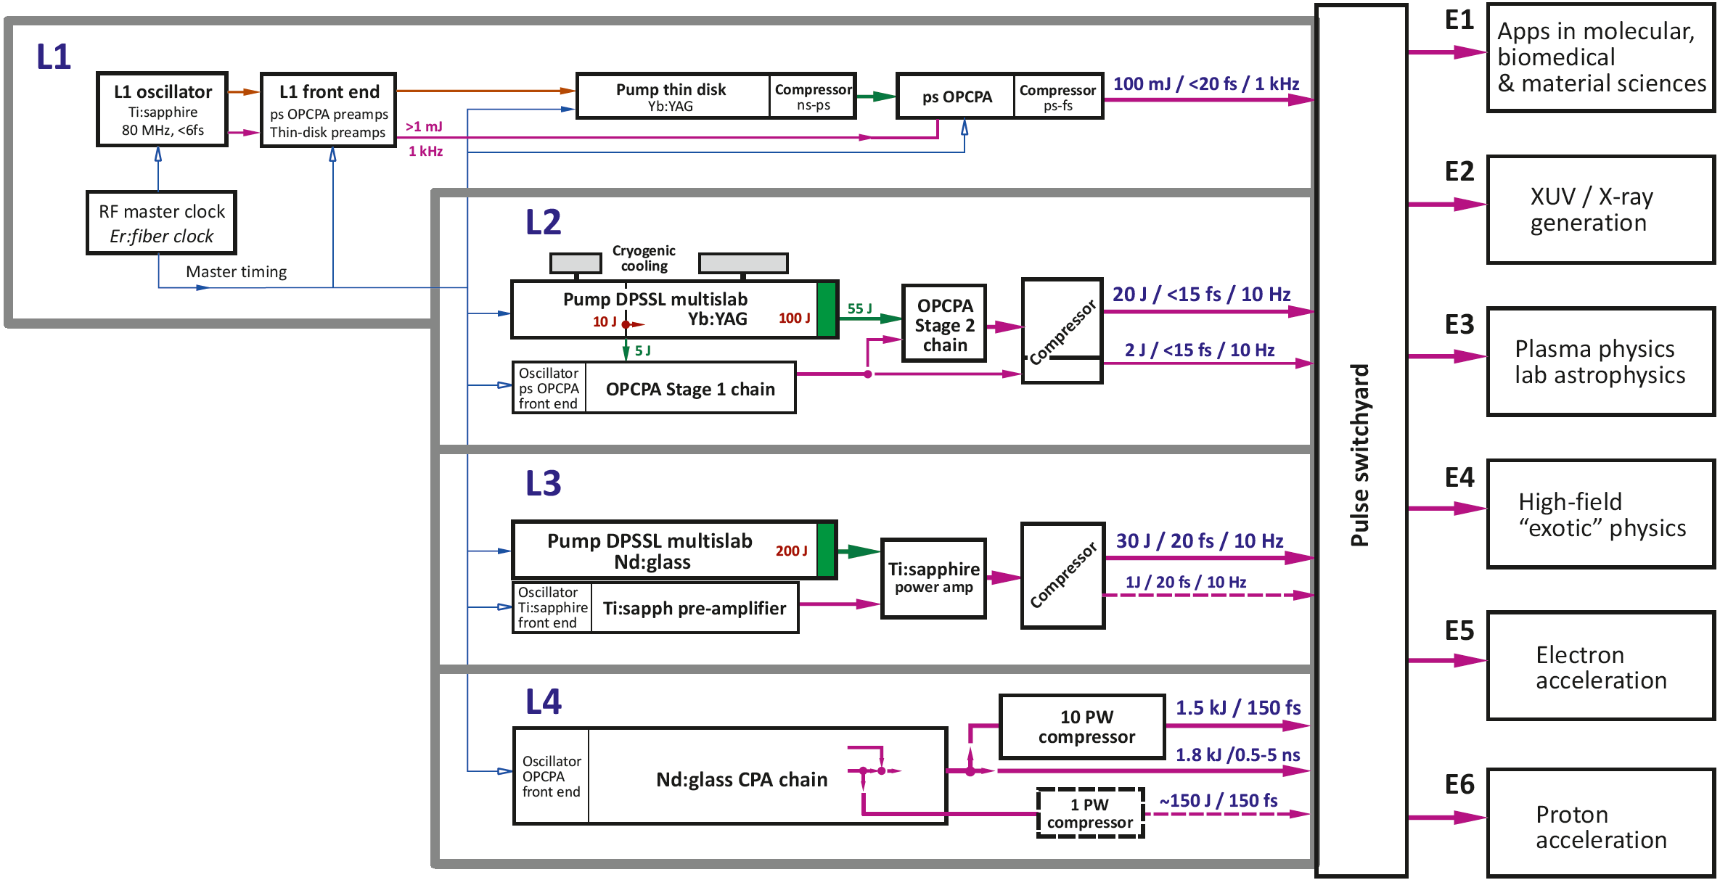
ELI-Beamlines master scheme: 4 laser systems

Slide 18
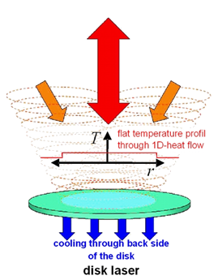
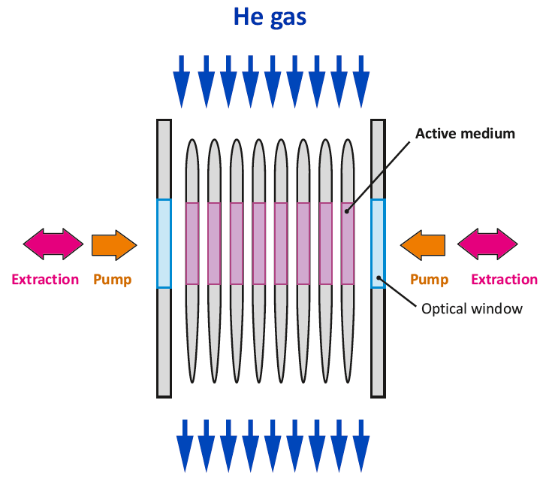
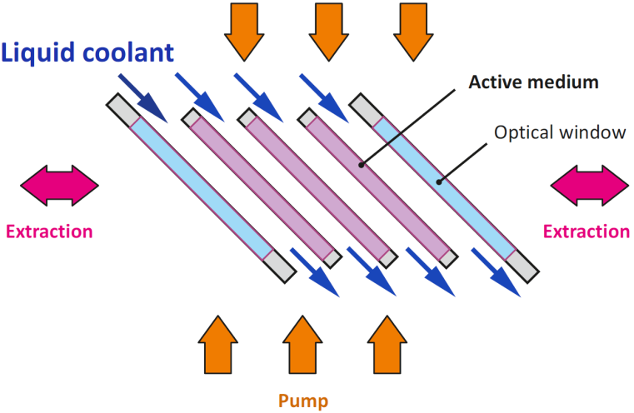
ELI-Beamlines will use new concepts of heat extraction from the laser gain medium to achieve high repetition rates
THIN DISK:
active mirror
≥kHz rep. rates
~kW average power
MULTISLAB:
face cooling by He gas
≥10 Hz rep. rates
> kW average power
MULTISLAB:
face cooling by liquid
up to 10 Hz rep. rates
High energy (>kJ) lasers
Courtesy T. Metzger (MPQ Garching)
Used in L1
Used in L2 and L3
Used in L4

Slide 19
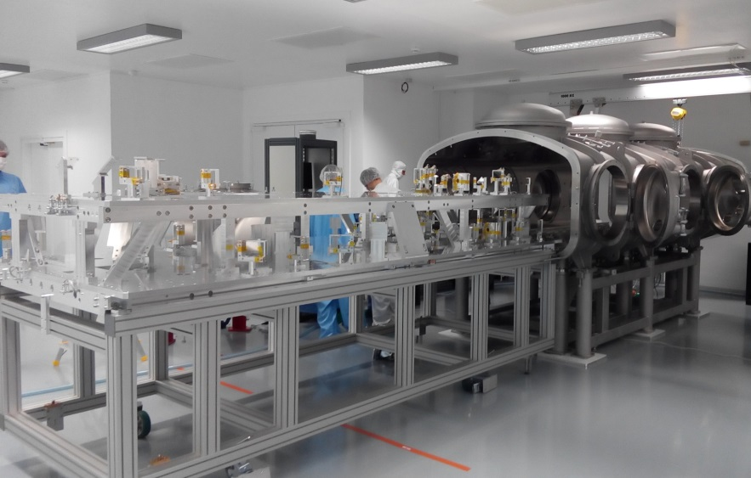
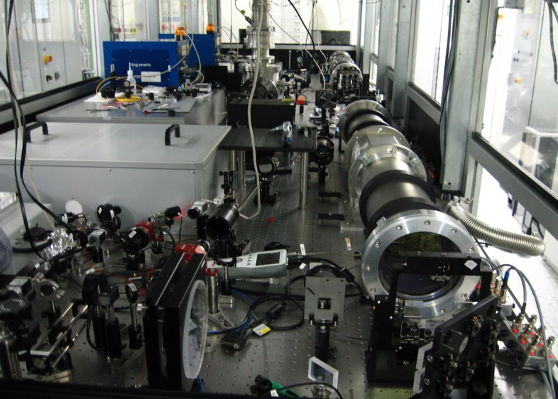
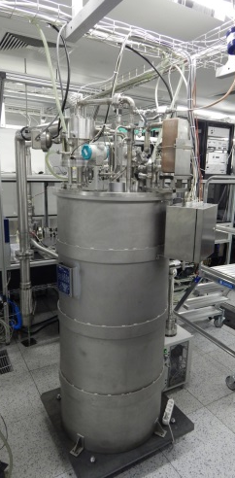
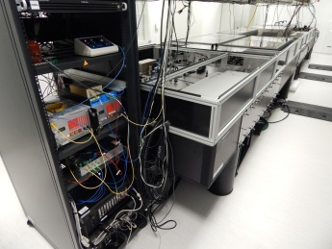
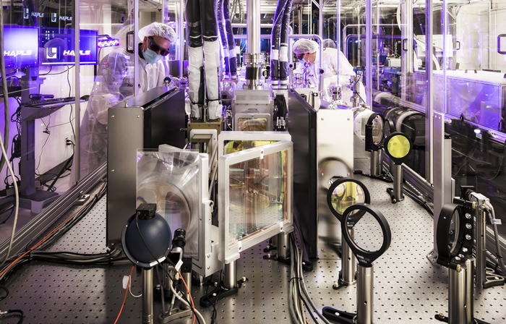
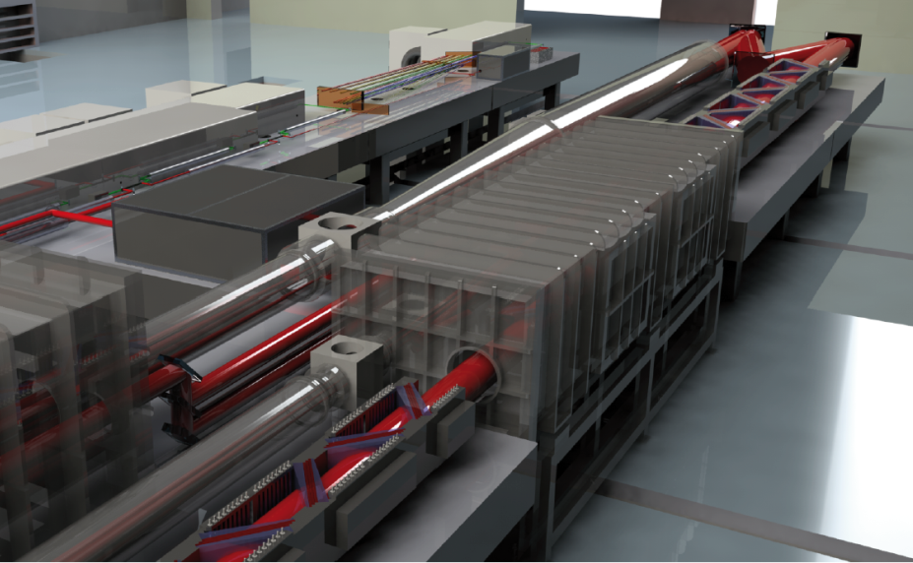
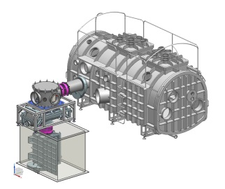
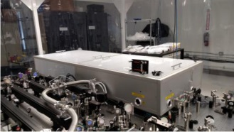
ELI-Beamlines laser systems: L1 / L2 / L3 / L4
L1
L2
L3
L4

Slide 20
ELI-Beamlines lasers: in-house development + suppliers
Beamline | L1 | L2 | L3 | L4
Peak power | >5 TW | PW | ≥PW | 10 PW
Energy in pulse | 100 mJ | ≥15 J | ≥30 J | ≥1.5 kJ
Pulse duration | <20 fs | ≤15 fs | ≤30 fs | ≤150 fs
Rep rate | kHz | 10 Hz | 10 Hz | 1 per min
Supplier | Pump lasers from commercial suppliers | External supplier / developer | Major contractor | Major contractor
ELI-Beamlines development | Short pulse chain developed in house | Specific technology development | Cooperative development of subsystems | Cooperative development of subsystems
 | Development of diagnostics of short pulse (15 fs to ps) laser pulses

Slide 21
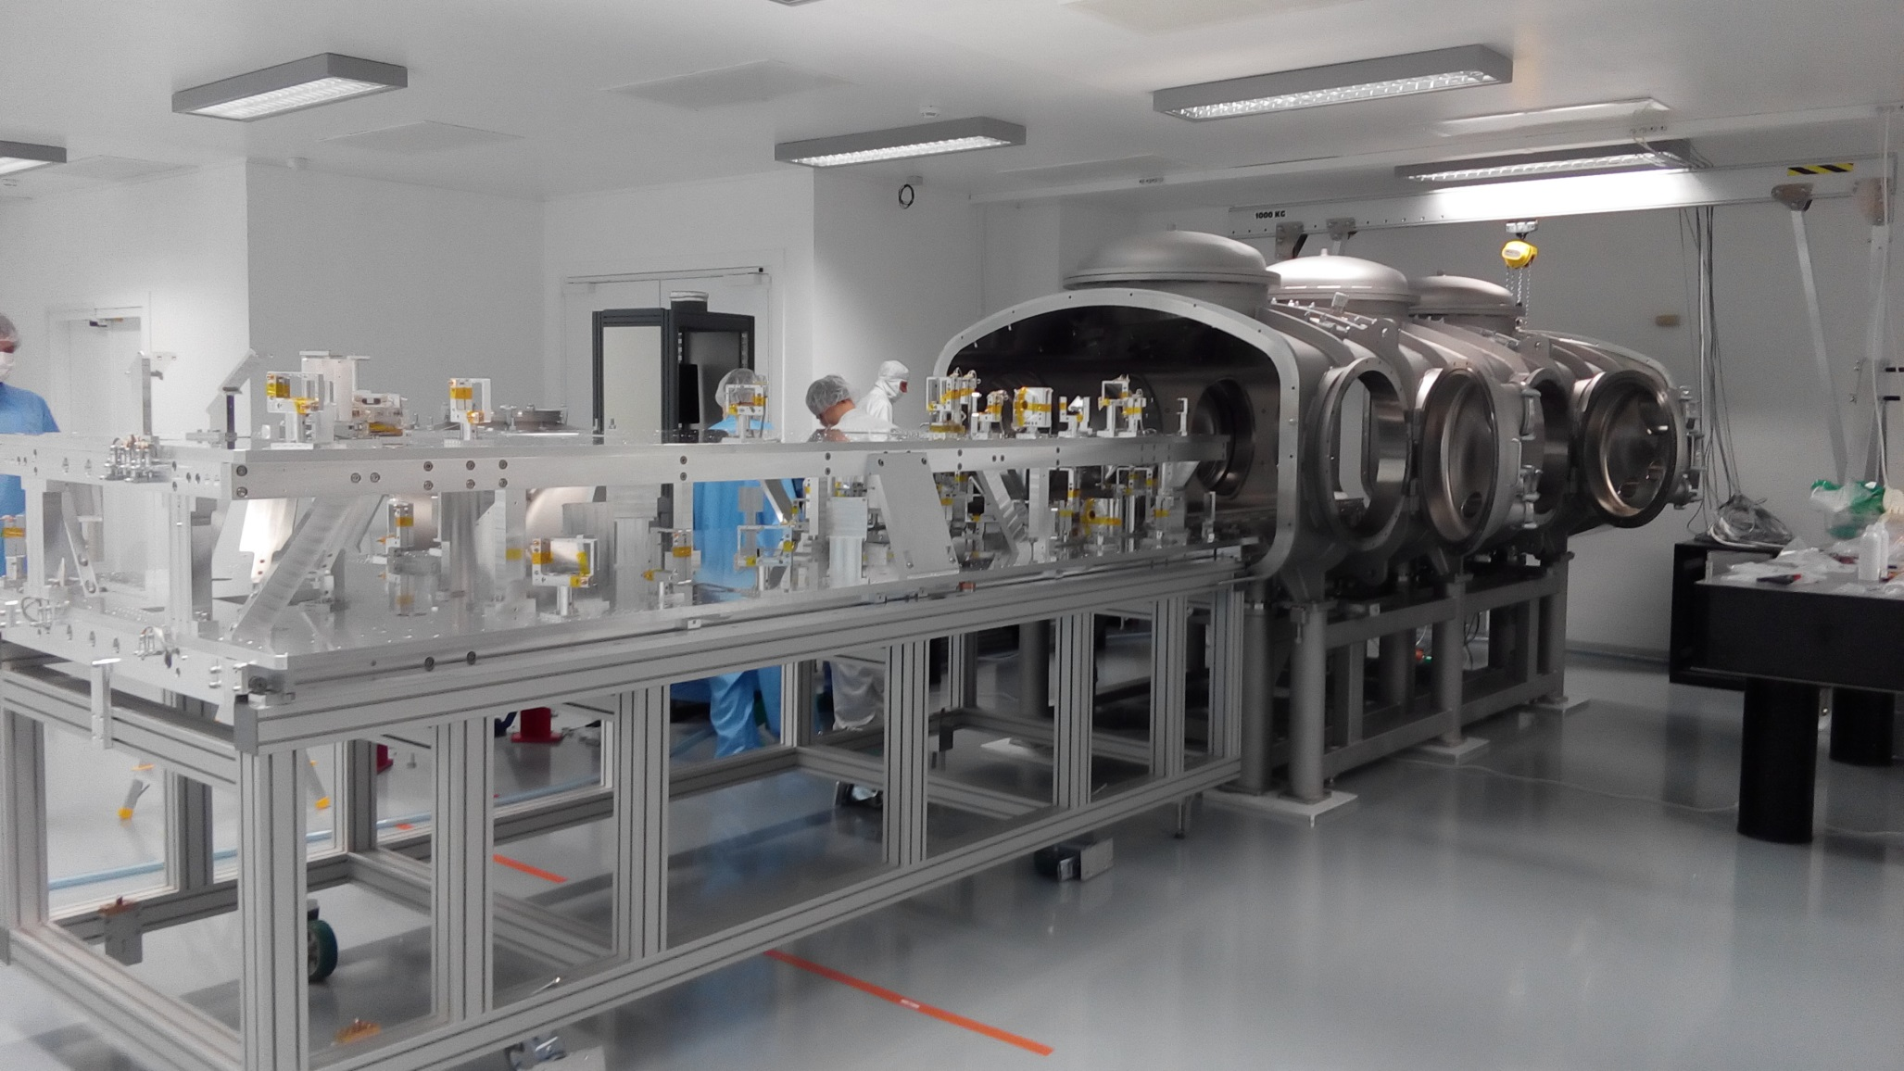
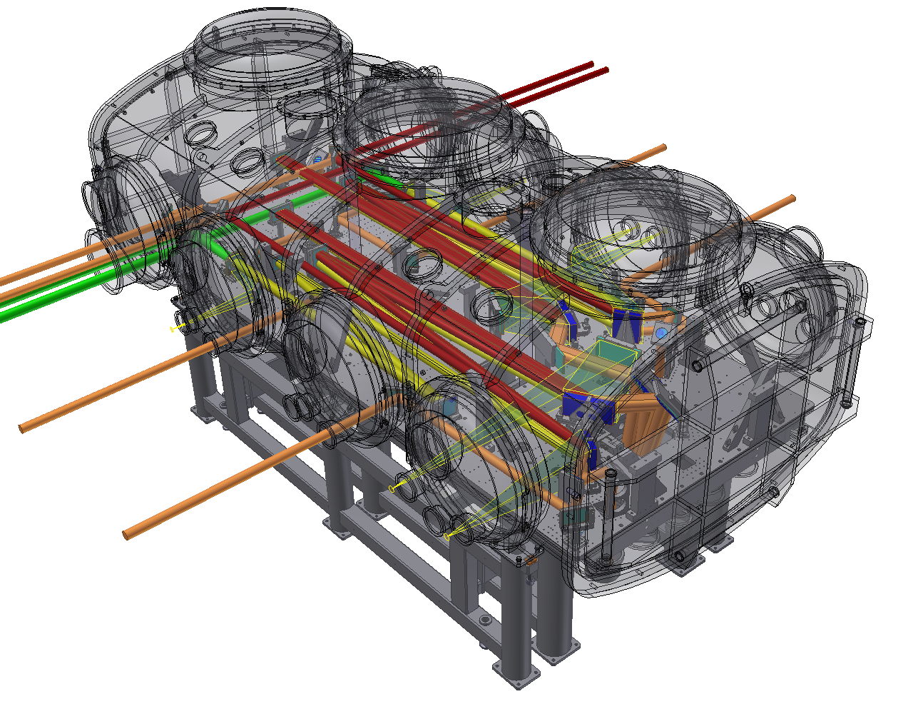
Example of ELI-Beamlines laser technology:
L1 picosecond compressor

Slide 22
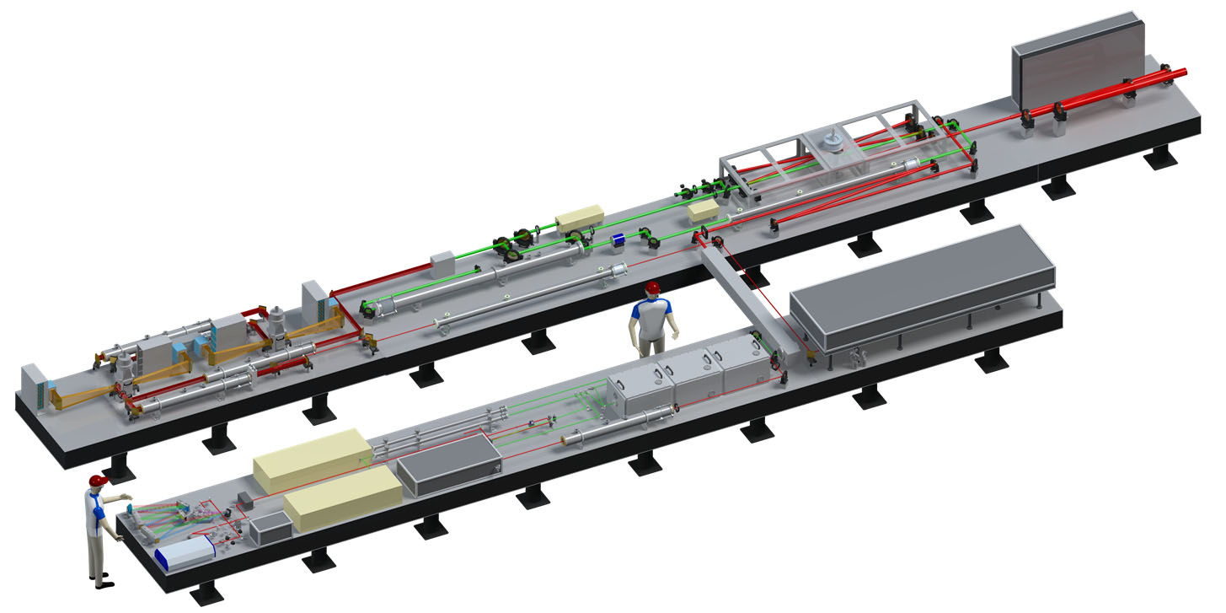

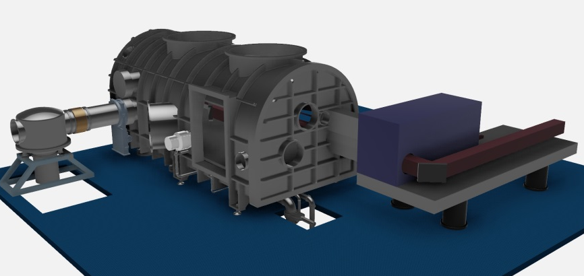
L3-HAPLS laser: cooperation with Lawrence Livermore National Laboratory (USA)
HAPLS = High Repetition Rate Advanced Petawatt Laser System
developed for ELI-Beamlines by LLNL
Ti:sapphire gas-cooled power amplifier
200 J / 10 Hz Nd:glass gas cooled DPSSL pump laser
Pump laser front end
Ti:sapphire pre-amp pumped by DPSSL
PW compressor
Short pulse diagnostics package (SPDP)
Front end: Ti:sapphire oscillator, stretcher, pulse cleaner, pre-amplifiers
PW compressor & diagnostics
developed by Inst. of Physics

Slide 23
Main challenges for development of PW laser diagnostics
High repetition rate
- The diagnostics must operate at high repetition rates (1 kHz for the L1 laser, and 10 Hz for the L2 and L3 lasers) and data has to be retrieved & stored
On-line measurement capability
- Laser pulse parameters have to be provided “on the shot”, i.e. without deviating entire laser output to the diagnostics (deviating of attenuated laser output to diagnostics is a widely used approach in current diagnostics)
- Diagnostics of the output laser pulses has to provide machine safety functions, e.g. stopping the laser if any early signs of damage of optics are detected
Automation
- The diagnostics package must be a “turnkey” system and must be integrated into control system of the laser
Reproducibility and reliability
- The diagnostics must provide same data over extended period of time, without need for readjustments and/or for realignment

Slide 24
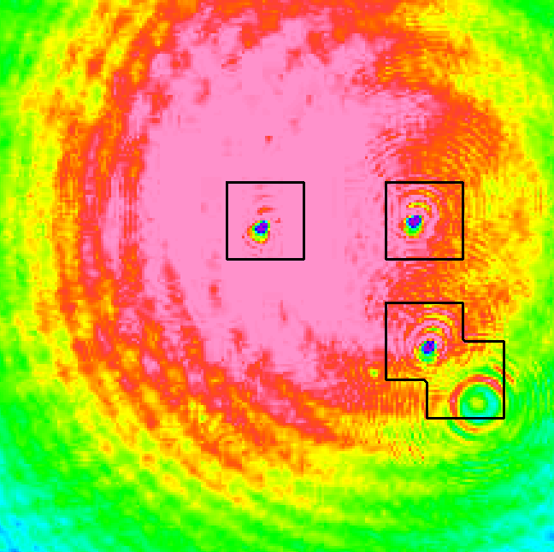
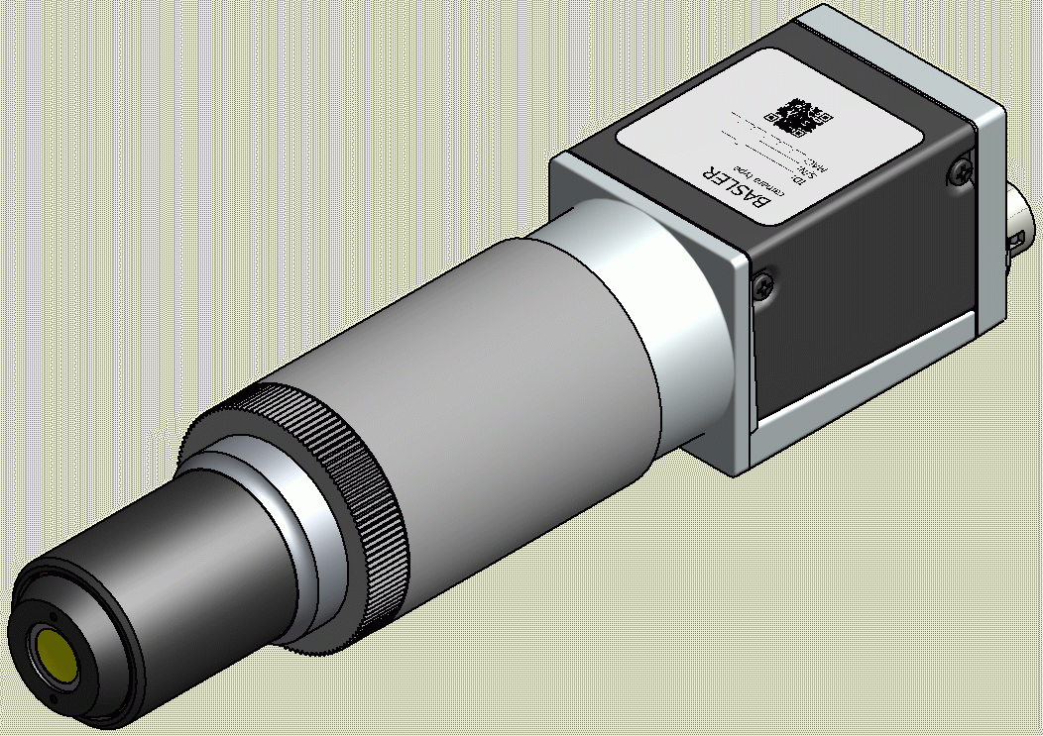
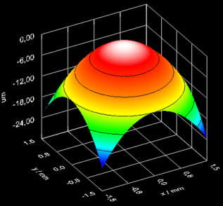
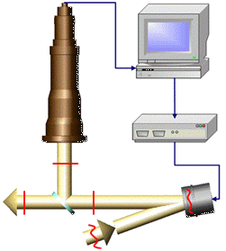

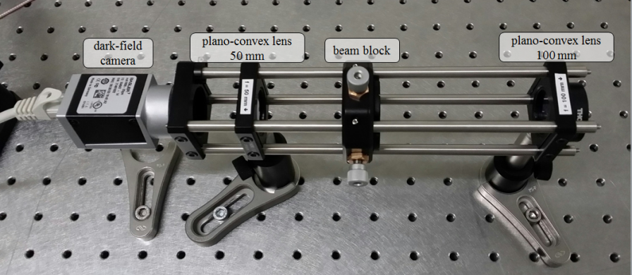
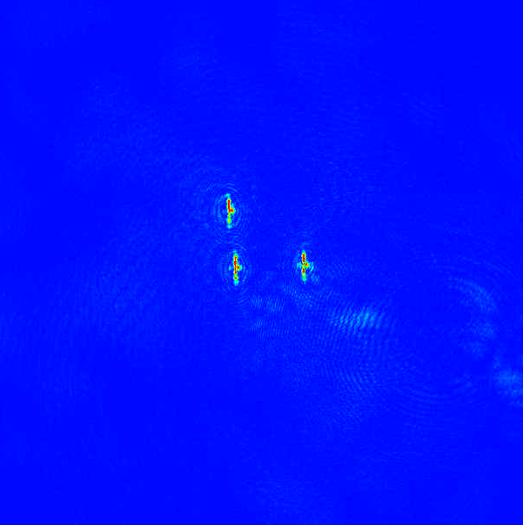






Example: automated spatial diagnostics developed
1) Near & Far field
+ Wavefront
Intensity profile
pointing, wavefront
Real-time
changes detection
2) Dark field
Real-time damage
detection
3 intentional
damage spots
3) Polarization
measurement
Spatially / spectrally resolved
polarization
detector:
25x25px
ND
λ/2
AOTF
CCD

Slide 25

Dark field image: automated beam spatial diagnostics

Slide 26




Temporal diagnostic: single-shot autocorrelator pulse length
Development of system with LabView real-time (LVRT) drivers and SW
Specifications
Pulse duration:
12-70 fs
Required energy:
>10 μJ
Resolution:
up to 1.7 fs (4.4 μm px)
Repetition rate:
up to 20 Hz
Attenuation:
fully variable (0-max)
Polarization:
linear
CCD camera
Nonlinear crystal
Delay line
Incoming beam
67 fs
raw data

Slide 27

Third-order autocorrelator (contrast measurement)
Development of core functions on LabView real-time drivers
& SW & library for processing
Specifications
Dynamic range:
>10¹⁰ (100 dB)
goal 10¹¹ (110 dB)
Scanning range:
up to 200ps
Required energy:
>100μJ
Repetition rate:
Slow - scanning
(depends on resolution)
Polarization:
linear
Incoming beam
BS
SHG
THG
PMT
Spher.
mirror
Delay stage

Slide 28

Example: Integrated short pulse diagnostic package
Temporal diagnostics
SHG autocorrelator (pulse duration)
SPIDER / Wizzler (pulse duration, spectral phase)
3rd order correlator (contrast measurement)
Spatial diagnostics
Near-field camera (beam profile, alignment)
Far-field (wavefront, alignment)
Wavefront sensor (wavefront )
Polarization module (spatially & spectrally resolved)
Dark-field (damage recognition)
Fully automated, 10 Hz real time operation
Signals for feedback and alignment
Pulse / beam diagnostics at the output of the final amplifier (before compression) and diagnostics of the compressed pulse
Power/energy, spectrum
Full aperture power meter (absolute meas. & calibration)
Pulse shot-to-shot energy (diode + integrating sphere)
Pulse optical spectrum

Slide 29








Diagnostics integration with laser control system
Diagnostics visualisation
Transition requests, operating mode
Trending, archiving, shot reports
Laser health monitoring
Laser HMI
Sequencer
Facility interface
Facility interface
Services layer
State & configuration control
Status & monitoring
EPICS Integration layer
Modbus network
Device layer
Real-time
embedded controller
RT node
Local post-mortem data buffer
Failure signals
I/O
FPGA
Camera-based diagnostics
FPGA
I/O
Machine protection
PLC
Critical and/or fast feedback is local to node
Analogue and digital I/O
Interlock permissions
Serial devices

