Slide 1


Developments of optical systems for X/gamma ray Compton machines at LAL

Slide 2
Outline
Compton Scattering
Standard Resonant Cavity (High average power, high rep. rate)
Resonant Burst Cavity (High peak power, medium rep rate)
Laser Beam Circulator (High peak power, low rep rate)
Notes:
I will present you the progress of Mighty Laser experiment
Limitations that we are confronted to
Then; next; later; afterward(s); subsequently
To begin

Slide 3
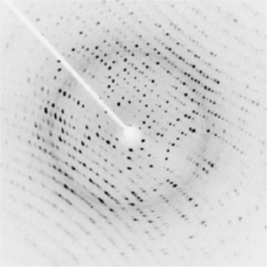
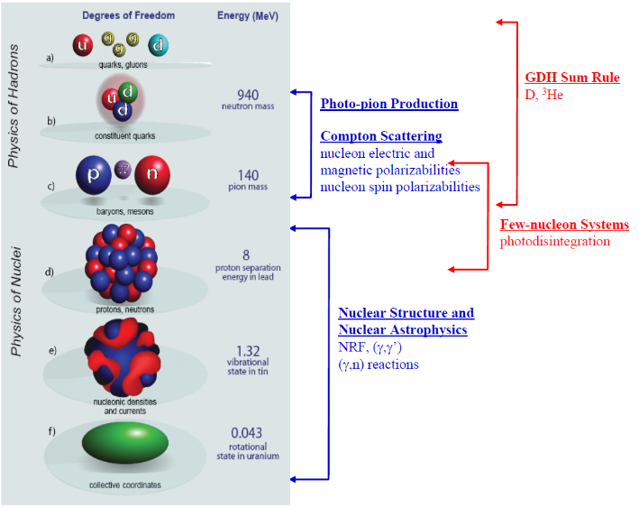
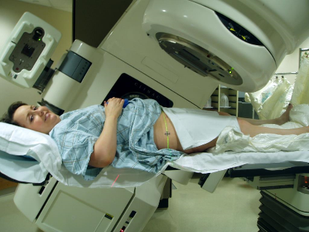
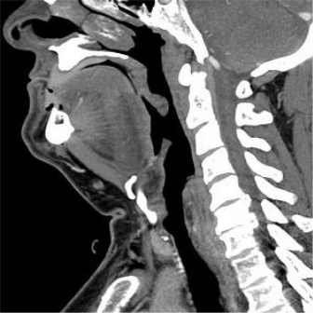
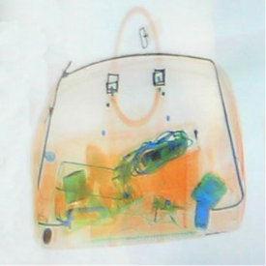
Applications
X-ray Imaging
Nuclear Physics
Radiotherapy
http://en.wikipedia.org/wiki/Radiation_therapy
http://en.wikipedia.org/wiki/X-ray
http://www.tunl.duke.edu/documents/public/higs2_prospectus_31aug2012.pdf

Slide 4
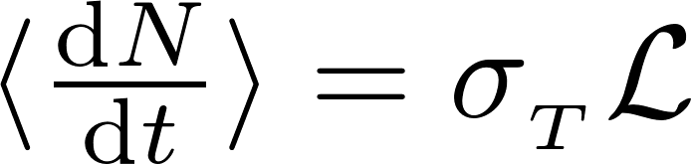
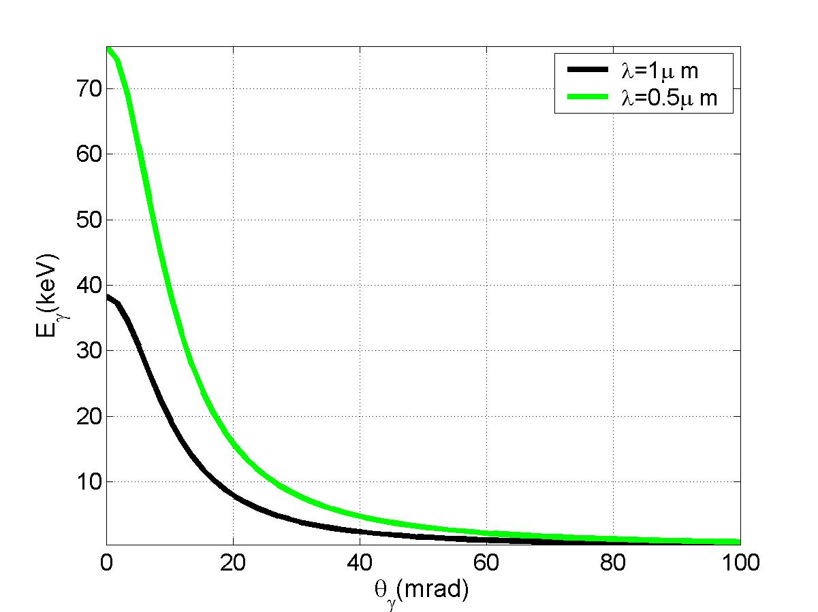
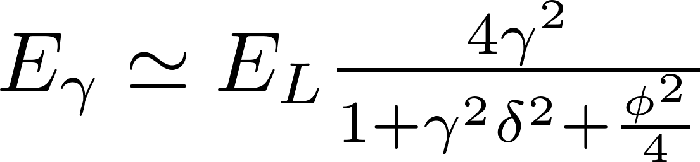
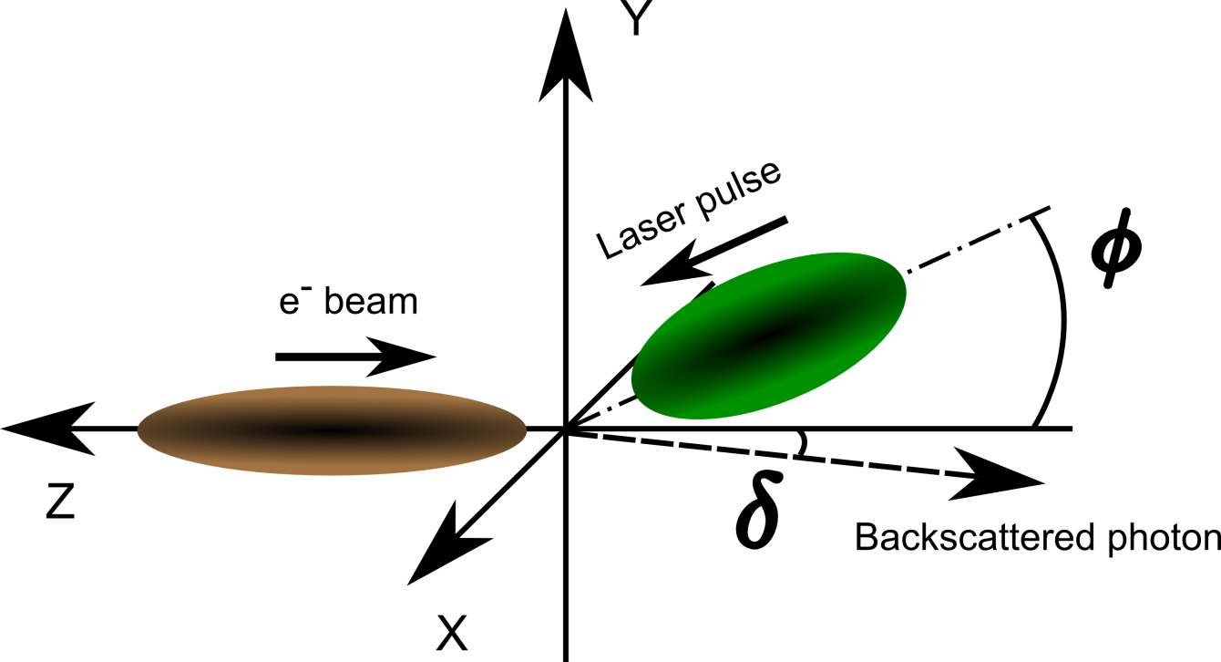
Compton Scattering
Cross-section ≈ physics
γ = 98
(E_{e} = 50 MeV)
luminosity ≈ geometry
E_{γ} (keV)
δ (mrad)

Slide 5
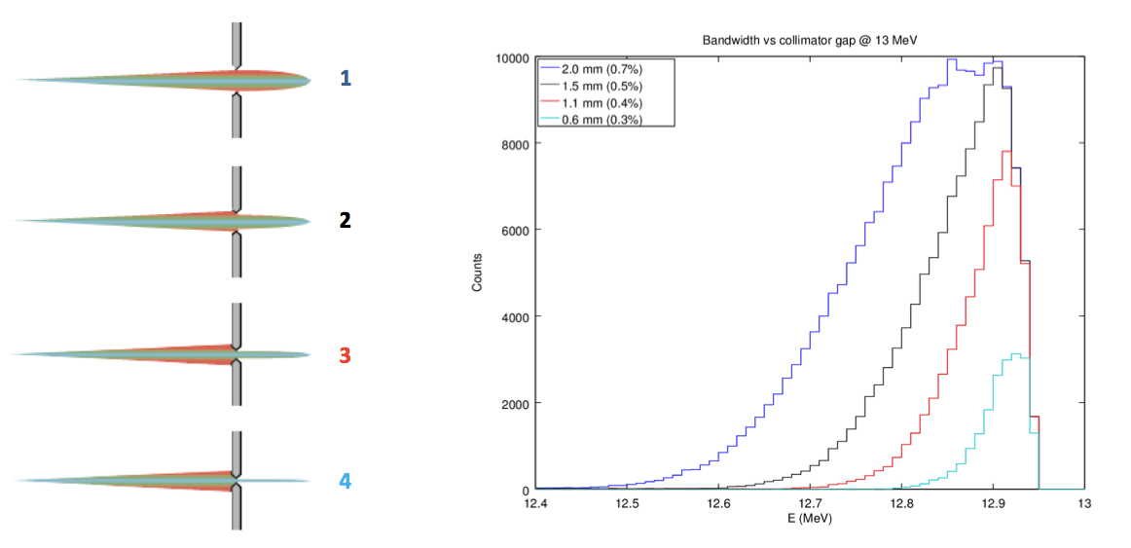
Compton Scattering properties
Electron beam
parameters
Laser beam
parameters
Nonlinear
effects
Angular acceptance
V. Petrillo et al., NIM A 693 (2012) 109–116
M. Gambiccini, P. Cardarelli et al. technical design meeting collimation and characterisation system review

Slide 6
Trade-off
Accelerator:
  ↑ bunches, electrons, rep. Rate
  ➔ ↓ beam quality (emittance, energy spread)
Laser:
  ↑ rep. rate
  ➔ ↓ peak power, ↑ average power
➔ Trade-off X-ray flux → X-ray bandwidth

Slide 7
Standard Resonant Cavity
(High average power, high rep. rate)

Slide 8
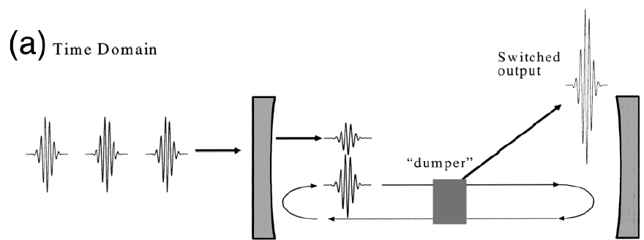
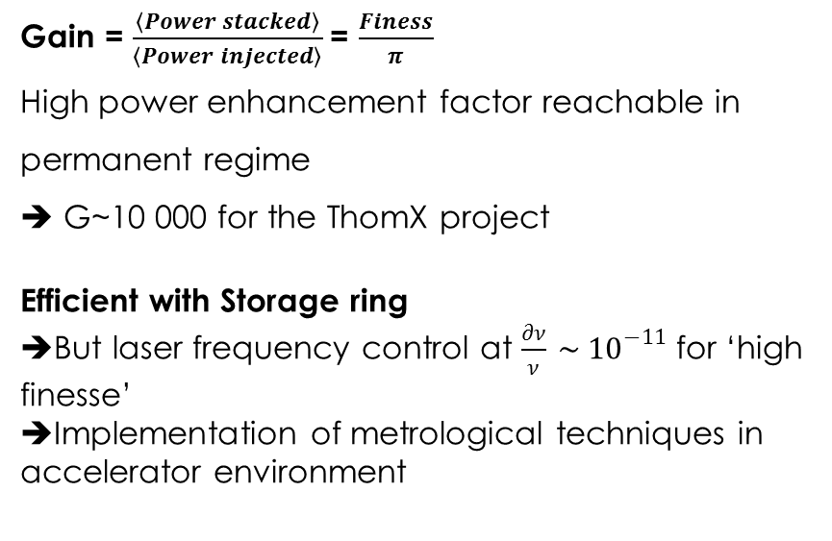
Optical Cavity
Electron beam
…
time
f_{rep}
Gain = $\frac{\left\langle Power stacked\right\rangle }{\left\langle Power injected\right\rangle }$= $\frac{Finess}{π}$
High power enhancement factor reachable in permanent regime
➔ G~10 000 for the ThomX project
Efficient with Storage ring
➔But laser frequency control at $\frac{∂ν}{ν} \sim {10}^{−11}$for ‘high finesse’
➔Implementation of metrological techniques in accelerator environment

Slide 9
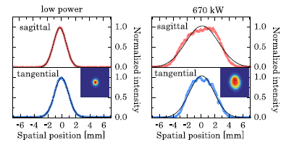
Stored Power
State of the art
LAL record
Cavity average power = 670kW@10ps ; 400kW@250fs
Laser + amplifier : 420W @ 250 MHz
Cavity enhancement factor ~ 2000
4-mirror high finesse cavity tested at KEK on ATF (1.3 GeV ring)
French-Japanese collaboration
➔100kW stored power
(before the earthquake)
Mirror surfaces degradation
➔ runs with 45kW at most
Carstens et al. Opt Lett 39 (2014) 2595
‘Huge’ average power can be stored inside the optical cavity
➔mirror thermoelastic deformations & damage
To further increase circulating power
Reduce fluence on the mirrors

Slide 10
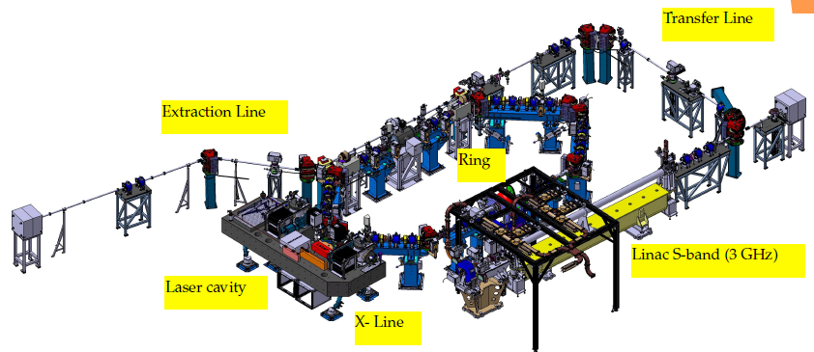
ThomX project
3 GHz gun and linac delivering 1 bunch of 1 nC at (50 or 70 MeV) every 20 ms (50 Hz)
The bunch is stored in a compact ring (Rev. Freq. ~17 MHz)
An Optical Resonant Cavity to store the laser pulse (max ~1 MW)
Up to 10¹³ photons/s (max energy 90 KeV)

Slide 11
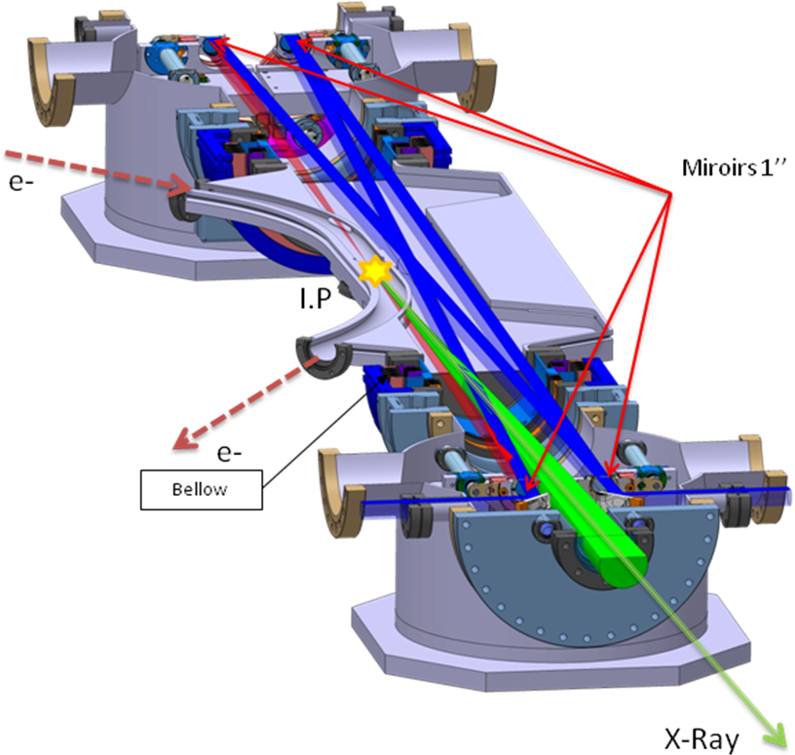
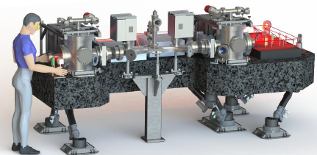
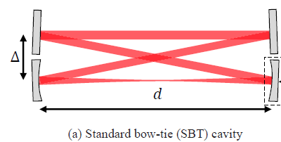
ThomX cavity
Parameters | Typical values
Laser repetition frequency | 33.3 MHz
Laser wavelength | 1031 nm
Cavity optical length | 8.994 m
Cavity finesse | 30 000
Cavity waist size | 70 µm
Injected power | 150 W
Circulating power | ~600 kW
Laser oscillator rep. rate & CEP locking

Slide 12
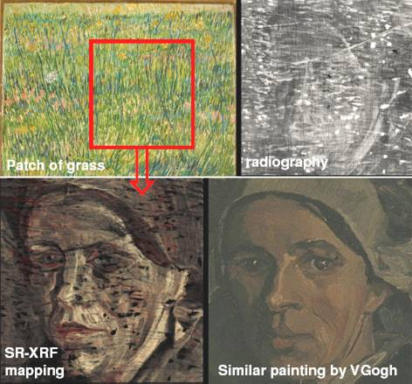
Painting / archeology analyses
‘K edge imaging’
Heavy chimical elements are
contained in painting pigments Characterised by K absorption edges
(Pb➔white, Hg➔ vermillion…)
of a Van-Gogh’s painting
X-ray attenuation
J. Dik et al., Analytical Chemistry, 2008, 80, 6436
http://www.vangogh.ua.ac.be/

Slide 13
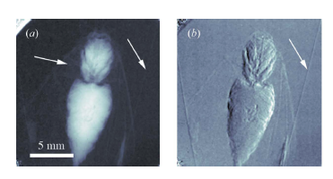
Phase contrast
1st Phase contrast image at Lyncean CLS
standard absorption
phase-contrast
[ Synch. Rad. 16, 2009, 43-47 ]
Proof of principle (long acquisition time, high dose, not soft tissues …)

Slide 14
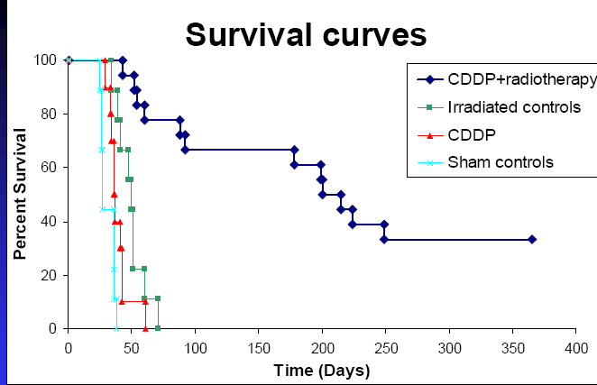
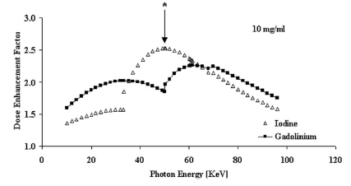
medical application as at ESRF (ID17)
Search for glioblastoms therapy
  Locate platinum (cisplatine) inside tumor cells (rat brains)
  Shoot with 78keV X-ray (platinum K-shell)
  Observed ~700% increase of life time
  Observed 34% survivals after 1 year …
  (Biston et al. Cancer reas.64(2004)2317)
X-ray imagery/therapy can also use contrast agent:
e.g. iodine (ongoing human trial at ESRF)
50 keV
But
relative to
water absorption
Adam et al Int.J.Rad.Onc.Biol. Phys.57(2003)1413

Slide 15
Resonant Burst Cavity
(High peak power, medium rep. rate)

Slide 16



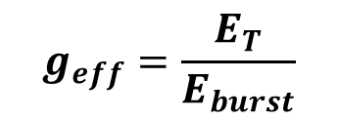
Optical Cavity
~100 Hz
Electron beam
…
…
…
time
~1000 pulses
Power
A simple continuous model
$$g_{eff}=\frac{E_{T}}{E_{burst}}$$
Cavity filling
Cavity decaying
$$E_{T}$$
Efficient with linac (low f_{rep})
➔But cavity maintain at resonance
➔Implementation of advanced techniques for locking
$$E_{burst}$$
t = 0
t1
t2
Time
e- bunch duration
Laser Burst duration

Slide 17
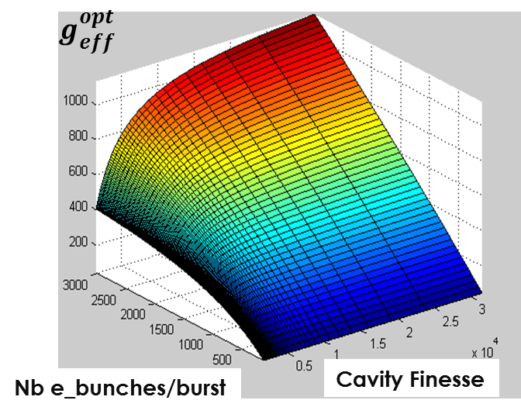
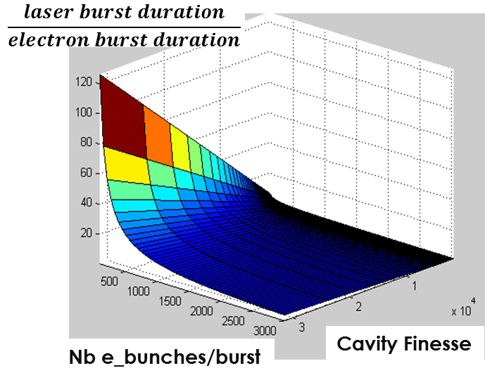
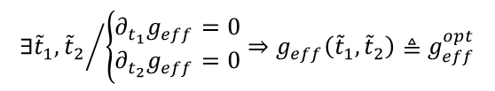
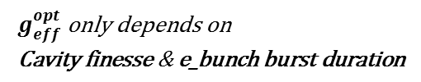
Stored Power
$$∃{\tilde{t}}_{1},{{\tilde{t}}_{2}}/{\left\{\begin{matrix}∂_{t_{1}}g_{eff}=0 \\ ∂_{t_{2}}g_{eff}=0\end{matrix}\right.}⇒g_{eff}\left({\tilde{t}}_{1},{\tilde{t}}_{2}\right)≜g_{eff}^{opt}$$
$$g_{eff}^{opt} \text{only} \text{depends} \text{on} \\ \text{Cavity} \text{finesse} \text{\&} \text{e}\text{_}\text{bunch} \text{burst} \text{duration}$$
Fine tuning of e_burst structure may lead to effective laser burst enhancement factor ~500

Slide 18
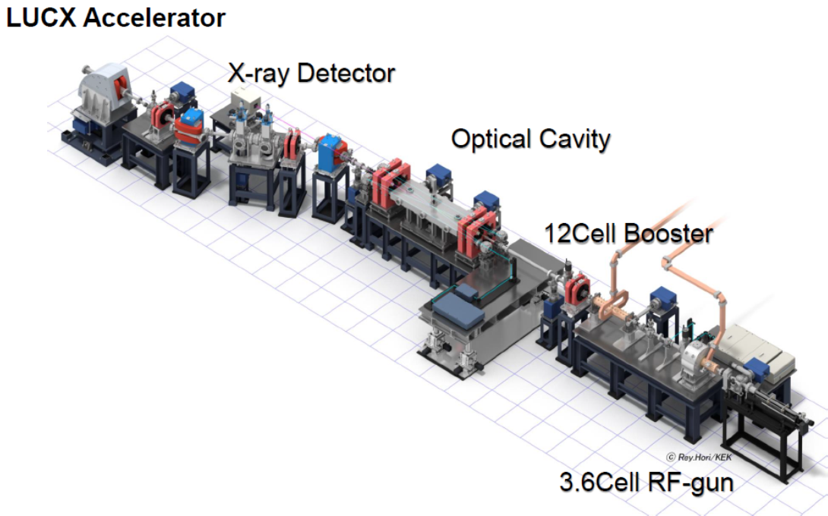
Experiments at LUCX

Slide 19
LUCX recent results
K. Sakaue, Development of a burst mode enhancement cavity for linac-based Laser-Compton source (LUCX), LAL meeting, 2016/03/24-25
K. Sakaue et al. NIMA637(2011)S107
M. Fukuda et al., IMPROVEMENT OF X-RAY GENERATION BY USING LASER COMPTON SCATTERING IN LASER UNDULATOR COMPACT X-RAY SOURCE(LUCX), to be published

Slide 20
Laser Beam Circulator
(High peak power, low rep rate)

Slide 21
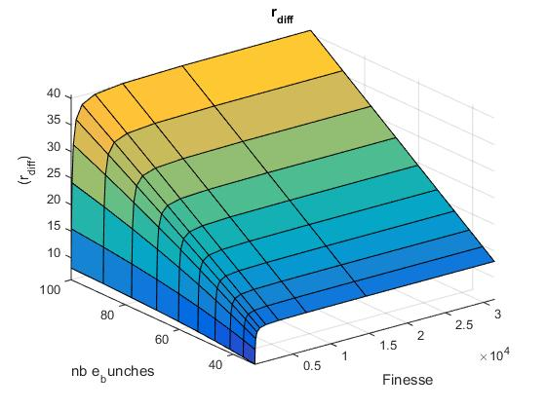
Resonant to non resonant cavities

Slide 22
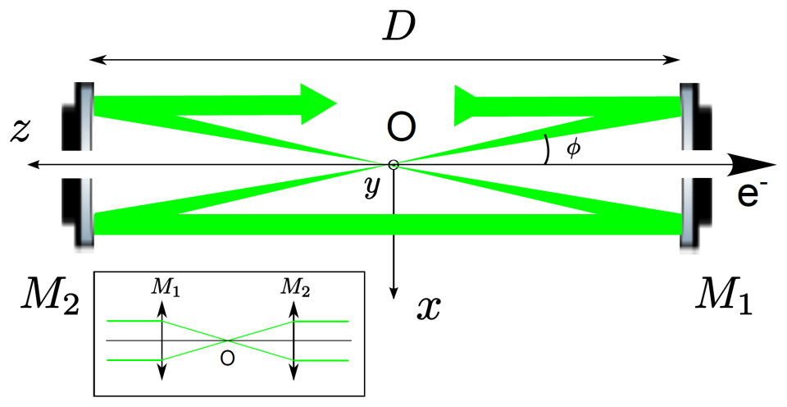
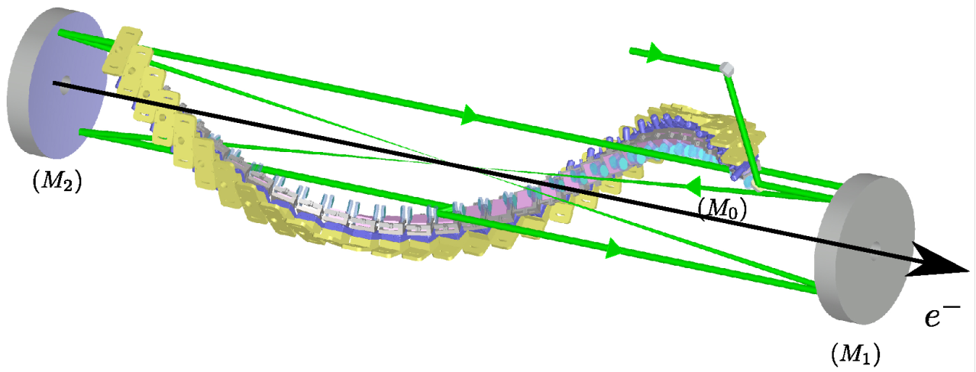




Optical system
Circulator principle:
2 high-grade quality parabolic mirrors ➔No spherical aberration
1 Mirror-Pair System (MPS) per pass ➔ Optical plan switching
➔ Constant Crossing angle + Unique Interaction Point
2D
Principle from:
“Dragon-Shape”
3D

Slide 23
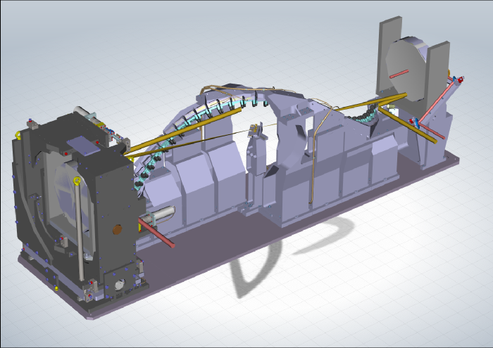
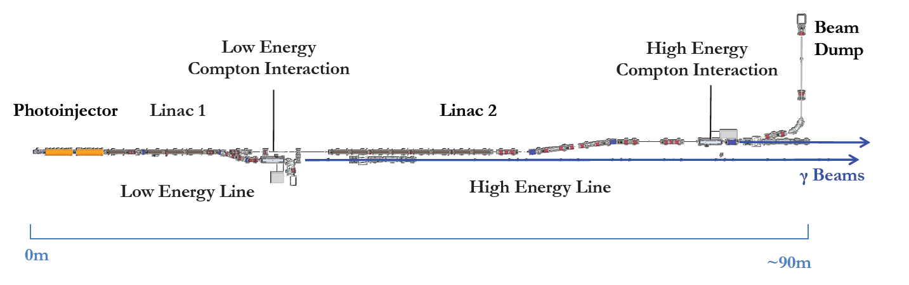

ELI-NP
Parameters | Value
Nb of passes | 32
Crossing angle | 8°
Corona radius | 166.2 mm
Waist size | 28.3 μm
Laser Energy / pulse | 400 mJ
Pulse duration | 3.5 ps
F_{rep} | 100 Hz
Equivalent Power | 1.28 KW
Laser 400 mJ
E_{e} ≈ 280 MeV
Laser 200 mJ
E_{e} ≈ 600 MeV

Slide 24
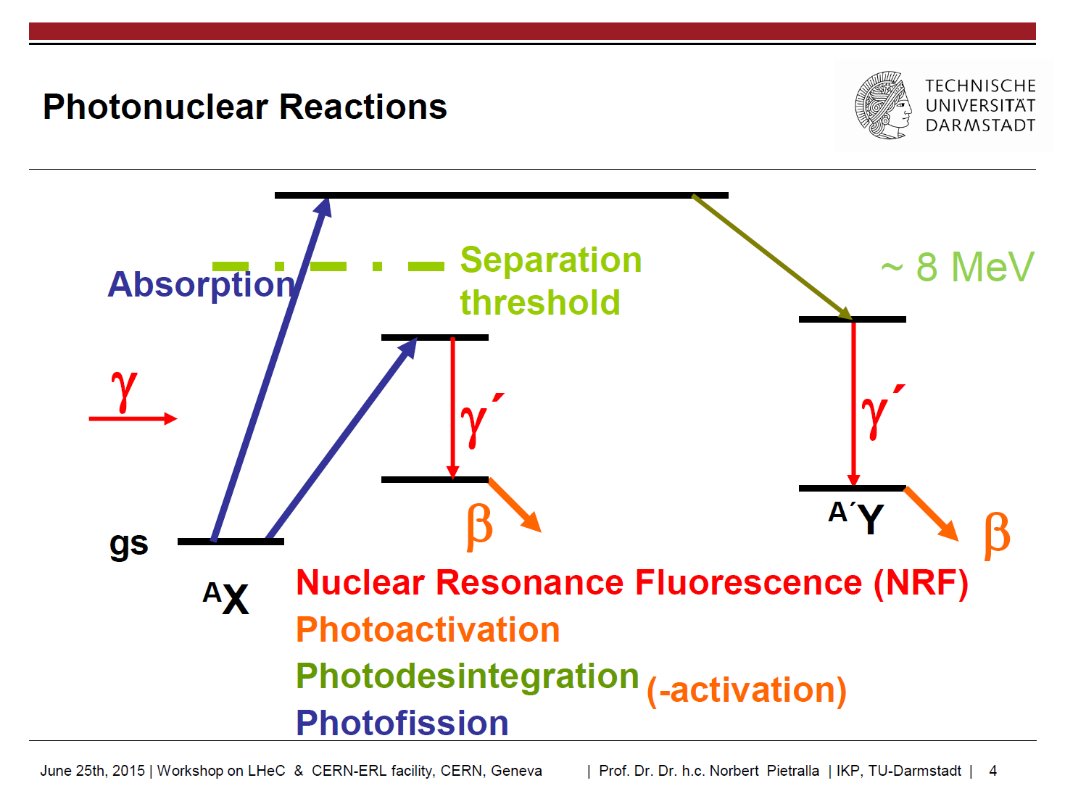
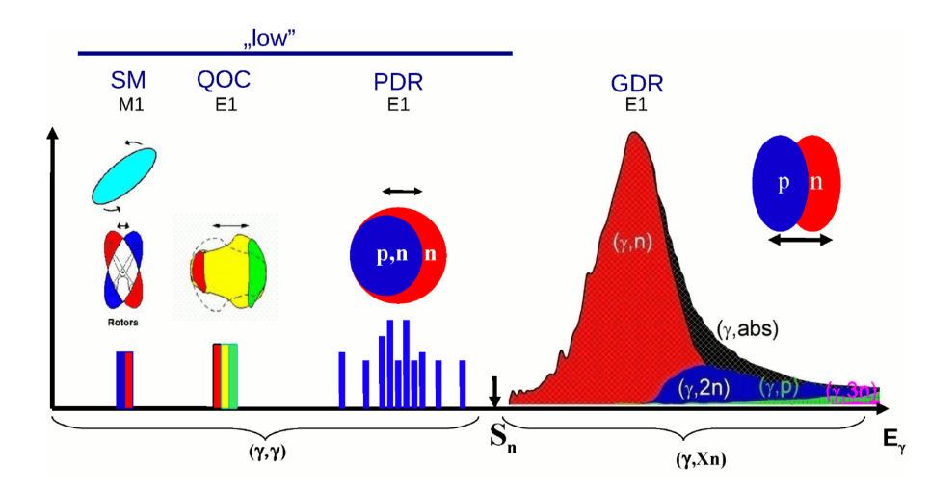

gamma-ray Applications
Gamma-beam specifications:
  Energies γ (E_{γ}) : 0,2 – 19,5 MeV
  Bandwidth (ΔE/E) : <0.5%
  Spectral density (TASD) : >5000 γ/(s.eV)
  Linear polarization: >95% + switching
~8 MeV
~30 MeV
AIP Conference Proceedings 1462, 177 (2012)

Slide 25
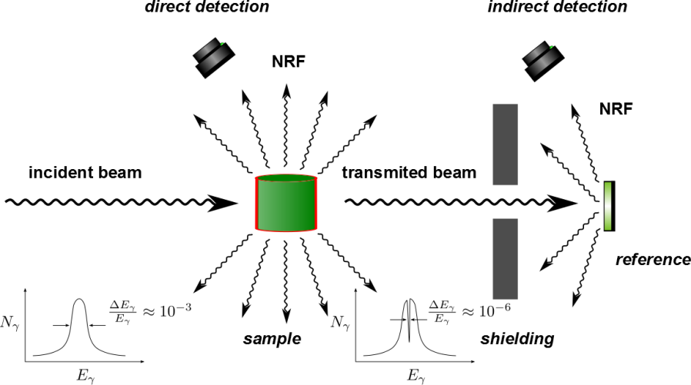
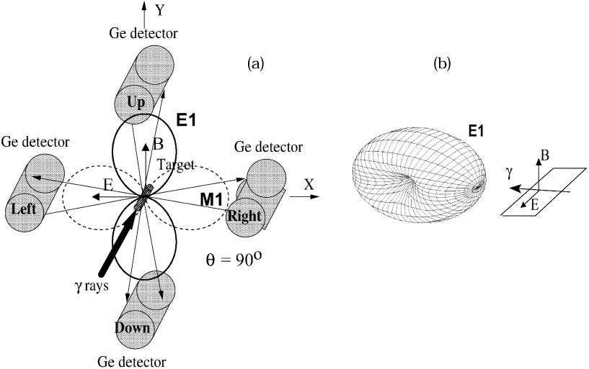
Nuclear Resonance Fluorescence
Material detection
Require small bandwidth
= Quasi-monochromaticity
Parity measurement
➔ Require polarized γ-ray
γ-ray linearly
polarized
NIM A 507 (2003) 527–536

Slide 26
Conclusion
X-Ray parameters
Standard Resonant Cavity (High average power, high rep. rate)
Resonant Burst Cavity (High peak power, medium rep rate)
Laser Beam Circulator (High peak power, low rep rate)
Optical system
Accelerator Type
Storage ring
∞
X-Ray Bandwidth
Nb of e⁻ bunches
X-Ray Flux
~100’s - ∞
Linac
~10’s - ∞

Slide 27
Thank you for your attention

