Slide 1
Accelerators for pedestrians a tutorial
Uli Raich
CERN BE - BI
(Beam Instrumentation)

Slide 2
No stupid questions
A proverb:
There is no such thing as a stupid question.
There are only stupid answers!
Lecturers take a big risk!

Slide 3
Beam Diagnostics
What do you expect from a lecture on „Beam Diagnostics“
Show how to measure beam parameters
Which beam parameters?
Beam presence
Beam intensity
Mean position
Trajectory
Transverse distribution in horizontal and vertical
Longitudinal distribution
Transverse and longitudinal emittance
Beam Tune, Resonances
Chromaticity
Beta function …..

Slide 4
Student lecturer
Who wants to come in front and explain to your fellow students what
Transverse emittance
Longitudinal emittance
Betatron Tune …
is?
Who thinks she/he would be able to do so?
Who of you has ever been at CERN or in one of the other big labs?
Who has ever seen an accelerator?

Slide 5
Introduction to accelerator for my grandma
Find answers to these questions in the film:
Where do the particles come from?
What is done to them to prepare them for acceleration?
Which type of field is used to accelerate?
How much is 1 eV?
At which speed do they enter the Booster?
What happens to the electric/magnetic fields when you accelerate in the Booster
What is the size of the Booster with respect to the PS
What is the circumference of the LHC?
How big is the current in an LHC magnet?
What is the revolution frequency in the LHC?

Slide 6

Introductory film:
CERN‘s Accelerators

Slide 7
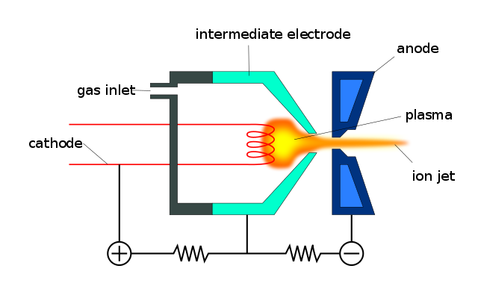
Answers to the questions
Where do the particles come from?
What is done to them to prepare them for acceleration?
Gas Bottle
Ionization (stripping
off electrons)
By Evan Mason - Own work, CC BY-SA 4.0, https://commons.wikimedia.org/w/index.php?curid=49972388

Slide 8
Answers to the questions (2)
Which type of field is used to accelerate?
How much is 1 eV?
Electric field: F=q*E
Magnetic field: F=q*v x B
proton
Electric field
+++++++++++++++++
Magnetic field
- - - - - - - - - - - - - - - - -
The energy gained by a particle of charge 1
when it falls through a potential of 1 V

Slide 9
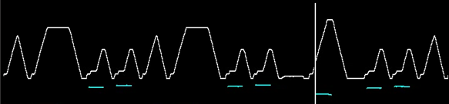

Answers to questions(3)
At which speed do they enter the Booster?
What happens to the electric/magnetic fields when you accelerate
$$β=0.3$$
The magnetic field must increase with increasing particle energy
The magnets are ramped.
At β=0.3 the particle speed increases and the revolution frequency increases
The accelerating RF must also increase

Slide 10
Answers to the questions(4)
What is the size of the Booster with respect to the PS
The PS is exactly 4 times bigger in circumference than the Booster.
The particles in each of the 4 Boosters rings fill the circumference of the PS

Slide 11
Answers to the questions (5)
What is the circumference of the LHC?
What is the current in an LHC magnet?
What is revolution frequency in the LHC?
27 km
Additional question: Why is it so big?
Difficulty to make magnetic fields stong enough to keep the
particles on their orbit
12000 A, you see why we need supraconducting magnets!
11 kHz: 11000 revolutions per second

Slide 12



More questions
How far does a proton travel when it stays in the LHC for 1 h?
If a particle has an angle of 0.01 degree and the vacuum chamber has a diameter of 10cm
How far does it travel before it crashes into the vacuum chamber?
Number of revolutions * no of seconds in 1 h * LHC circumference:
11000 * 3600 * 27 km = 1.069.200.000 km
or 300.000 km *3600 = 1.080.000.000 km
For comparison:
Distance earth to the mars: 119.000.000 km
$$\tan\left(φ\right)=\frac{d}{l}$$
$$l=\frac{d}{tan⁡(φ)}$$
φ
d
l
d=0.05 m
$$\tan\left(φ\right)=8.72∗{10}^{−4}$$
l= 286.5 m

Slide 13
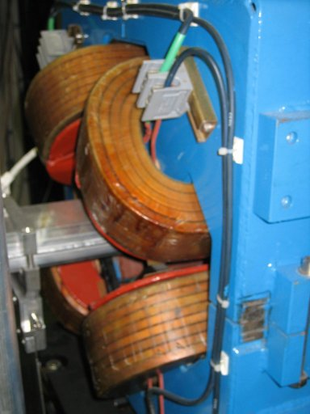
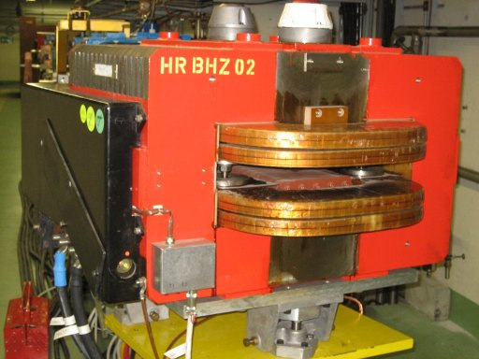
Magnets in the lattice
Which type of magnets are these?
Do we need bending magnets in an
Accelerator?
Focusing (quadrupole) magnet
Bending (dipole) magnet

Slide 14
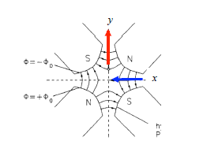
Why defocussing in the other plane?

Slide 15
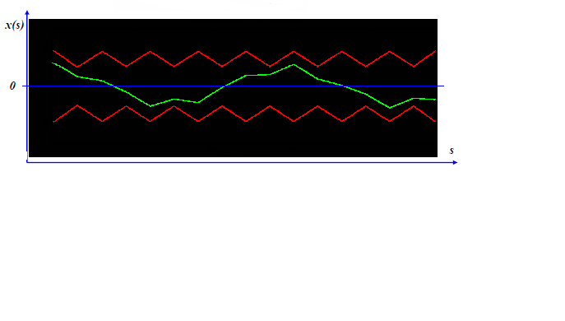
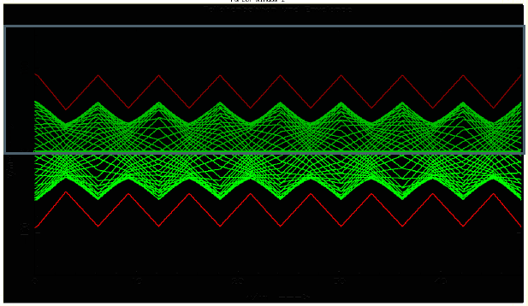
The Beta function
Inject a particle into a lattice and observe ist orbit.
This is a simple fodo lattice

Slide 16
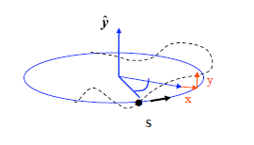
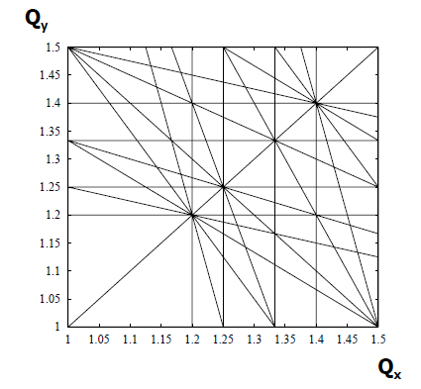
Betatron Tune
Tune Q = number of oscillations during
one turn
Q =1 is forbidden: small dipole error
always gives a kick at the same position
Q= ½ is forbidden small quadrupole error
gives a repetitive error
Same for Q=1/3, 1/4, 1/5 …

Slide 17
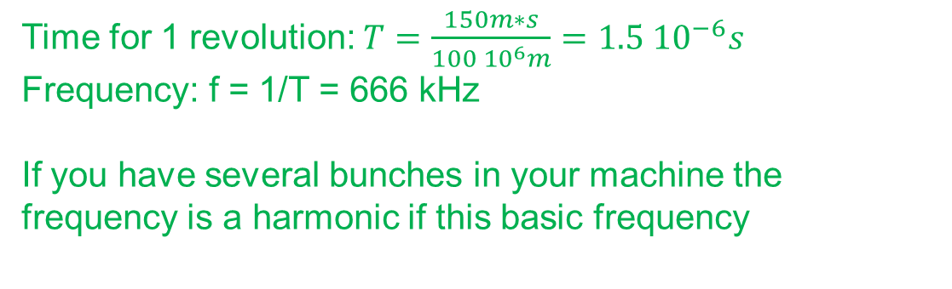
Acceleration
Acceleration is done in cavities with oscillating electrical fields.
Question: What is the revolution frequency of a particle when going at β=0.3 and the circumference is 150 m?
Time for 1 revolution: $T=\frac{150m∗s}{100 {10}^{6}m}=1.5 {10}^{−6}s$
Frequency: f = 1/T = 666 kHz
If you have several bunches in your machine the frequency is a harmonic if this basic frequency

Slide 18
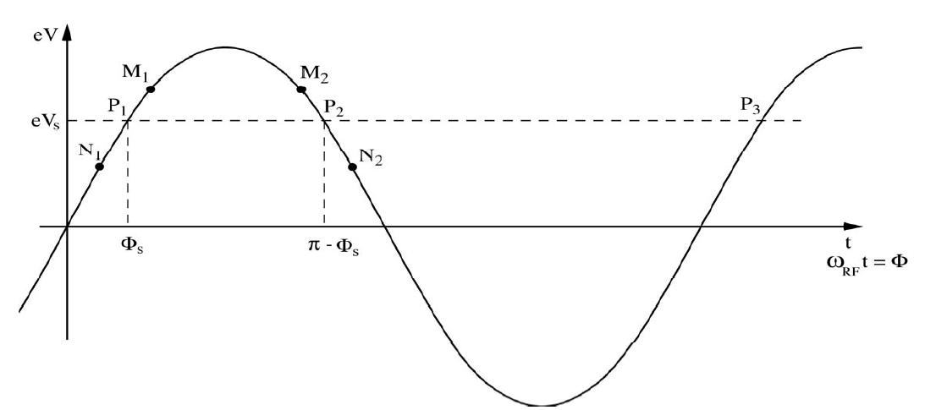
Non-synchronous particles
A synchronous particle P₁ sees a phase φ_{s} and get a energy kick ΔE_{s}
A particle N₁ arriving early with φ= φ_{s}−δ will get a lower energy kick
A particle M₁ arriving late with φ= φ_{s}+δ will get a higher energy kick
Remember: in a synchrotron we have bunches with a huge number of particles, which will always have a certain energy spread!

Slide 19

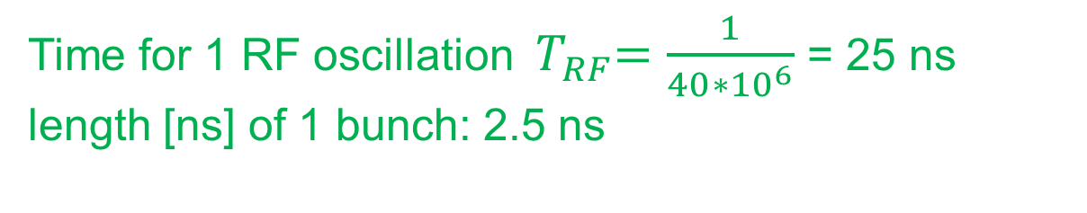
More questions (2)
How long is a particle bunch if the accelerating frequency is
40 MHz, the stable regions corresponds to 10% of the RF wave
and the particle travels at the speed of light?
Time for 1 RF oscillation ${ T}_{RF}=\frac{1}{{40∗10}^{6}}$ = 25 ns
length [ns] of 1 bunch: 2.5 ns
$$length \left[m\right]=300∗{10}^{6}\frac{m}{s}∗2.5{∗10}^{9}s=0.75m$$

Slide 20
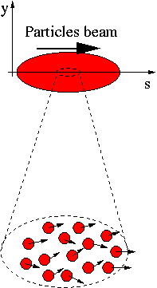
Emittance measurements
A beam is made of many many particles,
each one of these particles is moving with
a given velocity. Most of the velocity
vector of a single particle is parallel to the
direction of the beam as a whole (s).
There is however a smaller component of
the particles velocity which is
perpendicular to it (x or y).
Design by E. Bravin

Slide 21
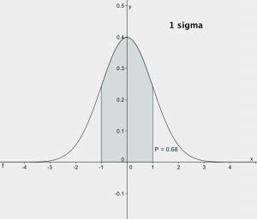
Phase Space
x’
x is the position of the particle
x‘ is ist angle
x
Projection to the x axis gives
the position distribution and
rms beam size
Projection to the x‘ axis the
angular distribution of the
particles

Slide 22
Emittance measurements
x’
If for each beam particle we plot its position and its transverse angle we get a particle distribution who’s boundary is an usually ellipse.
The projection onto the x axis is the beam size
Beam size
x

Slide 23
Transforming angular distribution to profile
Influence of a drift space
x’
x’
When moving through a drift space the angles don’t change (horizontal move in phase space)
When moving through a quadrupole the position does not change but the angle does (vertical move in phase space)
x
x
slit
slit
Influence of a quadrupole
x’
x
slit

Slide 24
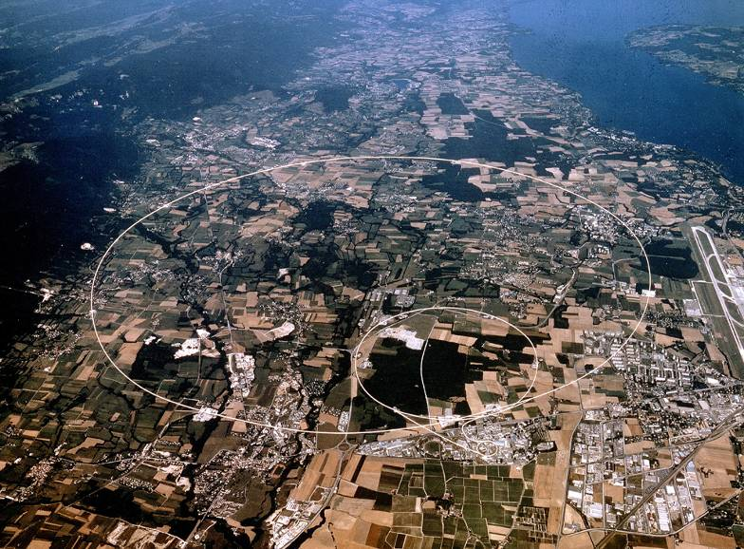
Photo CERN and its
Accelerator Chain

Slide 25

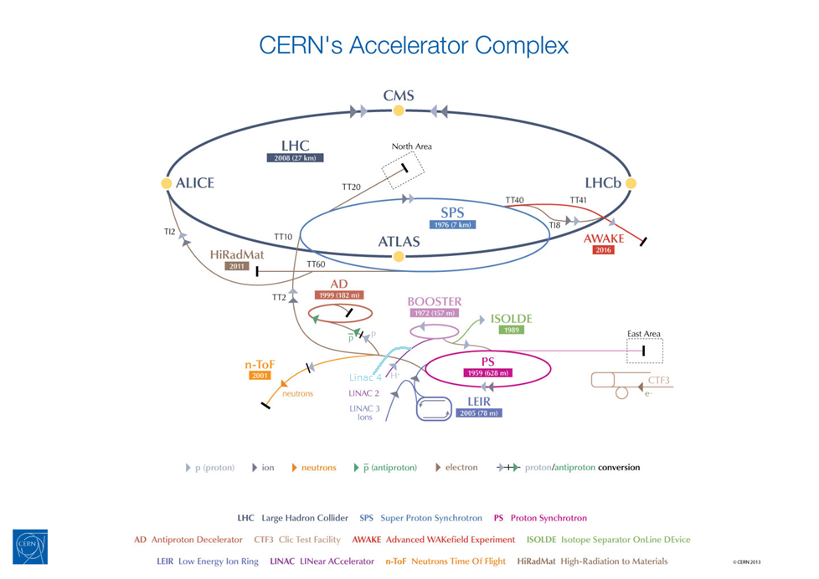

Slide 26
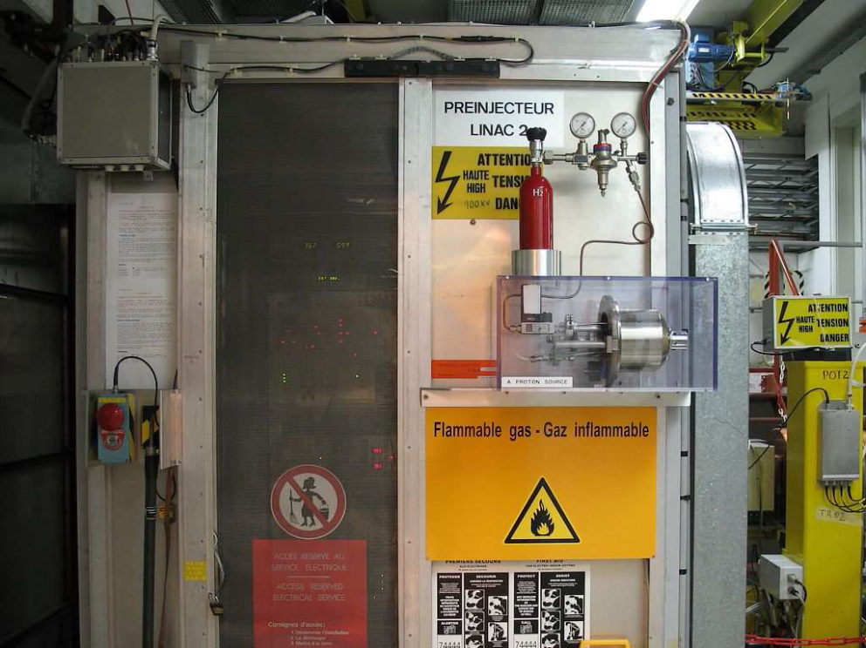
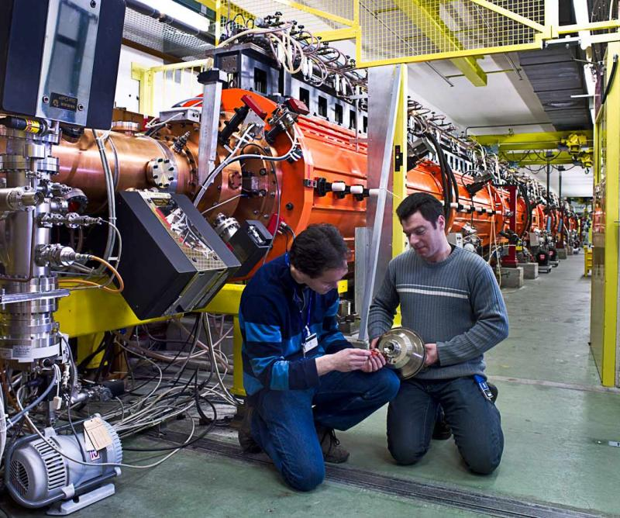
Proton Linac

Slide 27
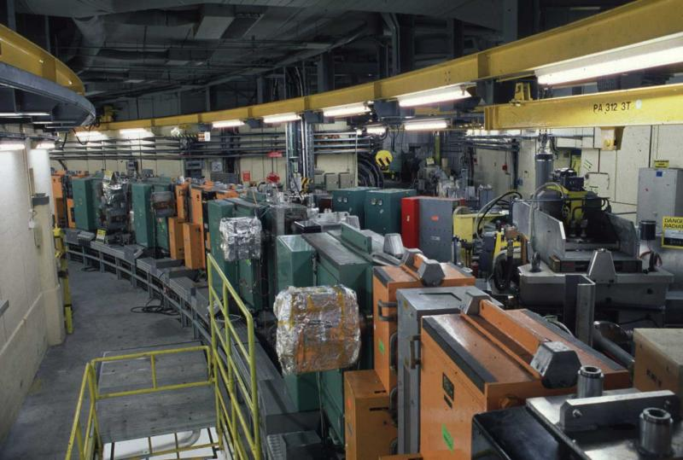
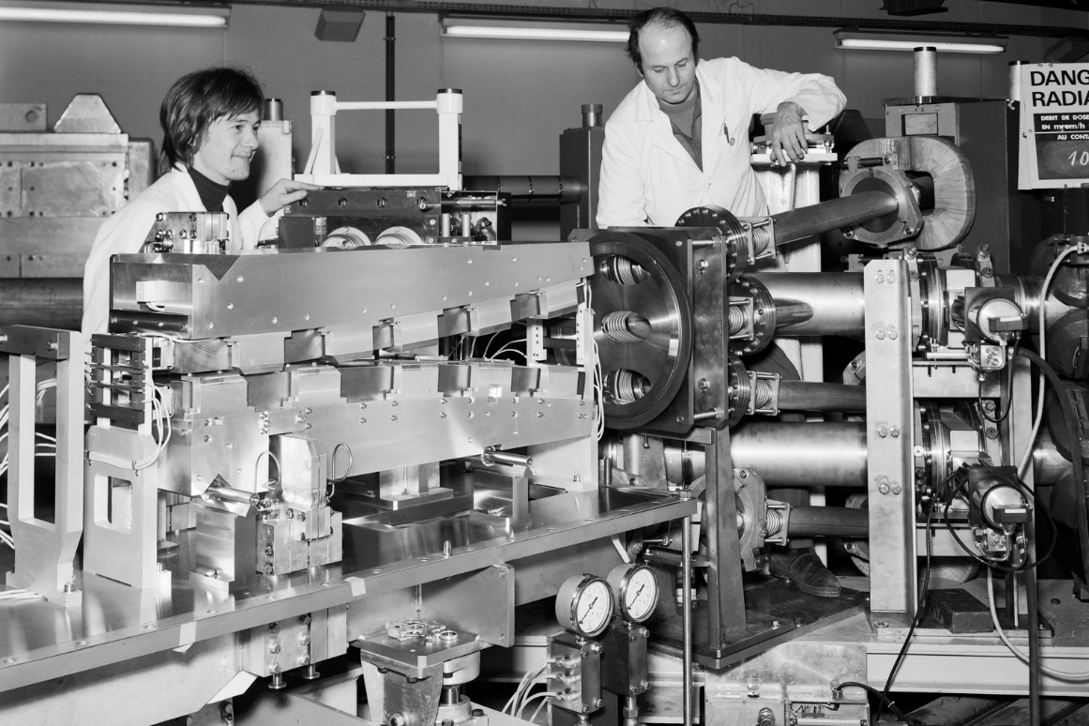
Booster

Slide 28
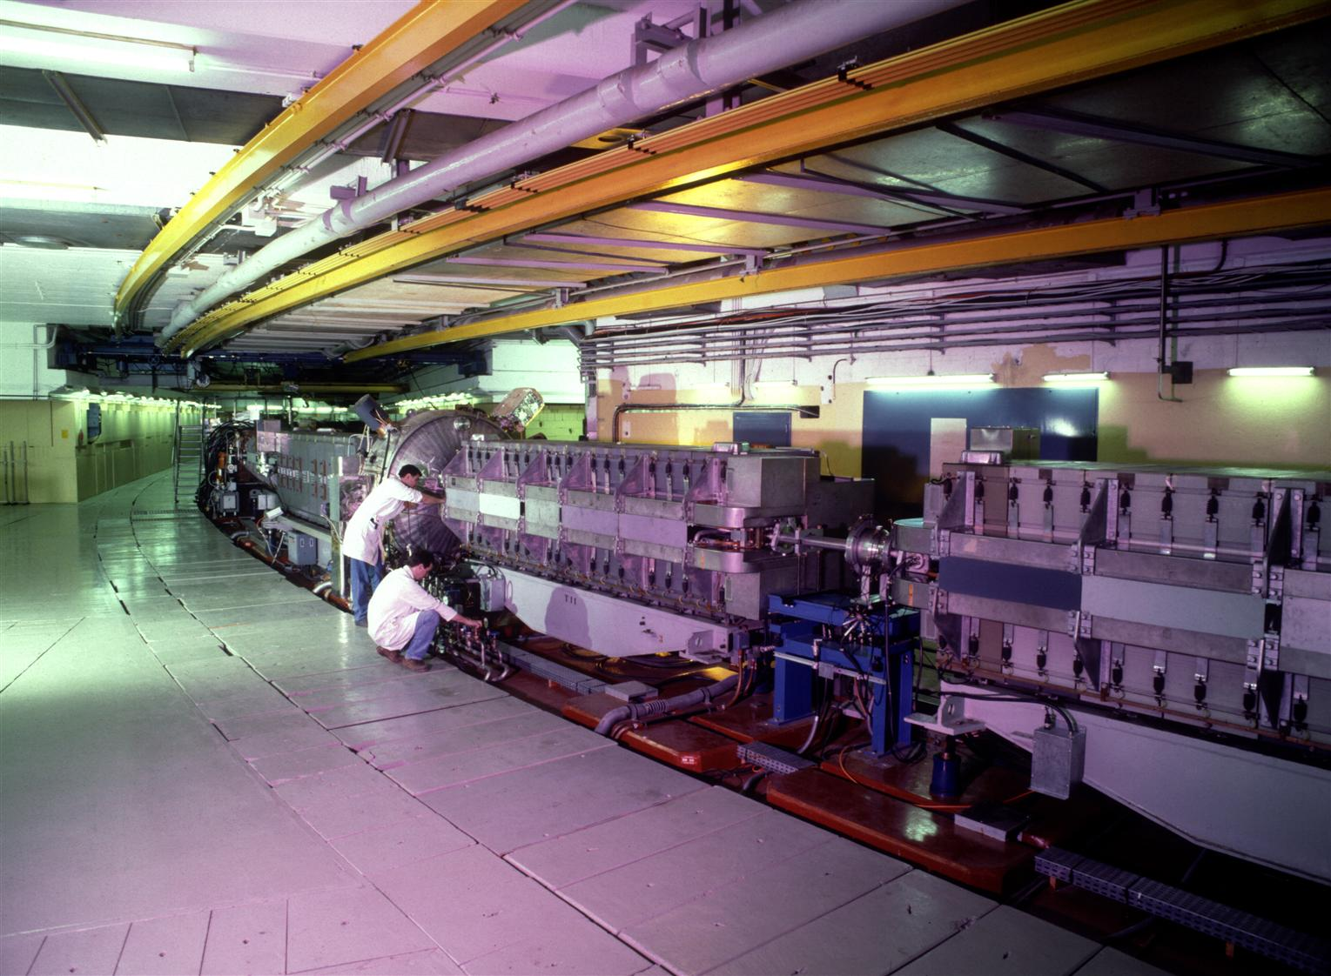
Proton Synchrotron

Slide 29
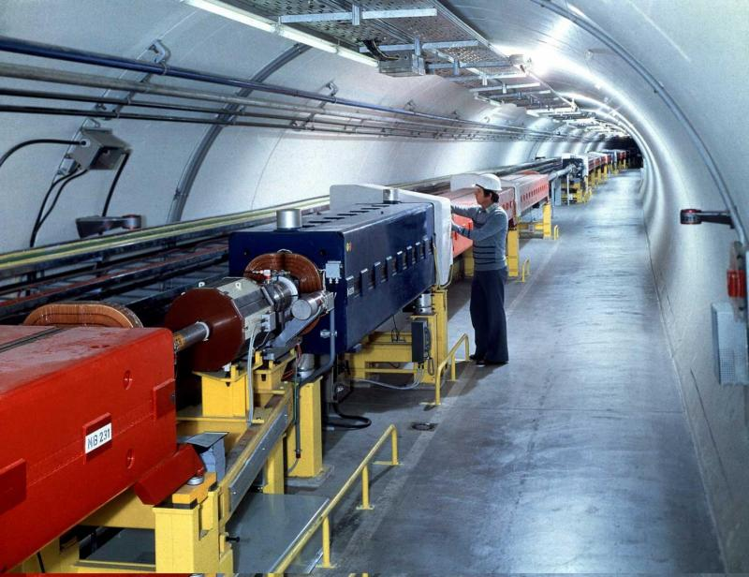
SPS

Slide 30
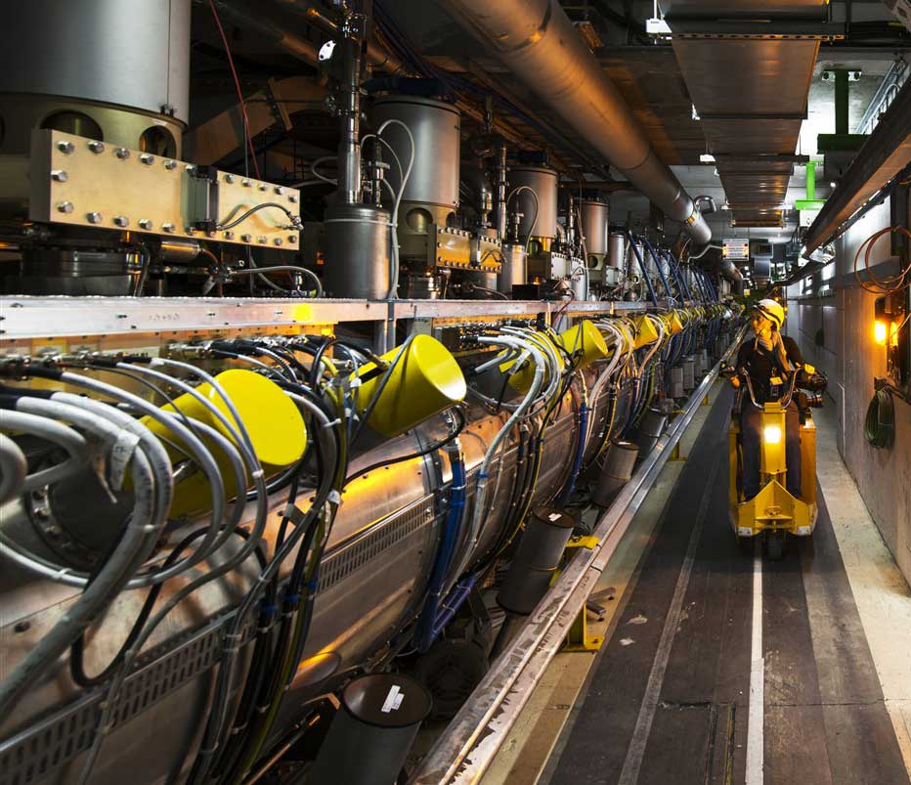
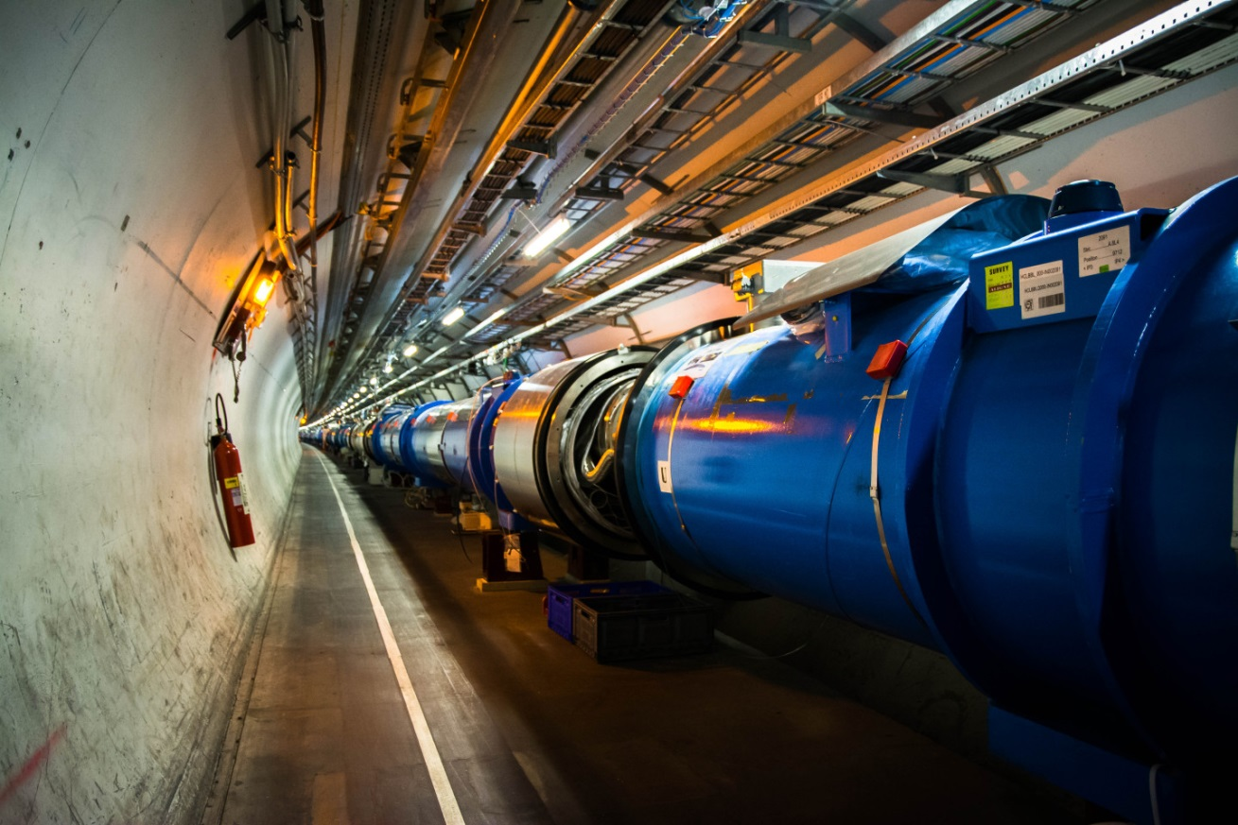
… finally the LHC

