Slide 1
References and exercises

Slide 2
Material
Brochures published by the Division of Physics of Beams of the American Physical Society (APS/DPB): "Accelerators and Beams: Tools of discovery and Innovation“
http://www.aps.org/units/dpb/upload/accel_beams_2013.pdf
Interesting movie, built for the ASP2010, explaining the LHC operation. See it at:
https://indico.esss.lu.se/event/378/contribution/25/material/video/0.m4v
More materials used for the previous ASP edition are available at:
ASP2010:http://indico.cern.ch/event/78565/other-view?view=standard
ASP2012: http://indico.cern.ch/event/145296/other-view?view=standard
ASP2014: https://indico.cern.ch/event/276481/other-view?view=standard
ASP2016: https://indico.cern.ch/event/528094/other-view?view=atlas
The link to the Nordic particle Accelerator School and Program:
https://npap.eu/

Slide 3
Homework
The velocity of a 1 GeV proton with respect to the velocity of a 1 MeV electron is
A – larger
B – the same
C - smaller

Slide 4
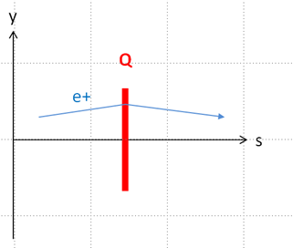
A positron is focused in the vertical plane by the quadrupole of the figure. An electron with the same energy enter the quadrupole in the opposite direction with coordinates (x, x’, y, y’) = (-0.1 mm, 1.2 mrad, 0 mm, 0.0mrad)
A – is horizontally focused
B - is horizontally defocused

Slide 5
The horizontal emittance in a linac for protons is accelerated from 200 keV to 2 MeV. Its horizontal emittance, disregarding space charge,
A – increases
B – decreases
C - remains constant

Slide 6
A synchrotron for electrons at 3 GeV has a magnetic structure with 36 dipoles. The magnetic field in the dipoles is 1.5 T. The bending radius in the dipoles is
sincrotrón para electrones de 3 GeV tiene una estructura magnética con 36 dipolos.
A – less than 10 m
B – equal to 10 m
C – larger than 10 m

