Slide 1
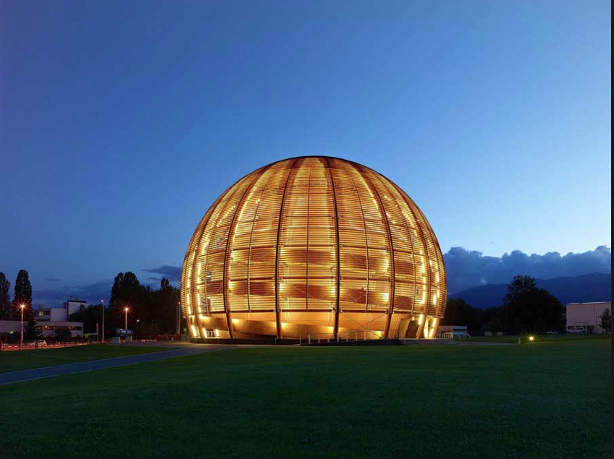
ADS and
Accelerator Requirements
Application of Accelerators to Nuclear Energy
ASP16 – 4th African School of
Fundamental Physics and Applications
University of Rwanda, Kigali, Rwanda
August 17, 2016
Yacine Kadi
CERN Engineering Department
Geneva, Switzerland

Slide 2
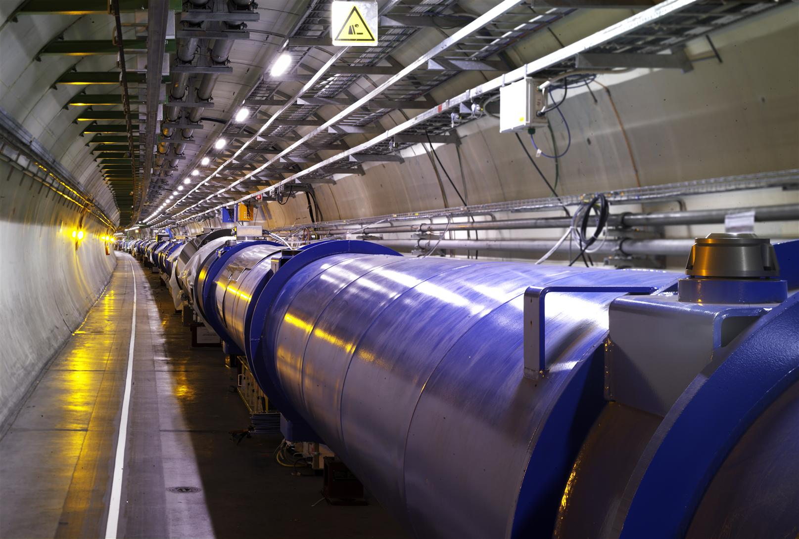
Outline
Brief historical account of ADS
Sub-critcal Reactor core physics
Accelerator and the physics of spallation
Motivations and global constraints on ADS

Slide 3
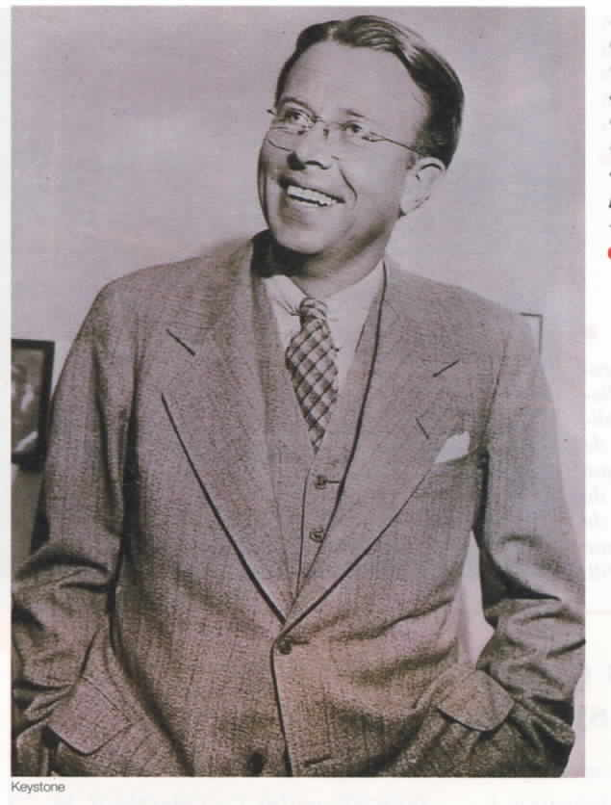
Accelerator Driven Systems
The basic process in ADS is nuclear transmutation
  1919 Rutherford (¹⁴N₇ + ⁴He₂ → ¹⁷O₈ + ¹p₁) ²¹⁰Po accelerator!
  1940 E.O. Lawrence/USA and W.N. Semenov/USSR proposed to use a particle accelerator as a neutron source
  1941 G. Seaborg produced the first μg
  of ²³⁹Pu with the Berkeley 60 inch cyclotron
  1950 E.O. Lawrence proposed the Materials
  Testing Accelerator (MTA) at the
  Lawrence Livermore Radiation Lab,
  to produce ²³⁹Pu from Oak Ridge
  depleted uranium
  1952 W.B. Lewis in Canada proposed to
  use an accelerator to produce ²³³U from
  thorium for CANDU reactors
  (electro-breeder concept)
Notes:
The making of the Atomic Bomb by Richard Rhodes
Seaborg used the 60 inch cyclotron at Berkeley, with 6 MeV deuteron on ²³⁸U

Slide 4
Accelerator Driven Systems
MTA and Lewis’ projects dropped or slowed down when (a) rich uranium deposits were discovered in the USA, and (b) it was realized that it required several hundred mA of beam intensity, hundreds of MW to produce the beam! [Pu, no amplification]
today ≤ 10 MW beams seem sufficient
Renewed interest in ADS in the 1980’s, when the USA decided to slow the development of fast critical reactors (Fast Flux Test Facility @ Argone National Lab.):
  H. Takahashi at Brookhaven National Lab: several proposals of ADS systems (PHOENIX), including the idea of burning minor actinides (Fast neutrons – k_{s}~0.99);
  Ch. D. Bowman at Los Alamos: thermal neutron ADS (ATW) with thorium & chemistry on-line for FP and ²³³Pa extraction;
  Japan launches Options for Making Extra Gains from Actinides (OMEGA, now JPARC) at JAERI (now JAEA).
Notes:
Options for Making Extra Gains from Actinides?? Japan Proton Accelerator Research Complex (JPARC) JAEA (Japan Atomic Energy Agency)
MTA 500mA 350 MeV deuteron linac: 175MW => several hundred MW tom produce such a beam. No multiplication in the target!
JPARC: Japan Proton Accelerator Research Complex; Fast Flux Test Facility (FFTF) sodium cooled fast neutron reactor : stopped in 1993 (IFR Itegral fast reactor project) Extenede burnup

Slide 5
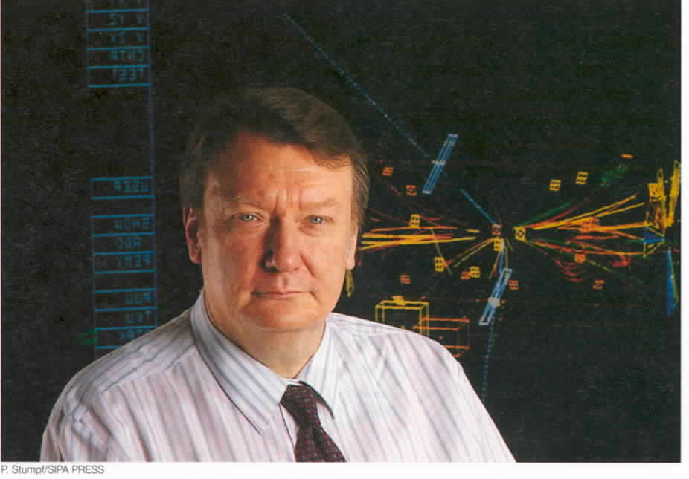
Accelerator Driven Systems
In the 1990s, Carlo Rubbia gave a big push to the ADS, by launching a vigorous research programme at CERN based on:
  development of innovative simulation of nuclear systems
  specific experiments to
  test basic concepts
  (FEAT, TARC)
  construction of an advanced
  neutron Time of Flight
  facility (n_TOF) to acquire
  neutron cross-section data,
  crucial to simulate reliably
  any configuration with new
  materials
  Followed by proposals for
  demonstrators
C. Rubbia triggered a major R&D effort on ADS worldwide
Notes:
Simulation integrating the spallation process, neutron transport and evolution of fuel.
Next step is temperature evolution
He is mainly responsible for our

Slide 6
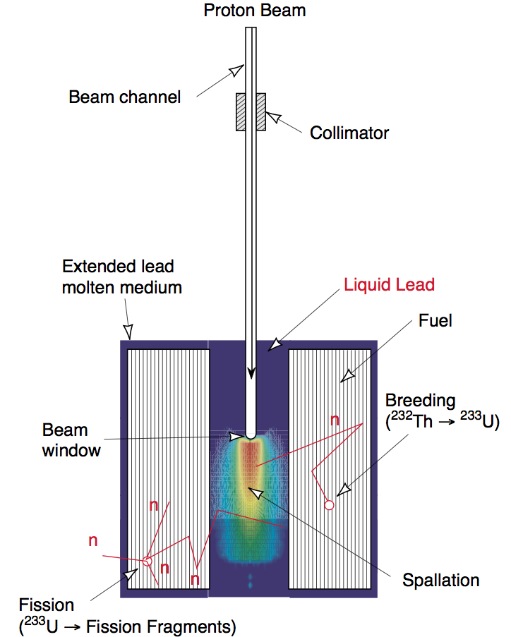
Basic elements of an ADS system
Spallation
A particle accelerator, to provide a neutron source
A core in which both source neutrons and fission neutrons are at work – restricted here to the case of a moderator allowing for a fast neutron spectrum
Two main areas of physics:
  Neutron production
  by spallation from the beam
  Neutron transport and interaction
  in the core
Physics also drives other ADS elements:
  Cooling (possibility of natural convection)
  Electric power production efficiency
  (go to highest possible temperature)
Fission
Non negligible contribution from the high energy tail
(n,xn)

Slide 7
Simplified model of subcritical systems
Theory of subcritical systems interesting in itself, to get insights into the physics. Properties are quite different from those of critical systems. (C. Rubbia, CERN/AT/ET/Internal Note 94-036)
Neutron flux geometry important to determine the generated power distribution and the uniformity of fuel burnup
Some simplifying assumptions (uniform material and mono-energetic neutrons, small absorption) to get a basic equation similar to that of a critical reactor, but with an external neutron source term in addition:
Fission
Spallation
Absorption
Leakage
Notes:
Several ways to be subcritical: kinfinity < 1 or > 1; gives rise to different types of solutions
You really need a MC for fast neutron spectra (n, xn), etc.

Slide 8
Simplified model of subcritical systems
Example of finite system at equilibrium:
Two regimes corresponding to two classes of solutions:
  k∞ < 1: the system is intrinsically subcritical (FEAT experiment: k∞ ~ 0.93) – Solution is an exponential
  k∞ > 1: subcriticality comes from the lack of confinement, it is a geometrical issue – Solution is oscillatory
  (C. Rubbia’s EA: k∞ ~ 1.2-1.3)
All modes are excited
Theorem:
Diffusion length
Notes:
For instance for a paralellepipedal box B**2; l,m,n = Pi**2(l**2/a**2+m**2/b**2+n**2/c**2), a quickly increasing function of the mode
B**2 increasing with increasing modes, => kl,m,n decreasing with increasing mode

Slide 9
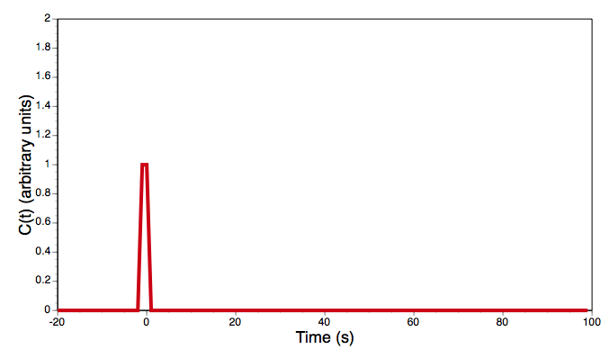
Time dependence
Diffusion equation (with Φ = βn, where β is the neutron velocity):
Case of a neutron pulse, given by C₀δ(t), and substituting
provides an equation for the time dependence:
, and the general solution
Characteristic decay time is shorter as modes become higher. At the criticality limit (k_{1,1,1}=1), the mode is infinitely long. Fermi used this to measure the approach of criticality in his Chicago Pile 1 in 1942, and the method can be used for an ADS.

Slide 10
Neutron multiplication factor
The neutron multiplication factor depends on the source:
The CERN LHC beam can be switched off in three turns of the machine, that is up to 270µs. The CERN SPS can be switched off in 46 µs. On a (much) smaller machine, such as foreseen for ADS, the switching off time is much shorter. So the reaction time will not be limited by the accelerator. The typically response time of a critical system to reactivity insertion is of the order of 5 ms.
Switching off the neutron source not only stops the main power generation, but also moves the system to a smaller k, from k_{s} to k_{eff}.
Fission
Spallation
For fast neutron systems,
(n,xn) reactions are
not negligible, in particular
for the source neutrons
Absorption
Leakage

Slide 11
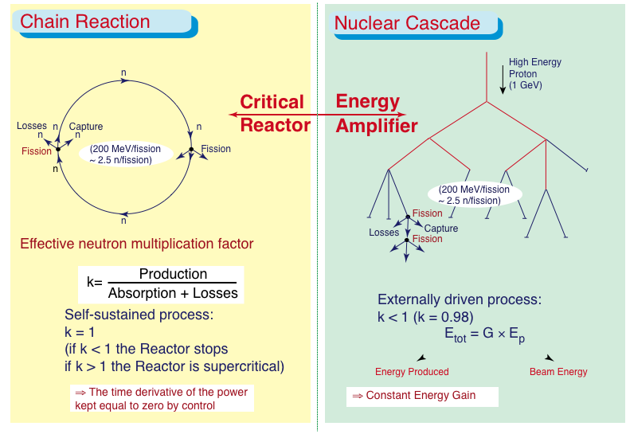
Critical versus Subcritical Systems

Slide 12
ADS energy gain
A source neutron is multiplied by fissions and (n,xn) reactions. Since k_{s}<1, neutron production stops after a limited number of generations:
The energy gain G is a characteristic of ADS:
G₀ includes information from the spallation process (G₀ ~ 3 for uranium; G₀ ~ 2.7 for lead, etc.)
Energy/fission
n/p
n/fission
Beam energy
Notes:
G = (ε/Eb)(1+ksEf/(1-ks)) where ε is the number of neutrons per proton, Eb is the kinetic energy of a proton, Ef is the energy released per fission

Slide 13
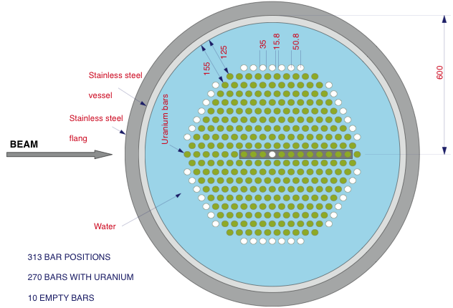
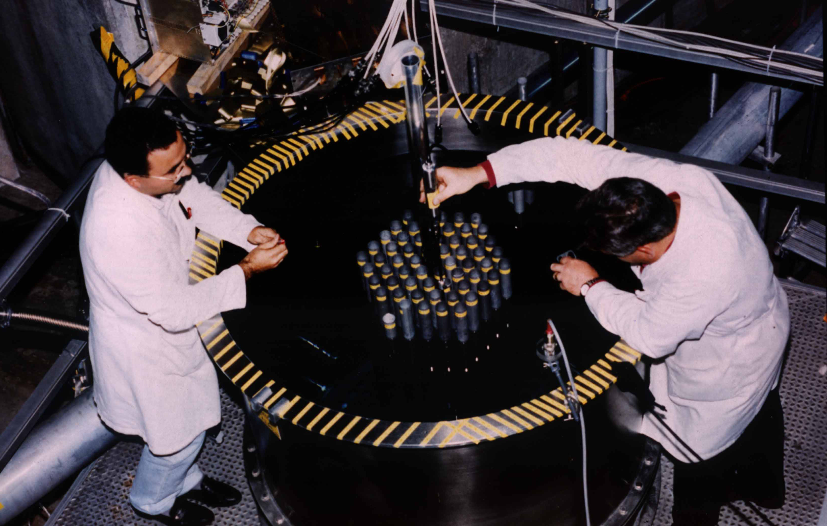
FEAT at the CERN PS (1994)
The goal of the First Energy Amplifier Test (FEAT) at the CERN PS was to check the basic concept of energy gain, and validate the innovative simulation developed by C. Rubbia and his group.
– Count fissions
– Measure temperature
3.62 t of natural uranium; k_{eff} ~ 0.9

Slide 14
Main results from FEAT
k∞ < 1: exponential
Energy gain well
reproduced by simulation
Two important results from FEAT:
  Optimum beam energy reached at about 900 MeV, with slow decrease at higher energies (ionization vs nuclear cascade production). Above 900 MeV, the neutron yield scales with proton energy. At much higher energies the gain drops because of pion production.
  Simulation validated from spallation to energy production

Slide 15
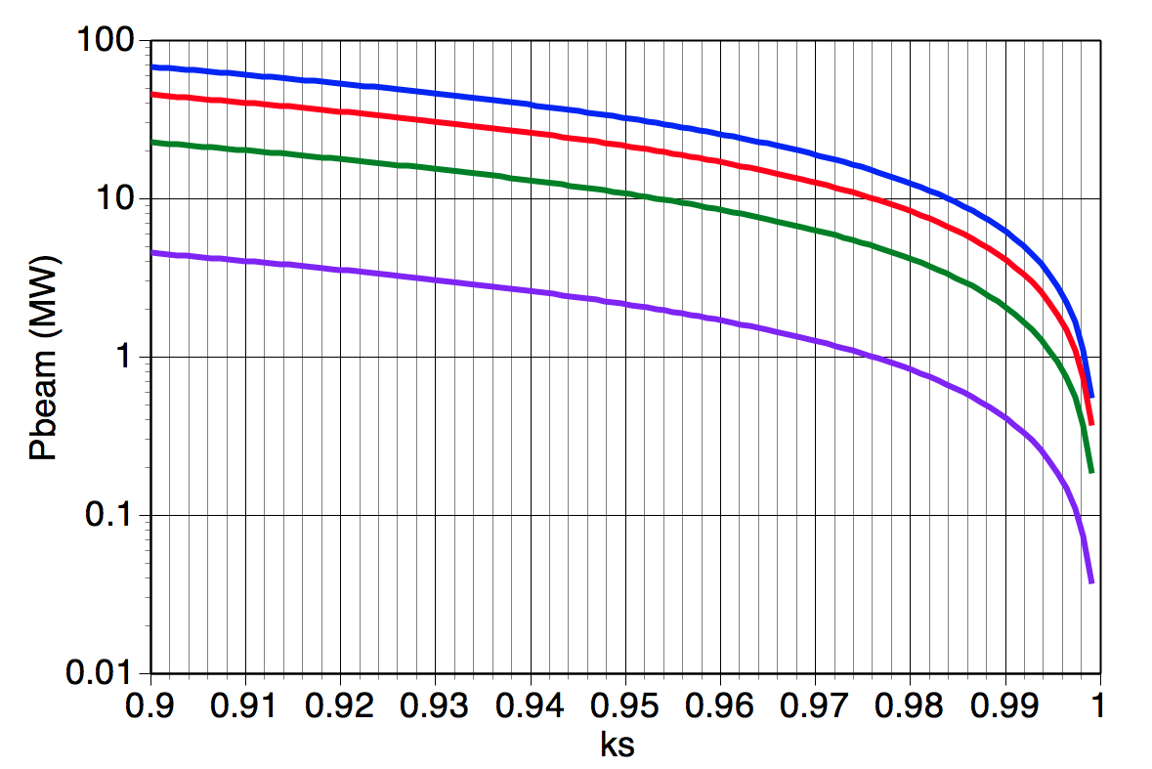
Energy gain in ADS systems
For a given power output, the energy gain (choice of k_{s} and G₀) determines the accelerator power.
Trade-off between accelerator power and criticality margin
Modulating the beam intensity allows variations in the power output (complementary with a fluctuating renewable energy source)
Neutronics with thorium very favourable compared to uranium t_{1/2} (²³³Pa) ~ 27d; t_{1/2} (²³⁹Np) ~ 2.3d! What was a problem in the use of thorium in critical reactors becomes an advantage in the case of ADS
Margin of
present
PWR
1000 MW
1500 MW
500 MW
100 MW
MEGAPIE
Rubbia’s EA
Assuming Pb target
With PSI separate turns cyclotron
(3 mA and 1.8 MW, with 0.59 GeV protons).
P_{ADS} = 243 MW_{th} with k = 0.98
P_{ADS} = 486 MW_{th} with k = 0.99.

Slide 16
Guidelines for ADS parameters choice
Safety:
  Eliminate criticality accidents by making the system subcritical (void coef., T coef., β_{eff} no longer “critical” parameters)
  This requires an external proton source!
  Operate system with passive safety elements to avoid core melting or limit its consequences, borrowing features from US advanced fast critical reactor designs;
  Avoid dangerous coolants such as liquid sodium (use lead) Generation IV?
Waste management:
  Use (1) fast neutrons, (2) thorium fuel, and (3) recycle long-lived transuranic actinides (TRU) to minimize waste.
Military proliferation:
  Use thorium fuel (small Pu prod., ²³³U very difficult mixture)
  Avoid Pu separation (Purex), use pyroelectro reprocessing instead (developed for uranium at Argone N.L.)

Slide 17
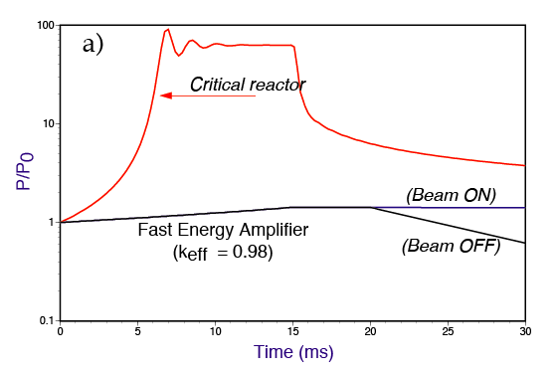
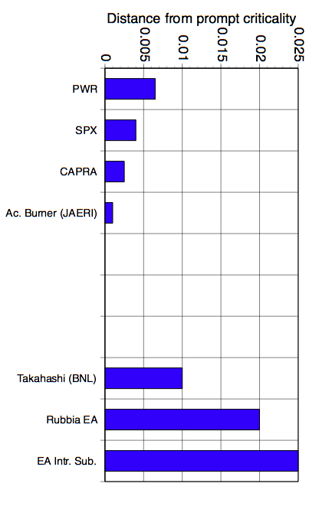
Physics of subcritical systems
Subcritical systems are insensitive to delayed neutron fraction (β);
safety margin (distance from prompt criticality) is a design choice, it is not imposed by Nature!
k_{s} = 0.975 makes the system subcritical under all conditions (after ²³³Pa decay)
The reactivity changes only very slowly; the beam can be switched off very quickly, reducing k_{s} to k_{eff}. It is possible to choose a higher k_{s} in order to reduce the load on the accelerator
(Takahashi, k_{s} = 0.99)
C. Rubbia’s EA with
natural convection
Delayed neutron
fraction
Deterministic
control
Notes:
LICE ~ 4.5 Mio nodes / 5000 volumesA; TLAS ~ 29 Mio nodes / 7000 volumes; CMS ~ 1.5 Mio nodes / 1500 volumesL; HCb ~ 18 Mio nodes / 700 volumes
From 1995 to 2009 computing power increased by factor 500 (Moors’s law)
170$/s for 15ms

Slide 18
Guidelines for ADS parameters choice
Safety:
  Eliminate criticality accidents by making the system subcritical (void coef., T coef., β_{eff} no longer “critical” parameters)
  This requires an external proton source!
  Operate system with passive safety elements to avoid core melting or limit its consequences, borrowing features from US advanced fast critical reactor designs;
  Avoid dangerous coolants such as liquid sodium (use lead) Generation IV?
Waste management:
  Use (1) fast neutrons, (2) thorium fuel, and (3) recycle long-lived transuranic actinides (TRU) to minimize waste.
Military proliferation:
  Use thorium fuel (small Pu prod., ²³³U very difficult mixture)
  Avoid Pu separation (Purex), use pyroelectro reprocessing instead (developed for uranium at Argone N.L.)

Slide 19
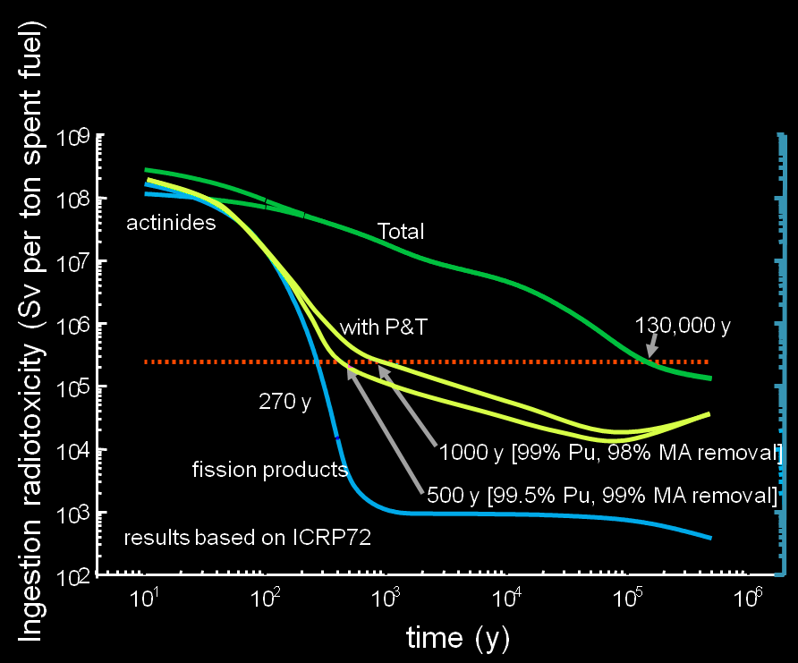
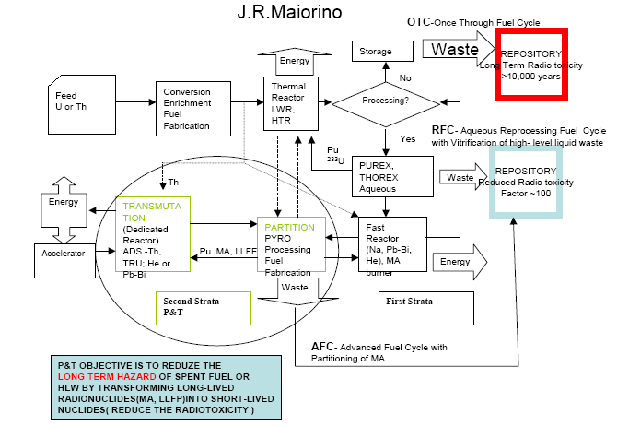
Partitioning &Transmutation
P/T applies to TRU (Pu and Minor Actinides) and Long Lived Fission Products.
It should be kept in mind that Plutonium is a special case: it can be considered as a valuable resource or part of the wastes.
However, P/T technologies must apply to all fuel cycles.

Slide 20
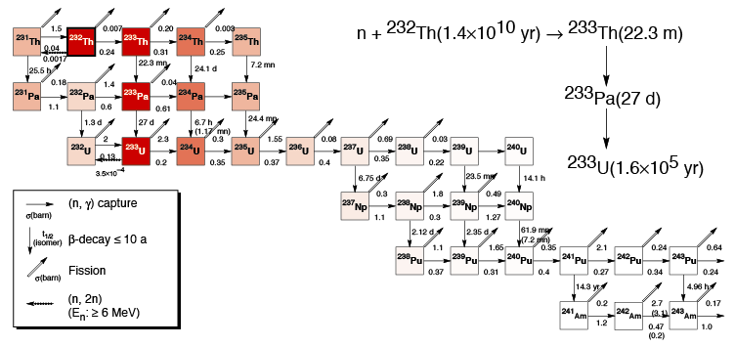
Physics of a thorium core
Thorium in a fast neutron flux:
  It takes 7 neutron captures to go from ²³²Th to ²³⁹Pu!
  ²³³Pa decay 10 times slower than ²³⁹Np
Pu equilibrium concentration ~ 10^{–4}
as opposed to 15% in a U-Pu system!
Thorium is a major asset to minimize waste production or to destroy waste
Notes:
231Pa bump after 250000 years; in once through cycle factor 100 at t ≤ 250000 years: => recycle TRU
Could be impurities in thorium ore from uranium => 230Th (231pa by capture or n2n on 232Th (main)

Slide 21
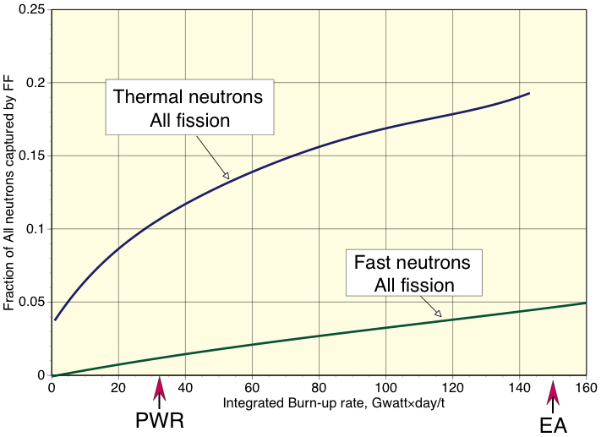
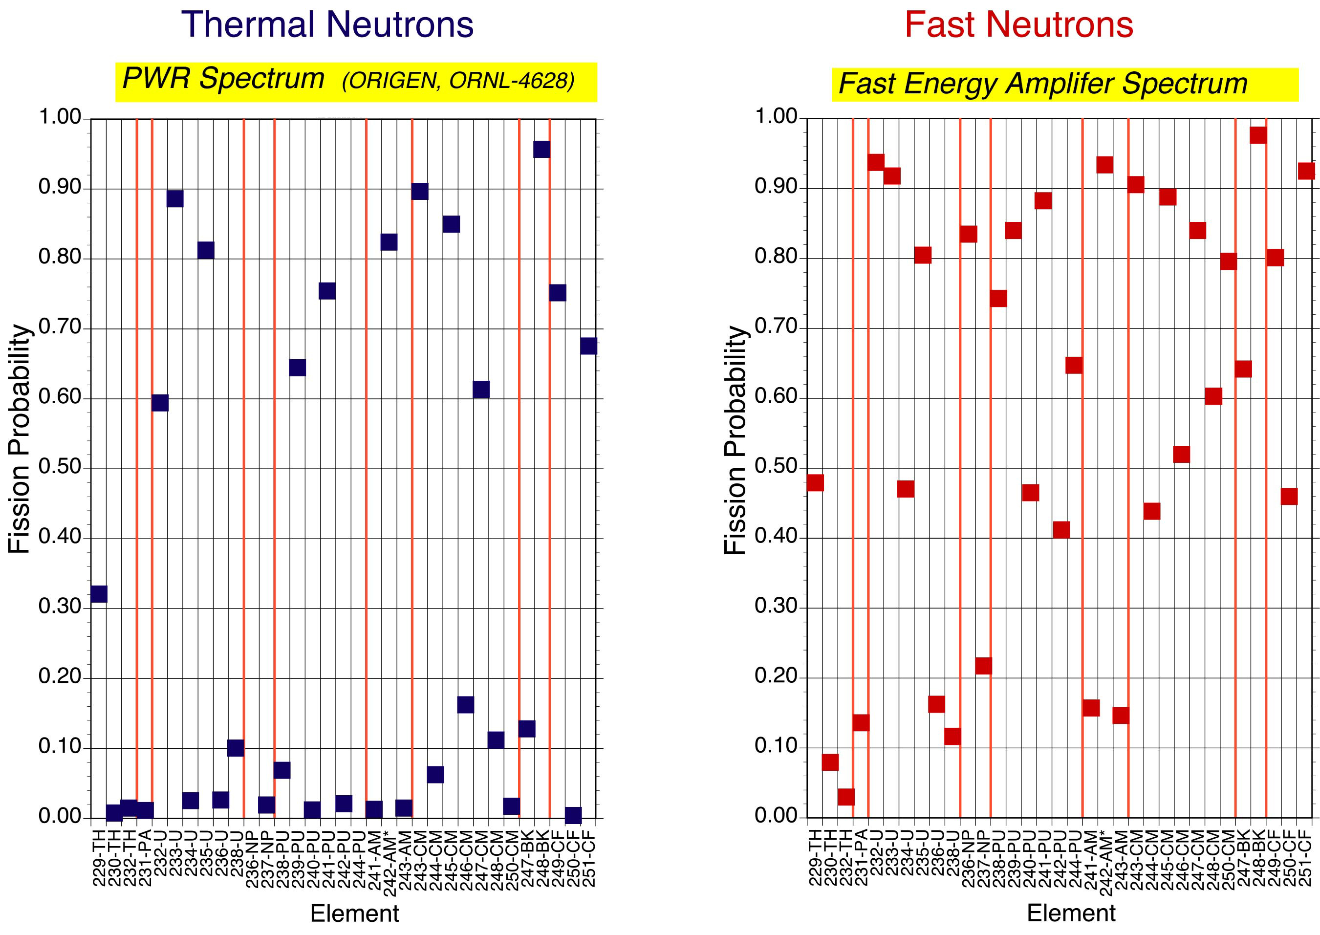
Why fast neutrons
Use fast neutrons:
  Enhances TRU fission probability
  No need to separate out Pu!
  (Pyro-Electro reprocessing)
  Reduces captures on FF, extends burnup
  (120 GW.day/t achieved in fast electro-
  breeder at Argonne N.L., in EA simulation)
Notes:
Minor actinides are the only thing that Nuclear Industry admits would requires ADS!

Slide 22
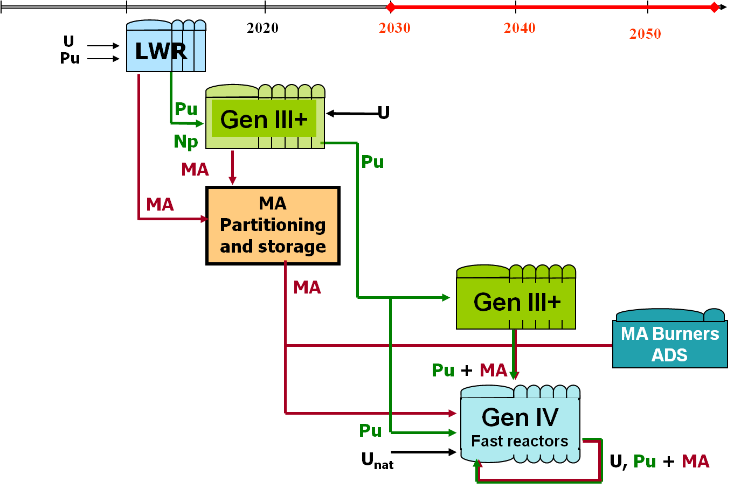
Common Deployment Scenario
The objectives of GEN-IV include P/T (waste minimization), as consistent with sustainability and non-proliferation: it is the path towards “Advanced Fuel Cycles”.
Implementation: currently related to Fast Reactor deployment. However, ADS is the only option for Minor Actinide elimination
2020
Implementation of MA partitioning
Waste minimization (Vitrified FP)

Slide 23
MA Transmutation
Typical transmutation rates (~ 50 kg/TWh) using MA based fuels.
Doping with Pu will sensibly decrease the transmutation efficiency of such systems

Slide 24

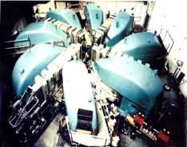
Alternative Deployment Scenario
²³²Th+ ²³³U
²³²Th
Nuclear
waste
STAGE 1
STAGE 2
ADS
LWR with reduced waste generation

Slide 25
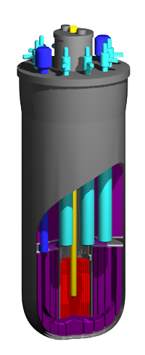
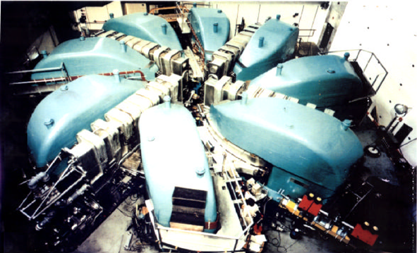
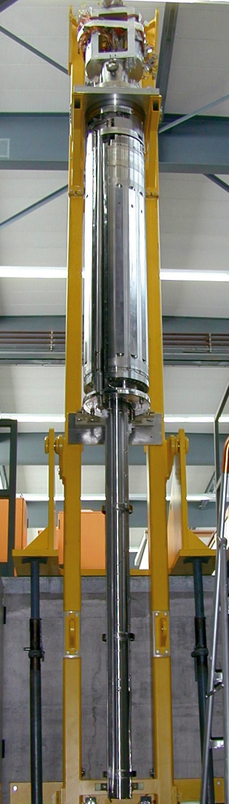
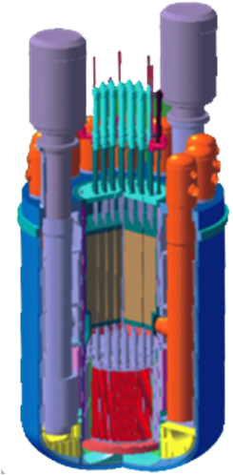
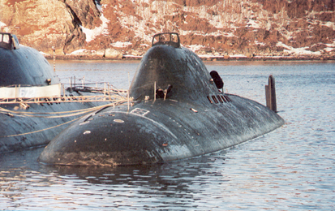
Fast track by Integration of Consolidated Technologies … by 2030 !
Technology of pyrochemical reprocessing of fuel
High power accelerators technology
UO
2
2+
UO
2
+PuO
2
PuO
2
2+
Technologies of fast reactors
with lead-bismuth coolant
Liquid metal targets technology

Slide 26
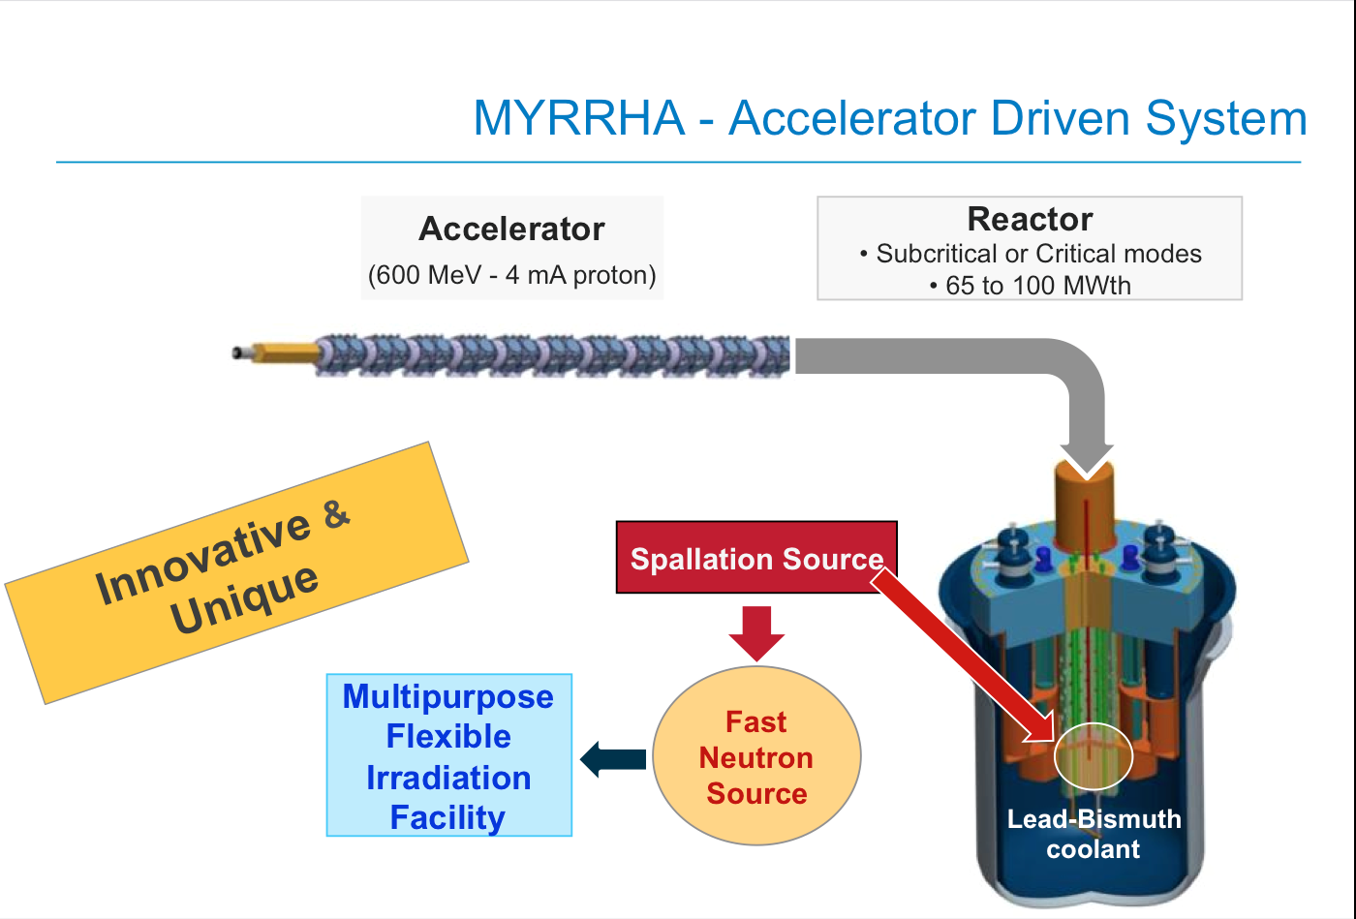
Europe ADS: MYRRHA
In principle MYRRHA should be the flagship of ADS projects.
Strong support from the Belgian government, however:
– several challenges faced at the same time: the accelerator, the subcritical core and their coupling
– no thorium in the plans
– only partially funded
– not before 2025?
– will not remain an ADS, and will be turneds into a critical reactor
Hamid Aït Abderrahim
SCK•CEN, Boeretang 200, 2400 Mol, Belgium
Hamid Aït Abderrahim

Slide 27
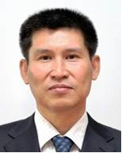
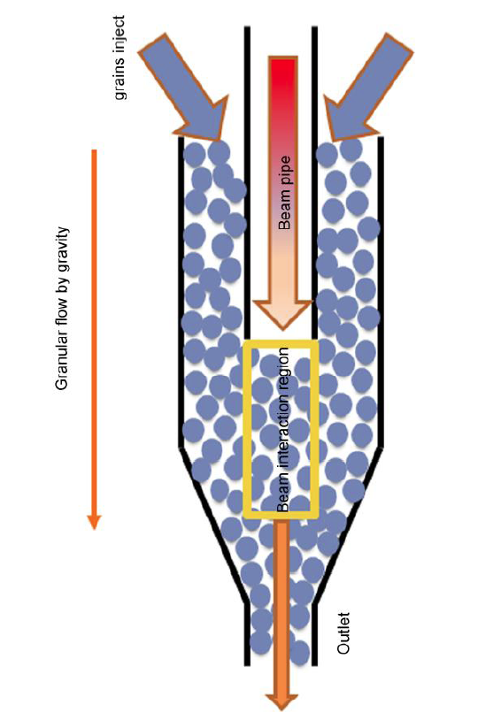
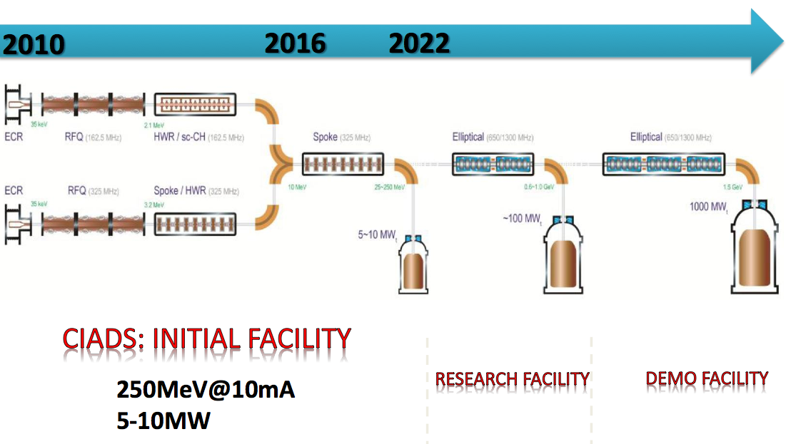
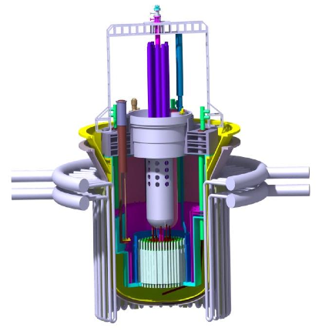
China ADS: ADANES
The Chinese Accelerator-Driven System (CADS) project includes the accelerator, the target and the blanket. Accelerator-Driven Advanced Nuclear Energy System (ADANES) proposed as a complete energy system, integrating nuclear waste transmutation, nuclear fuel multiplication and energy production, aiming at 1000 MWe.
ADANES has the potential to reach the requirements of sustainable development, safety, economic competitiveness, and nuclear weapon non-proliferation.
Innovative spallation target R&D
Also a linac approach for the accelerator
100MW
1000MW
Two injector solutions developed in parallel
5-10MW
in 2022

Slide 28
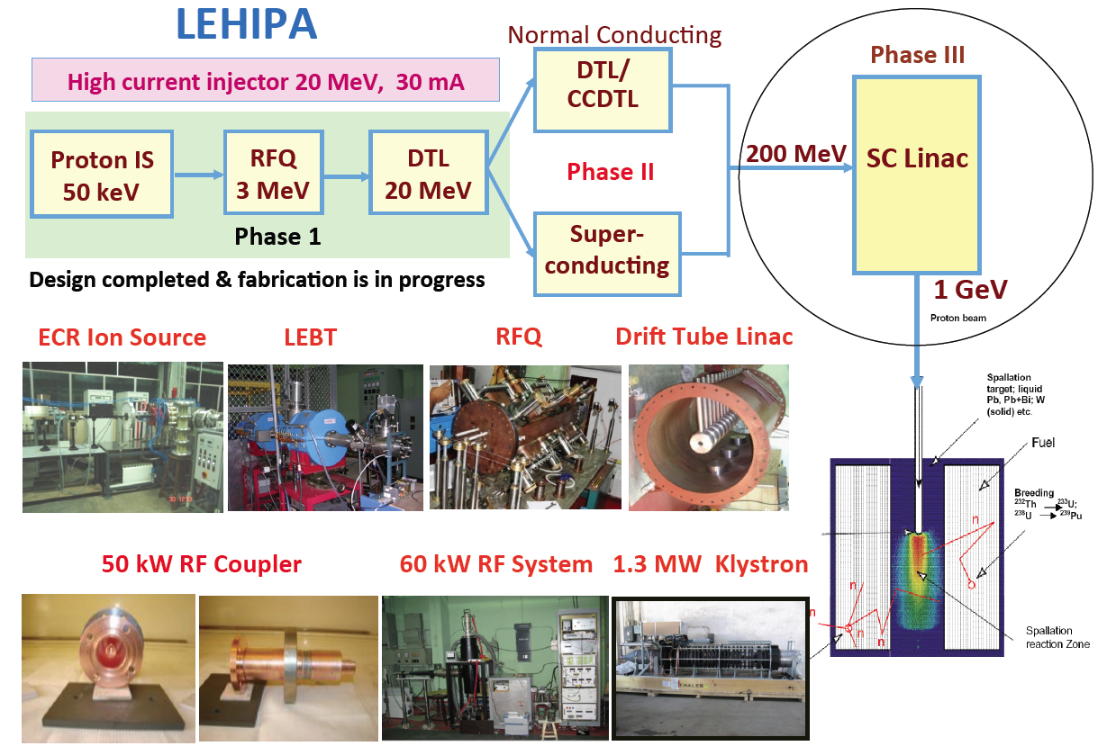
India ADS at BARC
Shashikant Degweker
India is mostly concentrating on the accelerator at this time
Study of a high-current, high-energy proton accelerator
(1 GeV and 30 mA), in collaboration with the USA (Old Fermilab Project X).
First phase: development of a 30 mA, 20 MeV linac injector (LEHIPA).
Second phase: accelerating the beam to an energy of 1 GeV by way of a superconducting linac.
Other AD R&D activities in may countries such as Venezuela, Turkey, Korea, Japan, Ukraine, UK (Aker Solutions with C. Rubbia) – Many activities in the world but a lack of cooperation

Slide 29
A brief history of ADS projects
Project | Neutron Source | Core | Purpose
FEAT (CERN) | Proton (0.6 to 2.75 GeV) (~10¹⁰p/s) | Thermal (≈ 1 W) | Reactor physics of thermal subcritical system (k≈0.9) with spallation source - done
TARC (CERN) | Proton (0.6 to 3.5 GeV) (~10¹⁰p/s) | Fast (≈ 1 W) | Lead slowing down spectrometry and transmutation of LLFP - done
MUSE (France) | DT (~10¹⁰n/s) | Fast (< 1 kW) | Reactor physics of fast subcritical system - done
YALINA (Belorus) | DT (~10¹⁰n/s) | Fast (< 1 kW) | Reactor physics of thermal & fast subcritical system - done
MEGAPIE (Switzerland) | Proton (600 Me) + Pb-Bi (1MW) | ----- | Demonstration of 1MW target for short period - done
TRADE (Italy) | Proton (140 MeV) + Ta (40 kW) | Thermal (200 kW) | Demonstration of ADS with thermal feedback - cancelled
TEF-P (Japan) | Proton (600 MeV) + Pb-Bi (10W, ~10¹²n/s) | Fast (< 1 kW) | Coupling of fast subcritical system with spallation source including MA fuelled configuration – reactivated
SAD (Russia) | Proton (660 MeV) + Pb-Bi (1 kW) | Fast (20 kW) | Coupling of fast subcritical system with spallation source - cancelled
TEF-T (Japan) | Proton (600 MeV) + Pb-Bi (200 kW) | ----- | Dedicated facility for demonstration and accumulation of material data base for long term – reactivated
MYRRHA (Belgium) | Proton (600 MeV) + Pb-Bi (1.8 MW) | Fast (60 MW) | Experimental ADS – under design, not fully funded, 2025?
CADS (China) | Protons (0.6 – 1.5 GeV) | Fast (100–>1000MW) | Four phase project: 2011 – 2032
U-ADS (Ukraine) | Electrons (100 MeV) | 100 kW | Uranium-based ADS prototype (KIPT) Status??
ADS (Russia) | Protons (250-500 MeV) | 1-5 MW | Using an existing facility at Troitsk – under consideration promoted by iThEC

Slide 30
Accelerator requirements
Choices for an industrial system will rely on specifications in terms of:
  Beam power: 1-10 MW depending of choice of k value, and desired unit power; E_{beam} ≥ 900 MeV
  Beam losses: minimize irradiation of the accelerator and of the environment; impact on the maintenance (minimize and localize beam losses)
  Reliability, minimize beam trips (have multiple sources); ease of maintenance
  Beam stability and control: 1% fluctuation on beam intensity is 1% fluctuation on the thermal power; beam intensity to be varied by a factor ≥ ?2
  Energy efficiency: maximize fraction of electric grid power stored into the beam) Improves with increasing beam power.
  Size, cost

Slide 31
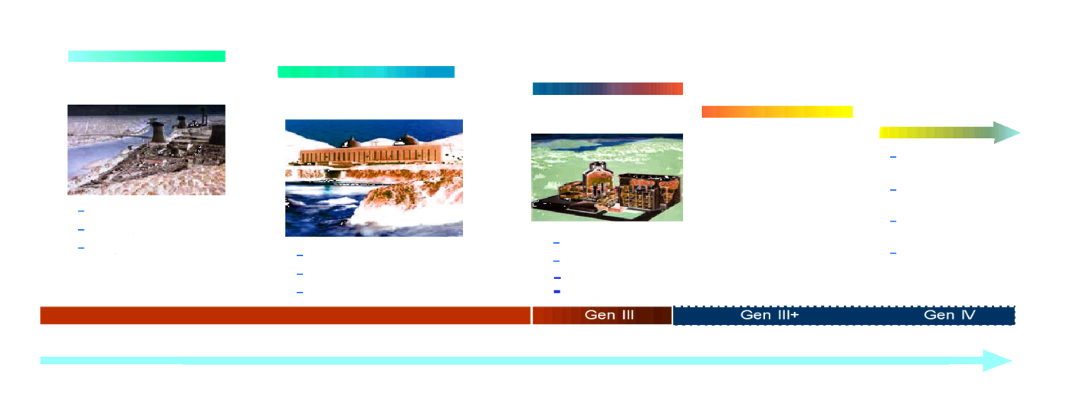
Development is Time-Consuming

Slide 32
Concluding remarks
Accelerator-driven systems offers a unique level of safety, which give operational flexibility to future systems for safe and clean energy production and waste transmutation
Present accelerator technology offers the possibility of closing the thorium fuel cycle. The Energy Amplifier is one of the examples with high potential
iThEC aims to promote the deployment of these technologies

Slide 33
Thank You

Slide 34
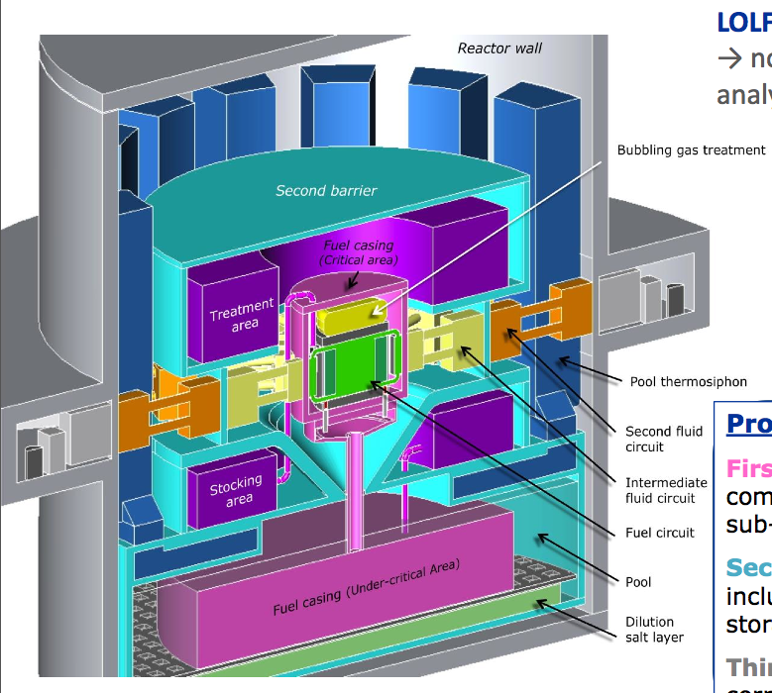
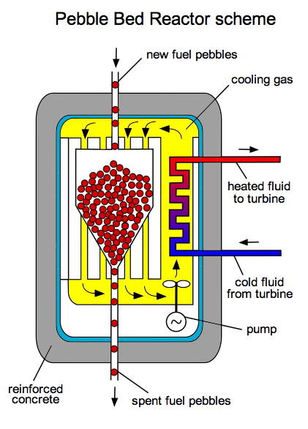
How to use thorium in practice?
Thorium blankets around fast critical reactors to breed ²³³U: the Indian approach, at the cost of maintaining three different nuclear reactor technologies
Continuously circulating fuel to always have fresh fuel in the core
Pebble bed or molten salt critical reactors (MSR) or Traveling wave reactors?
Provide extra neutrons with an accelerator: ADS
Pebble bed Scheme
Pebble-bed and Molten salt reactors have both severe issues to be resolved, mainly in terms of safety, in addition to the fact that they do not provide (so far) a fast neutron flux
Molten Salt Reactor Scheme

Slide 35
Thorium blanket: Indian strategy
India, with little uranium resources but a lot of thorium, has the most advanced practical scheme for using thorium (including front-end and back-end of the fuel cycle):
  Use heavy water reactors (CANDU) or LWR to produce plutonium
  Use sodium cooled U-Pu fast reactors with a thorium blanket to breed ²³³U
  Reprocess blankets and manufacture ²³³U-Th fuel for advanced fast reactors or heavy water reactors
The Indian scheme works. However, several issues remain concerning the complexity (three technologies), the sustainability and nuclear waste management.

Slide 36
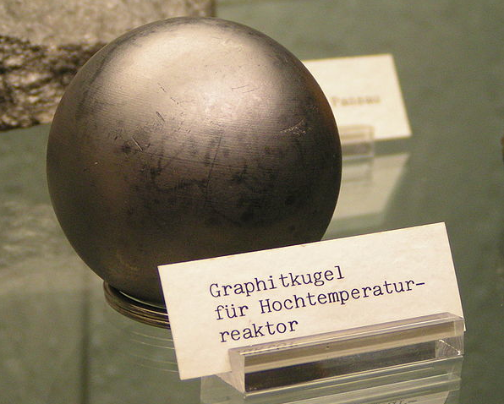
Pebble bed critical reactors
Proposed by Farrington Daniels at Oakridge, in the 1940s. Initial developments in Germany (AVR Jülich), followed by THTR-300MW (1983-1989). New developments in South Africa, now in the United States and Turkey.
  Presented as passively safe, as high temperature
  systems can be cooled by natural air convection
Several severe issues to be resolved:
  No containment building if cooling by
  natural air convection
  Uses flammable graphite as moderator
  Produces more high-level nuclear waste than
  current nuclear reactor designs
  Relies heavily on pebble integrity and fuel
  handling (pebble accident in THTR-300)
  Water ingress, reprocessing virtually impossible,
  etc.
Notes:
The THTR-300 was a thorium high-temperature nuclear reactor rated at 300 MW electric (THTR-300). The German state of North Rhine Westphalia, in the Federal Republic of Germany, and Hochtemperatur-Kernkraftwerk GmbH (HKG) financed the THTR-300’s construction.[1]
Operations started on the plant in Hamm-Uentrop, Germany in 1983, and it was shut down September 1, 1989. The THTR was synchronized to the grid for the first time in 1985 and started full power operation in February 1987.[2]
Whereas the AVR was an experimental pebble bed high-temperature reactor (HTR) used to develop the pebble fuel, the THTR-300 served as a prototype HTR to use the TRISO pebble fuel.
670,000 spherical fuel compacts each 6 centimetres (2.4 in) in diameter with particles of uranium-235 and thorium-232 fuel embedded in a graphite matrix

Slide 37
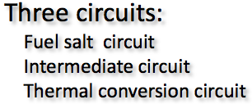
Molten salt critical reactors
This is clearly a technology that is concentrating interest (10 talks related to the subject at ThEC13): China, India, UK, USA, Czech Republic, France, Switzerland
Pioneered at Oakridge in 1960 (Molten Salt Reactor Experiment, UF4, 7.4MWth)
Advantages:
  Liquid fuel allows extending burnup indefinitely,
  because of reprocessing on-line
  High temperature (500˚C – 600˚C),
  heat produced directly in heat transfer fluid
  Passive cooling for decay heat removal
Several severe issues: neutrons emission,
on-line chemistry failure, corrosion,
licencing issues, etc.
Presently not using a fast neutron
spectrum (R&D should be extended to
other salts – PbCl₃, to minimize waste)
There is a particularly well focussed and
ambitious effort in China (Xu Hongjie,
Shanghai Institute of Applied Physics)
F-Li-Be salt
(Flibe)
Chemistry on-line
Elsa Merle-Lucotte @ ThEC13
Notes:
This cracking could be reduced by adding small amounts of niobium to the Hastelloy-N.
SINAP: Shanghai Institute of

