Slide 1
Design of beam lines inside 11T dipoles and TCLD collimators cryostats
Q. Deliege in collaboration with C. Garion, DLM section, V. Baglin, G. Bregliozzi, E. Page, J. Finelle, N. Zelko.
TE-VSC Seminar
Friday, 10th June 2016
CERN

Slide 2
Outline
Project guideline and status
Design of critical components
Instrumentation, integration and quality
Conclusion

Slide 3
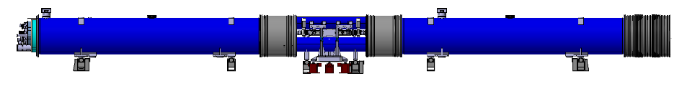
Integration baseline
Aim: Replace a main dipole (or a connection cryostat) by 2 11T dipoles (or 2 connection cryostats) and 1 TCLD collimator at several places in IR7 and IR2.
15660 mm
11 T dipole cold mass
By-pass cryostat
Interconnect
Space for Collimator
F. Savary, Introduction and New 11T Plan in HL-LHC, 6th April 2016

Slide 4
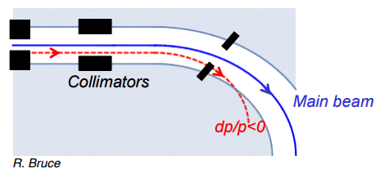
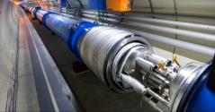
Goals
Create space in the DS regions of the LHC to install TCLD collimators (Target Collimator Long Dispersion suppressor)
These collimators will be installed to clean particles that start deviating downstream of LSS collimators in order to protect exposed magnets.
The pair of 11T dipoles will produce the same integrated field than a main dipole (119 T.m)

Slide 5
Needs and timeline
For more details F. Savary, HL-LHC integration meeting, https://indico.cern.ch/event/502026/
1 Bypass cryostat prototype
P2: 4 Connections cryostats + 2 bypass cryostat
IP7: 4 11T dipoles + 2 bypass cryostat
1 11T dipole spare unit*
1 prototype RRP
IP7: 4 11T dipoles + 2 bypass cryostat
1 11T dipole spare unit*
1 prototype PIT
Quantities to be confirmed
*The prototypes can be used as spare
TE-VSC aim: not to be the limiting element i.e we need to have assembled the bypass cryostat by the end of 2017 and the first dipole before LS2 (end 2018) and have the components ready to install in the other units (fully tested and controlled).
Note: The beam screen facility won’t be ready before mid-2017

Slide 6
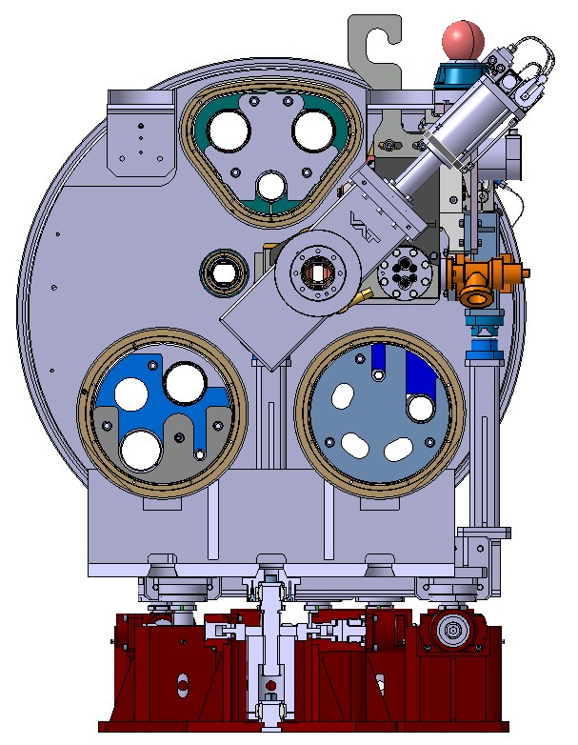
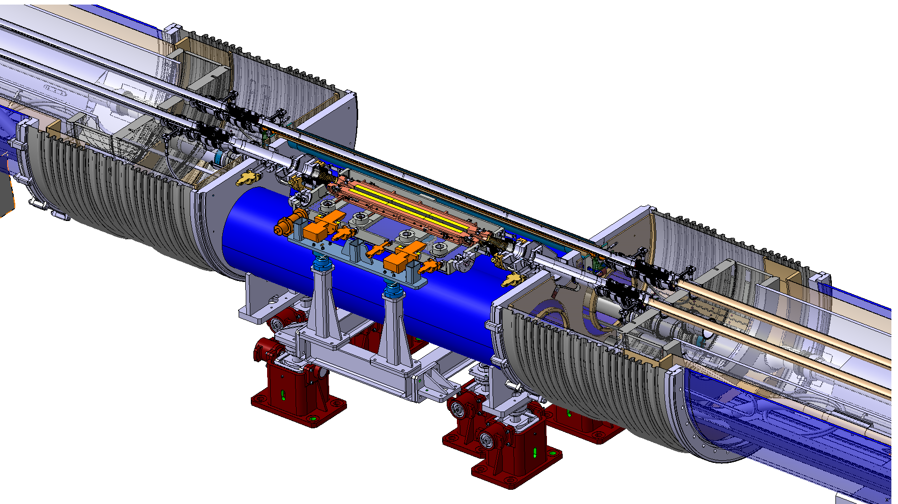
Current design status of beam lines
11T dipole or connection cryostat
Bypass cryostat
Cryogenic beam line with:
- High conductivity copper cold bore cooled down with superfluid He inside the collars at both ends
- Low conductivity supports designed by TE-MSC
Standard beam screen extremities &
DN100 collars
Standard beam screens (not represented) and cold bores with adapted lengths
11T dipole or connection cryostat
SSS BS bellows adapted to operational thermal contractions and interconnection length
SSS-MB Plug-In-Modules (PIM) adapted to operational thermal contractions
Cold/Warm Transition (CWT) with:
- RF ball port with grid for beam stabilisation
- Removable Penning extension
Bake out jackets for valves/collimator and tooling for welding, coating, transportation, storage of components.
800 mm TCLD Collimator with:
- 1 Pirani & 2 Penning pressure gages
2 NEG Ion pump D-500-5 Nextorr
1 VVFMF valve for mobile pumping
Non standard DN63 valve with CF63 – Conical CF100 flanges
ST0660382 – Christophe Mucher
Finished
On going
Not started

Slide 7
Outline
Project guideline and status
Design of critical components
Instrumentation, integration and quality
Conclusion

Slide 8
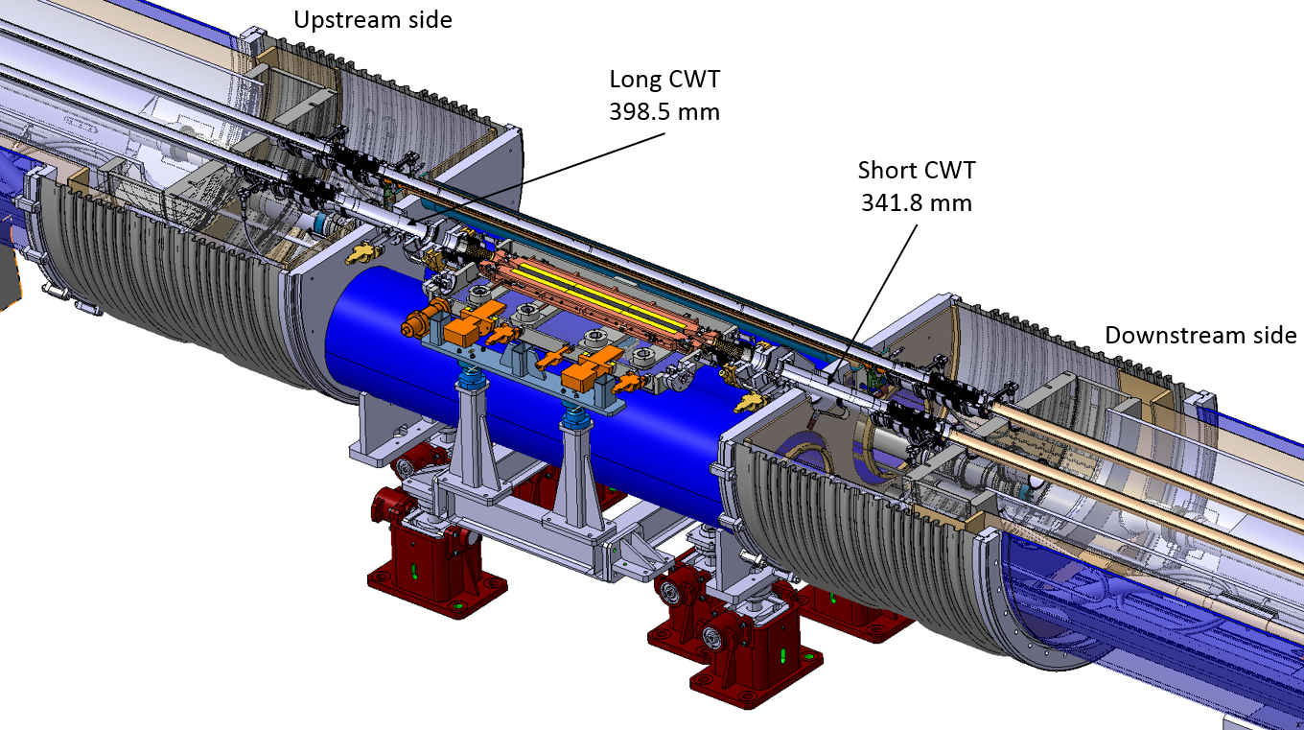
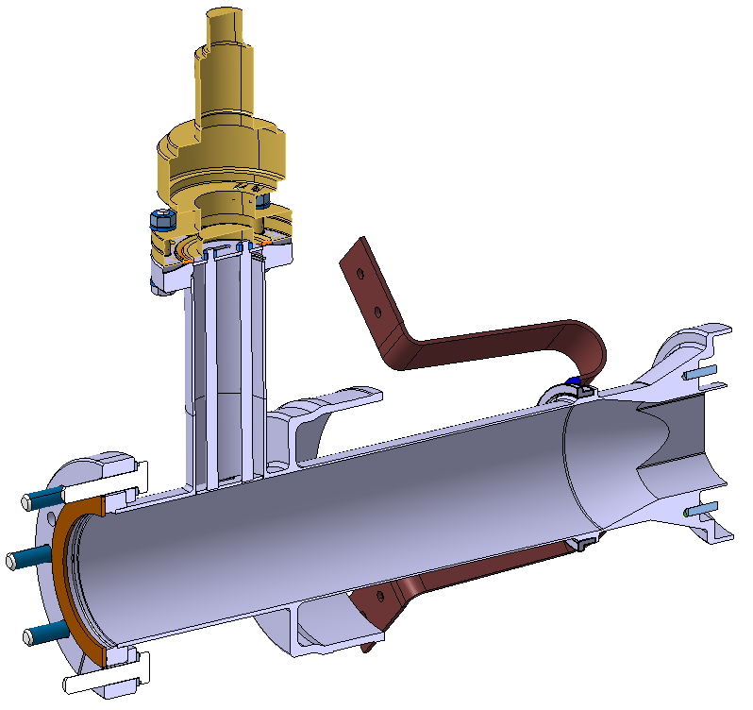
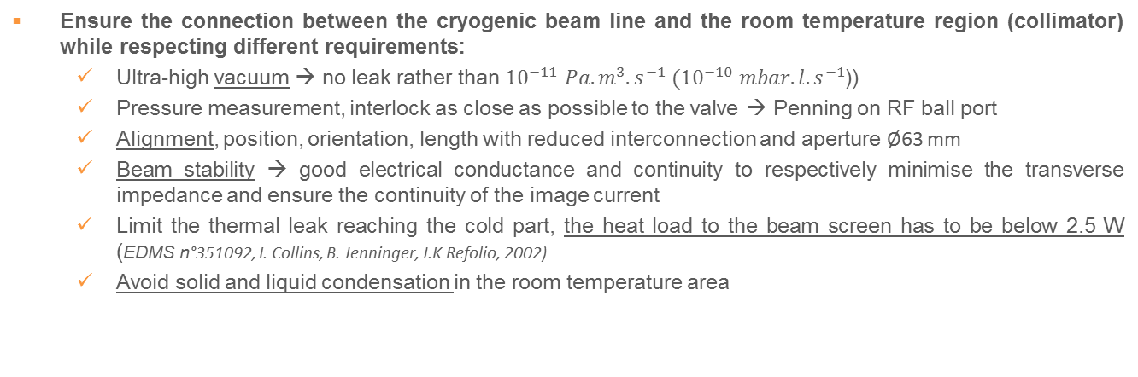
Cold-Warm Transition (CWT) - Requirements
Ensure the connection between the cryogenic beam line and the room temperature region (collimator) while respecting different requirements:
  Ultra-high vacuum → no leak rather than ${10}^{−11} Pa.m^{3}.s^{−1} ({10}^{−10} mbar.l.s^{−1}$))
  Pressure measurement, interlock as close as possible to the valve → Penning on RF ball port
  Alignment, position, orientation, length with reduced interconnection and aperture Ø63 mm
  Beam stability → good electrical conductance and continuity to respectively minimise the transverse impedance and ensure the continuity of the image current
  Limit the thermal leak reaching the cold part, the heat load to the beam screen has to be below 2.5 W (EDMS n°351092, I. Collins, B. Jenninger, J.K Refolio, 2002)
  Avoid solid and liquid condensation in the room temperature area

Slide 9
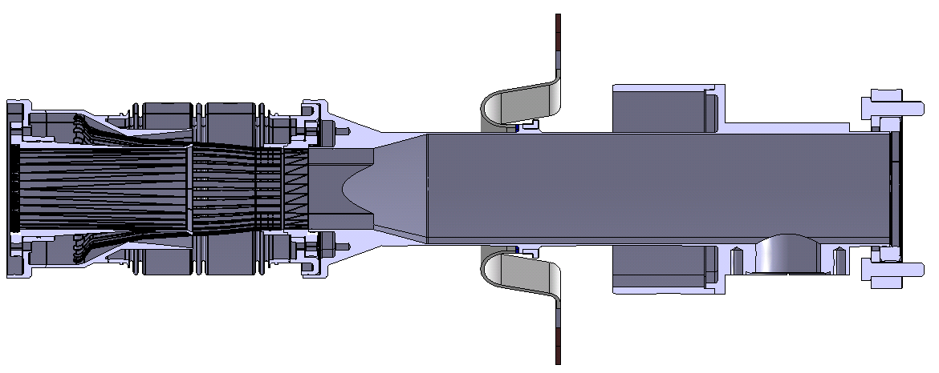




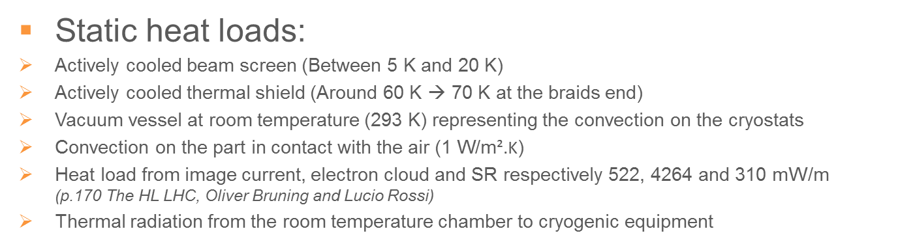






CWT - Finite element model
Static heat loads:
Actively cooled beam screen (Between 5 K and 20 K)
Actively cooled thermal shield (Around 60 K → 70 K at the braids end)
Vacuum vessel at room temperature (293 K) representing the convection on the cryostats
Convection on the part in contact with the air $\text{(1 }\text{W}\text{/}\text{m}\text{².}\text{K}\text{)}$
Heat load from image current, electron cloud and SR respectively 522, 4264 and 310 mW/m
(p.170 The HL LHC, Oliver Bruning and Lucio Rossi)
Thermal radiation from the room temperature chamber to cryogenic equipment
$$70K$$
$$Convection$$
$$L_{2}$$
$$L_{4}$$
Use of equivalent material for PIM RF fingers
Use of thin layer to represent the copper coating inside the CWT drift tubes
$$5K$$
$$Heat loads$$
$$Radiation$$
$$293K$$
$$Insulation vacuum$$
$$Ambient air$$
Where to position the heat interception (70K) ?

Slide 10
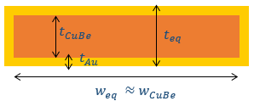
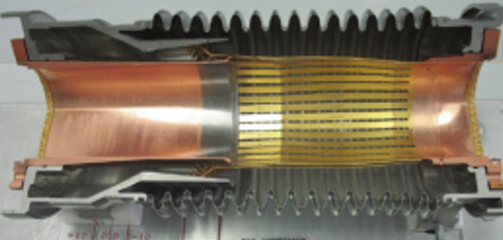
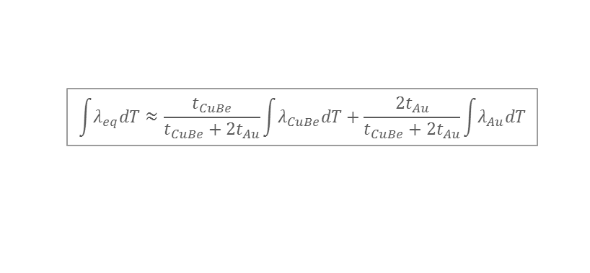
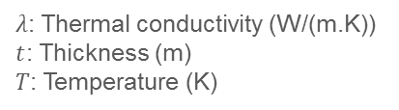
CWT - Material properties
Equivalent CuBe RF finger with 5 μm Au coating:
$$\int{λ_{eq}dT}≈\frac{t_{CuBe}}{t_{CuBe}+2t_{Au}}\int{λ_{CuBe}dT}+\frac{{2t}_{Au}}{t_{CuBe}+2t_{Au}}\int{λ_{Au}dT}$$
𝜆: Thermal conductivity (W/(m.K))
$t$: Thickness (m)
$T$: Temperature (K)
Data from MPDB database

Slide 11



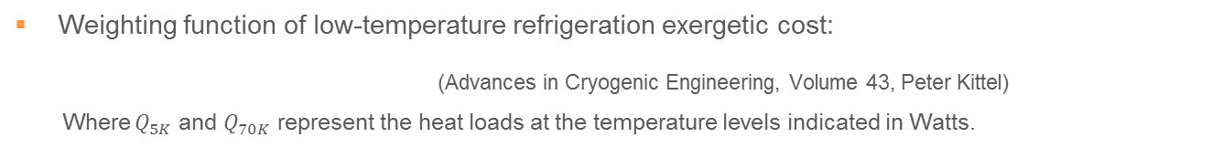



CWT - Thermal performance
$$70K$$
$$5K$$
$$L_{2}$$
$$L_{4}$$
$$293K$$
Weighting function of low-temperature refrigeration exergetic cost:
(Advances in Cryogenic Engineering, Volume 43, Peter Kittel)
Where $Q_{5K}$ and $Q_{70K}$ represent the heat loads at the temperature levels indicated in Watts.
$$Q_{tot}=Q_{5K}∗125+Q_{70K}∗16$$
The minimum of exergetic cost corresponds to the best position for the heat interception (70K) to minimise the refrigeration cost.
Best configuration in terms of thermal performance

Slide 12
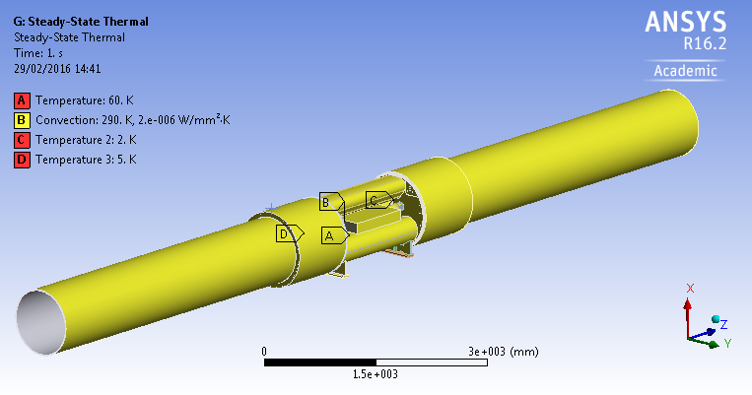
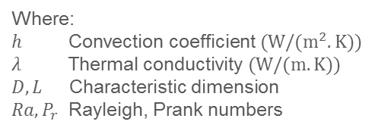
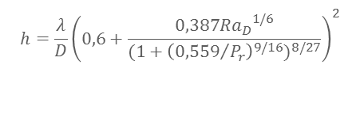


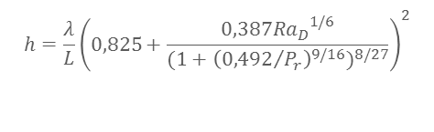
CWT - Condensation
Convection FE simulation on the entire model:
The convection coefficient has been set to an average value of 2 W/(m.K) assuming a small delta of temperature between the vacuum vessels and the air inside the LHC (around 17°C)
Churchill and Chu correlation and W. H. McAdams equations have been used to define the convection coefficient of each part in contact with the ambient air.
Analytical models used to calculate convection coefficients
$$h=\frac{λ}{D}{\left(0,6+\frac{0,387{{Ra}_{D}}^{1/6}}{{(1+{\left({0,559}/{P_{r}}\right)}^{9/16})}^{8/27}}\right)}^{2}$$
Horizontal cylinder
$$h=\frac{λ}{L}{\left(0,825+\frac{0,387{{Ra}_{D}}^{1/6}}{{(1+{\left({0,492}/{P_{r}}\right)}^{9/16})}^{8/27}}\right)}^{2}$$
Vertical plate
Horizontal plate cold surface facing down
$$h=\frac{λ0,27{{Ra}_{L}}^{1/4}}{L}$$
Horizontal plate cold surface facing up
$$h=\frac{λ0,14{{Ra}_{L}}^{1/3}}{L}$$
Where:
$h$ Convection coefficient$(W/(m^{2}.K))$
$λ$ Thermal conductivity $(W/(m.K))$
$D, L$ Characteristic dimension
$Ra,P_{r}$ Rayleigh, Prank numbers

Slide 13
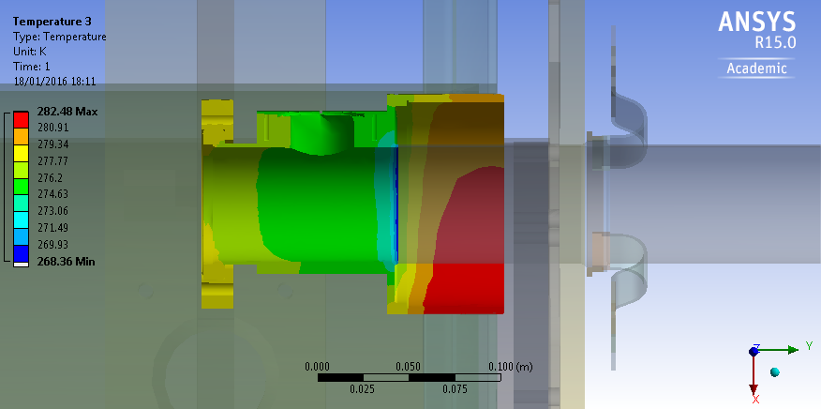
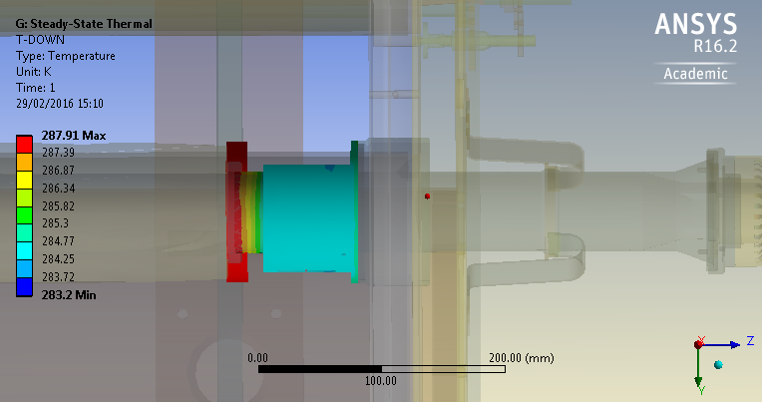
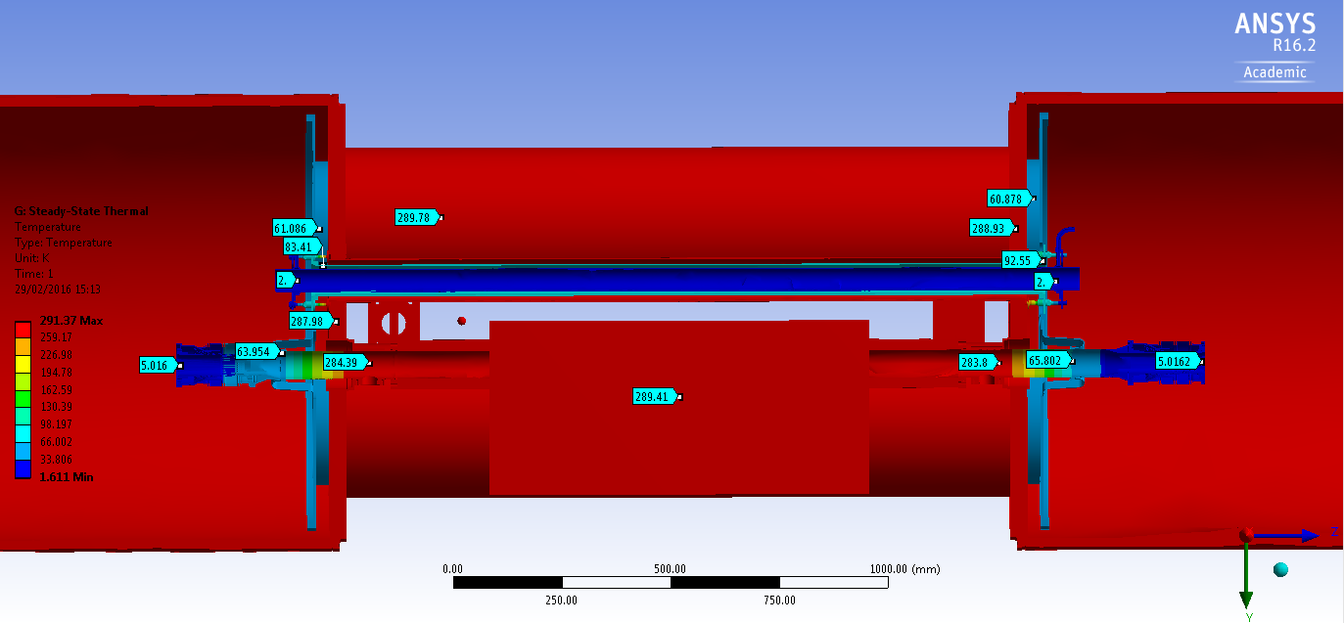
CWT - Condensation
Temperature on the part in contact with ambient air
Dew point temperature as a function of the ambient air temperature for 70% of humidity.
L4 = 100 mm
Average temperature in the LHC tunnel
Temperature repartition on cryostats and beam lines
L4 = 148 mm
We might observe a bit of condensation but very locally together with low temperature of high humidity rate.

Slide 14

CWT - Thermal performance
$$70K$$
$$5K$$
$$L_{2}$$
$$L_{4}$$
$$293K$$
Weighing function of low-temperature refrigeration exergetic cost:
(Advances in Cryogenic Engineering, Volume 43, Peter Kittel)
Where $Q_{5K}$ and $Q_{70K}$ represent the heat loads at the temperature levels indicated in Watts.
$$Q_{tot}=Q_{5K}∗125+Q_{70K}∗16$$
The minimum of exergetic cost corresponds to the best position for the heat interception (70K) to minimise the refrigeration cost.
Best configuration in terms of thermal performance

Slide 15
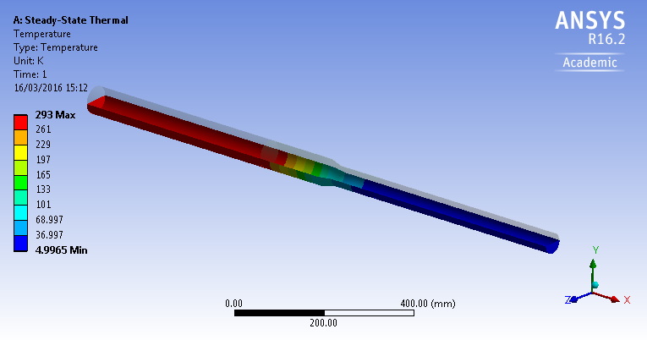
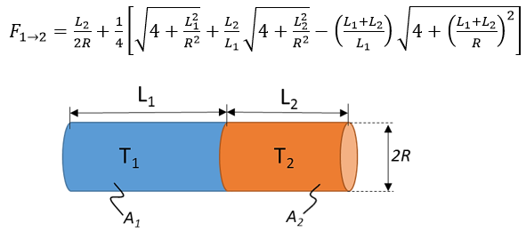
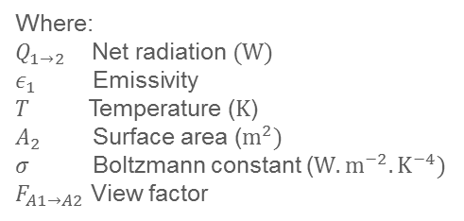
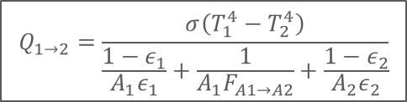
CWT - Radiation
Net radiation analytical model:
$$Q_{1→2}=\frac{σ\left(T_{1}^{4}−T_{2}^{4}\right)}{\frac{1−ε_{1}}{A_{1}ε_{1}}+\frac{1}{A_{1}F_{A1→A2}}+\frac{1−ε_{2}}{A_{2}ε_{2}}}$$
Where:
$Q_{1→2}$ Net radiation$(W)$
$ε_{1}$ Emissivity
$T$ Temperature ($K$)
$A_{2}$ Surface area ($m^{2})$
$σ$ Boltzmann constant (${W.m}^{−2}.K^{−4})$
$F_{A1→A2}$ View factor
CWT radiation model settled as surface to surface with 0.05 surface emissivity (copper coating)
With a view factor analytical model:
Heat loads due to radiation reaching each parts
Little influence of the radiation for this aperture
More details in the note, EDMS 1610910, Thermal radiation simulation guidelines for cylindrical enclosures, M.Sitko, Q. Deliege

Slide 16
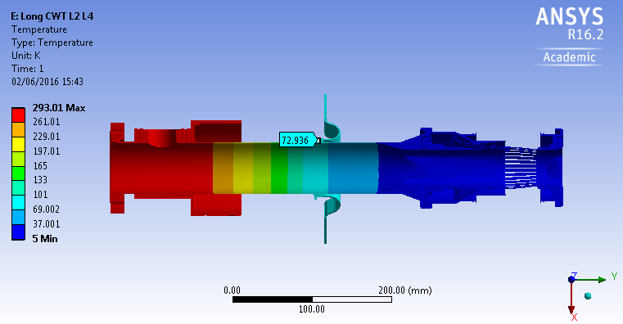
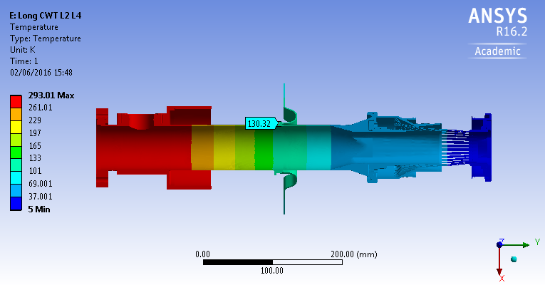
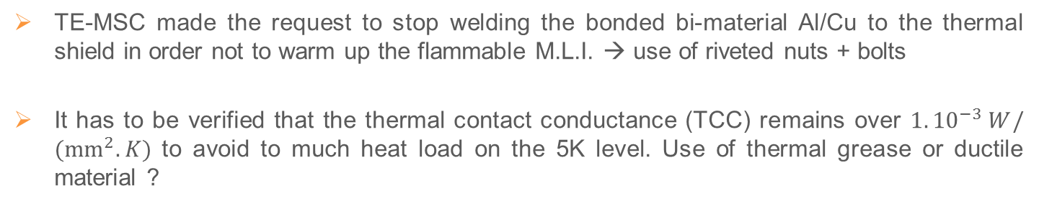

CWT - Braids
TE-MSC made the request to stop welding the bonded bi-material Al/Cu to the thermal shield in order not to warm up the flammable M.L.I. → use of riveted nuts + bolts
It has to be verified that the thermal contact conductance (TCC) remains over $1.{10}^{−3} W/({mm}^{2}.K)$ to avoid to much heat load on the 5K level. Use of thermal grease or ductile material ?
Perfect TCC
$TCC=1.{10}^{−3} W/({mm}^{2}.K)$

Slide 17
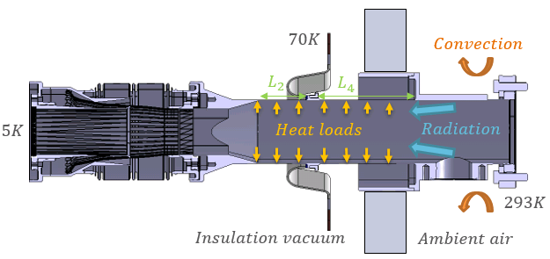
CWT - Conclusion
CWT drift tube total length (mm) | Short 148 mm | Long 214 mm | Average on both CWTs
PIM position | Upstream | Downstream
Exergetic costs (W) | 324 W | 210 W | 267 W
L2 (mm) | 0 mm | 66 mm | -
L4 (mm) | 148 mm | 148 mm | -
Heat load 5K including radiation (W) | 2,30 W | 1,23 W | 1,68 W
Heat load 70K including radiation (W) | 2,30 W | 3,49 W | 2,90 W
Not the best configuration for thermal performances but would avoid liquid and solid condensation.
The TCCs were considered as perfect in the different simulations. It would be interesting to carry out precise study on TCC, especially on the PIM that contributes a lot to reduce the heat load to the beam screen.

Slide 18
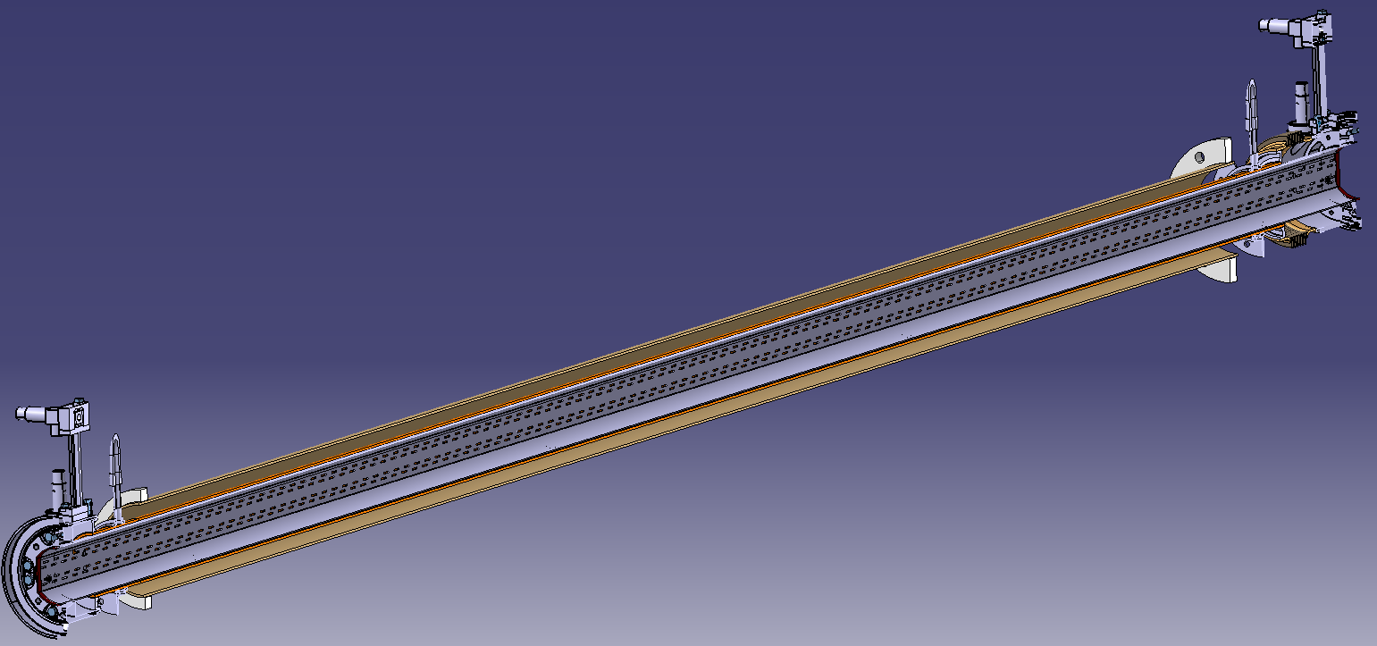
Cryogenic line design

Slide 19
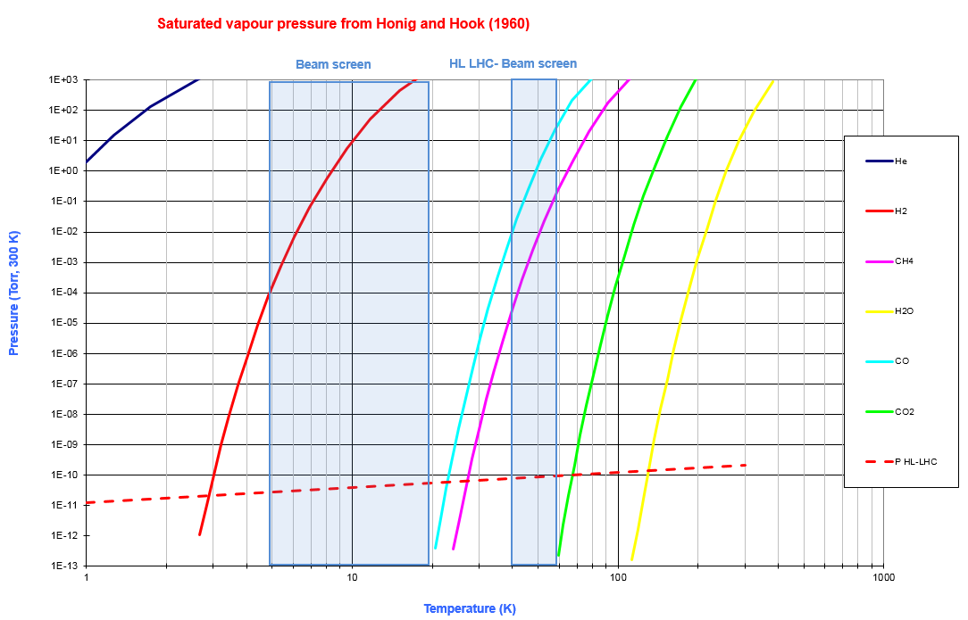
Cryogenic line design
Saturated vapour pressure from Honig and Hook (1960)
Courtesy V. Baglin
The cold bore temperature should remain < 2.7 K, where H2 saturated vapour pressure > HL-LHC beam vacuum baseline

Slide 20
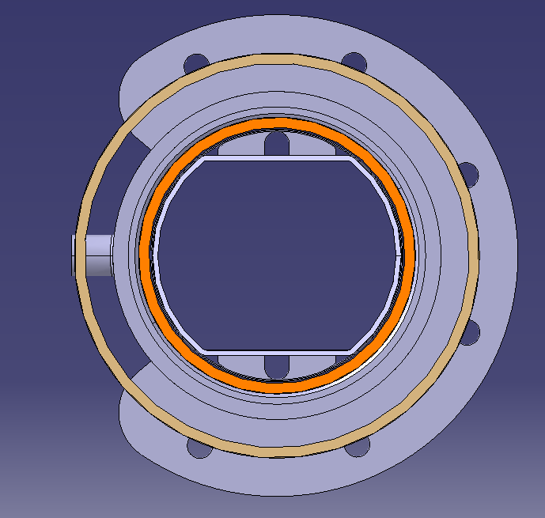
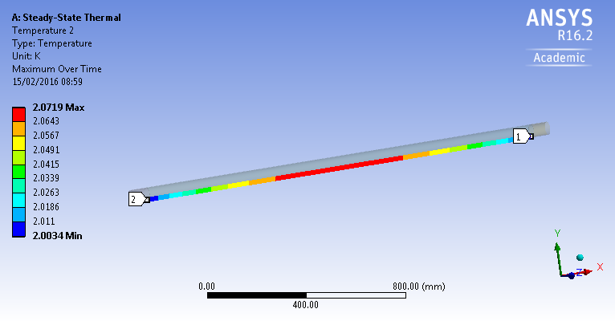
Cryogenic line – First FE approach
Load conditions
Thermal shield temperature: 70 K (conservative, usually 55-70 K)
He cooling rings temperature: 2 K on both sides of the cold bore
Perfect radiation: thermal shield → cold bore
Heat load: 0.009 W beam screen → cold bore (Edms n°350448)
Heat load: 0.035 W per support → cold bore (Ján Hrivňák presentation)
Materials
SS 316 LN: He cooling rings – welding nozzles
Al 1050: Thermal shield
Cu OFE RRR 70: Cold bore 170 W/(K.m) at 2 K
Radiation
TS-CB
70K
Heat load BS-CB
Thermal shield
2K
Cold bore
Beam screen

Slide 21
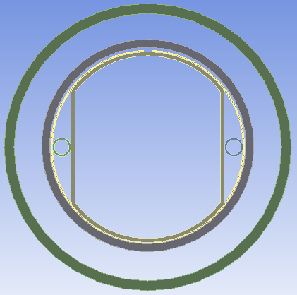
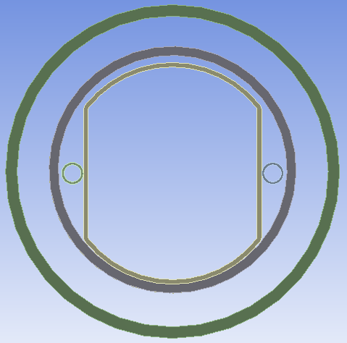
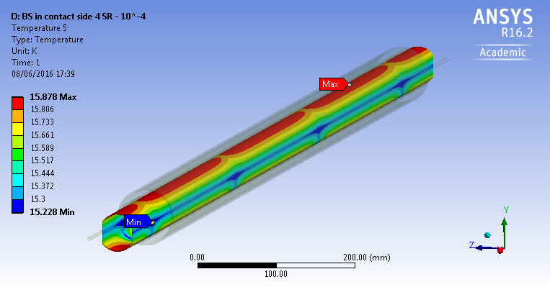
Cryogenic line – Second FE approach
Contact on the side, where the BS temperature is the highest.
Heat load from the beam around 5 W/m to the BS
Homogenous contact between 4 sliding rings and the CB on the entire length
No sliding ring, constant contact between the BS and the CB on the entire length

Slide 22
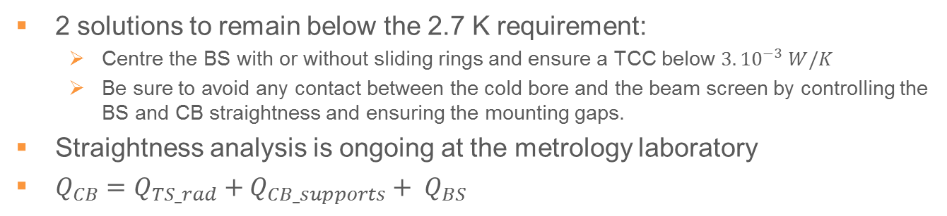
Cryogenic line – Second FE approach
2 solutions to remain below the 2.7 K requirement:
  Centre the BS with or without sliding rings and ensure a TCC below $3.{10}^{−3} W/K$
  Be sure to avoid any contact between the cold bore and the beam screen by controlling the BS and CB straightness and ensuring the mounting gaps.
Straightness analysis is ongoing at the metrology laboratory
$Q_{CB}=Q_{TS_rad}+Q_{CB_supports}+ Q_{BS}$
Not settled yet

Slide 23
Plug-in-Module design (PIM)

Slide 24
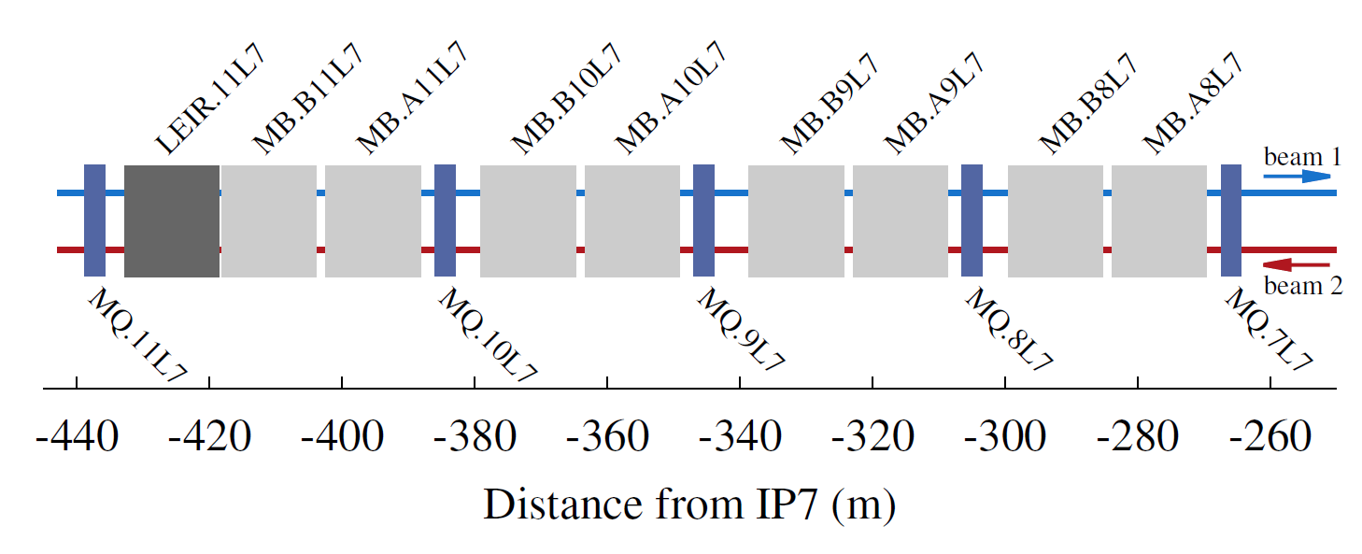
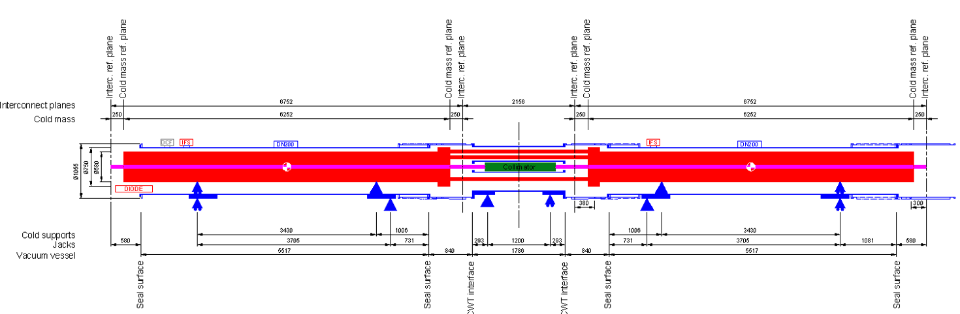
Plug-in-Module design (PIM)
Forecasted PIM displacement while replacing a MB.A10:
Maximum differential displacement (mm) | Temperature conditions | PIM MBHA UP | PIM UP (Cryo line) | PIM UP (RT line) | PIM DOWN (Cryo line) | PIM DOWN (RT line) | PIM MBHB DOWN
Cool down | CM1 at 150K BS at 293K CM2 at 293K | -5.93 | -11.09 | -11.09 | 3.63 | 3.63 | -0.19
 | Normal Operation CM1 at 1.8K 5K<BS<20K CM2 at 1.8K | 31.97 | 1.83 | 1.55 | 10.16 | 5.2 | 17.18
Warm up | CM1 at 293K BS at 150K CM2 at 150K | 30.83 | 13.47 | 13.27 | 3.8 | 0.01 | 13.3
Exeptional Service Conditions | Line C’ valve leaks during short intervention CM1<50K BS at 293K CM2<50K | -8.45 | -15.5 | -15.78 | 4.89 | 5.15 | -0.28
 | Line C’ valve leaks at a beginning of a cool down: CM1 at 293K BS at 150K CM2 at 293K | 30.83 | 13.28 | 13.27 | 3.99 | 0.01 | 13.3
At each interconnection the PIM expansion – compression is lower than the standard PIM installed in the LHC.
Problem for the image current continuity

Slide 25
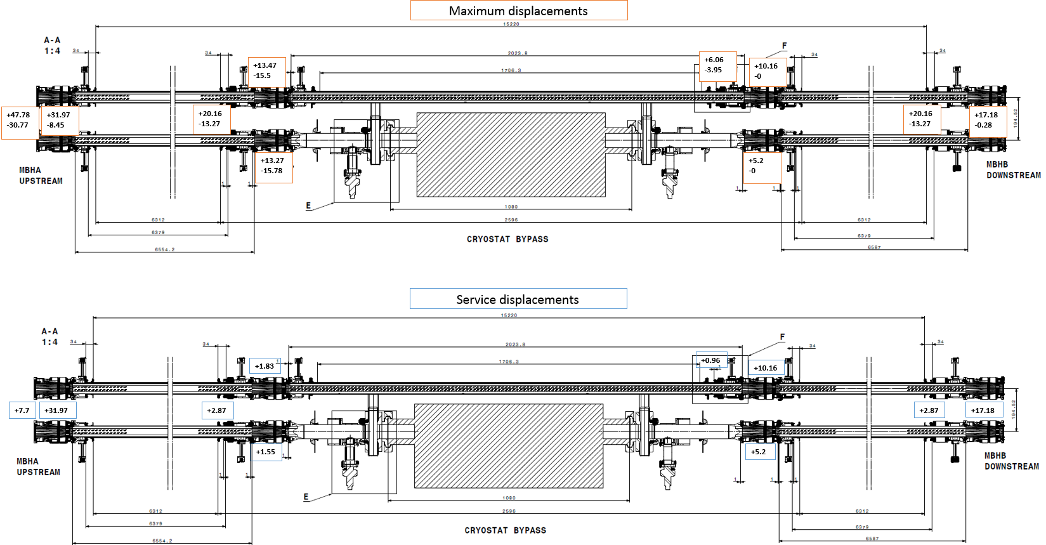
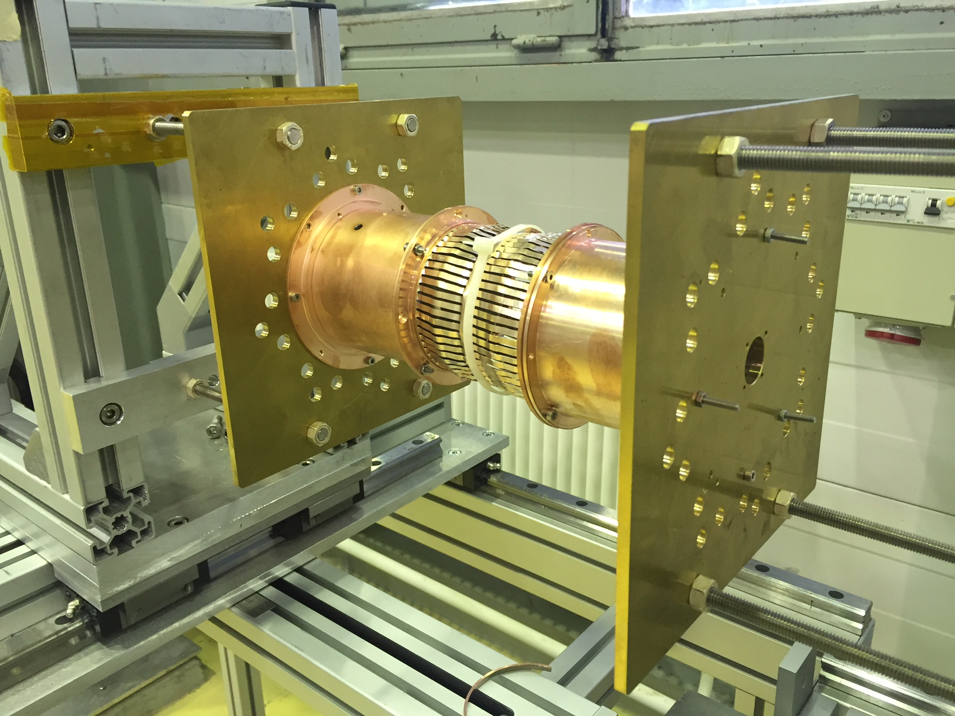
Plug-in-Module design (PIM)
4 PIM SSS-MB modified (standard 34.5 mm)
2 PIM MB-MB (40 mm)
2 PIM MB-SSS (22.1 mm)
Try to find the best configuration with standard PIM to ensure a good electrical contact. It will be measured on the test bench

Slide 26
Outline
Project guideline and status
Design of critical components
Instrumentation, integration and quality
Conclusion

Slide 27
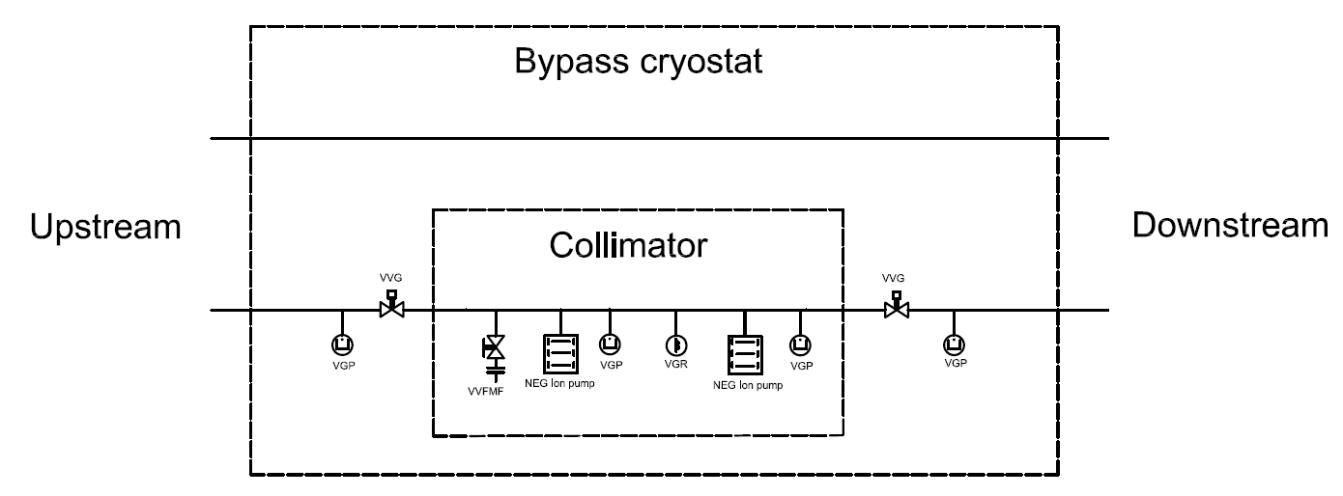
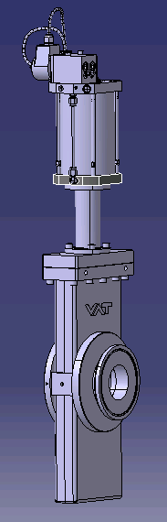
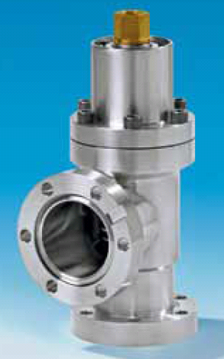
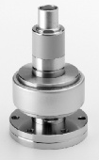
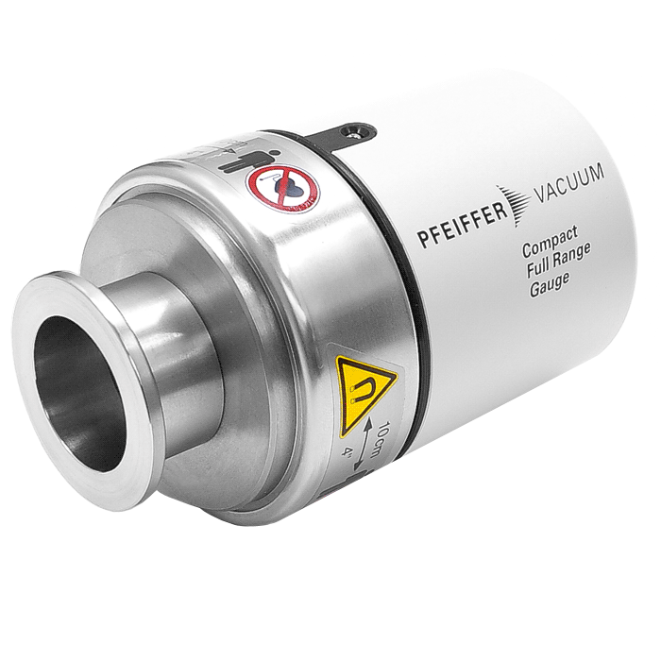
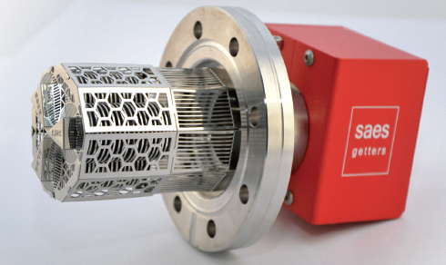
TCLD and bypass instrumentation
Vacuum performance with real collimators to be assessed (pumping speed of NEG cartridges, outgassing of materials)
All metal interlock gate valve VVG with integrated seal
All metal angle valve VVFMF for mobile pumping group
NEG Ion pump D-500-5 Nextorr (increases pumping efficiency for H2 and CH4)
Pressure gauge Pirani and Penning VGR/VGP

Slide 28
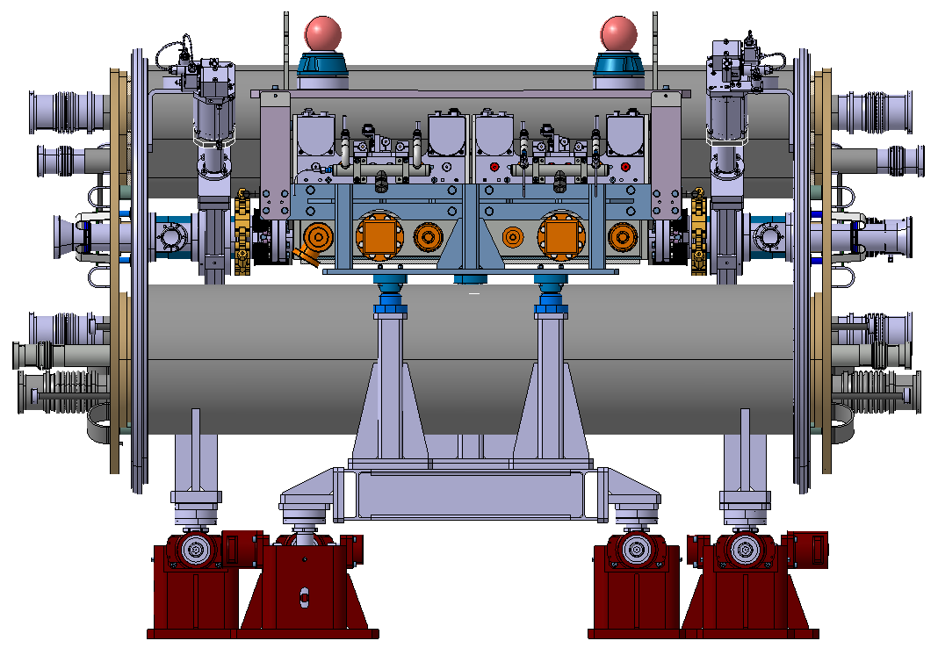
Integration and assembly
Room to mount the CWT on the valve and the Penning gauge
Room to mount the quick flanges and access the BPM flanges and collimator bellows
Room to assemble the vacuum instrumentation on the collimator
Room to bake out jackets

Slide 29
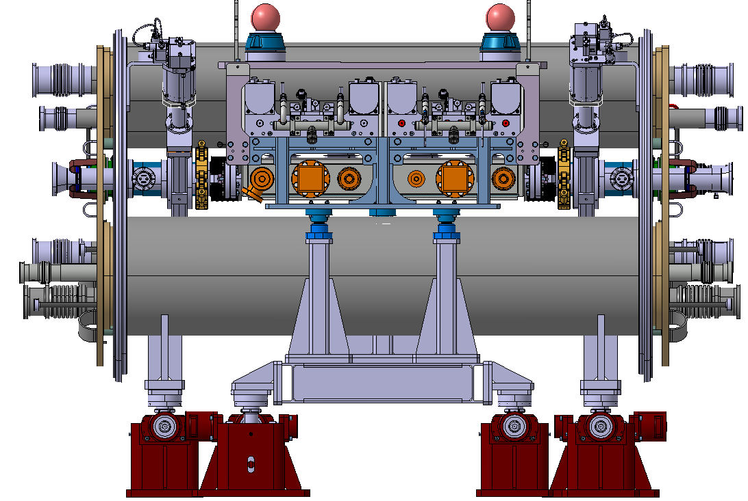
Integration and assembly
Some modifications have been done the last 2 weeks to improve the access to vacuum equipment.
It remains very tricky to assemble everything → further ways of improvement are under discussions

Slide 30

Integration and assembly
Any possible interference with survey, cryogenic equipment and transport have to be avoided

Slide 31


Bypass cryostat mockup (SMI2)
The prototypes of vacuum beam lines will be manufacture in the next months.
A bypass cryostat prototype is used for integration issues in SMI2.

Slide 32
Quality assurance – quality control
Conceptual specifications:
  From WP5 (collimation): EDMS n°1366517 and 1366519
  From WP11 (11T)
  From WP12 (Vacuum): EDMS n°1361087
Functional specifications (To be written)
Technical/engineering specifications (To be written)
Engineering documents and technical notes for main components (In progress for CWT, PIM and cryogenic line)
CDD equipment codes discussed with naming convention responsible:
  LHCVSSB_ for beam screen components
  LHCVCC__ for cold bore
  LHCVSTB_ for cold/warm transitions
  Integration drawings code to be defined
Drawing labels defined by LHC standards (EDMS n°1585240 and 1221536)
Manufacturing Inspection Plan (MIP) listing each manufacturing and quality control steps will be defined according to HL-LHC project management recommendations, UHV requirements and 11T project documentation management LHC-LBH-QA-0005. It will contain visual inspections, metrology control, welding inspections, pressure and leak tests results…
Assembly procedure establishment in collaboration with TE-MSC
Material procurement according to UHV requirements
Leak tests will be carried out after each manufacturing step
More details concerning HL-LHC project management recommandations in I. Bejar Alonso’s presentation, from PDR to TDR, October 2015

Slide 33
Conclusions
The design of beam lines inside 11T dipoles and TCLD collimators cryostats is still in progress.
A careful theoretical study on Thermal Contact Conductance together with an experimental study would be very interesting to carry out.
Electrical measurements on Plug-In-Modules will be done during the following weeks.
Prototypes of Cold-Warm Transitions and the cryogenic temperature beam line will be manufactured.
Functional and technical specifications have to be written as well as technical notes on specifically designed equipment.

Slide 34
Thank you for your participation !

Slide 35

Integration and assembly

Slide 36

Assembly procedure - On the surface
Note: protection tooling for transportation and storage is not represented
Bypass cryostat with beam lines aligned in the cryostat by surveyors and:
  Cold/warm transitions (CWT) welded on the vacuum vessel
  Valves screwed to CWTs with bake out jackets (To be checked with integration)
  Penning gauges installed
  Cold line equipped with beam screen, cooling tubes, cooling tube exits
  Superfluid Helium cooling collars welded to hoses
  Cold line supports assembled
Leak tests and pressure tests have to be carried out before sending the cryostat into the tunnel.

Slide 37
Assembly procedure - In the tunnel
  Final alignment of the bypass cryostat with 11T dipoles or connection cryostats
  Welding of interconnections (PIM for beam lines)
  Welding of the hoses carrying the He flow to the beam screens cooling tubes
  Collimator installation and beam line closure
  Mounting of collars on DN100 conical flanges linking the valves and the collimator bellows.
  Set up and control of the beam vacuum instrumentation
  Commissioning of room temperature and cryogenic temperature vacuum sectors
  Note: The bellows have to be protected up to the closure of the interconnection

Slide 38
List of beam lines components
CDD reference | Definition | ST reference | Quantity / bypass | Quantity / MBHA & MBHB or 2 connection cryostats
LHCVSSB_ | Warm upstream line |  | 1
LHCVSSB_ | Warm downstream line |  | 1
LHCVSSB_ | Cryogenic line |  | 1
LHCVSSB_ | MBHA V2 | ST0721080 |  | 1
LHCVSSB_ | MBHA V1 | ST0721087 |  | 1
LHCVSSB_ | MBHB V2 | ST0721090 |  | 1
LHCVSSB_ | MBHB V1 | ST0721093 |  | 1
LHCVSSB_ | Cold line assembly | ST0670736 | 1
LHCVSSB_ | Short copper cold bore ass. Up | ST0745721 | 1
LHCVSSB_ | Short copper cold bore ass. down | ST0745729 | 1
LHCVBMB_0002 | PIM | ST0152888 | 4 | 4
 | VAT valve with conical DN100 flange | ST0668056 | 2
 | Tensioning chain - CF 100 conical | ST0672539 | 2
LHCVSSB_0098 | Embout a souder male upstream | ST0677099 |  | 4
LHCLMQ_S0044 | Quadrupole welding flare V line | ST0721803 |  | 8
LHCVCC__0007 | Cold bore Ø50/53mm for 11T dipole | ST0695795 |  | 4
LHCVSSB_0097 | Embout a souder male downstream | ST0674129 |  | 4
LHCVSSB_0200 | Helium cooling collar | ST0692830 | 2
LHCVSSB_0196 | Manchon cold bore cuivre Ø50/54 | ST0670761 | 2
LHCVSSB_0194 | Embout a souder male upstream ID54 | ST0712272 | 1
LHCVSSB_0193 | Embout a souder male downstream ID54 | ST0712266 | 1
LHCVCC__0006 | Cold bore cuivre Ø50/54 | ST0676026 | 1
LHCVSTB_ | Short CWT cryostat BP coll. Ass. | ST0672337 | 1
LHCVSTB_ | Long CWT cryostat BP coll. Ass. | ST0717357 | 1
LHCVSSB_0162 | S/E Female cooling tube exit |  | 1 | 4
LHCVSSB_0161 | S/E Male cooling tube exit |  | 1 | 4
LHCVSSB_ | Ass. Beam screen BP cryostat V1 | ST0720086 | 1
LHCVSSB_ | Assembly beam screen 11T |  |  | 4
LHCVSSB_0192 | Ass. short beam screen bellow | ST0728371 | 1 | 2
LHCVSSBA0017 | Beam screen bellow Scodock B0102800 | ST0305551 |  | 2
 | Penning gauge |  | 4
 | Pirani gauge |  | 1
 | VVFMF valve for mobile pumping group |  | 1
 | INEG ion pump D-500-5 Nextorr |  | 2
Cold-warm transitions
LHCVSTB_0005 | Short CWT cryostat bypass coll. | ST0704675 | 1
LHCVSTB_0006 | Long CWT cryostat bypass coll. | ST0717362 | 1
LHCVSSB_0153 | Brazing ring CB51 Q1 | ST0326195 | 2
LHCVST__ | Braid Cold/warm transition ASS. | ST0740410 | 8
LHCVST__ | Copper braid | ST0740413 | 8
LHCVSSB_0155 | Braid end part 1 | ST0326281 | 8
LHCVSSB_0158 | Braid end part 2 | ST0326299 | 8
LHCVSSB_0159 | Bimettalic plate for Q1 | ST0326300 | 8
STDVFUHV0006 | V0172305MQ CWT CB53 FOR Q1 | ST0026422 | 2
LHCVSSB_0188 | DN63 Flange CWT extremity | ST0393796 | 2
SCEM : 47.62.83.112.5 | HEX HD SCREW M8X30 UHV FLANGE | ST0425234 | 16
LHCVST__0070 | Ass. Penning extension | ST0745812 | 2
LHCVST__ | Grid for RF ball port | ST0711134 | 2
LHCVST__ | Grid support for RF ball port | ST0745794 | 2
LHCVST__0067 | UHV CF flange DN40 with collar | ST0695165 | 2
LHCVST__ | Penning extension tube | ST0711136 | 2
LHCVST__0068 | UHV CF flange DN40 grid support | ST0684816 | 2
SCEM : 47.62.83.012.8 | HEX HD SCREW M6X25 UHV FLANGE | ST0392802 | 12
ISO 2338_4x16-A1 | Parallel pin unhardened 4x16 | ISO 2338_4x16 | 4
SCEM : 47.62.83.014.6 | HEX HD SCREW M6X35 UHV FLANGE | ST0465606 | 12
  List 90% complete containing all beam lines assemblies, components and sub-components. PIM and beam screen sub-components will be added when designed.
  80% of 2D drawings by the end of April. It will remain PIM, beam screens and assembly drawings.
  Spare of vacuum components are not included in this table.
  If available, the standard components will be taken from stocks. A list of components in stock is in progress.
Beam line assembly list
Components list
Sub-components example: Common components for the two CWTs

