Slide 1
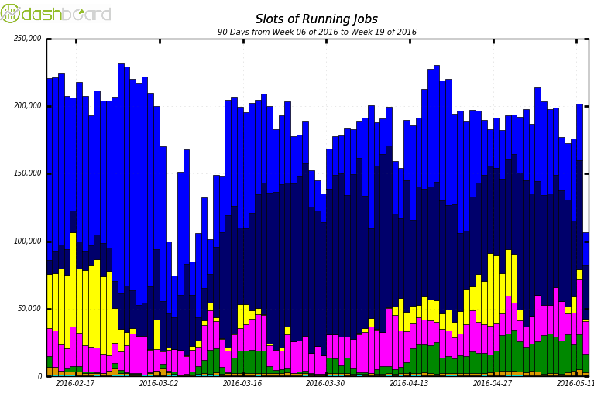
Offline Software and Computing status
Data processing steadily running beyond pledge
Athena 20.7 offline software delivered in Q1 2016. Will be used in 2016 and early 2017.
Smooth T0 operations so far: many improvements in the infrastructure and workflow
All 2015 pp data reprocessed with new software
2015 HI data processed in May after major improvements in CPU time and memory usage
MC Simulation
HI Processing
PP reprocessing
pledge
MC Reconstruction
Analysis Trains
Train Analysis producing samples with new software, for performance studies and physics analyses
First 2016 data processed by T0 and available on the Grid!

Slide 2
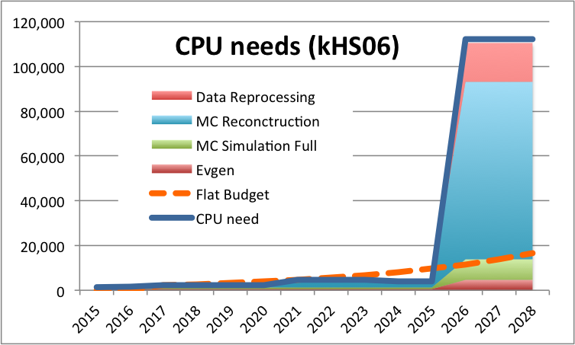
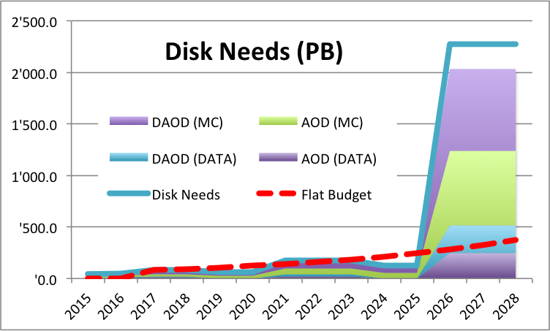
Evolution
New simulation release for the MC16 campaign starting June
  Improved geometry based on 2015 experience, based on Geant 4.10 (multithreading)
Reconstruction software working on Release21, which now builds on CMake
  To be used from 2017 until LS2, plan to validate the software by Fall 2016
AthenaMT (multithreaded offline framework) being actively developed
  Based on MT version of Gaudi, a widely used software which needs long term support
  AthenaMT planned to be ready by 2018, still many challenges to face
Initial studies on Computing for HL-LHC

