Slide 1
CMS Report
Daniele Bonacorsi
David Lange

Slide 2
CMS offline/computing management changes
CMS is now stably operating with 2 offline+computing project coordinators
  Each having a 2 year term
  Staggered as to have one coordinator per year
September 1: D. Lange replaced by
Liz Sexton-Kennedy (FNAL)

Slide 3
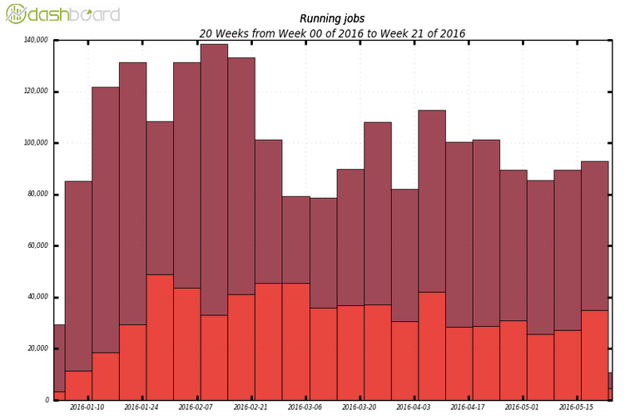
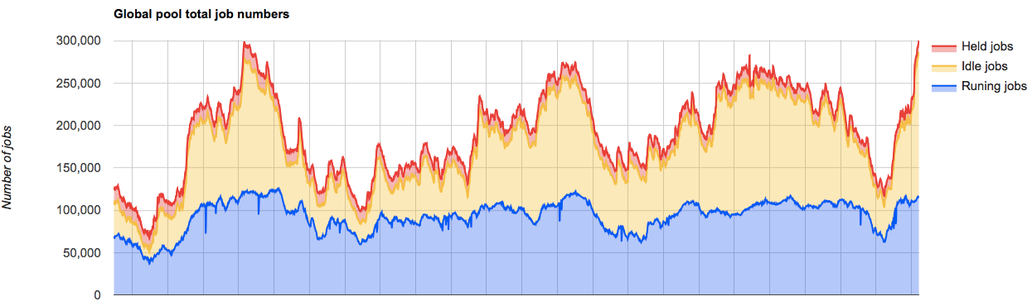
Resource usage remains high
Global pool running
at ~100k jobs regularly
Production
Analysis
d
May 1
today

Slide 4
Distributed analysis at all time high
Unprecedented levels in 2016
  # of distinct individuals per week
  slots used at all Tier levels
Started with a ramp
at Run-1 levels
  to complete Moriond analyses
Continued to stay high
  as samples - on average - started on be available more and more quickly
Bigger load continues to be our best “real-life” test of LS1 (and beyond) improvements
  good also as we now have collected sufficient data on miniAOD usage for study later in the year

Slide 5
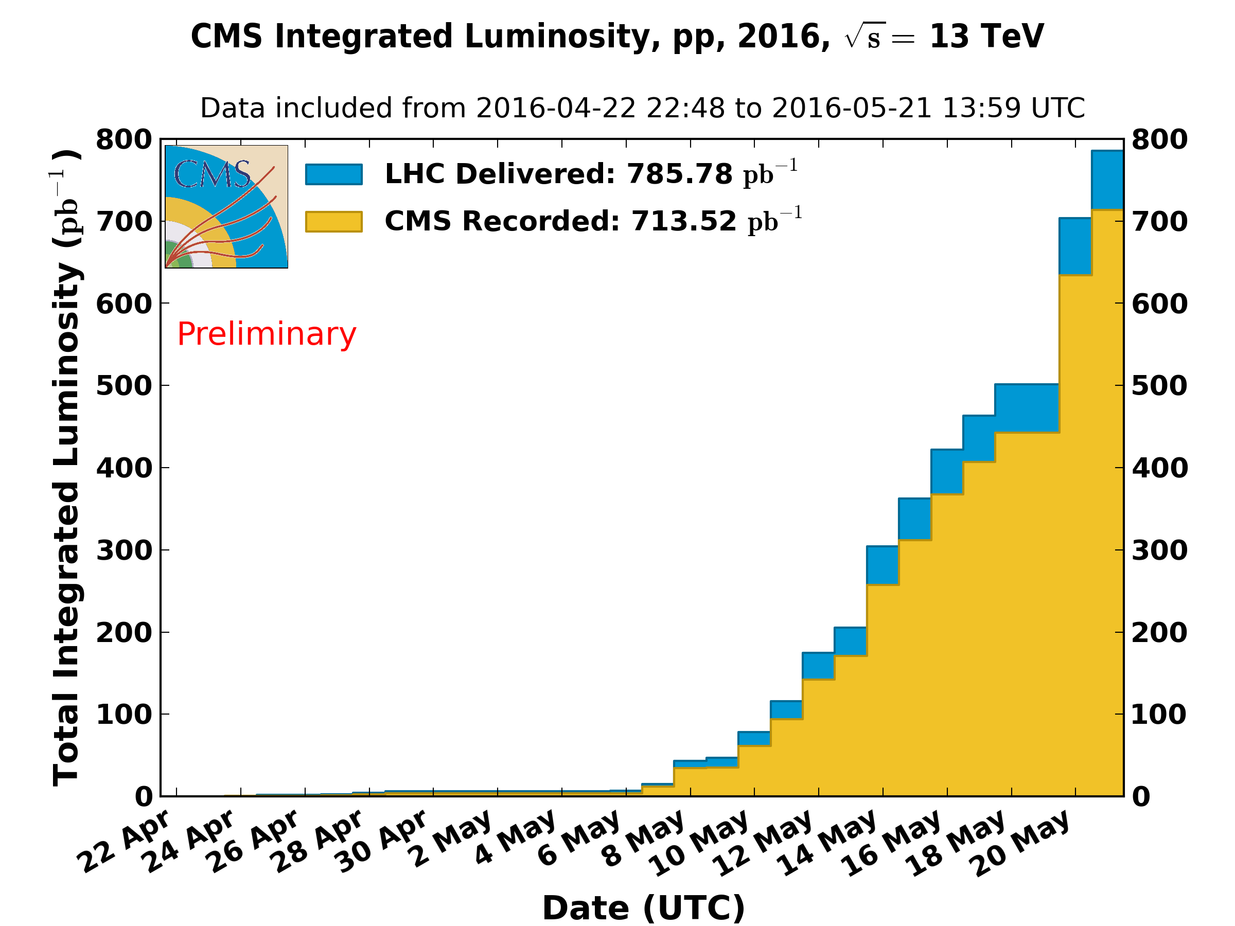
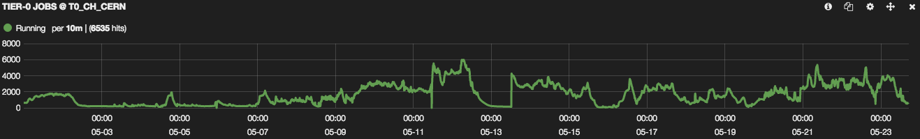
Tier-0 operations for 2016 run going well
2016 Tier-0 software and CMSSW software version deployed and running smoothly
  Major changes in both areas are already complete
New monitoring in place and regularly used by experts and shifters
Starting preparation work for p-Pb run for Heavy Ion program. We will (again) rely on very good throughput into EOS from P5
# of jobs
(mostly 4 core)

Slide 6
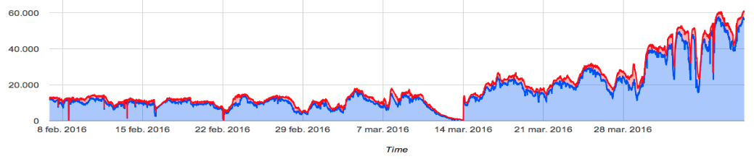
Tier-2 pilots transitioned to multicore
Campaign undertaken during February and March to have multicore pilots deployed across CMS Tier-2s for MC production which started in April
Now in good shape for deploying multicore MC
  Tier-1 and Tier-2 resources ready
  CMSSW software for 2016 ready
  We are in the process of deploying changes in CMS submission infrastructure to match # of cores to request to available cores
    We anticipate to always have resources with a variable set of available cores (e.g., opportunistic resources with Ncore=1)

Slide 7
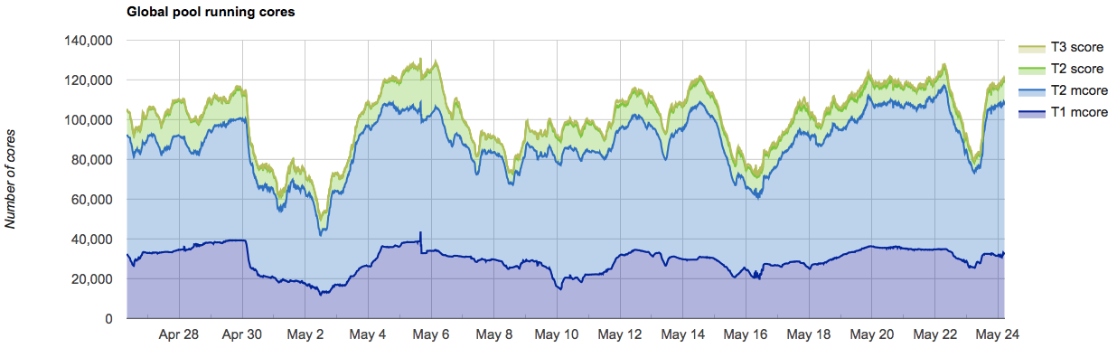
Multicore pilots now stably running
Global pool now running multicore pilots for the vast majority of CMS resources
  Transition to m-core at T1 done in late 2015
  Transition to m-core for (most) T2s since Feb-March 2016

Slide 8
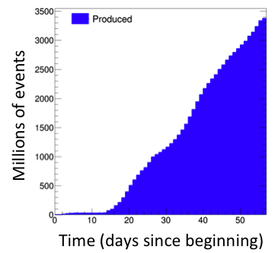
Major Monte Carlo campaign underway and going according to our planning
Given large luminosity expected to be available this summer, large samples are needed to enable the CMS analysis program.
  Our initial focus is on samples needed for analysis results planned for ICHEP
  Most samples use existing detector simulation samples so that resources are fully focused on the digitization and reconstruction
  After ICHEP we expect to include several improvements for the remaining 2016 MC production campaign

Slide 9
Workflow changes for upgraded L1 Trigger
A major Level-1 trigger upgrade has been deployed for 2016 data taking
  Good trigger emulation important for MC simulation production (and data taking).
  The upgraded trigger simulation was not part of our initial production as the development for much of this upgrade is just now finishing
Solution: Save temporarily the raw data in simulation samples where the accurate trigger results are required
  Once the L1+HLT workflow is fully validated, we will then run them over the raw information and update the AOD (without redoing the reconstruction)
  Thank you to CERN for providing CMS temporary EOS storage to enable this workflow.

Slide 10
Software development towards 2017
Major detector changes planned for 2017
  All new pixel detector including 4th layer of pixels
    Especially important as pileup increases as the upgrade addresses both data flow limitations in current detector
    Biggest impact for software is new track seeding capabilities given 4th layer
  Upgraded electronics in HCAL endcap
    This upgrade was previously planned for LS2 but has been partially moved to the EYETS given aging effects observed during data taking
    Provide TDC capability and effective depth segmentation
CMS will produce all new detector simulation samples for
2017-2018 data taking. Major reconstruction software changes
planned to be ready for production before data taking starts
Software for
HL-LHC TDRs in developed at the same time

Slide 11
Detector simulation and Geant4
Detector simulation is among the most important CMS software developments for 2016. Primary goals are
  Final 2017 detectors (Pixel, HCAL)
  TDR version of HL-LHC detectors (primarily tracker, endcap calorimeter, muons)
  Update of Geant4 and physics lists
    We see substantial physics changes between simulations done with 10.0, 10.1 and 10.2
      Has prompted us to revive test beam analysis
      Discuss with the Geant4 hadronic physics group underway
We expect all of these effects to converge in the all for MC sample production in time for 2017 running and TDR timelines

Slide 12
Conclusion
2016 startup going well. Resource usage is high and is expected to continue given LHC performance
Lots of new development in parallel:
  Transition to multicore for all workflows
  Exploitation of opportunistic resources
  2017 and HL-LHC simulation and reconstruction projects

Slide 13
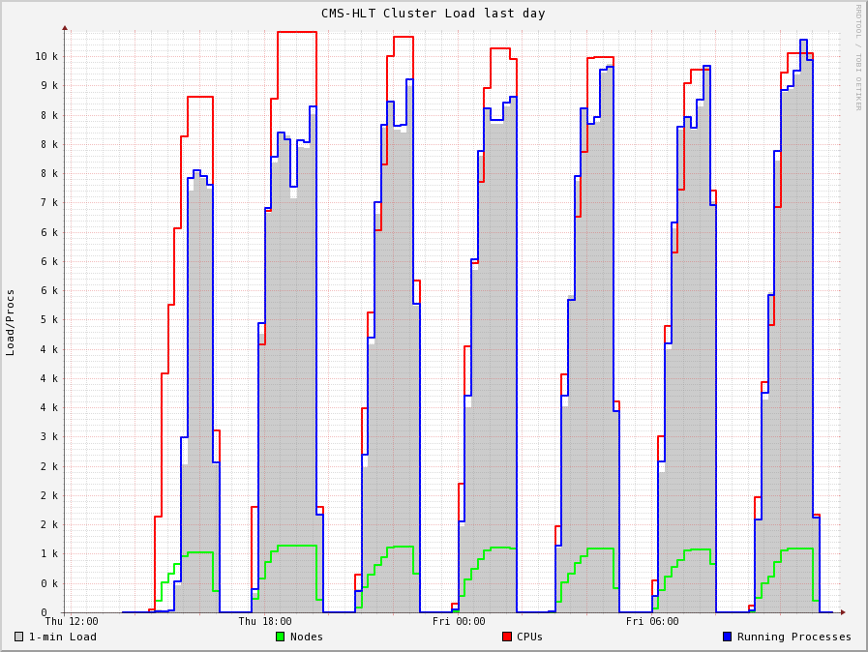
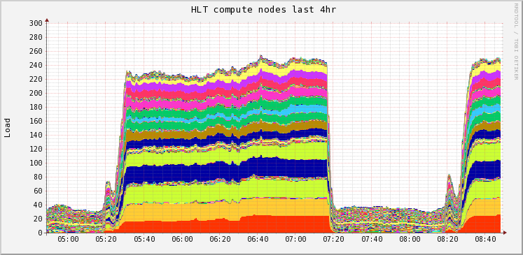
Work towards efficient use of HLT “cloud” in interfill periods continues to advance
Cycling tests
Load on hypervisors
Next studies: Improve overall efficiently by pausing VMs

