Slide 1
LHCb Computing Report
Marco Cattaneo, Stefan Roiser
LHCC Referees Meeting
24 May 2016

Slide 2
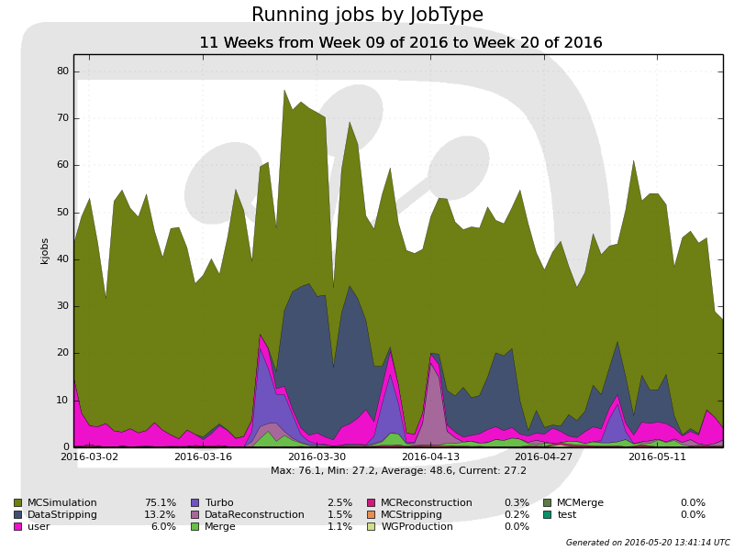
Main Computing Activities by Type
Overall, very
high activity
75 % Simulation
~ Pledge
Run 1 Incremental Stripping
2015 Turbo
re-processing
User jobs
2016 first data validation
2015 Lead reconstruction

Slide 3
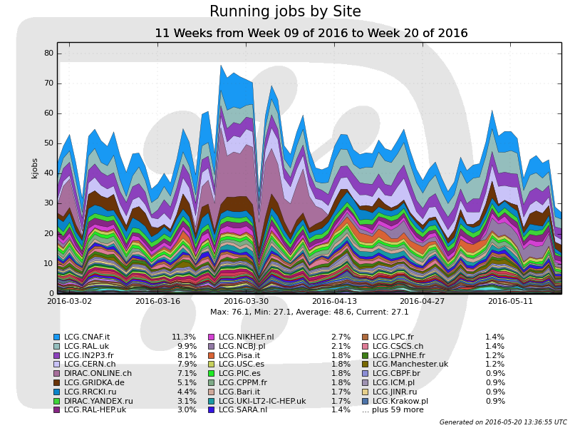
Main Computing Activities by Sites
very little HLT for offline
HLT
HLT farm contributed until mid April to distributed computing
Up to 20 % of CPU power provided
Only little contribution from HLT for offline processing until end of year stop
Because of deferred triggering HLT busy during interfill-gaps and into technical stops

Slide 4
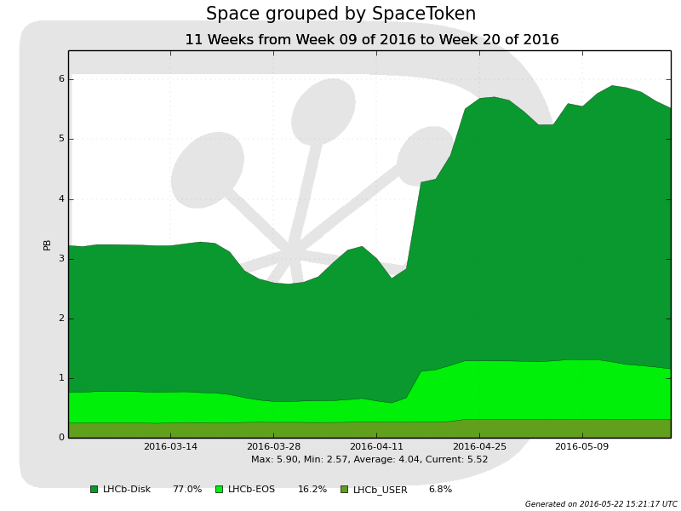
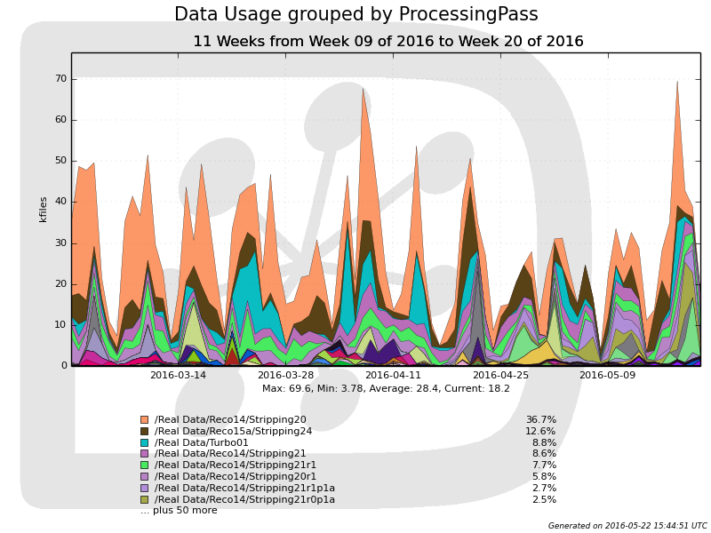
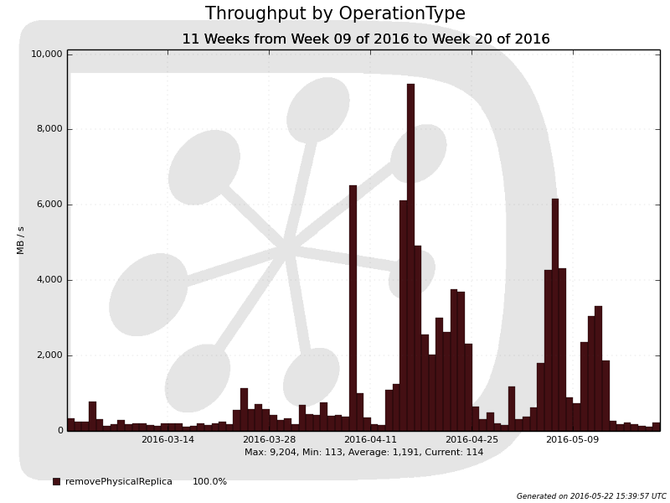
Data Management
2016 pledges coming in
Visible in jump in free disk space
Disk optimization done in “manual mode” by experts
Steered by data popularity
… and bookkeeping of datasets
Free space for disk resident data
Popularity of physics data
Reduction of
data replicas
Removal of MC data sets
Cleanup of
lead data

Slide 5
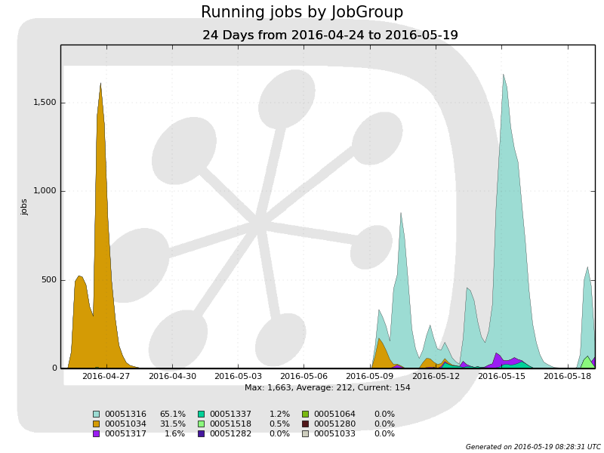

2016 data taking validation
Plan: during LHC ramp up period take data to
Validate the online and offline workflows
Test new features, e.g. provide reco info with the Turbo stream
Accumulate enough data for a 2016 detector alignment
With the final 2016 detector calibration
Move to physics production
Last week, enough data available for detector alignment
Final calibrations provided, switch to data processing production imminent
Magnet “Up”
Magnet “Down”

Slide 6
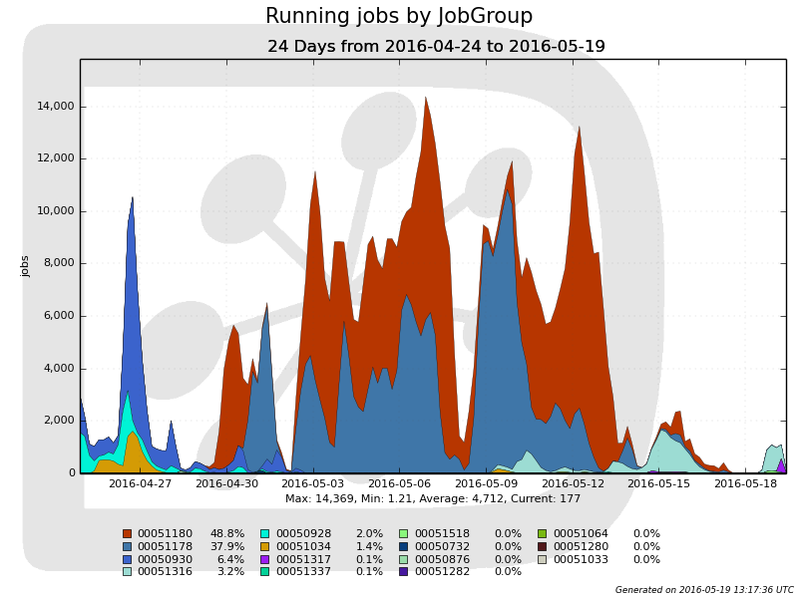
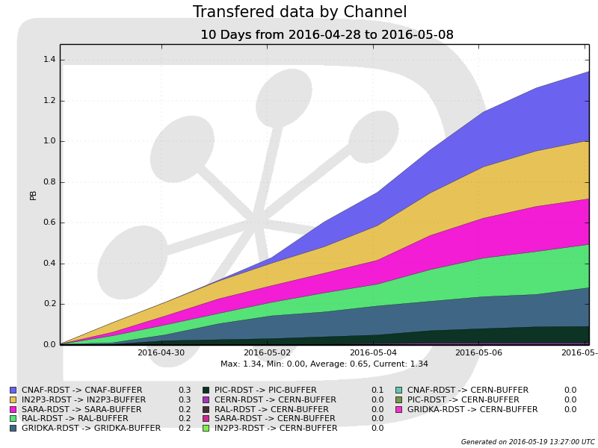
More activities on the grid
Time of the “marten” incident used to stage in remaining 2012 data for Run 1 incremental stripping campaign
Used tape storages for 1.4 PB staged from tape in 10 days
Then data processed in parallel with the remaining validations
Run 1 incremental stripping campaign now finished
Run 1
Incremental stripping
Validation productions
1.4 PB staged from tape

Slide 7
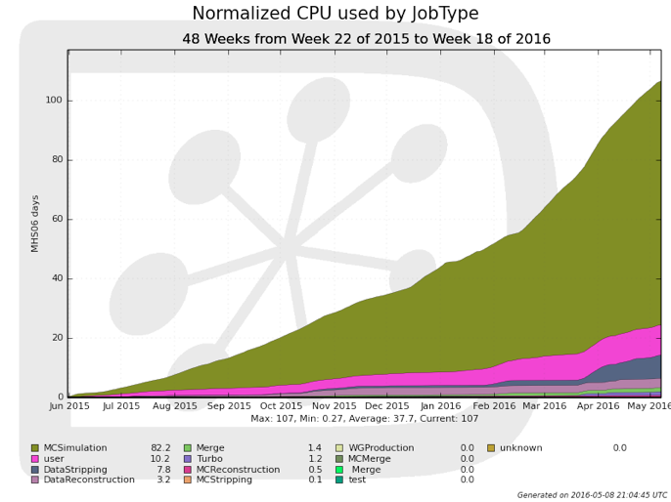
Simulation
Ongoing productions for Run1 with current simulation framework “Sim08”
New simulation productions “Sim09” to start imminently for 2015 data, early samples for 2016 and for Run1 new analysis
New generators and Geant4 9.6.p02
Carried out extensive validation campaign
New MC microDST format with roughly 1/10th of space footprint
Exploring a variety of options for faster simulations for Run3
from fully parameterized options to code optimization
2016

Slide 8
Software & Infrastructure
Software infrastructure currently moving to CERN/gitlab & Cmake
In parallel supporting “old” infrastructure on CMT & svn for transition period
+ needed modifications for software development, runtime environment and testing infrastructure
2016 data taking applications built with gcc 4.8 + gcc 4.9
New branches for all repositories created with gcc 4.9 only
To be used 2017 onwards
Allows C++14 constructs in code
Build infrastructure solely based on CMake

Slide 9
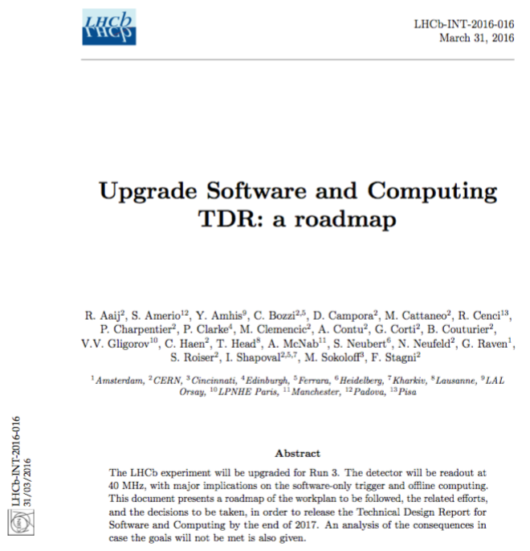
Upgrade work towards Run 3
“Roadmap” document presented to collaboration in March, provides
a work plan to be followed
the related effort of the different areas
decisions to be taken
... to write a TDR by Q4/17
Also presented yesterday in “LHCC in-depth review”

Slide 10

2 main areas of the upgrade work
“Revolution”
Task force established
Adiabatic integration into
current environment

Slide 11
2 main areas of the upgrade work
“Revolution”
Task force established
Very tight schedule for “revolutionary part”
Aim to provide “demonstrators” by Q1/17
Will guide the decisions towards the TDR and the upgrade work
Need expert programmers. They are willing to contribute but at the same time are also busy with Run 2 operations
Looking for additional personpower for tasks during limited period

Slide 12
Summary
Personpower is a concern for LHCb computing upgrade
Experts needed for tasks occupied with Run 2 operations
Constant high usage of distributed computing resources in reference period at or above pledges
2016 data validated for offline processing successfully
Data processing productions to start imminently
“Gaps” in LHC delivered data used successful for other activities
Several changes in Run 2 software infrastructure
Move to gitlab, CMake, gcc 4.9
Next major version of the Simulation framework validated
Further increase in simulation processing expected

Slide 13
Backup

Slide 14
Executive Summary
Very high usage of distributed computing resources during reference period
2016 detector aligned, data processing start imminently
New version of the simulation framework validated
To be used for new Run1 analysis, 2015 and 2016 data sets
Upgrade work towards Run 3 split into two main parts
“Revolution” on framework, scheduling, event model tackled with taskforce – personpower is a concern in this area
“Evolution” on simulation, distributed computing, computing model – can be tested already within Run 2 operations
~ Pledge

