Slide 1
WLCG Topics
Ian Bird, CERN
WLCG LHCC Referee Meeting
25th May 2016

Slide 2
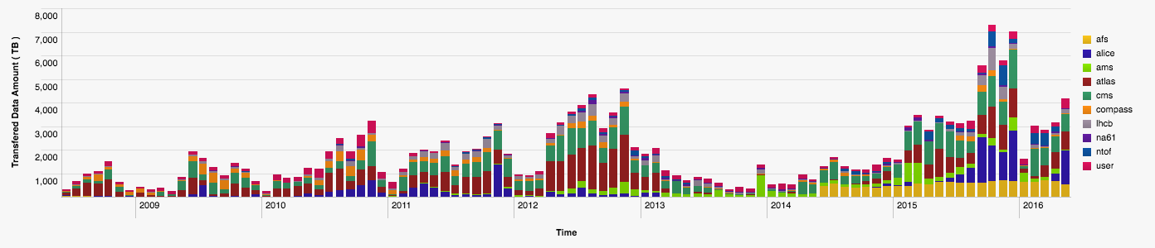
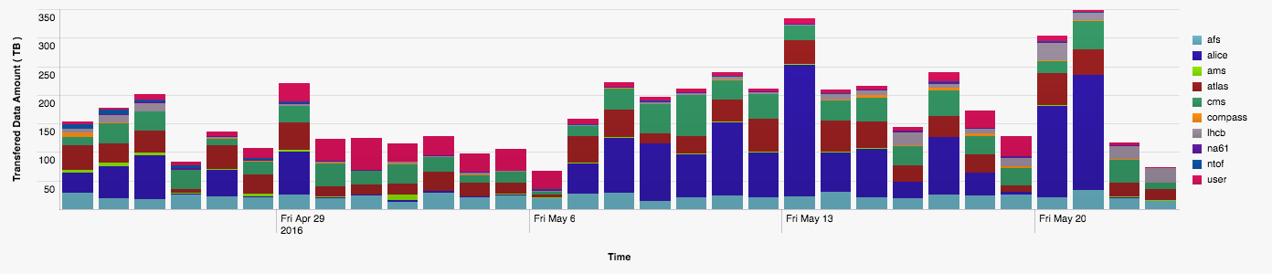
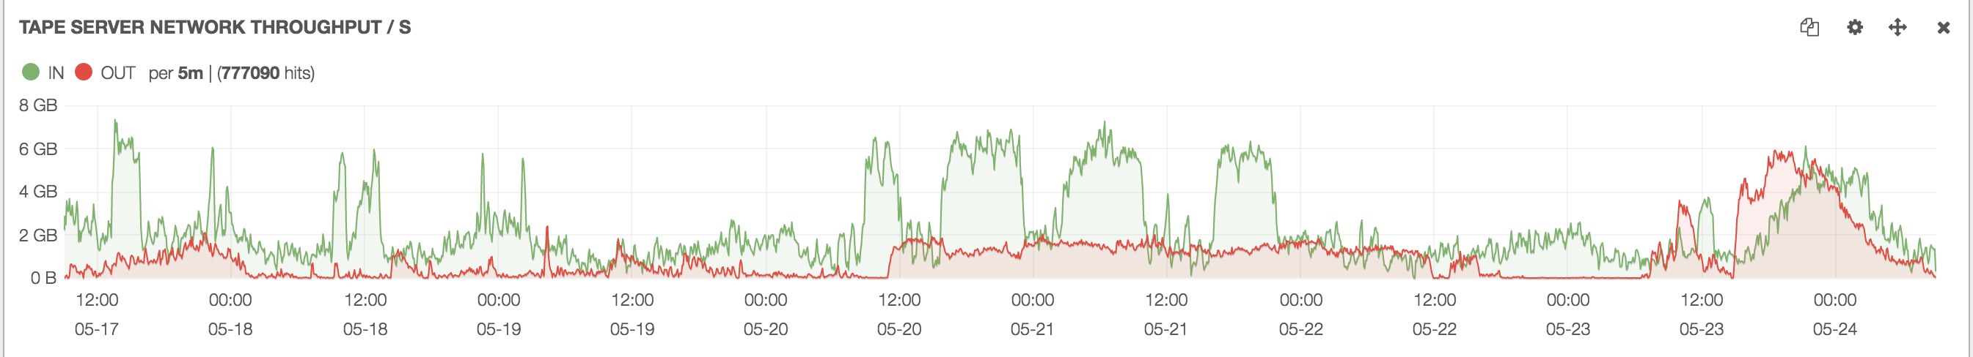
2016 data in Tier 0
Last 30 days
Last 7 days: rate to/from tape

Slide 3
Ramp-up of WLCG CPU

Slide 4
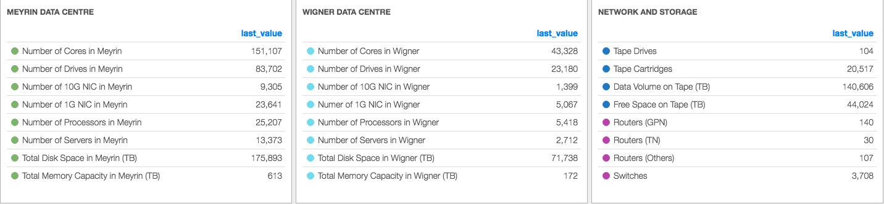
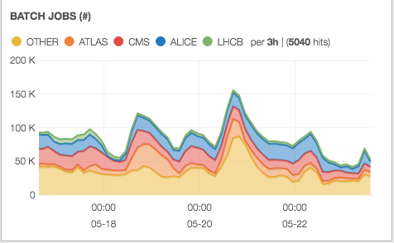
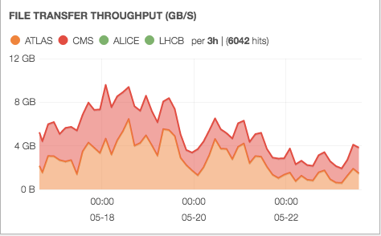
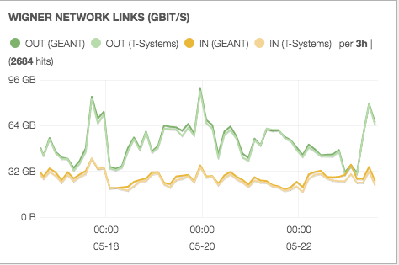
Tier 0

Slide 5
Resources - 2017

Slide 6
Growth

Slide 7
Planning - progress
Planning assumptions
  Work has started to document baseline assumptions for Run 4 - ongoing
  Following format of resource outlook from Run 2 document
Software topics
  See Benedikt’s talk today, following HSF workshop; including first performance workshop

Slide 8
Planning: Demonstrators
Work has started on prototypes for:
  Storage federations:
    Reliable storage at large sites (clustering of storage between sites) – single view for experiments;
      concrete proposal for this based on EOS, to be prototyped in Russia initially
    Opportunistic (caches) at small sites – essentially to support active work, but not long term
      No concrete work yet, but could be based on DPM
  Machine Learning:
    Interest from all experiments; investigate anomaly detection in production workflows, and in data management systems; in particular combining information from >1 experiment
      Some funding in Russia, efforts in ATLAS and LHCb, CMS also interested
Under discussion:
  How to instantiate a “Tier 2 in a box” → simplified deployment of a site with minimal effort needed
    Several ideas being investigated – to be followed up

Slide 9
Performance session at HSF
https://indico.cern.ch/event/496146/timetable/
  Alice
  ATLAS
  CMS
  Astro Physics
  Root
  Geant(V)
  Art/LArSoft
Followed by a panel discussion: (summary) https://indico.cern.ch/event/496146/contributions/2147420/attachments/1265860/1895094/SummaryPanel.pdf

Slide 10
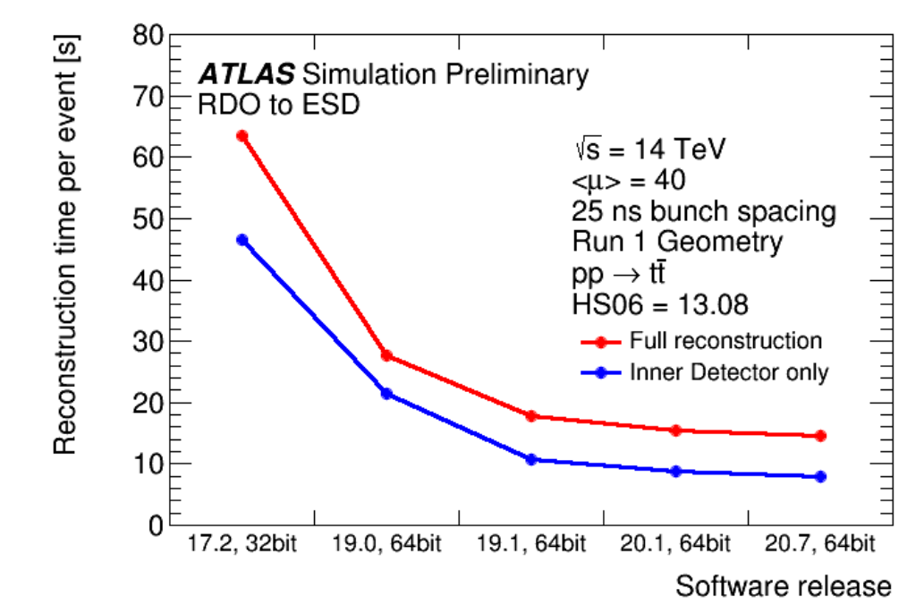
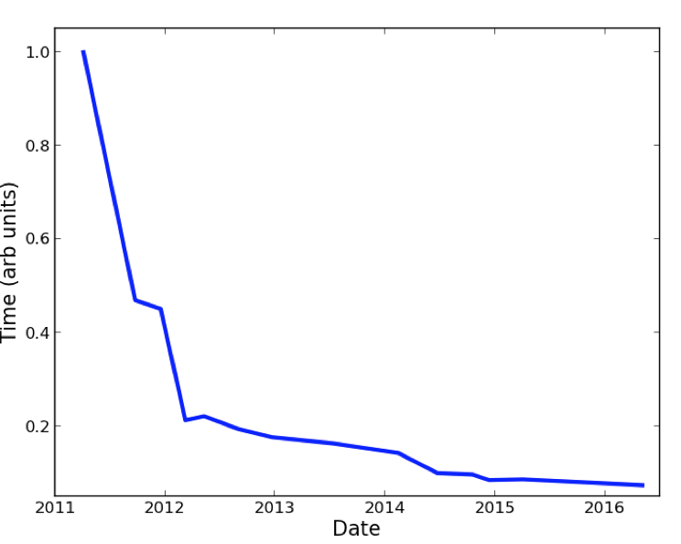
Observations:
Massive work has been invested in improving the code used in Run1
  Selection of efficient libs (CLHEP→ Eigen)
  Tracking in magnetic fields …........
  Static code analysis
  Performance monitoring
    Many different tools
  Reorganisation of data structures
  Experiments know where the time is spent
    Which doesn’t mean that it is clear how to speed it up…
  Huge improvements, but:
    gains are getting smaller → region of diminishing return?
ALICE invested heavily in understanding the use of GPUs
  New tracking code developed with GPUs and parallelism in mind
    Improved performance also in CPUs
    Many systematic studies (see slides)
Cooperation between experiments exists, especially in
tracking
Everyone states that what matters is throughput, but most
work is focussed on acceleration of code
  Event/sec is used as unit, not event/sec per unit of hardware investment
Experience from other communities: Astro
  Classical HPC applications, “standard” codes, limited number of algorithms
  HEP use cases much more divers, many algorithms in the same job, data intensive ….
CMS

Slide 11
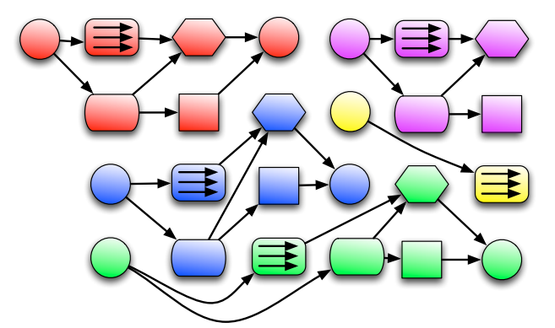
Future directions
Exploiting parallelism wherever possible
  Starting from the frameworks (Gaudi, AthenaMT, ROOT,…)
  GPUs, accelerators, multi core
Part of the community is convinced that HEP computing will depend in the future on efficient usage of HPC machines
  Part of the community disagrees strongly
Evolution not revolution
  Effort levels exclude a revolution
  Not clear how much can be gained from evolution
Agreement that common approach is needed for HL-LHC
  Community Whitepaper
  Working groups

