Slide 1
The DarkSide search for WIMP dark matter
Henning O. Back
Pacific Northwest National Laboratory
Lake Louise Winter Institute 2017

Slide 2
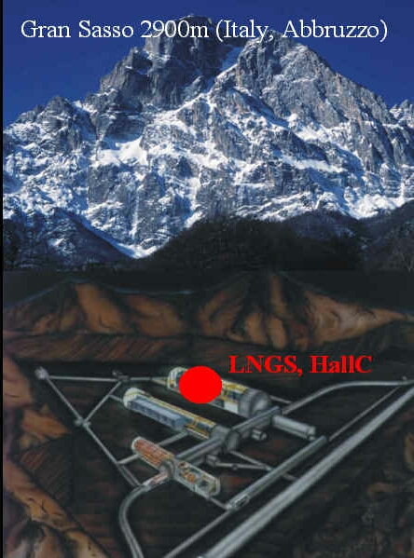

Located in Gran Sasso National Lab (LNGS)

Slide 3
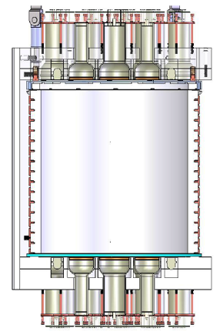
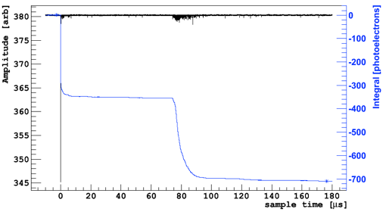
The dual phase TPC principle
The DarkSide-50 detector
S2 = Scintillation light proportional to free electrons after primary ionization
Ar gas
S2
Ar liquid
e⁻
S1 = Primary Scintillation light
S1
Time difference between S1 and S2 gives z position
PMT hit pattern give x-y position
γ, n, χ
S1
S2
drift time

Slide 4
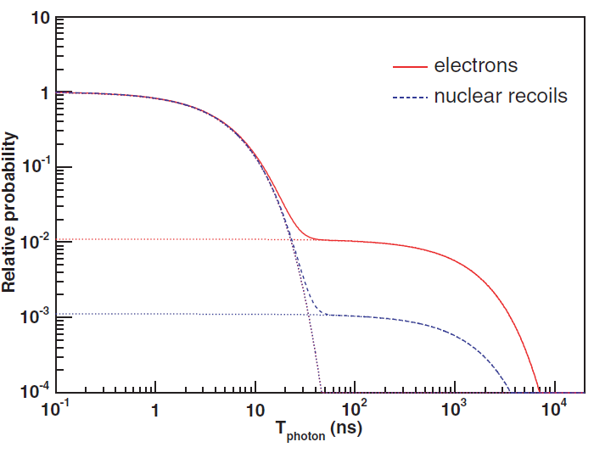
Why argon?
Powerful scintillator (10,000s VUV photons/MeV)
e⁻
β’/γ’
β/γ
electronic recoil
χ’/n’
χ/n
nuclear recoil
Boulay and Hime, Astropart. Phys. 25 (2006) 179

Slide 5
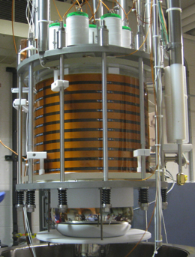
The DarkSide program
DarkSide-10 prototype
(2011-2013)
DarkSide-50
(2013-present)
DarkSide-20k
(2020 – )
Not to scale

Slide 6
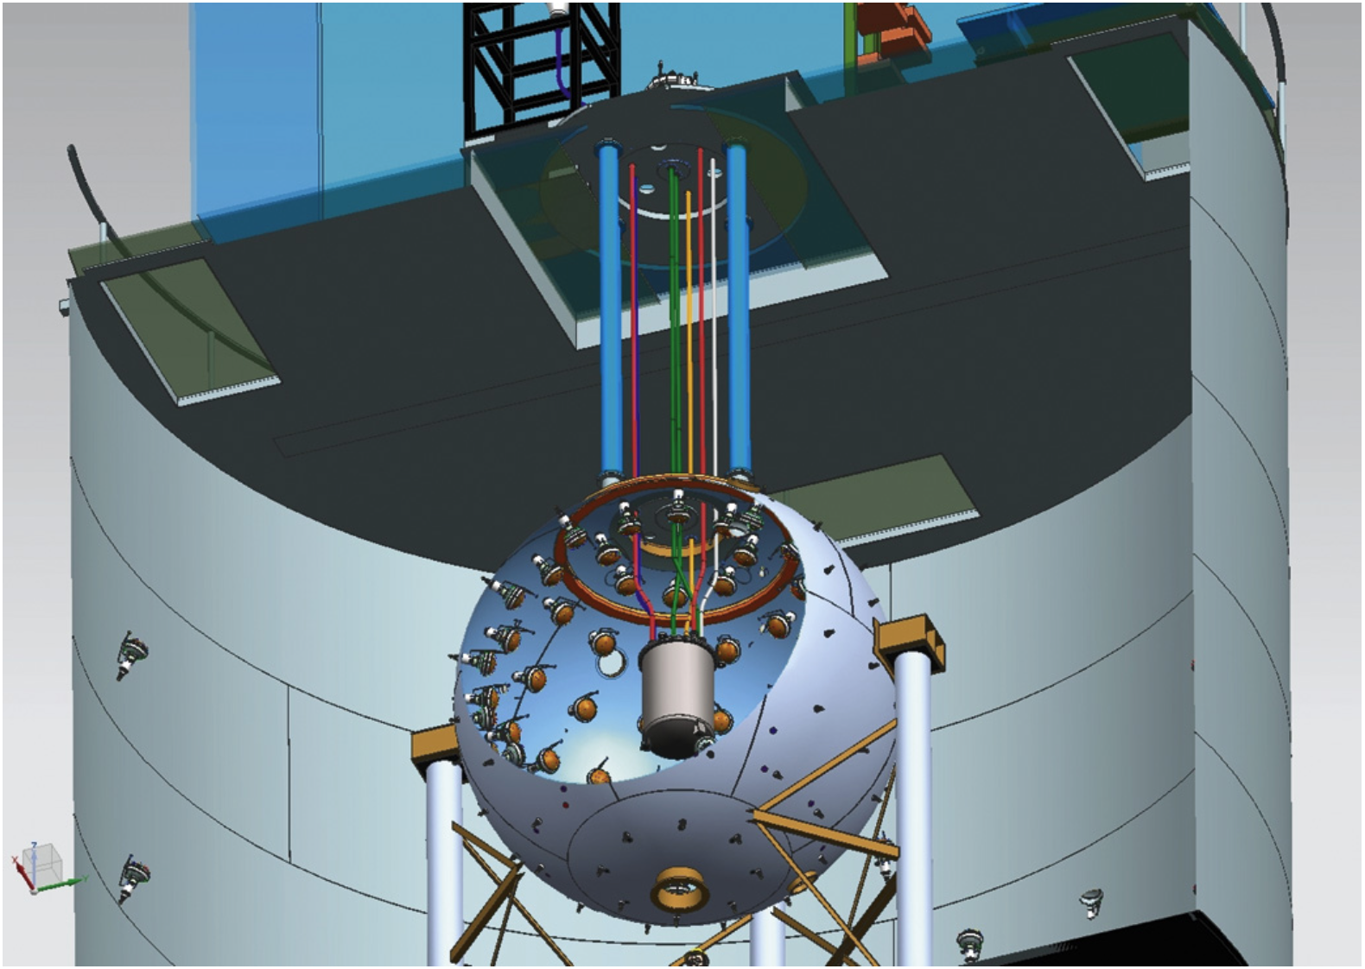
DarkSide-50
TPC cryostat
  47 kg active argon target
  PMT readout
Neutron veto
  30 tons borated liquid scintillator
  >99.1% efficiency for radiogenic neutrons
Muon veto and gamma shield
  11m diameter
  1000 ton water
  Instrumented as Cherenkov muon veto
“The veto system of the DarkSide-50 experiment”, JINST 11 P03016, (2016)

Slide 7
DarkSide-50 results
Physics Letters B, 743 (2015) & Phys. Rev. D 93, 081101(R) (2016)
X1400 reduction in ³⁹Ar

Slide 8
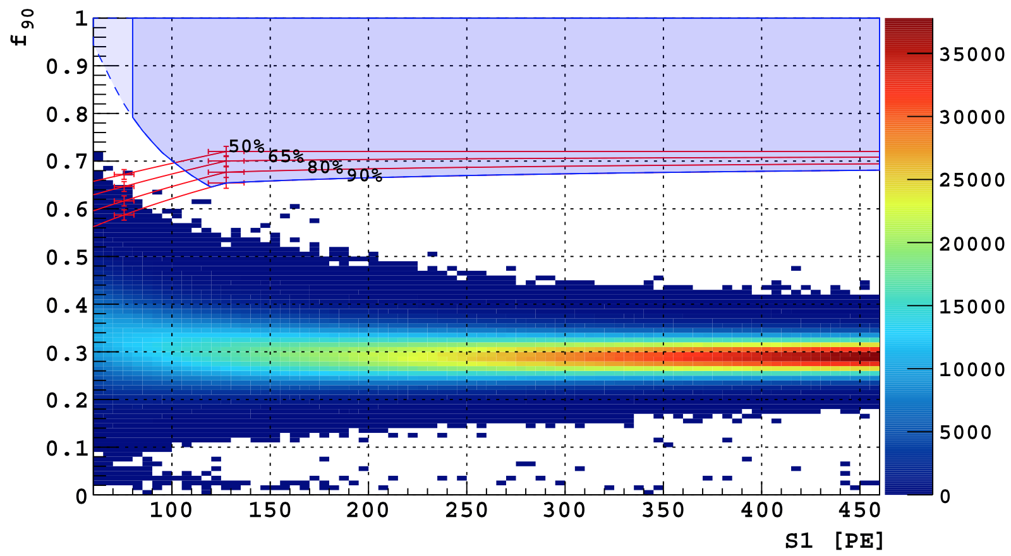
DarkSide-50 results
Physics Letters B, 743 (2015) & Phys. Rev. D 93, 081101(R) (2016)
Exposure: 1422 ± 67 kg-day (atmospheric argon)
Exposure: 2616 ± 43 kg-day (underground argon)
Power of S1/S2
Not used in WIMP search

Slide 9
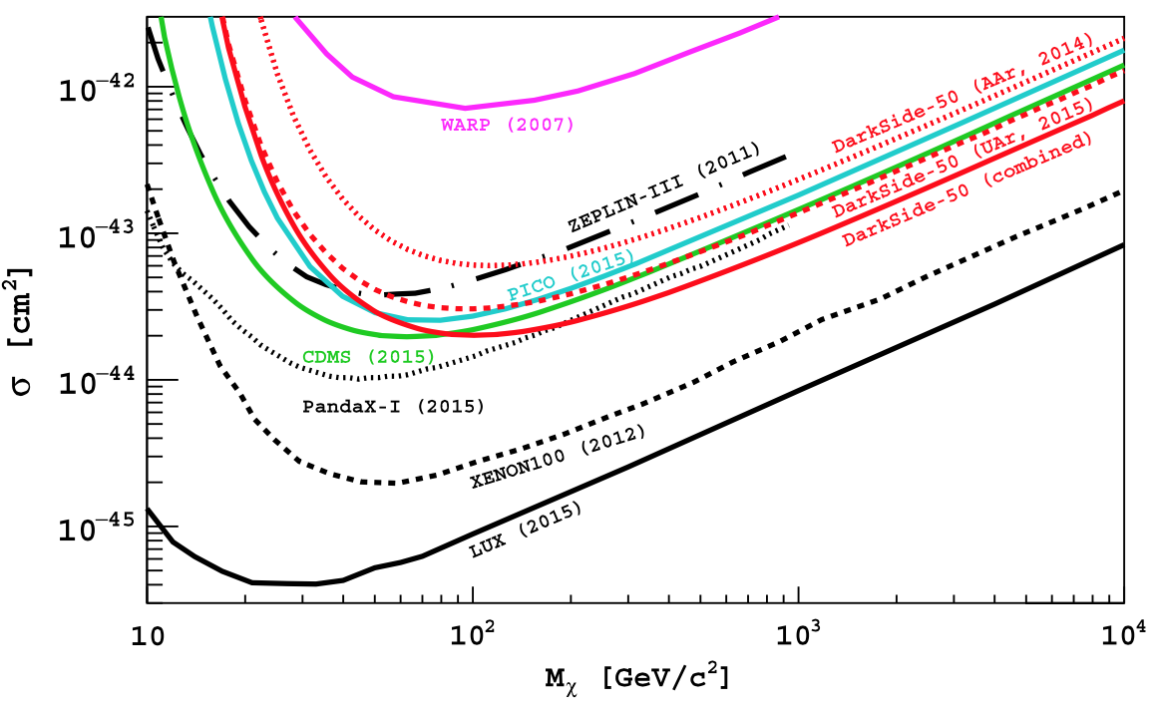
DarkSide-50 results
Phys. Rev. D 93, 081101(R) (2016)

Slide 10
DarkSide-20k
(Publication in preparation)
Scaling up to 100 ton-year background free exposure
14 m diameter water shield and cosmic veto
8 m diameter stainless steel sphere
Borated liquid scintillator active neutron veto
Dual phase TPC containing 23 tons
low-radioactivity argon (30 tons total)
Silicon Photomultiplier light readout

Slide 11
Silicon Photo Multiplier (SiPM)
2016 IEEE Nuclear Science Symposium and Medical Imaging Conference, Strasbourg
Key Goals
5 x 5 cm²
Power ≤ 250 mW
Photon detection efficiency ≥ 40% @ 420 nm
Dark count rate < 0.1 Hz/mm² at detector operating temp.
Low radioactivity materials
Achieved in R&D
2 x 2 cm²
Power < 250 mW
Photon detection efficiency > 40% @ 420 nm
Dark count rate <0.01 Hz/mm² at low field & 87K
Rigorous ongoing campaign

Slide 12
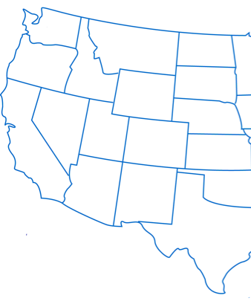
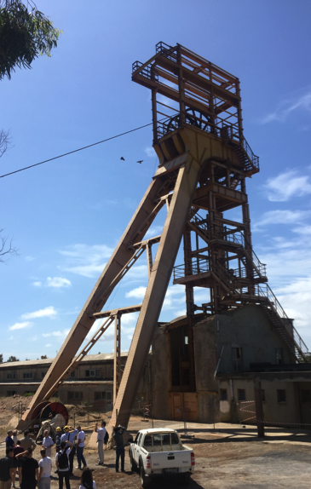
Low radioactivity underground argon (UAr)
The DarkSide-20k target
Urania (planned)
  Extracts argon from CO2
  Same source as DarkSide-50 target
  Production:
    100 kg/day
    99.9% pure
Aria (under construction)
  Final argon purification
  Capable of isotope separation (³⁹Ar depletion)
  Located in the Seruci mine in Sardinia, Italy

Slide 13
DS-20k physics reach
0.1 t-yr
100 t-yr

Slide 14
DarkSide Collaboration
69 institutions

