Slide 1
Interconnection Gluing
S. Lauciani on behalf of INFN NSW GROUP
DWG – 12/05/2016

Slide 2
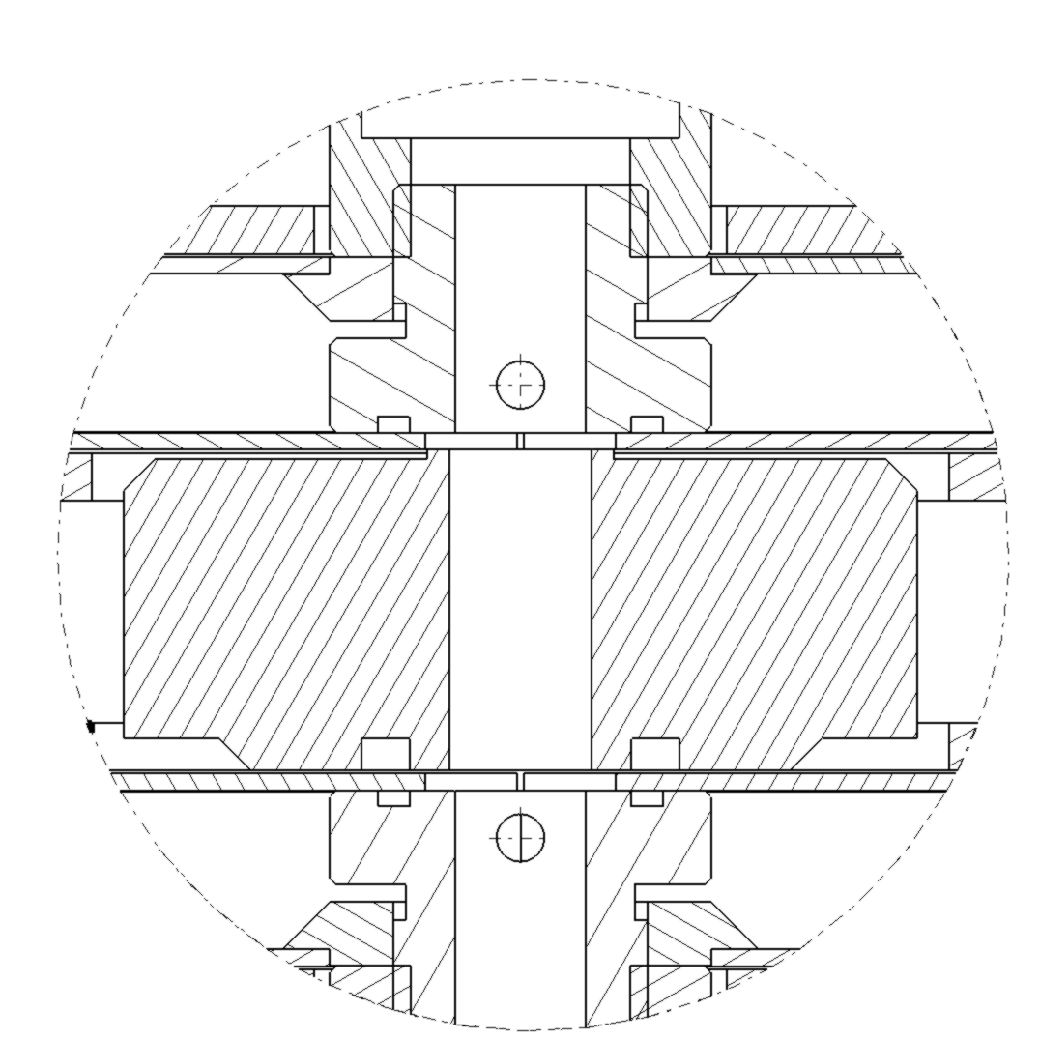
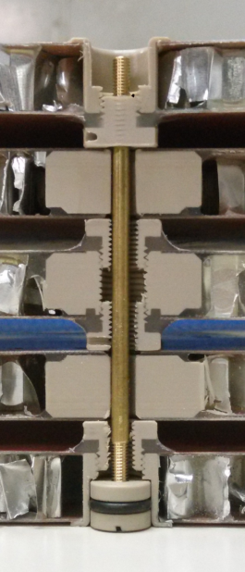
Interconnection design
Kapton Tape

Slide 3
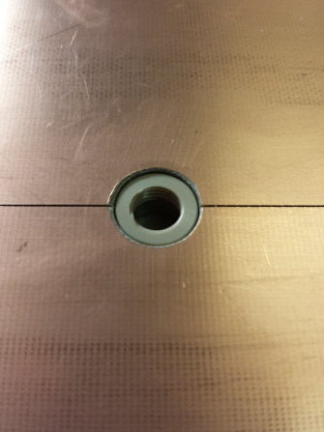
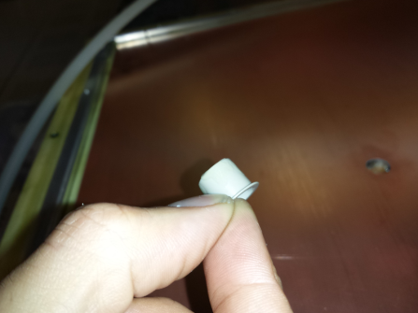
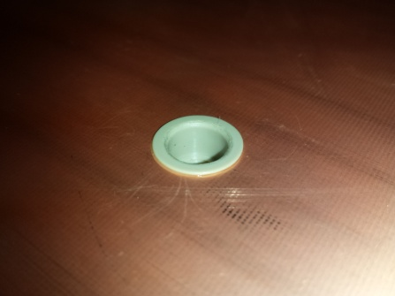
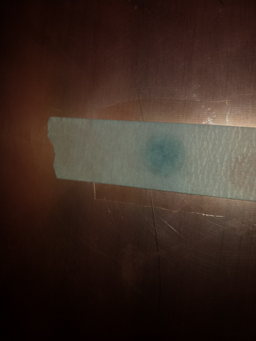
Drift interconnections gluing - I
1. Small quantity of glue is applied on the external surface of interc. part
3b. Topside view of interc.
2. Interconnection inserted in the DRIFT hole
3a. Panel with interc. is layed down to the granite table. Small piece of mylar sheet is used to prevent gluing of panel with granite table

Slide 4
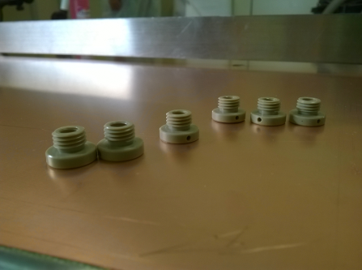
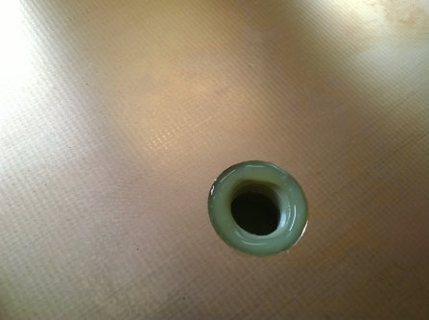
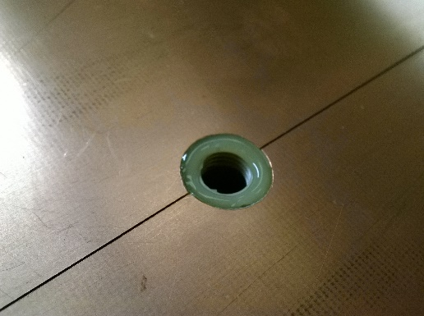
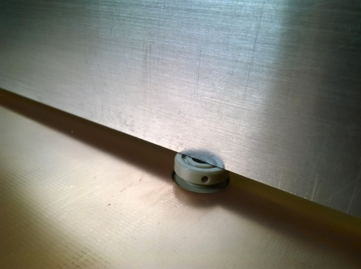
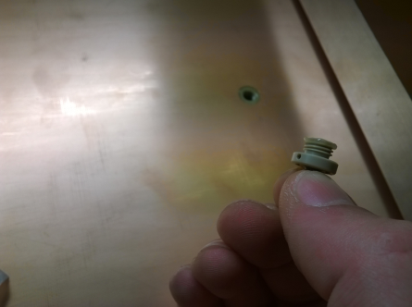
Drift interconnections gluing - II
1a. Interconnection detail
2. Sealing of interconection-PCB area
1b. Interconnection detail
3. Glue on the first thread

Slide 5
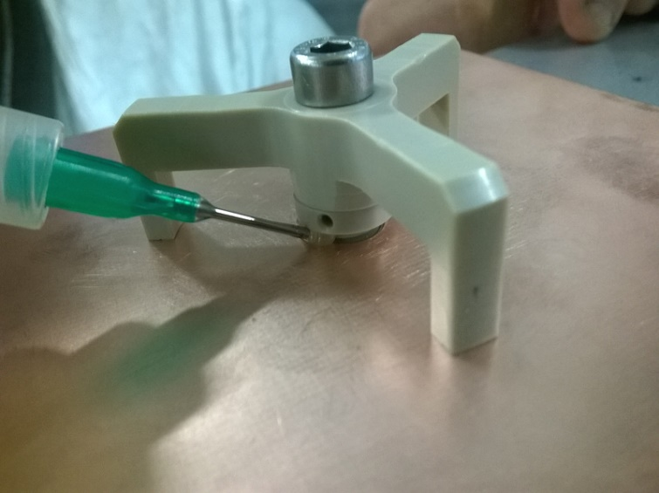
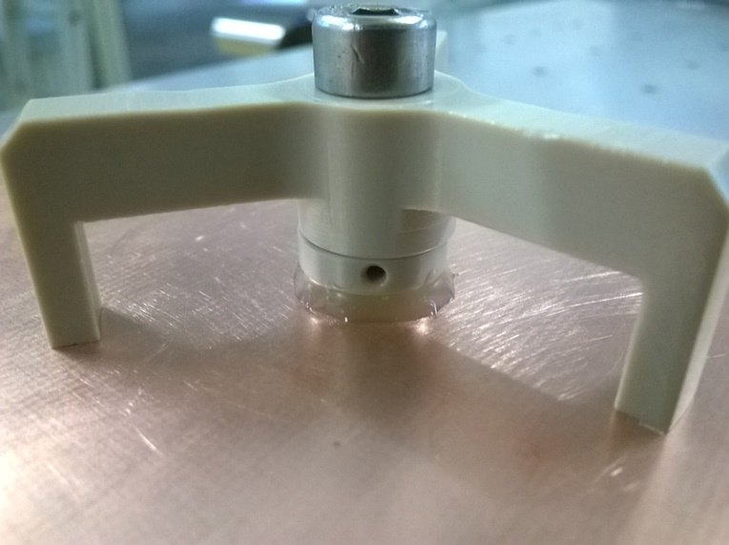
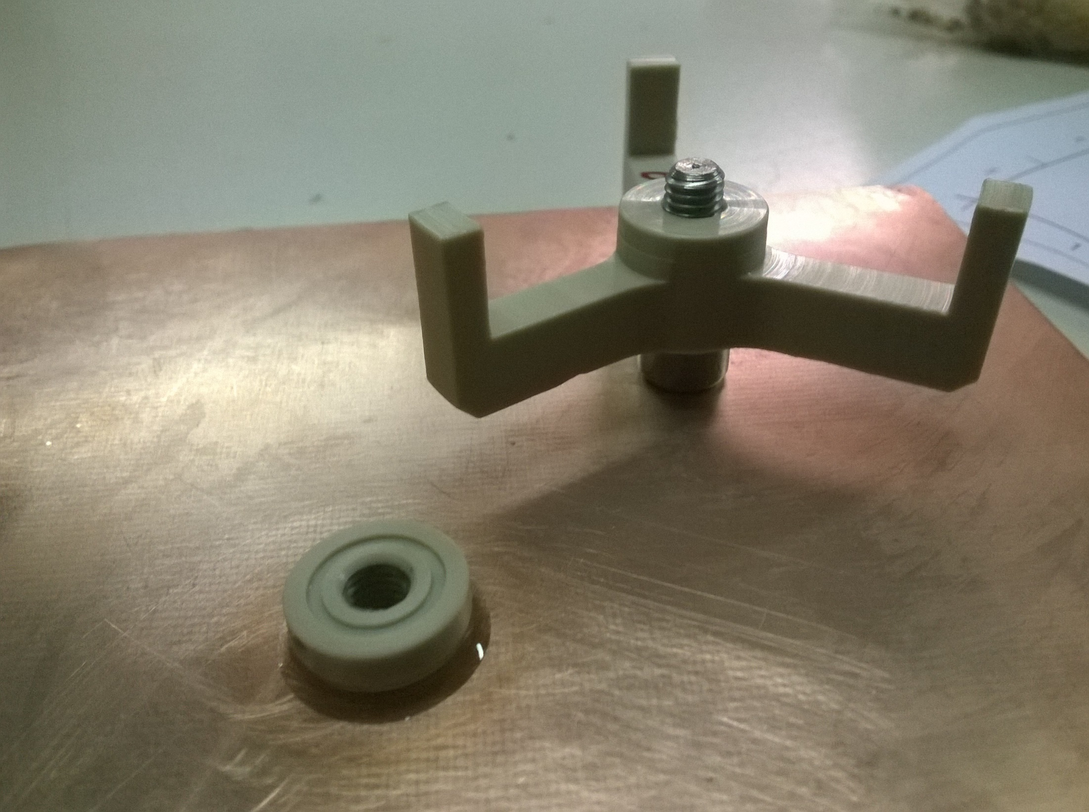
Drift interconnections gluing - III
5. Second gluing

Slide 6
Interconnection measurements

