Slide 1
The role of University as a catalyst for science, technology and society: the Trieste science system
Maurizio Fermeglia
rettore@units.it

Slide 2

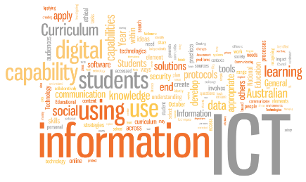
Globalisation: facilitators
Ease of mobility
Fall of transportation costs
Information and Communication Technology
Role of Multinational Enterprises
and emergence of a more global/ internationalized share of the labor market
English as a lingua franca (probably more an outcome than a driver though)
More interconnectedness, more visibility to and of the world

Slide 3
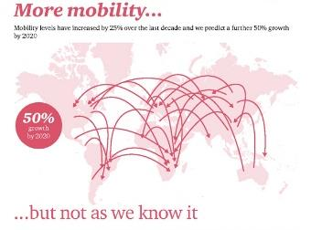
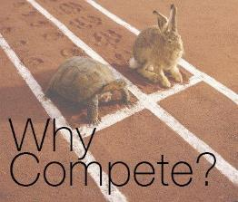

Globalisation: effects
People mobility
  Increasing migration
  Increasing highly skilled migration
  Student and academic mobility
Liberalization and competition
  Privatization in higher education
  Trade in higher education, GATS
  Economic competition for students and for first mover advantage
Global area of higher education
  International rankings
  International actors: EU, WTO, etc.
  University networks
  Research networks
Notes:
General Agreement of trade in services

Slide 4
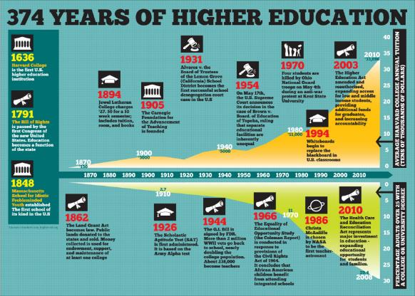
Global expansion of HE will continue (+15% by 2025 in OECD)
  Projection: +15% on average by 2025 in the OECD area
Notes:
Expansion of HE will likely continue
Political factors
Demand of the economy
Projection: +15% on average by 2025 in the OECD area
Expansion of cross-border education
Student and programme mobility mainly
Its nature may change over time

Slide 5
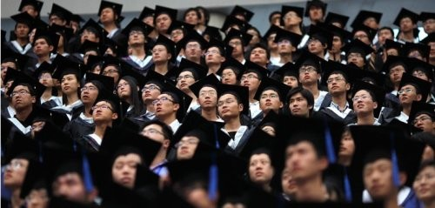
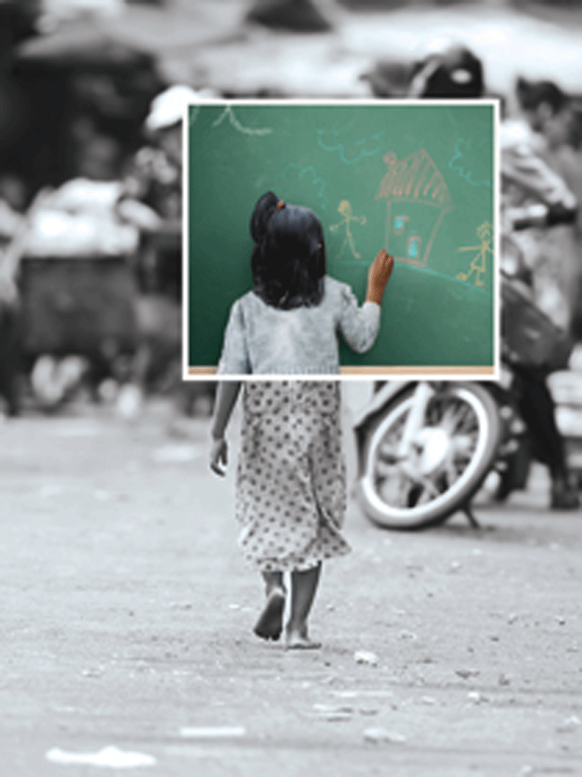
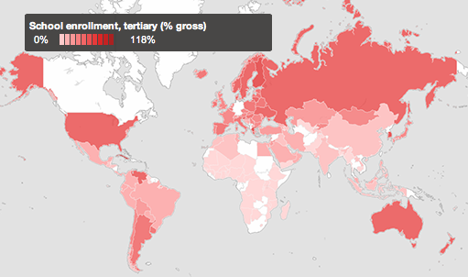
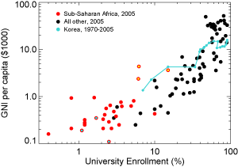
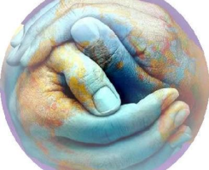
It is proven that GDP scales with the University enrolment

Slide 6

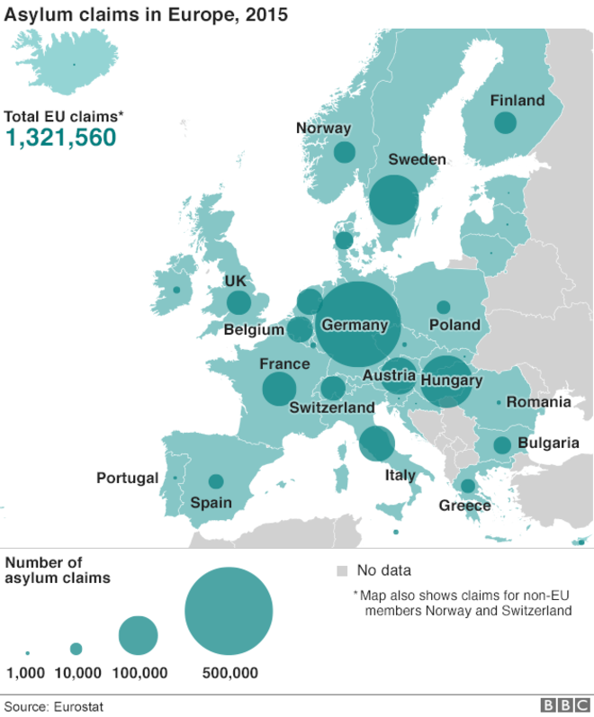

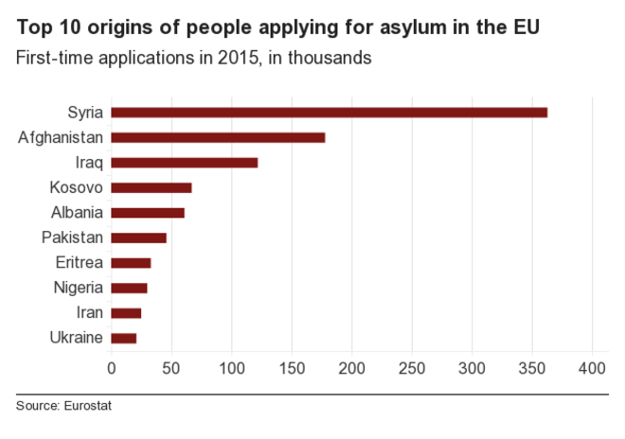
Migration: the Fort Apache logic does not work

Slide 7
Scenarios for higher education systems
International
Open Networking
Higher Education Inc.
Serving Local
Communities
New Public
Responsibility
Administration
Supply-driven
Market
Demand-driven
National
Source: Stéphan Vincent-Lancrin - OECD - www.oecd.org/edu/universityfutures

Slide 8
Scenario 1: Serving local communities
Open Networking
Higher Education Inc.
Serving Local
Communities
New Public
Responsibility
Drivers
  Backlash against globalization
  More geo-strategic sensitivity in research
Features
  (Re)focus on national and local missions
  Public funding and control of the academic
  profession
  Convergence between universities and polytechnics
  Elite universities struggle to stay more internationalized
  Less research, mainly on humanities
  Big science relocated to government sector (more secretive and less internationalized)
Related developments
  Highlight of regional missions
  Anti- globalization movements
Source: Stéphan Vincent-Lancrin - OECD - www.oecd.org/edu/universityfutures

Slide 9
Scenario 2: New public responsibility
Drivers
  Pressure on public budget (ageing, public debt, etc.)
  Diffusion of governance structures based on
  new public management
Features
  Mainly public funding but autonomous institutions
  controlled at arm’s length (incentives + accountability)
  Mixed funding: new markets +
  more tuition fees (income contingent loans)
  Demand-driven system with more marked division of labor (specialization but most HEIs continue to do some research)
  Research funds allocated through domestic competitive process
Related developments
  Autonomy given to HEIs (sometimes legally privatized)
  Debates on cost sharing
  Encouragement of competition between HEIs
Open Networking
Higher Education Inc.
Serving Local
Communities
New Public
Responsibility
Source: Stéphan Vincent-Lancrin - OECD - www.oecd.org/edu/universityfutures

Slide 10
Scenario 3: Higher education, Inc.
Drivers
  Trade liberalization in education (GATS, bilateral)
Features
  Global competition for education & research services
  Public funding for non-commercially viable disciplines
  exclusively
  Segmentation of the education and research market
  Vocational higher education is an important share of the market
  Strong (international) division of labor according to competitive advantage
  Concentration of research and worldwide competition for funding
  English as main language of study
Related developments
  Rise of trade in HE & inclusion of education in trade negotiations
  International competition for students
  Increase of cross-border funding of research
Open Networking
Higher Education Inc.
Serving Local
Communities
New Public
Responsibility
Source: Stéphan Vincent-Lancrin - OECD - www.oecd.org/edu/universityfutures

Slide 11
Scenario 4: Open Networking
Open Networking
Higher Education Inc.
Serving Local
Communities
New Public
Responsibility
Drivers
  International cooperation & harmonization
  of systems
  Technology
  Ideal of open knowledge
Features
  Intensive networking among institutions, scholars,
  students (& industry)
  Modularization of studies under academics’ control
  International collaborative research
  Strong hierarchy between networks but quick spillovers
  Lifelong learning outside the HE sector
Related developments
  Bologna process, international academic partnerships and consortia,
  Increasing computing power and culture of openness challenging traditional intellectual property rights
Source: Stéphan Vincent-Lancrin - OECD - www.oecd.org/edu/universityfutures

Slide 12
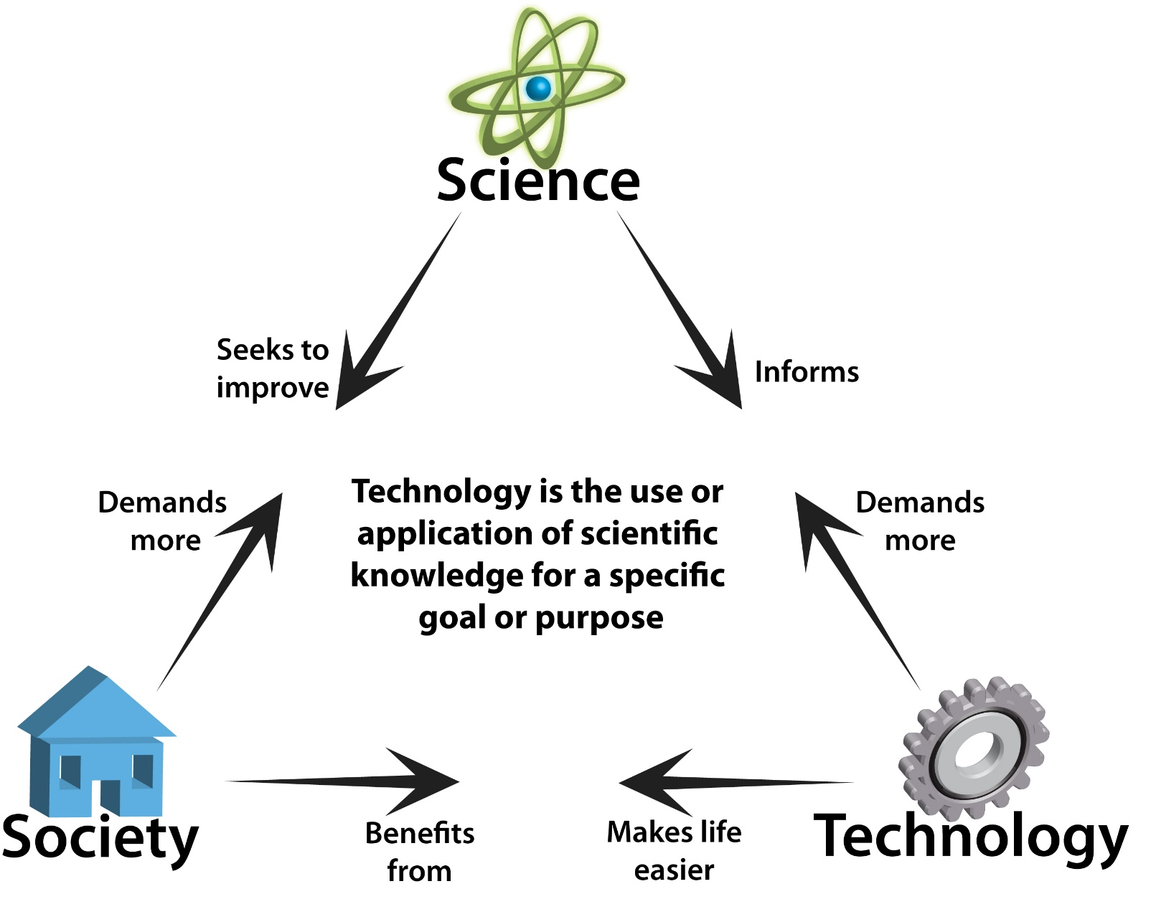
Science, technology & society

Slide 13

Science, technology & society

Slide 14
Disciplines and challenges
Physics
Chemistry
Engineering
Biology
Medicine
Economy
Humanities
Social sciences
Energy
Water
Environment
Food
Human health

Slide 15
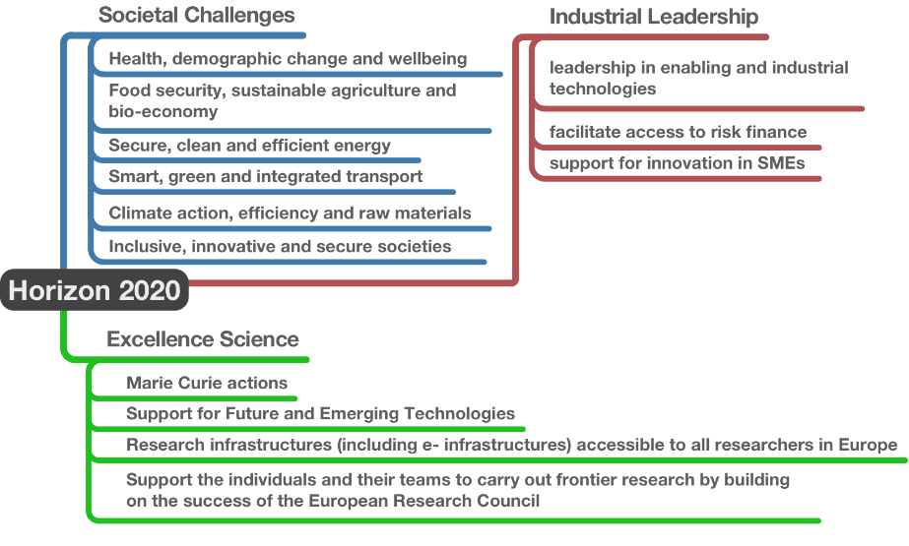
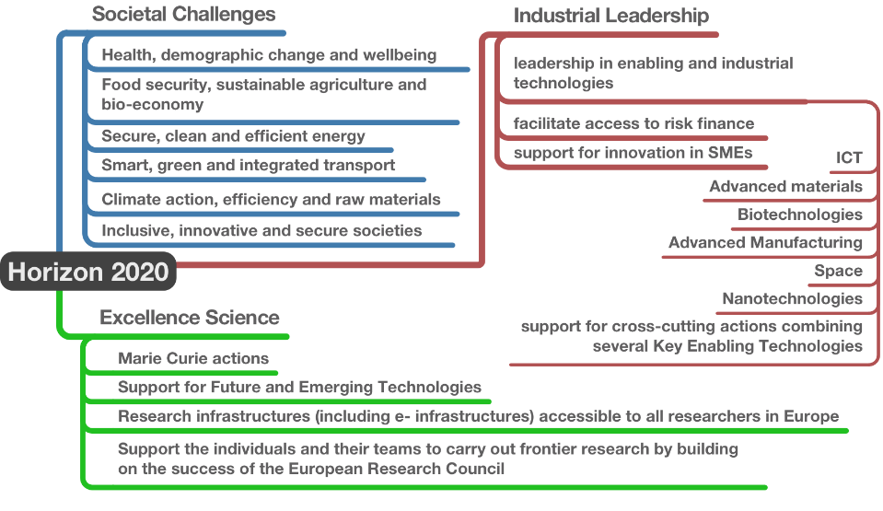
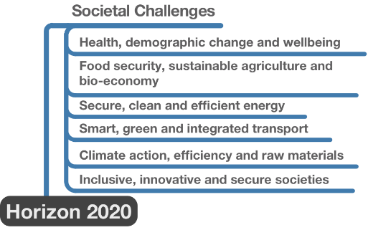
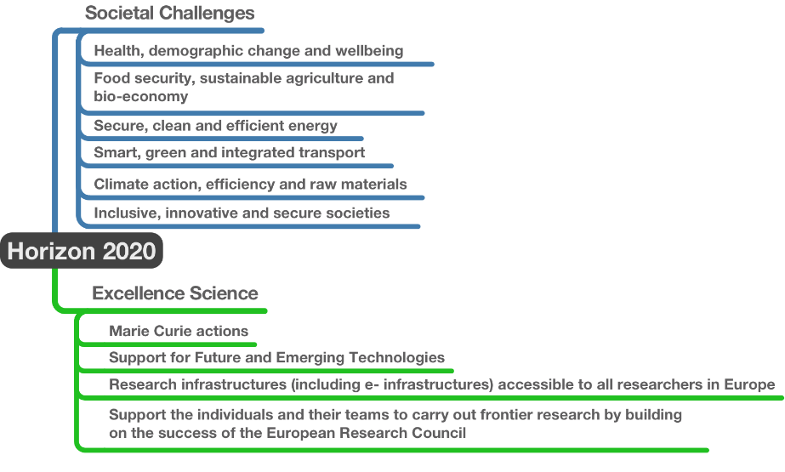
Horizon2020 Structure
KET

Slide 16
EU – smart specialisation strategy
Correlations between FVG regional strategy strands, Horizon 2020 societal challenges and UniTS expertise
SC6 - inclusive, innovative and secure societies
SC1 - health, demographic change and well-being
MARINE TECHNOLOGY
Short-term effects: answering the needs of enterprises; keeping or increasing the number of operators in the target sectors; improving the uptake of medium- and high-level professional profiles.
AGRO FOOD
Medium-term effects: creating new, hi-tech, synergic production environments.
SC4 - smart, green and integrated transport
SC5 - climate action, resource efficiency and raw materials
SC2 - food security, sustainable agriculture, marine and maritime research and the bio-economy
Strategic production chains: METAL & BUILDINGS
SMART HEALTH
Long-term effects: making the regional production substrate more compact and resilient to future social, environmental and economical challenge & changes.
CULTURE, CREATIVITY AND TOURISM
SC3 - secure, clean and efficient energy

Slide 17
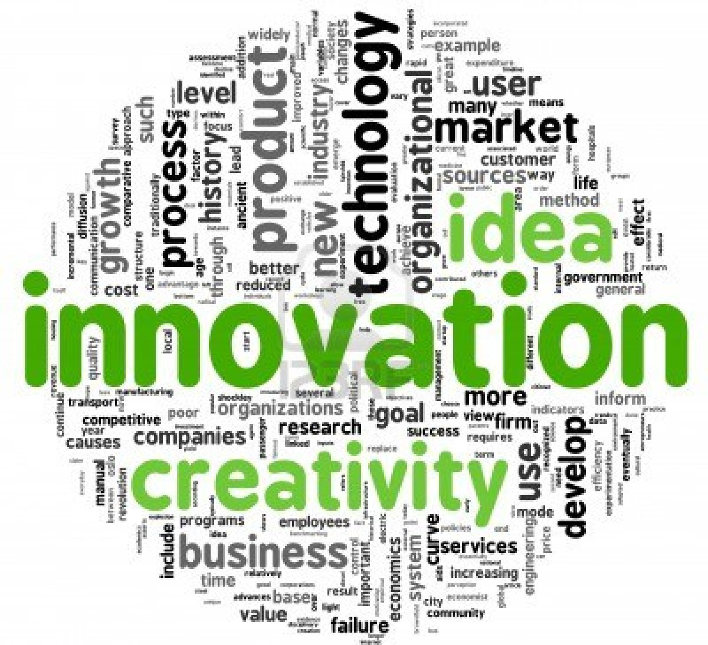
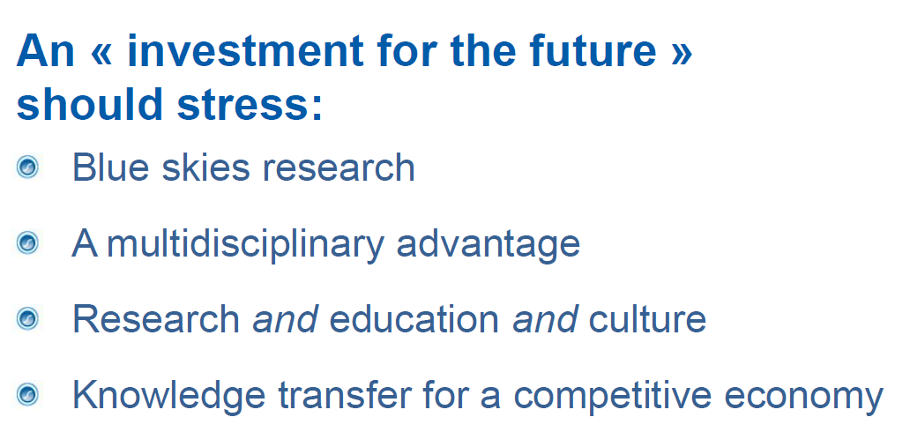
Innovation in Science
Culture
Curiosity
Creativity
Competency

Slide 18
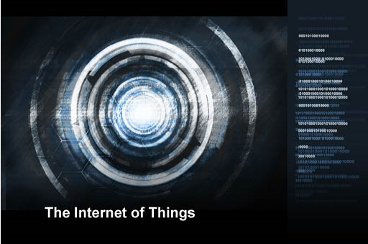
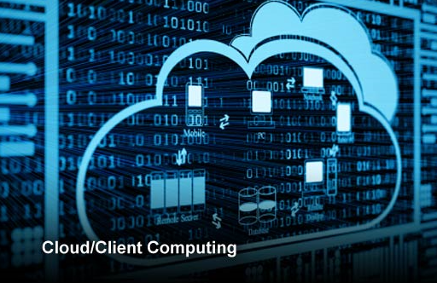
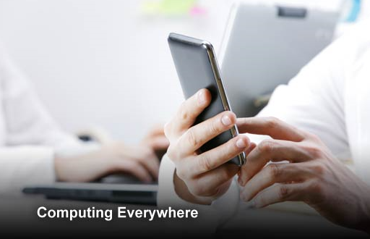
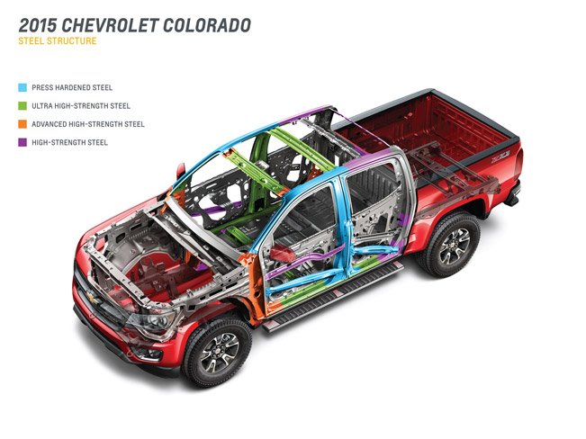
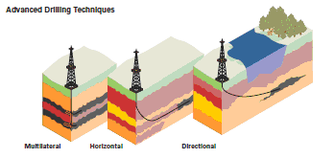
12 Disruptive technologies
Mobile Internet
Automation of knowledge work
Internet of Things
Advanced robotics
Cloud
Autonomous or Near-Autonomous Vehicles
Next-generation Genomics
Next generation Storage
3D Printing
Advanced Materials
Advanced Oil and Gas Exploration and Recovery
Renewable Electricity
Fonte: IntelligentHQ, Fonseca, 2014

Slide 19
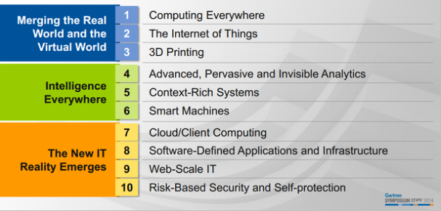
Top 10 Strategic Technology Trends

Slide 20
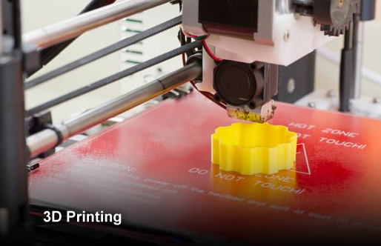
Merging the real world and the virtual world
Notes:
Computing Everywhere
As mobile devices continue to proliferate, Gartner predicts an increased emphasis on serving the needs of the mobile user in diverse contexts and environments, as opposed to focusing on devices alone.
"Phones and wearable devices are now part of an expanded computing environment that includes such things as consumer electronics and connected screens in the workplace and public space," said Mr. Cearley. "Increasingly, it's the overall environment that will need to adapt to the requirements of the mobile user. This will continue to raise significant management challenges for IT organizations as they lose control of user endpoint devices. It will also require increased attention to user experience design."
The Internet of Things
The combination of data streams and services created by digitizing everything creates four basic usage models — manage, monetize, operate and extend. These four basic models can be applied to any of the four "Internets." Enterprises should not limit themselves to thinking that only the Internet of Things (IoT) (assets and machines) has the potential to leverage these four models. For example, the pay-per-use model can be applied to assets (such as industrial equipment), services (such as pay-as-you-drive insurance), people (such as movers), places (such as parking spots) and systems (such as cloud services). Enterprises from all industries can leverage these four models.
3D Printing
Worldwide shipments of 3D printers are expected to grow 98 percent in 2015, followed by a doubling of unit shipments in 2016. 3D printing will reach a tipping point over the next three years as the market for relatively low-cost 3D printing devices continues to grow rapidly and industrial use expands significantly. New industrial, biomedical and consumer applications will continue to demonstrate that 3D printing is a real, viable and cost-effective means to reduce costs through improved designs, streamlined prototyping and short-run manufacturing.

Slide 21
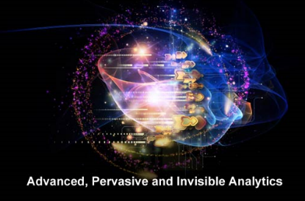
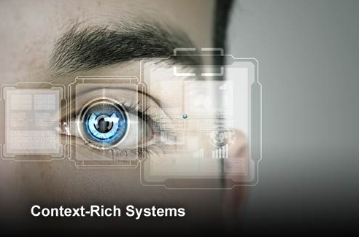
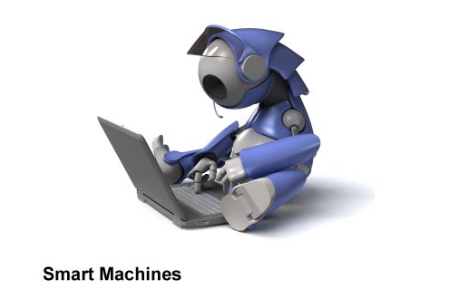
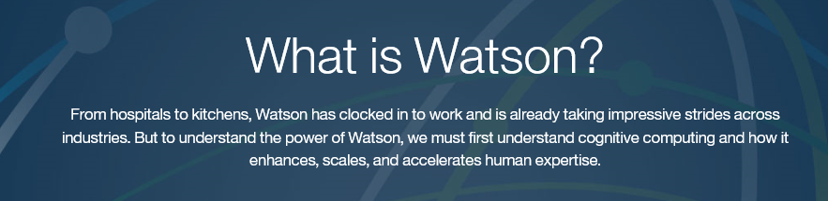
Intelligence everywhere
Notes:
Advanced, Pervasive and Invisible Analytics
Analytics will take center stage as the volume of data generated by embedded systems increases and vast pools of structured and unstructured data inside and outside the enterprise are analyzed. "Every app now needs to be an analytic app," said Mr. Cearley. "Organizations need to manage how best to filter the huge amounts of data coming from the IoT, social media and wearable devices, and then deliver exactly the right information to the right person, at the right time. Analytics will become deeply, but invisibly embedded everywhere." Big Data remains an important enabler for this trend but the focus needs to shift to thinking about big questions and big answers first and Big Data second — the value is in the answers, not the data
Context-Rich Systems
Ubiquitous embedded intelligence combined with pervasive analytics will drive the development of systems that are alert to their surroundings and able to respond appropriately. Context-aware security is an early application of this new capability, but others will emerge. By understanding the context of a user request, applications can not only adjust their security response but also adjust how information is delivered to the user, greatly simplifying an increasingly complex computing world.
Smart Machines
Deep analytics applied to an understanding of context provide the preconditions for a world of smart machines. This foundation combines with advanced algorithms that allow systems to understand their environment, learn for themselves, and act autonomously. Prototype autonomous vehicles, advanced robots, virtual personal assistants and smart advisors already exist and will evolve rapidly, ushering in a new age of machine helpers. The smart machine era will be the most disruptive in the history of IT.

Slide 22
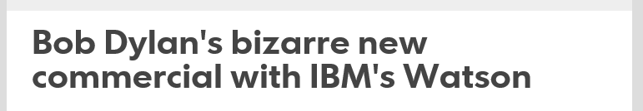


Slide 23

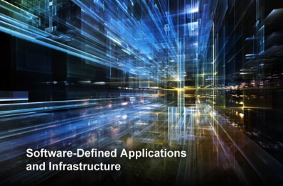

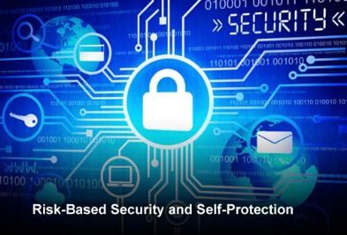
The new IT reality emerges
Notes:
Cloud/Client Computing
The convergence of cloud and mobile computing will continue to promote the growth of centrally coordinated applications that can be delivered to any device. "Cloud is the new style of elastically scalable, self-service computing, and both internal applications and external applications will be built on this new style," said Mr. Cearley. "While network and bandwidth costs may continue to favor apps that use the intelligence and storage of the client device effectively, coordination and management will be based in the cloud."
In the near term, the focus for cloud/client will be on synchronizing content and application state across multiple devices and addressing application portability across devices. Over time, applications will evolve to support simultaneous use of multiple devices. The second-screen phenomenon today focuses on coordinating television viewing with use of a mobile device. In the future, games and enterprise applications alike will use multiple screens and exploit wearables and other devices to deliver an enhanced experience.
Software-Defined Applications and Infrastructure
Agile programming of everything from applications to basic infrastructure is essential to enable organizations to deliver the flexibility required to make the digital business work. Software-defined networking, storage, data centers and security are maturing. Cloud services are software-configurable through API calls, and applications, too, increasingly have rich APIs to access their function and content programmatically. To deal with the rapidly changing demands of digital business and scale systems up — or down — rapidly, computing has to move away from static to dynamic models. Rules, models and code that can dynamically assemble and configure all of the elements needed from the network through the application are needed.

Slide 24
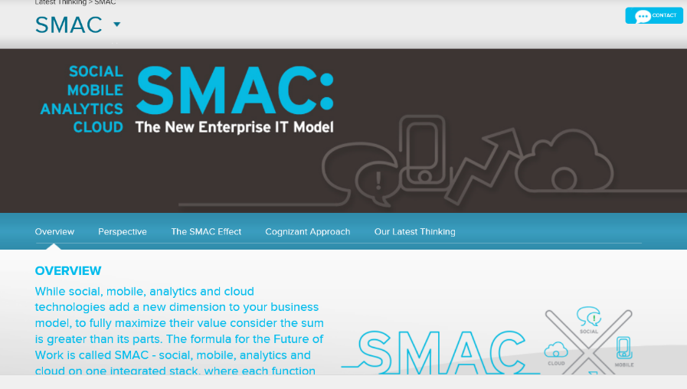
Social, Mobility, Analytics, Cloud
Internet of things

Slide 25
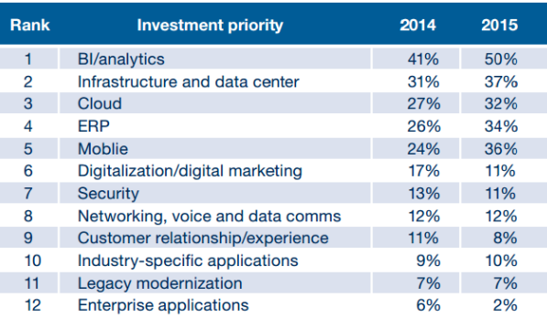
Investments priorities in ICT

Slide 26
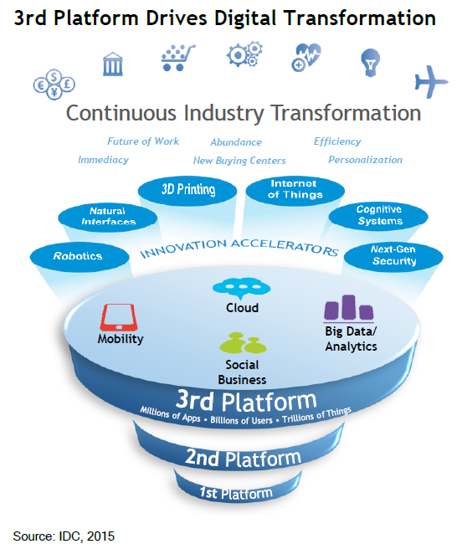
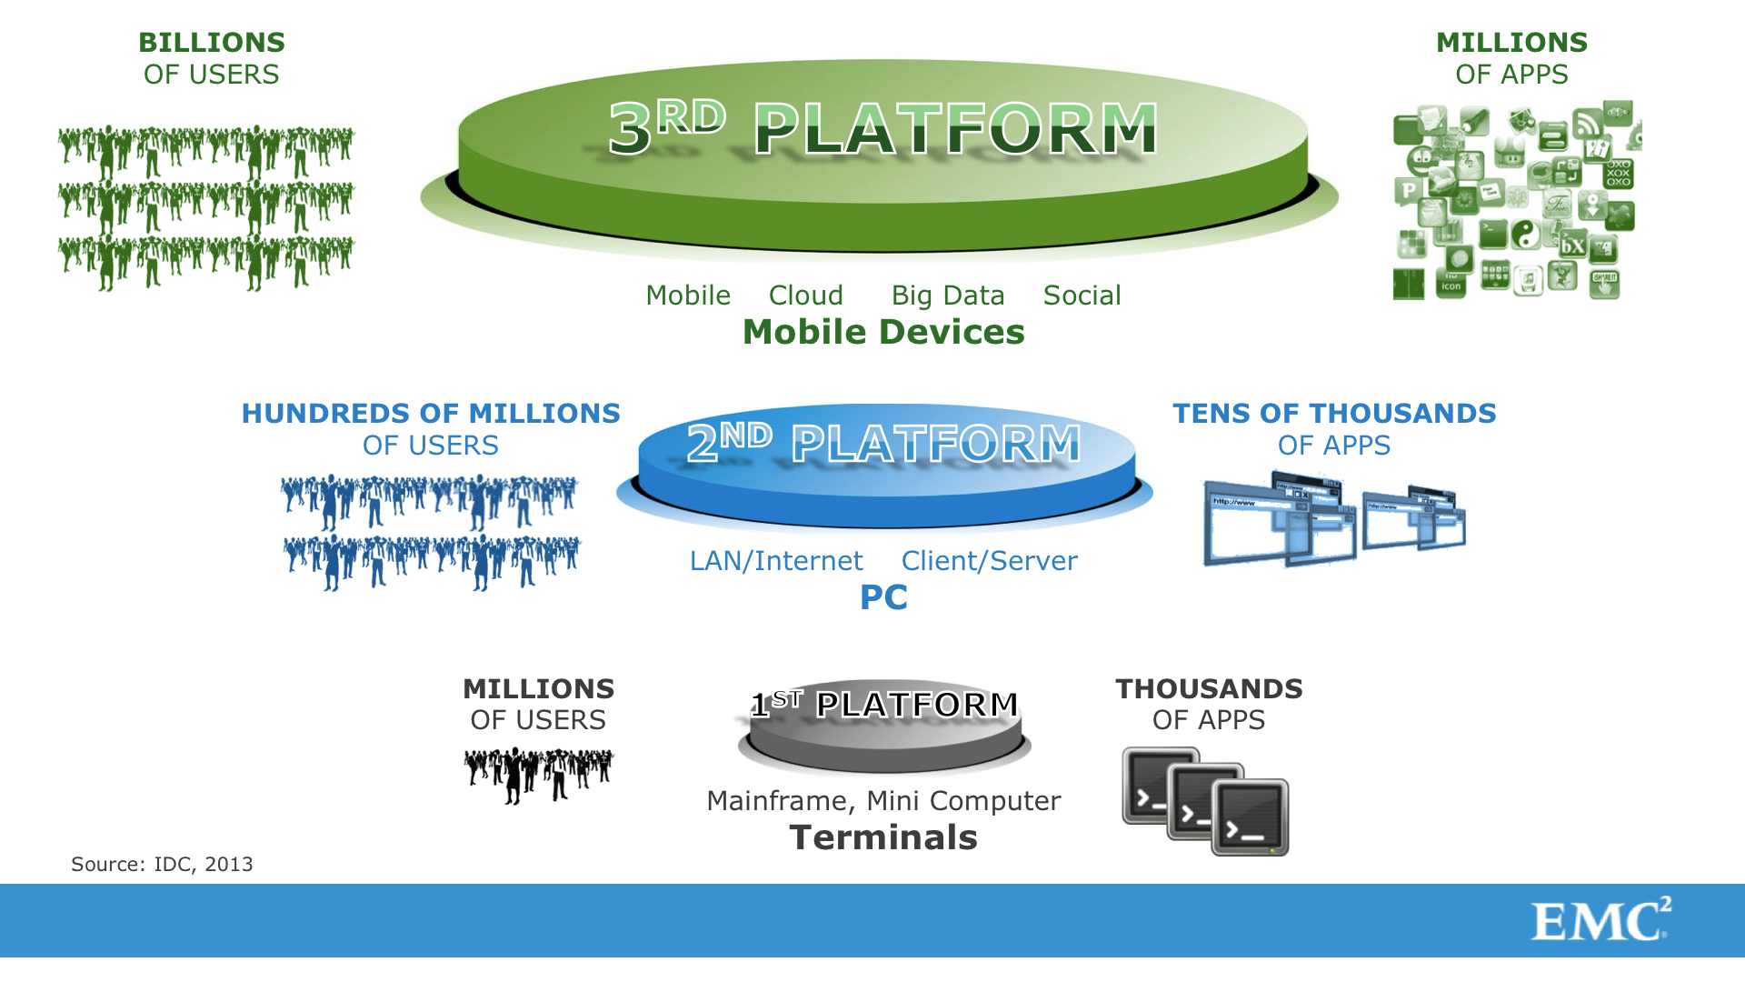
Trasformazione continua dell’industria

Slide 27
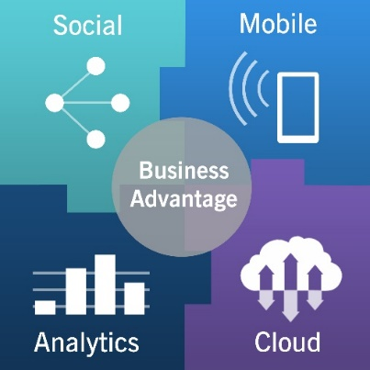
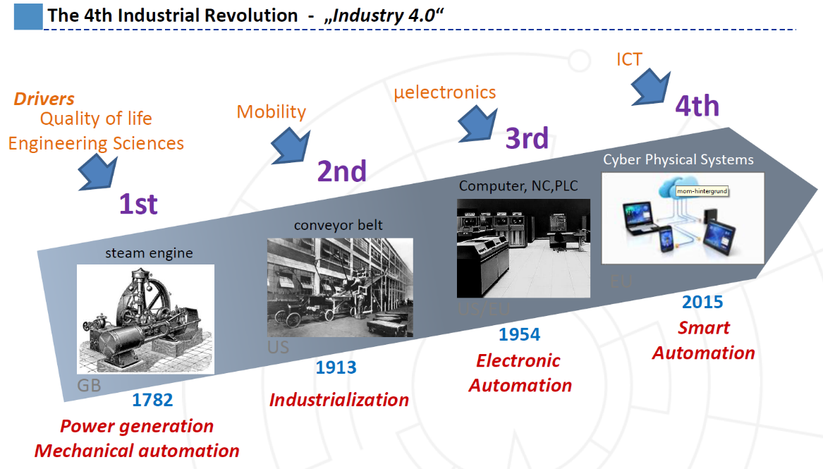
Industry 4.0

Slide 28
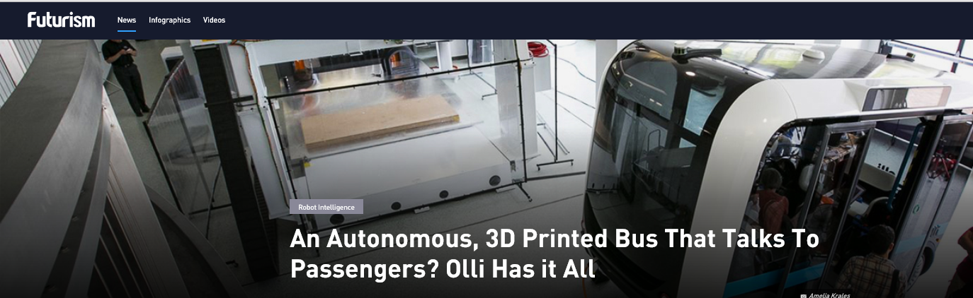
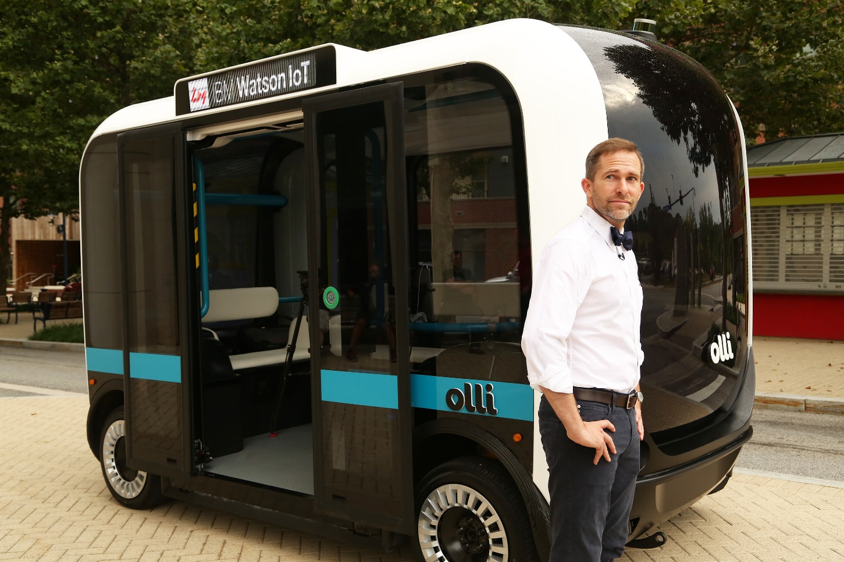
Notes:
Self-driving vehicles are the Holy Grail of the transportation technology of the next age. It’s the stuff of science fiction, but it’s coming to life. Big companies like Google, Tesla, General Motors, and even the US Government are accelerating research into the field. But it seems like a small startup beat them to the punch.
Arizona-based startup Local Motors has just revealed a 3D-printed, autonomous, electric shuttle bus that is partially recyclable. It’s called Olli.
The electric vehicle, which can carry up to 12 people, is equipped with IBM Watson Internet of Things (IoT) for Automotive, which is IBM’s car-focused cognitive learning platform.
IBMThe company, unlike others that mix traditional automotive making and self-driving tech, builds the vehicles from the ground up, and produces most components with 3D printers.
The company is able to print a vehicle in about 10 hours and assemble it in another hour. They are also looking at “micro-factories” that could opensource the building of future designs. In fact, the use of 3D printing allows designs based on what individual customers want, and lacks the large infrastructure costs of traditional automakers.
Brains of the Operation
Olli is the first vehicle to utilize the cloud-based cognitive computing capability of IBM Watson IoT to analyze and learn from high volumes of transportation data, which is produced by more than 30 sensors embedded throughout the vehicle.
In fact, IBM Watson will not only allow automated driving, but also interaction with passengers. Passengers will be able to interact conversationally with Olli while traveling from point A to point B, discussing topics about how the vehicle works, where they are going, and why Olli is making specific driving decisions.
“By having authentic conversations with riders about their journey the more they will be connected to technology itself, making them part of the experience rather than an observer. This user experience is the key to making self-driving vehicles a real part of our lives rather than a tech vision of the future”, says Harriet Green, General Manager of IBM Watson Internet of Things in a press release.

Slide 29
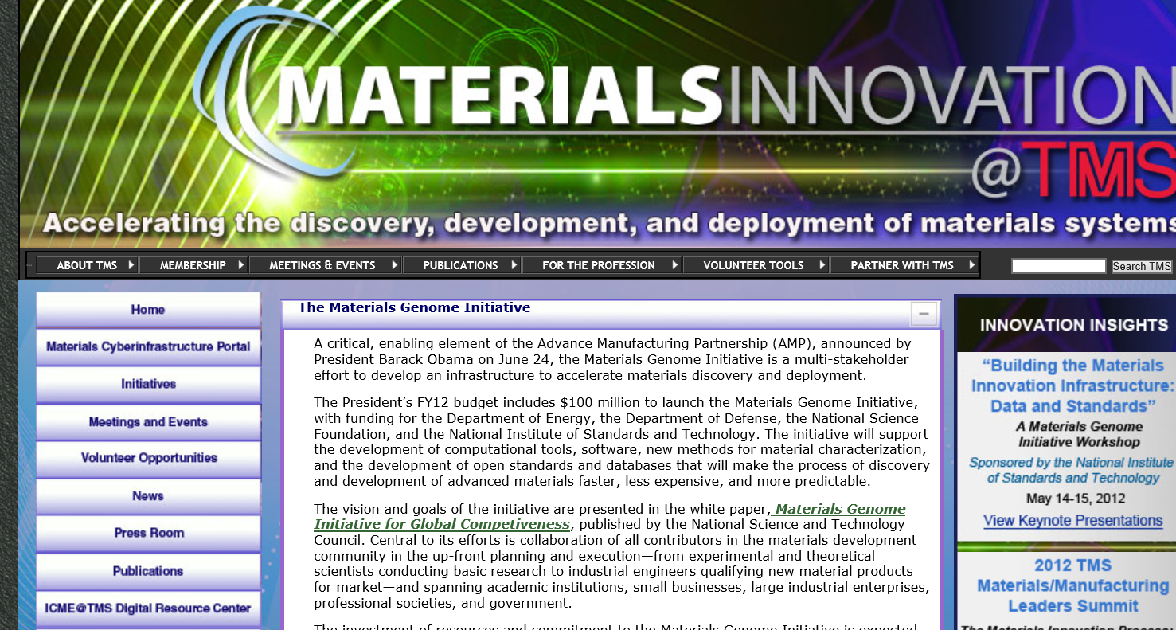
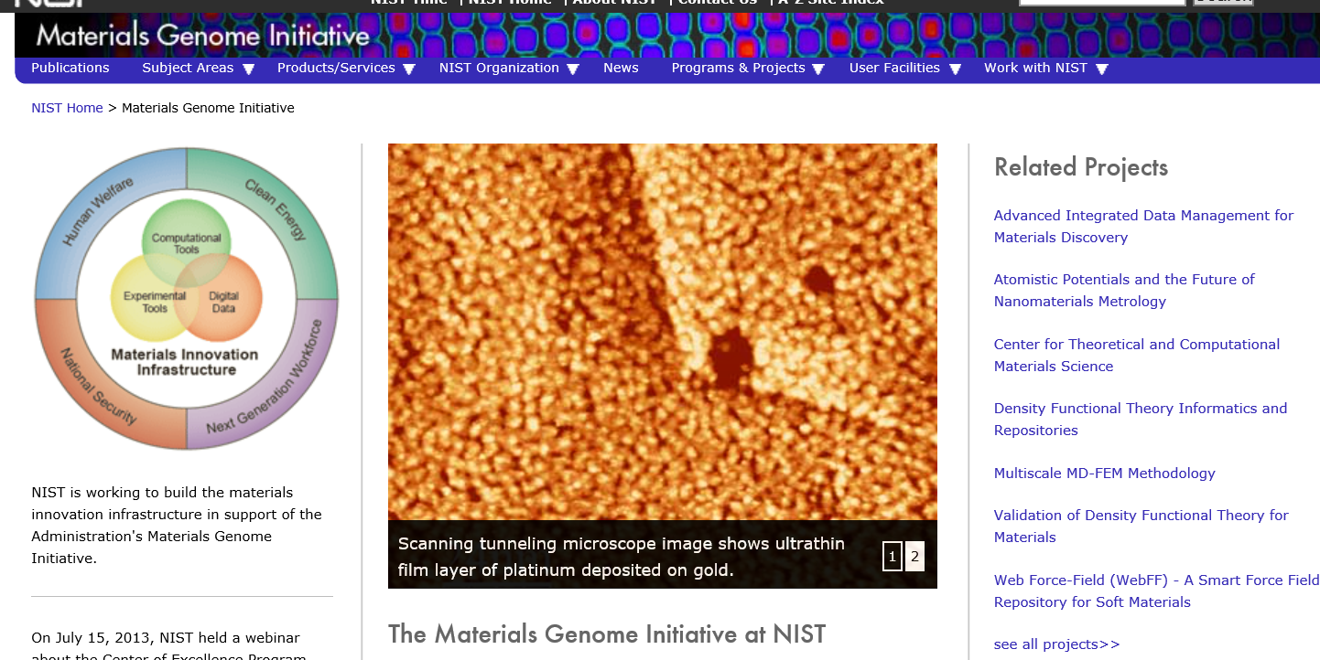
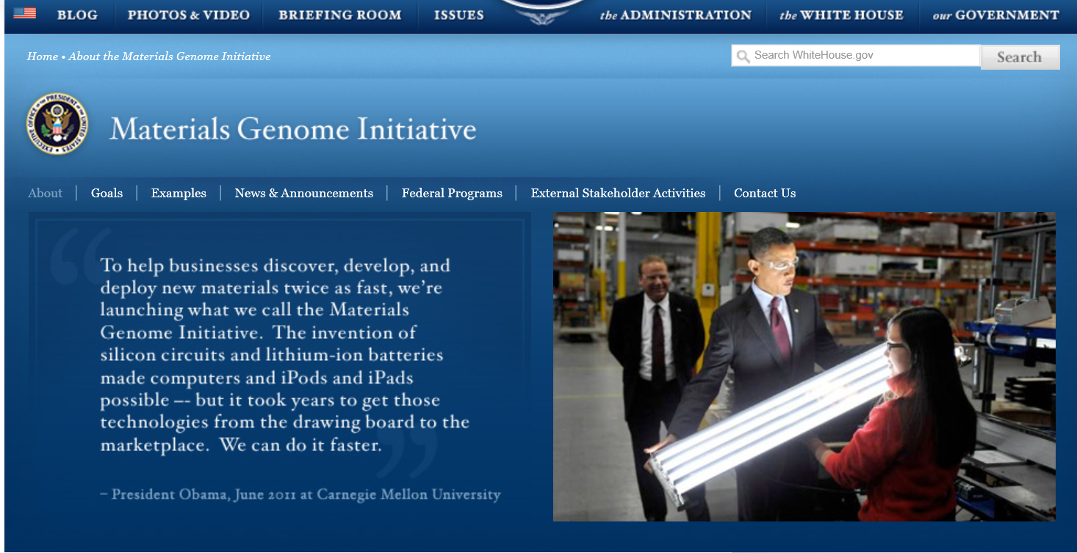
Materials Genome Initiative (MGI)

Slide 30
The future of employment
Probability of massive reduction of occupation by 2030
Occupation
Home Carer
Memory Surgeon
Telemarketers
Accountants & Auditors
Retail Salespersons
Real Estate Sales Agents
Structural Iron and Steel Workers…
Machinists
Audio and Video Technicians
Taxi drivers/drivers
Firefighters
Chemical Engineers
Music Directors and Composers
Marine Engineers - Naval Architects
Clergy
Athletic Trainers
Dentists
99%
94%
92%
86%
83%
…
65%
55%
55%
…
17%
2%
1.6%
1.0%
0.8%
0.8%
0.7%
0.4%
…
Body Part Maker
Digital Architect
3D-printing
expert
Traceability Manager
Energy
Manager
Personal
Brander
Geomicro
Biologist
SEO
Manager
Online Community Manager
Broadband
Architect
…
Source: Bureau of labor statistics, the Future of Employment (Frey & Osborne, 2013)

Slide 31
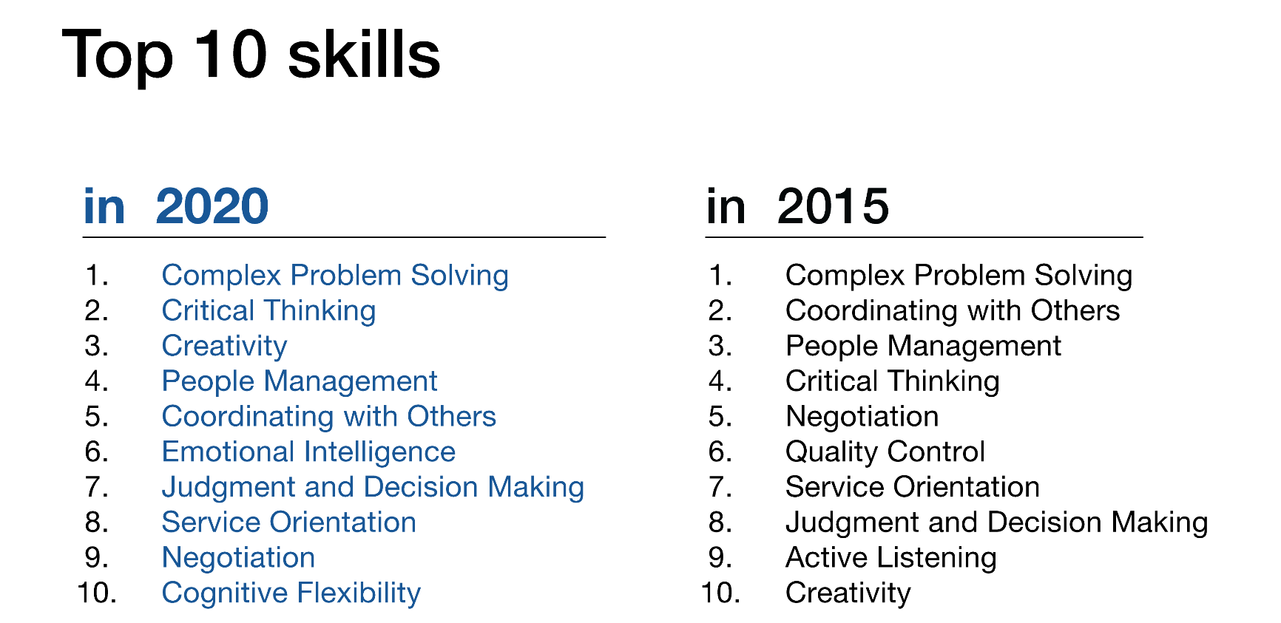

The Future of Jobs and Skills
New categories of jobs will emerge, partly or wholly displacing others
65% of children entering primary school today will ultimately end up working in completely new job types that don’t yet exist.

Slide 32
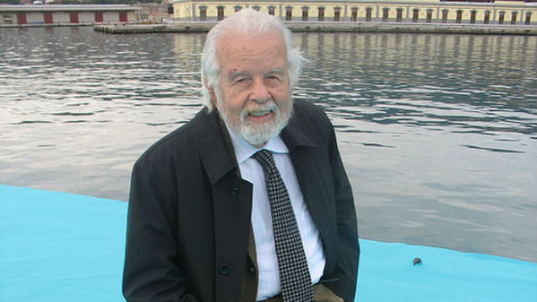
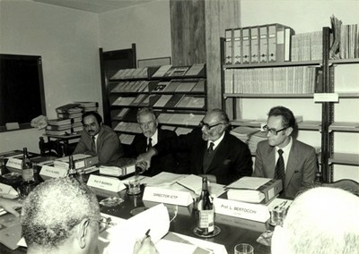

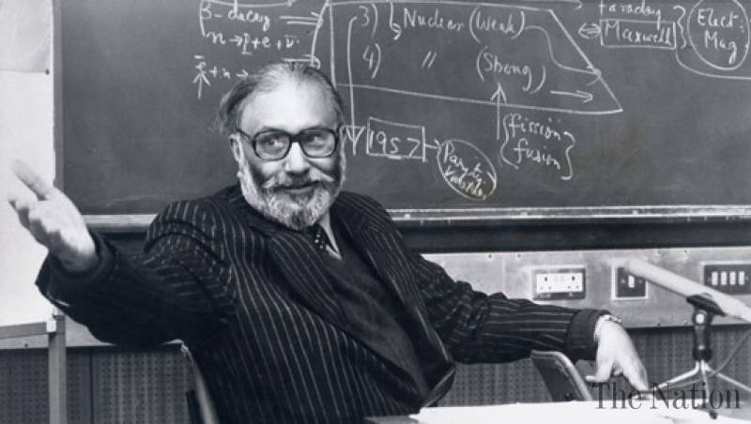
Where everything started ….

Slide 33
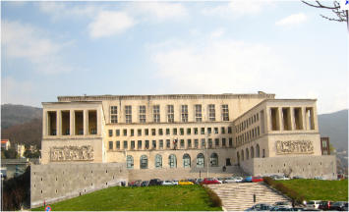

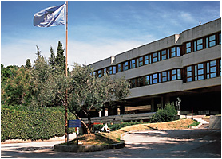
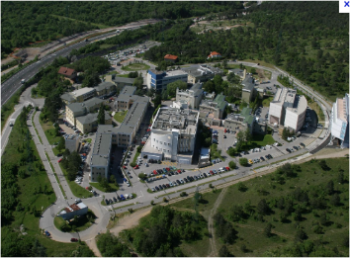




A network of scientific institutions

Slide 34

The Trieste System
CBM
TWAS
Thirld World
Academy of Science
LNCIB
Natiolnal Lab
Interuniv. cons
Biotecnology
ICTP
International Centre
For Theoretical
Physics
ICGEB
International Centre
For Genetics and
Biotechnology
OGS
National Institute
For Oceanography and
Exp. Geophysics
Trieste
University
Elettra
Synchrotron
ISMAR-CNR
Marine Science
INAF
Astrophysics
Astronomy
Over 30 researchers every 1,000 active citizens (8.1 in USA, 9.1 in Japan, 5.7 in Europe)
Area
Science Park
TASC
Surface Physics
INFN
Nuclear Physics
SISSA
1841
Sea Observatory
1898
Astronomical
Observatory
1924-1938 University
1981 Area Science Park
1993 ELETTRA
1978 SISSA
1987 ICGEB
1964 ICTP
1983TWAS
1850
1900
2000

Slide 35











The United Universities of
Friuli Venezia Giulia

Slide 36



International relationships …

Slide 37

21st Century Learning Competencies
“We are responsible for preparing our students to address problems we cannot foresee with knowledge that has not yet been developed using technology not yet invented.”
“The problems we have cannot be solved at the same level of thinking at which we created them.”
Albert Einstein

Slide 38

Is Higher Education Primarily for Economic Gain?

Slide 39
Or Developing the Nation’s Talent and Creativity?

Slide 40

… anyway!!
“If you think education is expensive,
try ignorance”
Derek Bok - Presidente of Harvard University 1971-1990

