Slide 1

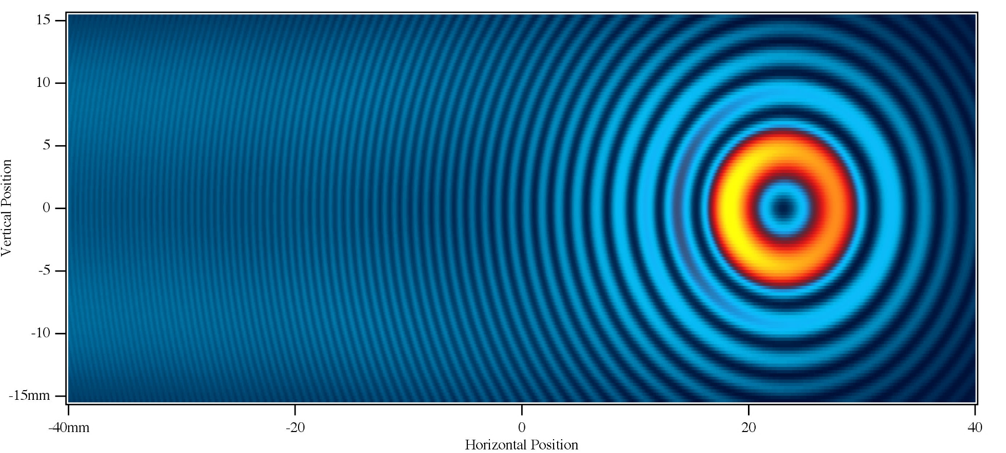
SESAME Infrared Beamline: Briefly!
Gihan kamel
IR-beamline Scientist
On Leave from: Department of Physics, Faculty of Science, Helwan University, Cairo , Egypt

Slide 2
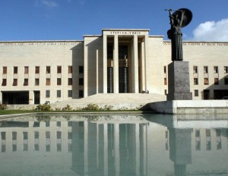
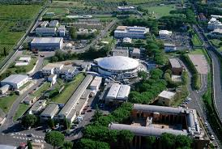
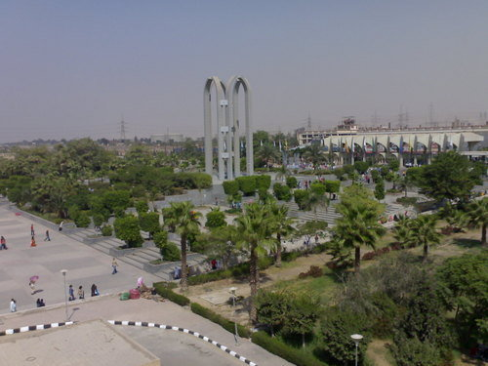
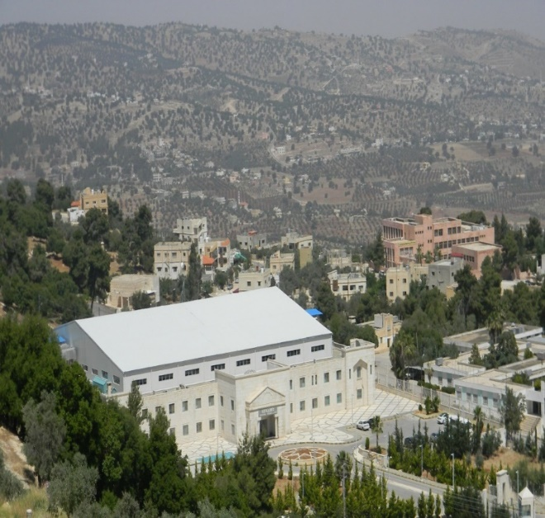
3
Reverse the brain-drain in the region
University of Rome, Italy
LNF-INFN, Italy
Opportunity
Helwan University, Egypt
SESAME, Jordan

Slide 3
A few things to remember..!
Not operational (yet) but working..
Similar but different..
Weakness and strength..
Black and White but there is also pink..
Challenges more than problems..
Not the (wow) but competing..
A dream but not a fantasy..
UNIQUE

Slide 4
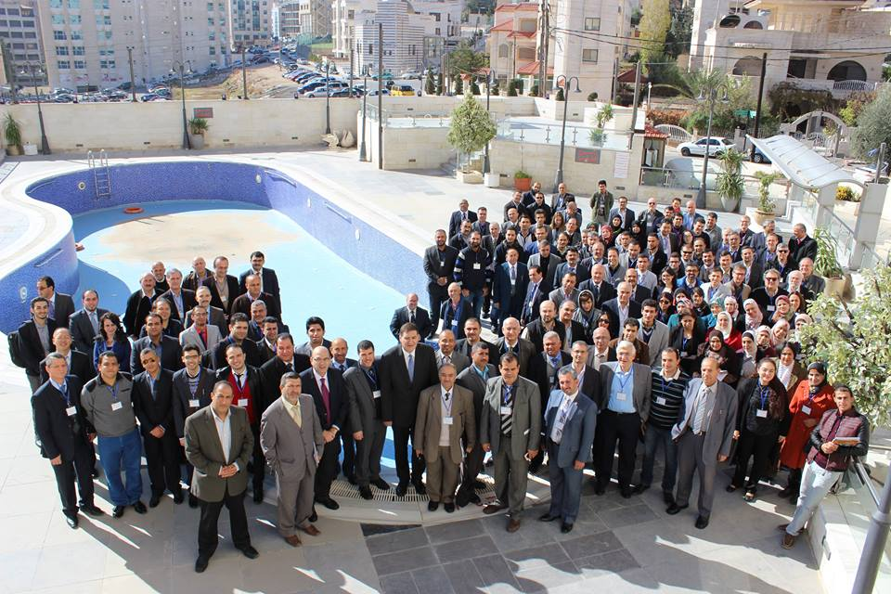
You may say I’m a dreamer, but I’m not the only one!
SESAME 13th Users’ Meeting, Jordan, 26-27 November 2015

Slide 5
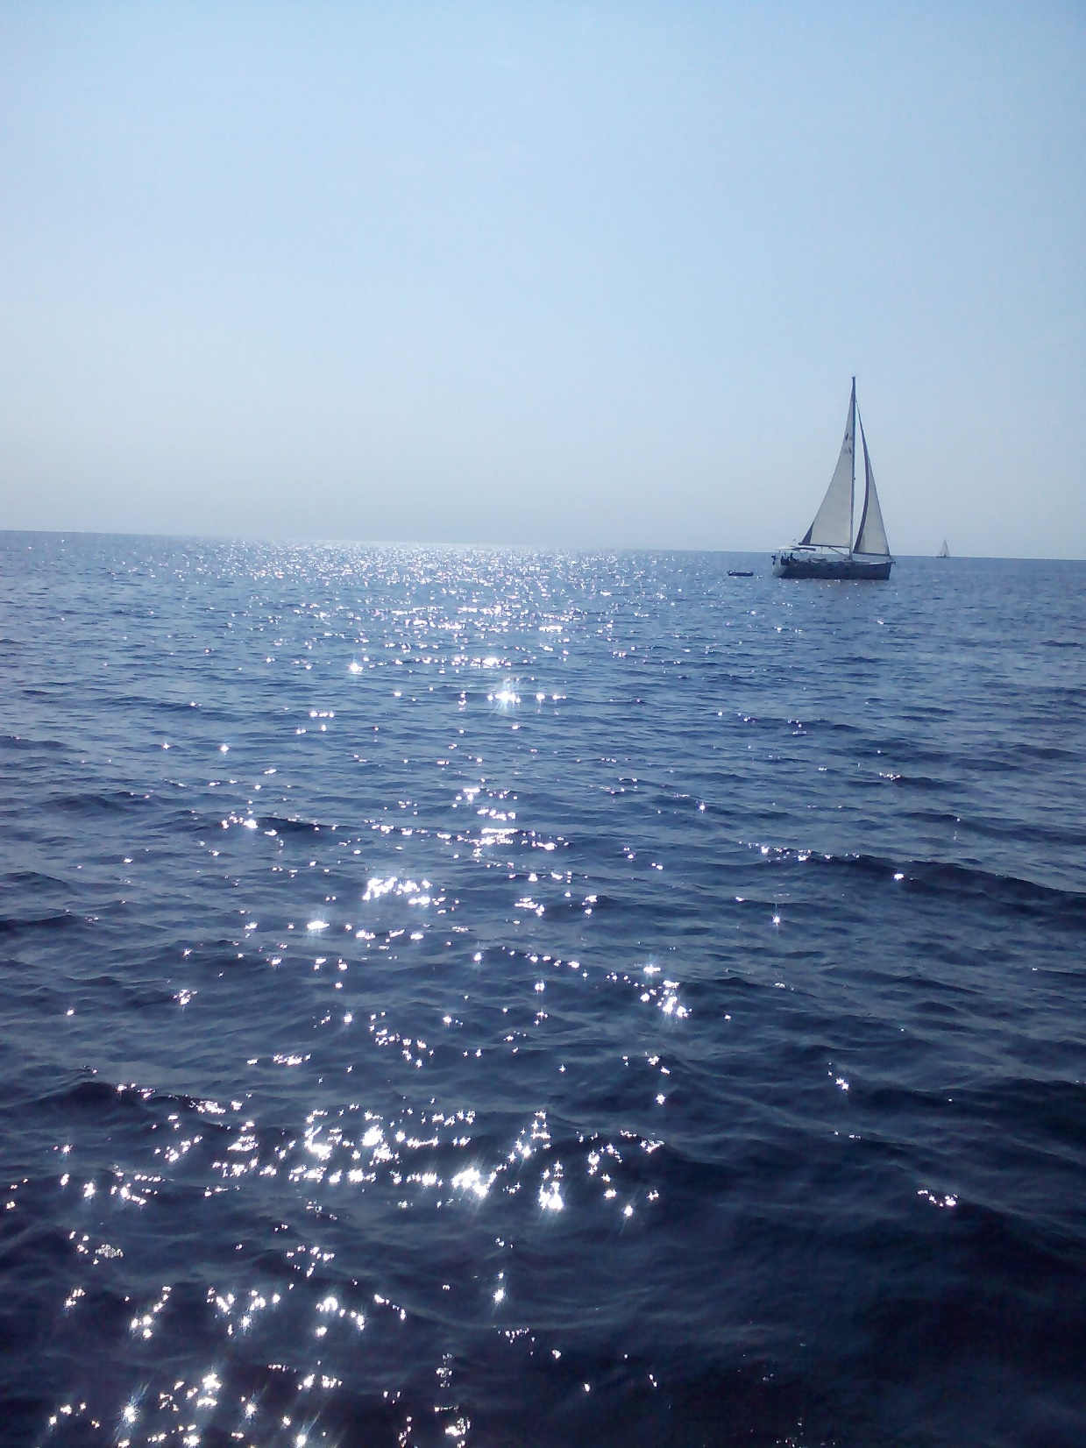
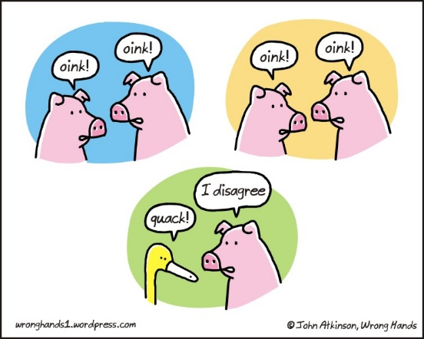
Notes:
.. The right to an opinion does not make it right..

Slide 6
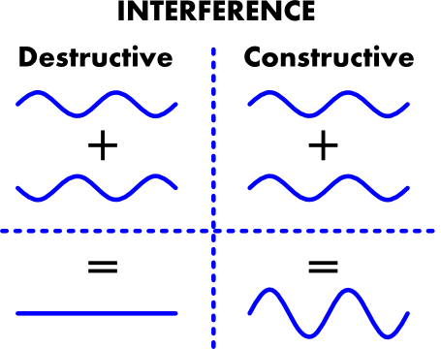
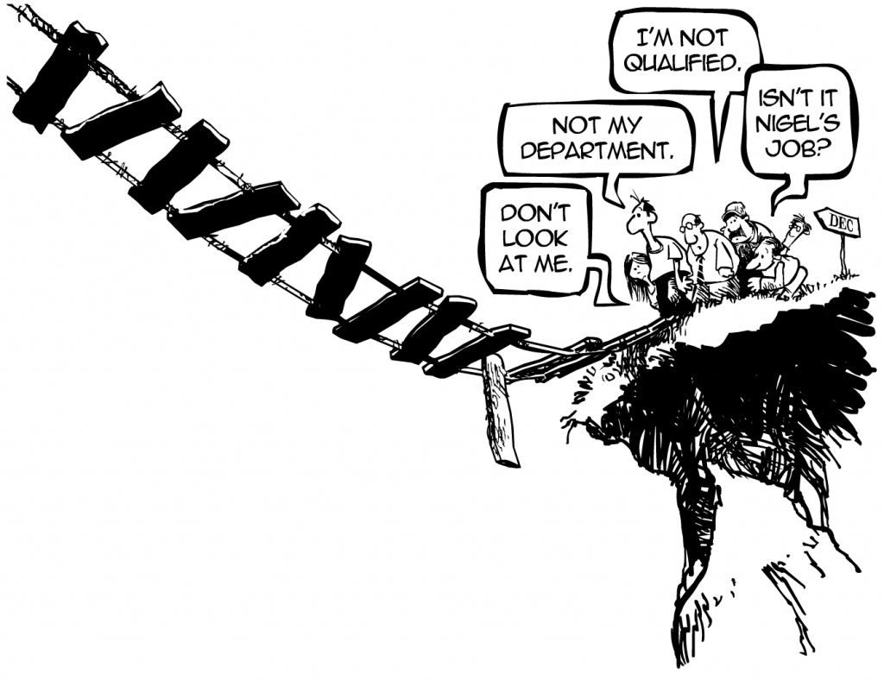
Darkness

Slide 7
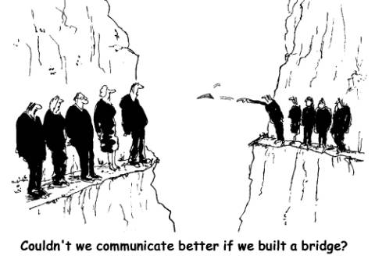
Brightness
Science= common language + common values + mutual benefits
Notes:
“It is well demonstrated that in today’s information age, distances and languages are no longer barriers to the transfer of knowledge. With the power of technology and advancements in science, collaboration across cultures could bring massive leaps and rapid advances towards solving shared global challenges and achieving mutual benefits, while also contributing to intercultural dialogue – Hanan Dowidar and Ahmed Salim.
* Facilitate International Science [ > capacity of
a single country]
- Sharing Facilities?
Joint Projects?
* Improving the international relations between countries: solving common problems, and enhance biodiversity among nations
Shared Infrastructure & Collaborative Research
More science opportunities depend on LARGE INFRASTRUCTURES-: accelerators, SR-sources, large FELs, reactors and neutron sources, super computers, networking,…
Obvious reasons to share infrastructures?
a. beyond budgets and technical expertise of individual countries..
b. potential user base not large enough to justify the cost in individual countries..
Obvious reasons to scientifically collaborate?
- the critical need for mass in terms of manpower and expertise..
(Not) so obvious reasons ( to funding agencies)
Combining intellectual resources to have better science and stronger networks..
Bring all partners up to the highest standards
Building bridges across political divides
Why not??
- Inertia lack, complicated decision making, choice of site,… Sir. Chris L. Smith

Slide 8
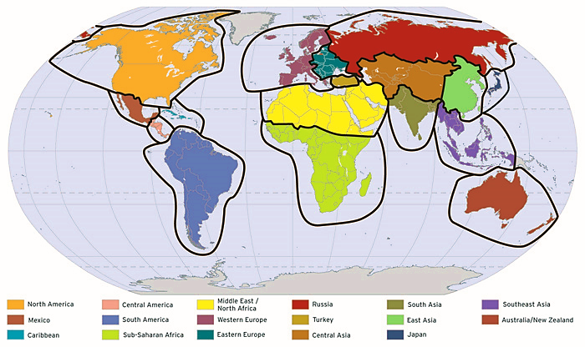

Map of the world as seen by Politicians
Map of the world as IT SHOULD BE seen by Scientists
2
Understanding among people of diverse backgrounds through scientific cooperation
Disease
Pollution
Energy
Global warming
Could it have an impact in this age and time?
..etc.
Disaster management
Food security
Economy
No barriers
Notes:
Each dot changes from green to red as more people in that area get sick.
The top map shows what could happen if we didn’t do anything, and the bottom shows the effect of giving people a less effective vaccine while a better one is being developed.

Slide 9
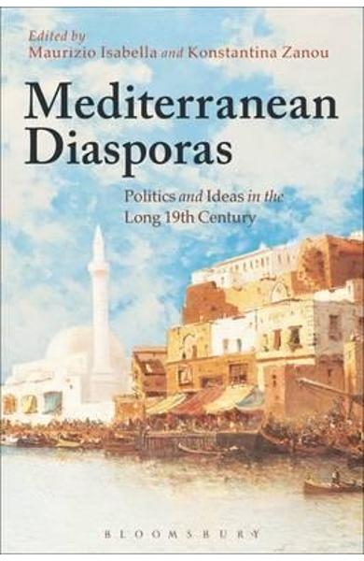


Notes:
May 2016, a delegation from the Physics Depart
The visit aimed at discussing possible means of mutual cooperation between An-Najah and the centre ment at An-Najah visited the International Research Centre (SESAME) in Amman, Jordan.

Slide 10
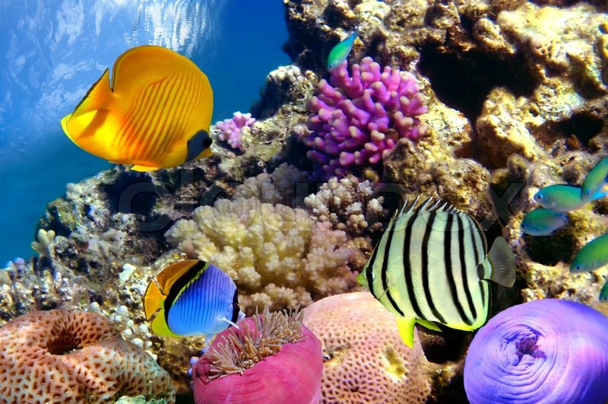
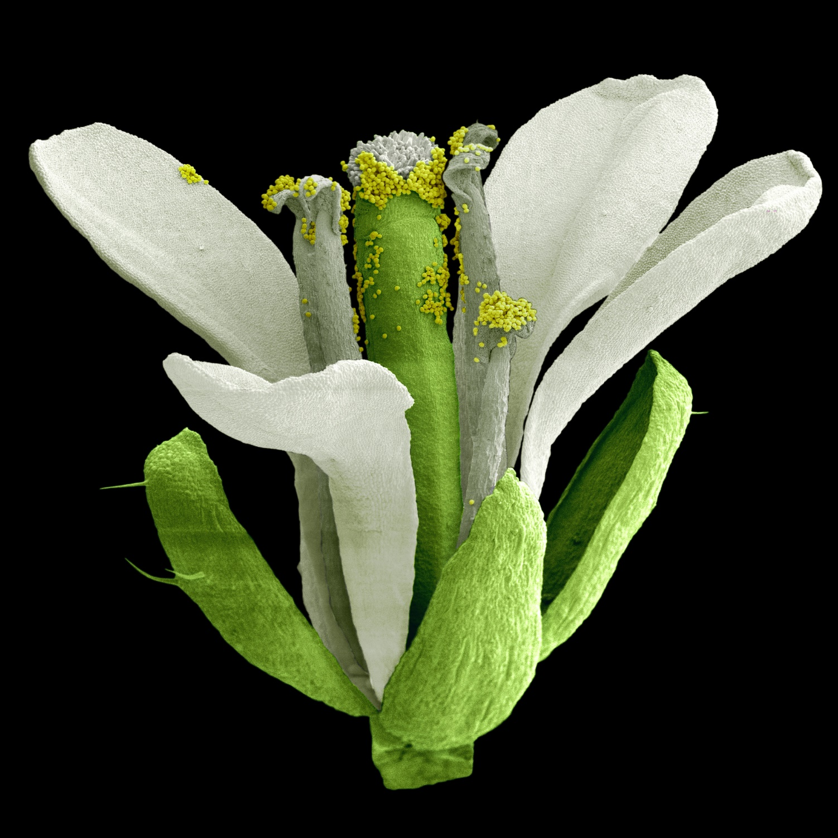
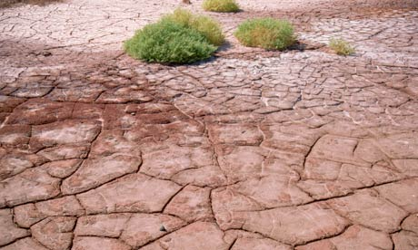
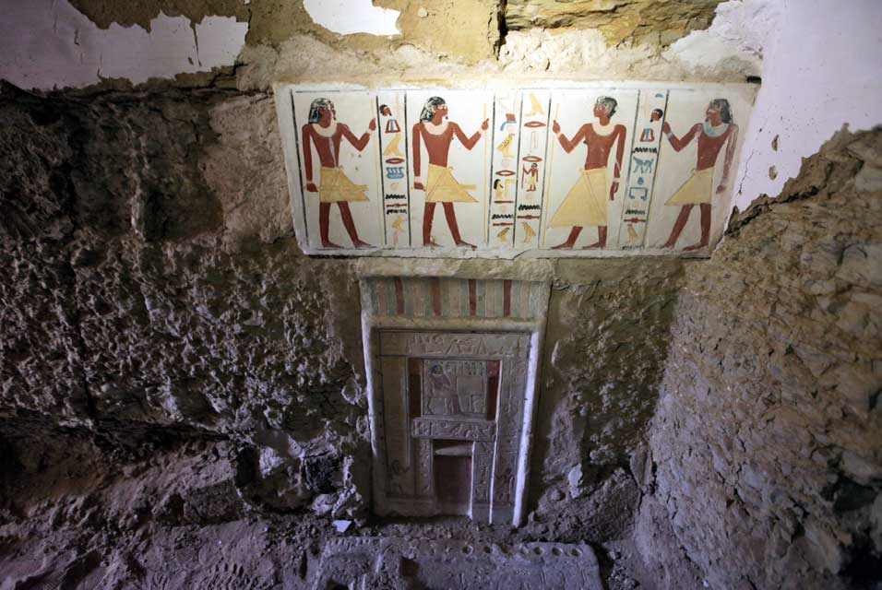
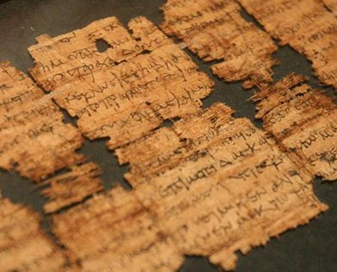
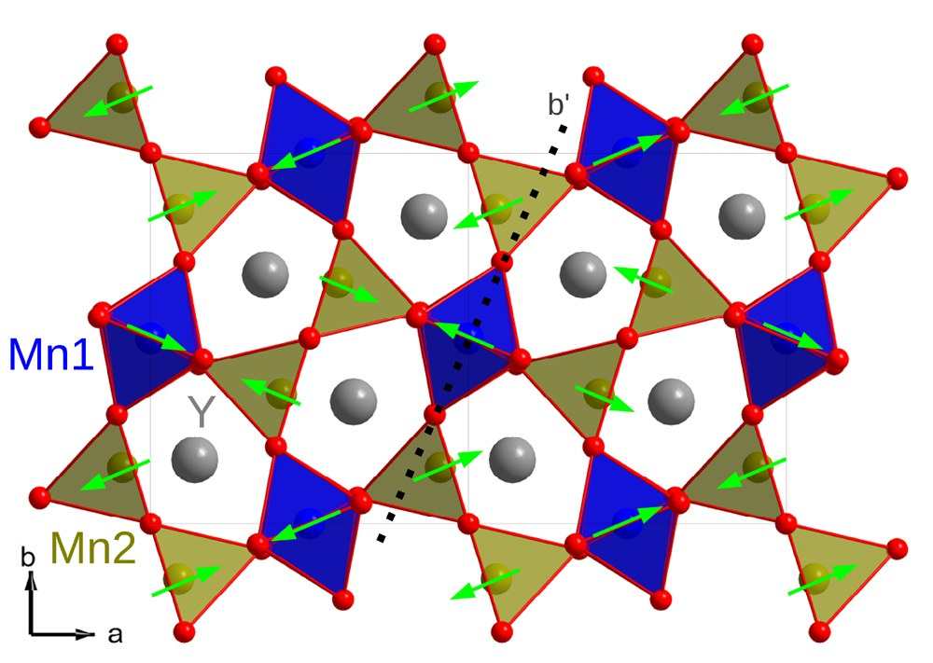
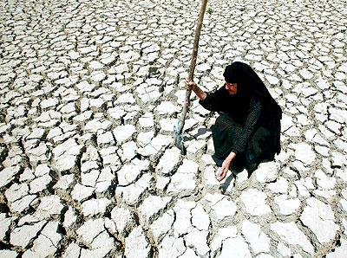
SR-FTIR: search for a scientific pokemon!!
Notes:
We care about details.. The more details we can reveal, the more information we can get..
The wow science is done here
Importance of synchrotron radiation (SR) in science and technology cannot be overestimated.
At present, all over the world, about 80 large and medium size storage rings are producing altogether hundreds of intense collimated light beams.

Slide 11
Infrared Beamlines in the world
Is it of similar interest to the Middle-East Scientific Community?

Slide 12
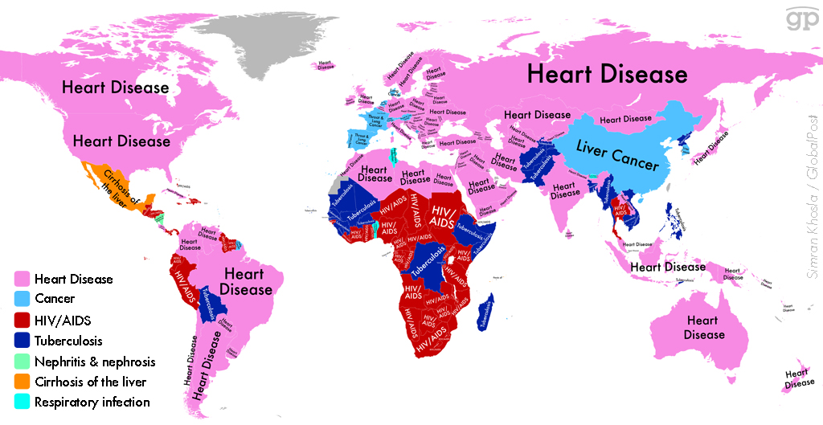
Middle-East, et al.
Diseases are deeply connected to geographical environments..
Leading: cardiovascular, cancer, chronic respiratory diseases, and diabetes..

Slide 13
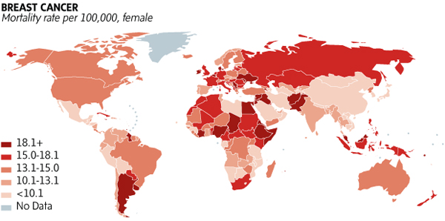
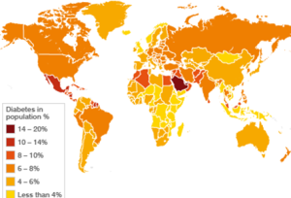
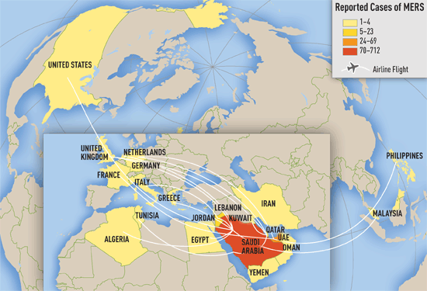
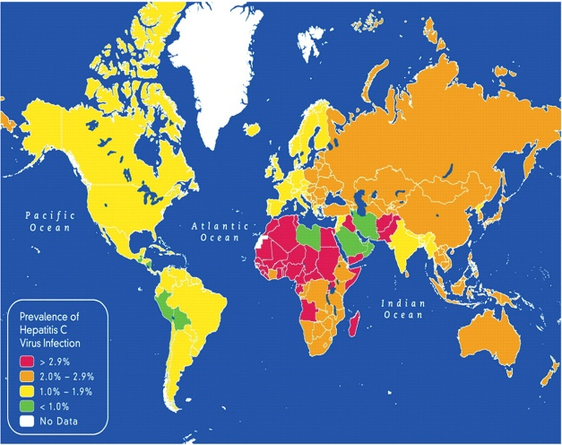
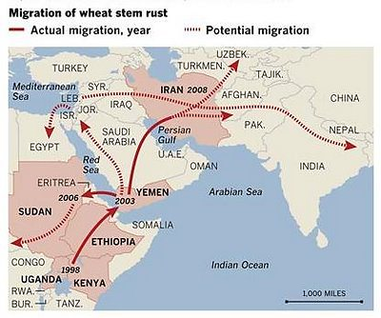
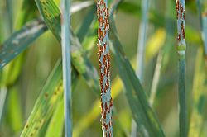
Breast Cancer
Some targets?
Middle-East Respiratory Syndrome (MERS)
Diabetes
Migration of Wheat Stem Rust
Hepatitis C Virus
Notes:
The Health and Environment Linkages Initiative (HELI)
World Health Organization (WHO)
The Hepatitis c virus, HCV, is a national and international health problem. The HCV RNA polymerase is an attractive drug target with an active site and five allosteric binding sites. The prevalent genotype in Egypt and the Middle East is genotype 4, which infects more than 90% of cases in Egypt. Currently, there is no vaccine for HCV. Also, standard care of Peg-IFN+Rvv is 50% successful. Therefore, highly effective new therapies are urgently needed.
Scientific data and assessment tools
The stem, black and cereal rusts are caused by the fungus Puccinia graminisand are a significant disease affecting cereal crops. Crop species which are affected by the disease include bread wheat, durum wheat, barley and triticale.^{[1]}An epidemic of stem rust on wheat caused by race TTKSK (e.g. isolate Ug99) is currently spreading across Africa, Asia and the Middle East and is causing major concern due to the large numbers of people dependent on wheat for sustenance. The strain was named after the country where it was identified (Uganda) and the year of its discovery (1999).^{[2]} It spread to Kenya, thenEthiopia, Sudan and Yemen, and is becoming more virulent as it spreads.^{[2]}Scientists are working on breeding strains of wheat that are resistant to UG99. However, wheat is grown in a broad range of environments. This means that breeding programs would have extensive work remaining to get resistance into regionally adapted germplasms even after resistance is identified.^{[2]}
Even in a world of rapid information access, synthesizing vital scientific knowledge and evidence about environmental health problems, and potential solutions, into readily understandable concepts and statistics remains a formidable challenge.
However, a range of scientific tools exist to facilitate such synthesis. Those include tools for quantifying population health impacts (e.g. burden of disease assessment), which measure the health impacts of environmental hazards in very simple terms such as mortality. Another useful burden of disease measure, disability-adjusted life years (DALYs), combines the burden due to death and disability in a single index.
Geographic Information Systems (GIS) may, among other things, describe ecological features; patterns of ecological degradation/rehabilitation; identify areas of high risk; and provide information useful in monitoring trends. Environment and health indicators provide basic data to identify priority issues, and to track progress to the goal; Environment and health standards, guidelines and certain multilateral agreements/conventions set baselines or thresholds for permissible pollution or pollution exposure levels, and define goals to be achieved. Links to these resources are provided below.
Health indicators/trends
Description of trends and key health indicators, e.g. mortality, morbidity and health expenditure, as summarized in The World Health Report of the World Health Organization and its statistical annexes (available in PDF and excel formats).
Environmental trends
Background information on Global Environment Outlook Assessments
Environmental data and indicators
GEO data portal of the United Nations Environment Programme; more than 450 different variables; national, regional and global statistics/geospatial data sets;on range of themes including, freshwater, population, forests, emissions, climate, etc.
Quantifying environmental health impacts
Resources and methods for quantifying 'burden of disease' from key environmental risks at national and local level.
Environmental mapping systems
Policy brief and directory of resources.
Children environmental health indicators
Also provides links to major children's environmental health portals and publications within UNEP/WHO, the United Nations system, and other
Priority risks
Challenges in decision-making
Impact assessment
Economic assessment

Slide 14
1
Foster science and technology in the ME region
DAY-1 Beamline
IR beamline @ SESAME:
The FIRST fully designed,
in collaboration with SOLEIL Synchrotron, France
“In the context of beamline selection and approval within the portfolio of the potential end stations, as expressed by various letters of interest generated by diverse communities..”
Purpose: Addressing the present and the future requirements of the scientific community in the Middle East.
Notes:
Facilities for performing IR spectroscopy have been installed throughout the world in
Infrared microspectroscopy is the main objective of the initial operation of the beamline.

Slide 15
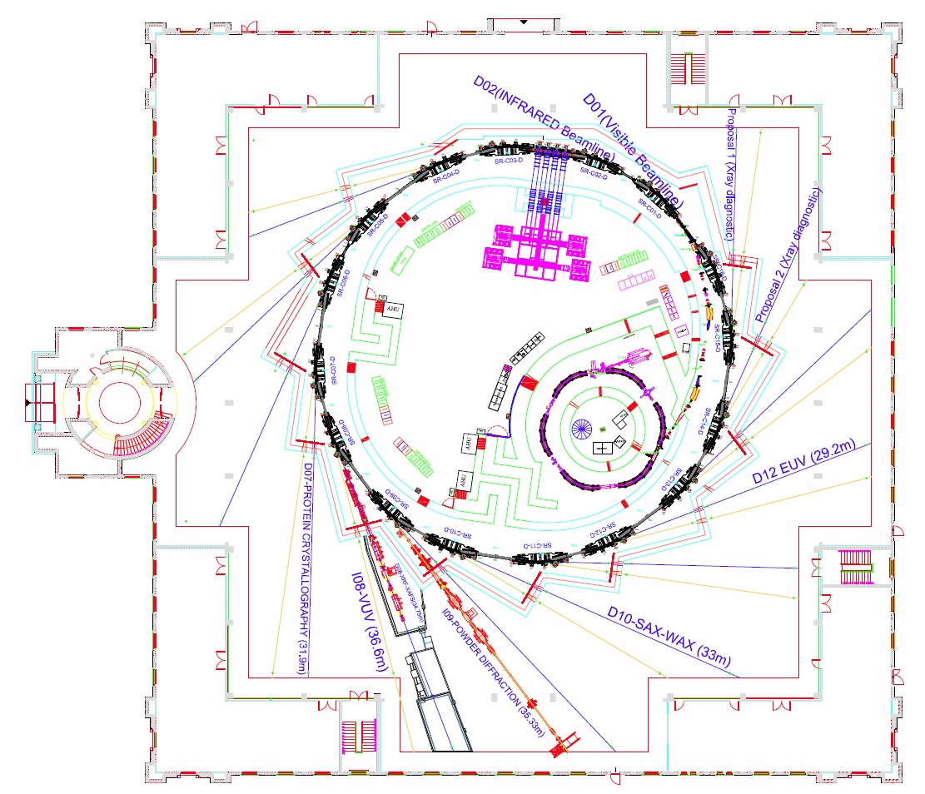
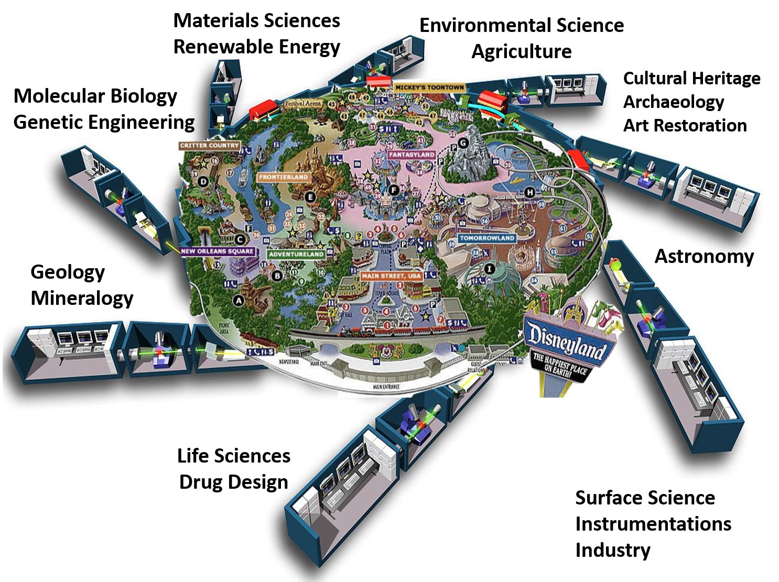
Phase 1 Beamlines
InfraRed
Energy; 2.5 GeV
Circumference; 133m
EUV BL
Macromolecular Crystallography
VUV
SAXS-WAXS
XAFS-XRF
Materials science
Notes:
Get the latest layout update – technical sector

Slide 16
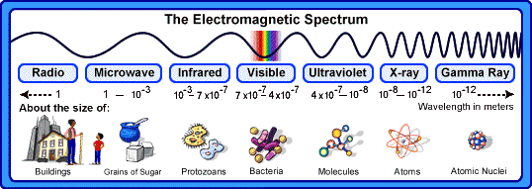
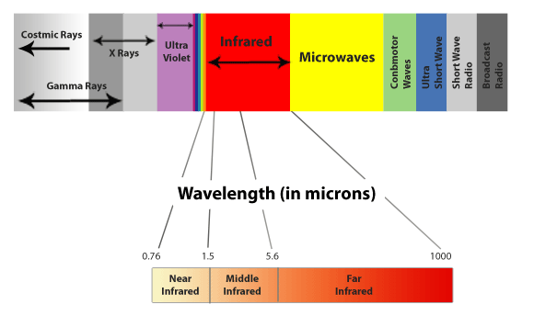
IR beamlines..

Slide 17
Why Synchrotron?
Infrared signal through various aperture sizes using a synchrotron versus globar source. A confocal IR microscope was used with a single-point detector. (B)
Infrared spectra of a single red blood cell collected with a synchrotron versus globar source. A square aperture of 5×5 μm was used.
L.M. Miller, P. Dumas / Biochimica et Biophysica Acta 1758 (2006) 846–857

Slide 19
SESAME
SR-IR Emission Sources..
Vertical collection angle = 15 mrad
Horizontal collection angle = 39 mrad
Edge Radiation (ER): Emitted at the entrance (exit) of the bending magnet (BM) due to the rapid variation of the magnetic field (B)
Standard Bending Radiation: Emitted during the circular trajectory in the bending magnet (BM) due to the constant magnetic field (B)
Collection geometry was optimized using SRW & Rays Tracing software
Operational beamlines exploits both sources of radiation (SOLEIL, Australian Synchrotron, DIAMOND, NSRC, ALBA, ANKA)
Notes:
A injects the electrons into an 800 MeV booster synchrotron. The 800 MeV beam is transported through the to the main storage ring, and after accumulation, accelerated to 2.5 GeV.
We propose to exploit both sources at SESAME, by modifying a dipole chamber in order to collect large vertical ( 18 mrad) and horizontal( 40 mrad) angles

Slide 20
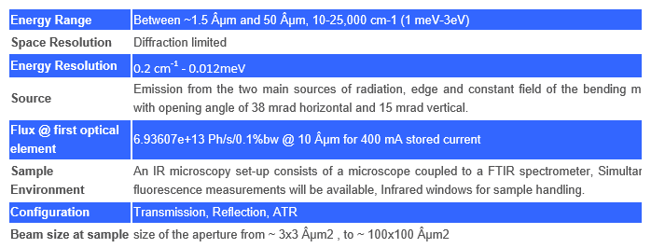
Beamline features:

Slide 21
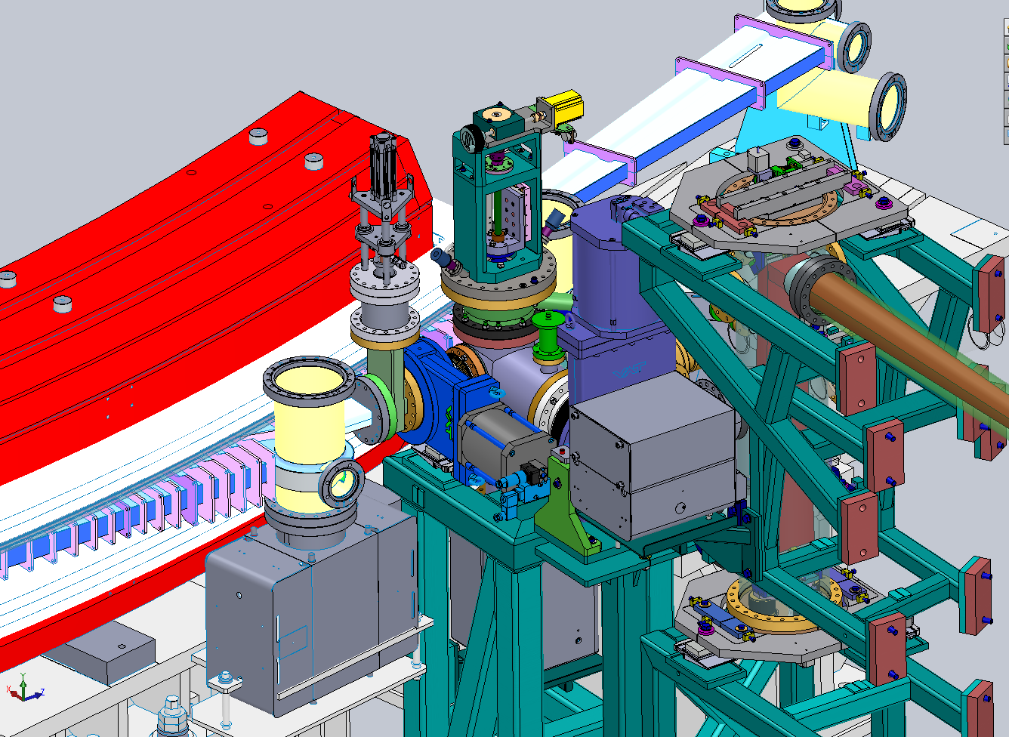
Implementation of the Infrared Beamline compatibility with SESAME layout has been validated and confirmed.
IR Extraction port

Slide 22
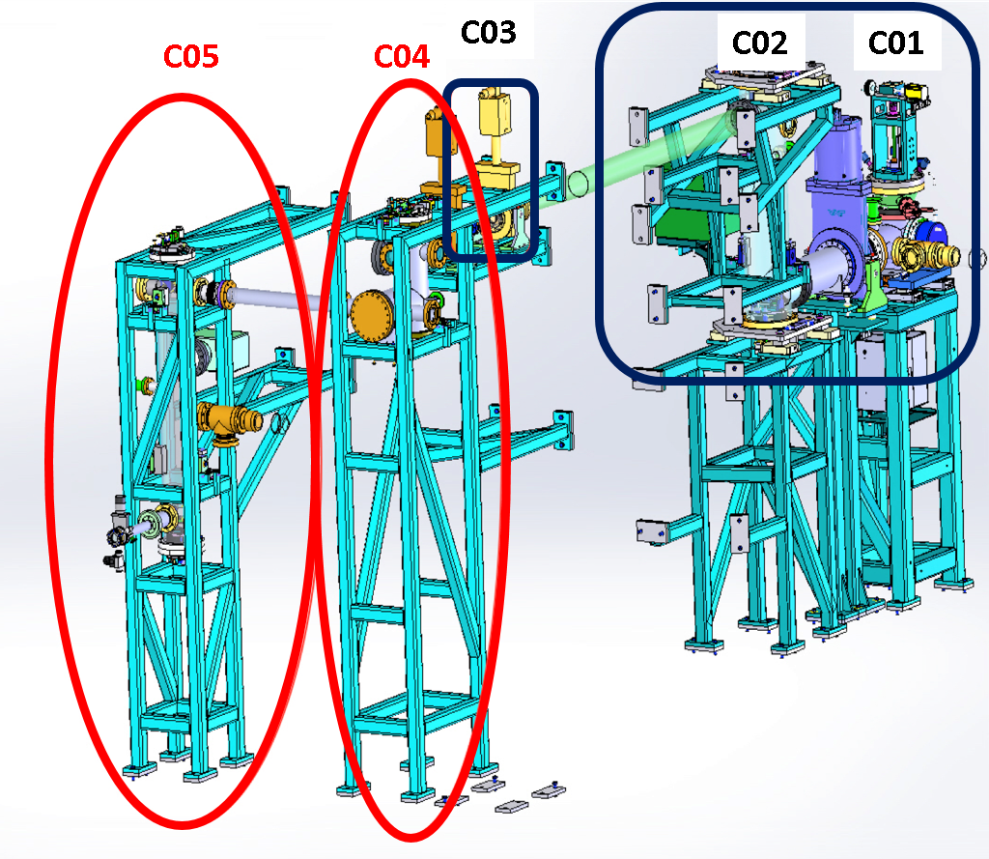
An agreement has been established with chosen company (France) to manufacture the beamline components and deliver them to SOLEIL.
.. is divided into 2 stages to accelerate the construction:
Stage I: C01-C03
Stage II: C04-C05

Slide 23
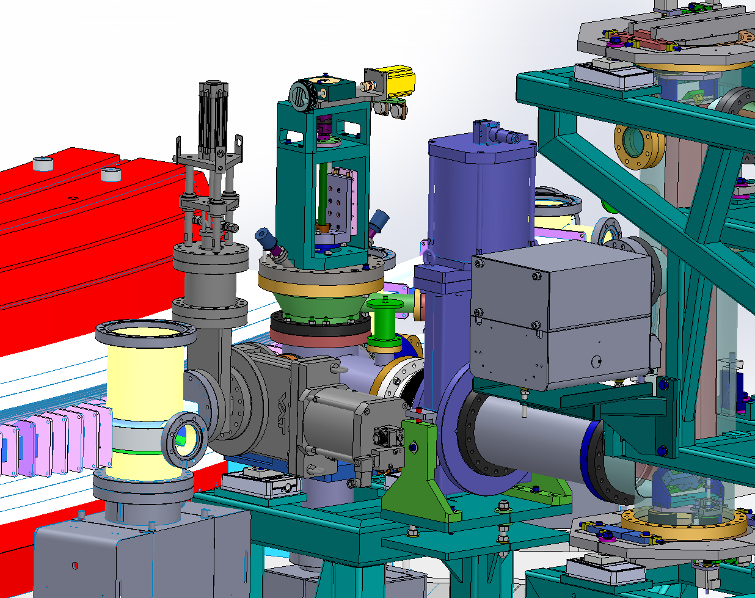
New modifications (SESAME-SOLEIL) have been introduced to the beamline 3D Design for the protection of the first mirror (critical component) and to ensure the optimum beam extraction.
Stage I: C01-C03 Progress:
M1 Extraction Mirror
Absorber (SOLEIL)
New Absorber (SESAME)
New Sectioned gate valve (SESAME)

Slide 24
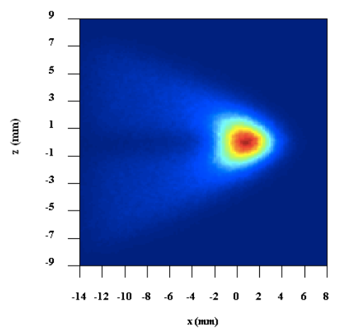
Stage II (C04-C05) Progress:
The construction of the second part of the beamline aims at propagating the beam, reshaping it, and adapt to the size to the spectrometer entrance. A new optical set-up is proposed to secure DAY-1 Commitments.
Feasibility of this option is checked with beam simulation
Beam @ spectrometer entrance

Slide 25
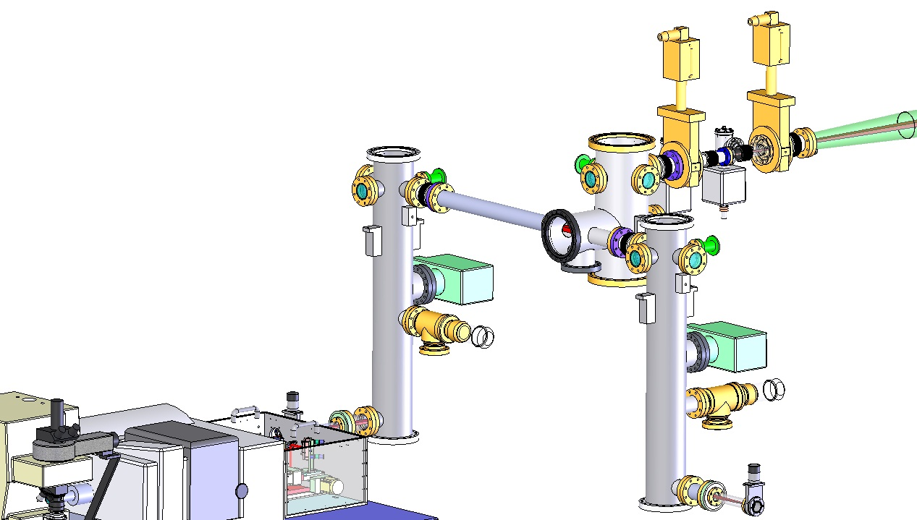
Experimental Station of the IR-beamline..
General View of the IR-beamline..
Beamline Optical system:
Coupling to the Spectrometer
Cylindrical mirrors chamber
(M7-M8) A Chamber
(M7-M8) B Chamber
Working
End Station 1
Splitting mirror
Branch 1
Ion pump
End Station 2
Branch 2
Matching box
Postponed..
Notes:
Infrared beamlines around the Word are built around two types of emission:
Bending magnet ( constant field) emission : Most of IR beamlines in the Word uses this type of emission
Edge radiation : more recently exploited, and few beamlines uses this type of emission.

Slide 26
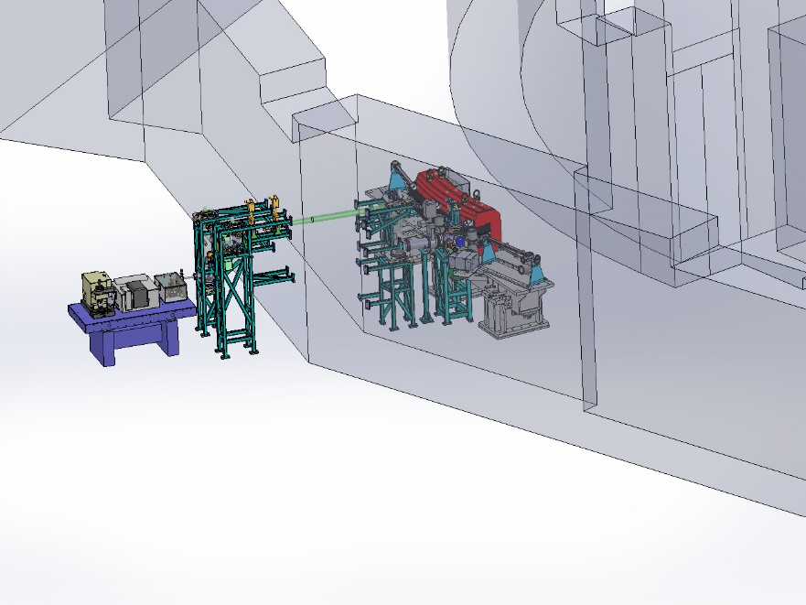
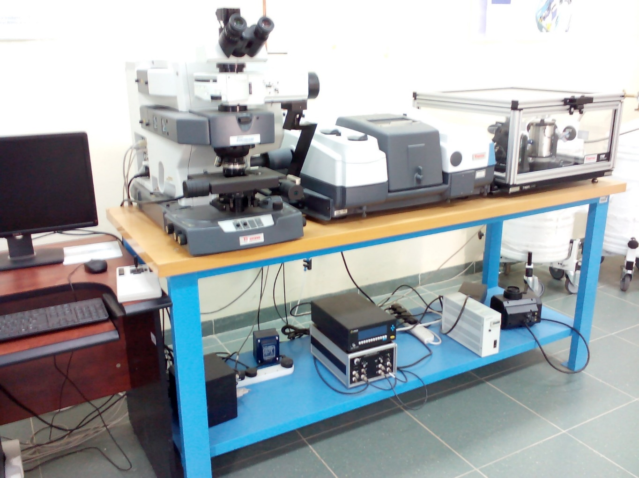
Infrared Laboratory..
Construction Stage

Slide 27
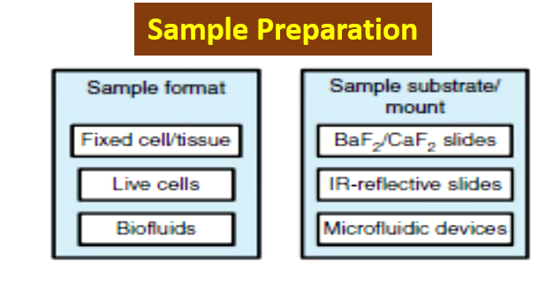
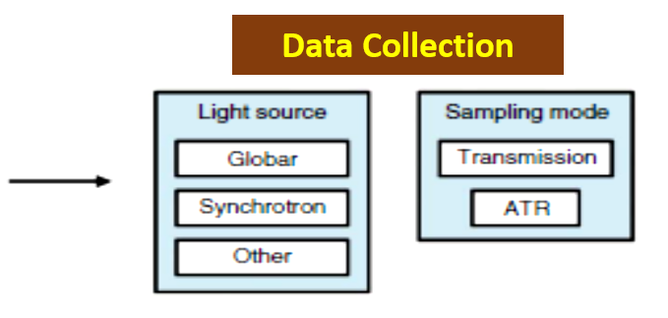
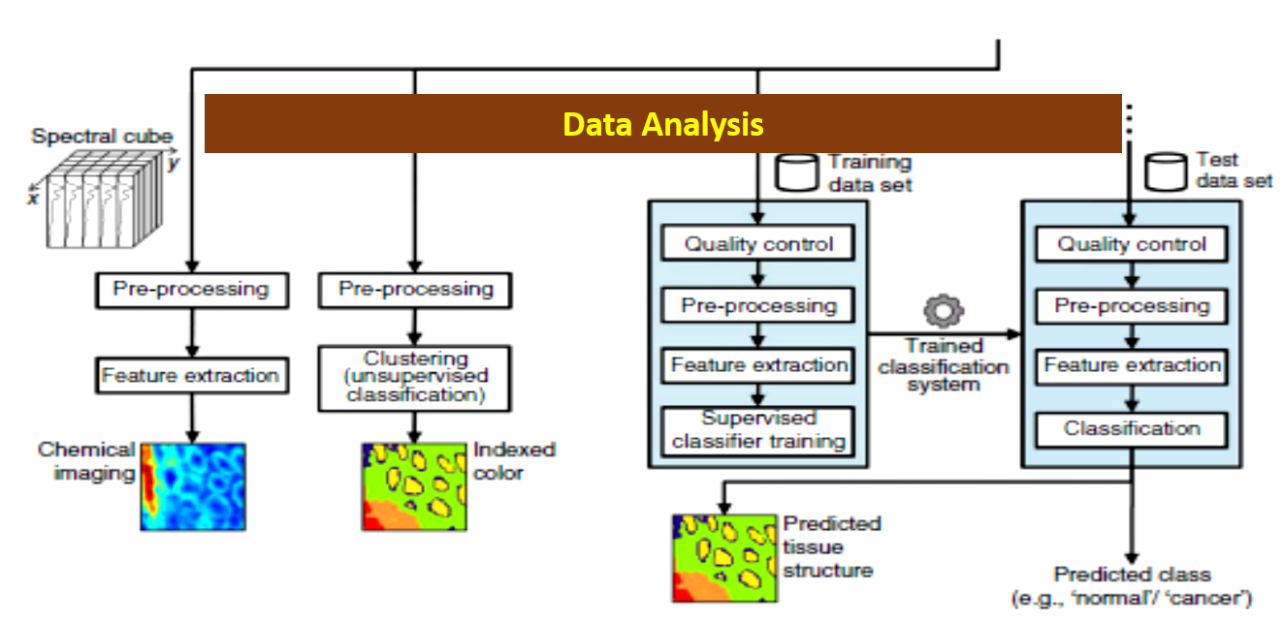
Work Flow for Imaging and Diagnosis
Globar
Notes:
FTIR spectroscopy work flow for imaging and diagnosis. The three major steps are sample preparation, FTIR spectral acquisition and data analysis. Sample preparation may differ depending on the sample format, requiring different materials and procedures. At FTIR spectral acquisition, several options have to be considered for light source and sampling mode. Data analysis presents different paths depending on the analysis goal (i.e., imaging or diagnosis). The framework for diagnosis is somewhat more complex, involving training of classification systems and validation of these systems using test data sets. Although not illustrated, the data sets used for testing are also obtained through sample preparation followed by FTIR spectral acquisition.

Slide 28

Producing Science…
Members and Observers
“Human Histone Deacetylases Are Flexible Enzymes”- Collaborators:
Egypt, Israel, UK and USA
“Photodynamic Therapy of Human Melanoma Cells”- Collaborators:
Egypt and USA
“Assessment of Resource Partitioning in Algae”- Collaborators:
Jordan, USA, Italy.
Peer Review Committee:
  BESSY II, Germany
  ELETTRA, Italy
  NSLS, USA
IR-Beamline Call for Proposals, 2013
Iraq
9%
France
9%
Iran 9%
Jordan
45%
Egypt 9%
Pakistan
18%
Environment
9%
Pharmacy 9%
Material Science
18%
Biology
9%
Marine
9%
12 submitted
11 accepted
CONVENTIONAL Infrared source

Slide 29
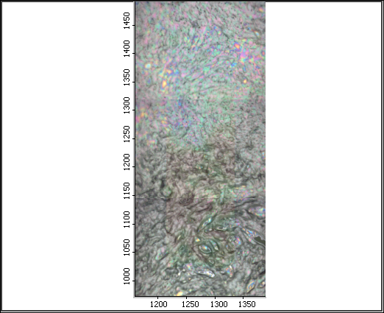
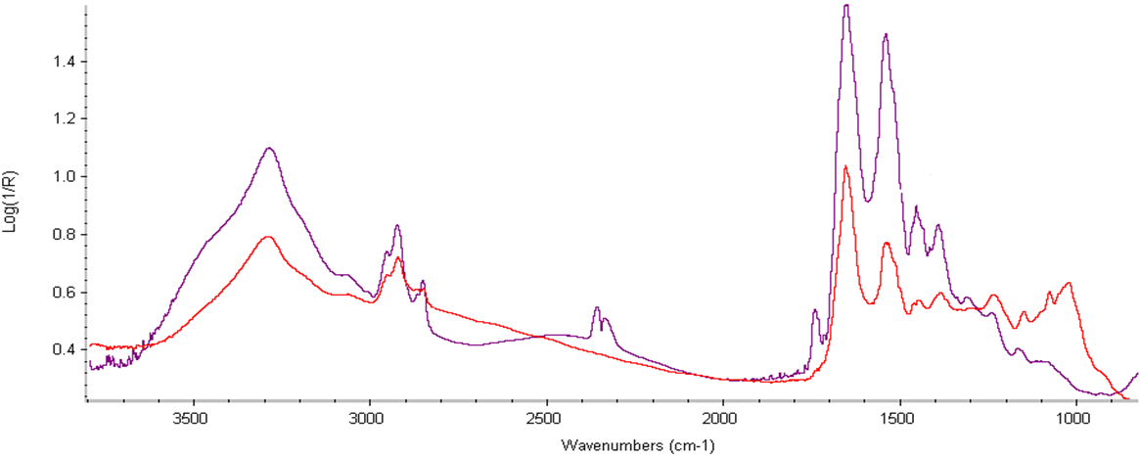
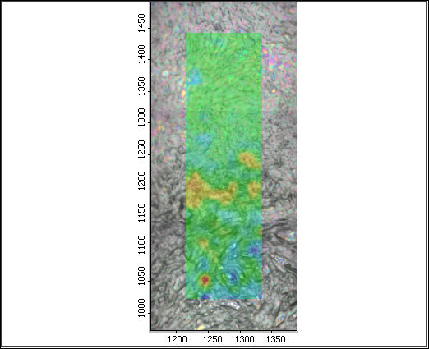
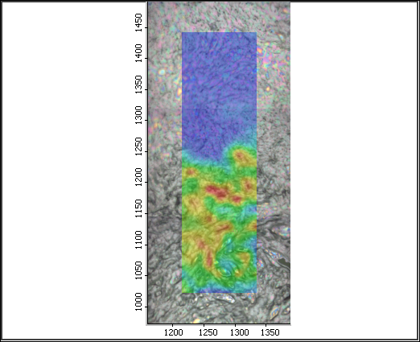
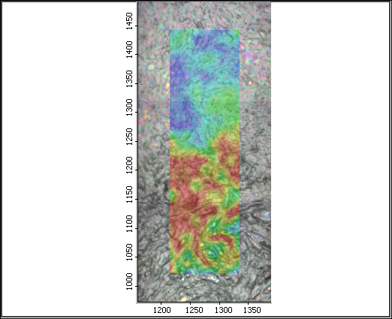
Infrared Microspectroscopic Analysis of Breast Cancer. Fatemeh Elmi, Iran.
Amide II
Amide I
Healthy region
Red- Cancerous Breast tissue
Purple- Normal Breast tissue
Lipids
(CH2 & CH3)
as CH3
s CH3
Ester
C=O
as PO₂ ⁻
s PO₂ ⁻
Cancerous region
Lipids
Carbohydrates
Proteins
Notes:
2. Chemical Maps are showing the distribution of some biochemical components inside the Breast Tissue.

Slide 30
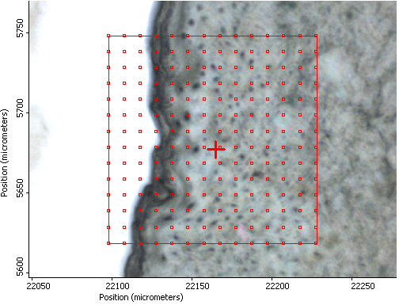
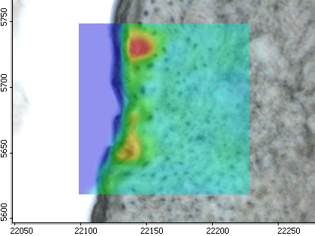
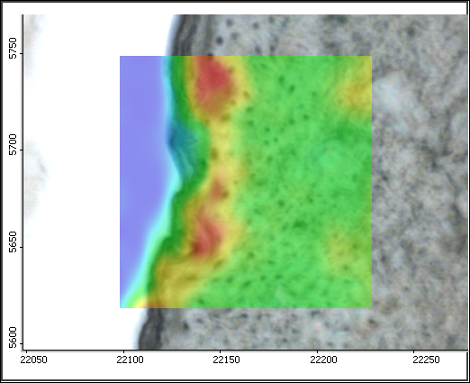

Effects of pharmaceutical products on skin layers. Randa Mansour, Jordan.
Stratum corneum
Amide I
Lipids
(CH2 & CH3)
Amide II
Dermis
Sugar
Epidermis
Lipids
Sugar
Proteins

Slide 31
Nanoparticles in glioma cells: combined Infrared microspectroscopy and
X-ray irradiation effect. Immaculada Martinez-Rovira, France.
Collaborators:
SESAME, France, Spain, and UK.
Funding: SESAME, IAEA, ICTP, Richard Lounsbery Foundation, CNRS and L’Oréal-UNESCO.
Notes:
The project has been initiated at SESAME in collaboration with scientists from the Centre National de la Recherche Scientifique (France), Universitat Autònoma de Barcelona (Spain) and Keele University (UK). All the FTIR measurements were performed at SESAME, including spectra collection and data analysis. You can find the details of our work in the attached pdf file.
As acknowledged in the article, we warmly thank the following organizations/institutions for participating in funding the project: SESAME synchrotron, the International Atomic Energy Agency (IAEA), the International Centre for Theoretical Physics (ICTP), the Richard Lounsbery Foundation, the Centre National de la Recherche Scientifique (CNRS) and L’Oréal-UNESCO.

Slide 32
New Approach for structural evaluation of some doped-lithium glasses. Amr Abdelghany, Egypt.
Collaborators:
SESAME, NRC-Egypt.
Funding: SESAME,
ASRT, NRC-Egypt.

Slide 33

Structural Changes of Malignant and Benign Human Breast Tissues.
Sohaila Rehman, Pakistan.
On-going

Slide 34
Examination of cytotoxicity on wounds granulation tissues and the identification of different microorganisms in diabetic foot infections. Deema Jaber, Jordan.
J.P. Maity et al. / Spectrochimica Acta Part A: Molecular and Biomolecular Spectroscopy 116 (2013) 478–484
Notes:
Statistically and experimentally, FTIR spectroscopy can be used
to identify and differentiate among different organisms with specific
spectral signatures. The peak at 1313 cm1 was revealed to
correspond to amide-III for all of the bacteria representing possible
bacterial signature. A peak at 1096 cm1 represents a specific fingerprint
for OS2. The peak at 1360 cm1 exhibited the specific fingerprints
of reference S. maltophilia (ATCC 19861). The specific
fingerprint signature was found at 1339 cm1 for OS1 and
1382 cm1 for B. flexus ATCC 49095, allowing the two strains of
B. flexus to be differentiated. This spectral signature originated
from cell phospholipids and RNA. Moreover, the clear segregations
(PCA analysis) with distinct sample clusters were revealed from
Bacillus flexus (ATCC 49095), S. maltophilia (ATCC 19861), OS1 and
OS2 in amide (1300–1200 cm1) and fingerprint region (1500–
860 cm1). The results exhibit that representative specific spectral
biomarkers are applicable for identification and discrimination of
different bacteria and that this technique should be widely applicable
to other areas of microbial research.

Slide 35



SESAME people…
Marine Biology:
Mamoon Al-Rshaidat, Jordan: Role of Coral Reef Sponges in Carbon Cycling on Red Sea Coral Reefs.
Plant Biology:
Fatma Afifi, Jordan: Environmental Pollution effect on Medicinal Plants.
Archaeology:
Jan Gunneweg , Israel: Dead Sea Scrolls and Pottery at Qumran.

Slide 36

ICTP - International Centre for Theoretical Physics
The SESAME infrared laboratory is recognized as an Affiliated Centre of the ICTP, Trieste, Italy.
Equipment + 3-6 Months Fellowships at SESAME IR Laboratory
“Different Drugs Effects on the Human Skin Tissue”
Worood Shadeed, Palestinian Authority
“Activity of a combination of Doxorubicin/Quercetin on Breast Cancer Cell Lines”
Nirmeen Elmadany, Palestinian Authority
Next Fellowship is granted to: Rawan Qawasmi, Palestinian Authority

Slide 37
Scheduled Experiments:
“Spectroscopic and Molecular Modelling Study of Egyptian Soil Organic Samples.”
Hend Shahid, Palestinian Authority
“Characterization of Cell Wall Chemical Composition Differences and Developmental activity of some Jordanian Plant Species Using FTIR”
Khaldoun Al-Hadid, Jordan

Slide 38


Egypt (ASRT) – Italy (INFN) Joint Call for Proposals
Submitted February 2015
Approved May 2015
“Leptin and Related Lipid Metabolism after Radiation Exposure: Combined Heavy Charged Particles Irradiation, Infrared Imaging, and Biological Approaches.”
Partners:
(PI) Helwan University, EG.
(PI) LNF, INFN, Frascati, IT
ENEA, Frascati, IT
LNS, INFN, Catania, IT
Notes:
Key areas: Radiation Biology, heavy charged particles, biological tissues, FTIR imaging, Radiotherapy, Cosmic radiation

Slide 39


- 3 years project that aims at creating a unique Virtual Research Environment (VRE) in Southeast Europe and the Eastern Mediterranean (SEEM),
WP3 – e-Infrastructure services
Notes:
e-Infrastructure Services:
- Networking computing (HPC, Grid, Cloud) and standard interfaces,
- Access to combination of resources for the same project,
- The integrated services will be provided to end-users, by supporting the regional e-infrastructure.
- A hub for the Middle East integrating resources in Cyprus, Israel, Egypt, and Jordan, connecting them to resources of the nodes in other areas.
- Will significantly strengthen the research capacities of user communities, thus improving research productivity and competitiveness.
VI-SEEM builds on the success of its predecessor e-Infrastructure projects that have been crucial for enabling high-quality research & ICT developments by providing networking and computational resources, application support and training, in both South East Europe and Eastern Mediterranean, and have supported the European vision of inclusive and smart growth, based on knowledge and innovation, enriching the European Research Area.
The project unifies existing e-Infrastructures into an integrated platform to better utilize synergies, for an improved service provision within a unified Virtual Research Environment to be provided to scientific communities of high impact in the combined South East Europe and Eastern Mediterranean region.
VI-SEEM will significantly leverage and strengthen the research capacities of user communities, thus improving research productivity and competitiveness on the pan-European level. Joining, sharing and exploiting the resources across the SEEM region in a common platform will ensure continuity and expansion of the available resources and services that will further propel excellence across the region.

Slide 40

SESAME 13th Users’ Meeting in numbers
IR-workshop: 133 out of 185 applicants (Members + Non-members)
SESAME MEMBER | IR Session /TOTAL
EGYPT | 36/50
IRAN | 15/20
ISRAEL | 2/2
JORDAN | 46/65
PAKISTAN | 4/10
PALESTINIAN AUTHORITY | 7/12
TURKEY | 15/19

Slide 41
100 Participants
117 Participants
171 Participants

Slide 42




2015
2011
2013
2012

Slide 43








Better late than never!

Slide 44

THANK YOU!

