Slide 1
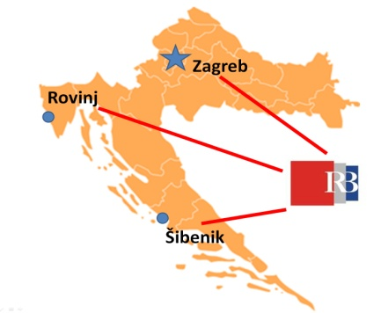
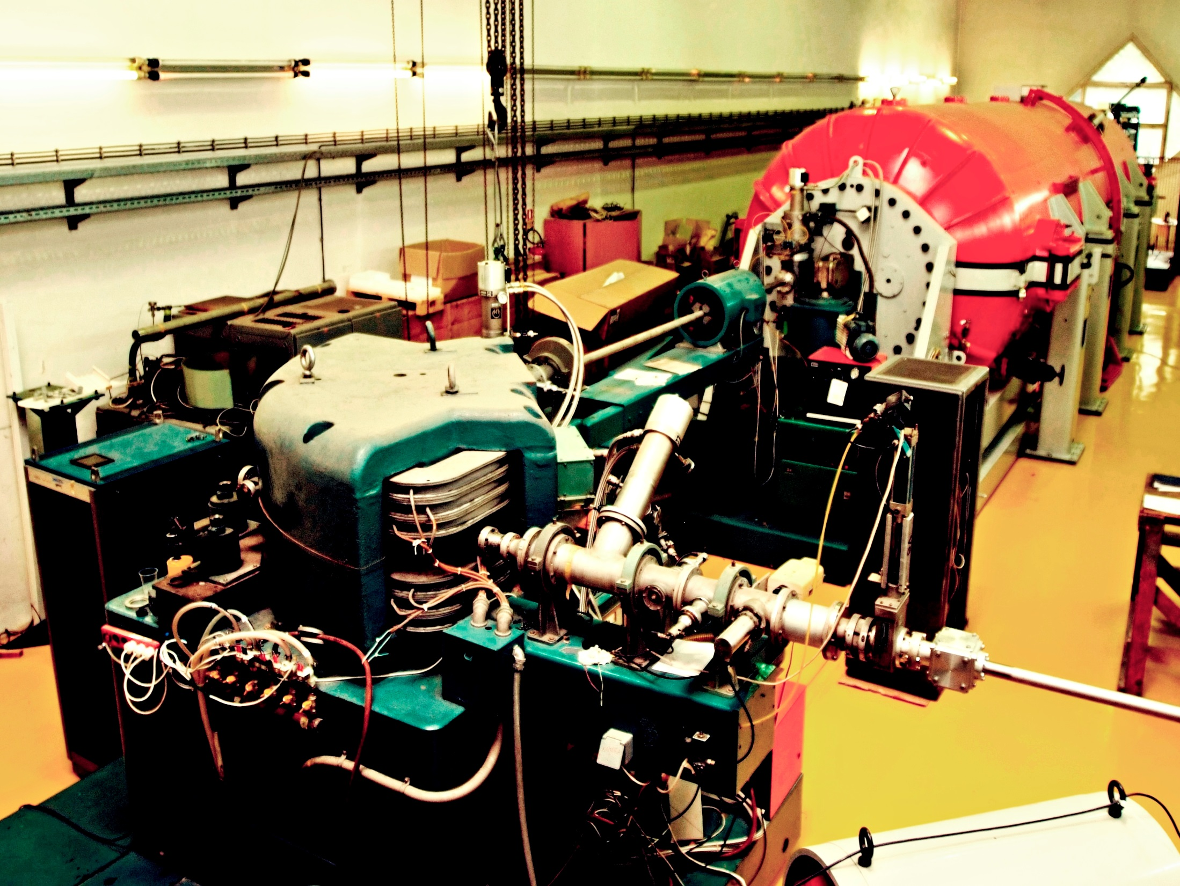
Rudjer Boskovic Institute (RBI) – largest Croatian institute
MULTIDISCIPLINARY science institute
130,000 m² area
82 research laboratories
11 research divisions
850 EMPLOYEES
OVER 450 PhDs
Tome Antičić
director

Slide 2

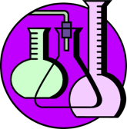
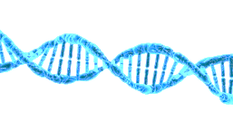


5% of Croatian researchers
~ 60% of Croatian Horizon 2020
20% of Croatian publications
50% of top 20% publications
PHYSICS
CHEMISTRY
LIFE SCIENCES
ENVIRONMENT
COMPUTER SCIENCE
THEORETICAL PHYSICS | MATERIAL CHEMISTRY | MOLECULAR MEDICINE | SEA & ENVIROMENT | ELECTRONICS
MATERIAL PHYSICS | ORGANIC CHEM. & BIOCHEMISTRY | MOLECULAR BIOLOGY | CENTAR FOR SEA RESEARCH
EXPERIMENTAL PHYSICS | PHYSICAL CHEM.
 | NMR
Excellent science
Strong involvement in higher education
Leading contribution to the growth of the national economy
Notes:
Izvor IRB Ured za projekte i međunarodnu suradnju

Slide 3

RBI- CRO LEADER IN INTERNATIONAL PROJECTS
2 ERCs (out of 4 in Croatia), both within past two years, both returnees
2 CENTRES OF EXCELLENCE ( 1 out of 1 in material sciences, 1 out of 2 in biotech, key partner in 1 in ICT)
...
10
5
0
Croatian projects
FP7/Horizon 2020
OTHER CROATIAN
SCIENTIFIC INSTITUTIONS
2010
2011
2012
2013
2014
2015
NEW PROJECTS, MILLIONS OF EUROS
PERCENTAGE OF HORIZON2020 FUNDING

Slide 4
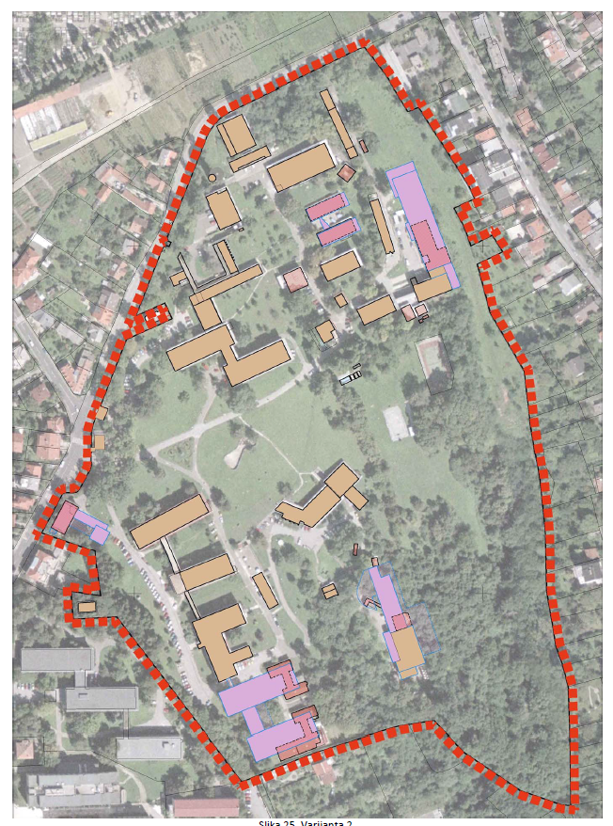
OPEN SCIENTIFIC INFRASTRUCTURAL PLATFORM FOR INNOVATIVE APPLICATIONS IN THE ECONOMY AND SOCIETY: O-ZIP
60 million Euro
RH Operational Programme 2014-2020
Smart Specialisation Strategy
BIOMEDICINE
ENVIRONMENT AND SEA
ADVANCED MATERIALS
ICT
BEGINNING 2018

Slide 5
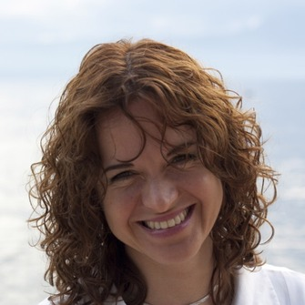

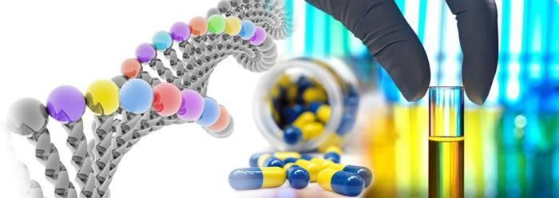

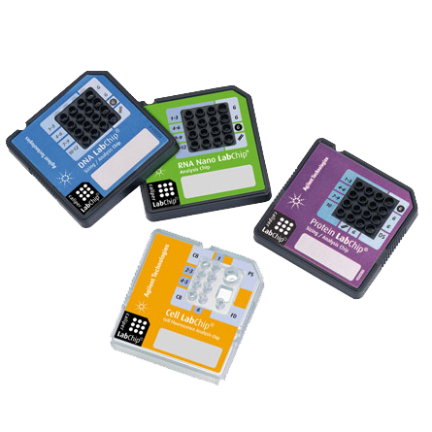


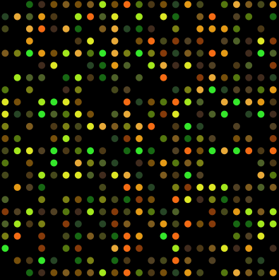
Life sciences
Life science
NewSpindleForce/Iva Tolic: A new class of microtubules in the spindle exerting forces on kinetochores
Satellite DNA
Evolutionary genetics
Cell biology and biophysics
Microbiology
Plant biology
Neuroscience
Protein dynamics
Experimental therapy
Oxidative stress
Mitochondrial bioenergetics
Virology and bacteroiology
Hereditary cancer
Personalized medicine
Epigenomics
Genomics
FP7 (largest in Croatia): Enhancement of the Innovation Potential in SEE through new Molecular Solutions in Research and Development – InnoMol - investigation of relevant diseases such as cancer

Slide 6
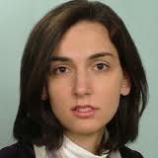
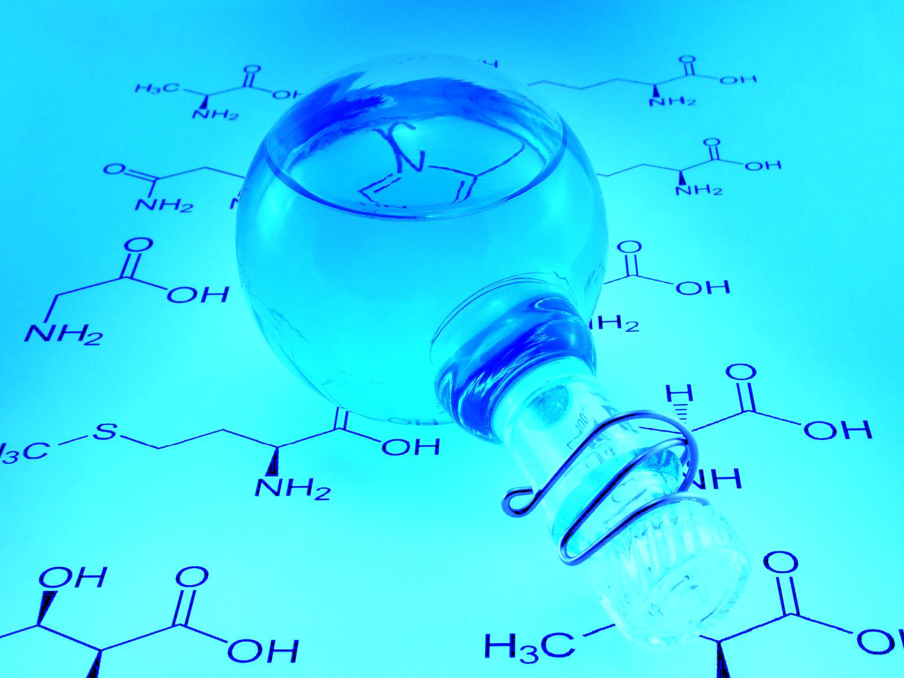
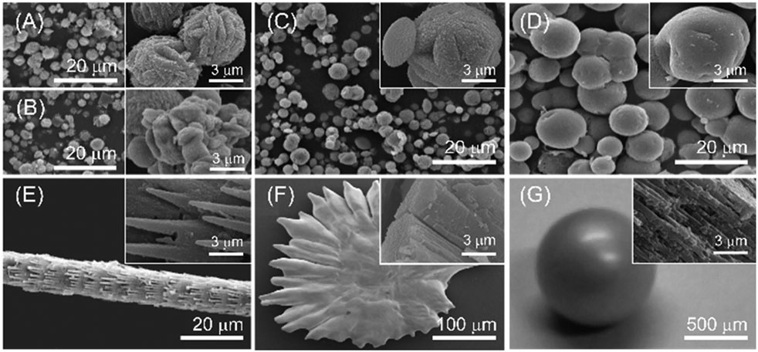
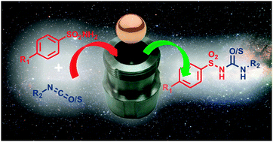
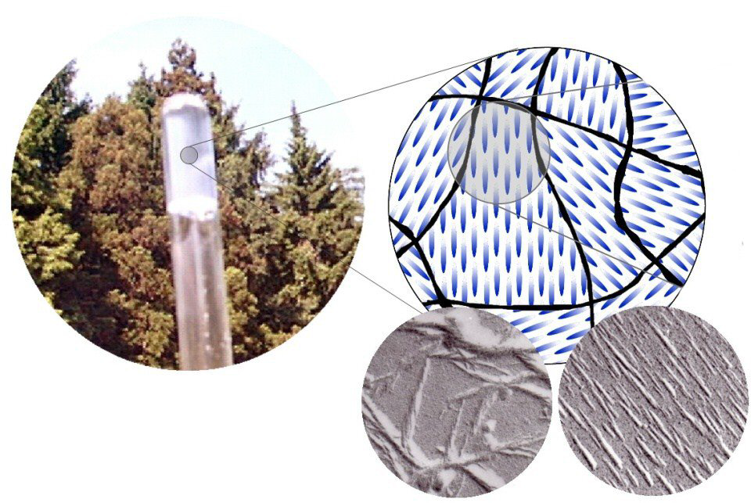
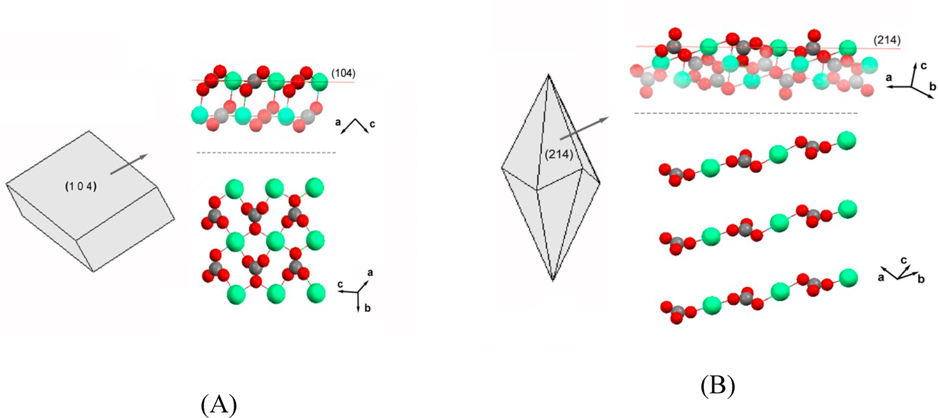
Life sciences
Chemistry
MEMBRANES ACT/Ana Suncana Smith: Biological Membranes in Action: A Unified Approach to Complexation, Scaffolding and Active Transport
Organic chemistry and biochemistry
Biomimetic chemistry
Supramolecular chemistry
Biomolecular interactions
Stereoselective katalysis
Protein biochemistry
Solid state chemistry
Precipitation processes
Radiation chemistry
New material synthesis
Functional materials
Mass spectrometry
Computational biosciences
Surface chemistry
Mechanochemical synthesis
Chemical and biological crystallography
NMR

Slide 7
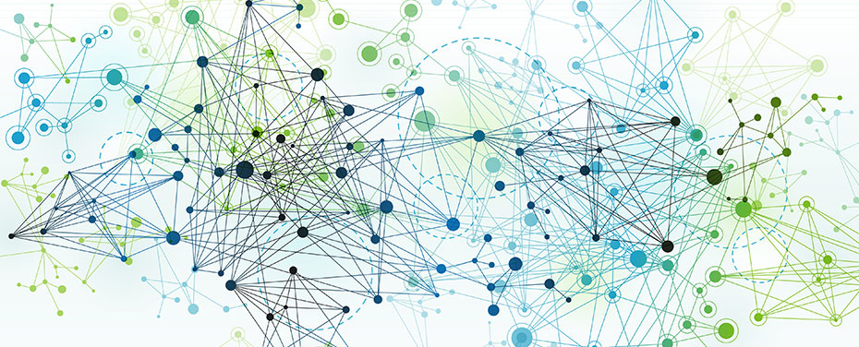
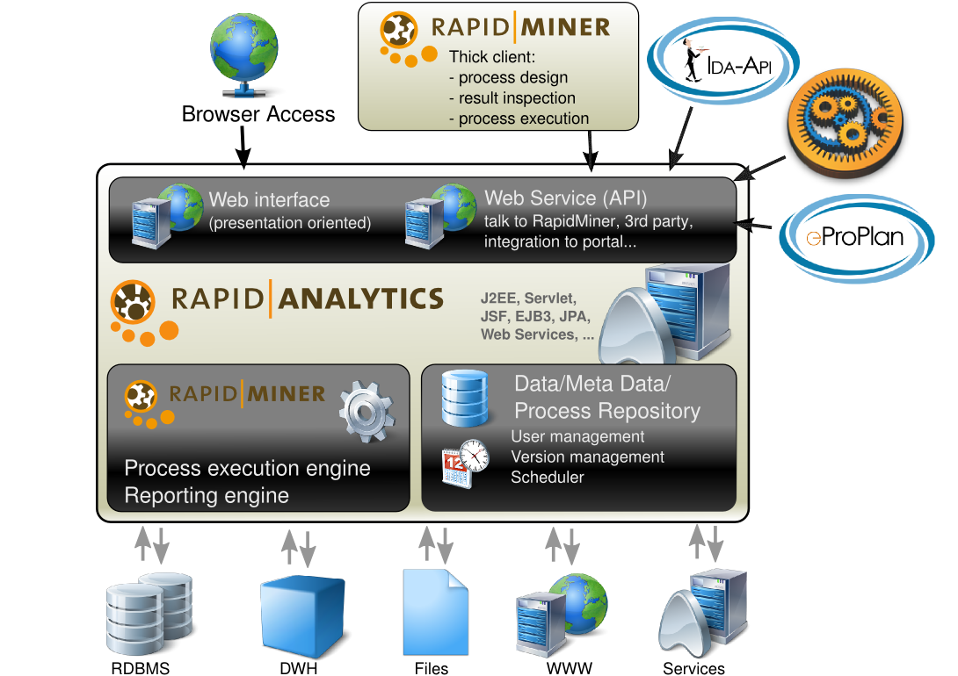
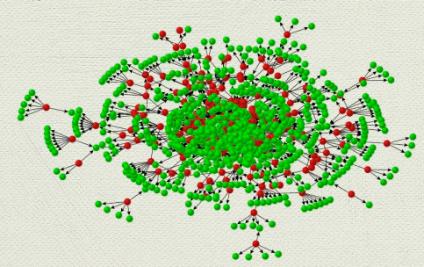
ICT
FP7: e-Laboratory for Collaborative Interdisciplinary Research in Data Mining and Data Intensive Sciences - Enlarged European Union - e-LICO
FP7 : Foundational Research on MULTIlevel comPLEX networks and systems
FP7 : Learning from Massive, Incompletely annotated, and Structured Data
H2020: Integrating Distributed Data Infrastructures for Global Exploitation
H2020: Supercomputing Expertise for Small and Medium Enterprise Network
Key part of Center of excellence for Big Data
Information Communication
Cloud computing
Optoelectronics and visualisation
Bioinformatics
Machine learning
Stochastic signals

Slide 8

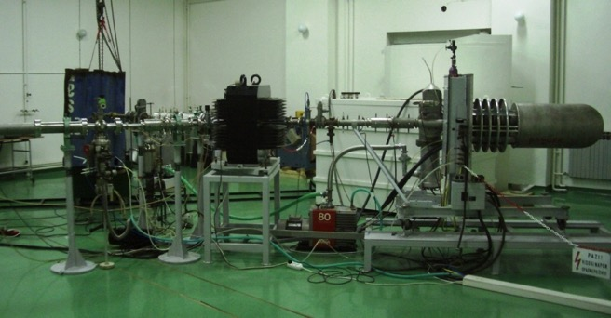
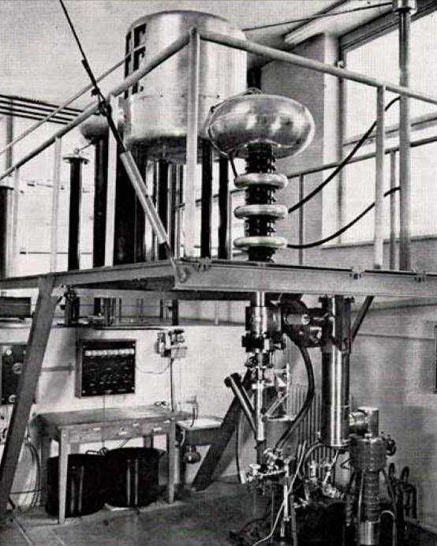
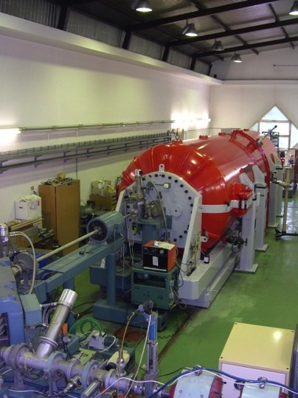
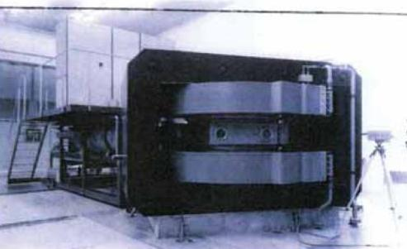
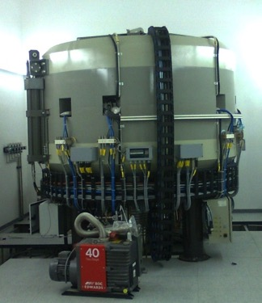
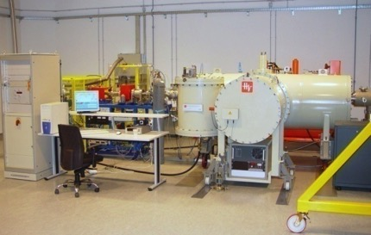
RBI & accelerators:
1973
1956
1987
1962
2009
2005

Slide 9
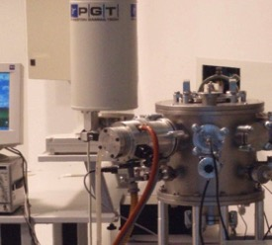
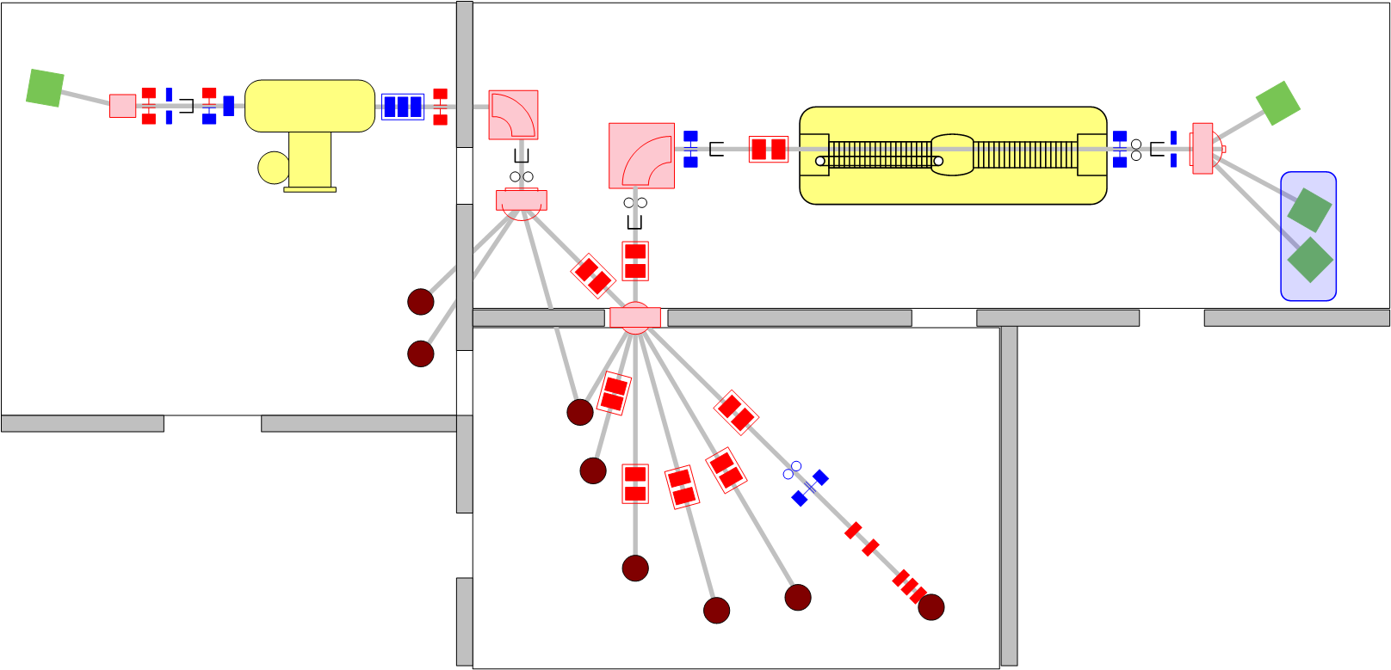
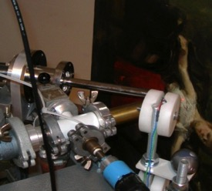
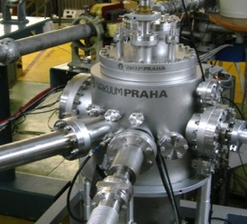
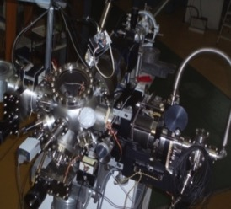
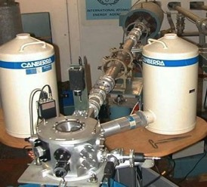
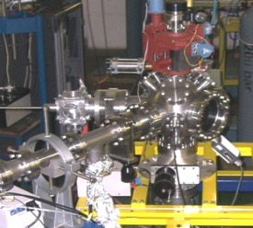
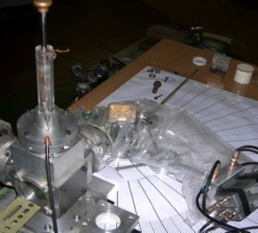
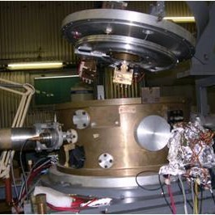
RBI ACCELERATOR CENTER TODAY
PIXE/RBS
1.0 MV HVE Tandetron accelerator
6.0 MV EN Tandem Van de Graaff accelerator
In-air PIXE
Dual-beam irradiation
Ion microprobe
IAEA beam line
TOF ERDA
PIXE crystal spectrometer
Nuclear reactions
Detector
testing

Slide 10

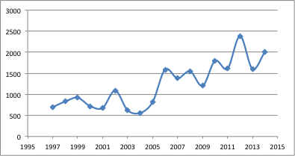
Current major RBI Accelerator related projects
H2020 ERA Chair: Particle and Radiation Detectors, Sensors and Electronics
IAEA TC projects
EuroFusion
H2020: AIDA - Advanced European Infrastructures for Detectors at Accelerators
C-ERIC – EU Research Infrastructure open for external basic and applied users in the fields of Materials, Biomaterials and Nanotechnology
Center of excellence for advanced materials and sensors
Nuclear physics
Particle Physics/CERN
Astroparticle physics
Condensed matter
Thin films
Sensors
Photonics and optics
Ion beam physics
Beam time statistics
First (and only) EU TNA (transnational access) provider in Croatia

Slide 11
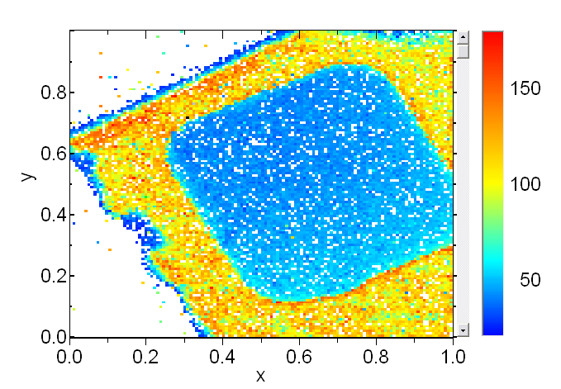
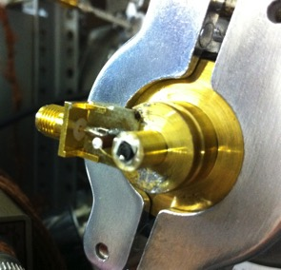
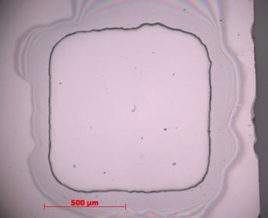
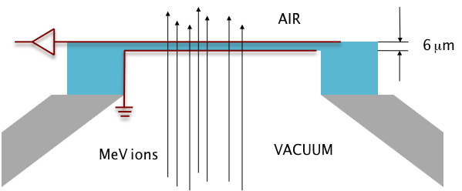
State of the art techniques
Example: Diamond membrane detector
First in the world (with JAEA Takasaki i CEA Saclay)
Diamond membrane 6 μm thick dual role:
Vacuum window;
Charged particle detector
Extreme radiation hardness
- eq. 10¹⁶ cm⁻² 1 MeV neutrons !!

Slide 12
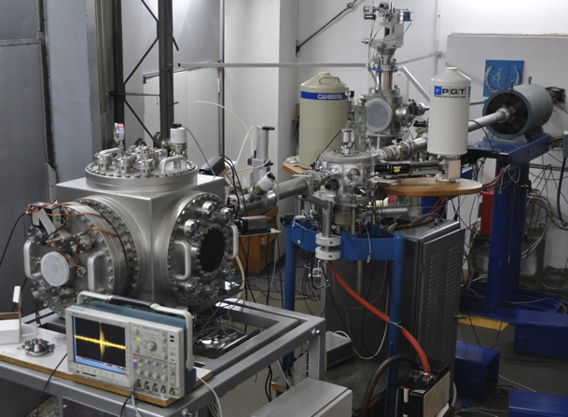
IAEA beam line Agreement
Since 1996.
RBI – among the closest facilities to Vienna
Used up to 20 days/year by:
  IAEA staff (different projects)
  IAEA trainees (TC projects)
  Training courses
Exploring other possibilities

Slide 13
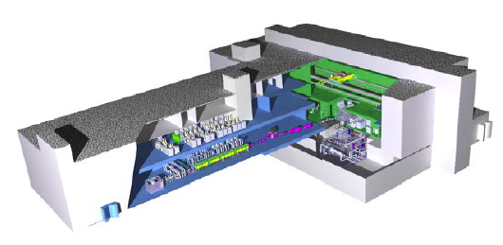
The amazing future??
DONES
H2020 ERA Chair:
H2020 Twinning:
IAEA TC projects
EuroFusion
H2020: AIDA
C-ERIC
Center of excellence
O-ZIP
...
These activities could, among other, make RBI an important factor for
DEMO Oriented Neutron Source (DONES)
Accelerator – neutron source for modification and testing of materials for DEMO, the planned succesor to ITER fusion reactor (under construction)
EU investment ≈ 400 M €
Estimated start of construction : 2016.
Open possibility for DONES to be located in Croatia! (negotiations under way for 200-300 million Euros to come from Croatian structural funds)
SESSION 7
Financing challenges, possibilities and synergies between financing instruments
09.22.2015

Slide 14


Structural investments/funds
Sustained focus on excellence and project success
Strong focus on cooperation with the industry
Brain gain
Strategic scientific and industrial partners outside Croatia
RBI PLAN/VISION: WITHIN 10-20 YERAS BECOME A TOP 100 SCIENTIFIC INSTITUTION IN THE WORLD, AND REGIONAL LEADER IN MAIN RBI ACTIVITIES

Slide 15
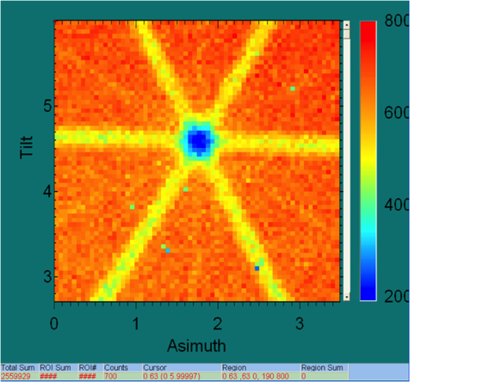
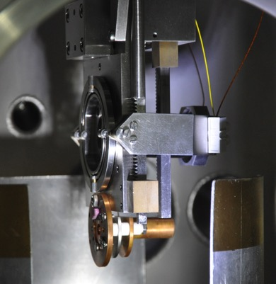
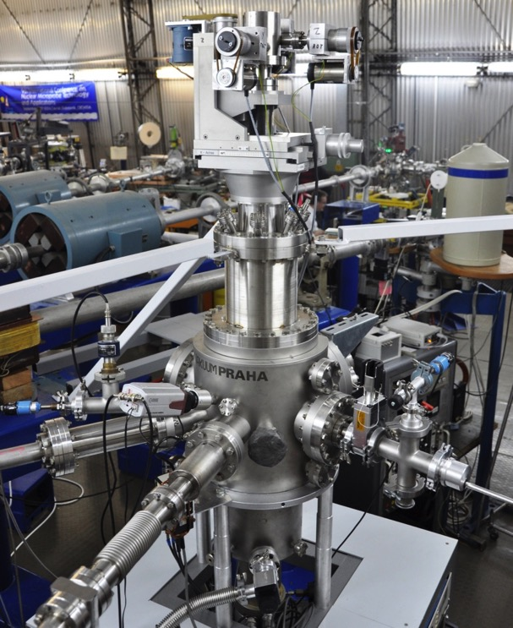
State of the art techniques
Example: Dual beam irradiation
Simulation of neutron irradiation
Ion from 6.0 MV tandem
Ion from 1.0 MV tandem

Slide 16

Success not accidental
NEW rules
STRUCTURAL FUNDS
STATUTE
FOCUS ON HORIZON2020
AND SIMILAR
membership in dep. councils,
financial support,
project support
INTERNATIONAL
PROJECTS
requirement for key positions
ORGANISATION
HIRING AND ADVANCEMENT
COOPERATION WITH
INDUSTRY
Patents,
membership in dep. councils
INTERNATIONAL EXCELLENCE
AND POSTDOCTORAL
EXPERIENCE
requirenment for hiring and
career advancement
IRB²
OPEN ACCESS – SPACE AND EQUIPMENT
flexible organisation,
dependent on international projects
Financial and logistical
help for returnees
RESTRUCTURING OF
LABORATORIES AND
DEPARTMENTS
term limits,
parallel function number limits
open infrastructure,
flexibility of space
HUGE STEP FORWARD FROM COMMON PRACTICE IN CROATIA

Slide 17

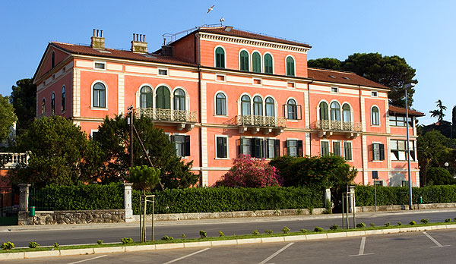
Life sciences
Environment
Center of excellence for bioprospecting of the sea
Biological Effects of Metals
Chemistry of traces
Marine and water systems
Environmental Modelling
Organic Compounds
Environmental geochemistry
Aquaculture and Aquatic Organisms
Marine biochemisty and atmosphere
Molecular ecotoxicology
Radioecology
Marine processes
Marine ecotoxicology
Marine microbial ecology
Benthos
Marine biotechnology
Evolutionary ecology
Biotechnology in aquaculture

Slide 18
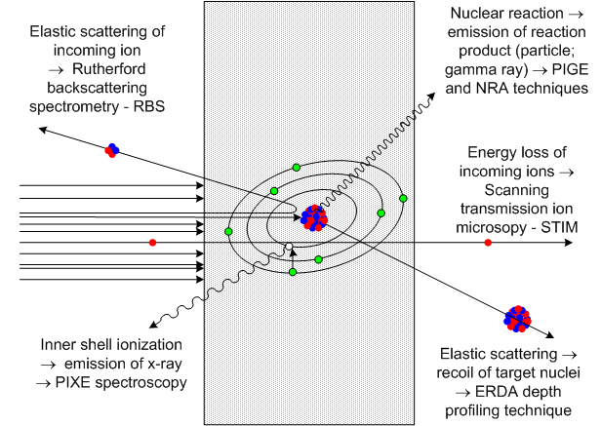
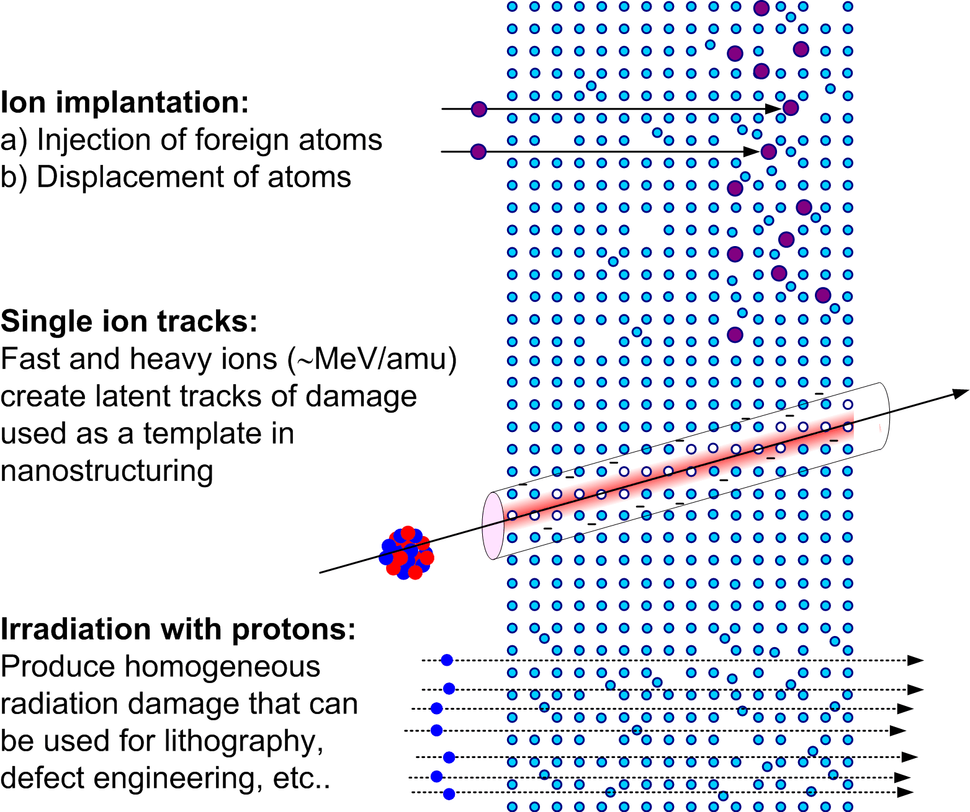
Ion beam applications
ION BEAM ANALYSIS
MATERIALS MODIFICATION

