Slide 1

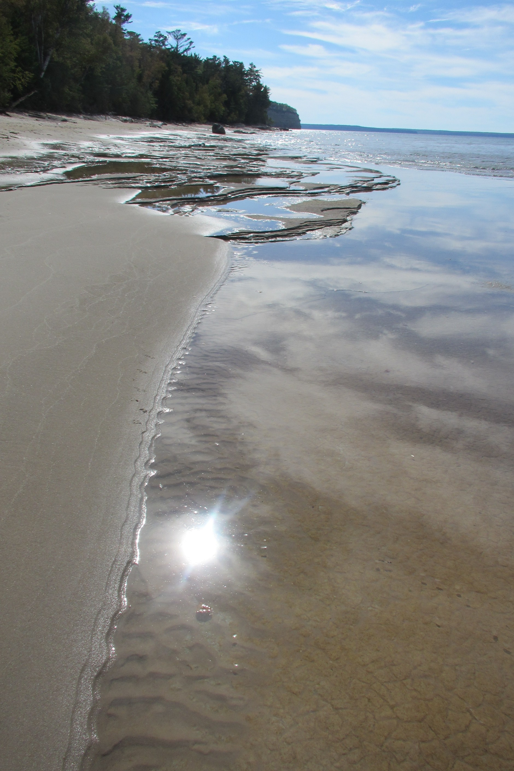

AGLT2 Site Report
Shawn McKee/University of Michigan
Bob Ball, Chip Brock, Philippe Laurens, Ryan Sylvester, Richard Drake
HEPiX FALL 2016 / LBNL

Slide 2
Site Summary
The ATLAS Great Lake Tier-2 (AGLT2) is a distributed LHC Tier-2 for ATLAS spanning between UM/Ann Arbor and MSU/East Lansing. Roughly 50% of storage and compute at each site
  8200 single core job slots
  MCORE slots 720 (dynamic) + 10 (static)
  720 Tier-3 job slots usable by Tier-2
  Average 10.08 HS06/slot
  4.7 Petabytes of storage (soon ~7 PB)
  Total of 83.5 kHS06
  Tier-2 services virtualized in Vmware 5.5
2x40 Gb inter-site connectivity, UM has 100G to WAN, MSU has 10G to WAN, lots of 10Gb internal ports and 20 x 40Gb ports, 32x100G/40G ports
High capacity storage systems have 2 x 50Gb bonded links
40Gb link between Tier-2 and Tier-3 physical locations

Slide 3
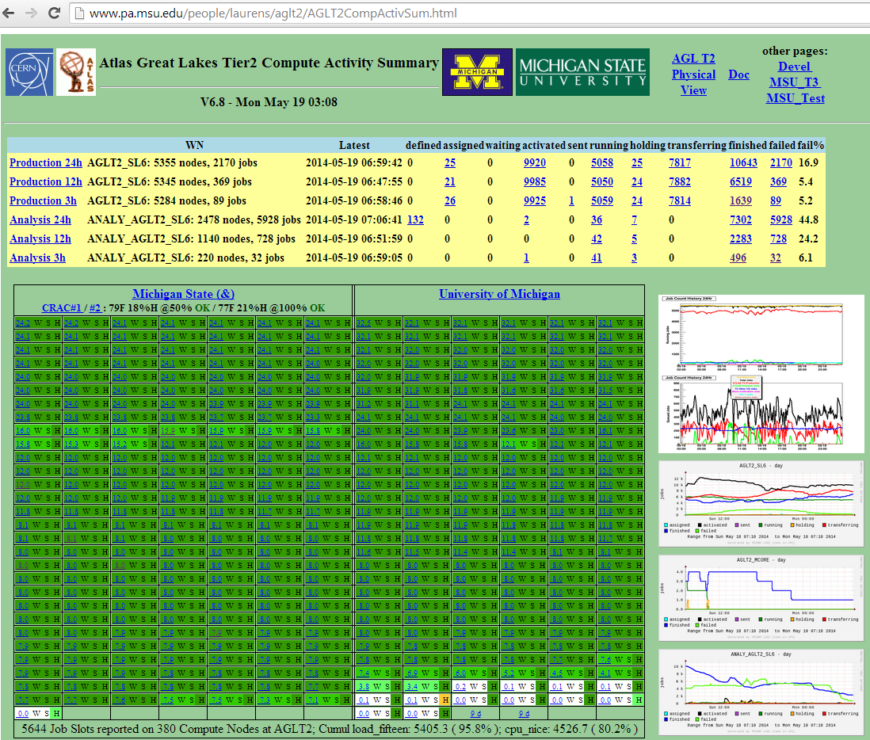
AGLT2 Monitoring
AGLT2 has a number of monitoring components in use
As shown in before we have:
Customized “summary” page->
OMD (Open Monitoring Distribution) at both UM/MSU
Ganglia
Central syslog’ing via ELK: Elasticsearch, Logstash, Kibana
SRMwatch to track dCache SRM status
GLPI to track tickets (with FusionInventory)

Slide 4
Personnel Changes
Our new hire Ryan Sylvester (announced at the last HEPiX) has moved on to a new job working for the Veterans Administration.
  As Ryan was a air-force it was a logical career move
For the near-term, we are not planning on hiring a replacement
  We have been very successful in getting good undergraduates to work on an hourly basis for us
  Looking to augment our current student with 1-2 more

Slide 5
Hardware Changes Since Last Mtg
  This summer we had a one-time infusion of NSF funds to ensure our ATLAS MOU was based upon reliable, warrantied equipment
    AGLT2 received $398K additional funds for hardware
  We negotiated good pricing with Dell and purchased:
    55 R630s; 2xE2640v4 processors, 128GB ram, 2x800 SSDs
    4 Storage nodes (R730xd+MD3460+MD3060e; 120x8TB)
    2 MD3060e shelves (each 8x60TB disk)
    All 5-year warranties
  Total addition was 24 kHS06, 4.8 PB(raw) / 3.84 PB(r6)
    Still have 3 storage units to commission (at SC16)
    24 R630s not yet in production

Slide 6
Software Updates Since Last Mtg
Tier-2 VMs rebuilt to use SL7 (old SL5)
dCache updated to 2.13.42 and Postgresql 9.5
HTCondor now running version 8.4.7
OSG CE updated to 3.3.11
Various switch firmware updates applied in summer; bios/firmware on Dell systems in August
Configuration of Mellanox SN2700 (32x100G) completed.
  Using it as “core” storage/cluster switch at UM
  Supports 100G, 40G, 2x50G, 4x25G and 4x10G on ports

Slide 7
Lustre at AGLT2
We have updated our Lustre storage, using new hardware and incorporating old servers
The new Lustre server and storage shelves were racked in the Tier-2 center last year
  Lustre version 2.7.0 was installed and new file system created (Using ZFS)
  Old files from /lustre/umt3 were copied to the new system
  Old Lustre servers were then recycled to increase total storage in new file system
  New Lustre file system is (re)mounted at the old location, /lustre/umt3
Current AGLT2 lustre size is now 1.05 PB (retired some *old* storage)
Next up: go to the almost released 2.9+ZFS (v0.7) version

Slide 8
Possible Relocation at UM
I reported in spring that AGLT2 may need to move to a new physical location at the University of Michigan
Good news: After exploring our requirements the University is instead planning to have the architects involved with the building renovation work around our Tier-2 center
Baseline plan is the we are NOT planning on moving
  However, if there are snags inn the design this could again change

Slide 9
Future Plans
Participating in SC16 (simple infrastructure for 100G+)
Still exploring OpenStack as an option for our site. Testing Ceph for a back-end.
  Our Tier-2 will be first OSiRIS Client (see Thursday’s talk)
Working on integration of OVS (Open vSwitch) on production storage and Software Defined Networking (OpenFlow). We are experimenting with SDN in our Tier-2 and as part of LHCONE point-to-point testbed.
Working on IPv6 dual-stack for all nodes in our Tier-2
  Have IPv6 address block
  Ticket reopened with IT. Hung up on engineering discussion ☹

Slide 10
Summary
Conclusion
Tier-2 services and tools are evolving. Site continues to expand and operations are smooth.
Monitoring stabilized, update procedures working well
FUTURE: OpenStack, IPv6, SDN
Questions ?

Slide 11
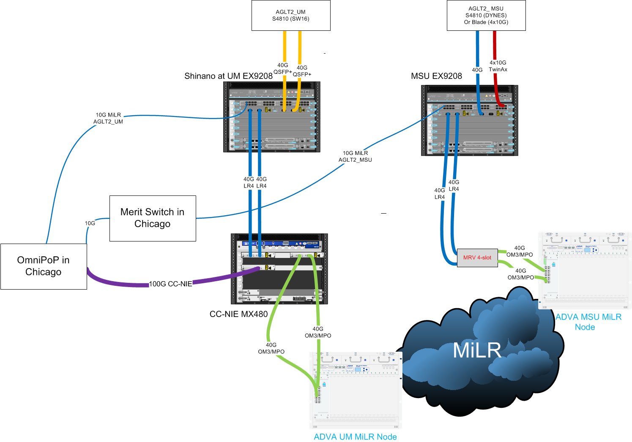
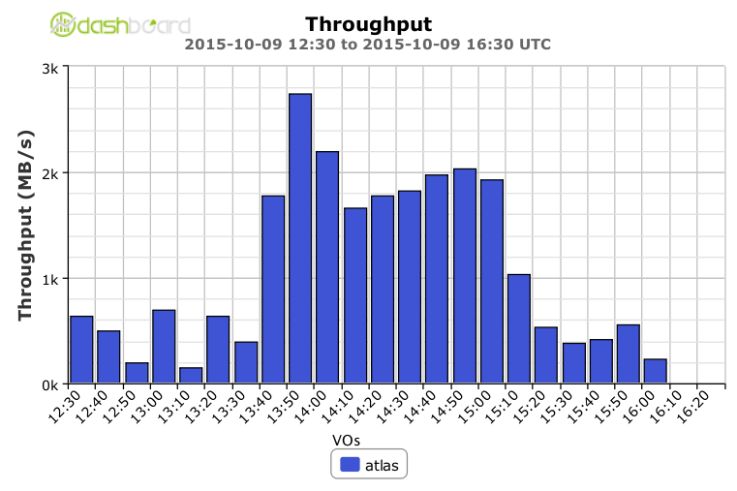
AGLT2 100G Network Details
100G to WAN works
Last Fall: “normal” FTS transfer hit 2.73 Gbytes/sec

