Slide 1

Annual Report
Instructions
Lucie Linssen
CERN

Slide 2
Annual report chapters
Publishable summary <= MGT team
Project objectives 2008 <= MGT team
Work progress and achievements during the period
Deliverable and milestones tables
Project management
Explanation of the use of the resources <= Mar’s talk
Financial statements <= Mar’s talk
Where to find the template?
SLHC-PP EDMS site => PROJECT FILES => reports

Slide 3
Chapter 4 “Deliverables and Milestones table”
Essentially this is a summary table => MGT team
However, it is based on the:
  Deliverables reports => WP coord
  Milestones reports => WP coord
Deliverables and Milestones reports are due on the exact date (e.g. M9, M12…)
Where to find the template?
SLHC-PP EDMS site => PROJECT FILES => reports

Slide 4
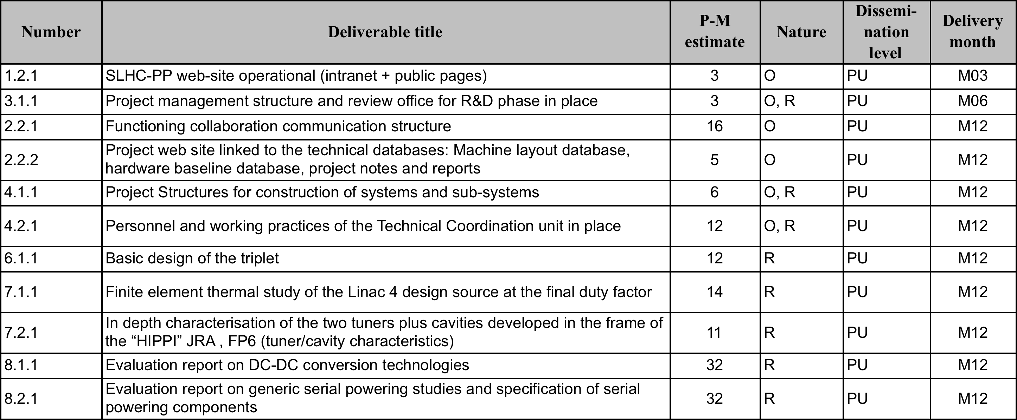
Deliverables 1st year

Slide 5
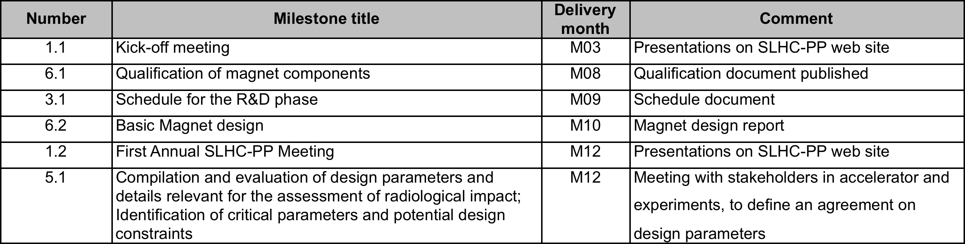
Milestones 1st year

Slide 6
Chapter 5 “Project Management”
Shall contain:
  Management summary => MGT team
  List of project meetings => WP coord
  List of:
    Publications based on SLHC-PP work => WP coord
    Conference contributions and presentations based on SLHC-PP work => WP coord
The project office secretaries will prompt the WP coordinators for the above input (template)

Slide 7
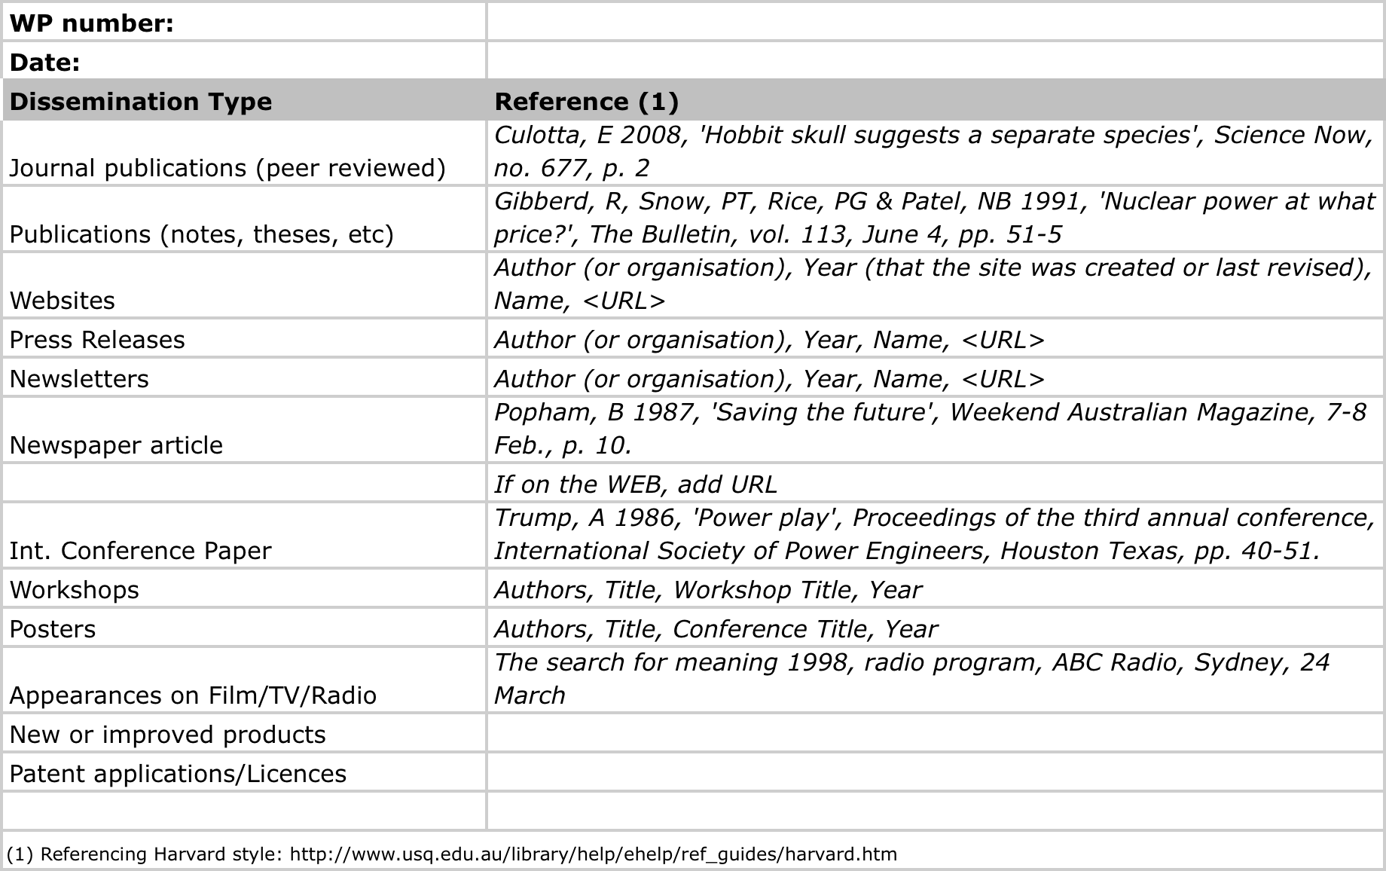
Template Dissemination Activities

Slide 8
Chapter 3 “Work progress…”
Chapter 3 (<= WP coord) shall contain:
  Summary of progress towards objectives
  Highlight significant results
  Reasons for deviations from plan or failing, if any
Guideline: 1 or 2 pages per task

Slide 9
Reporting Deadlines
Period 1: April 1st 08 – March 31st 09
Deadline for Submission of Periodic Report: + 60days

Slide 10
Section |  | Content | Editors | Template Provided
1 | Publishable summary |  | Mgt team
2 | Project Objectives for the Period |  | Mgt team
3 | Work Progress and Achievements during the period | WP2 to 8: Summary of progress Significant results Deviations from Annex I Reasons for non achieved objectives Statement use or resources and deviations Corrective actions | WP leaders | Yes
4 | Deliverables and Milestone Tables | Table of deliv. & milestones, with forecast delivery dates if delayed | Mgt & WP leaders | Yes
5 | Project Management | Management of the Consortium Mgt activities Problems occurred Changes in the Consortium List of meetings Project planning Impact of deviations in miles. & deliv. SLHC-PP Website Dissemination activities (list of publications, Tech. Notes, WP’s web sites, Workshops, conferences, etc) | Mgt Mgt Mgt WP leaders Mgt WP leaders Mgt WP leaders | Yes Yes Yes
6 | Explanation use of resources | Tables per partner/WP | Partner rep. | Yes
7 | Financial Statements | Form C per partner Summary Financial Report | Partner rep. Mgt | Yes Yes
8 | Certificates (CFS) | If requested EC contribution > 375000 E >> Not needed in Period1 | Partner rep.
Technical
Financial

