Slide 1

Financial Reporting
Instructions
Mar Capeans
CERN
SLHC-PP Annual Meeting - Governing Board Meeting 2 - CERN, February 25th, 2009

Slide 2
Reporting Deadlines
Period 1: April 1st 08 – March 31st 09
Deadline for Submission of Periodic Report: + 60days

Slide 3
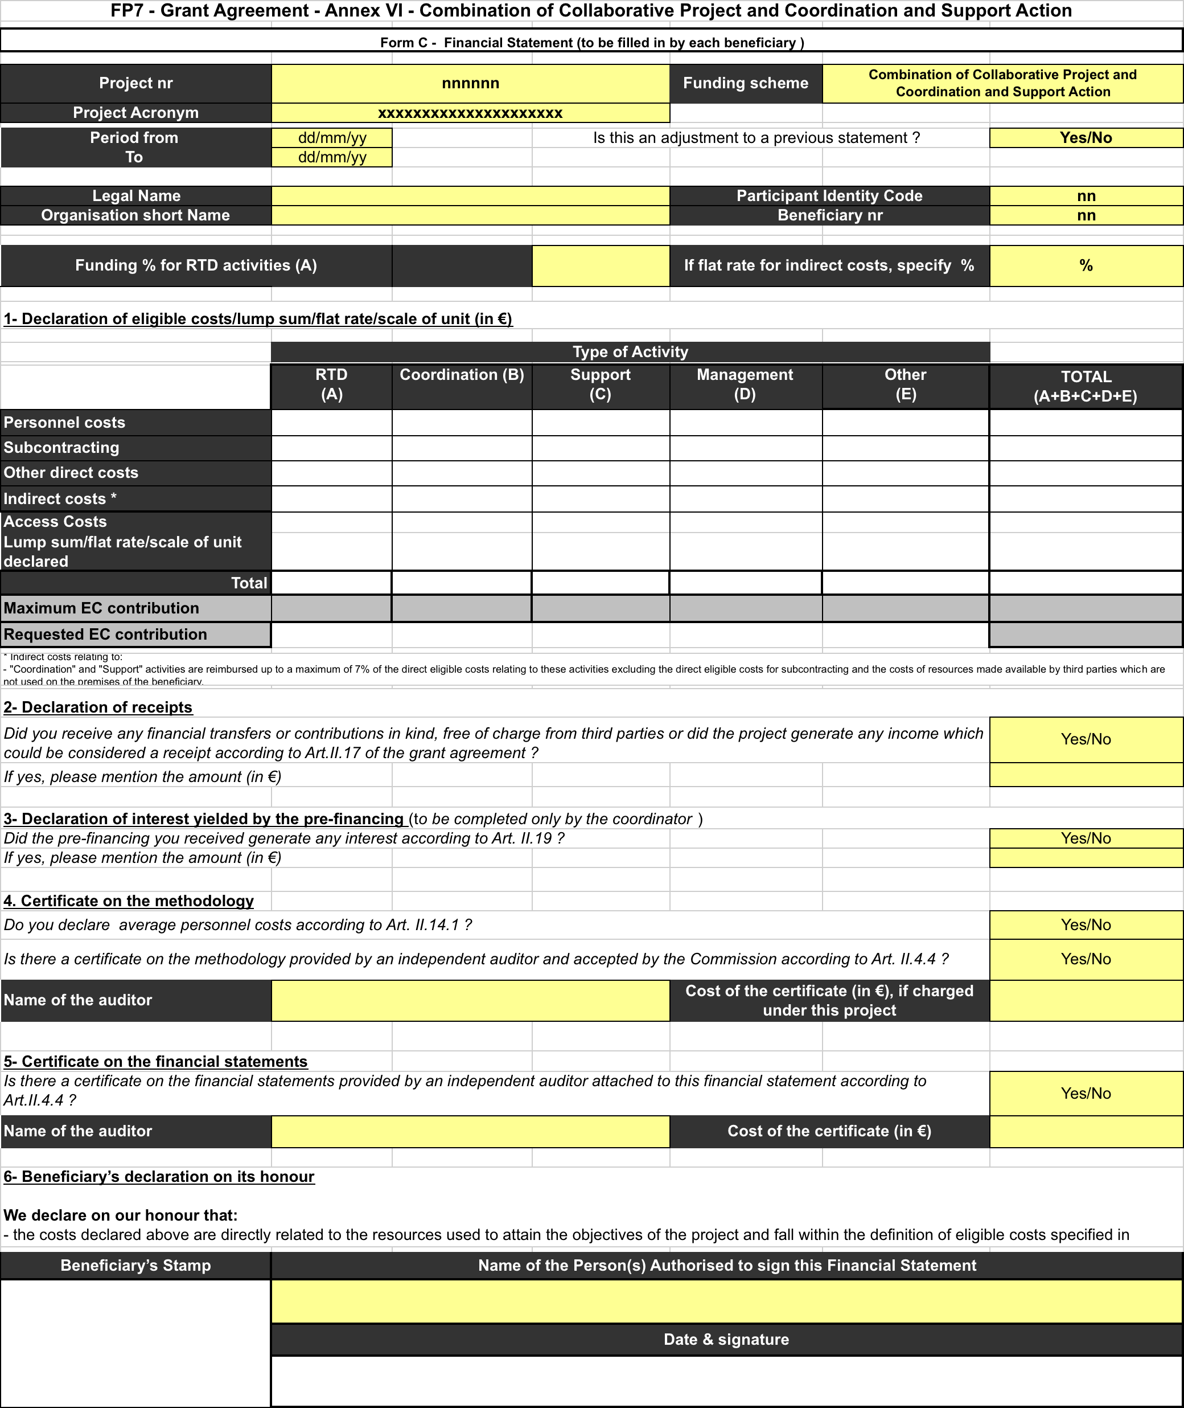
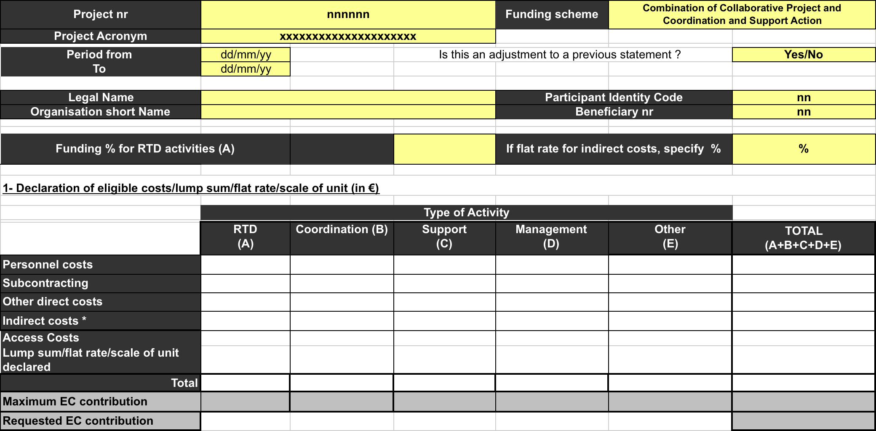
Form C
Personnel
Other Direct
Indirect
EC Contrib.
WP1
WP2
WP3
WP4
WP5
WP6
WP7
WP8

Slide 4
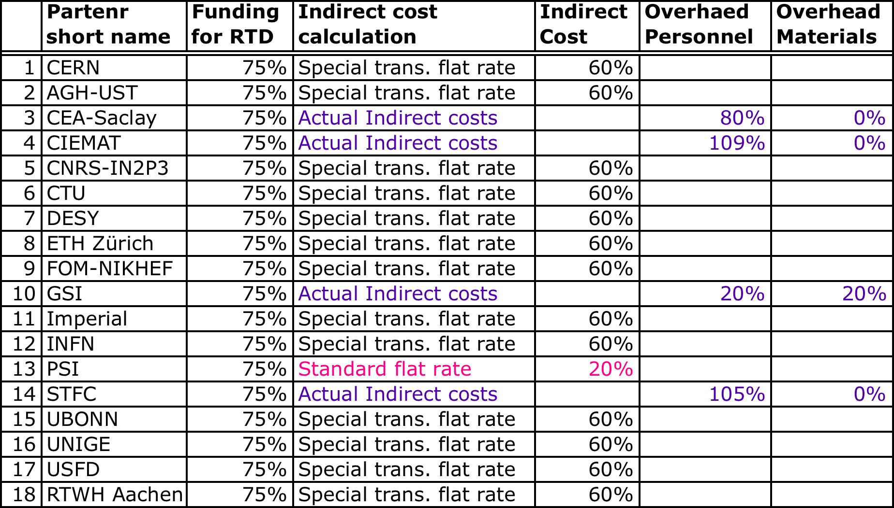
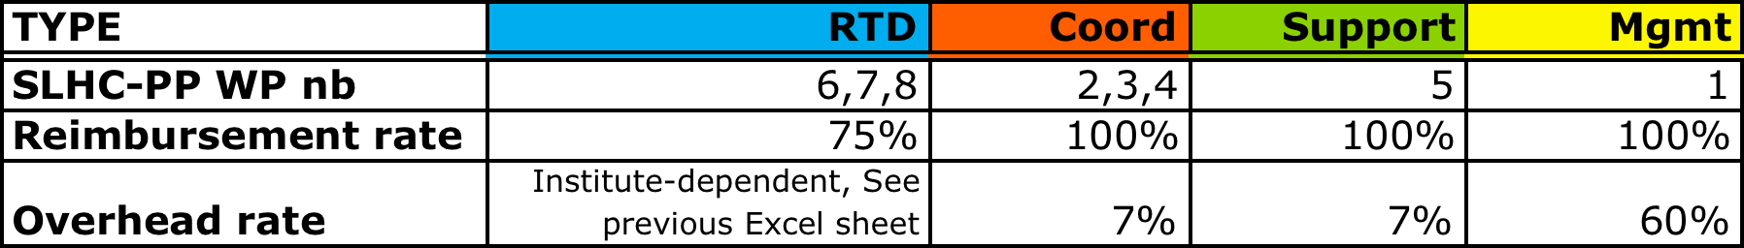
SLHC-PP Internal Cost Claim: ICC
Excel Template that prepares data for Form C
Input:
DIRECT COSTS
(personnel, travel, materials)
Output:
INDIRECT COSTS
TOTAL ELIGIBLE COSTS
REQUESTED EC CONTRIBUTION

Slide 5
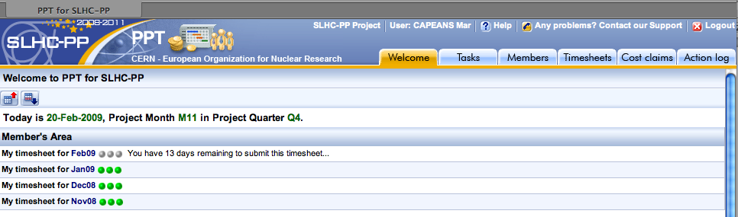
Demo: ICC > Form C
PPT >>> https://pptevm.cern.ch/slhcpp/ui/main.do

Slide 6
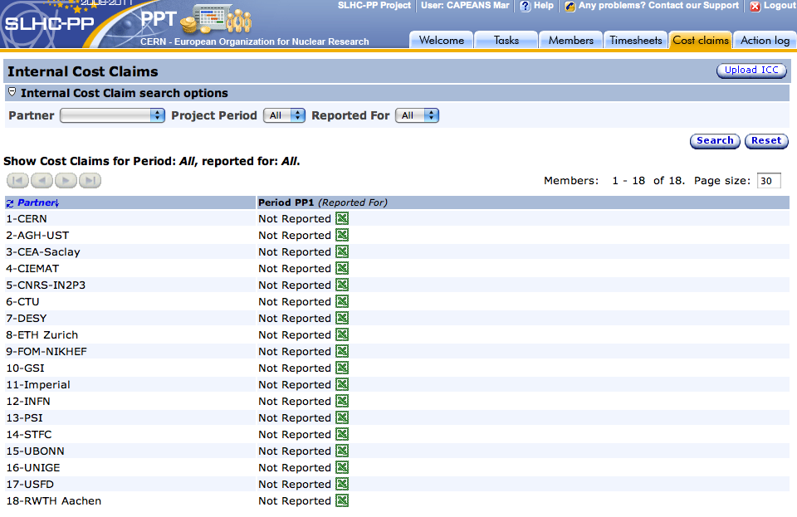
Demo: ICC > Form C
Click to Download your Excel File (.xls)

Slide 7
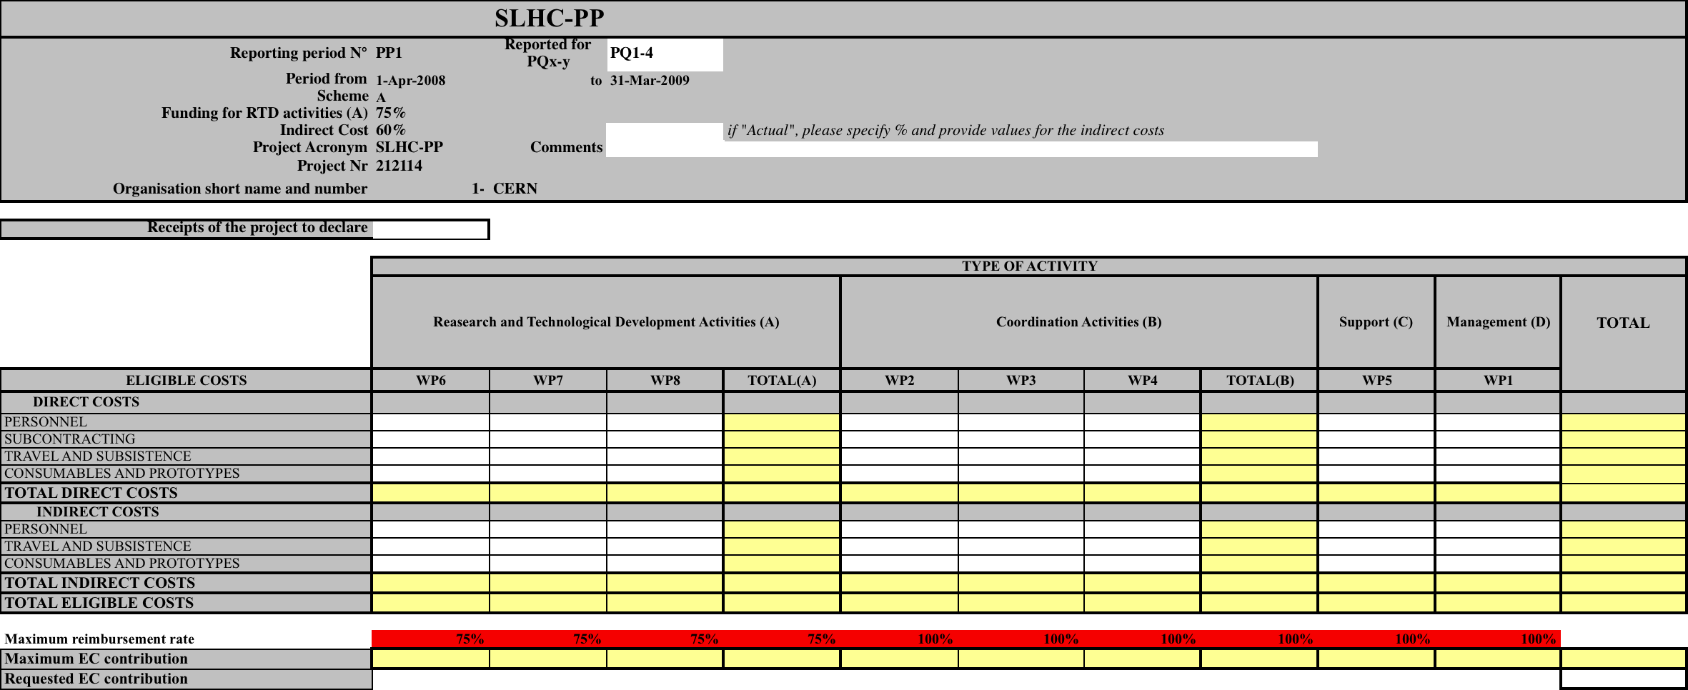
Demo: ICC > Form C
Before March 25th
Fill Empty White Cells for your WPs
Calculations are automatic

Slide 8
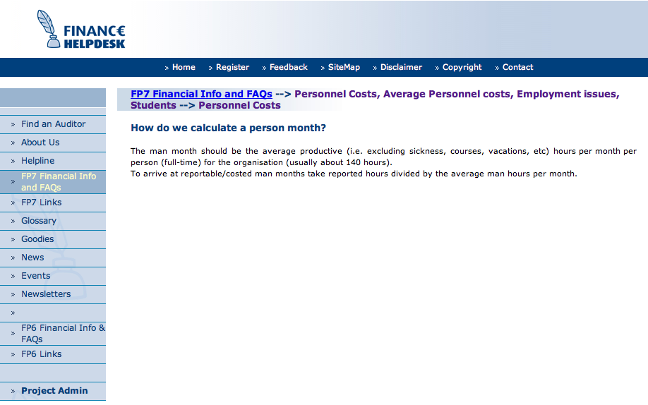
Definition of PM, Cost of PM
http://www.finance-helpdesk.org
PM = Reported Productive hours / average man hours per month
Their Cost per Hour will be total employer’s cost divided by productive hours multiplied by EU time (we suggest that the annual figures give the most accurate and fair calculation)

Slide 9
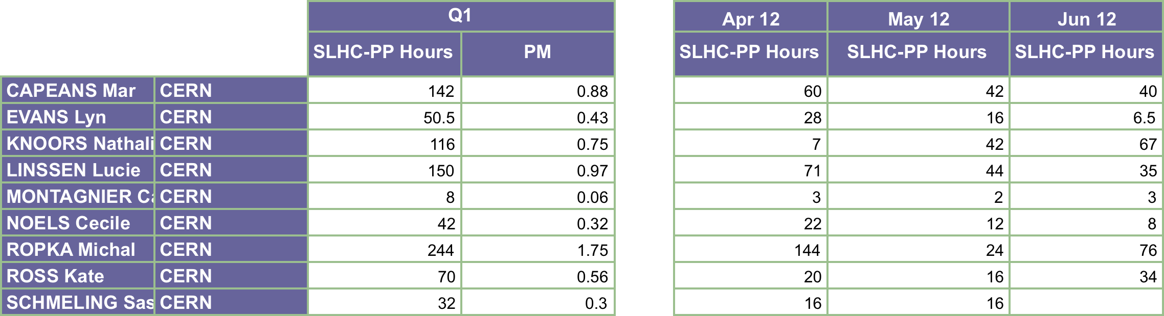
Cost of PM
Effort Report (PM) provided by CERN to each beneficiary
Random values in this example
Partner’s job: convert PM to Euro
Random values in this example
 | PM | Cost (€)
CAPEANS Mar | 0.88 | 8066.7
EVANS Lyn | 0.43 | 3941.7
KNOORS Nathalie | 0.75 | 5000.0
LINSSEN Lucie | 0.97 | 8891.7
MONTAGNIER Catherine | 0.06 | 400.0
NOELS Cecile | 0.32 | 2933.3
ROPKA Michal | 1.75 | 16041.7
ROSS Kate | 0.56 | 3733.3
SCHMELING Sascha | 0.3 | 2750.0
TOTAL COST (PM in WP1) | 6.02 | 51758.3
Yearly Cost of member 1
Cost Member 1 = PM x
12
.
.
.
.
.
.
Total Cost of Personnel in WP1 for FORM C

Slide 10
Exchange Rates
Costs shall be reported in Euro
Exchange rates as published on European Central Bank website.
http://www.ecb.int/stats/exchange/eurofxref/html/index.en.html
Apply either:
  The rate of the first day of the month which follows the end of the period (i.e. April 1st 2009)
  The rate on the date that the actual costs were incurred

Slide 11
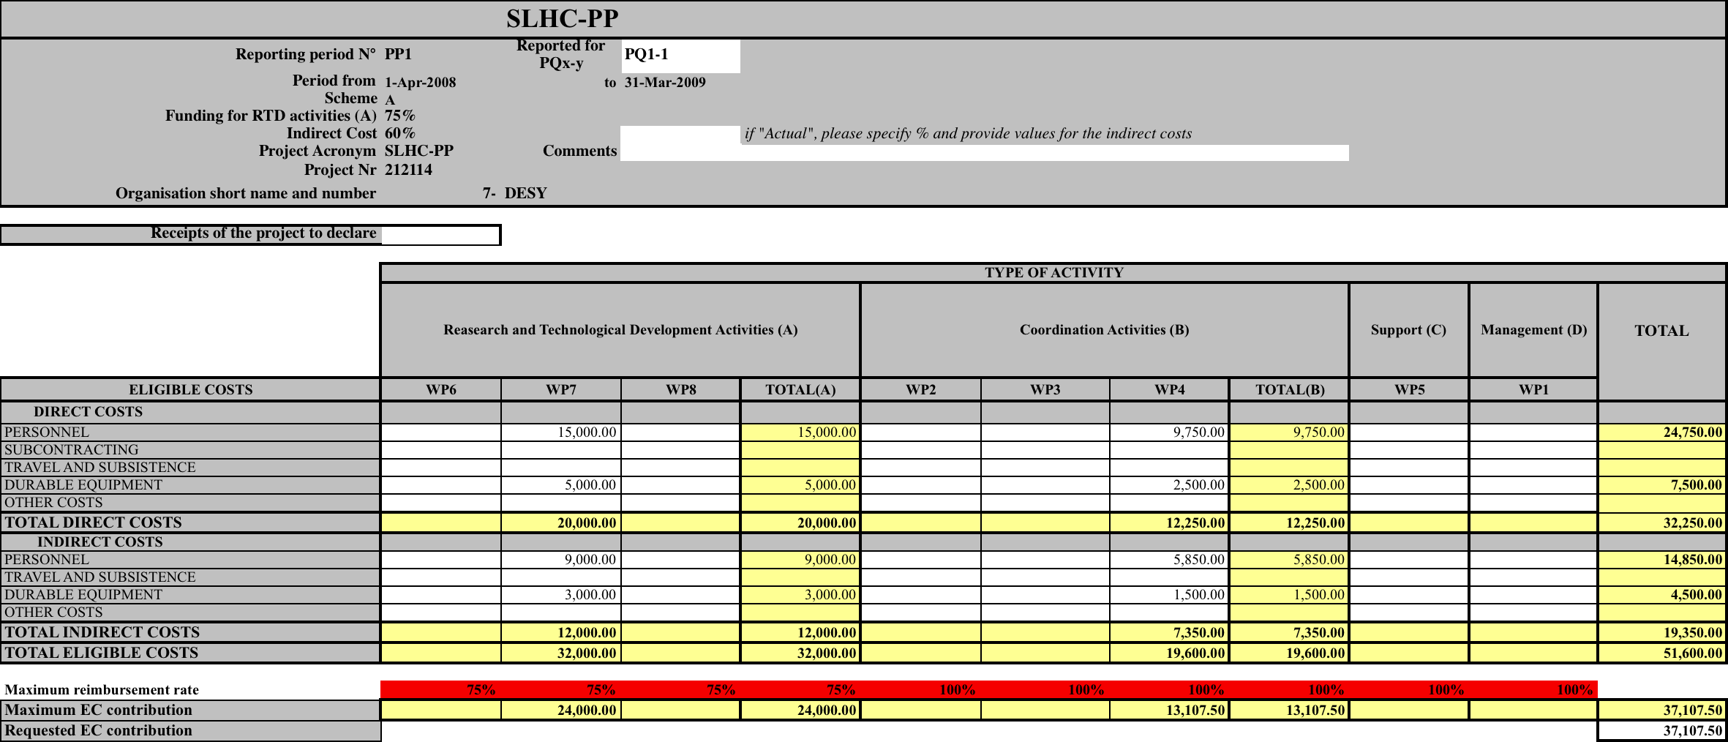
Demo: ICC > Form C
Before March 25th
Ex: Desy >>> 1.95 PM in WP4 and 3 PM in WP7

Slide 12
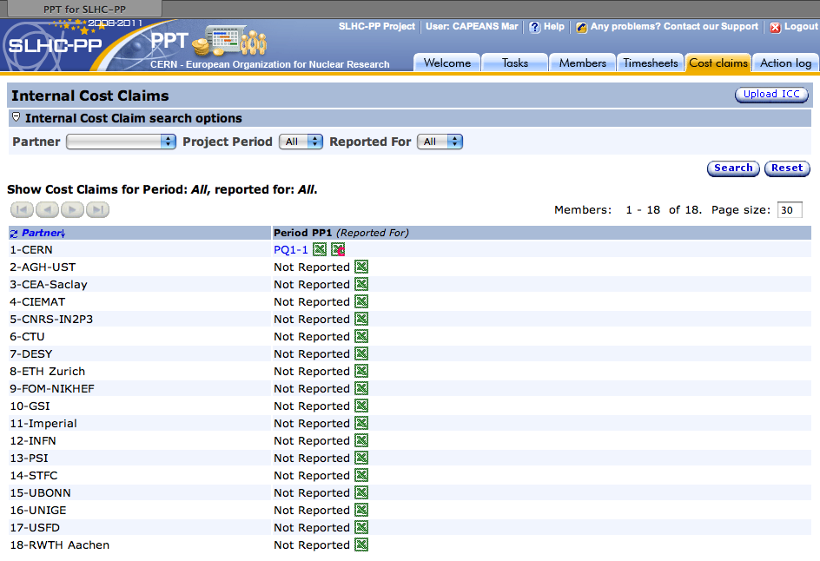
Upload ICC in PPT
Before March 25th

Slide 13
Information Flow (For each Partner)
CERN
< 8/04
Provide Nb of PM/member
Convert PM into Euro
Collect material & travel expenses
Download your ICC from PPT
< 22/04
Partner
Upload completed ICC in PPT
< 25/04
Partner
ICC Checks
Feedback to partners
CERN
< 30/04
Form C with signatures sent to CERN
< 9/05
Partner
CERN
15/05
Consolidated Form C

Slide 14
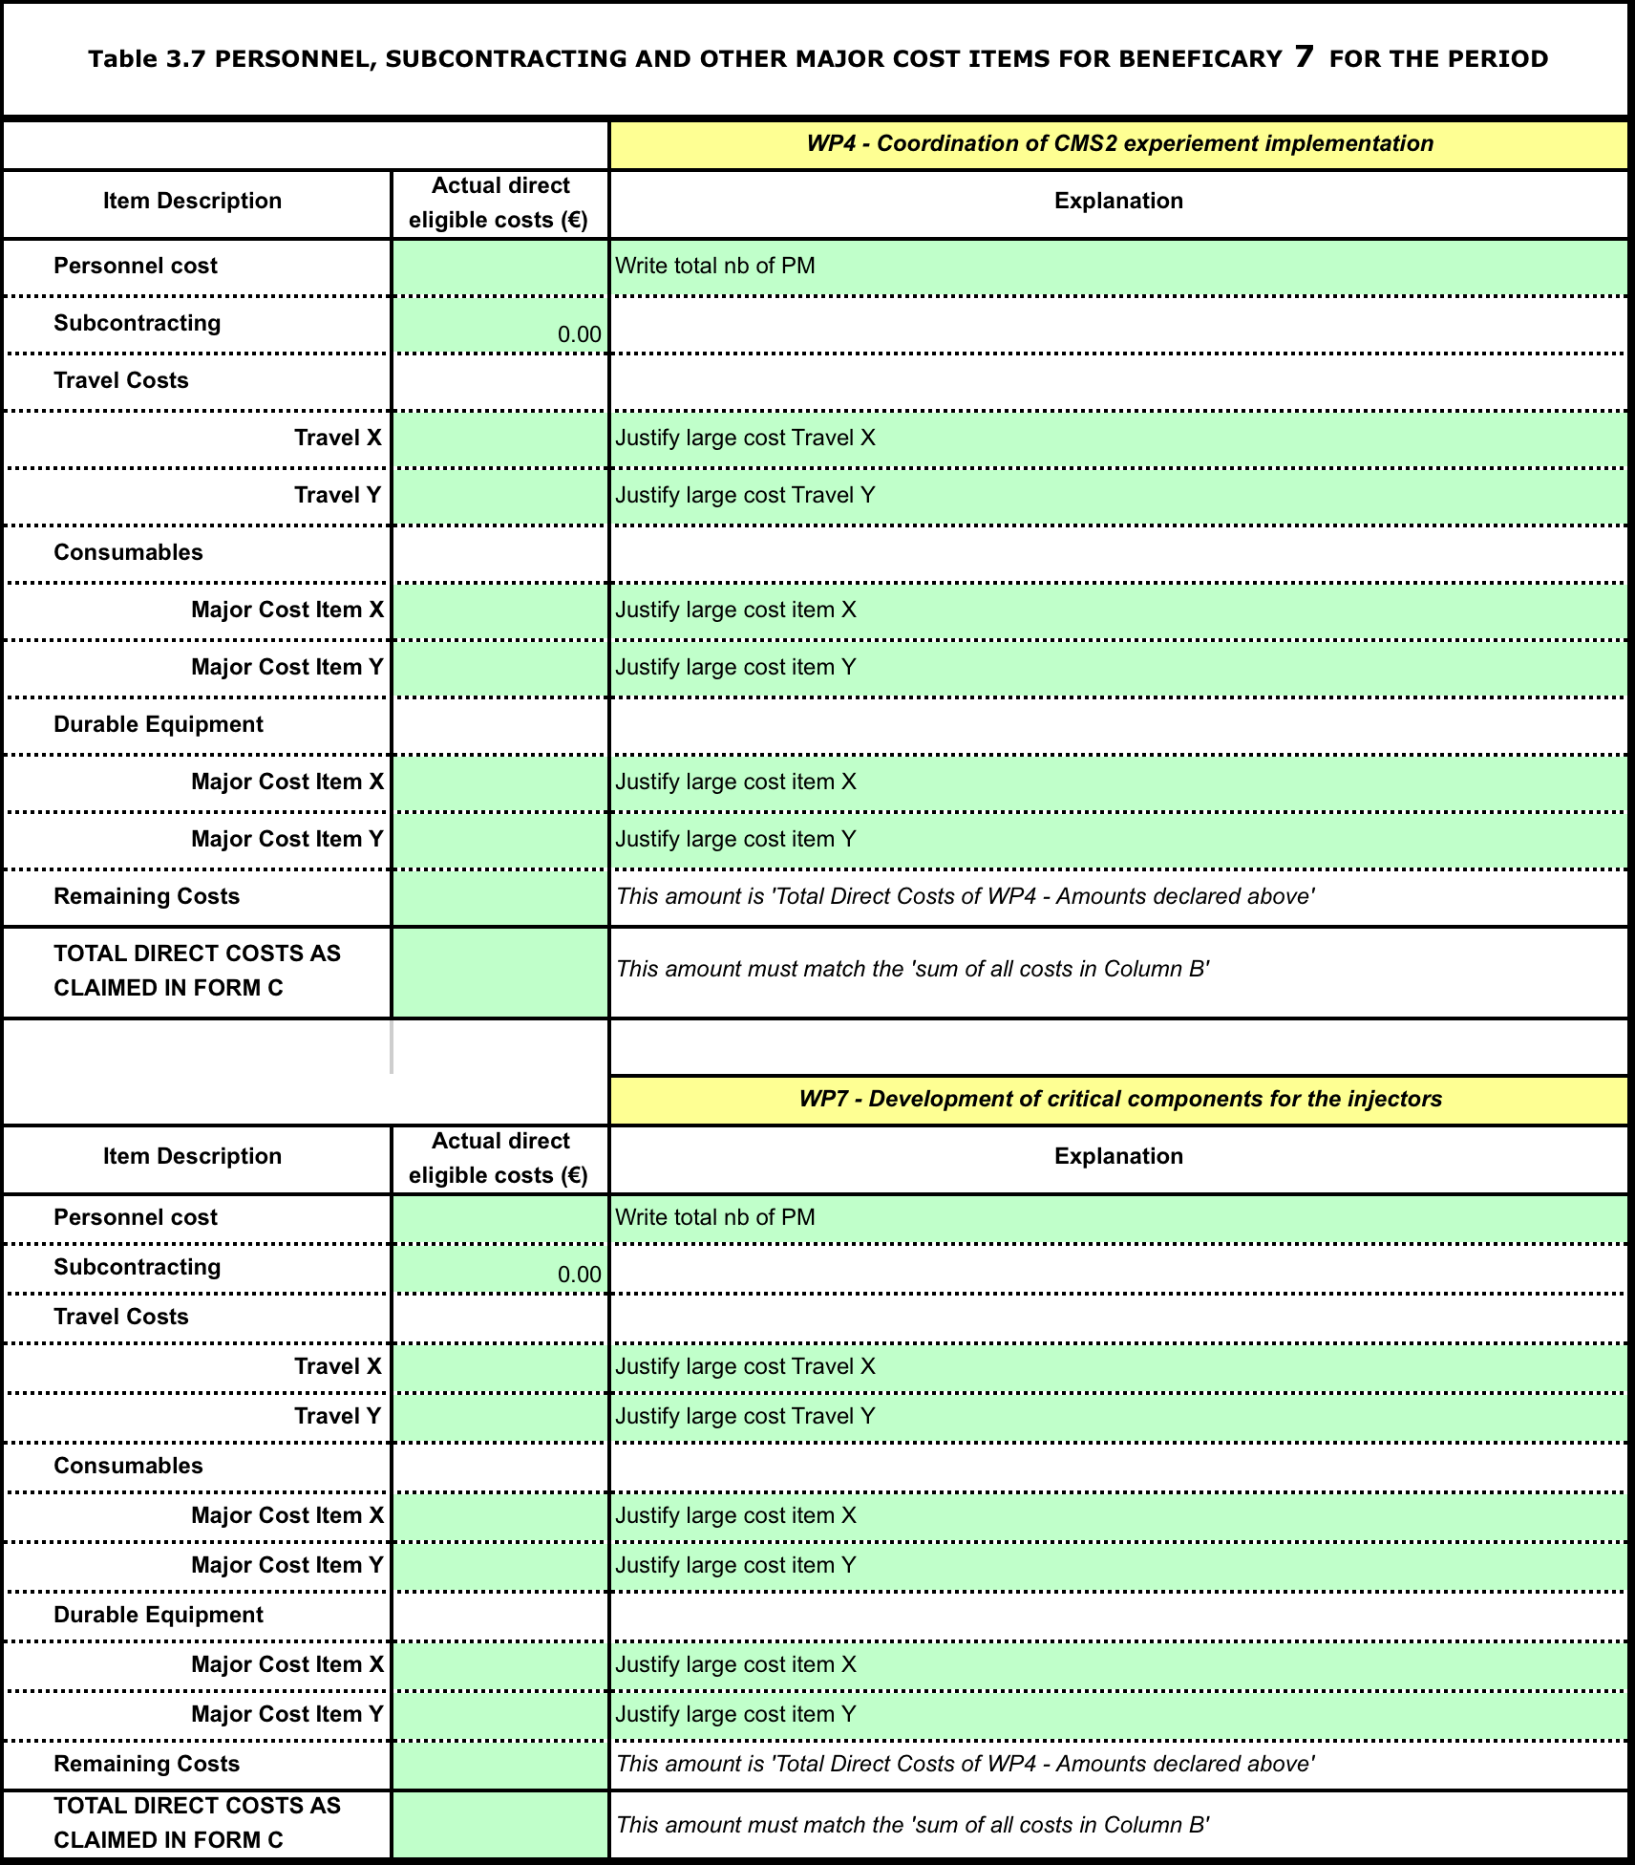
Template for Explanation of Use of Resources
(Section 6 of the Annual Report)
Example: DESY
WPs: 4 & 7
IDENTIFY and JUSTIFY major cost items (personnel, travels, consumables) per WP

Slide 15
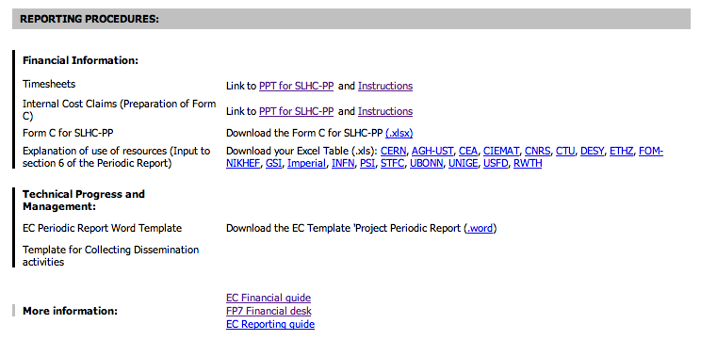
Help
https://cern.ch/info%2DSLHC%2DPP/Internal/MT.htm
mar.capeans@cern.ch

Slide 16
Acknowledgments
Project Office Team:
    Nathalie Knoors
    Kate Ross
    Catherine Montagner
IT-AIS team:
    M.Ropka

