Slide 1

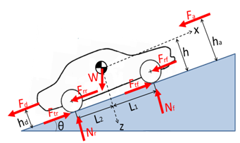
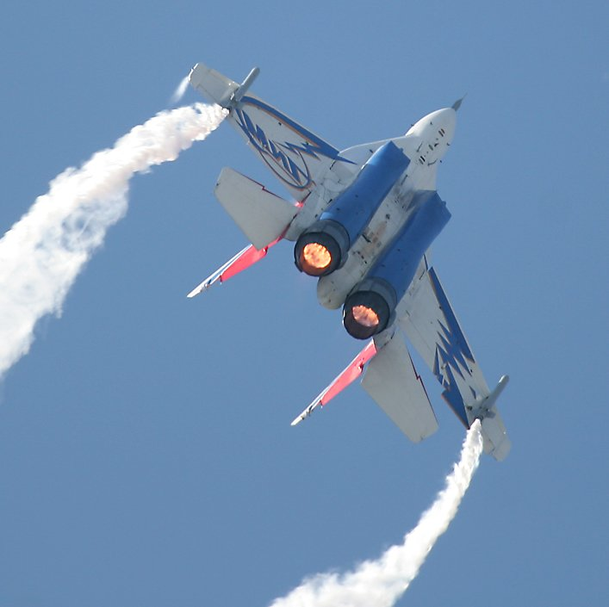
LONGITUDINAL beam DYNAMICS in circular accelerators
Frank Tecker
CERN, BE-OP
Introduction to Accelerator Physics
Budapest, 2-14/10/2016

Slide 2
Summary of the 2 lectures:
Introduction
Circular accelerators: Cyclotron / Synchrotron
Dispersion Effects in Synchrotron
Stability and Longitudinal Phase Space Motion
Stationary Bucket
Injection Matching
RF manipulations in the PS
More related lectures:
  Linacs – David Alesini
  Cyclotrons - Mike Seidel
  RF Systems - myself
  Electron Beam Dynamics - Lenny Rivkin

Slide 3
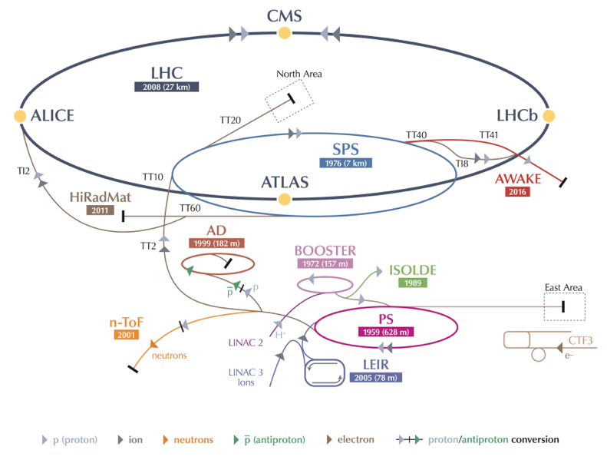
The CERN Accelerator Complex
-> 7 TeV
-> 450 GeV
50 MeV-> 1.4 GeV
-> 25 GeV

Slide 4
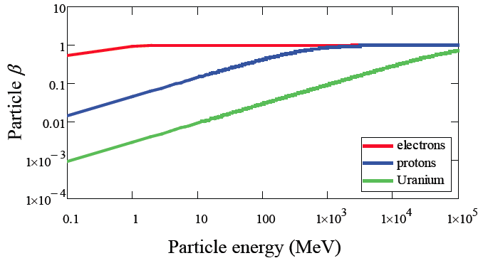
Particle types and acceleration
The accelerating system will depend upon the evolution of the particle velocity along the system
• electrons reach a constant velocity at relatively low energy
• heavy particles reach a constant velocity only at very high energy
-> we need different types of resonators, optimized for different velocities
-> the revolution frequency will vary, so the RF frequency will be changing
Particle rest mass:
electron 0.511 MeV
proton 938 MeV
²³⁹U ~220000 MeV
Relativistic
gamma factor:

Slide 5
Velocity, Energy and Momentum
normalized velocity
electrons
normalized velocity
=> electrons almost reach the speed of light
very quickly (few MeV range)
protons
total energy
rest energy
total energy
rest energy
electrons
protons
Momentum
=> Magnetic field needs to follow
the momentum increase

Slide 6

Acceleration: May the force be with you
To accelerate, we need a force in the direction of motion!
Newton-Lorentz Force on a charged particle:
2nd term always perpendicular to motion => no acceleration
Hence, it is necessary to have an electric field E
(preferably) along the direction of the initial momentum (z),
which changes the momentum of the particle.
The 2nd term - larger at high velocities – is used for:
- BENDING: generated by a magnetic field perpendicular to the plane of the particle trajectory. The bending radius ρ obeys to the relation :
in practical units:
- FOCUSING: the bending effect is used to bring the particles trajectory closer to the axis, hence to increase the beam density.

Slide 7
Energy Gain
The acceleration increases the momentum, providing kinetic energy to the charged particles.
In relativistic dynamics, total energy E and momentum p are linked by
W kinetic energy
Hence:
The rate of energy gain per unit length of acceleration (along z) is then:
and the kinetic energy gained from the field along the z path is:
where V is just a potential.

Slide 8
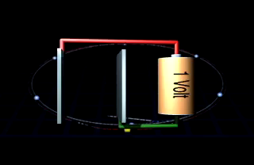
Unit of Energy
Today’s accelerators and future projects work/aim at the TeV energy range.
LHC: 7 TeV -> 14 TeV
CLIC: 380 GeV -> 3 TeV
HE-LHC/FCC: 33/100 TeV
In fact, this energy unit comes from acceleration:
Basic Unit: eV (electron Volt)
keV = 1000 eV = 10³ eV
MeV = 10⁶ eV
GeV = 10⁹ eV
TeV = 10¹² eV
LHC = ~450 Million km of batteries!!!
3x distance Earth-Sun
1 eV (electron Volt) is the energy that 1 elementary charge e (like one electron or proton) gains when it is accelerated in a potential (voltage) difference of 1 Volt.

Slide 9
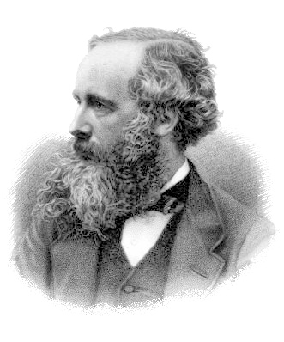
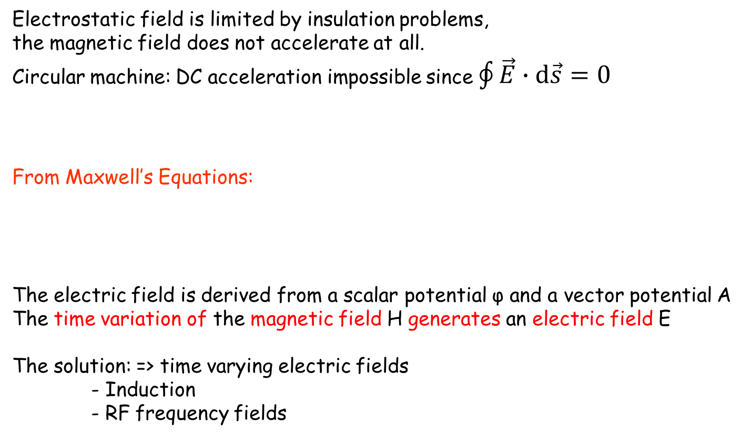
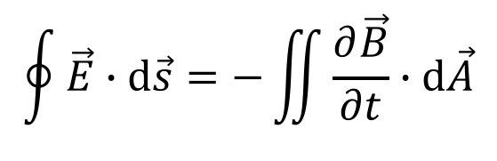
Methods of Acceleration: Time varying fields
Electrostatic field is limited by insulation problems,
the magnetic field does not accelerate at all.
Circular machine: DC acceleration impossible since $\oint{\vec{E}∙\text{d}\vec{s}=0}$
From Maxwell’s Equations:
The electric field is derived from a scalar potential φ and a vector potential A
The time variation of the magnetic field H generates an electric field E
The solution: => time varying electric fields
- Induction
- RF frequency fields
or
$$\oint{\vec{E}∙\text{d}\vec{s}=−\iint{\frac{∂\vec{B}}{∂t}∙\text{d}\vec{A}}}$$

Slide 10
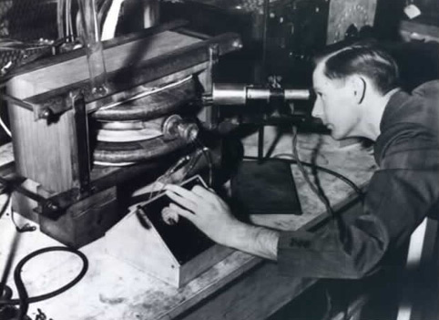
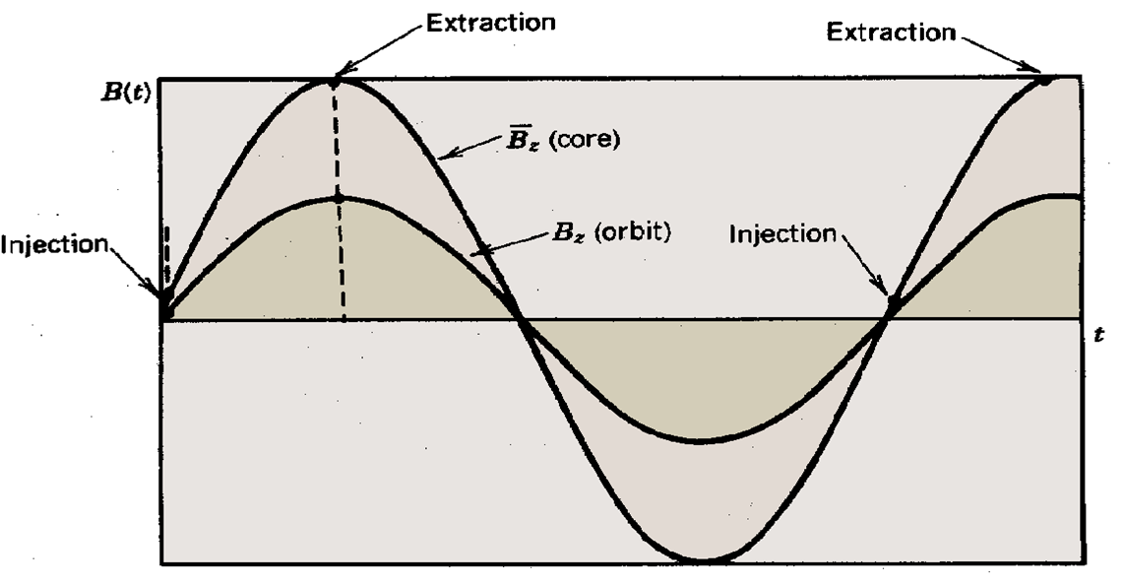
Acceleration by Induction: The Betatron
It is based on the principle of a transformer:
- primary side: large electromagnet - secondary side: electron beam.
The ramping magnetic field is used to guide particles on a circular trajectory as well as for acceleration.
Limited by saturation in iron (~300 MeV e-)
Used in industry and medicine, as they are
compact accelerators for electrons
side view
vacuum pipe
beam
B_{f}
iron yoke
coil
E
top
view
beam
R
time
B
B_{f}
Donald Kerst with the first betatron, invented at the University of Illinois in 1940

Slide 11
Summary: Relativity + Energy Gain
Newton-Lorentz Force
2nd term always perpendicular to motion => no acceleration
Relativistics Dynamics
RF Acceleration
(neglecting transit time factor)
The field will change during the passage of the particle through the cavity
=> effective energy gain is lower

Slide 12
Common Phase Conventions
For circular accelerators, the origin of time is taken at the zero crossing of the RF voltage with positive slope
For linear accelerators, the origin of time is taken at the positive crest of the RF voltage
Time t= 0 chosen such that:
1
2
φ₁
φ₂
3. I will stick to convention 1 in the following to avoid confusion

Slide 13
Longitudinal phase space
The energy – phase oscillations can be drawn in phase space:
ΔΕ, Δp/p
ΔΕ, Δp/p
acceleration
move
forward
move
backward
deceleration
φ
φ
reference
The particle trajectory in the phase space (Δp/p, φ) describes its longitudinal motion.
Emittance: phase space area including all the particles
NB: if the emittance contour correspond to a possible orbit in phase space, its shape does not change with time (matched beam)

Slide 14
Circular accelerators
Cyclotron
Synchrotron

Slide 15

Circular accelerators: Cyclotron
Courtesy: EdukiteLearning, https://youtu.be/cNnNM2ZqIsc

Slide 16
Circular accelerators: Cyclotron
Used for protons, ions
B = constant
ω_{RF} = constant
RF generator, ω_{RF}
Synchronism condition
B
g
Ion source
Cyclotron frequency
γ increases with the energy ⇒ no exact synchronism
if v << c ⇒ γ ≅ 1
Extraction electrode
Cyclotron Animation
Ions trajectory
Animation: http://www.sciences.univ-nantes.fr/sites/genevieve_tulloue/Meca/Charges/cyclotron.html

Slide 17
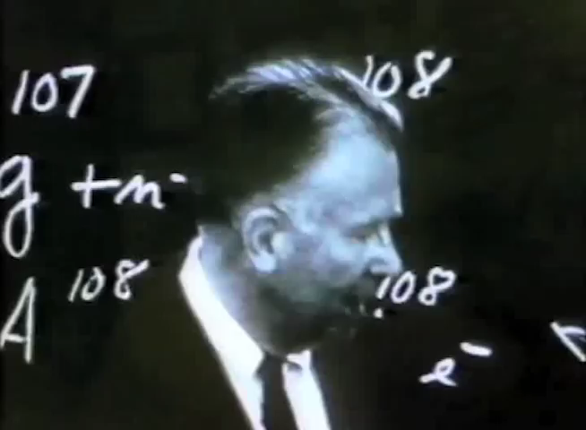
Circular accelerators: Cyclotron
Courtesy Berkeley Lab, https://www.youtube.com/watch?v=cutKuFxeXmQ

Slide 18
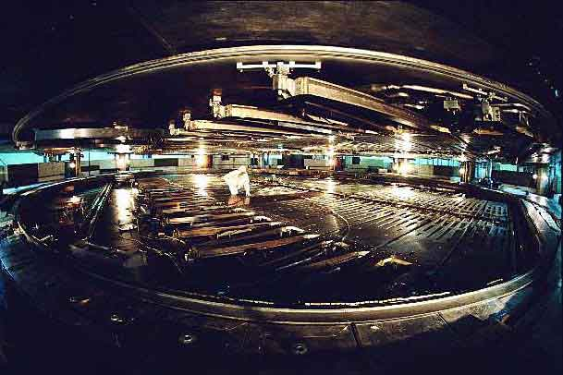
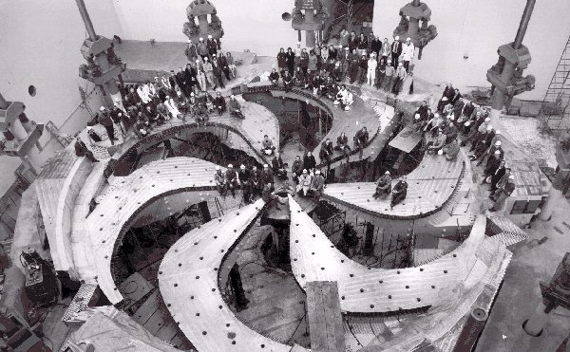
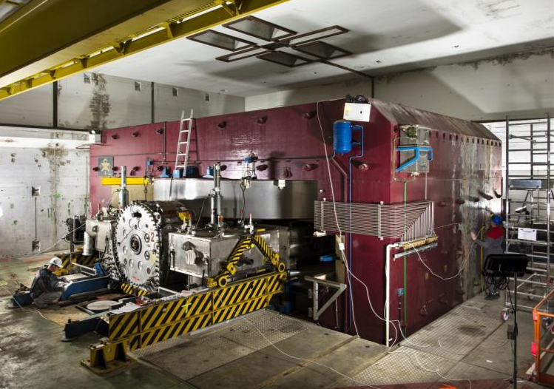
Cyclotron / Synchrocyclotron
TRIUMF 520 MeV cyclotron Vancouver - Canada
CERN 600 MeV synchrocyclotron
Synchrocyclotron: Same as cyclotron, except a modulation of ω_{RF}
B = constant
  γ ω_{RF} = constant
ω_{RF} decreases with time
Allows to go beyond the
non-relativistic energies
The condition:

Slide 19

Circular accelerators: The Synchrotron
B
Constant orbit during acceleration
To keep particles on the closed orbit, B should increase with time
ω and ω_{RF} increase with energy
R
E
RF frequency can be
multiple of revolution frequency
RF cavity
RF generator
$$ω_{RF}=hω$$
h integer,
harmonic number:
number of RF cycles
per revolution
Synchronism condition

Slide 20
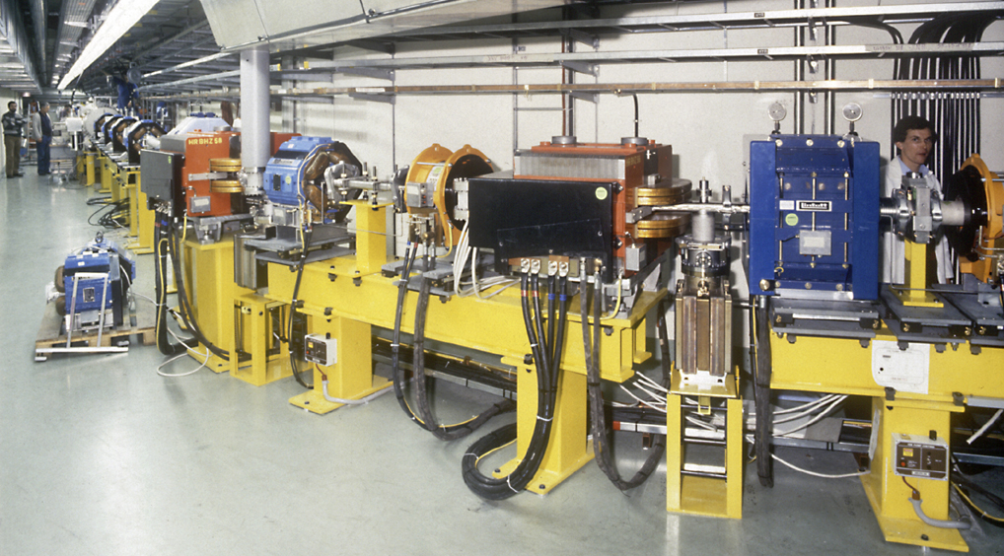
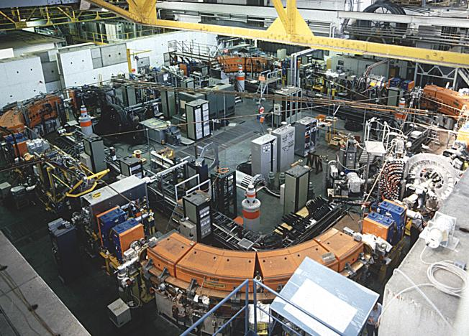
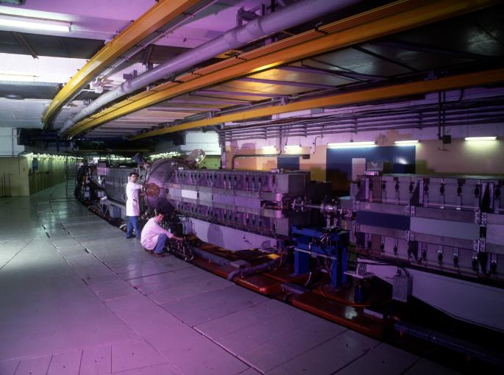
Circular accelerators: The Synchrotron
EPA (CERN)
Electron Positron Accumulator
LEAR (CERN)
Low Energy Antiproton Ring
© CERN Geneva
© CERN Geneva
Examples of different proton and electron synchrotrons at CERN
+ LHC (of course!)
PS (CERN)
Proton Synchrotron
© CERN Geneva

Slide 21

The Synchrotron
The synchrotron is a synchronous accelerator since there is a synchronous RF phase for which the energy gain fits the increase of the magnetic field at each turn. That implies the following operating conditions:
E
Energy gain per turn
Synchronous particle
RF synchronism
(h - harmonic number)
Constant orbit
Variable magnetic field
B
Bending
magnet
R=C/2π
injection
extraction
$$ω_{RF}=hω$$
ρ
bending
radius
If v≈c, ω hence ω_{RF} remain constant (ultra-relativistic e⁻ )

Slide 22
The Synchrotron – LHC Operation Cycle
The magnetic field (dipole current) is increased during the acceleration.
beam dump
energy ramp
coast
coast
7 TeV
start of the ramp
injection phase
preparation and access
450 GeV
L.Bottura

Slide 23
The Synchrotron – Energy ramping
Energy ramping by increasing the B field (frequency has to follow v):
Since:
Stable phase φ_{s} changes during energy ramping
The number of stable synchronous particles is equal to the
harmonic number h. They are equally spaced along the circumference.
Each synchronous particle satisfies the relation p=eBρ.
They have the nominal energy and follow the nominal trajectory.

Slide 24
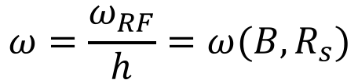
The Synchrotron – Frequency change
During the energy ramping, the RF frequency increases to follow the increase of the revolution frequency :
$$ω=\frac{ω_{RF}}{h}=ω(B,R_{s})$$
Hence: ( using )
Since the RF frequency must follow the variation of the B field with the law
This asymptotically tends towards when B becomes large compared to
which corresponds to

Slide 25
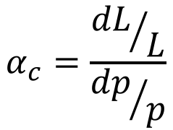
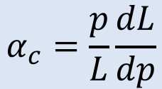
Dispersion Effects in a Synchrotron
If a particle is slightly shifted in momentum it will have a different orbit and the orbit length is different.
The “momentum compaction factor” is defined as:
cavity
E
Circumference
2πR
$$α_{c}=\frac{{dL}/L}{{dp}/p}$$
$$α_{c}=\frac{p}{L}\frac{dL}{dp}$$
E+δE
If the particle is shifted in momentum it will have also a different velocity.
As a result of both effects the revolution frequency changes with a “slip factor”:
p=particle momentum
R=synchrotron physical radius
f_{r}=revolution frequency

Slide 26
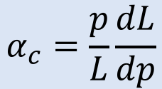
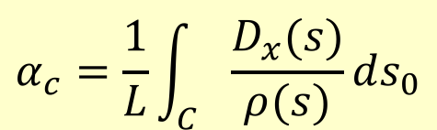
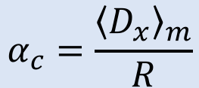
Momentum Compaction Factor
$$α_{c}=\frac{p}{L}\frac{dL}{dp}$$
x
dθ
The elementary path difference from the two orbits is:
definition of dispersion D_{x}
leading to the total change in the circumference:
< >_{m} means that the average is considered over the bending magnet only
$$α_{c}=\frac{1}{L}\int_{C}{\frac{D_{x}(s)}{ρ(s)}ds_{0}}$$
With ρ=∞ in straight sections we get:
$$α_{c}=\frac{{\left\langle D_{x}\right\rangle }_{m}}{R}$$

Slide 27
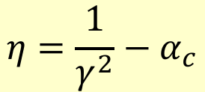
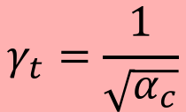
Dispersion Effects – Revolution Frequency
There are two effects changing the revolution frequency:
the orbit length and the velocity of the particle
c
definition of momentum compaction factor
$$η=\frac{1}{γ^{2}}−α_{c}$$
c
$$γ_{t}=\frac{1}{\sqrt{α_{c}}}$$
η=0 at the transition energy

Slide 28
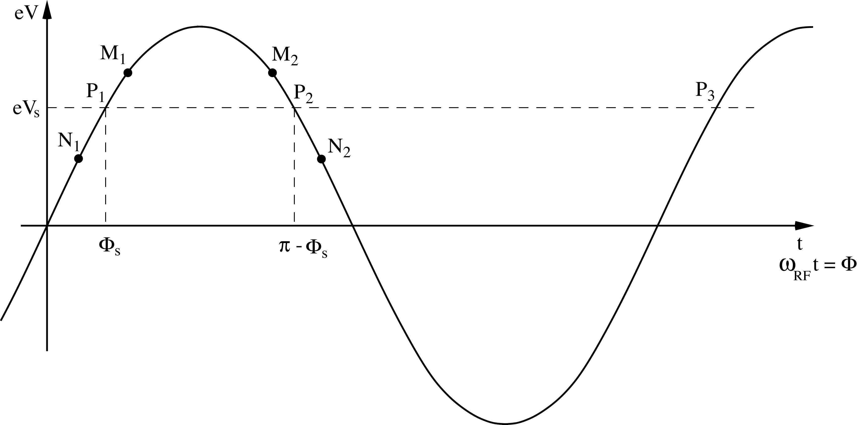
RECAP: Principle of Phase Stability (Linac)
Let’s consider a succession of accelerating gaps, operating in the 2π mode, for which the synchronism condition is fulfilled for a phase Φs .
is the energy gain in one gap for the particle to reach the
next gap with the same RF phase: P₁ ,P₂, …… are fixed points.
energy
gain
early
late
For a 2π mode, the electric field is the same in all gaps at any given time.
If an energy increase is transferred into a velocity increase =>
M₁ & N₁ will move towards P₁ => stable
M₂ & N₂ will go away from P₂ => unstable
(Highly relativistic particles have no significant velocity change)
Notes:
Edwin McMillan of UC Berkley, and the Russian V.I. Veksler independently discovered Phase stability in 1945.

Slide 29

Phase Stability in a Synchrotron
From the definition of η it is clear that an increase in momentum gives
- below transition (η > 0) a higher revolution frequency
(increase in velocity dominates) while
- above transition (η < 0) a lower revolution frequency (v ≈ c and longer path)
where the momentum compaction (generally > 0) dominates.
energy
gain
Stable synchr. Particle for η < 0
above transition
η > 0
early
late
$$η=\frac{1}{γ^{2}}−α_{c}$$

Slide 30
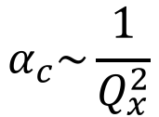
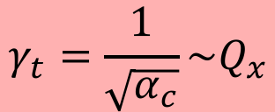
Crossing Transition
At transition, the velocity change and the path length change with momentum compensate each other. So the revolution frequency there is independent from the momentum deviation.
Crossing transition during acceleration makes the previous stable synchronous phase unstable. The RF system needs to make a rapid change of the RF phase, a ‘phase jump’.
$$α_{c}\sim \frac{1}{Q_{x}^{2}}$$
$$γ_{t}=\frac{1}{\sqrt{α_{c}}}\sim Q_{x}$$
In the PS: γ_{t} is at ~6 GeV
In the SPS: γ_{t}= 22.8, injection at γ=27.7
=> no transition crossing!
In the LHC: γ_{t} is at ~55 GeV, also far below injection energy
Transition crossing not needed in leptons machines, why?

Slide 31

Dynamics: Synchrotron oscillations
Simple case (no accel.): B = const., below transition
$$γ<γ_{t}$$
The phase of the synchronous particle must therefore be φ₀ = 0.
Φ₁ - The particle B is accelerated
- Below transition, an energy increase means an increase in revolution frequency
- The particle arrives earlier – tends toward φ₀
B
φ₂
φ₀
φ₁
φ₂ - The particle is decelerated
- decrease in energy - decrease in revolution frequency
- The particle arrives later – tends toward φ₀

Slide 32
Synchrotron oscillations
A
V
time
B
1st revolution period
600th revolution period
700th revolution period
800th revolution period
200th revolution period
300th revolution period
400th revolution period
500th revolution period
100th revolution period

Slide 33
Synchrotron oscillations
A
V
time
B
800th revolution period
Particle B has made one full oscillation around particle A.
The amplitude depends on the initial phase and energy.
Exactly like the pendulum
This oscillation is called:
Synchrotron Oscillation

Slide 34
The Potential Well
A
Cavity voltage
Potential well
B
phase

Slide 35
Longitudinal Phase Space Motion
Particle B oscillates around particle A
This is a synchrotron oscillation
Plotting this motion in longitudinal phase space gives:
ΔE
higher energy
early arrival
late arrival
Δt (or φ)
lower energy

Slide 36
Synchrotron oscillations – No acceleration
φ₂
φ₀
φ₁
Phase space picture
stable region
unstable region
separatrix

Slide 37
Synchrotron oscillations (with acceleration)
Case with acceleration B increasing
$$γ<γ_{t}$$
1
φ
2
φ_{s}
Phase space picture
stable region
unstable region
The symmetry of the case B = const. is lost
separatrix

Slide 38
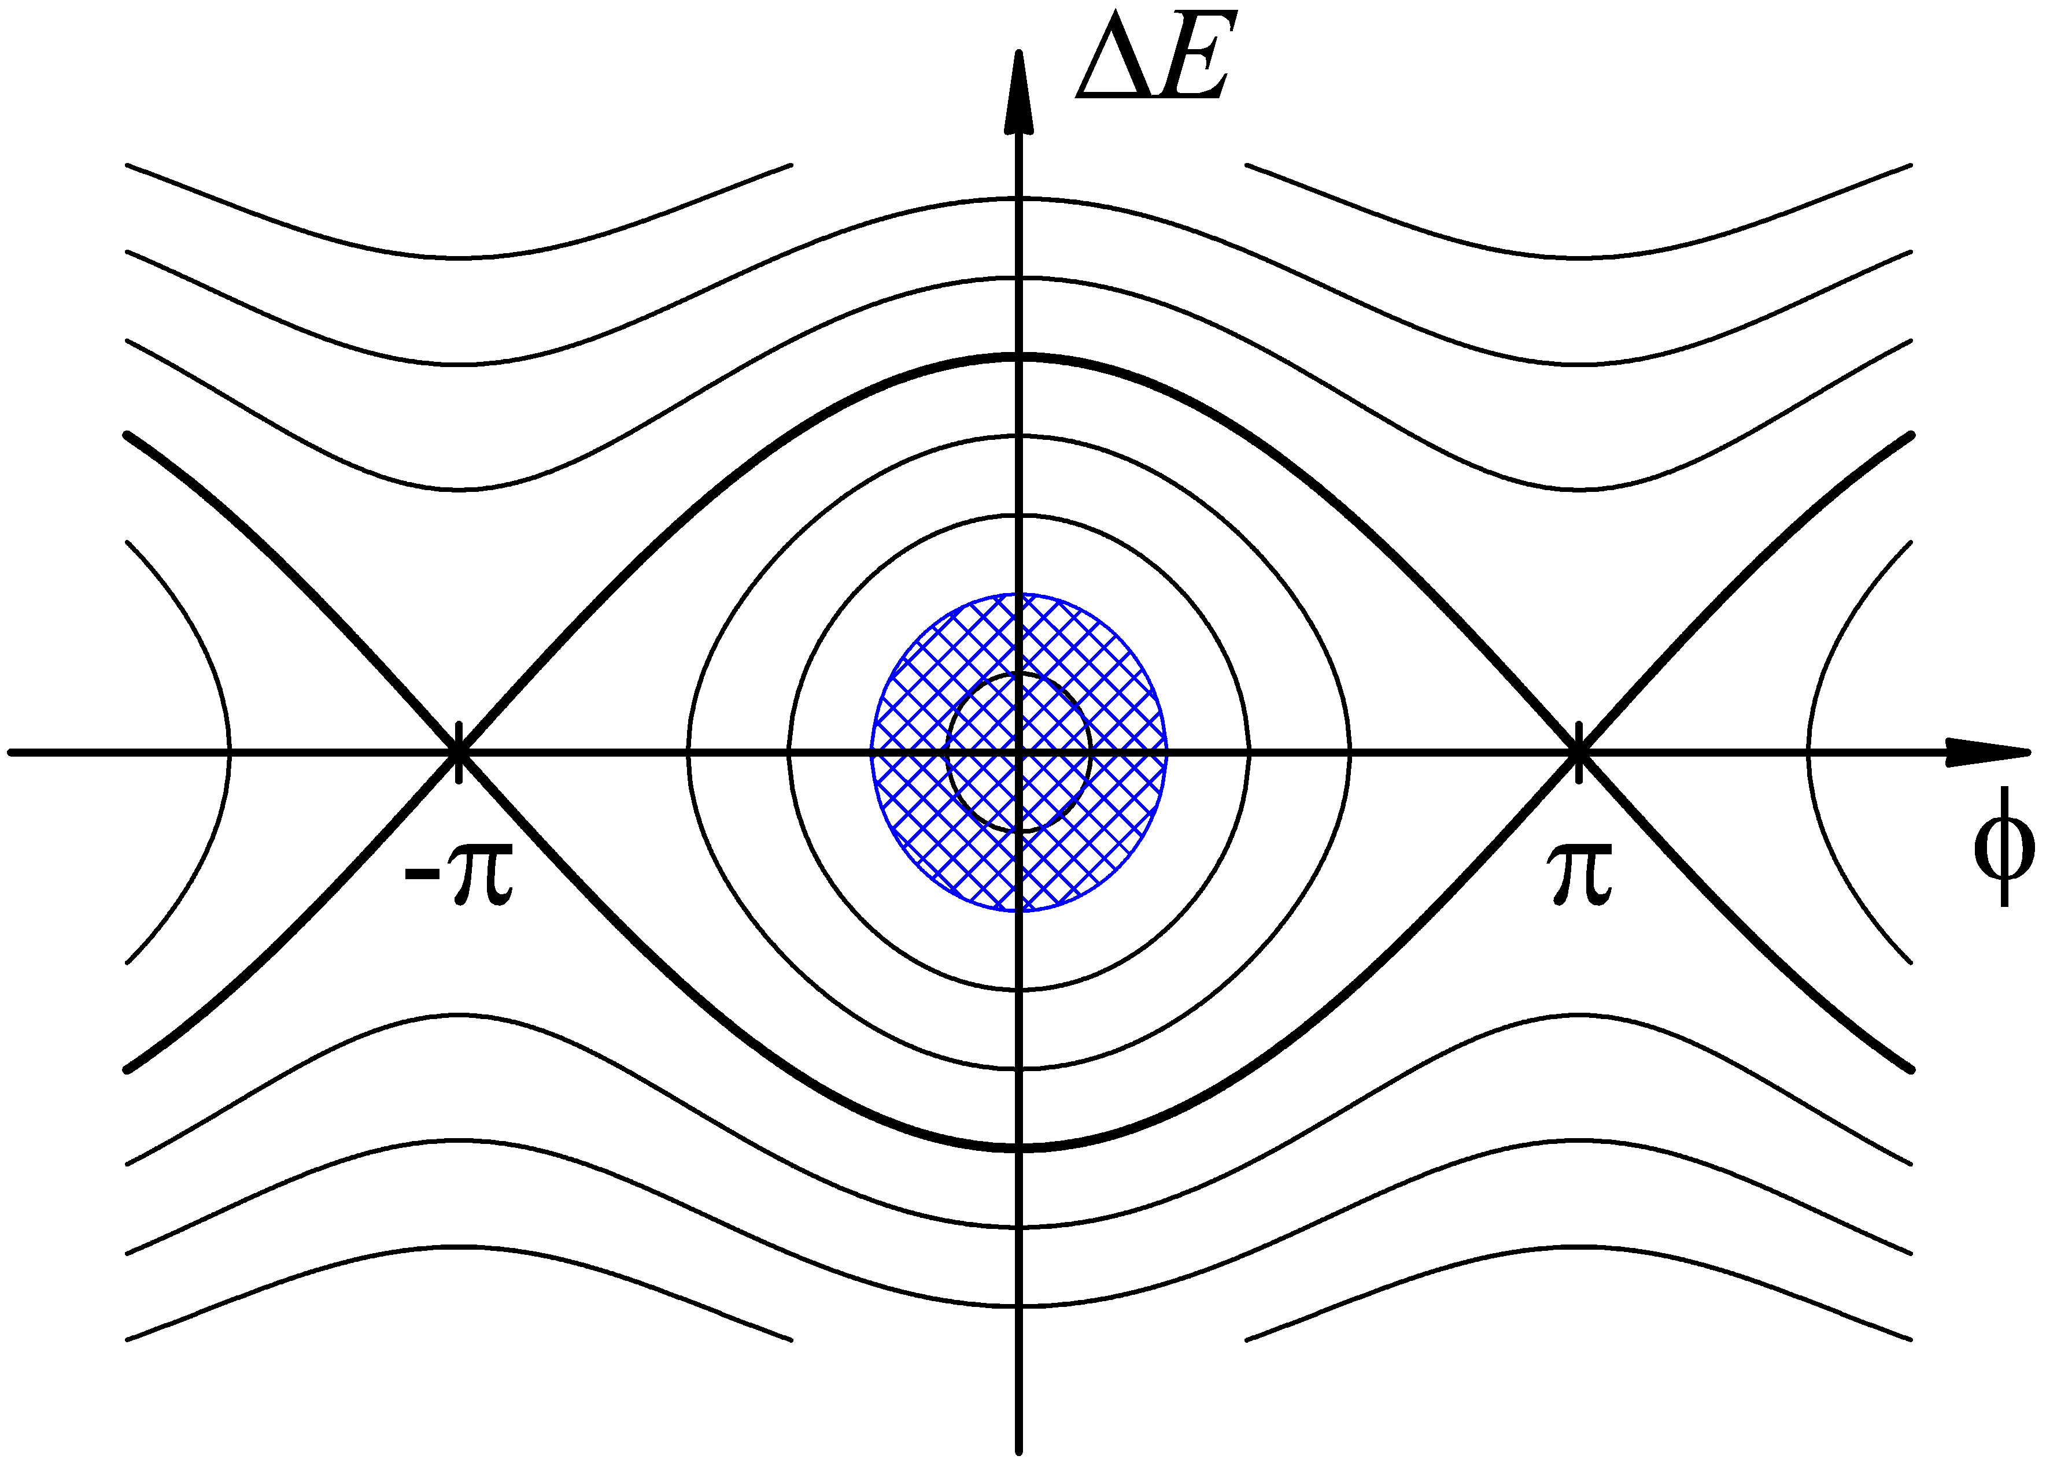
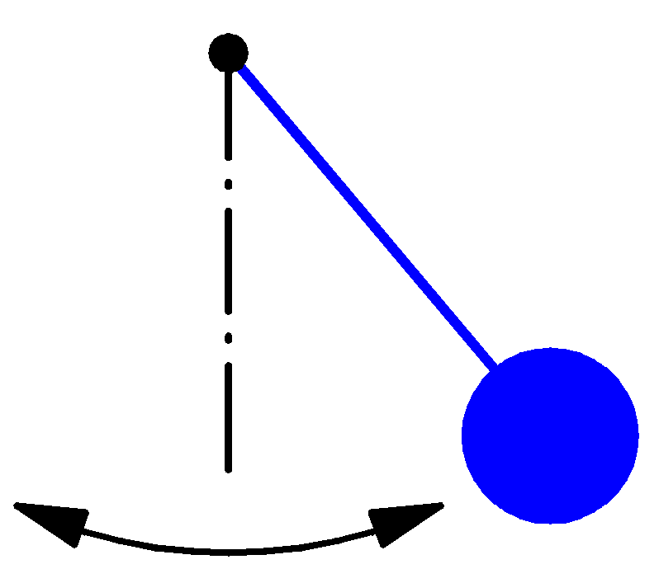

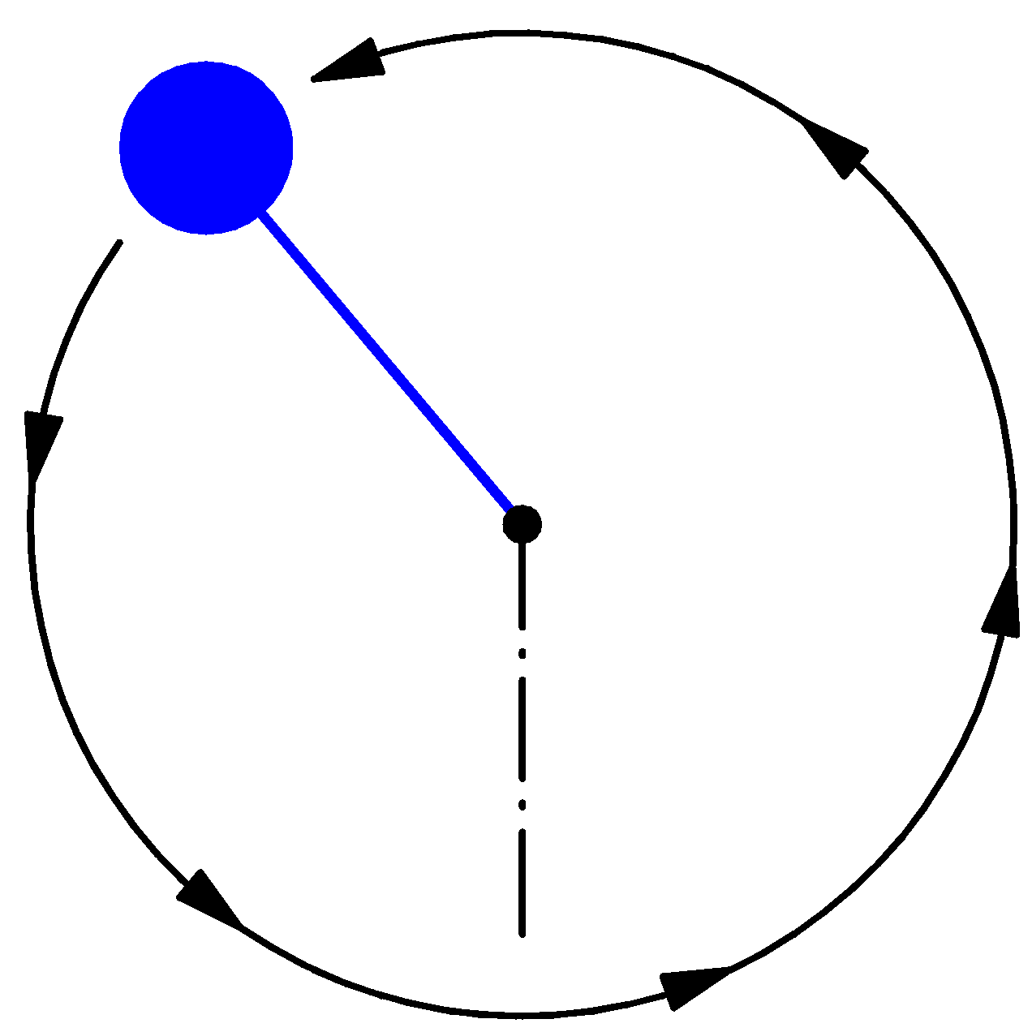
Synchrotron motion in phase space
Dynamics of a particle
Non-linear, conservative oscillator → e.g. pendulum
ΔE-φ phase space of a stationary bucket (when there is no acceleration)
Particle inside the separatrix:
Particle at the
unstable fix-point
Bucket area: area enclosed by the separatrix
The area covered by particles is the longitudinal emittance
Particle outside the separatrix:

Slide 39
(Stationary) Bunch & Bucket
The bunches of the beam fill usually a part of the bucket area.
ΔE
Bunch
Bucket
ΔE
Δt (or φ)
Δt
Bucket area = longitudinal Acceptance [eVs]
Bunch area = longitudinal beam emittance = 4π σ_{E} σ_{t} [eVs]
Attention: Different definitions are used!

Slide 40
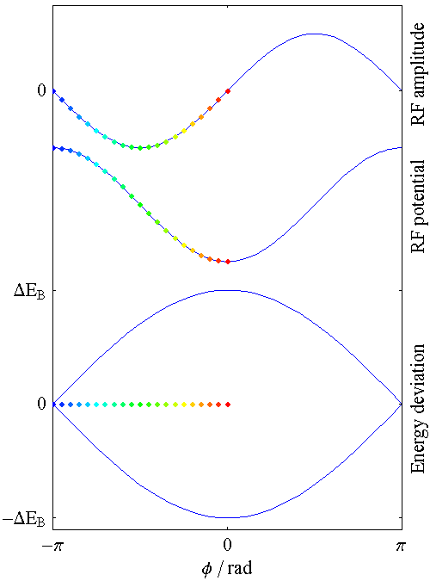
Synchrotron motion in phase space
The restoring force is non-linear.
speed of motion depends on position in
phase-space
(here shown for a stationary bucket)

Slide 41
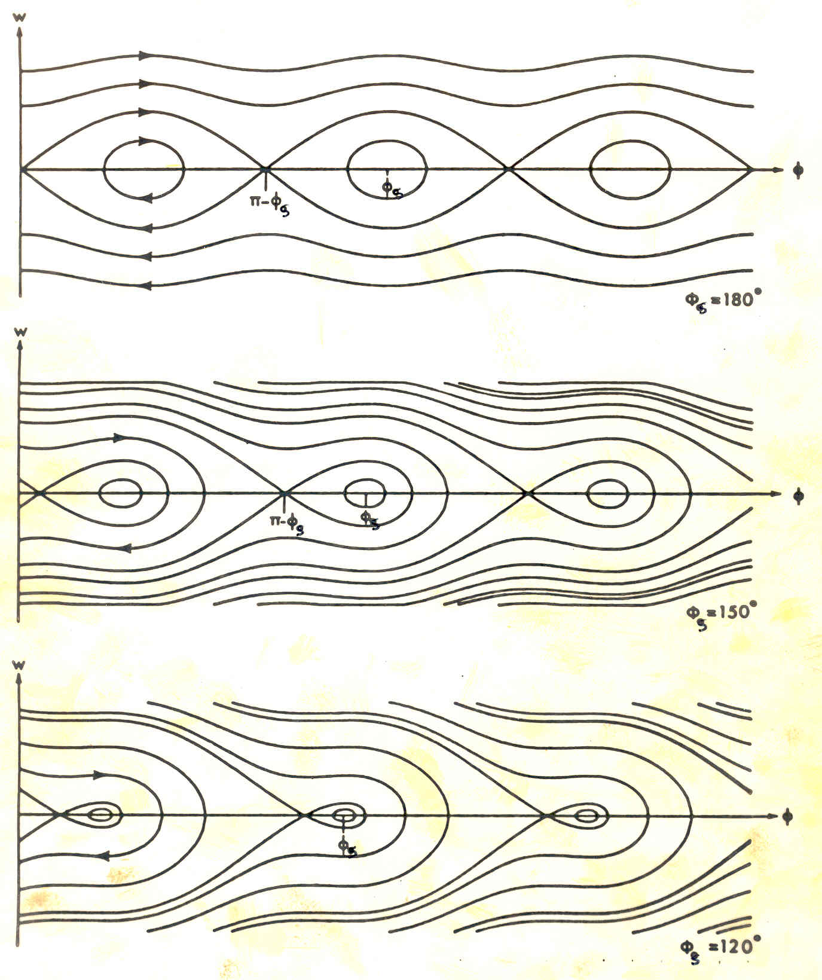
RF Acceptance versus Synchronous Phase
The areas of stable motion (closed trajectories) are called “BUCKET”.
As the synchronous phase gets closer to 90º the buckets gets smaller.
The number of circulating buckets is equal to “h”.
The phase extension of the bucket is maximum for φ_{s} =180º (or 0°) which correspond to no acceleration . The RF acceptance increases with the RF voltage.

Slide 42
Longitudinal Dynamics in Synchrotrons
It is also often called “synchrotron motion”.
The RF acceleration process clearly emphasizes two coupled variables, the energy gained by the particle and the RF phase experienced by the same particle. Since there is a well defined synchronous particle which has always the same phase φ_{s}, and the nominal energy E_{s}, it is sufficient to follow other particles with respect to that particle.
So let’s introduce the following reduced variables:
revolution frequency : Δf_{r} = f_{r} – f_{rs}
particle RF phase : Δφ = φ - φ_{s}
particle momentum : Δp = p - p_{s}
particle energy : ΔE = E – E_{s}
azimuth angle : Δθ = θ - θ_{s}

Slide 43
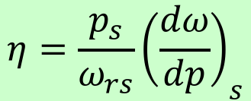
First Energy-Phase Equation
v
Δθ
particle ahead arrives earlier
=> smaller RF phase
θ_{s}
R
For a given particle with respect to the reference one:
$$η=\frac{p_{s}}{ω_{rs}}{\left(\frac{dω}{dp}\right)}_{s}$$
Since:
and
one gets:

Slide 44
Second Energy-Phase Equation
The rate of energy gained by a particle is:
The rate of relative energy gain with respect to the reference particle is then:
Expanding the left-hand side to first order:
leads to the second energy-phase equation:

Slide 45
Equations of Longitudinal Motion
deriving and combining
This second order equation is non linear. Moreover the parameters within the bracket are in general slowly varying with time.
We will study some cases in the following…

Slide 46
Small Amplitude Oscillations
Let’s assume constant parameters R_{s}, p_{s}, ω_{s} and η:
with
Consider now small phase deviations from the reference particle:
(for small Δφ)
and the corresponding linearized motion reduces to a harmonic oscillation:
where Ω_{s} is the synchrotron angular frequency

Slide 47
Stability condition for ϕ_{s}
Stability is obtained when Ω_{s} is real and so Ω_{s}² positive:
cos (φ_{s})
V_{RF}
𝛾 < 𝛾_{tr}
𝛾 > 𝛾_{tr}
𝛾 > 𝛾_{tr}
𝛾 < 𝛾_{tr}
Stable in the region if
acceleration
deceleration

Slide 48
Large Amplitude Oscillations
For larger phase (or energy) deviations from the reference the second order differential equation is non-linear:
(Ω_{s} as previously defined)
Multiplying by and integrating gives an invariant of the motion:
which for small amplitudes reduces to:
(the variable is Δφ, and φ_{s} is constant)
Similar equations exist for the second variable : ΔE∝dφ/dt

Slide 49
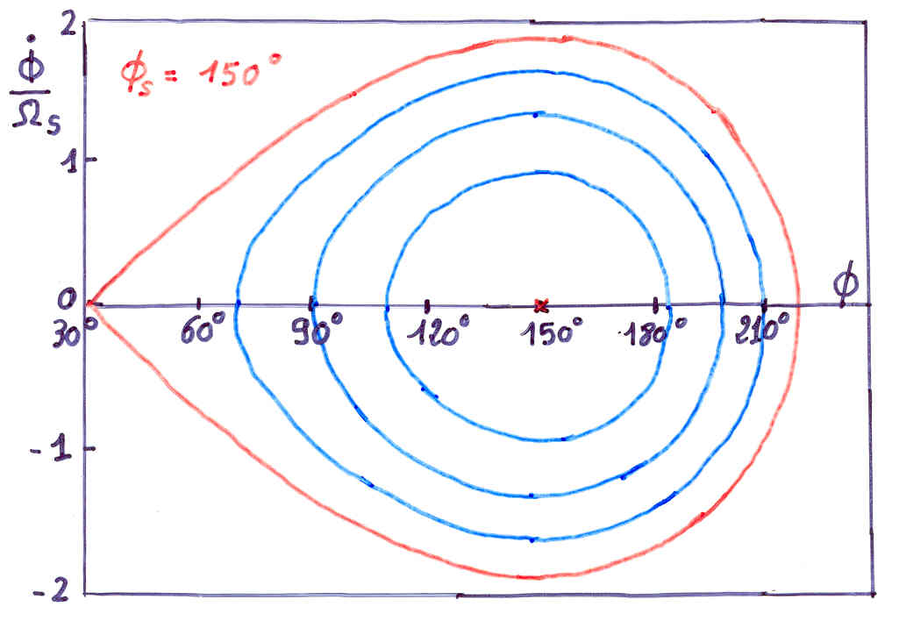
Large Amplitude Oscillations (2)
When φ reaches π-φ_{s} the force goes to zero and beyond it becomes non restoring.
Hence π-φ_{s} is an extreme amplitude for a stable motion which in the
phase space( ) is shown as
closed trajectories.
Equation of the separatrix:
Second value φ_{m} where the separatrix crosses the horizontal axis:

Slide 50
Energy Acceptance
From the equation of motion it is seen that reaches an extreme
when , hence corresponding to .
Introducing this value into the equation of the separatrix gives:
That translates into an acceptance in energy:
This “RF acceptance” depends strongly on φ_{s} and plays an important role for the capture at injection, and the stored beam lifetime.
It’s largest for φ_{s}=0 and φ_{s}=π (no acceleration, depending on η).
Need a higher RF voltage for higher acceptance.

Slide 51
RF Acceptance versus Synchronous Phase
The areas of stable motion (closed trajectories) are called “BUCKET”.
As the synchronous phase gets closer to 90º the buckets gets smaller.
The number of circulating buckets is equal to “h”.
The phase extension of the bucket is maximum for φ_{s} =180º (or 0°) which correspond to no acceleration . The RF acceptance increases with the RF voltage.

Slide 52
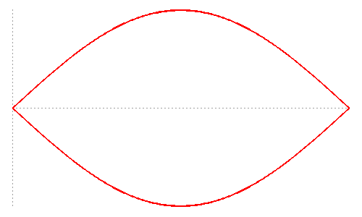
Stationnary Bucket - Separatrix
This is the case sinφ_{s}=0 (no acceleration) which means φ_{s}=0 or π . The equation of the separatrix for φ_{s}= π (above transition) becomes:
Replacing the phase derivative by the (canonical) variable W:
W
W_{bk}
and introducing the expression for Ω_{s} leads to the following equation for the separatrix:
φ
0
π
2π
with C=2πR_{s}

Slide 53
Stationnary Bucket (2)
Setting φ=π in the previous equation gives the height of the bucket:
This results in the maximum energy acceptance:
The area of the bucket is:
Since:
one gets:

Slide 54
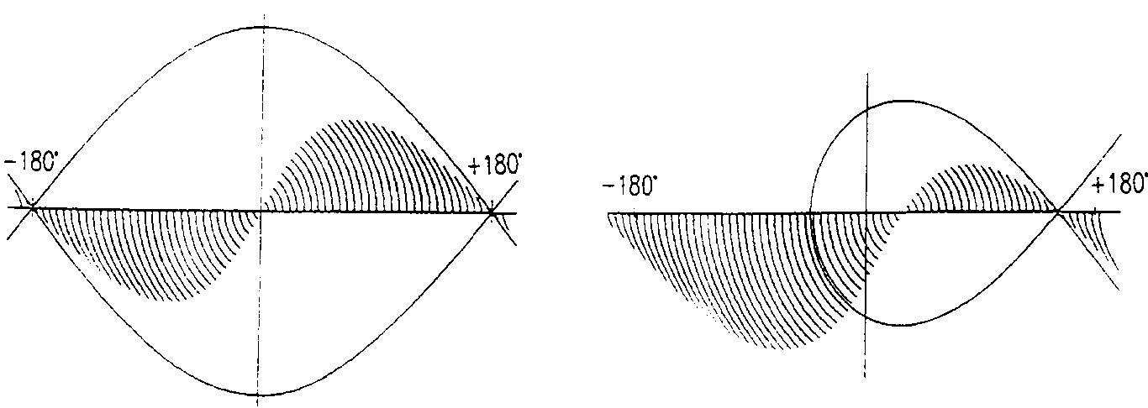
Effect of a Mismatch
Injected bunch: short length and large energy spread
after 1/4 synchrotron period: longer bunch with a smaller energy spread.
W
W
φ
φ
For larger amplitudes, the angular phase space motion is slower
(1/8 period shown below) => can lead to filamentation and emittance growth
W
W
φ
φ
W.Pirkl
restoring force is
non-linear
stationary bucket
accelerating bucket

Slide 55
Bunch Matching into a Stationnary Bucket
A particle trajectory inside the separatrix is described by the equation:
φ_{s}= π
W
The points where the trajectory crosses the axis are symmetric with respect to φ_{s}= π
W_{bk}
W_{b}
0
π
φ
π
2π
φ_{m}
2π-φ_{m}

Slide 56
Bunch Matching into a Stationnary Bucket (2)
Setting φ = π in the previous formula allows to calculate the bunch height:
or:
This formula shows that for a given bunch energy spread the proper matching of a shorter bunch (φ_{m} close to π, small)
will require a bigger RF acceptance, hence a higher voltage
For small oscillation amplitudes the equation of the ellipse reduces to:
Ellipse area is called longitudinal emittance

Slide 57
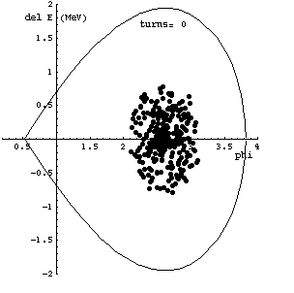
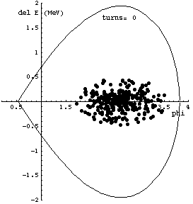
Effect of a Mismatch (2)
Evolution of an injected beam for the first 100 turns.
For a matched transfer, the emittance does not grow (left).
matched beam
mismatched beam – bunch length

Slide 58
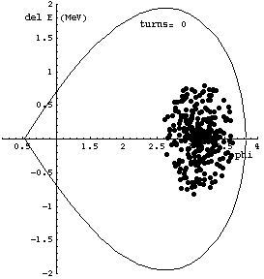
Effect of a Mismatch (3)
Evolution of an injected beam for the first 100 turns.
For a mismatched transfer, the emittance increases (right).
matched beam
mismatched beam – phase error

Slide 59
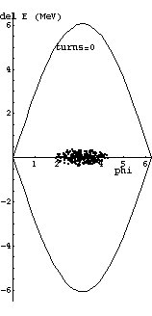
Bunch Rotation
Phase space motion can be used to make short bunches.
Start with a long bunch and extract or recapture when it’s short.
initial beam

Slide 60
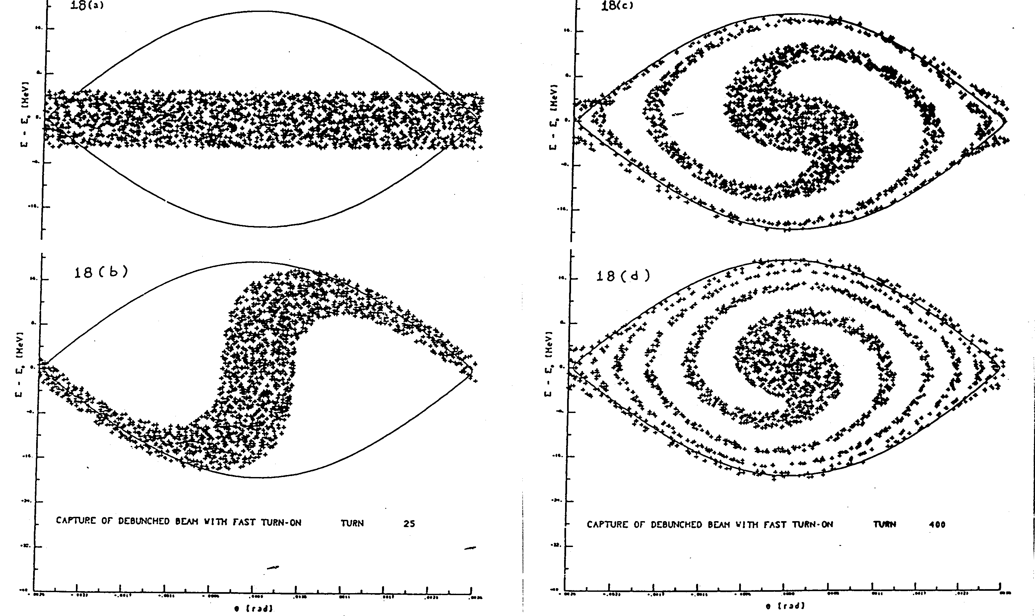
Capture of a Debunched Beam with Fast Turn-On

Slide 61
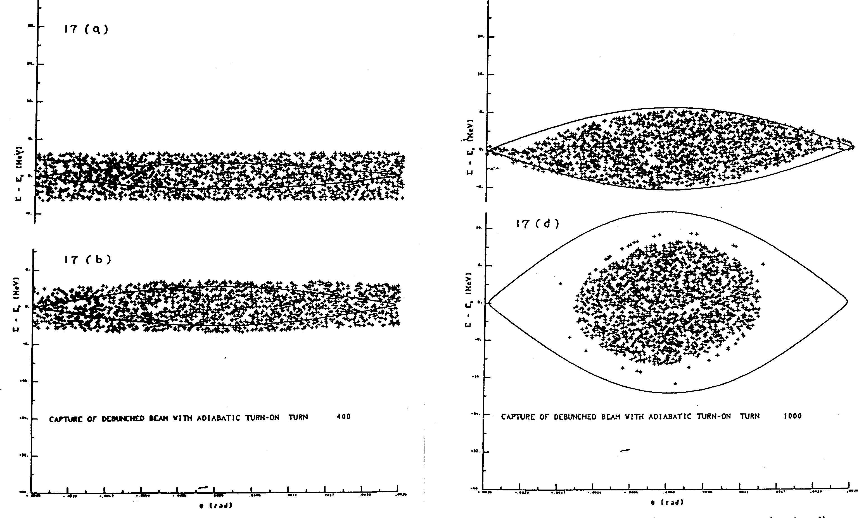
Capture of a Debunched Beam with Adiabatic Turn-On

Slide 62
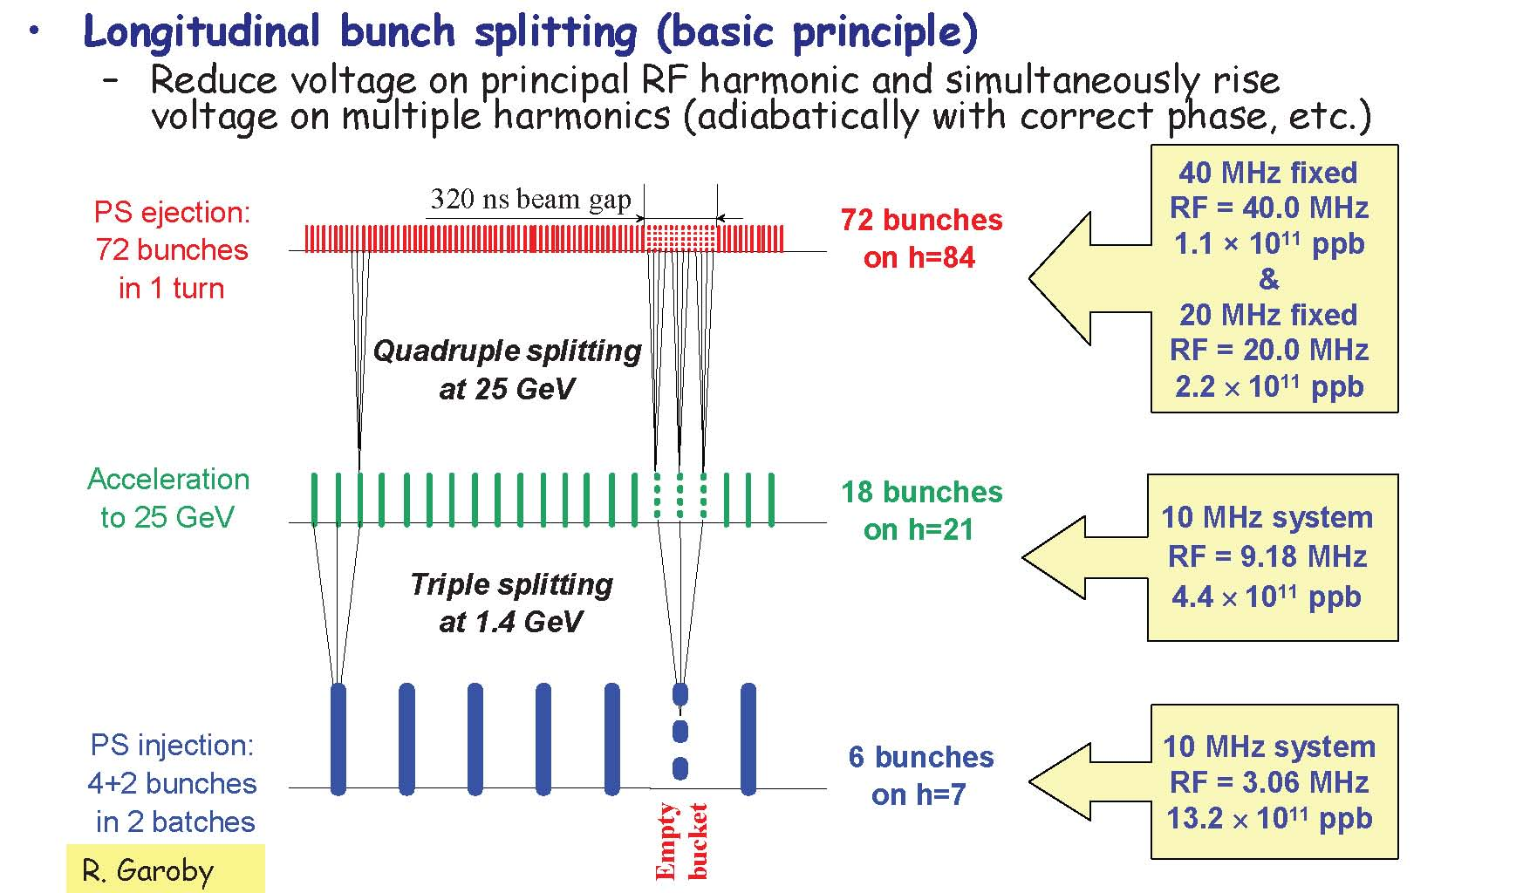
Generating a 25ns LHC Bunch Train in the PS
Use double splitting at 25 GeV to generate 50ns bunch trains instead

Slide 63
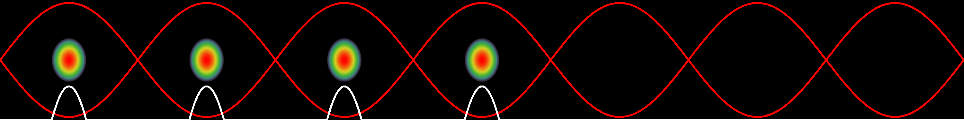
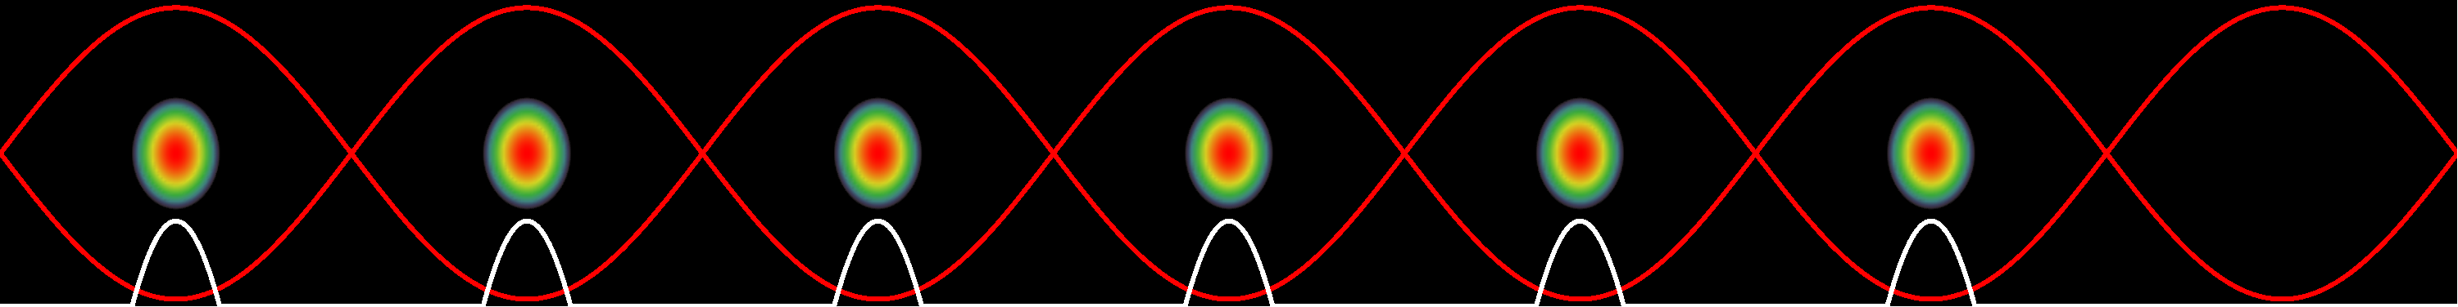
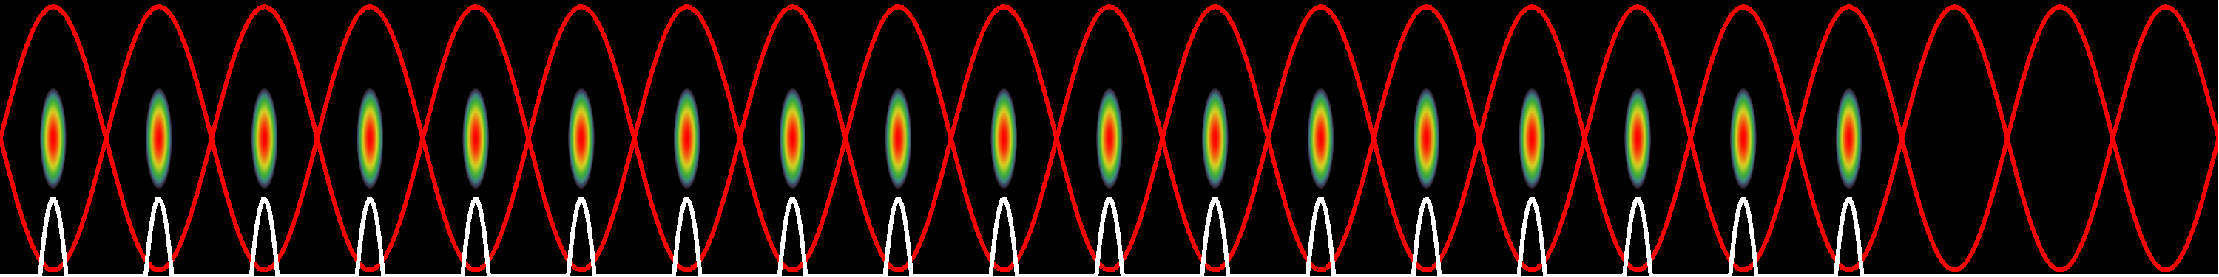
Production of the LHC 25 ns beam
1. Inject four bunches
~ 180 ns, 1.3 eVs
Wait 1.2 s for second injection
2. Inject two bunches
3. Triple split after second injection
~ 0.7 eVs
4. Accelerate from 1.4 GeV (E_{kin}) to 26 GeV

Slide 64
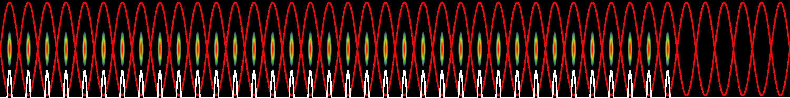
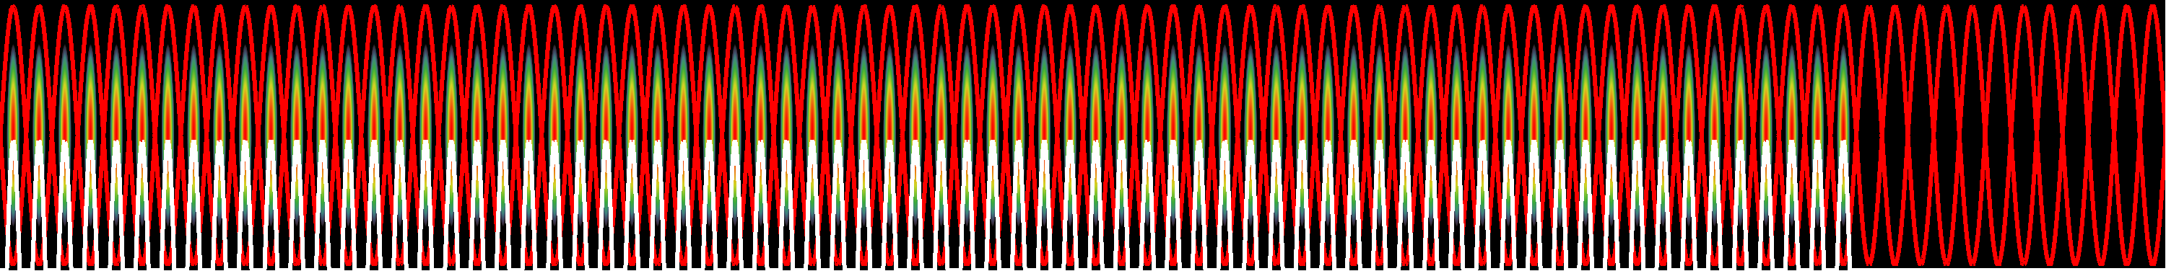
Production of the LHC 25 ns beam
5. During acceleration: longitudinal emittance blow-up: 0.7 – 1.3 eVs
6. Double split (h21 → h42)
7. Double split (h42 → h84)
~ 0.35 eVs, 4 ns
10. Fine synchronization, bunch rotation → Extraction!

Slide 65



The LHC25 (ns) cycle in the PS
Eject 72 bunches
(sketched)
h = 21
Inject 4+2 bunches
h = 7
γ_{tr}
h = 84
Triple splitting after 2nd injection
Split in four at flat-top energy
2nd injection
1.4 GeV
26 GeV/c
→ Each bunch from the Booster divided by 12 → 6 × 3 × 2 × 2 = 72

Slide 66

Triple splitting in the PS
h=14
h=21
h=7

Slide 67

Two times double splitting in the PS
Two times double splitting and bunch rotation:
h=84
h=21
h=42
Bunch is divided twice using RF systems at
h = 21/42 (10/20 MHz) and h = 42/84 (20/40 MHz)
Bunch rotation: first part h84 only + h168 (80 MHz) for final part

Slide 68

Potential Energy Function
The longitudinal motion is produced by a force that can be derived from a scalar potential:
The sum of the potential energy and kinetic energy is constant and by analogy represents the total energy of a non-dissipative system.

Slide 69
Hamiltonian of Longitudinal Motion
Introducing a new convenient variable, W, leads to the 1st order equations:
The two variables φ,W are canonical since these equations of motion can be derived from a Hamiltonian H(φ,W,t):

Slide 70
Summary
Cyclotrons/Synchrocylotrons for low energy
Synchrotrons for high energies
constant orbit, rising field and frequency
Particles with higher energy have a longer orbit (normally) but a higher velocity
  at low energies (below transition) velocity increase dominates
  at high energies (above transition) velocity almost constant
Particles perform oscillations around synchronous phase
  synchronous phase depending on acceleration
  below or above transition
bucket is the region in phase space for stable oscillations
matching the shape of the bunch to the bucket is important

Slide 71
Bibliography
M. Conte, W.W. Mac Kay An Introduction to the Physics of particle Accelerators
        (World Scientific, 1991)
P. J. Bryant and K. Johnsen The Principles of Circular Accelerators and Storage Rings
        (Cambridge University Press, 1993)
D. A. Edwards, M. J. Syphers An Introduction to the Physics of High Energy Accelerators
        (J. Wiley & sons, Inc, 1993)
H. Wiedemann Particle Accelerator Physics
(Springer-Verlag, Berlin, 1993)
M. Reiser Theory and Design of Charged Particles Beams
        (J. Wiley & sons, 1994)
A. Chao, M. Tigner Handbook of Accelerator Physics and Engineering
        (World Scientific 1998)
K. Wille The Physics of Particle Accelerators: An Introduction
        (Oxford University Press, 2000)
E.J.N. Wilson An introduction to Particle Accelerators
        (Oxford University Press, 2001)
And CERN Accelerator Schools (CAS) Proceedings

Slide 72
Acknowledgements
I would like to thank everyone for the material that I have used.
In particular (hope I don’t forget anyone):
- Joël Le Duff (from whom I inherited the course)
- Rende Steerenberg
- Gerald Dugan
- Heiko Damerau
- Werner Pirkl
- Genevieve Tulloue
- Mike Syphers
- Daniel Schulte
- Roberto Corsini
- Roland Garoby
- Luca Bottura
- Berkeley Lab
- Edukite Learning

